Slide 1
IBM University Engagement Project Submission
“Exploring the Power of Agentic AI with IBM Granite and IBM Bob”

Slide 2

Project Title – Audio Signal Processing Assistant Agent
Domain of Project – Electronics & Telecommunications / IoT (Agentic AI)
Student Name | Recent Passport Photo | Email ID | Mobile number [WhatsApp]
Vishala Valige |  | vishalavalige@gmail.com | 9392097680

Slide 3
Problem Statement -
Problem Statement: Audio Signal Processing Assistant Agent
The Challenge
Smart environments generate constant audio signals — dog barking, glass breaking, appliance hums — but most systems cannot interpret what these sounds mean or how urgently a user should respond. Without an intelligent listener, important events go unnoticed while harmless ones cause false alarms.
The Objective
Build an agentic AI system that listens to an audio stream, classifies the event it hears, and generates an appropriate, context-aware notification. The solution should:
Audio Feature Extraction – Extract MFCC, spectral centroid, and RMS energy from incoming audio using librosa.
Event Classification – Map extracted features to an event label (dog_barking, glass_breaking, background_hum) and an urgency level.
Agentic Development – Use IBM Bob to autonomously write, run, and verify the processing and classification pipeline.
Natural-Language Response – Use an IBM Granite model on watsonx.ai to turn a classification result into a clear, tone-appropriate notification.
Hardware-Aware Design – Reflect a realistic embedded deployment using an ESP32 + I2S microphone, designed and simulated in Wokwi.

Slide 4
Proposed Solution -
Proposed Solution: Audio Signal Processing Assistant Agent
The proposed solution is an agentic audio-monitoring assistant, built primarily using IBM Bob, with IBM watsonx.ai and Granite models powering the natural-language response layer.
IBM Bob was used as the AI development partner for this project: given a single natural-language task description, Bob planned the project structure, created all required files (synthetic audio generator, feature-extraction module, rule-based classifier, main agent script, README, requirements.txt), installed dependencies, executed the pipeline, and self-corrected a bug it found during its own verification run — all with checkpoint approvals along the way.
The pipeline itself works in four stages:
Feature Extraction – librosa extracts MFCCs, spectral centroid, and RMS energy from each audio clip.
Rule-Based Classification – Thresholds on these features map the sound to an event label and urgency level (low/medium/high).
Agent Response Generation – The classification result is passed to IBM Granite-4.0-H-Small via the watsonx.ai SDK, which generates a short, context-appropriate notification.
Hardware Context – An ESP32 + I2S microphone design, simulated in Wokwi, represents how audio would be captured in a real embedded deployment.
Overall, this project demonstrates end-to-end agentic development — from a single prompt to a working, self-verified Python application — using IBM Bob as the core development partner.

Slide 5
Technology Used
IBM Bob – AI development partner used to plan, write, run, and self-verify the entire Python pipeline from a single natural-language prompt.
IBM Granite-4.0-H-Small – 30B parameter IBM foundation model, used to generate context-aware natural-language notifications from classification results.
IBM watsonx.ai – Platform used for Prompt Lab testing and model access via the ibm-watsonx-ai Python SDK.
Python + librosa – Core audio feature extraction: MFCCs, spectral centroid, RMS energy, zero-crossing rate.
Wokwi – ESP32 + I2S microphone hardware/firmware design and simulation.
GitHub – Public repository hosting the full project code and documentation.

Slide 6
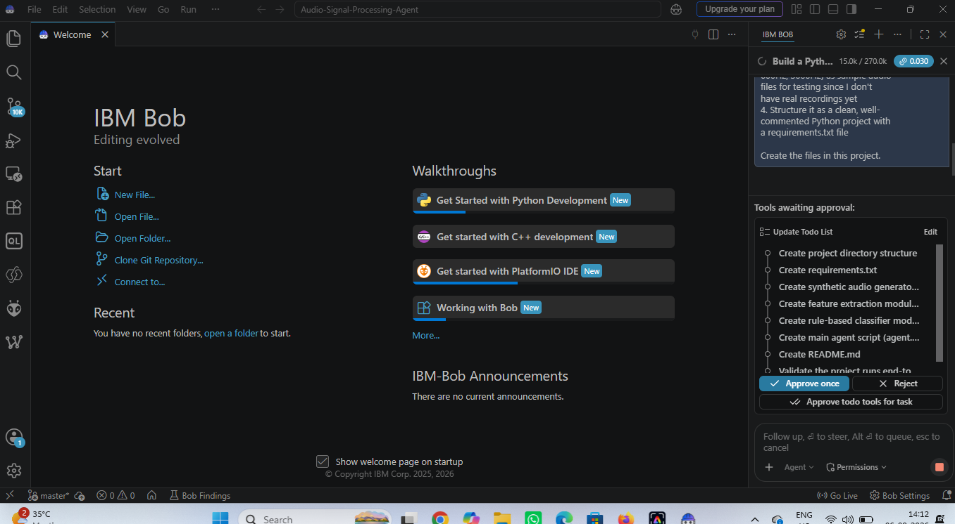
Required Files created using IBM bob -

Slide 7
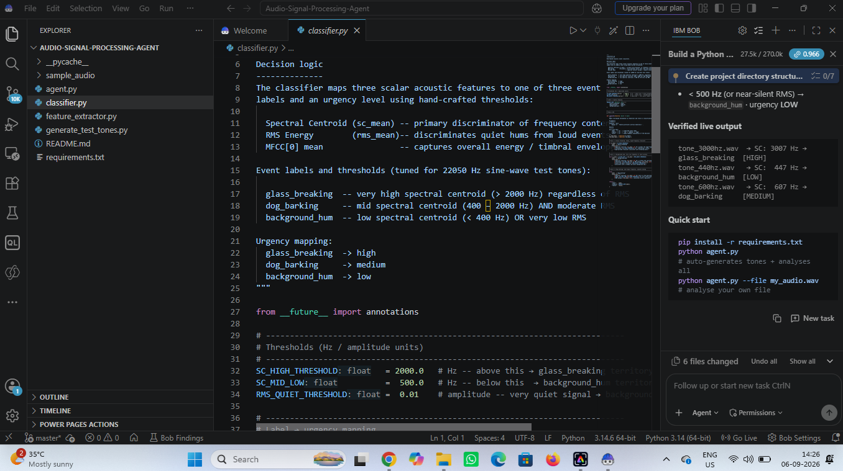
IBM Bob Screenshots:

Slide 8
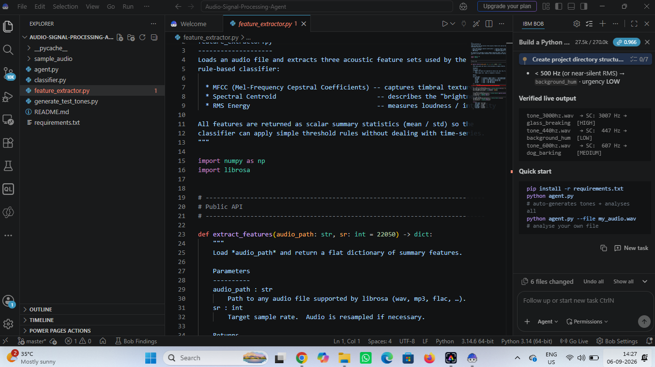

Slide 9
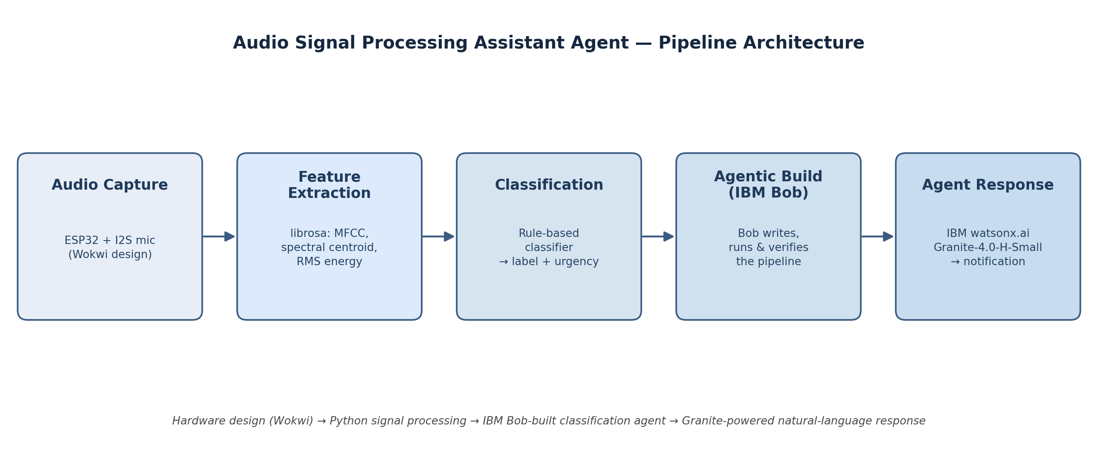
Architecture blueprint for IBM bob:

Slide 10

Role of Agentic AI in the solution
Role of Agentic AI in the Audio Assistant
Agentic AI is what allows this project to move beyond a static script into an autonomous development and reasoning process.
During development, IBM Bob acted as an agentic coding partner: given one natural-language task, it independently planned a 7-step build (project structure, dependencies, synthetic test data, feature extraction, classifier, agent script, README), executed each step, ran the pipeline, read its own output, and corrected a bug it found in the classifier — without needing step-by-step instructions.
At runtime, the agent layer (Granite-4.0-H-Small on watsonx.ai) brings context awareness to the output: the same classification pipeline produces a calm status update for a low-urgency background hum, a friendly suggestion for medium-urgency dog barking, and an urgent safety alert for high-urgency glass breaking — adjusting tone and content automatically rather than using fixed templates.
Together, the build-time agent (Bob) and the runtime agent (Granite) make the system proactive and adaptive rather than a fixed if-else script.

Slide 11
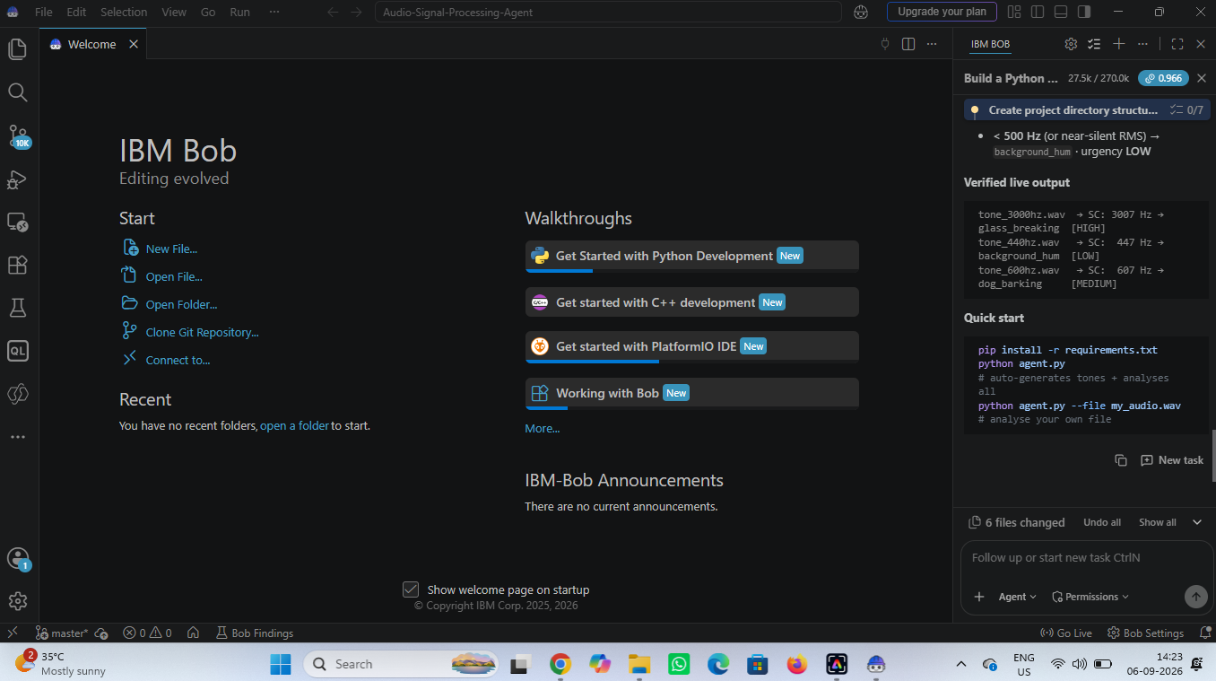
Token Usage
~12,500 tokens used for the full build + self-verification task
Before Prompt
After the Prompt

Slide 12
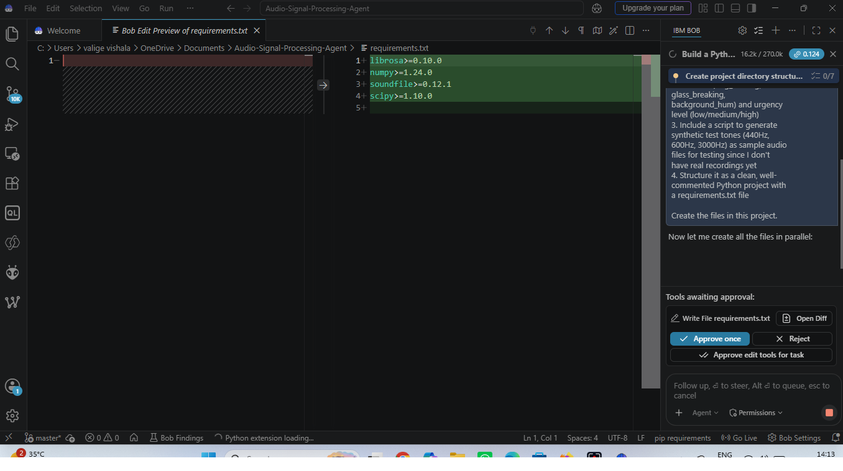
Project Output Screenshot
IBM Bob writing requirements.txt and requesting approval before installing dependencies and creating the remaining files.

Slide 13
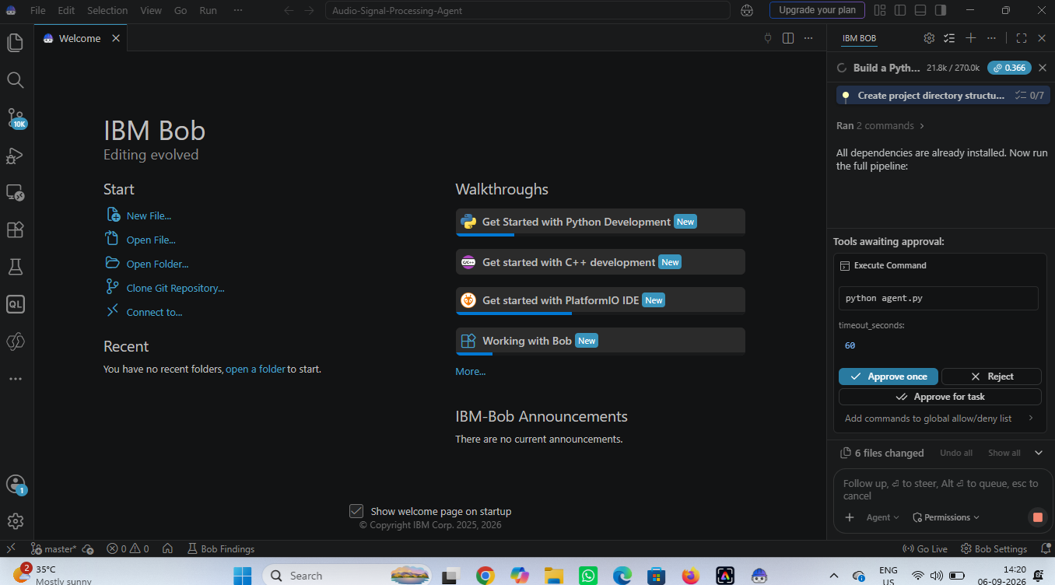
Project Output Screenshot
IBM Bob requesting approval to execute 'python agent.py' after installing all dependencies and creating all 6 project files.

Slide 14
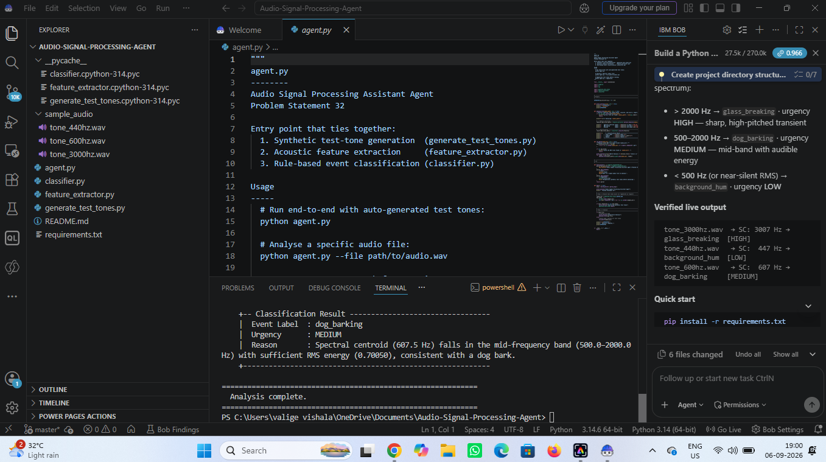
Project Output Screenshot
IBM Bob's agent.py run on the dog-bark test tone — output shows the classified event, urgency, and the spectral-centroid reasoning behind the decision.

Slide 15
Novelty and Uniqueness
The proposed Audio Signal Processing Assistant Agent stands out by combining agentic development, real-time signal processing, and personalized natural-language response into a single system.
Agent-Built, Not Just Agent-Powered – The entire codebase was planned, written, executed, and self-corrected by IBM Bob from one natural-language prompt, not hand-coded step by step.
Self-Verifying Pipeline – Bob ran the finished pipeline itself, read the output, and fixed a classifier bug it discovered — without manual debugging.
Context-Aware Responses – IBM Granite-4.0-H-Small adjusts tone and content by urgency, from calm status updates to safety alerts, with no hard-coded templates.
Hardware-Grounded Design – An ESP32 + I2S microphone design in Wokwi keeps the solution grounded in a realistic embedded deployment path.
Engineering Transparency – The project documents a real limitation found during testing (spectral-centroid sensitivity to background noise) and how it was addressed.
Scalable Foundation – Built on IBM watsonx.ai and Granite models, with a clear path to real audio data and a trained ML classifier.
This makes the solution both a working audio-monitoring assistant and a demonstration of agentic, AI-assisted software development.

Slide 16
Git Hub Link
GitHub Repository (public, README enabled):
https://github.com/Vishalavalige/Audio-Signal-Processing-Assistant-Agent
Repository includes:
All agent-relevant files created by IBM Bob (agent.py, classifier.py, feature extraction module, synthetic audio generator, requirements.txt)
Project report (Audio_Agent_Project_Report.docx)
Problem statement and this project presentation (.pptx)
README.md with project overview, architecture, and results

Slide 17
Future Scope
1. Real Hardware & Real Audio –
Deploy the ESP32 + I2S microphone design on physical hardware and replace synthetic test tones with real recorded audio, so the classifier is validated against real-world acoustic conditions rather than clean sine waves.
2. Trained ML Classifier –
Replace the rule-based, threshold classifier with a trained model (e.g. a small CNN on mel-spectrograms) to handle background noise and overlapping sounds robustly — addressing the noise-sensitivity limitation found during testing.
3. Live Deployment & Tool-Calling –
Deploy the pipeline as a watsonx.ai endpoint for real-time inference, and register formal tool definitions so the Granite agent can directly trigger actions (e.g. send_alert) rather than only describing them.

Slide 18
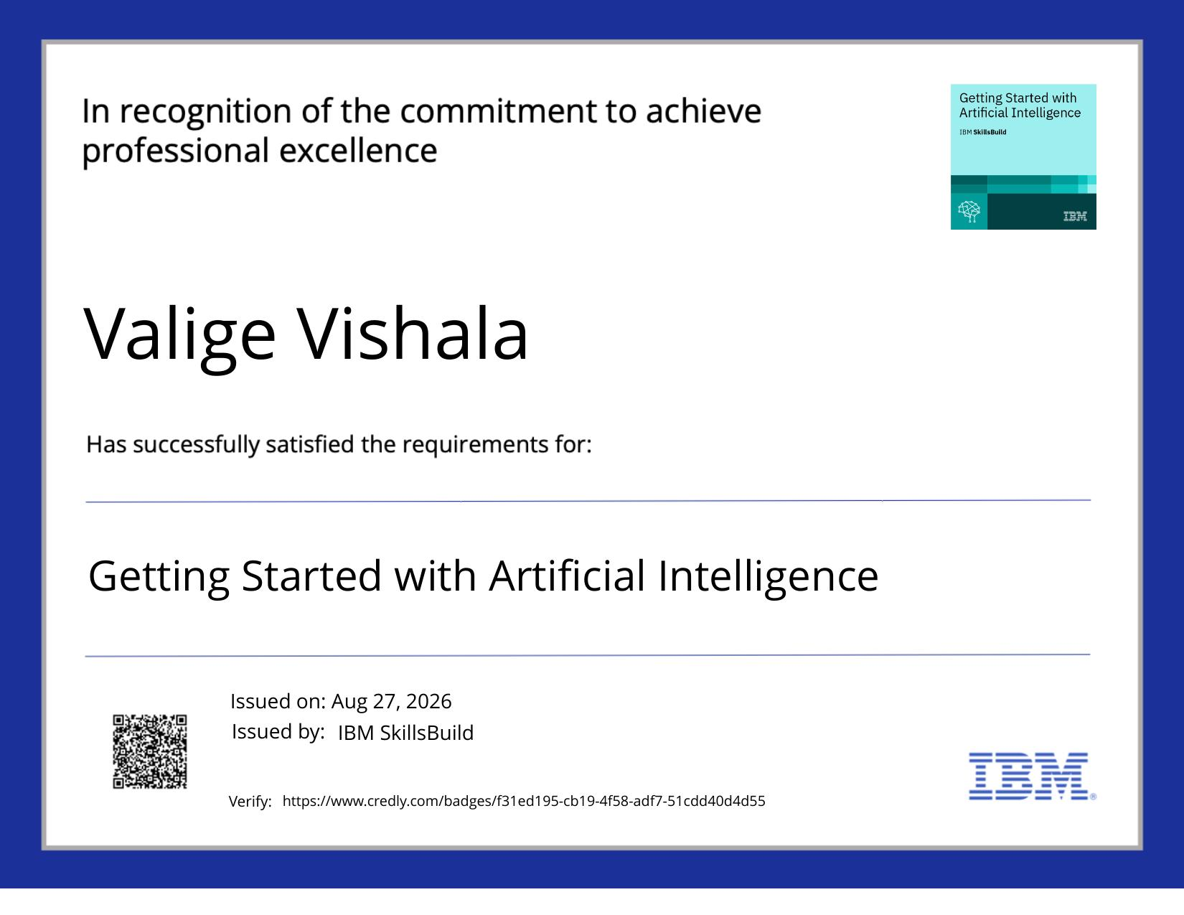
Certificates Earned:
Getting Started with Artificial Intelligence — IBM SkillsBuild

Slide 19
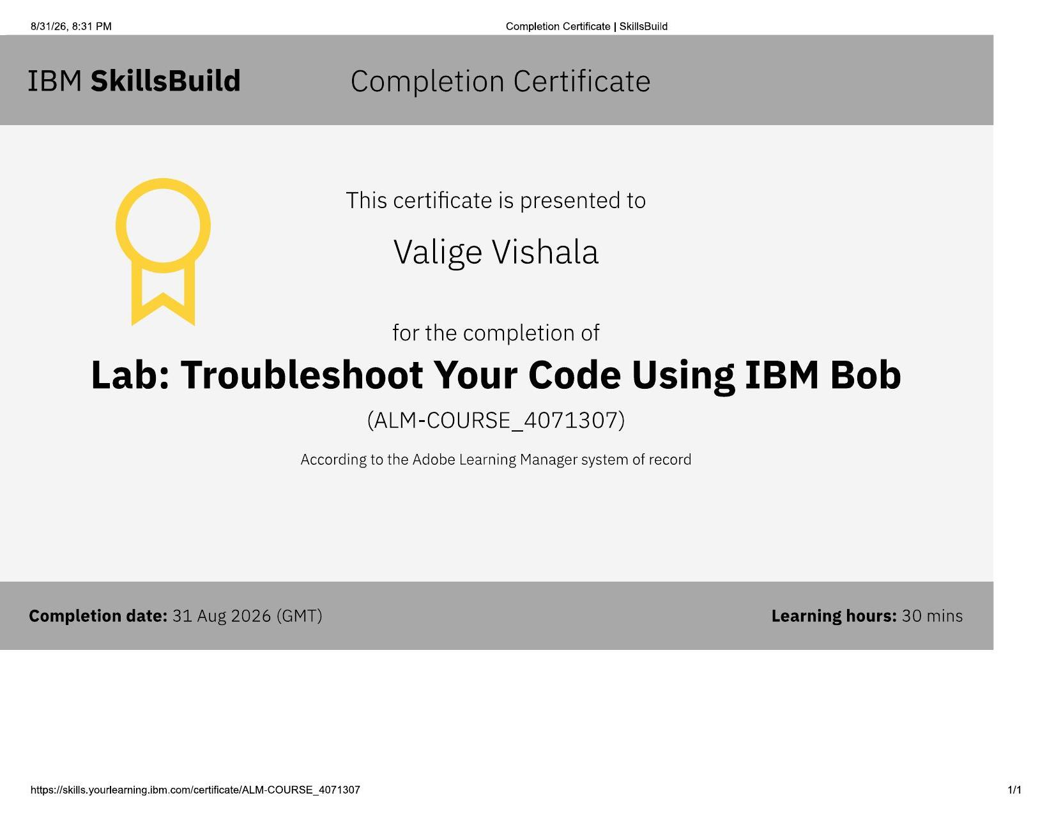
Certificates Earned:​
Lab: Troubleshoot Your Code Using IBM Bob

Slide 20


