Slide 1

Car Market Trends Analysis with CarDekho Data
AICTE STU ID : STU69f08d1ccdd421777372444
Vishala Valige

Slide 2

PROBLEM STATEMENT
Used car buyers and sellers often lack a reliable, data-driven way to judge fair resale value. Prices depend on many interacting factors — fuel type, transmission, mileage, ownership history and vehicle age — which makes manual pricing inconsistent and confusing.
This project analyzes 300+ real CarDekho used-car listings to uncover the key drivers of resale price and support smarter buying and selling decisions.

Slide 3
Project Description A hands-on data analytics project exploring real used-car listings from CarDekho to understand what actually drives resale price in the Indian second-hand car market. Using Python and Pandas, a dataset of 301 cars (model years 2003–2018) was cleaned and analyzed across fuel type, transmission, seller type, mileage, ownership history and vehicle age to surface pricing patterns buyers, sellers and dealers can act on.

Slide 4

WHO ARE THE END USERS?
Used car buyers who want a fair, data-backed sense of a vehicle's worth before purchasing
Individual sellers deciding how to price their car to sell quickly and fairly
Car dealerships and resale platforms (e.g. CarDekho) refining pricing recommendations
Loan and insurance providers estimating vehicle valuation
Analysts and students studying trends in the automotive resale market

Slide 5

Technology Used
Python (Pandas, NumPy) – data cleaning & analysis
Matplotlib & Seaborn – data visualization
Jupyter Notebook – exploratory data analysis
CSV Dataset – CarDekho used car listings (301 records, 9 features)
Git & GitHub – version control and submission

Slide 6
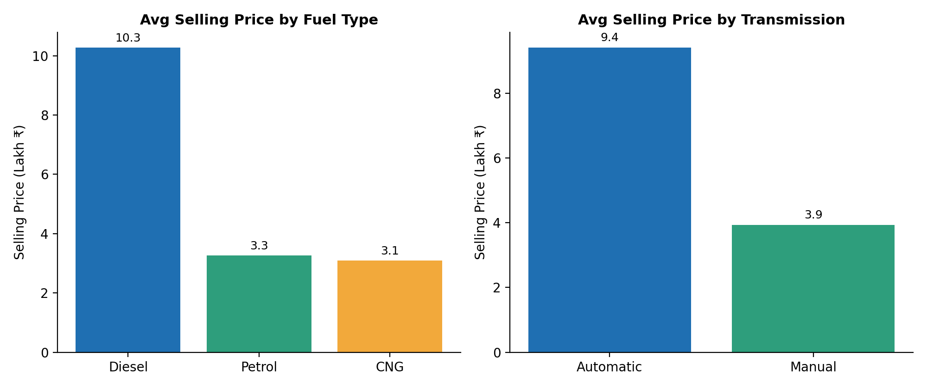
RESULTS
Average Selling Price by Fuel Type & Transmission
Insight: Diesel and automatic-transmission cars fetch roughly 2–3x higher average resale prices than petrol/manual cars.
Source: CarDekho Used Car Price dataset (Kaggle) – 301 listings, 2003–2018

Slide 7
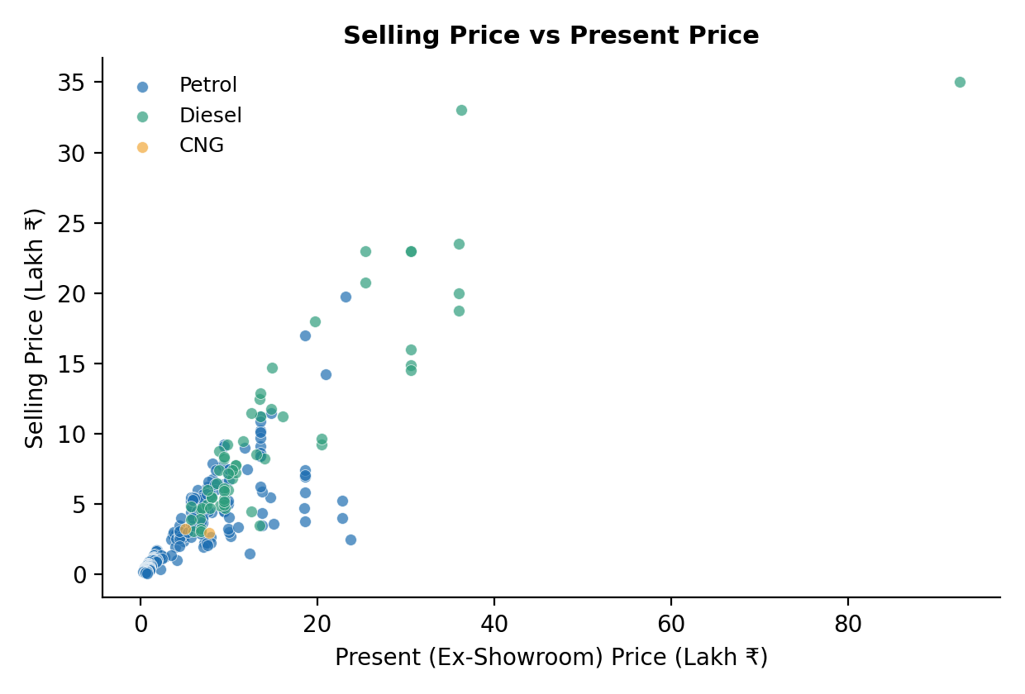
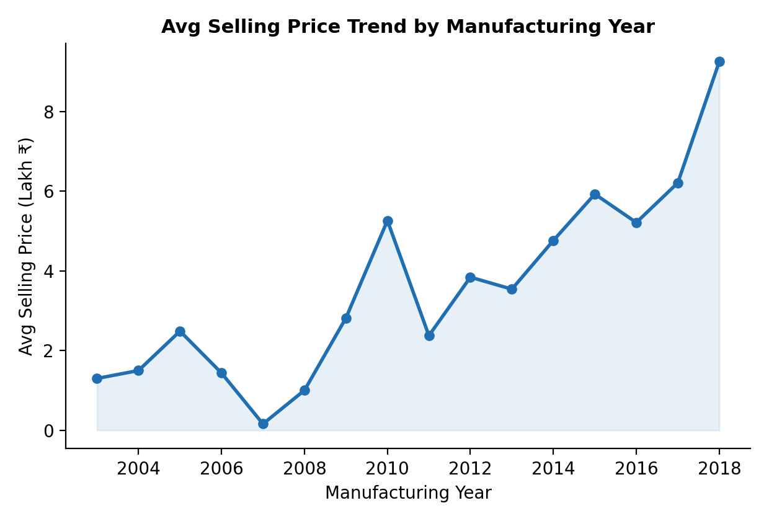
RESULTS
Price Relationships & Year-wise Trend
Insight: Selling price closely tracks present price (r ≈ 0.88), the strongest predictor of resale value.
Newer cars (post-2015) fetch higher prices from lower mileage and less depreciation.
Source: CarDekho Used Car Price dataset (Kaggle) – 301 listings, 2003–2018

Slide 8
Thank you
GitHub: github.com/Vishalavalige/car-market-trends-analysis
.
.

