Slide 1
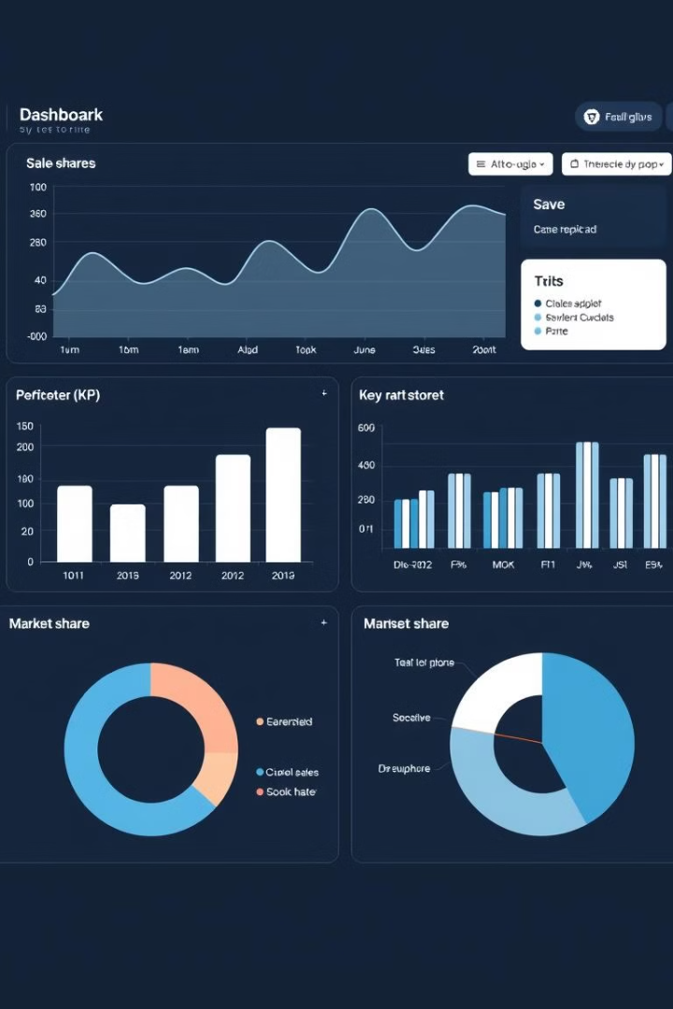

Analytical CRM Development for a Bank
VG
by Vishal Goswami

Slide 2
AGENDA
Problem Statement
Data Description
Objective Key Metrics and Visualizations
Subjective Question for Insights

Slide 3
Problem Statement
You are an analytical CRM (Customer Relationship Management) specialist hired by a bank to extract meaningful insights from various customer-related datasets. The bank aims to reduce customer churn, improve service delivery, and enhance customer satisfaction. They have provided you with datasets including customer demographics, transaction details, customer exit information, and active customer profiles.

Slide 4

Methodology
We began by thoroughly examining the problem statement and understanding the dataset. To extract insights, we utilized SQL and employed a variety of commands including SELECT, GROUP BY, ORDER BY, JOIN, window functions, RIGHT(), UPDATE, and ALTER. In Power BI, we developed calculated columns, applied DAX functions to create measures, and implemented features such as conditional formatting and slicers to enhance interactivity. We designed multiple visualizations and compiled them into a comprehensive dashboard using Power BI. Additionally, we identified inconsistencies in the Is Active Member column. To address this, we created a calculated column using an IF function to correct the discrepancies.

Slide 5




Data Collection and Summary
Data Sources
Data Types
Variety of datasets
Structured and unstructured
Data Overview
Key metrics summarized
In our data the following details are present :
CustomerId: A unique identifier for each customer.
CreditScore: A numerical representation of the customer's creditworthiness.
Credit score:
Excellent: 800–850
Very Good: 740–799
Good: 670–739
Fair: 580–669
Poor: 300–579
GeographyID: A numerical identifier that likely corresponds to a geographical location, such as a country or region.
GenderID: A numerical identifier for the customer's gender, where for example, '1' could represent male and '2' could represent female.
Age: The age of the customer.
Tenure: The number of years the customer has been with the bank.
Balance: Current balance in the customer's account.

Slide 6
NumOfProducts: refers to the number of products that a customer has purchased through the bank.
HasCrCard: denotes whether or not a customer has a credit card. This column is also relevant, since people with a credit card are less likely to leave the bank.
1 represents credit card holder
0 represents non credit card holder
IsActiveMember: active customers are less likely to leave the bank (as per the criteria defined by the bank for identifying the activeness).
1 represents Active Member
0 represents Inactive Member
Estimated Salary: as with balance, people with lower salaries are more likely to leave the bank compared to those with higher salaries.
Exited: whether or not the customer left the bank.
0 represents Retain
1 represents Exit
Bank DOJ: date when the Customer associated/joined with the bank.

Slide 7
Churn Rates
Customer churn is the rate at which customers stop using a company's products or services, is a crucial metric for banks.
The churn rate directly impacts revenue and profitability.
Here, we will analyze our bank's customer churn rates, focusing on gender, recent years, customers with credit cards, number of products used, credit score-wise churn count, and geography-wise churn count.

Slide 8
Key Insights
Customer Churn & Behavior
Churn Rate: Average ~20.45%, highest in Germany (32.44%), and among female customers (25.05%) vs. males (15.37%).
Product Usage:
70% of churned customers had only 1–2 products.
Customers with 3+ products tend to consolidate funds before leaving.
Credit Card Impact:
Non-credit-card holders churn more.
Holding a credit card reduces likelihood of exit.
Demographics & Risk Segments
Middle-aged (30–50) and low credit score customers are at higher churn risk.
Younger customers tend to maintain higher balances.
Females and customers with poor credit are more likely to exit.

Slide 9
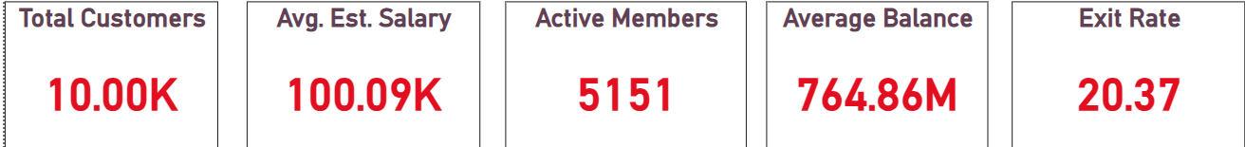

Key Insights from Analysis
Sales Trends
Customer Behavior
Operational Bottlenecks
Growth in key regions
Preferences and patterns
Inefficiencies identified

Slide 10
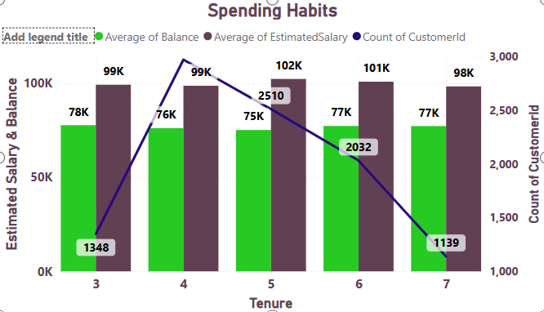
Customer Behaviour Analysis
Financial Stability and Tenure There is a noticeable peak in financial metrics during the 4th year of customer tenure, followed by a gradual decline in subsequent years.
Targeted Engagement Strategy Customers with 3–5 years of tenure exhibit higher spending capacity, making them a prime segment for personalized engagement initiatives. While long-tenured customers may have higher earning potential, retention strategies should also prioritize newer customers to build long-term value.

Slide 11
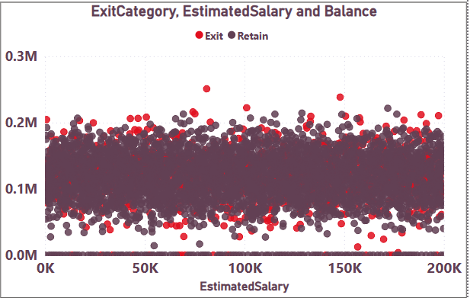
Salary vs. Balance
Here, by just looking to this chart we can say that there is no relationship between the salary and the balance of customers.
No correlation is found between the two.

Slide 12
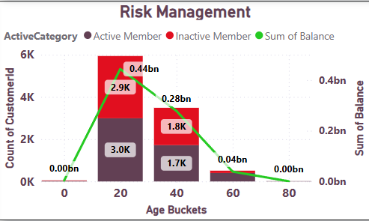
Risk Management Assessment
Younger customers tend to maintain higher account balances, indicating that targeted strategies to engage and retain inactive individuals in this age group could yield significant benefits for the bank. Although engagement initiatives for the oldest age group may not substantially influence the total balance, they can foster diversity and open new avenues for growth.

Slide 13
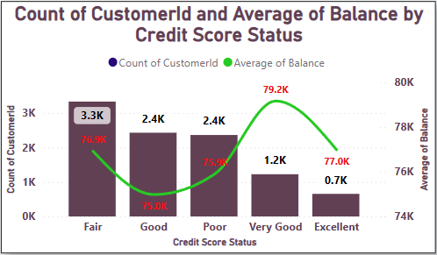
Customer Lifetime Value Forecast
Credit Card Usage and Exit Trends
Customers who hold credit cards exhibit lower exit rates, indicating stronger customer retention.
Female customers show a slightly higher propensity to exit the bank compared to male customers.
Tenure and Financial Stability
As tenure increases, customers tend to display more consistent financial behavior, suggesting a correlation with long-term financial stability.
Credit Score and Account Balance Insights
Higher credit scores are generally linked to higher average account balances.
However, credit score alone does not fully account for balance variations, indicating that other factors (such as income, spending behavior, or financial products used) also influence account balances.

Slide 14
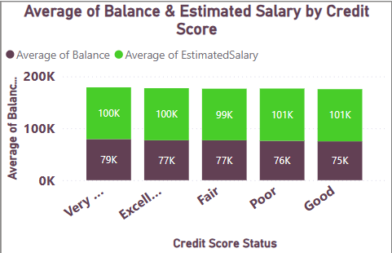
Marketing Campaign Effectiveness
Customers were segmented into five credit score categories: Excellent, Very Good, Good, Fair, and Poor.
Those in the higher credit score segments (Excellent and Very Good) tend to have higher account balances
and greater estimated salaries, suggesting a positive correlation between creditworthiness and financial strength.

Slide 15
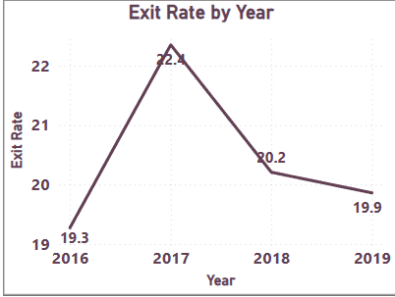
Campaign Effectiveness over Time
We observed variations in exit rates over the years 2016 to 2019.
In 2017, the exit rate was highest at 22.4%, followed by 2018 at 20.2%.
However, the exit rate decreased slightly in 2019 to 19.9%, suggesting potential fluctuations in customer churn rates in response to marketing campaigns over time.

Slide 16
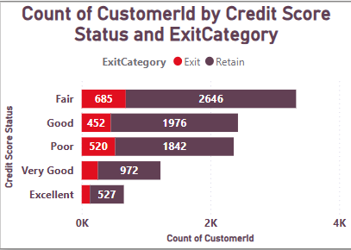
Comparative Analysis
The Fair credit score category exhibits the highest exit rate, followed by the Poor category. However, across all credit score segments, customer retention remains relatively strong in terms of volume. This suggests that credit score alone is not a significant predictor of customer. churn.

Slide 17
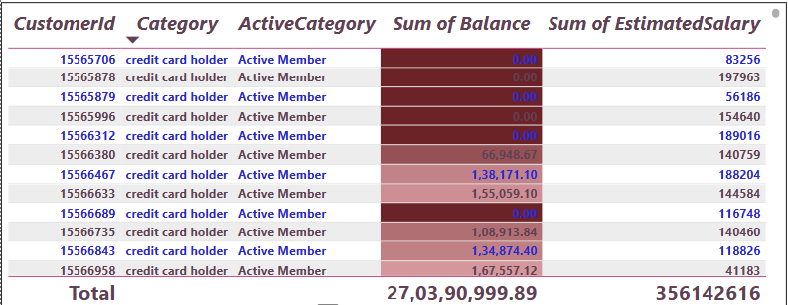
Customer Segmentation Strategy

Slide 18
Conclusion
Despite the increase in the number of customers over the years, the bank has experienced a consistent churn rate.
Middle age group customers have the highest churn rates, indicating specific retention challenges.
Improving customer engagement, enhancing customer service, and offering competitive products or services are key strategies to reduce churn.
Targeted marketing and personalized offers can help retain customers in critical age and credit score groups.
We have also seen that customer with highest average balance are more likely to churn, in this case targeted marketing and personalized offers can help in retaining those customers.
Overall, by focusing on customer engagement, service enhancement, and targeted strategies for specific customer segments, the bank can reduce churn, improve customer retention, and foster long-term customer loyalty.

Slide 19
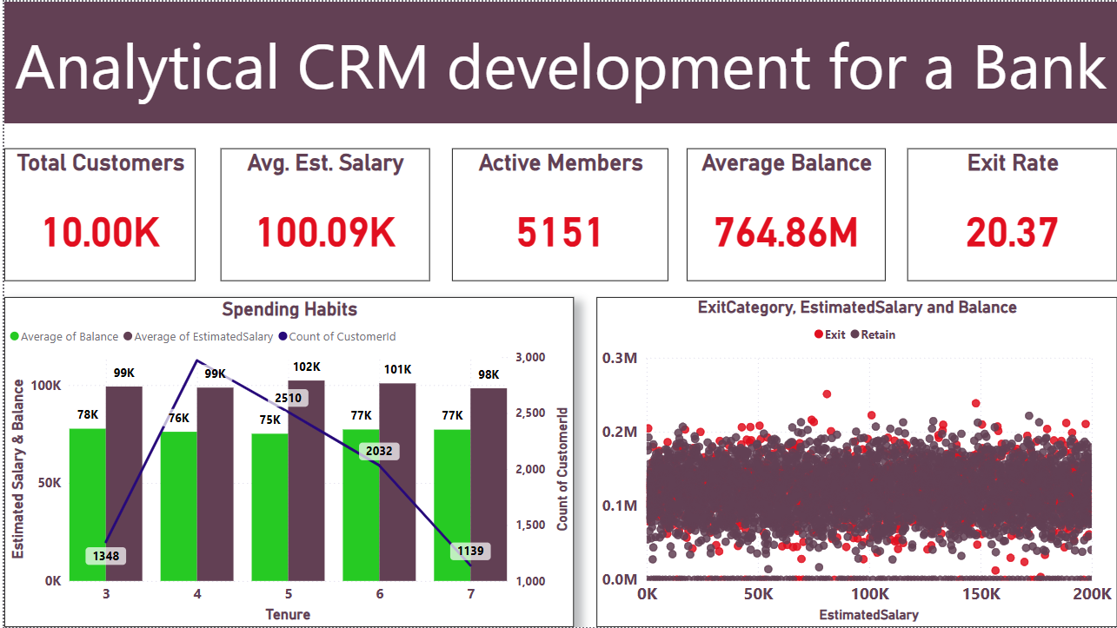
Dashboard Screenshot

Slide 20
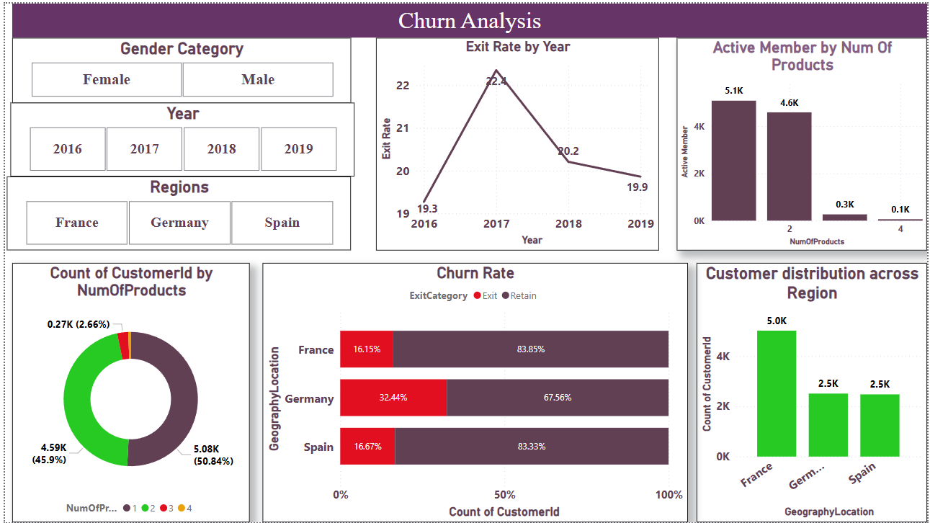

Slide 21
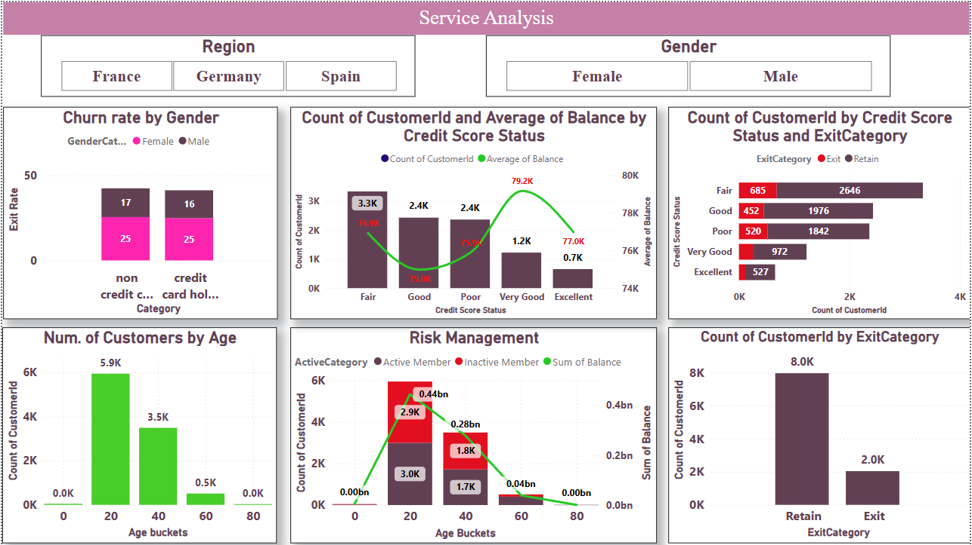

Slide 22
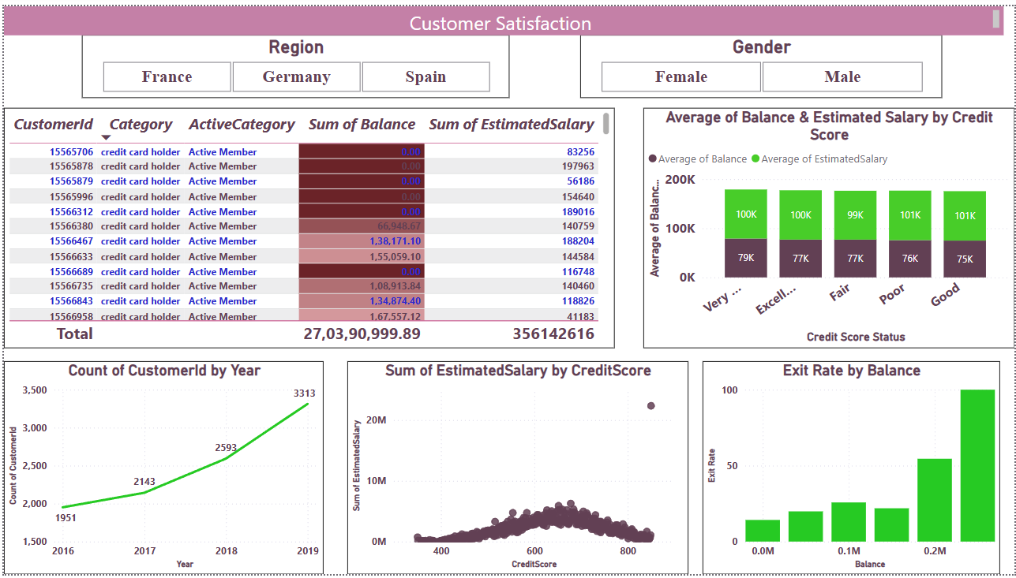

Slide 23


