Slide 1

Team Details
Team name
MYTHOS
Team leader
Vishal Karun

Slide 2
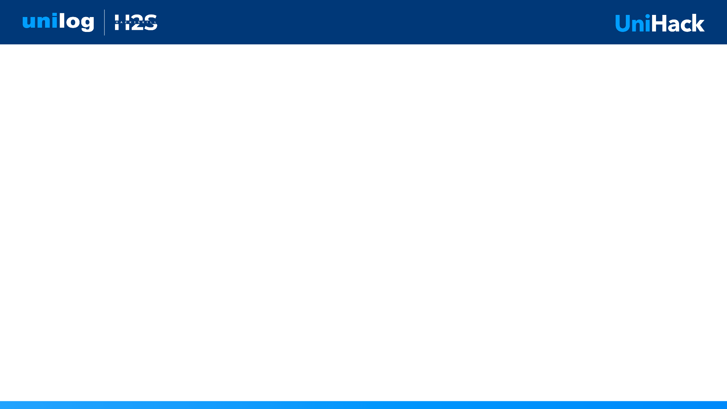
Product data you can sign off on
Six input columns to a 252-column delivery sheet — with a reason behind every empty cell
Everyone can generate product data. Nobody can prove it is right.
THE PROBLEM
WHY THAT FAILS
OUR MOVE
Frontier models already hit ~91% F1. Vendors attach a confidence score — the model's opinion of its own work, highest exactly where it is most certainly wrong.
A tool right nine times in ten, with no way to tell which nine, has not removed the review. It has moved it. Distributors still check 100% of records.
Treat the model as an untrusted proposer. Six independent external checks judge every value; only what survives is published. The rest becomes a queue with reasons.
61 / 252
1.14 s
759
100%
columns populated from 6 inputs
per product, warm
tests passing
offline — no API cost

Slide 3
How it enriches, proves and scales
1
Enriching minimal input
Six columns in. 699 of 1,000 descriptions carry their own part number — a second channel the identity check reads.
Route to a three-level taxonomy, retrieve that category's schema and vocabulary, then extract against it: retrieval over master data, not free generation.
2
Accuracy and trust
Six external verifiers per value: unit algebra, constraints, vocabulary, identity, coherence, ensemble disagreement.
Descriptions are deterministic templates over verified values — a description cannot contain an unverified fact. A test asserts it.
3
Scaling to enterprise catalogs
1.14 s/product ≈ 19 minutes per 1,000, offline on one 8 GB laptop GPU. No per-record API cost at catalog scale.
Concurrency is implemented and deterministic; the measured ceiling is 1.09× and the cause is VRAM, not the code.

Slide 4
What makes it different
The category is crowded with generation. It is empty on proof.
EVERY OTHER APPROACH
CRUCIBLE
× Generates values, attaches a self-reported confidence score
× A score is the model's own opinion — miscalibrated exactly where it matters
× Reviewer still has to check everything, so the cost never leaves
× Cloud API per record; unreleased pricing leaves the building
✓ External tools judge the model, not the model itself
✓ Every empty cell carries a stated reason
✓ Review queue is only what failed — with the failure named
✓ Runs entirely on the operator's own machine
THE USP
A model cannot correct an error it is certain about. Something outside the model has to — and it has to say so in words a merchandiser can act on.

Slide 5
What the solution does
Taxonomy routing
Grounded extraction
Normalisation
Three-level Dept / Class / Fine with Classpath, over per-category attribute schemas.
Local VLM, grammar-constrained JSON. Every value carries a source quote.
Trade abbreviations expanded, units to one form, house spacing rule applied.
Six verifiers
Certification
Review queue
Unit algebra, constraints, vocabulary, identity, coherence, ensemble.
Conformal risk control turns evidence into a certified error rate.
Only what failed, each with the verifier's reason attached.
Five descriptions
Evidence sidecar
Delivery sheet
Invoice, short, long, retail, mobile — at required lengths and casing.
Every populated cell: source quote, provenance, six verdicts.
252-column CSV/XLSX in the client's own format, downloadable.

Slide 6
How a value becomes publishable
One product, end to end — the decision point is the last step, not the first
Ingest
Route
Extract
Normalise
Verify
Certify
6 columns
taxonomy
local VLM
units, terms
6 checks
conformal
PUBLISHED
REVIEW QUEUE
LEFT EMPTY
Survived every applicable check. Written to the delivery sheet with its evidence.
A check objected. Routed to a person with the objection in plain words.
Cannot be derived from the input. The reason is recorded, not the guess.
The three outcomes are the product. A system that only ever produces the first one is the system distributors already refuse to trust.

Slide 7
The review queue, live
A ball bearing. The model proposed seal_type = C4 and was certain about it.
CHECK
VERDICT
REASON
ensemble
1.00
identical across 3 independent samples
coherence
1.00
'C4' appears in 10% of this category
dimensional
abstained
nominal attribute — nothing to check
constraint
abstained
no constraint mentions seal_type
identity
abstained
not an identity claim
vocabulary
0.00
'C4' is not a term seal_type accepts
C4 is a bearing clearance code, not a seal type. The model agreed with itself three times out of three. The statistical profile said it looked normal. Both were confidently wrong.
Only the check that knows what the category actually sells caught it.

Slide 8
Architecture
INPUT
PROPOSE
VERIFY
CERTIFY
DELIVER
Distributor CSV
6 columns
median 35 chars
Taxonomy router
qwen3-vl:8b local
grammar-constrained
normaliser
dimensional · constraint
vocabulary · identity
coherence · ensemble
each may abstain
learned fusion
conformal bound
publish / review / empty
252-column sheet
evidence sidecar
review queue
Abstention is a distinct signal. "Nothing to check" and "checked and satisfied" are different facts; merging them auto-publishes exactly the values nothing examined.
No path from source text to output prose bypasses a verified value. The five descriptions are deterministic templates, so a composed description cannot contain an unverified fact.

Slide 9
Technologies used
MODEL & INFERENCE
VERIFICATION
APPLICATION
ENGINEERING
qwen3-vl:8b (vision-language)
Ollama — local, offline
Grammar-constrained JSON
Deterministic decoding
pint — unit algebra
Controlled vocabularies
Robust statistics (median/MAD)
Conformal risk control
Python 3.11 · uv
FastAPI + uvicorn
pydantic — typed records
scikit-learn — signal fusion
pytest — 759 tests
ruff — format + lint
Deterministic seeds
Preflight GPU placement check
WHY LOCAL, AND NOT AN API
Unreleased pricing and specifications are exactly the data a distributor cannot send to a hosted model. Local inference is the requirement, not a convenience — and it removes per-record cost at catalog scale.

Slide 10
Implementation cost
The economics are the reason local-first is a design decision, not a limitation
Hosted frontier API
Crucible (local)
Per 1,000 products
metered per token
₹0 — one-time hardware
A 500,000-SKU catalog
recurring, scales linearly
₹0 — same laptop, more hours
Data leaves the building
yes
no
₹0
~19 min
8 GB
$30–50
marginal cost per product
per 1,000 products
VRAM — a laptop, not a cluster
/mo only if hosting is wanted
Honest note. No free hosting tier provides a GPU, so a live public instance would cost $30–50/month. What is published free instead is the evidence: the real output rows, the verifier verdicts and the downloadable delivery sheet.

Slide 11
What the MVP produces
Measured on the supplied 1,000-product dataset — every figure reproducible
COVERAGE
QUALITY
Identity, taxonomy, attributes
25 / 252
INVOICE_DESC ≤ 40 chars
100%
+ description composers
41 / 252
Upper case where required
100%
+ commerce columns
61 / 252
Units spaced (24 in, never 24in)
100%
All five descriptions
120 / 120
MOBILE_DESC 60–80 chars
77%
The remaining 191 need images, GTINs or distributor-internal ids that six input columns cannot supply.
The 77% is the composer refusing to pad. Inventing words to hit a character count is what the guide says scores zero.
Verification works: realised error on published values falls 12.3% → 3.2%, a 4× improvement. Certification refuses below α = 15% rather than issuing a bound this sample size cannot support.

Slide 12
What we measured that did not work
Negative results, kept because they are load-bearing
Icecat: 0 / 999
Scanned all 28,547 index entries against 999 part numbers. Zero real matches — it is consumer-electronics-weighted and does not cover US building materials. It was priority 1 in our own handoff.
Coverage, not quality, was the constraint
First real-catalog run scored AUROC 0.532 — a coin flip. 62% of values got no verifier opinion at all. Adding the vocabulary verifier took coverage 38% → 88%.
A wrong vocabulary rejects everything
wheel_type held ISO codes and matched 0 of 38 real values, because this catalog writes "Cut Off". The verifier worked perfectly against a wrong list — invisible without a compliance metric.
NEXT
— The 27,000-row manufacturer/brand authority unlocks the brand-mismatch check — one file away, and we can name the file.
— The 200-row answer key replaces injected-fault labels and tightens the certified bound.
— A larger GPU turns the implemented concurrency into real parallelism.

Slide 13
Links
GitHub repository
github.com/Vishalk1604/CRUCIBLE
Demo video (3 minutes)
https://drive.google.com/drive/folders/1uBIsqU3d-xMb38Khr7qaFPDvXcqFD7xz?usp=sharing
Working prototype
https://vishalk1604.github.io/CRUCIBLE/
Reproduce every figure in this deck: uv sync · ollama pull qwen3-vl:8b · uv run pytest -q · uv run crucible enrich · uv run crucible evaluate

Slide 14


