Slide 1
USE CASE: LOYALTY LENS
BY:
SANTHOSHKUMAR
VISHAL
SARVESH KUAMR

Slide 2
DATA COLLECTION /CREATION
EXPLORATORAY DATA ANALYSIS (EDA)
FLOW CHART(APPROACH)
LOYALTY POINTS ENGINE
RFM & TRENDS
CLV SCORING
CUSTOMER SEGMENTATION
DASHBOARD & RESULT

Slide 3
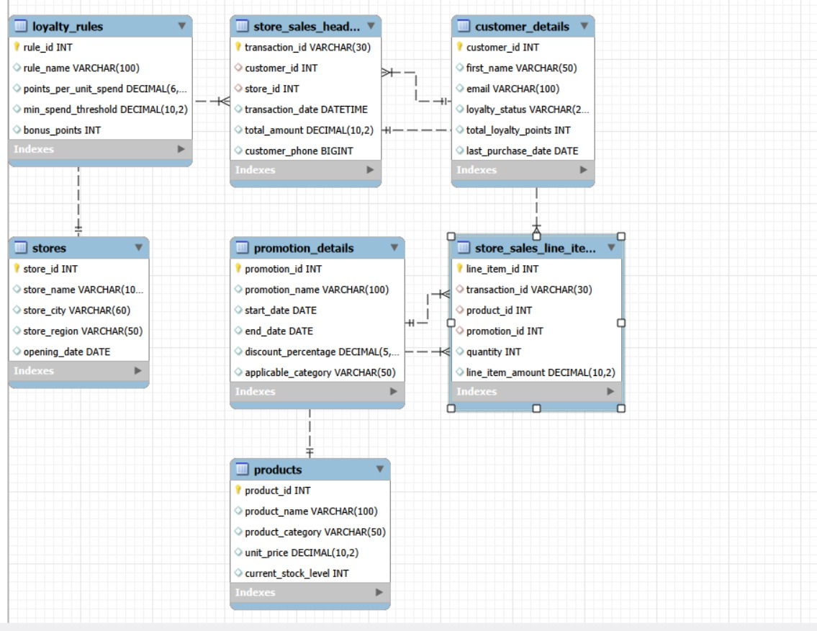
ER DIAGRAM

