Slide 1
RETAIL DATA PROCESSING USE CASE: LOYALTY LENS
TEAM – SIKKAL SOLVERS
BY:
SANTHOSHKUMAR R H(108122088)
K R VISHAL(108122046)
S SARVESH KUMAR(108122119)

Slide 2
DATA COLLECTION /CREATION
EXPLORATORAY DATA ANALYSIS (EDA)
FLOW CHART(APPROACH)
LOYALTY POINTS ENGINE
RFM & TRENDS
CLV SCORING
CUSTOMER SEGMENTATION
DASHBOARD & RESULT

Slide 3
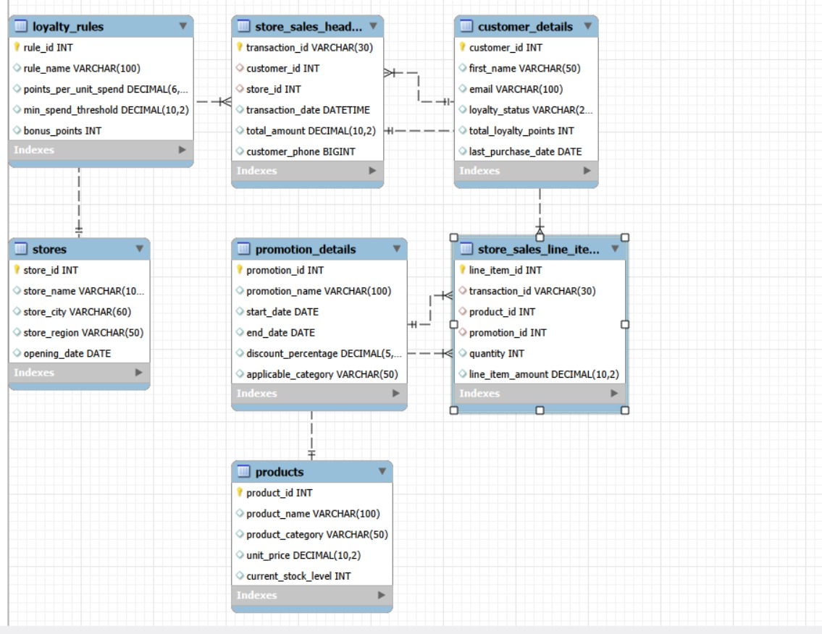
ER DIAGRAM

Slide 4
SOLUTION ARCHITECTURE DIAGRAM :
Source CSV FILES: Products,Customers,
Stores,Promotion,Loyalty rules,Store-Sales,
Data Ingestion Layer: Python ETL Scripts(Pandas)
Data quality Validation
Processing Layer 1.Loyalty Points 2.RFM 3.CLV
Combining Tables

Slide 5
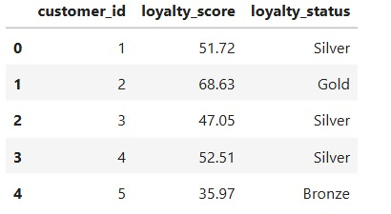
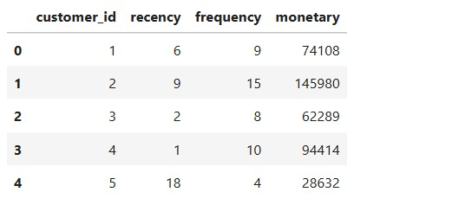
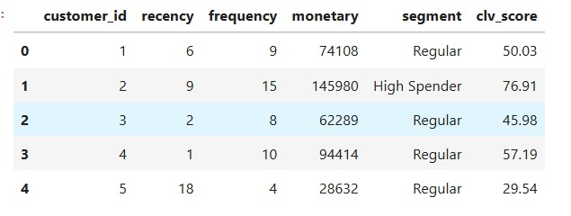
LOYALTY STATUS
RFM Scores
CLV Scores

