Slide 1
CREDIT EDA CASE STUDY

Slide 2
ANALYSIS ON CURRENT APPLICATIONS DATA

Slide 3
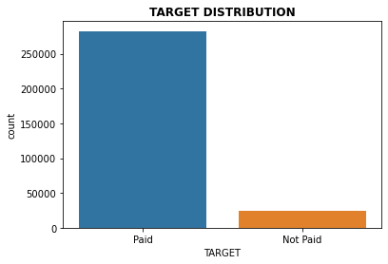
TARGET VARIABLE DISTRIBUTION/BALANCE
The data seems highly imbalanced as most applicants have either repaid or not defaulted on any installment
payments.

Slide 4
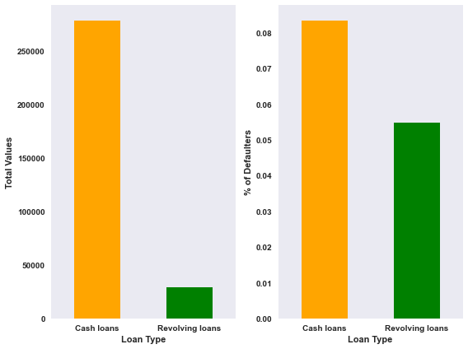
CONTRACT TYPES
We can clearly see that cash loans is the preferred loan type among customers.
Cash loans have a default rate of more than 8% while revolving loans have a default rate of close to 6%.
This, however, should be looked at in conjecture with the volumes, i.e, revolving loans despite having a slightly
lower default rate is still not reliable as the sheer volume of such loans is only 10% of the cash loans.

Slide 5
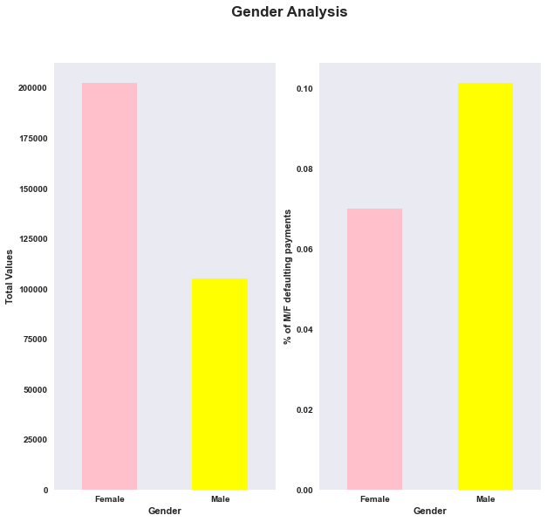
Gender Impact
Females are twice as likely to apply for a loan as shown in the first chart.
Also females have a significantly lower default percentage than males which means that males are more likely
to default on a payment than females.

Slide 6
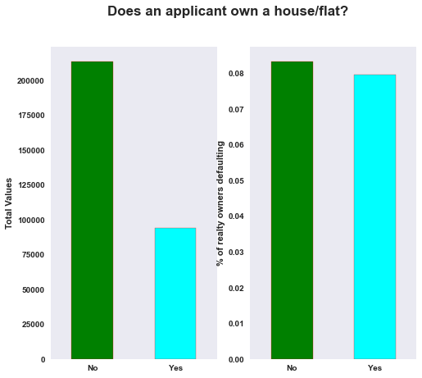
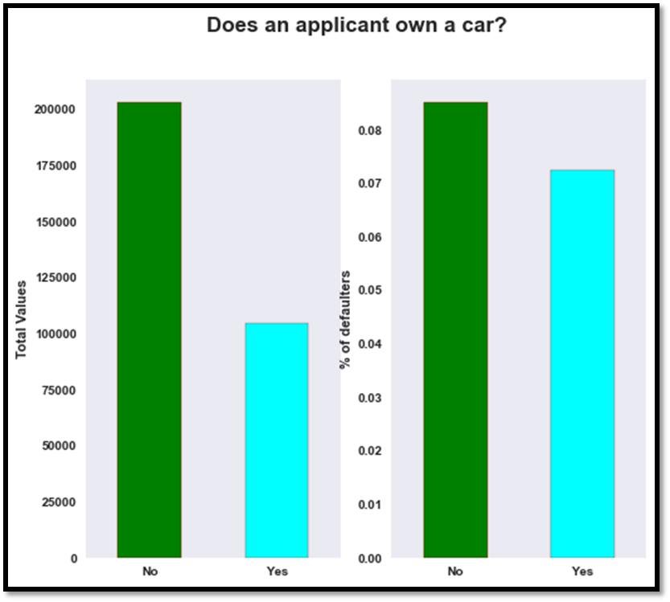
CAR/REAL ESTATE OWNERSHIP
Majority of the applicants do not own real estate.
The rate of default for applicants that do not own a house/flat is higher (approx. 8% of over 200k applicants) as compared to house/flat owners(approx. 8% of over 85k applicants.)
Majority of the applicants do not own a car.
Applicants who do own a car are only slightly
lower when it comes to default rate.

Slide 7
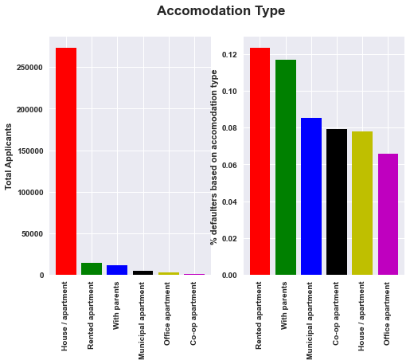
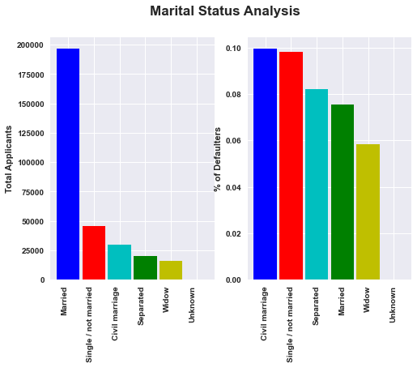
ACCOMODATION AND MARITAL STATUS
Most applicants stay in a house/apartment and the rate of default for such applicants is almost 8%.
Almost 12% of applicants who stay in rented apartments or with their parents default on their
payments which is significantly higher.
Most applicants are married and close to 7% of such applicants default on their payments.
In proportion to their total applications in each category, civil marriage has the highest default rate.

Slide 8
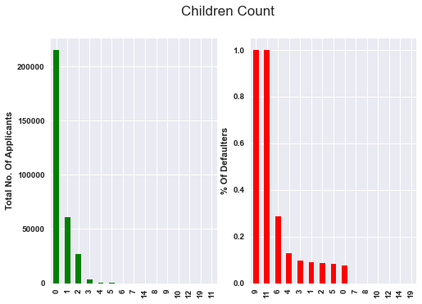
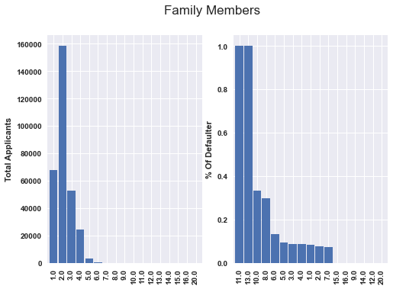
Children and Family
People with no children form the largest percentage of applicants.
The data shows applicants with 9 or 11 children will definitely default. This does make logical sense but we have to note that sample space for such instances is very small.
Most number of applicants have a family member count of 5.
The data shows applicants with 11 and 13 family members will definitely default. This does make sense but we have to note that sample space for such instances is very small.

Slide 9
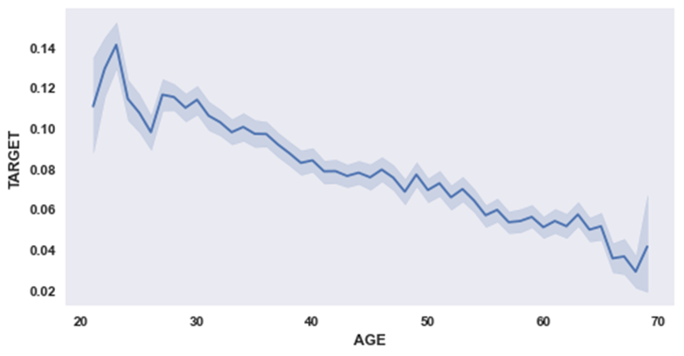
Age
The age of all applicants lies between 20 and 70 years.
Young people, till their late 20’s are more likely to default on their payments.
As the applicants grow older the likelihood of defaulting keeps decreasing pointing towards financial
stability as a person grows older.

Slide 10
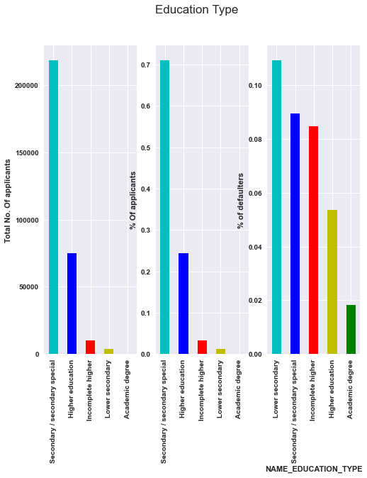
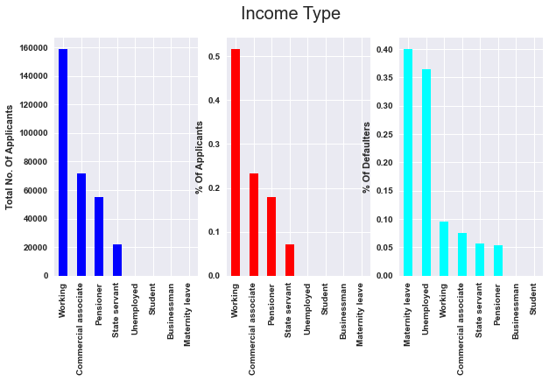
Education and Income Type
Most applicants have secondary/secondary special as their highest qualification.
As the education qualifications increase the default rate conversely drops.
Working professionals(60%) and commercial associates(23%)form the bulk of the applicants.
Applicants on maternity leave or unemployed
are more likely to default on their payments.

Slide 11
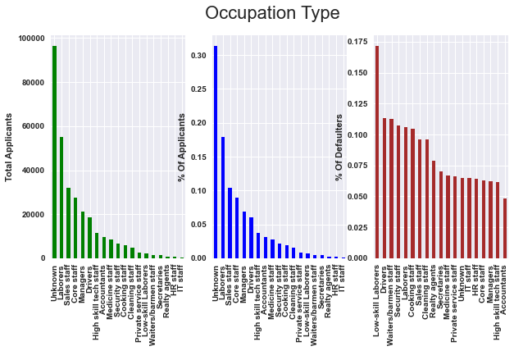
OCCUPATION TYPE
Applicants are usually reluctant in sharing their occupation information.
Low skilled laborers tend to default more on their payment commitments (almost 17%) followed by waiters.
Laborers are the most known category of applicants. Almost 11% of laborers who apply for loans default on their payment commitments.

Slide 12
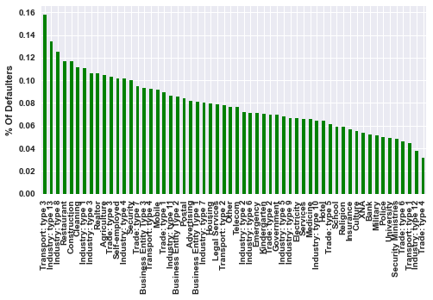
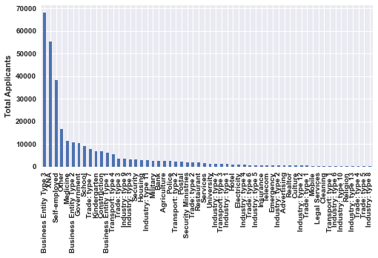
ORGANIZATION TYPE
Business entity type 3 forms the largest share of applicants and their default rate is almost 10%.
Applicants with transport:type3 in their organization category are more likely to default on their payments.

Slide 13
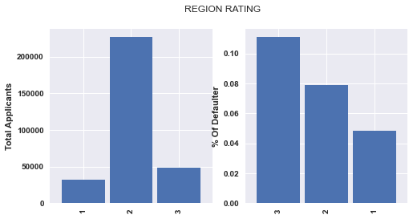
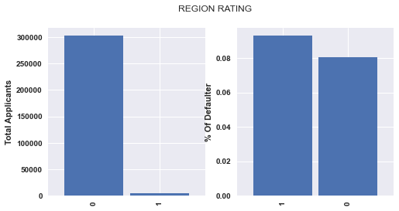
Regional Analysis/Address Mismatch
Major application comes from region with rating 2.
Maximum default rate is for applicants belonging to region with rating 3.
Most applicants contact address is same as permanent address.
The people defaulting on their commitments with contact and permanent address being different are more(9%).

Slide 14
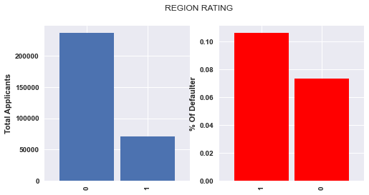
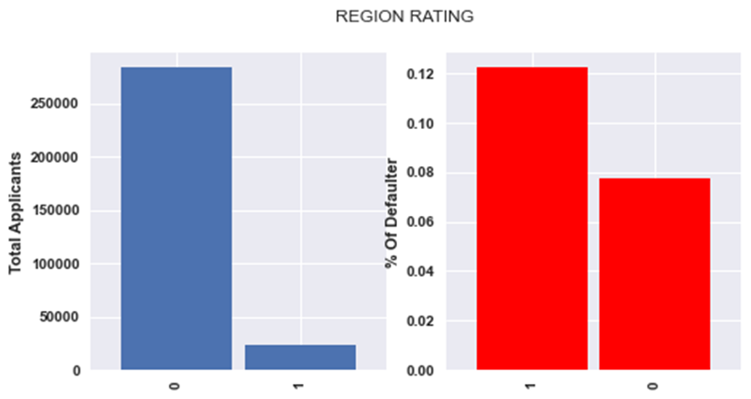
Regional Analysis/Address Mismatch
Most applicants have city in their work address matching with city in permanent address.
Most defaulting applicants have their cities mismatched in work and permanent address.
Most applicants have city in their contact address matching with city in permanent address.
Most defaulting applicants have their cities mismatched in contact and permanent address.

Slide 15
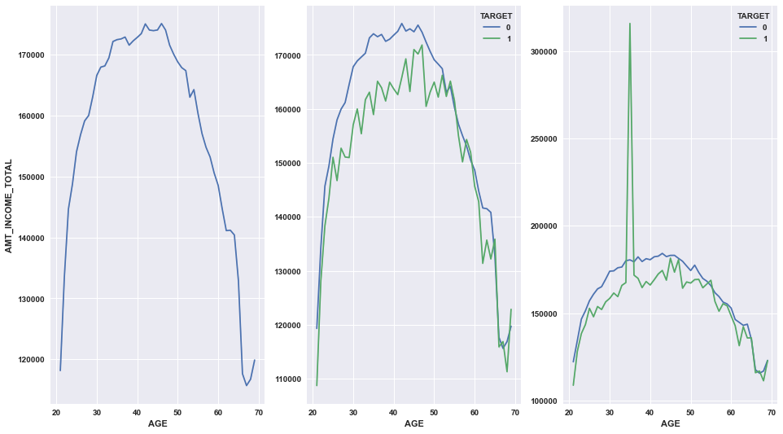
INCOME ANALYSIS
As age rises, the total income rises and after reaching mid 40s it starts to decline again.
Income of applicants in the age group 40-50 who have paid the loan is higher than those who have defaulted barring a few exceptions.
People in the age group 40-50 generally have higher income and their default rate is also low.
The third plot shows the impact of extreme income values on our distribution which have been fixed in the second plot.

Slide 16
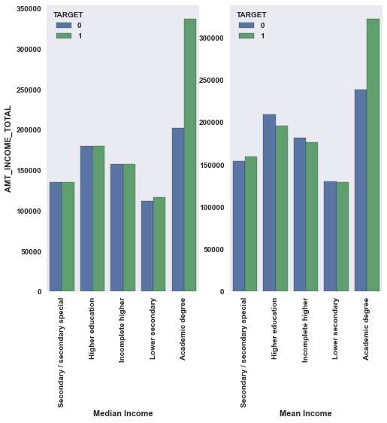
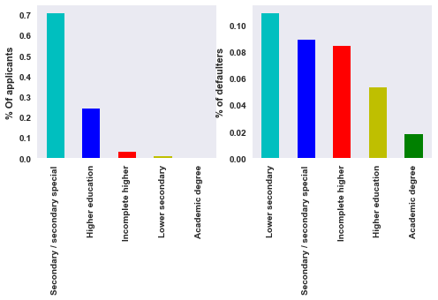
Income distribution over Education
Applicants with lower educational qualification tend to earn lower annual income and their default rate is the maximum.
Median income of all educational qualifications except lower and academic degree holders is same for those who have repaid and those who have defaulted.
Mean income of all educational qualifications except secondary/secondary special and academic degree holder is same for both the categories(paid/not paid).

Slide 17
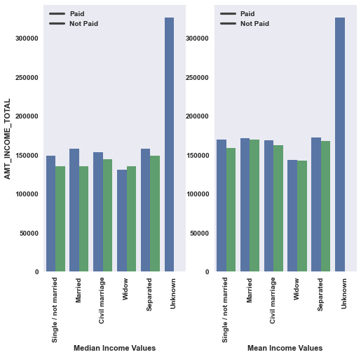
Income distribution over Marital Status
Median income of most applicants with different marital statuses are higher for those who have defaulted except for widow category.
Mean income of most applicants with different marital statuses are higher for those who have defaulted except for widow category.

Slide 18
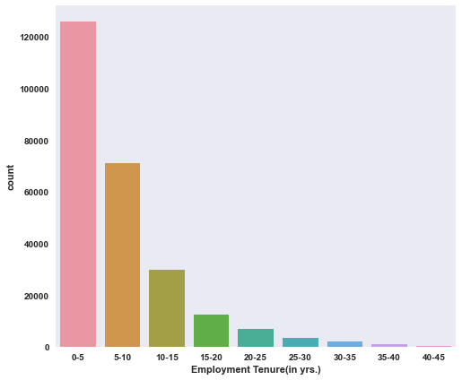
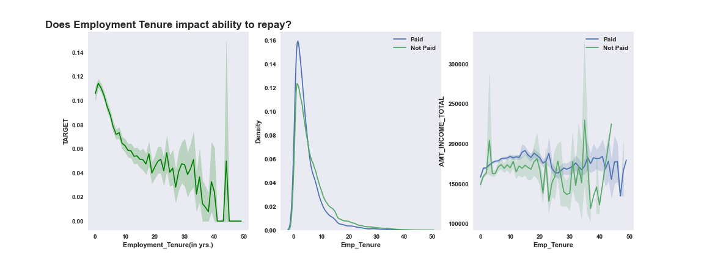
Employment Tenure Impact
Most of the applicants have a tenure of 0-5 years as shown on the left.
The default rate for people who have an employment tenure between 0 and 10 years is high and we can see it reduces as employment tenure increase in the first plot below.
The second plot below shows the density of both defaulters and non-defaulters in terms of their employment tenure.
The third plot is a distribution of total income for both defaulters and non defaulters across different employment tenures.

Slide 19
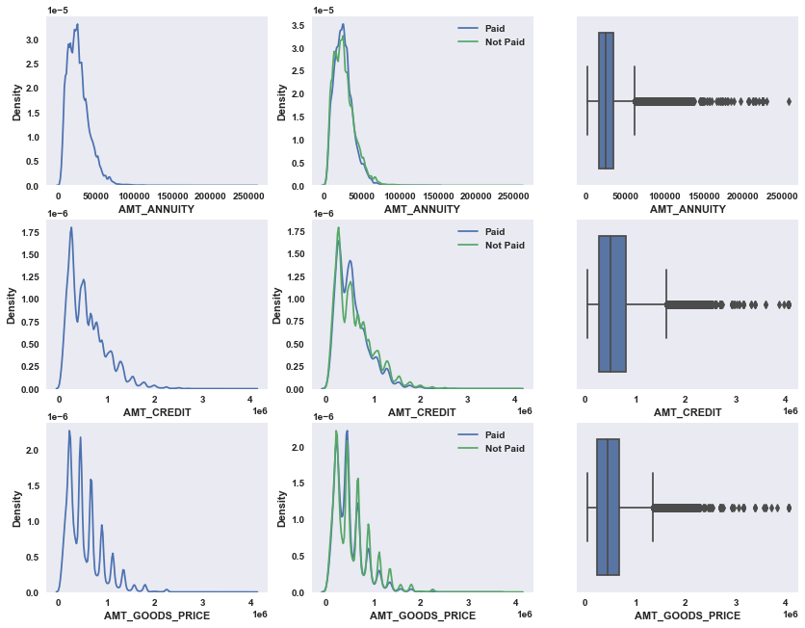
Relation between AMT_ANNUITY , AMT_CREDIT and AMT_GOODS_PRICE and outlier identification using boxplots :-
We can see that the distribution of selected metrics tends to skew towards the right which signifies that the mean of these metrics is greater than its median.

Slide 20
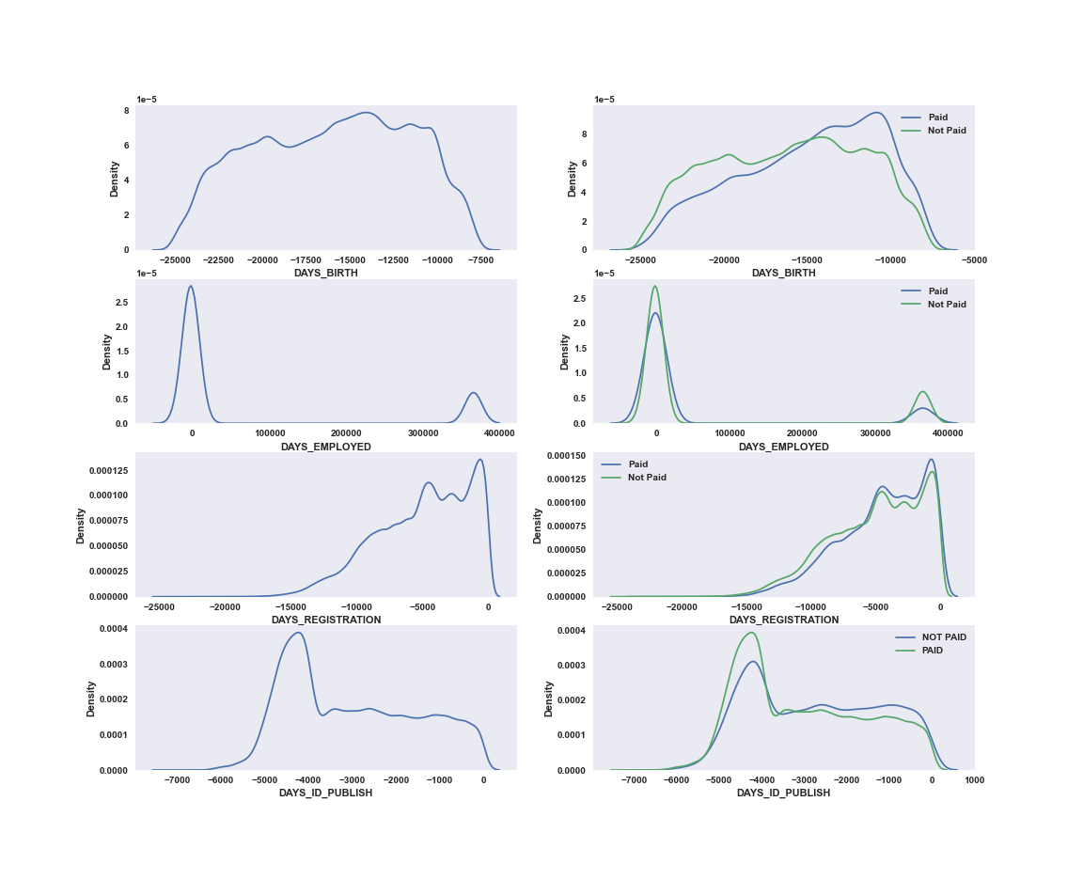
Understanding the distribution of metrics related to age, employment, application registration
And Days_Id_Publish :

Slide 21
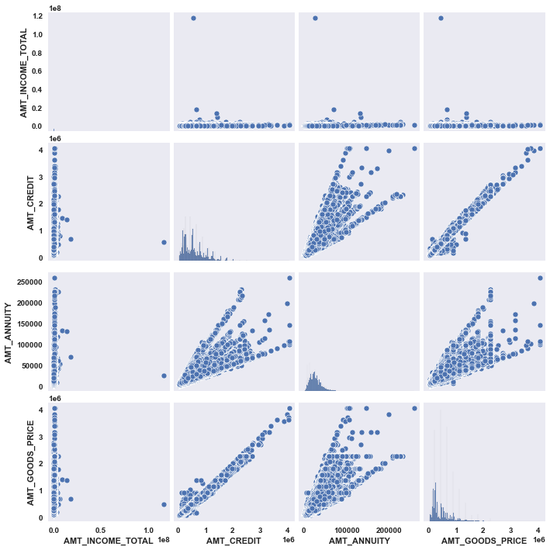
Representation of correlation between selected metrics using pairplots :-

Slide 22
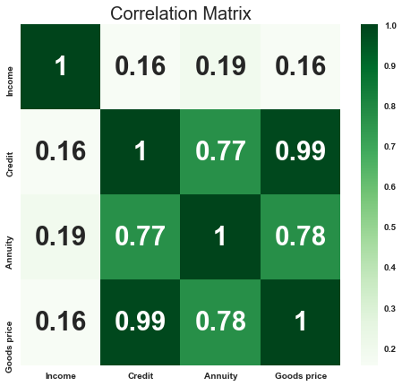
Correlation between major numeric variables
There is a very high correlation between amt_credit and amt_goods_price, amt_credit and amt_annuity, amt_annuity and amt_goods_price.
Total income has very low positive correlation to all other variables.

Slide 23
ANALYSIS BY MERGING PREVIOUS APPLICATIONS DATA AND CURRENT APPLICATIONS DATA

Slide 24
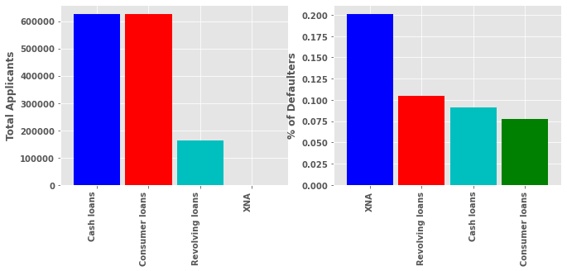
CONTRACT TYPES (INCLUDING PREVIOUS APPLICATIONS DATA)
Previous application data shows that there were three prevalent contract types i.e. contract loans , cash loans, and consumer loans.
Cash loans and consumers loans were preferred over revolving loans and surprisingly the rate of default(10%) on revolving loans were the highest in proportion to total revolving loans. Close to 10% and 8% defaults were made.
XNA indicates the applicants for which information is unknown.

Slide 25
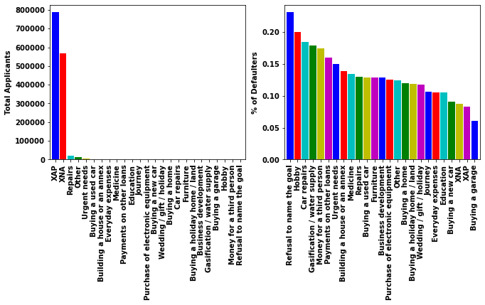
Loan Purpose (Including Prev. applications)
Around 24% of applicants in our current sample who have defaulted had, in their previous applications
refused to give the purpose of their loans.
In proportion to total applications for loans for repairs purposes, the default rate is high(approx 18%).

Slide 26
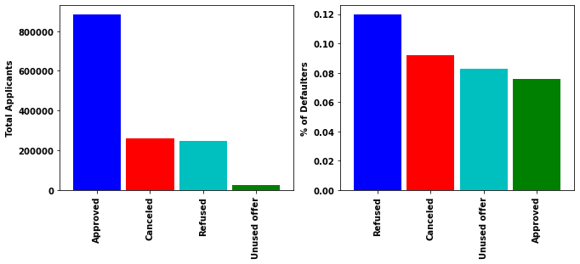
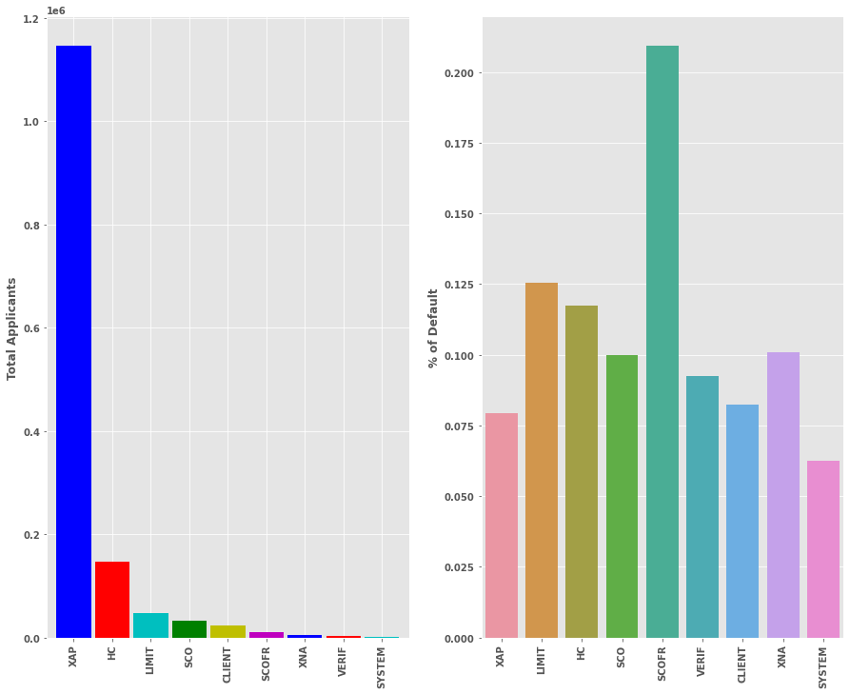
Approval Status (Including Prev. Applications)
7% of approx. 850k who were on previous occasions given loans have defaulted on their commitments.
Applicants who were refused earlier and were given loans in the current application have the highest default rate (approx. 12%).
Major previous applications that were refused due to unknown reasons("XAP") followed by HC,LIMIT,SCO etc.
The rate of default for our current applicants whose previous applications were refused/rejected are high for LIMIT,HC,SCO.

Slide 27
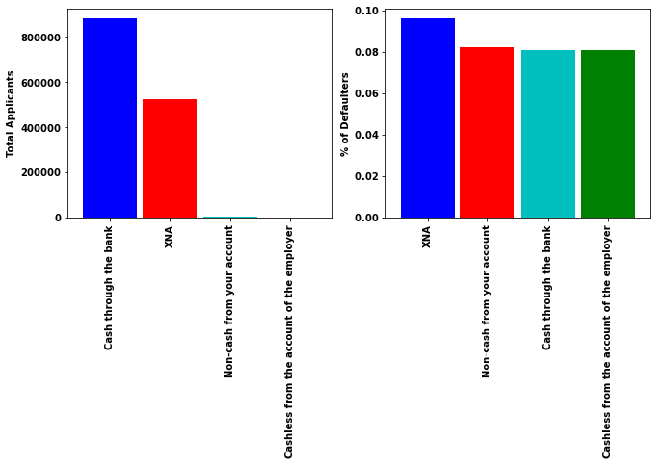
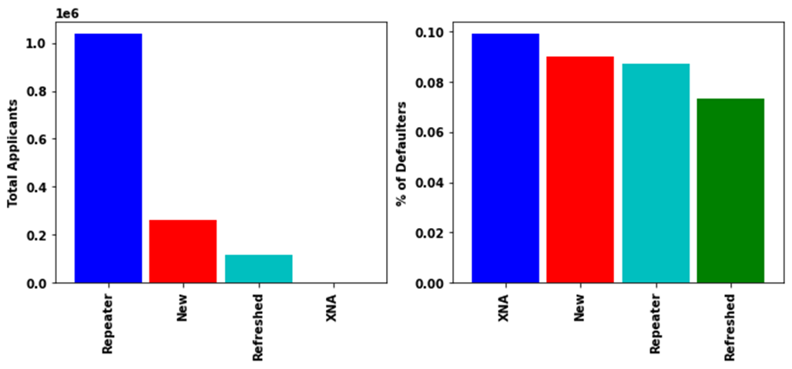
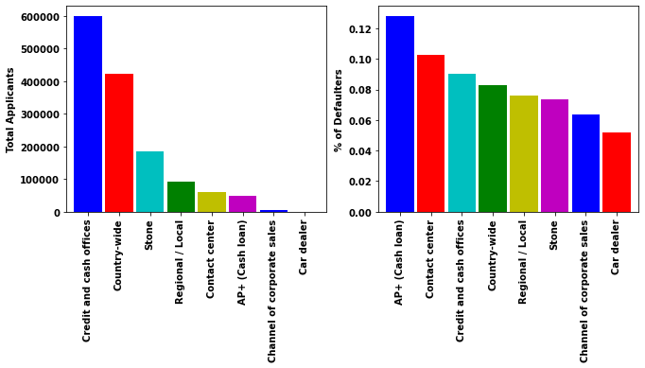
Payment, Client, Channel Type (Including Prev. Applications)
Most applicants in our current sample paid for their previous loan using 'cash through bank'.
8% of applicants who used cash through bank to pay previously have defaulted in current application.
Most applicants currently are repeaters out of which 9% defaulted in their current applications
200k applicants were new when they applied previously out of which almost 9% defaulted in current application.
Most of our previous applicants were acquired through credit and cash offices(almost 600k).
Applicants in our current sample who previously defaulted on their loans were mostly acquired through AP+Cash loan (13%) followed by contact center(10%)

Slide 28
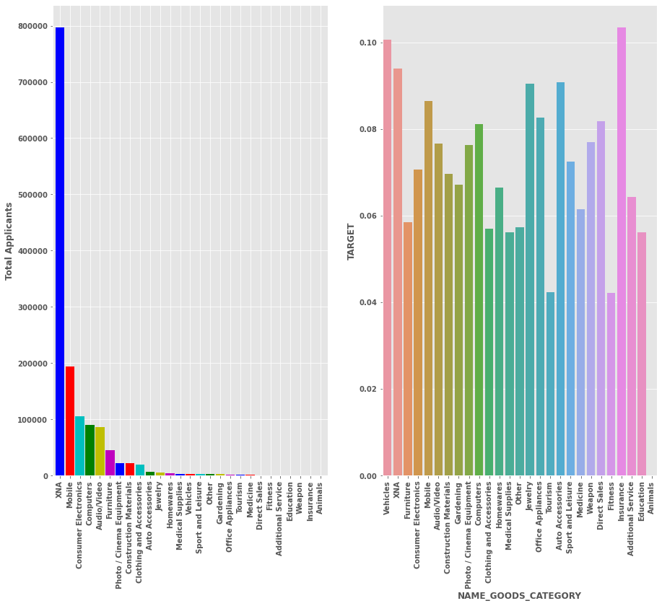
Goods Category (Including Previous Applications)
A huge chunk of previous applications were made for buying electronic consumables(approx 500k).
The rate of default in our current application for applicants who have taken loans to buy such products is specifically high for electronic gadgets such as mobile, consumer electronics, audio-video, furniture etc.

