Slide 1
Context Aware Smart Energy Recommender (CASER)
-Vishal Sarda
(112007720)

Slide 2
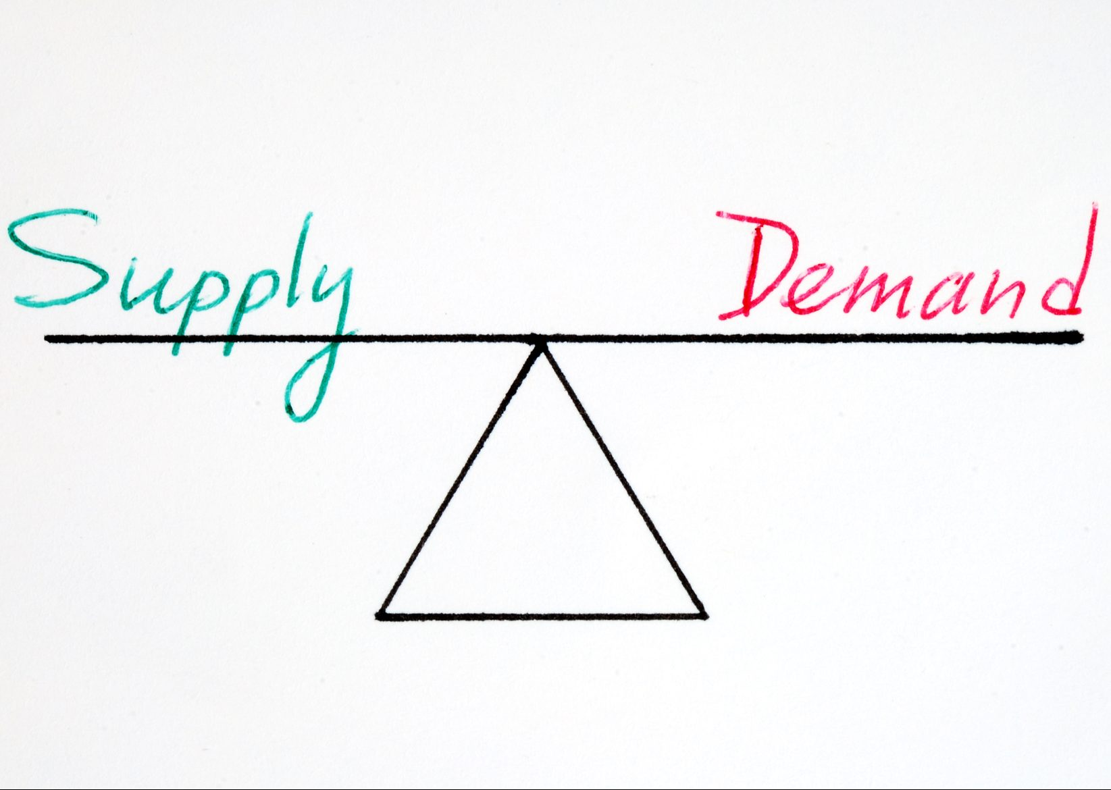
Need for balancing electricity supply and demand
Effective storage of electricity at large-scale capacity is impractical
High fluctuations in demand
Under-utilization of power grid infrastructure
Recent example of uncertainty in demand due to COVID-19

Slide 3

A possible solution
The demand response strategy
Improving the management of residential loads at the consumer and energy provider level
Incentives to customers for altering their consumption
Reducing the peak demand
Win-win situation for both consumer and supplier

Slide 4

Challenges in implementation
Absence of context-awareness
Maintaining user engagement in the data
Lack of effective visual communication to consumers
Diversity of consumer profiles at the local level
Accuracy of energy consumption prediction for the immediate future
Limited exploration of provider side visual interface

Slide 5
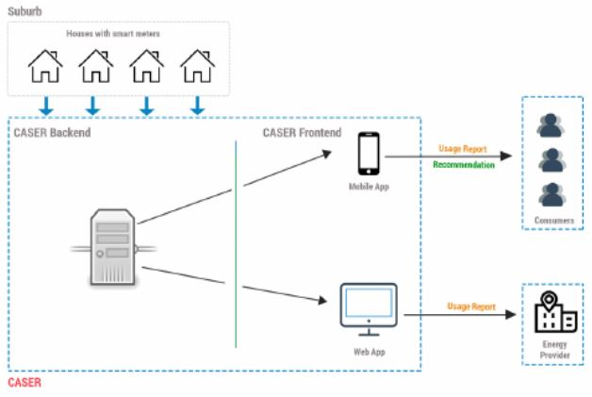
CASER – A context aware smart energy recommender
A rule-based smart energy recommender that considers the resident’s energy plan, tariff as well as their current and historical energy consumption
Context-aware prediction of consumption load at individual household and substation level
Implementation of proposed smart energy recommender as a mobile application and a web portal
Measurement of the impact of different types of context on load prediction

Slide 6
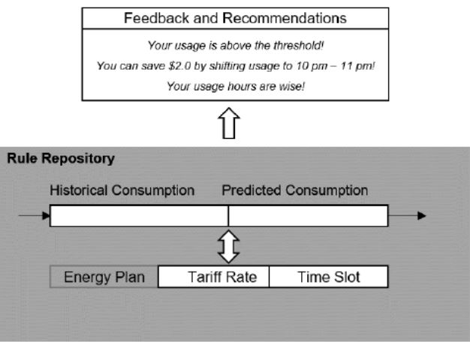
Methodology and Architecture
Recommendation module and Rule repository module
Household threshold and substation threshold
Data collected from smart meters used for recommendation and applied to SVM Regression with Gaussian Kernel
Rule repository can be updated as per the energy plans and tariff rates of the provider

Slide 7
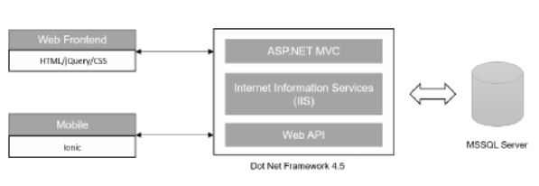
Implementation

Slide 8
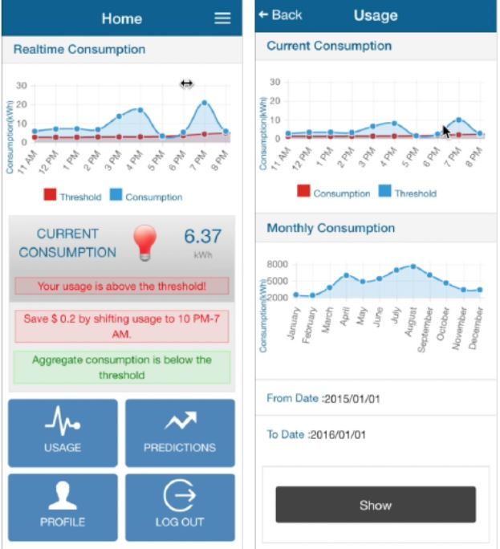
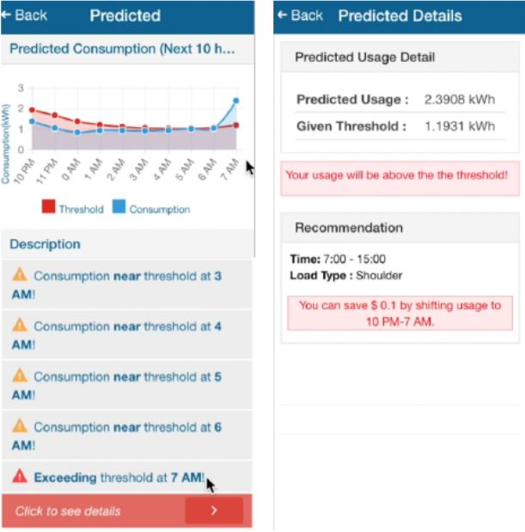
Implementation
Client-side mobile app for consumers

Slide 9
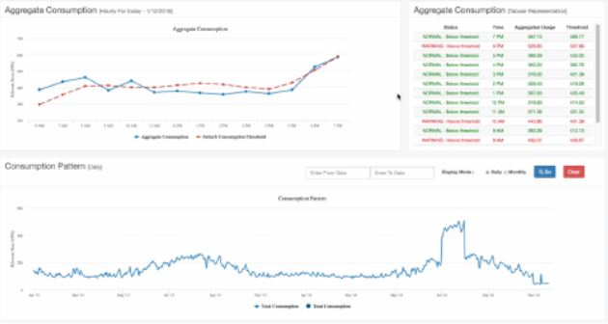
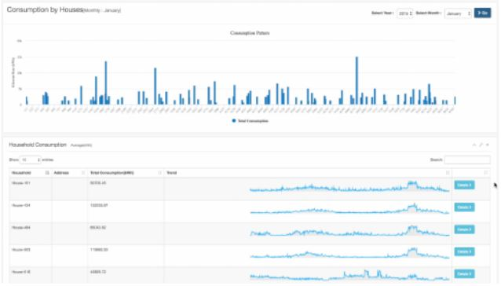
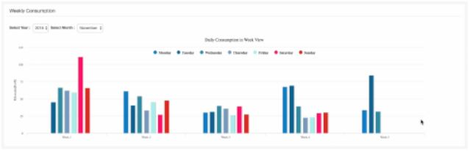
Implementation
Client-side desktop app for providers

Slide 10
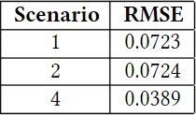
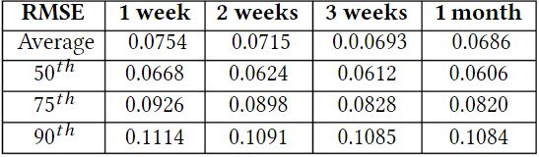
Evaluation
Publicly available Pecan Street dataset of Australia for 3 months
Aggregate energy use of 125 houses to simulate the substation load
Impact of contextual information, mainly outdoor temperature, date and time of the day on prediction accuracy
Metric - Root Mean Square Error (RMSE)
Training to testing data ratio - 1:2

Slide 11
Conclusion
Improves energy savings at residential houses with acceptable accuracy
Enables energy providers to better monitor and manage substation load
Usage of real data and incorporation of key contextual information
Intuitive visualization
Shortcomings and future work scope:
Only 3 factors (temperature, date, time) considered in contextual data
Sample size can be increased
Algorithms other than SVM can be evaluated
User studies to measure effectiveness of visualization methods

Slide 12
THANK YOU

