Slide 1

BIKE RENTAL MANAGEMENT SYSTEM
Department of Computer Science and Emerging Technologies (CS)
Noida Institute of Engineering and Technology
Submitted To: Mr. Anshul Varshney (Assistant Professor)
Group Members
Name of Member | Roll Number | Role | Department n Section
Aditya Jadon | 2301330120009 | Team Lead, Design, and Database | CS-A
Vishal Sinha | 2301330120117 | Front-end Development | CS-B
Vikash Vaibhav | 2301330120116 | Back-end Development | CS-B
Arihant Kumar | 2301330120028 | Documentation | CS-A

Slide 2
Abstract
There is growing demand for flexible and affordable transportation.
Current rental systems lack automation and real-time tracking.
Problem: Current rental systems lack automation and real-time tracking.
Solution: A web-based system for booking, renting, and managing bikes
Technologies used: HTML, CSS, JavaScript, PHP, Bootstrap, MySQL
Expected output: Efficient, user-friendly rental management platform.

Slide 3
Introduction / Background
Bike rentals are increasingly popular for daily commuters and tourists
Manual booking systems cause delays and errors.
Need for a centralized web-based system for managing users, bookings, and payments.
Scope: Online registration, bike availability check, booking, billing, and admin dashboard

Slide 4
Problem Statement
Existing manual/partial digital systems are time-consuming and error-prone
Lack of real-time bike availability updates.
No proper system for user authentication, billing, or tracking.

Slide 5
Objectives
To design a user-friendly bike rental web system.
To provide real-time availability of bikes.
To automate booking, payment, and return process.
To develop an admin panel for managing bikes, customers, and reports.
To ensure secure user authentication and transaction management.

Slide 6
Literature Review / Existing System
Traditional bike rental shops still use manual registers for customer details, manual billing, paper agreement by giving a slip having bike and customer details etc..
This causes errors in calculation, and no data analytics (owners don’t know usage trends and peak times.)

Slide 7
System Architecture / Design
Frontend: HTML, CSS, JavaScript.
Backend: PHP
Database: MySQL.
Workflow:
User Request → Backend Processing → DB Query → Response → UI Display.

Slide 8
Methodology
Steps in development
Requirement Analysis → System Design → Development →
Implementation → Testing → Deployment
Tools and programming languages : HTML, CSS, JavaScript, Bootstrap and PHP
Database : MySQL

Slide 9
Hardware & Software Requirements
Hardware:
A working PC, Laptop, or Mobile Phone with internet connection.
Software:
OS: Windows & Linux
IDE: VS Code
DBMS: MySQL

Slide 10

Expected Output / Results

Slide 11
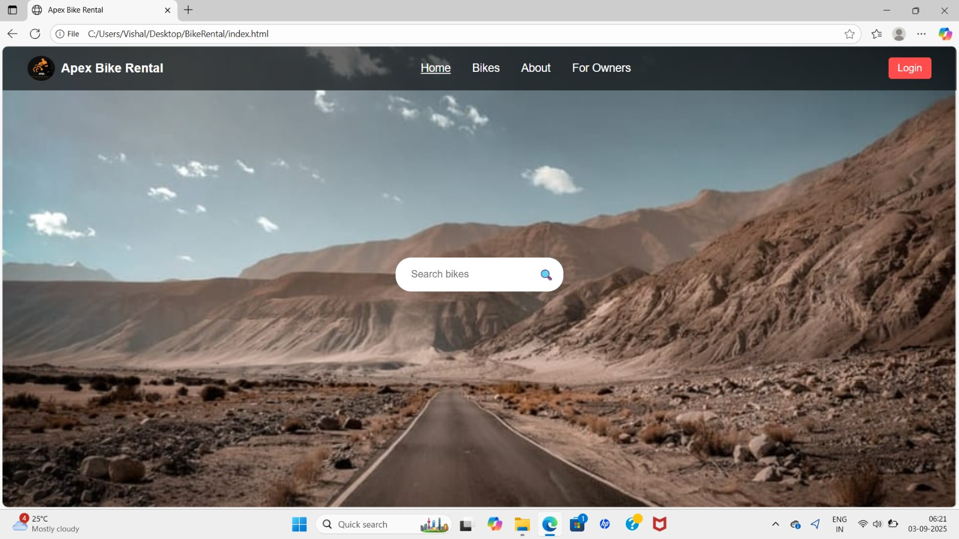

Slide 12
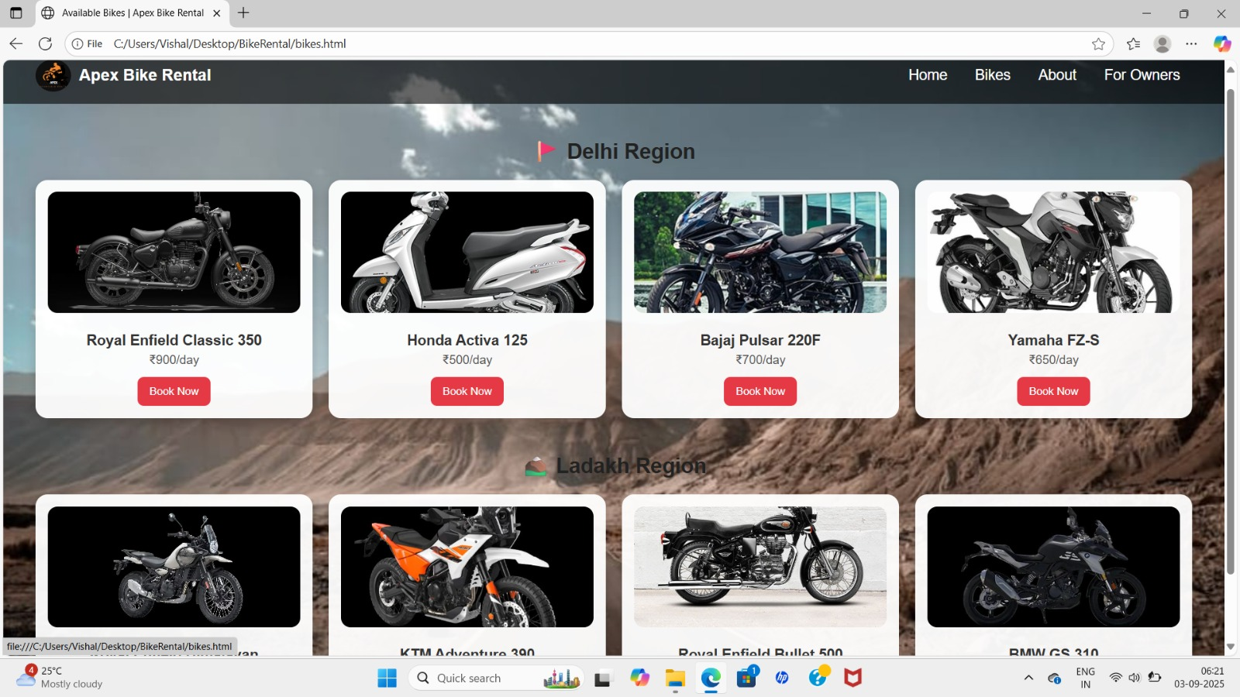

Slide 13
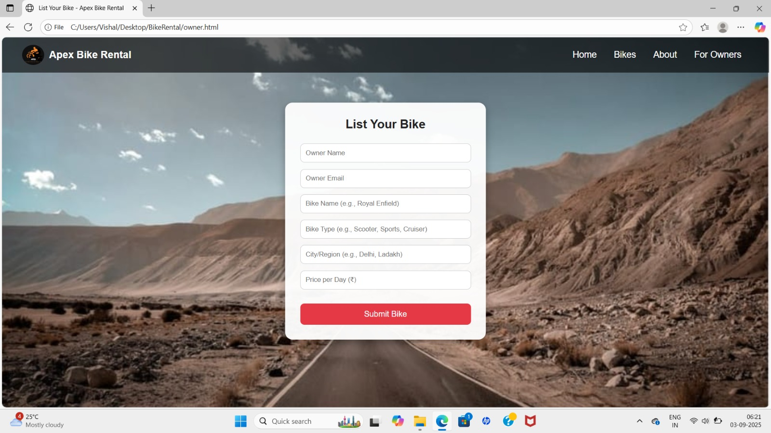

Slide 14
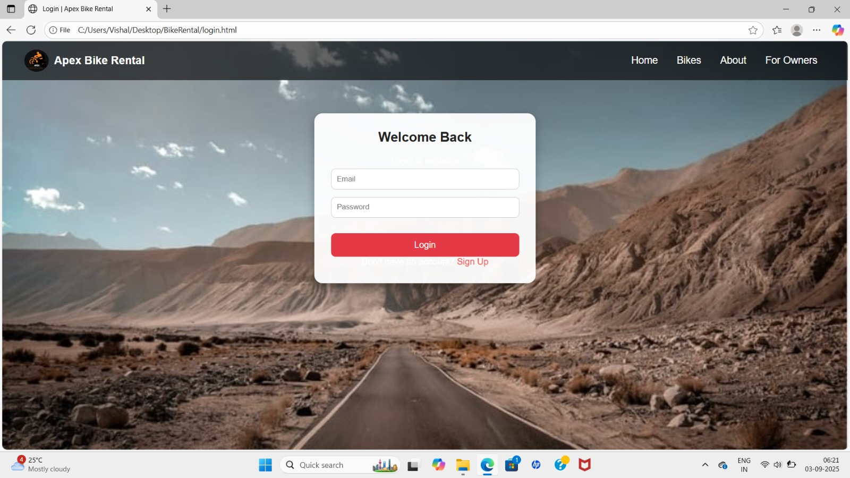

Slide 15
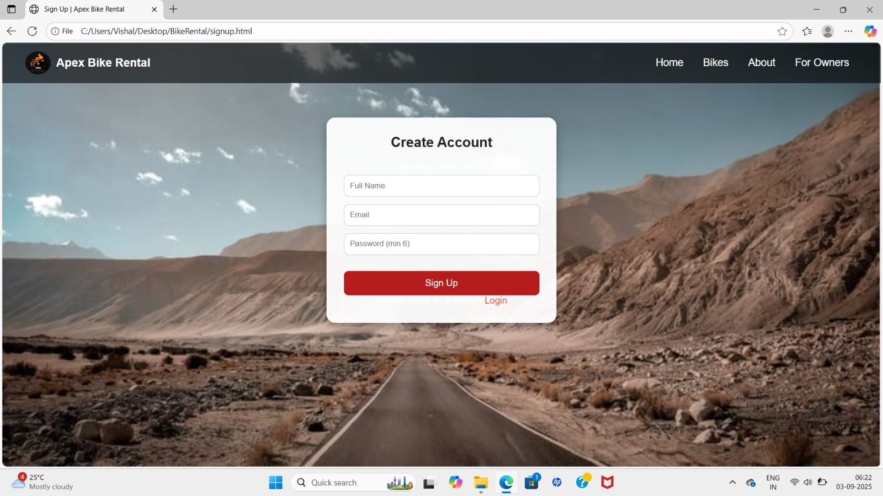

Slide 16
Applications
Bike rental shops
Tourist agencies
Solo Travellers

Slide 17
Future Enhancements
Emergency Mode:-
If the user’s bike breaks down mid-ride → app shows nearest mechanic or replacement bike station.
SOS button to request emergency pickup or alternative ride.
Weather Based Suggestions:-
App shows warnings like:
-Rain expected in 30 minutes.
-Strong winds, consider postponing ride.

Slide 18
References
[1] GitHub having Bike rental system projects: sabbir-hossain-abir/Bike-Rental-System
[2] Websites having Bike Rental Service: https://bikerentalmanager.com/

Slide 19
Thank You

