Slide 1

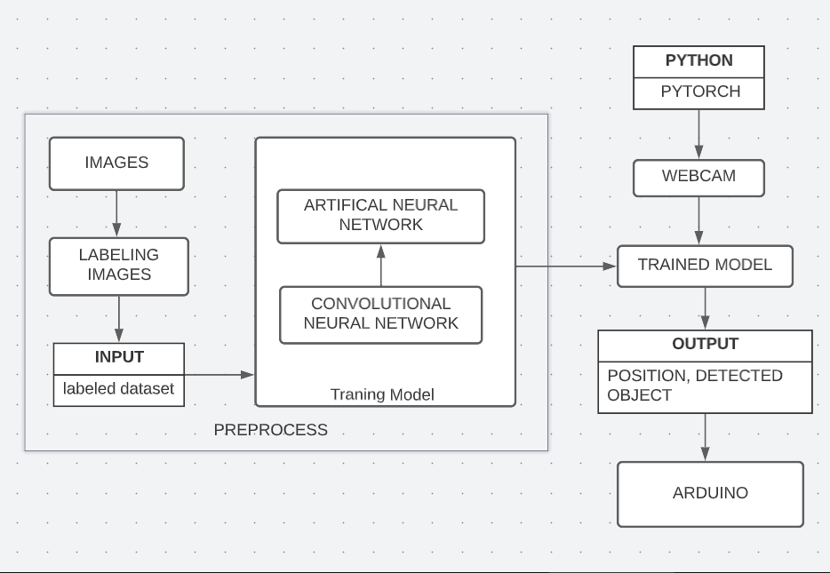
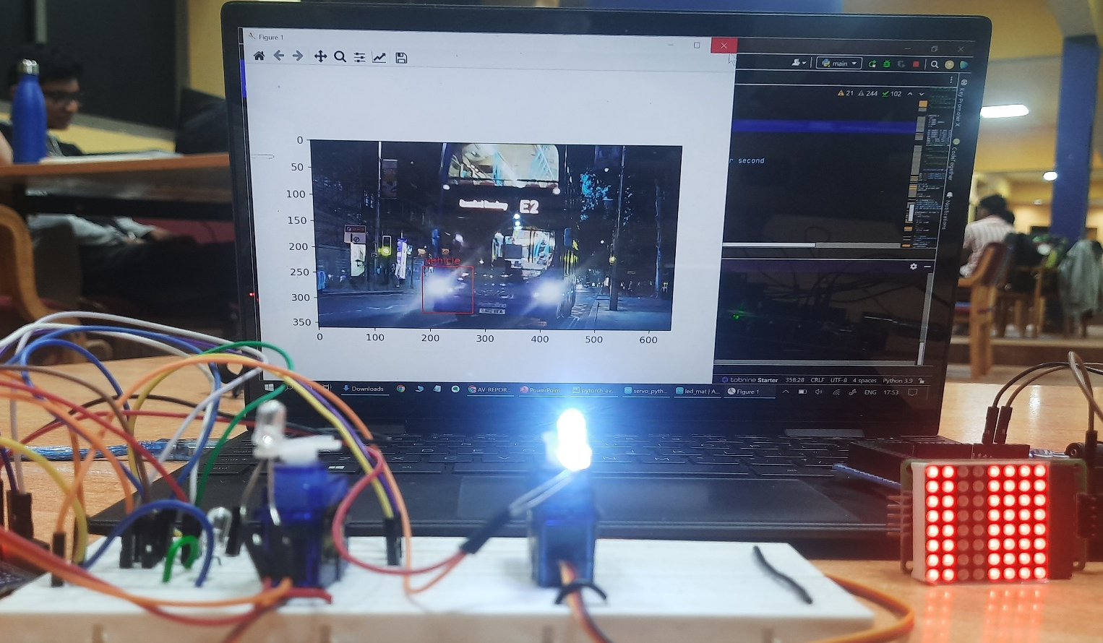
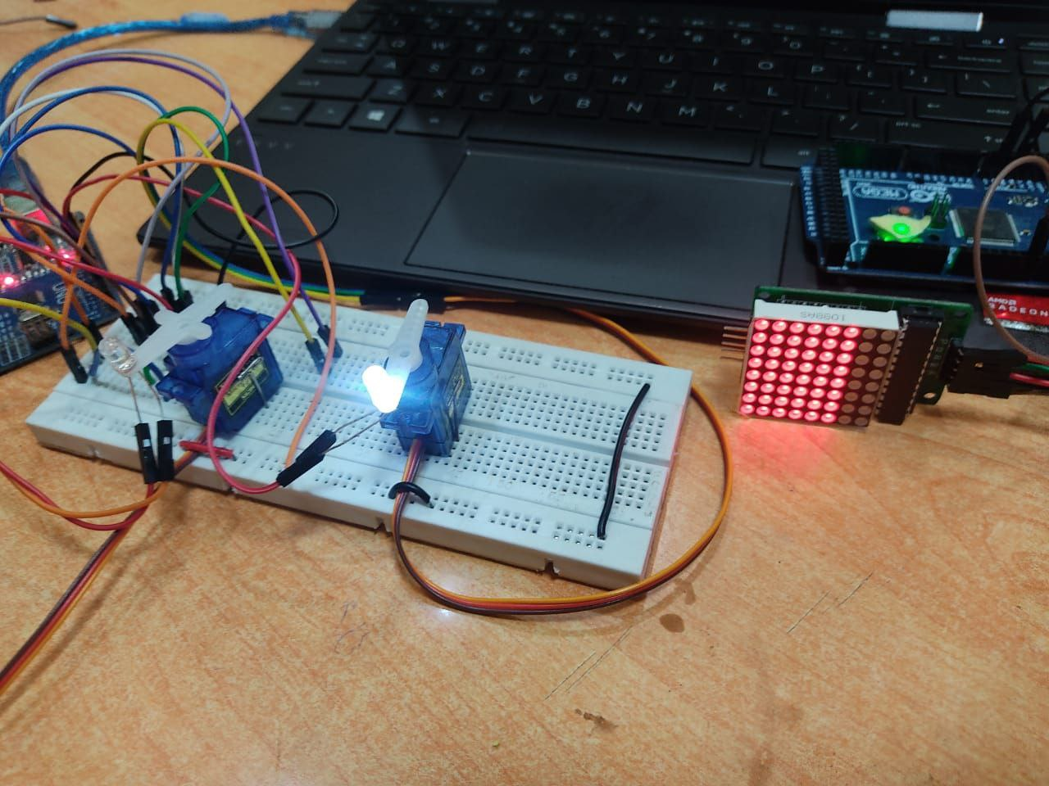
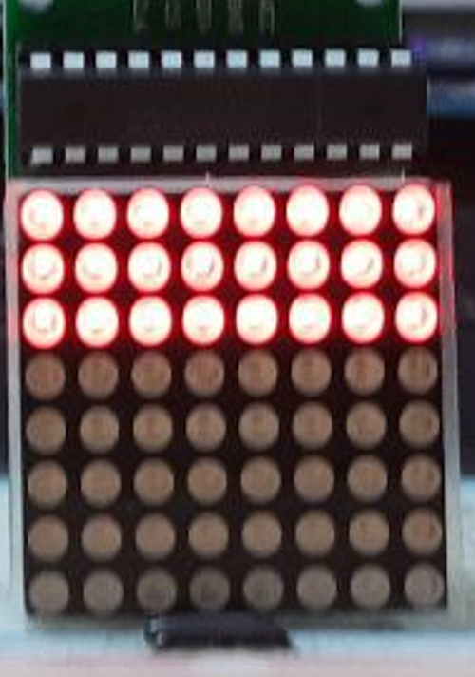
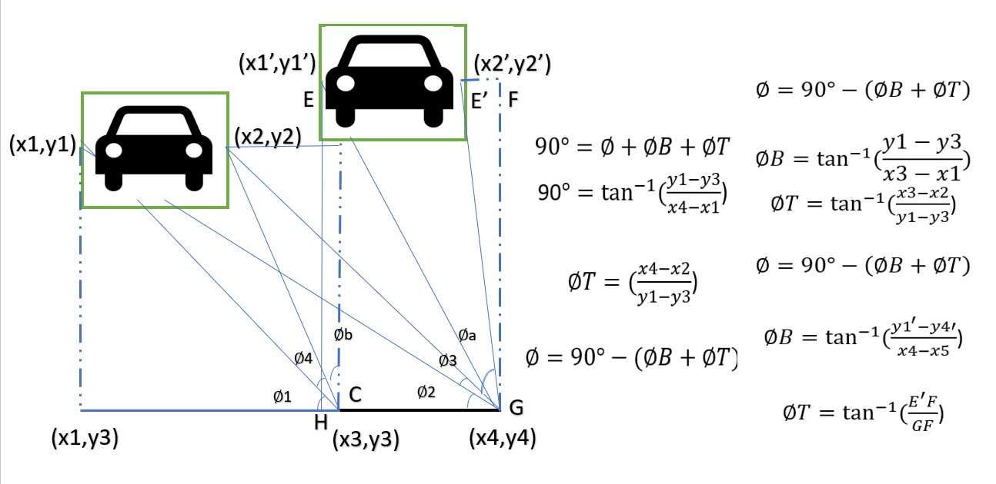
An Adaptive Driving Beam(ADB) System based on Angle and position information of opposite vehicle
Rajashekar, Vishal, Revati, Abhishek
Guide: Prof.Heera Wali, Team no : 16
School of Electronics and Communication
Problem statement
Methodology
Model is trained on more than 500 images, has a detection accuracy of 0.86, to detect vehicle in dark
Estimate the vehicles position and determine the appropriate angle(refer fig1) to adjust the high beam
The 8x8 LED matrix and servo motor is attached to Arduino mega as a peripheral, the position and angle data is sent and output is processed.
Results
To develop an appropriate solution for headlight high beam that avoids glare using machine learning algorithm, to demonstrate how the flexibility of LEDs can be used to create safer driving environment under low light/dark conditions. The main objective of this technology s to illuminate as much of road as possible while not dazzling other drivers.
Objectives
To reduce the dazzling effect due to high beam.
Using LED dot matrix
Adaptive LED high beams
Compare both the models
Achieve minimum latency possible.
The Raspberry PI 3B with an ARM Advanced RISC Machine; and RISC - Reduced instruction set computing technology is supplied with power from a constant 5v supply thereby instantiating the further p.
Contributions
Development of this device can be helpful for the entire visually impaired community. This is a much safer option considering the traditional stick to detect the object.
This can improve the quality of living of the visually impaired people in a good way.
Fig1.2
Fig1
Conclusions
Literature survey
After comparing led matrix and adaptive headlight we came to the conclusion that adaptive headlight is a better choice than lead matrix because it is more volatile than led matrix and has lower latency, which can reduces the dazzling effect for both near and long distance.
According to research conducted Blindness affects about 3.2 percent of the world’s population. And India has the highest percentage in the world
Blind stick helps them with their disability to a certain extent, but they fail in aspects that require detection of fast-moving objects and instant decision-making. Often, these devices or technologies are designed only for specific tasks.

