Slide 1
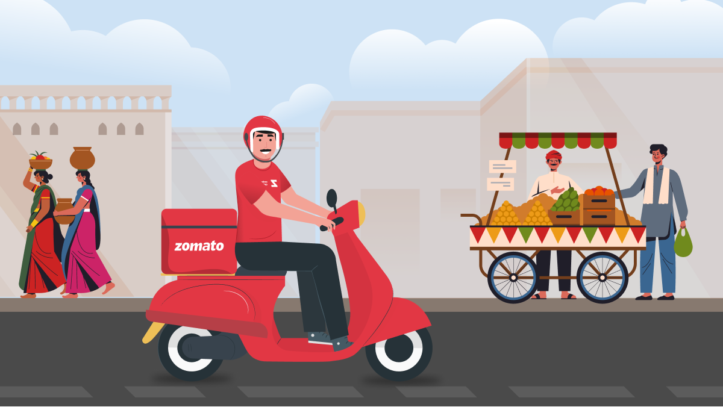
Zomato Restaurants Expansion
By
Vishal Pawar

Slide 2
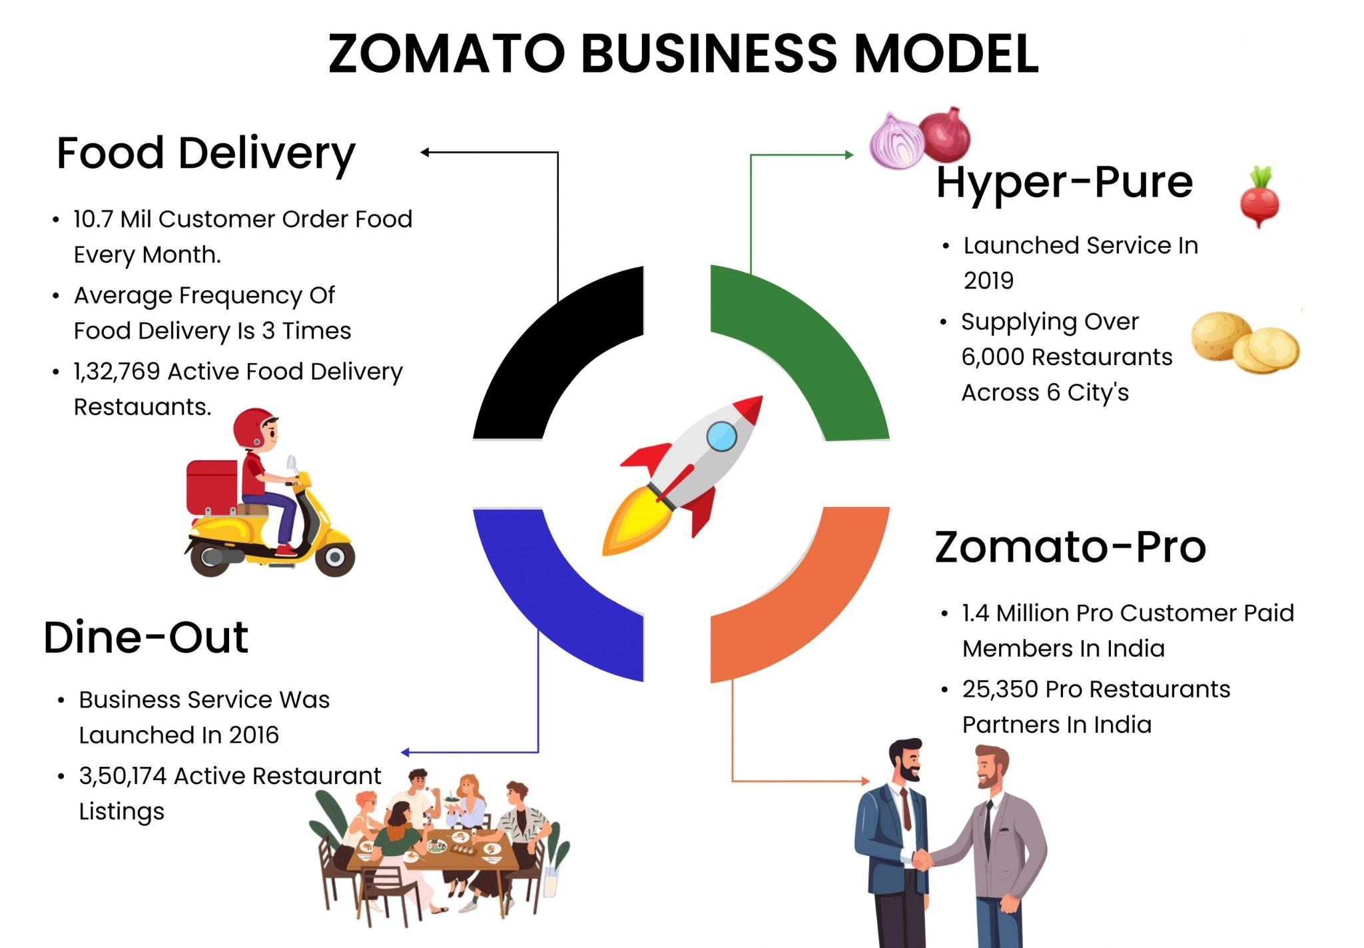
How
Z
O
M
A
T
O
Works

Slide 3
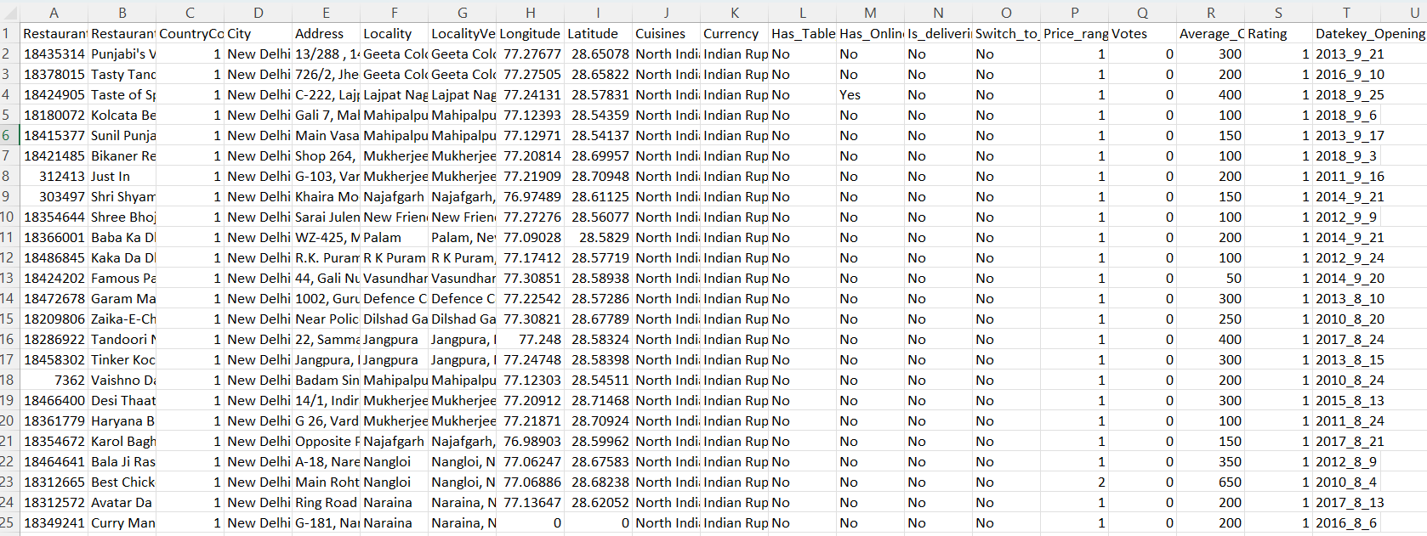
Problem Statement
You are hired as a consultant data analyst by zomato where the team is looking for expansion and opening restaurants. Your task is to come up with strategies/suggestions about opening newer restaurants.

Slide 4
Data dictionary
Restaurant ID: Unique identifier for each restaurant.
Restaurant Name: The name of the restaurant.
CountryCode: Country code of the location where the restaurant is situated.
City: The city where the restaurant is located.
Address: The specific address of the restaurant.
Locality: The locality or neighborhood where the restaurant is situated.
Locality Verbose: Detailed information about the locality.
Longitude: The geographical longitude coordinate of the restaurant.
Latitude: The geographical latitude coordinate of the restaurant.
Cuisines: The type of cuisine offered by the restaurant.
Currency: The currency used for transactions in the restaurant.
Has_Table_booking: Indicates whether the restaurant has a table booking option (Yes/No).
Has_Online_delivery: Indicates whether the restaurant offers online delivery (Yes/No).
Is_delivering_now: Indicates whether the restaurant is currently delivering (Yes/No).
Switch_to_order_menu: Indicates whether users can switch to the order menu (Yes/No).
Price_range: A numeric value indicating the price range category of the restaurant.
Votes: The number of votes or ratings/(feedback) received by the restaurant.
Average_Cost_for_two: The average cost for two people dining at the restaurant.
Rating: The overall rating of the restaurant is based on user reviews.
Datekey_opening: The date when the restaurant was opened.

Slide 5
Data Overview
Total Number of restaurants : 9551 restaurants.
Total Countries : 15 countries
Geographical Information : Columns like City, Address, Locality, Locality Verbose, Longitude, Latitude provides geographical information of the restaurants.
Services Offered : Cuisines, Table Booking, Online delivery, Average Cost for two people helps understand the services available in the restaurants.
Quality Inference : Price_range and Rating gives idea about the customer feedback and indicates popularity of the restaurants.

Slide 6
Primary objectives of the project
Z
O
M
A
T
O
Identify countries, and cities suitable for opening new restaurants.
Analyze restaurant performance metrics (ratings, votes, price range, cuisines).
Assess online delivery and table booking impacts on customer ratings.
Provide strategic recommendations supported by dashboards, pivots, and visuals for restaurant expansion.

Slide 7
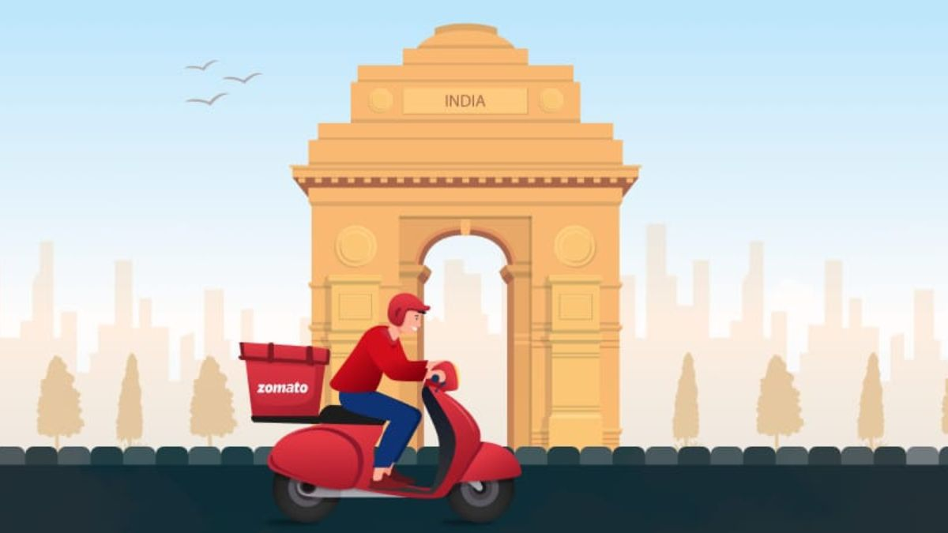
Analytical approach and tools
M
E
T
H
O
D
O
L
O
G
Y
Data Cleaning : Used function like LEFT, VALUE, MID, COUNTBLANK and Remove Duplicates and imputed NULL values to ensure data quality and accuracy.
Data Enrichment : Utilized VLOOKUP function to extract country for specified Country code.
Descriptive Analysis : Used Pivot Tables to summarize the data by country, cities, cuisines, price and rating, etc.
Helper Columns : Added Opening_year column and Average_Cost_INR column for fair analysis in future.
Visualization : Plotted charts based on the Pivot tables to gather data driven insights for the analysis.

Slide 8
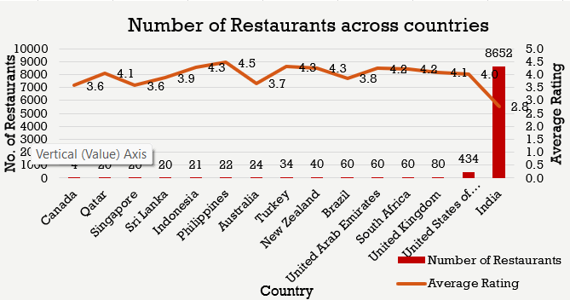
Number of restaurants across countries :
The chart shows the number of restaurants in each country with its average rating.
This chart helps understand the restaurant density across each country.
Canada has least restaurants whereas India with highest number of restaurants.

Slide 9
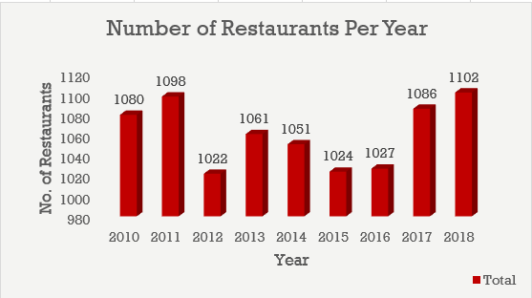
Number of restaurants per year
The column chart showcases the number of restaurants opened each year.
Every year 1000+ new restaurants are opened.
This tells us about the positive growth in the field.

Slide 10
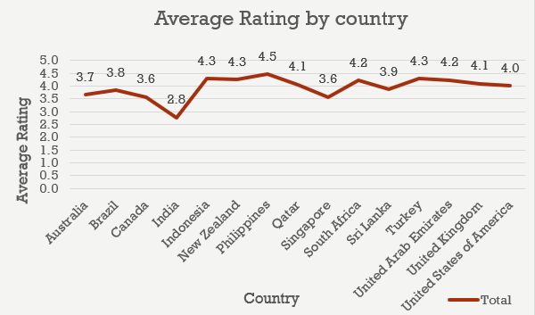
Average Rating of restaurants across countries
Rating is one of the most fundamental metrics considered for the analysis.
Countries with high average ratings shows high customer satisfaction.
Example : Philippines, Indonesia, Qatar

Slide 11
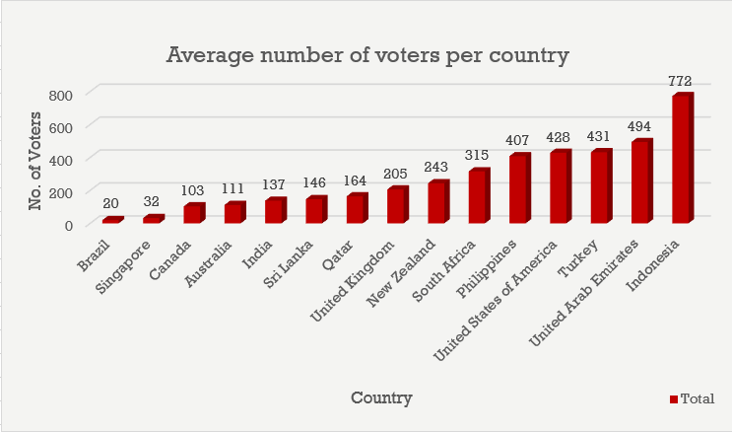
Average number of voters across countries
Another metric which shows high customer engagement is average number of voters.
High Average : Indonesia, UAE, Turkey, USA, Philippines.
Low Average : Brazil, Singapore.

Slide 12
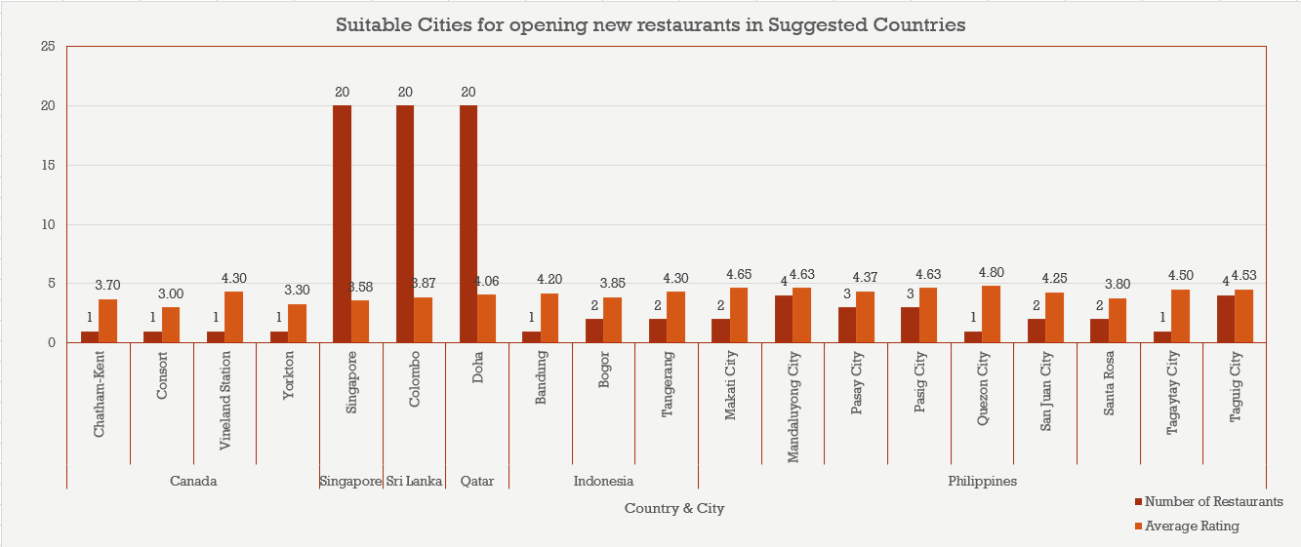
Suitable cities for opening new restaurants
Canada : Chatham-kent, consort, Yorkton, Vinland station.
Indonesia : Bandung, Bogor, Tangerang.
Philippines : Makati city, Pasay city, Pasig city, Quezon city, etc.
Singapore city, Doha, and Colombo city from Singapore, Qatar and Sri Lanka respectively.

Slide 13
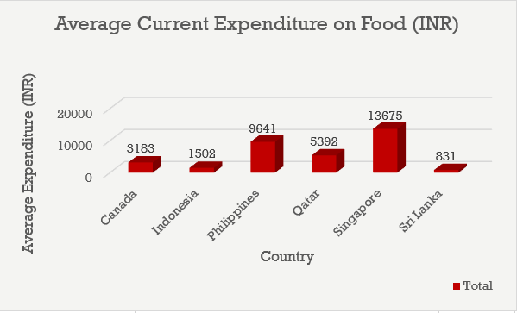
Average Expenditure on Food
Singapore spends most on the food with 13,675 INR, making it the top choice for expansion.
Followed by Philippines, where the team can consider to invest more.
Canada and Qatar falls in the mid range category in terms of expenditure on food.
While Indonesia and Sri Lanka spends the least on food.

Slide 14
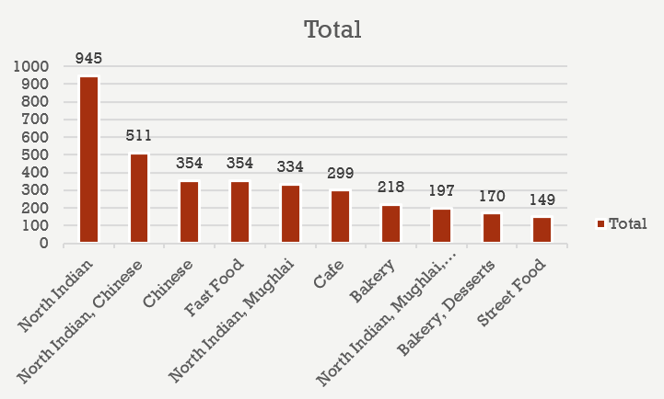
Top 10 cuisines
As the India has highest number of restaurants North Indian Food tops the list available in 945 restaurants.
Combination of North Indian and Chinese food is served in 511 restaurants.
Whereas street food stands at 10th position in the list.

Slide 15
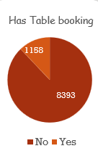
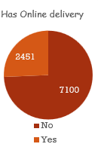


Online delivery and Table booking
Majority of restaurants don’t offer online delivery and table bookings.
But those who offer, receive a higher rating.

Slide 16
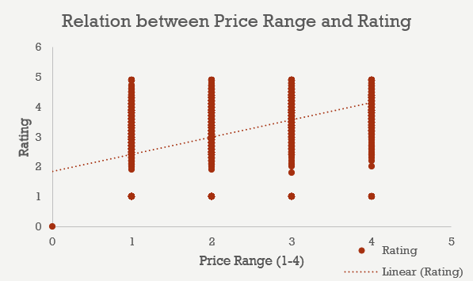
Relation between Price and Rating
There’s a positive correlation between the price of cuisines and rating of the restaurants.
High price range cuisines grab higher ratings.
Whereas Low price range restaurants get lower average ratings.
Thus prioritizing high price range cuisines is recommended.

Slide 17
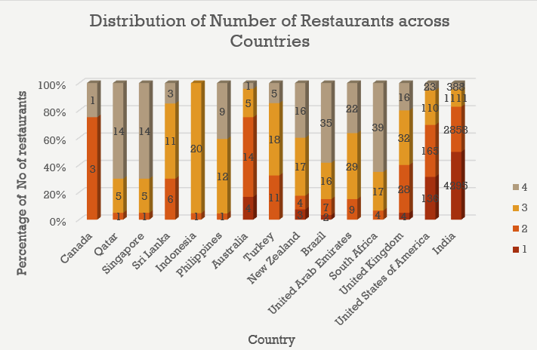
Price Range Distribution across countries
India and United States of America are having maximum number of restaurants that offer lower price range food.
Qatar, Singapore, South Africa, Philippines have high price range cuisines focus.
Whereas majority of countries have food in the price range 3.

Slide 18
Strategic recommendations
Canada, Qatar, Singapore, Sri Lanka, Indonesia and Philippines are the most suitable countries for opening new restaurants as less number of restaurants are there which gives us less competitive edge.
Following cities within above suggested countries are to be considered for opening new restaurants.
Canada : Chatham-kent, Consort, Vinland Station, Yorkton
Qatar : Doha
Singapore : Singapore city
Sri Lanka : Colombo city
Indonesia : Bandung, Bogor, Tangerang
Philippines : Makati City, Mandaluyong City, Pasay City, Pasig City, Quezon City, San Juan City, Santa Rosa, Tagaytay City, Taguig City

Slide 19
Strategic recommendations
Management can make high financial expenditure in Qatar, Philippines and Singapore based on the above chart.
But cost controlled solutions need to be implemented in Sri Lanka, Indonesia and Canada.
Japanese, American, Filipino, Desserts, Korean, Asian are the most popular cuisines which we need to focus on in our new restaurants.
Both Online delivery and Table booking services directly affect the customer ratings thus these services should be offered in new restaurants in order to get higher customer engagement.
The team should keep the rate of cuisines higher because that positively affects the feedback.

Slide 20
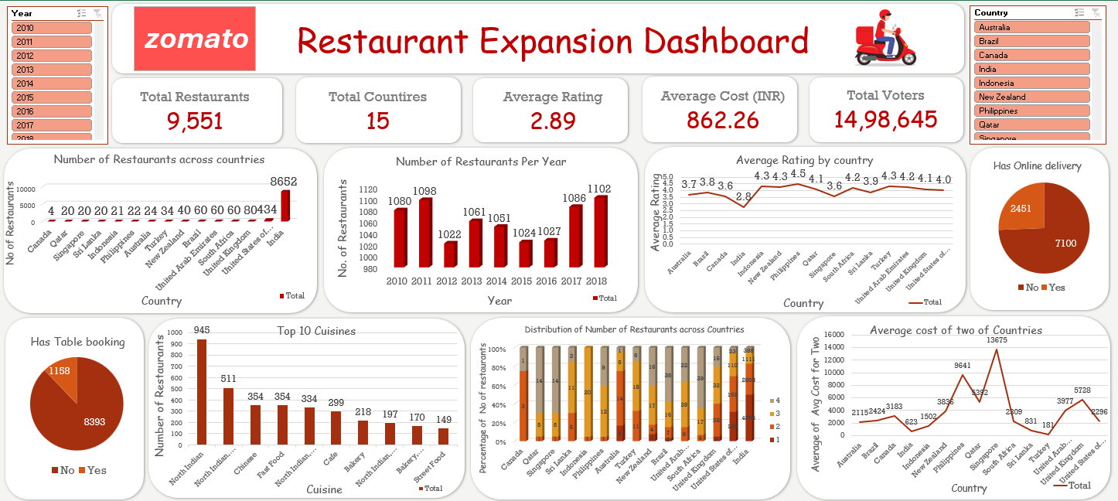
Dashboard

Slide 21

Conclusion
Low-competition markets—Canada, Qatar, Singapore, Sri Lanka, and Indonesia and Philippines—present the strongest opportunities for Zomato’s expansion.
High-rated cuisines and balanced pricing in these markets can drive customer engagement and sustainable growth.
Online delivery and table booking significantly boost customer satisfaction and should be prioritized in new outlets.
Closing Statement: This data-driven strategy equips Zomato to expand intelligently, minimize risk, and strengthen its global market presence.
“A small Zomato outlet opened in a quiet Singapore neighborhood two years ago. With thoughtful pricing, popular local cuisines, and seamless online delivery, it quickly became a community favorite—proof that the right place, the right features, and the right strategy turn opportunities into success. These insights guide Zomato to replicate that story across new markets.”

Slide 22
References
Cool Article to do effective story telling
Understanding Zomato Business Model
Building Interactive dashboards
Zomato Company Information and Global Operations
Google Workplace Learning Center

Slide 23
Thank You

