Slide 1

Business Analyst Assignment

Slide 2

Q1. Customer Lifetime Value

Slide 3
Customer Lifetime Value
First calculate the amount earned by the company on month basis.
Then I take average of that to get a sense of how much a customer typically
pay. Then I calculated the average customer lifespan. This will happen by
taking the maximum and minimum date of users to get the lifespan data.
Then I calculated the difference between times in days, divided by 30 to get month number of months.
Finally, I can take the average of that to get the average lifespan for a customer.
Now I have my ACV and ACL, I divided them to get my overall LTV for the business

Slide 4
Q2. Sikka Vs Sikka Pro

Slide 5
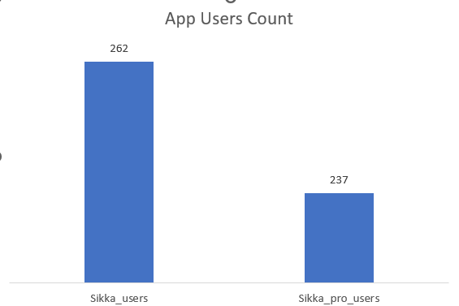
Offer Initiation By Users
I have calculated the number of users with respect to the app they are using.
From here we can see that we have a difference of 25 users between the sikka and sikka pro app.
This data gives us an overview that people are installing sikka more than sikka pro.

Slide 6
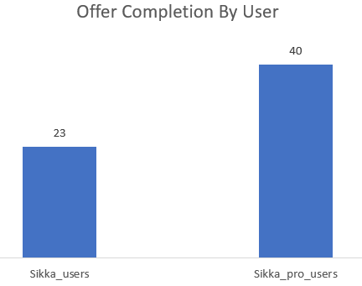
Offer Completion By Users
I have selected the users who have status saying that there process has been completed.
And from here we can see that sikka pro have more users who have completed there offer.

Slide 7
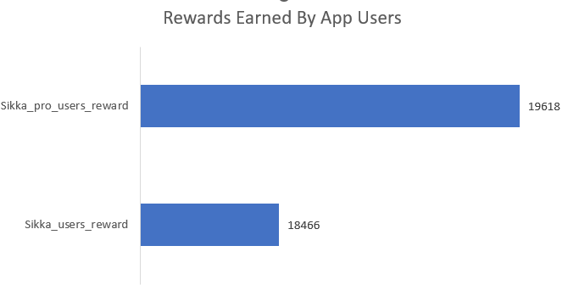
Rewards Earned By Users
I have calculated the sum/total amount or rewards users have earned in each app.
And from the given bar chart we can see that sikka pro users have earned more rewards w.r.t sikka users

Slide 8
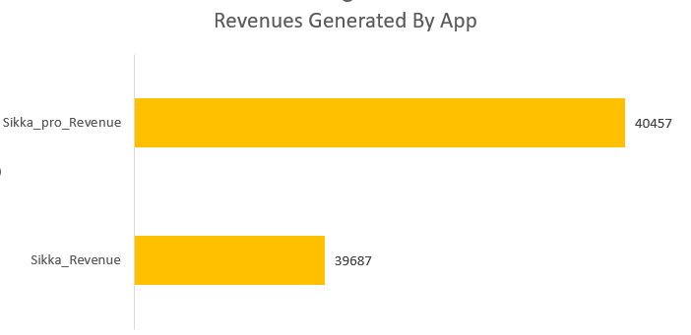
Revenue Generated
I have calculated the total revenue apps have been generated through the users.
And from here we can see that sikka pro have made more revenue w.r.t sikka users
From all the data and KPIs present we can see that inspite of sikka having more users sikka pro has performed pretty well. It has given more rewards to the users which will make it more likeable in users in upcoming time and also Sikka pro has generated more revenue so it will be profitable for the company too.

Slide 9
Q3. Referrals Prediction

Slide 10
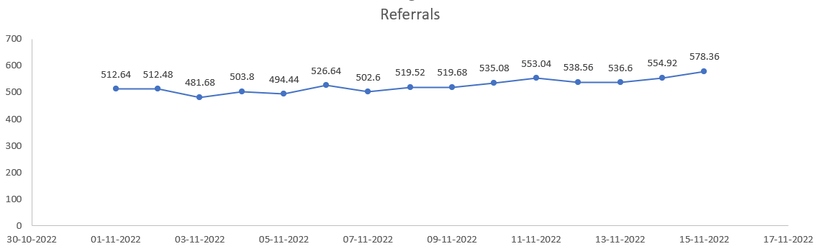
Prediction Of Referrals
I calculated the referrals per DAU and this gives me the ratio of how many users are coming through referrals from DAU.
After this I calculated the average and multiplied the number(avg number) with the DAU for dates from 1-NOV to 15-NOV and this will give me an approx. referrals number for these days.
Here in the line chart we can see the number of referrals for the given date.

Slide 11
Q4. Anomaly

