Slide 1

Methodist College of Engineering & Technology
Detection of Parkinson’s Disease using Machine Learning
Group Members
SL. NO | Name of Student | Roll Number
1. | P Saritha | 160718733047
2. | T Kamaljeet | 160718733037
3. | R Vishal | 160718733040
Batch Number Project Guide Project Coordinator
MPCSE2018A1 Mr. P. V. Ramanaiah Mr. P. V. Ramanaiah
(BATCH NO: 11) Asst. Professor Asst. Professor
Department of CSE Department of CSE,
Mr. T. Praveen Kumar
Asst. Professor
Department of CSE

Slide 2
CONTENTS
Abstract
Introduction
Literature Survey
Existing system
Problem statement
Objectives
Proposed work
Data flow diagrams
Implementation
Output screenshot
Conclusion
Future work
Reference
Thank you

Slide 3
Abstract
Parkinson's disease is a brain disorder that leads to shaking, stiffness, and difficulty with walking, balance, and coordination. Parkinson's symptoms usually begin gradually and get worse over time. As the disease progresses, people may have difficulty walking and talking.
Accurately detecting Parkinson's disease at an early stage is certainly indispensable for slowing down its progress and providing patients the possibility of accessing to disease-modifying therapy.
Most Parkinson Disease patients suffer from vocal cord disorders.
Speech impairment is an early indicator of Parkinson Disease.

Slide 4
Introduction
Parkinson’s disease is a neurodegenerative disorder of central nervous system that causes partial or full loss of motor reflexes, speech, behavior, mental processing, and other vital functions.
It is generally observed in elderly people and causes disorders in speech and motor abilities of 90% of the patients.
People with Parkinson’s disease suffer from speech impairments like dysphonia (defective use of the voice), hypophonia (reduced volume), monotone (reduced pitch range), and dysarthria (difficulty with articulation of sounds or syllables).

Slide 5
Literature Survey
An article titled “ Machine learning system for the Detection of Parkinson’s Disease from Speech Signals and Its Application to Multiple Speech Signal Types” by Ismail and Fethullah in the year 2018.
An article titled “Automated Detection of Parkinson’s Disease Based on Multiple Types of Sustained Phonation” by Liaqat Ali in the year 2019.

Slide 6
Existing Systems
There are currently no blood or laboratory tests to diagnose nongenetic cases of Parkinson's disease. Parkinson's disease can't be cured, but medications can help control the symptoms, often dramatically. Early detection and treatment becomes vital.
MRI or CT scan – Conventional MRI cannot detect early signs of Parkinson’s disease.
There is need for improvement in accuracy of detection of Parkinson’s disease.
In existing system, Parkinson’s Disease at the secondary stage only which leads to medical challenges.
Thus existing system is not effective in early prediction and accurate medicinal diagonosis to the effected people.

Slide 7
Problem Statement
To develop a machine learning model to detect if a person has Parkinson's disease or not on the basis of input voice features using supervised machine learning models.

Slide 8
Objectives
To accomplish improved accuracy of the models used for detecting and predicting Parkinson’s disease.
To build supervised machine learning algorithms to train the models on cleaned UCI Parkinson's dataset.
To design an application to take as parametric input and check if a person has Parkinson’s disease or not.
To implement a system which monitors activities of patient suffering from Parkinson's disease and stores their history.

Slide 9
Proposed Work
The system proposes a method for detecting Parkinson’s disease using the voice features using supervised machine learning classification algorithms–KNN, Logistic Regression, Stacking and Random Forest.
An application where data about patients can be recorded which can be accessed and reviewed by doctors to monitor the condition of the patients is also proposed.

Slide 10
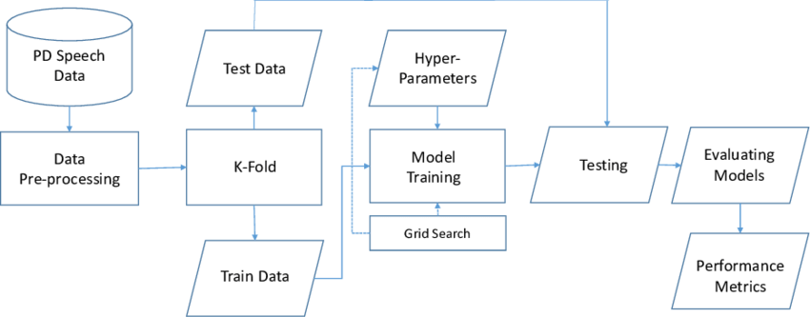
System Architecture

Slide 11
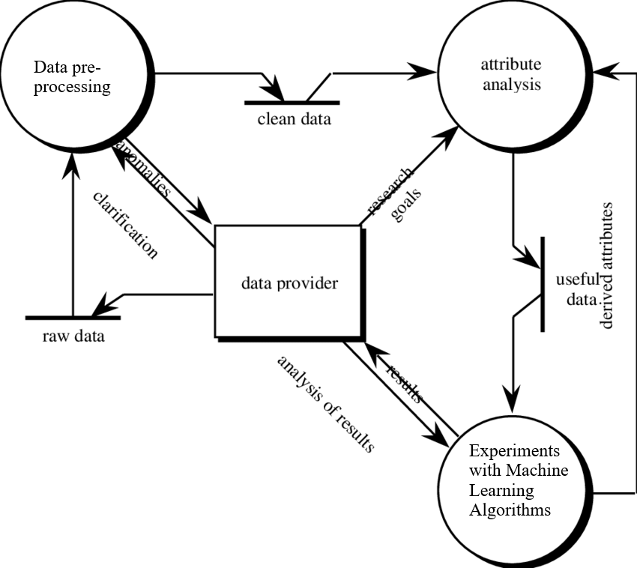
Data Flow Diagram

Slide 12
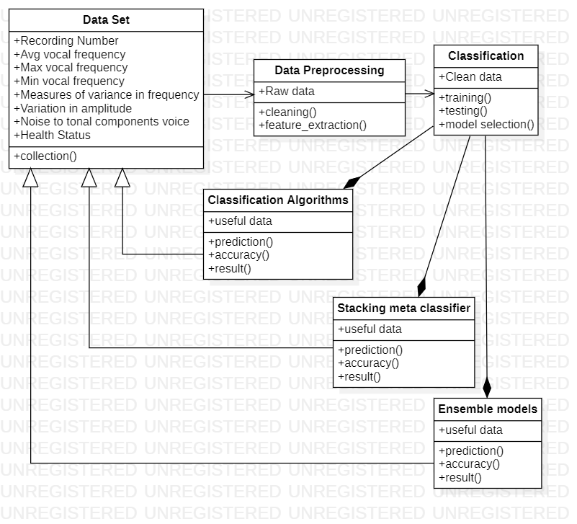
UML Diagram Class Diagram

Slide 13
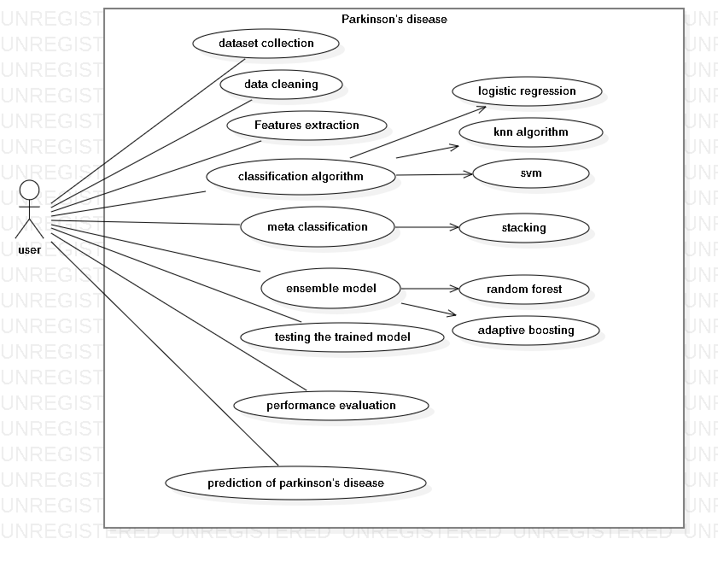
Use Case Diagram

Slide 14
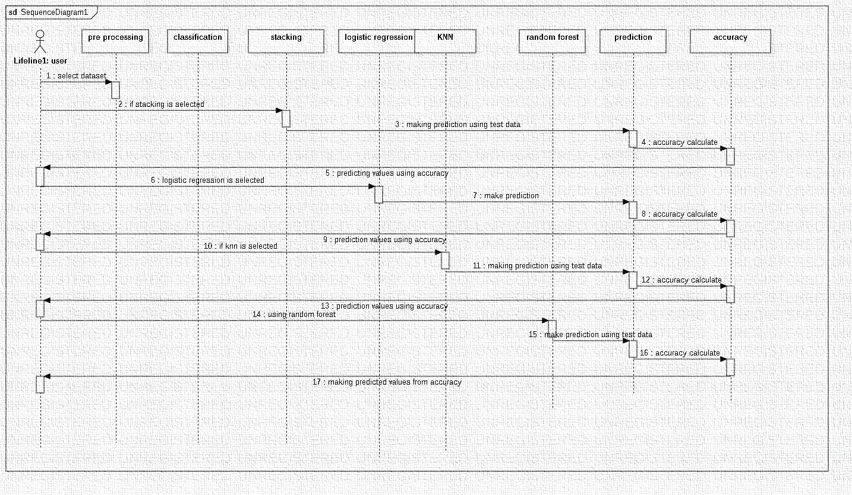
Sequence Diagram

Slide 15
Implementation
Logistic Regression:
Logistic regression is one of the most popular Machine Learning algorithms, which comes under the Supervised Learning technique. It is used for predicting the categorical dependent variable using a given set of independent variables.
KNN K-Nearest Neighbor (KNN) Algorithm
K-Nearest Neighbour is one of the simplest Machine Learning algorithms based on Supervised Learning technique.

Slide 16
Support Vector Machine Algorithm:
Support Vector Machine or SVM is one of the most popular Supervised Learning algorithms, which is used for Classification as well as Regression problems. However, primarily, it is used for Classification problems in Machine Learning.
Random Forest Algorithm:
Random Forest is a popular machine learning algorithm that belongs to the supervised learning technique. It can be used for both Classification and Regression problems in ML. It is based on the concept of ensemble learning, which is a process of combining multiple classifiers to solve a complex problem and to improve the performance of the model.

Slide 17
ADABOOST (ADAPTIVE BOOSTING):
AdaBoost also called Adaptive Boosting is a technique in Machine Learning used as an Ensemble Method. The most common algorithm used with AdaBoost is decision trees with one level that means with Decision trees with only 1 split. These trees are also called Decision Stumps.
LIBRARIES USED:
Numpy
Pandas
Matplotlib
Seaborn
Scikit Learn

Slide 18
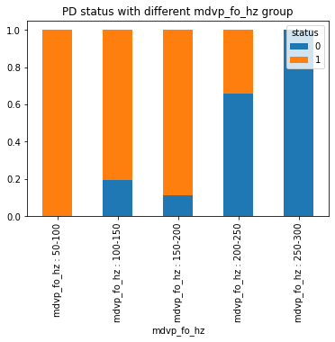
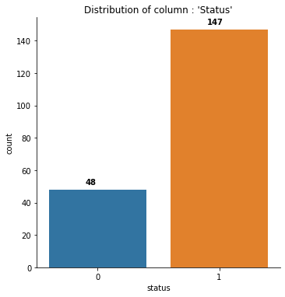
OUTPUT SCREEN

Slide 19
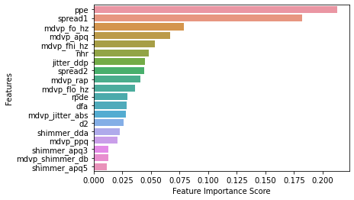
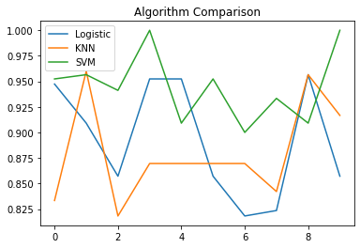
>

Slide 20
Accuracy scoring of the Models
Logistic Regression model have mean Accuracy of 0.84 and SD Accuracy of 0.08 K-NN model have mean Accuracy of 0.8 and SD Accuracy of 0.07 SVM model have mean Accuracy of 0.92 and SD Accuracy of 0.05 Stacking model have mean Accuracy of 0.9 and SD Accuracy of 0.06 Random Forest model have mean Accuracy of 0.9 and SD Accuracy of 0.07 Adaptive Boosting model have mean Accuracy of 0.88 and SD Accuracy of 0.07
F1 scoring of the Models
Logistic Regression model have mean F1-Score of 0.89 and SD F1-Score of 0.05 K-NN model have mean F1-Score of 0.88 and SD F1-Score of 0.05 SVM model have mean F1-Score of 0.95 and SD F1-Score of 0.03 Stacking model have mean F1-Score of 0.95 and SD F1-Score of 0.05 Random Forest model have mean F1-Score of 0.93 and SD F1-Score of 0.05 Adaptive Boosting model have mean F1-Score of 0.92 and SD F1-Score of 0.05
We can conclude from the above Accuracy and F1 scoring method that, Stacking Model performs better than other models. Stacking Model have mean Accuracy of 90% with standard deviation of 6% . And, Stacking Model have mean F1-Score of 95% with standard deviation of 5%

Slide 21
Conclusion
This project aims to provide a better prediction for Parkinson’s disease by optimizing and tuning the parameters of KNN, SVM and Random Forest Algorithms. This project also provides a reliable health monitoring system for those suffering from Parkinson’s disease.
To help in early detection of Parkinson’s disease which would help in early diagnosis thus slowing down disease progression.
Provide machine learning models which would increase accuracy of detection of the Parkinson’s disease.

Slide 22
Future Scope
Several areas pertaining to Parkinson’s Disease! biomarkers require further inquiry. Additional longitudinal studies are needed to deter-mine which biomarker techniques will be most useful in the earlier detection of PD and for identifying preclinical, at-risk populations. Potential diagnostic imaging or biofluid assays may be compared to the gold standard of neuropathology, rather than solely clinical assessment, since in some settings, this diagnostic accuracy may be low .Biomarker study methodologies must be fine-tuned and standardized, especially relevant for biofluid assays and neuroimaging protocols, as methodological differences may account for inconsistent results. Lastly, novel biomarkers and analytic methods must be identified. Imaging methods to detect α-synuclein in the brain are in development.

Slide 23
References
[1]B. E. Sakar et al., "Collection and Analysis of a Parkinson Speech Dataset With Multiple Types of Sound Recordings," in IEEE Journal of Biomedical and Health Informatics, vol. 17, no. 4, pp. 828-834, July 2013, doi: 10.1109/JBHI.2013.2245674.
[2]Benba, A., Jilbab, A. & Hammouch, A. Analysis of multiple types of voice recordings in cepstral domain using MFCC for discriminating between patients with Parkinson’s disease and healthy people. Int J Speech Technol 19, 449–456 (2016).

Slide 24
Thank You

