Slide 1
The Hunt – Group 4

Slide 2

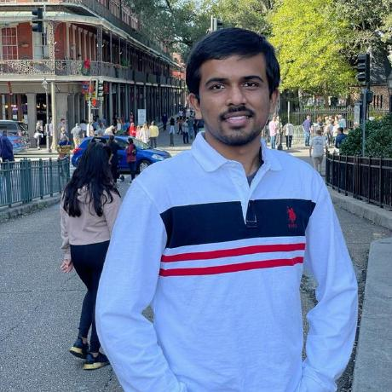
Team Members
Rohith Chittimalla Vishal Reddy Vennavaram
S538308 S538349

Slide 3
Description:
A progressive web application that allows users to find out treasures located in various places by following the directions provided.
The application is made available through Heroku.
It will have two squares located side by side to play the game.
If the user clicks on square1 the game is ready to begin.
If the user clicks on square2 he will get the directions to find the treasure.

Slide 4
Stack Used:
Platform : Node
Web Framework: Express
View Engine: EJS
ORM: Sequelize
Database: Postgre SQL
API : Google Maps
Hosted app link: https://fsa3.herokuapp.com/
Github Repo link: https://github.com/Vishalreddy114/FSA3

Slide 5
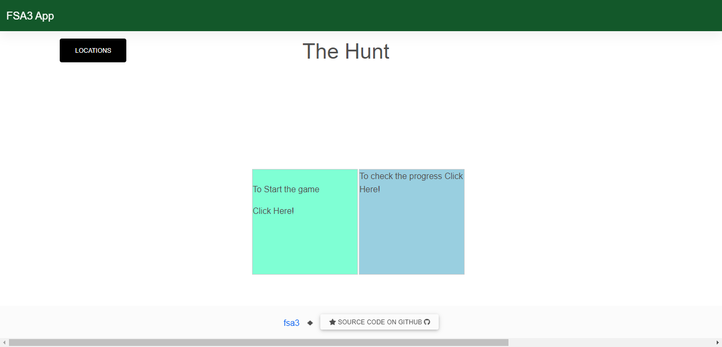
Screen shot for home page

Slide 6

Screenshot when outside the location

Slide 7

Screenshot for inside the location

Slide 8
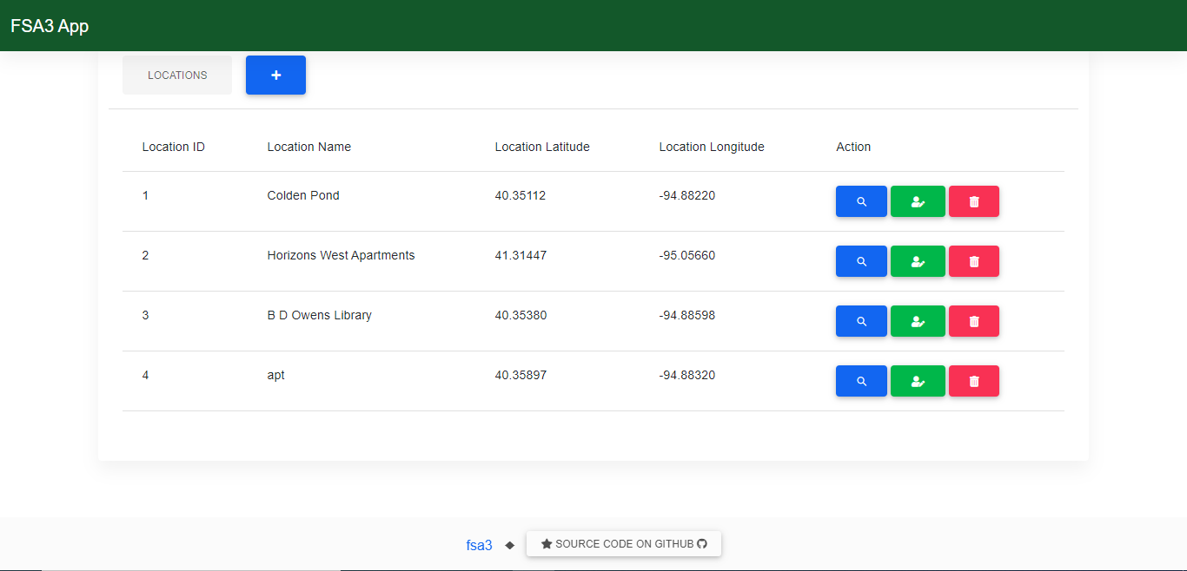
Screenshot for displaying the locations

Slide 9

THANK YOU

