Slide 1

UNIVERSITY INSTITUTE OF ENGINEERING
DEPARTMENT OF COMPUTER SCIENCE AND ENGINEERING
Numerical Methods and Optimization Using Python
Course Code- 22CSH-259/22ITH-259
Dr. Hardeep Kaur (15828)
DISCOVER . LEARN . EMPOWER

Slide 2
Root-finding Methods : Bisection method
Introduction
The Bisection Method is a fundamental numerical technique used for finding roots of a continuous function. It is a bracketing method, meaning it works by narrowing down the interval in which a root lies until the interval is sufficiently small. The Bisection Method is particularly useful due to its simplicity and guaranteed convergence for continuous functions where the Intermediate Value Theorem applies.

Slide 3
Basic Principle
The Bisection Method relies on the Intermediate Value Theorem, which states that if a continuous function f(x) changes sign over an interval [a,b], then there exists at least one root in that interval. The method repeatedly bisects the interval and selects the subinterval in which the function changes sign, thereby narrowing down the interval that contains the root.

Slide 4
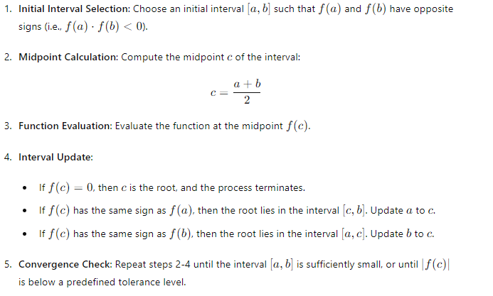
Steps of the Bisection Method

Slide 5
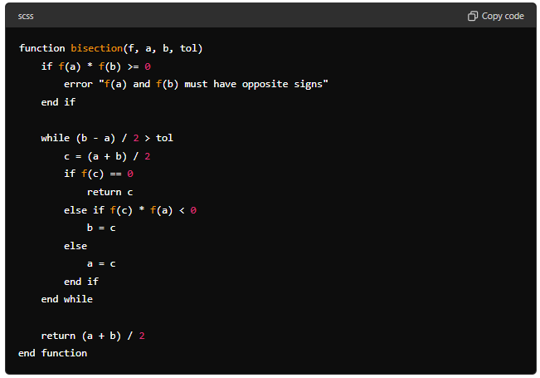
Pseudocode
Here's a simple pseudocode representation of the Bisection Method:

Slide 6
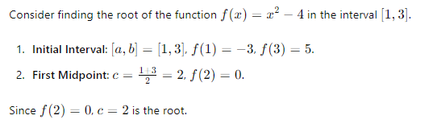
Example:

Slide 7
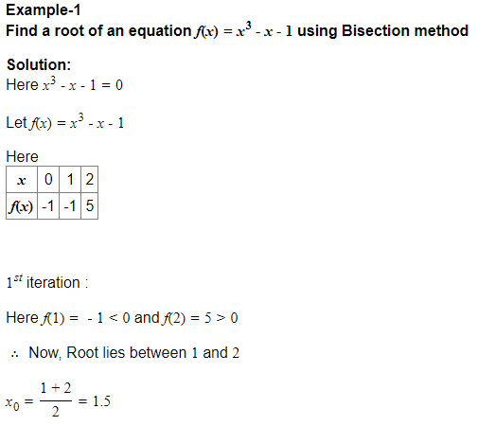

Slide 8
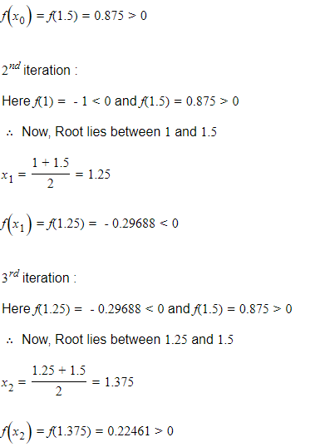

Slide 9
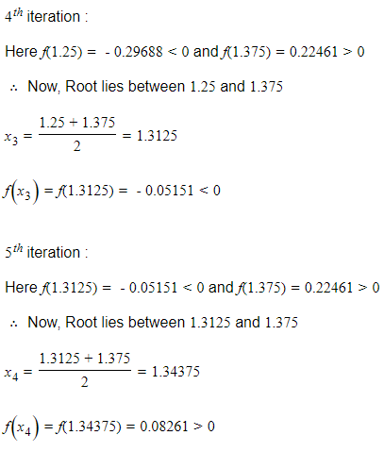

Slide 10
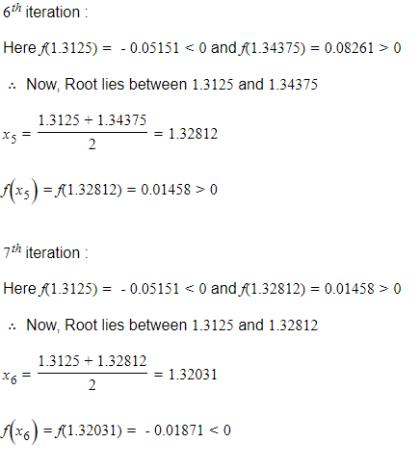

Slide 11
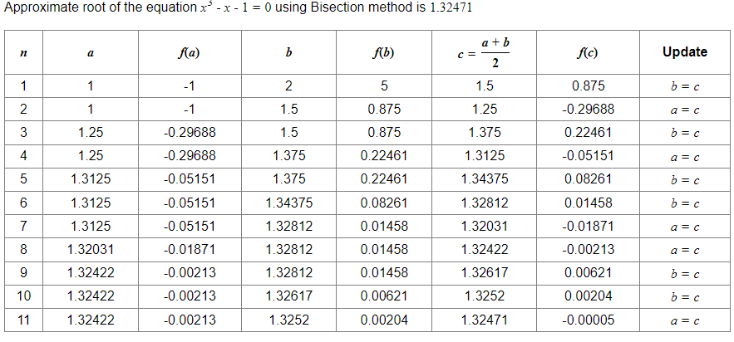

Slide 12
Advantages and Disadvantages
Advantages:
Simplicity: The method is easy to understand and implement.
Guaranteed Convergence: It always converges to a root if the initial interval is chosen correctly.
Robustness: Works well for a wide range of functions.
Disadvantages:
Slow Convergence: The method converges linearly, which can be slow compared to other methods like Newton's method.
Initial Interval Requirement: Requires an initial interval where the function changes sign.

Slide 13
Applications
The Bisection Method is used in various fields such as engineering, physics, economics, and any area that requires finding roots of equations. It is particularly useful in scenarios where the function is not well-behaved or where other root-finding methods may fail.

Slide 14
Conclusion
The Bisection Method is a powerful tool in numerical analysis for finding roots of continuous functions. Its simplicity and guaranteed convergence make it a reliable choice, especially when dealing with functions that exhibit problematic behavior. Despite its slow convergence, its robustness ensures that it remains a valuable method in the numerical analyst's toolkit.

Slide 15
THANK YOU

