Slide 1
The Fitness Agent
IBM CAPSTONE PROJECT
Presented By:
Vishal Singh Negi
Galgotias University
B.Tech CSE

Slide 2
Problem Statement : 13
Creates personalized workout plans based on user goals, fitness level, and available time.
Suggests healthy and culturally appropriate meal ideas.
Provides motivational tips and habit-building reminders.
Adapts routines dynamically based on progress and feedback.
Offers equipment-free workout alternatives.
Tracks and optimizes fitness schedules for consistency.

Slide 3
Proposed Solution
Build The Fitness Agent using IBM Cloud Lite services and IBM Granite.
Conversational AI interface powered by IBM Watson Assistant.
Understands user preferences, resources, and health conditions.
Provides real-time, adaptive, and personalized health recommendations.

Slide 4
Technology Used
IBM Cloud Lite services
Natural Language Processing (NLP)
Large Language Models (LLM)
IBM Granite model
IBM App Connect

Slide 5
IBM Cloud Services Used
IBM Cloud Watsonx AI Studio
IBM Cloud Watsonx AI Runtime
IBM Cloud Functions
IBM Granite (via Watsonx.ai Studio)
IBM Cloud Object Storage
IBM AI Tools

Slide 6
Wow Factors
Personalized workout and nutrition plans in seconds
Real-time adaptation based on user progress
Natural language understanding for tailored suggestions
Equipment-free workout options
Interactive chat experience powered by Watson Assistant
Serverless backend logic for efficiency

Slide 7
End Users
Individuals aiming to improve overall fitness
Busy professionals with limited time
Students and beginners
People without access to gym facilities
Individuals with dietary restrictions or health conditions

Slide 8
Setting Up
Clone the GitHub repository
Open Watsonx AI Studio project
Upload fitness & nutrition dataset or use built-in database
Enter goal, time, and equipment
Receive personalized workout & diet plan instantly

Slide 9
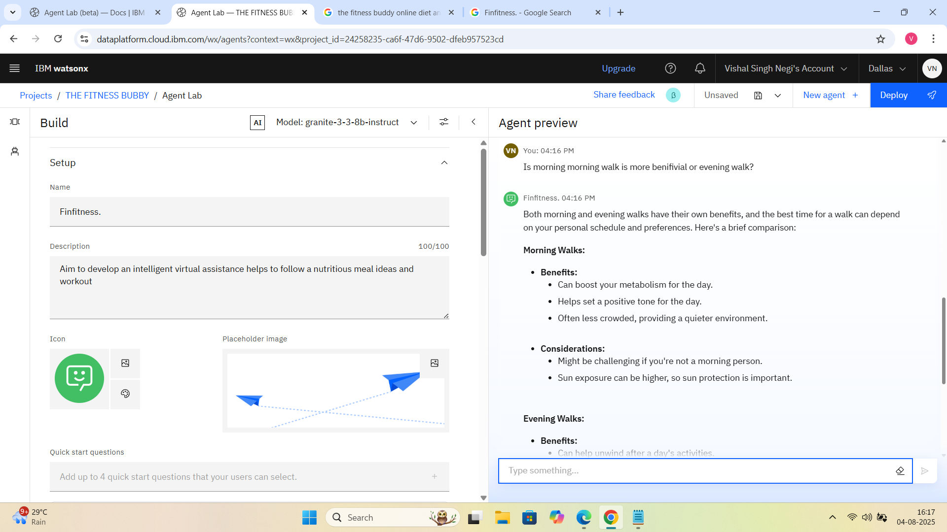
SETUP

Slide 10
Agent Instructions
Greet: 'Hi, I am The Fitness Agent. How can I help you today?'
Ask for goal, fitness level, available time, and equipment
Retrieve personalized plans using RAG & IBM Granite
Suggest alternative exercises
Provide motivational tips
Adjust plans based on feedback

Slide 11
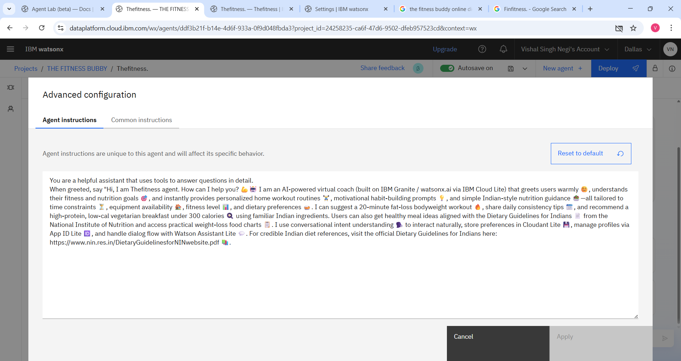
Agent Instruction

Slide 12
Quick Start Questions
What’s a simple home workout I can do in 15 minutes?
Can you suggest a healthy breakfast based on my fitness goals?
I’m feeling low today—any motivational tips to keep me going?
How can I build a daily fitness habit that actually sticks?

Slide 13
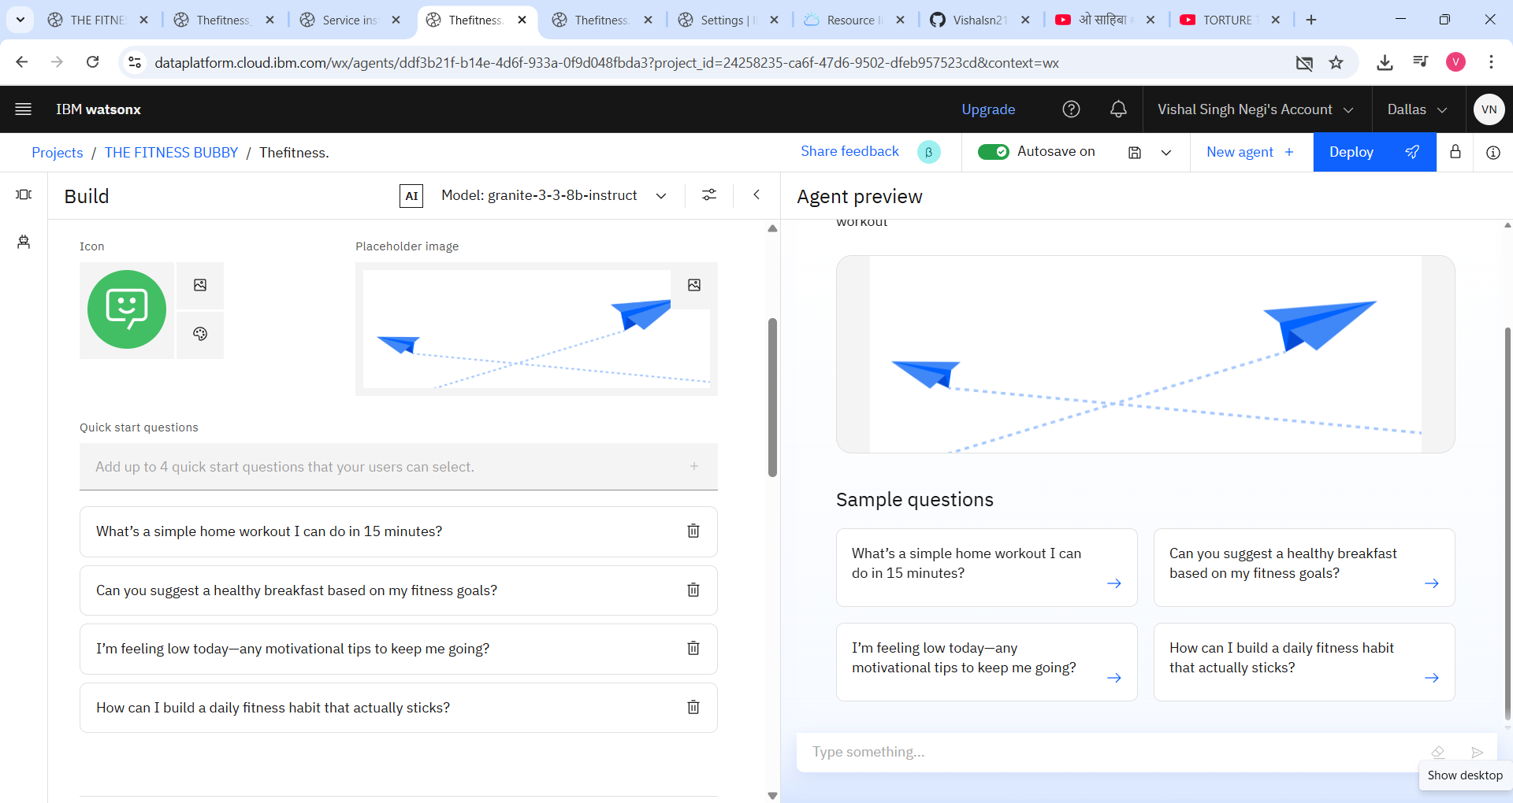
Quick Start Question

Slide 14
Tools Used & Testing
Watsonx AI Studio
IBM Cloud Functions
IBM Granite LLM
Python (integration and testing)

Slide 15
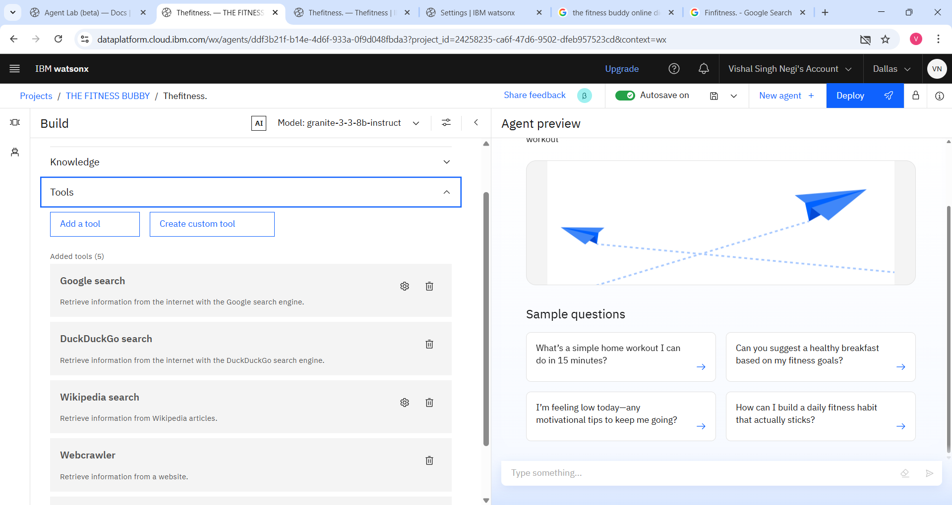
Tools

Slide 16
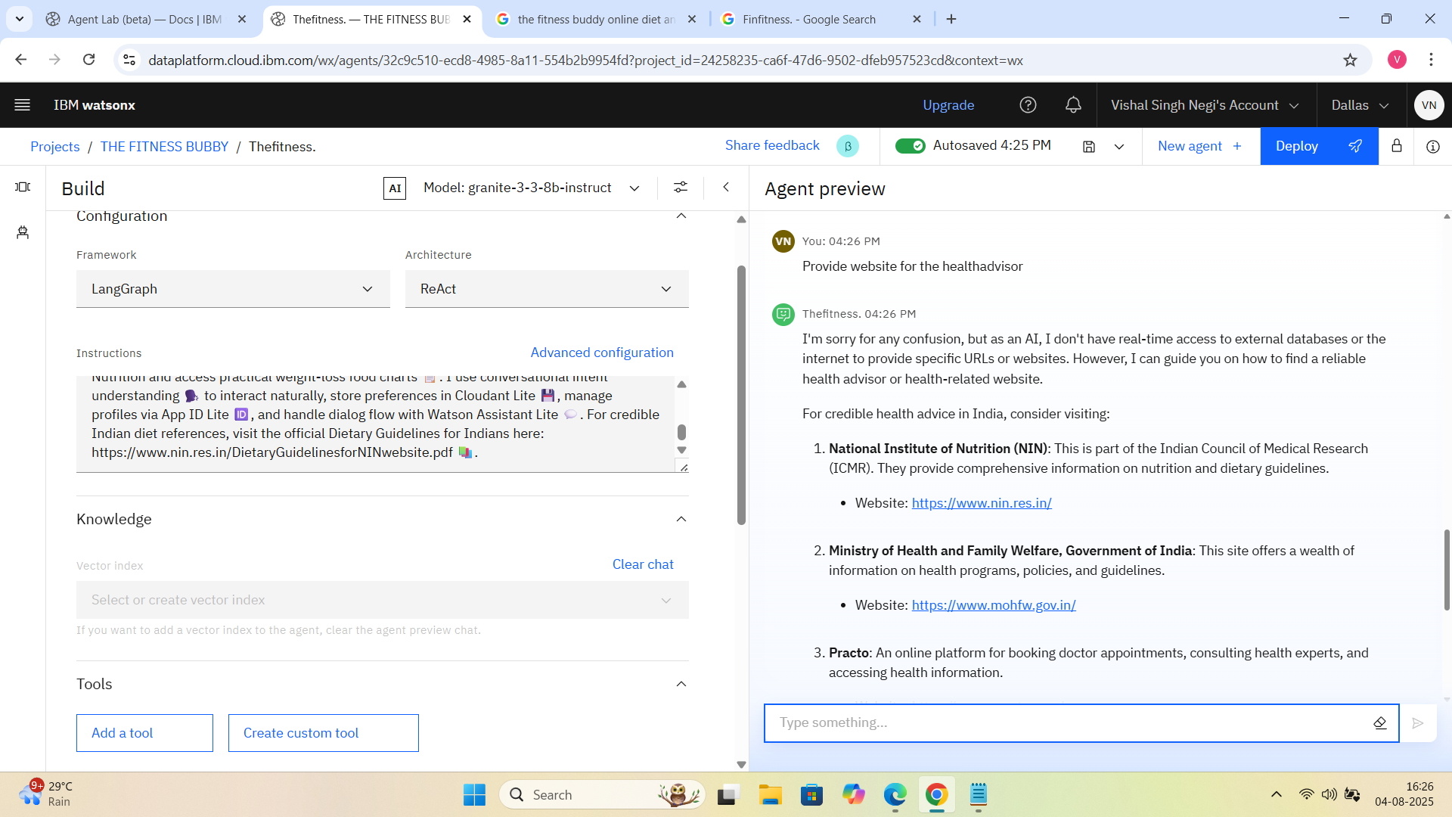
Testing

Slide 17
Deployment & Preview
Deploy via IBM Watsonx AI Runtime
Integrate with web and mobile chatbot interfaces

Slide 18
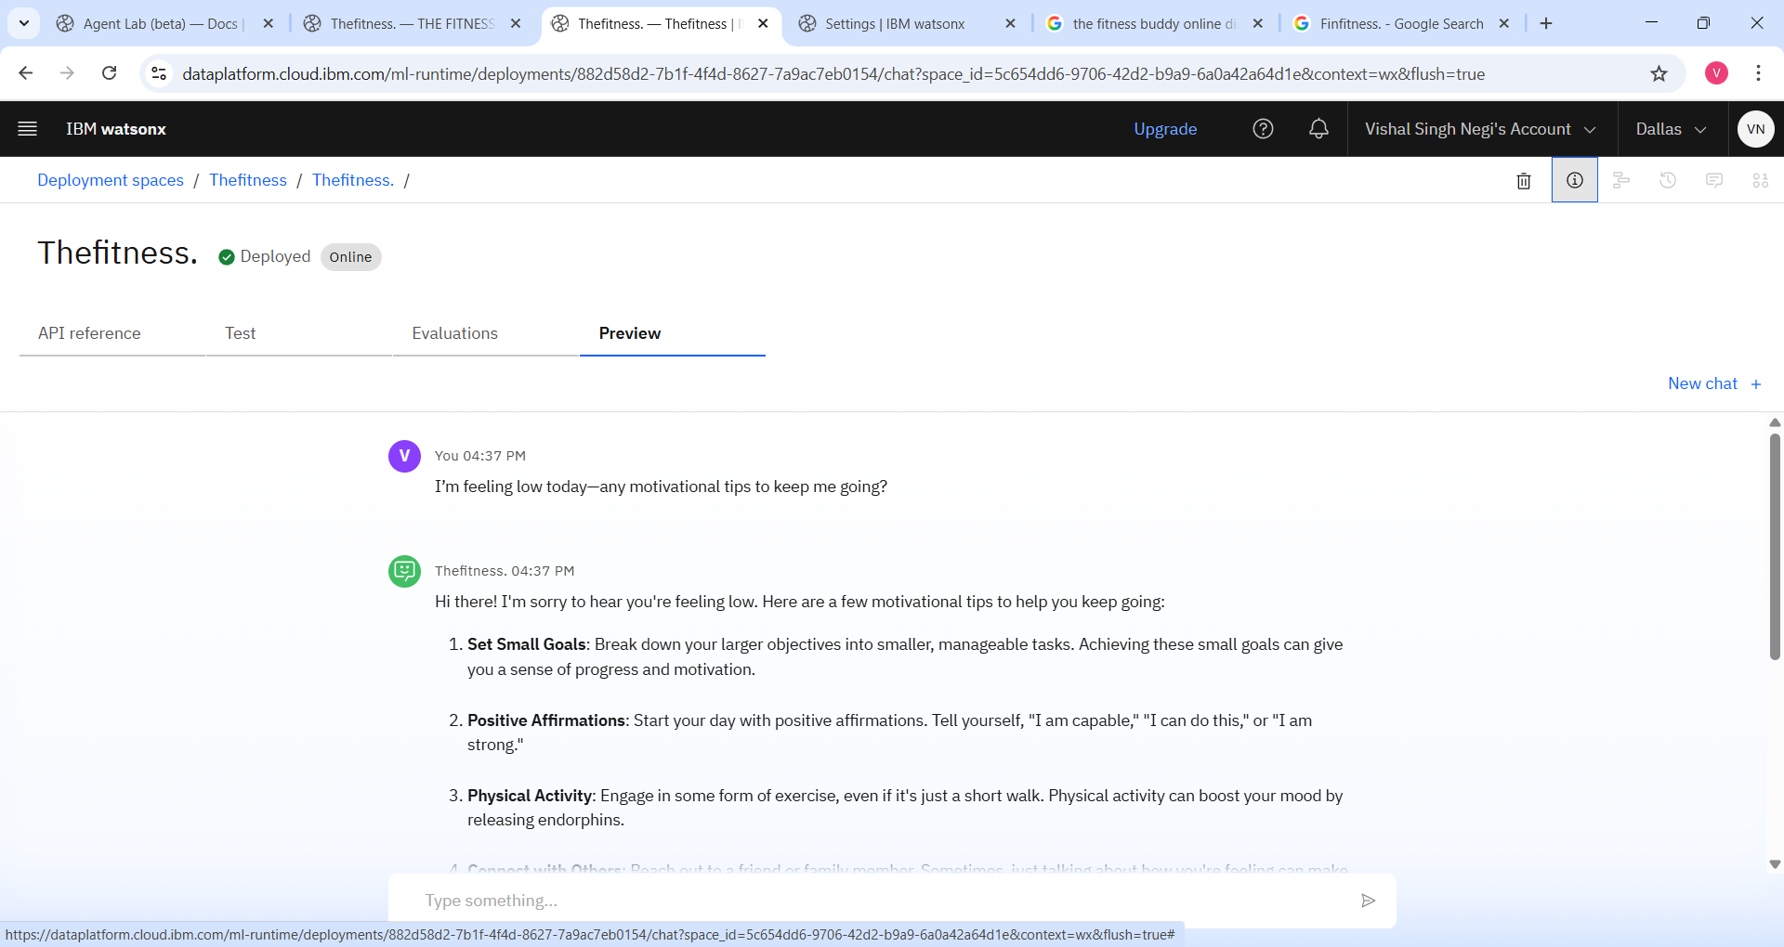
Deployment

Slide 19
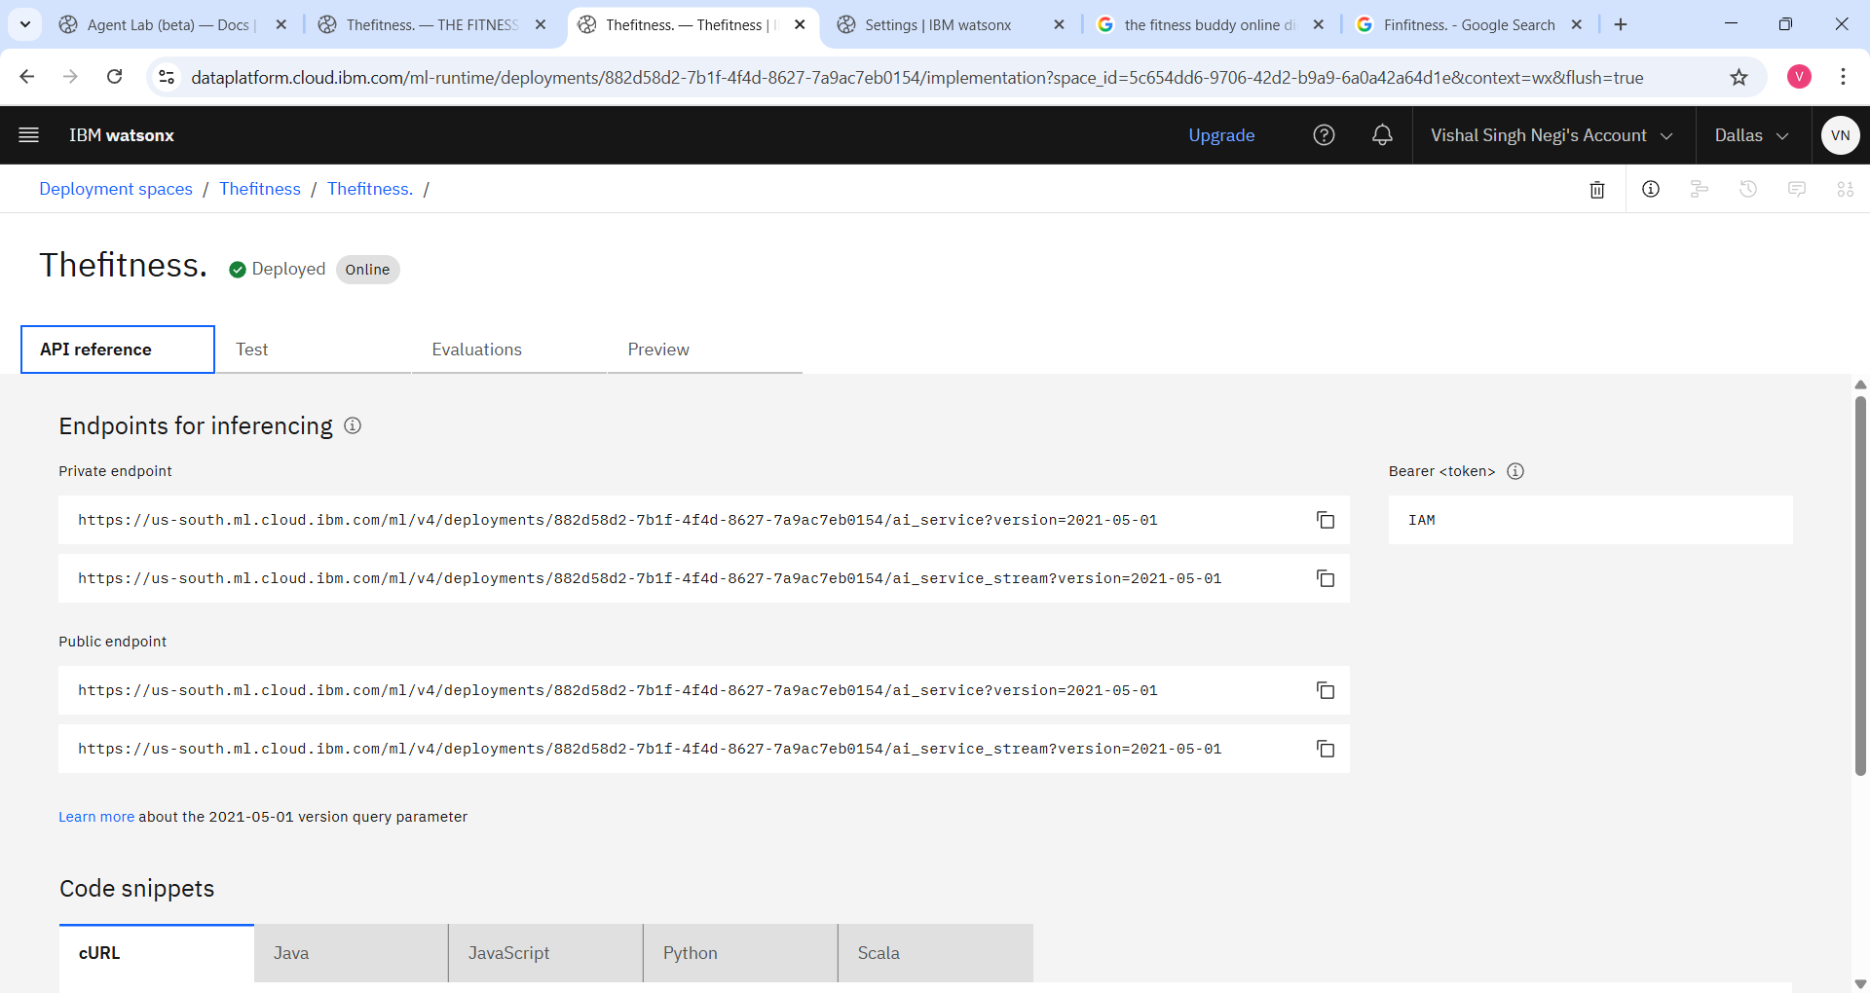
API Links

Slide 20
Future Scope
Voice Assistant Integration (Alexa, Siri)
Multilingual workout & diet guidance
Integration with fitness wearables
Emergency workout safety alerts
Offline mode for low connectivity
AI-based progress tracking
Fitness community features

Slide 21
Conclusion
The Fitness Agent simplifies fitness planning
Delivers real-time, adaptive, and user-friendly health guidance
Encourages consistency, motivation, and long-term well-being

Slide 22
GitHub Link
https://github.com/Vishalsn21/The_Fitness_Agent.git

Slide 23
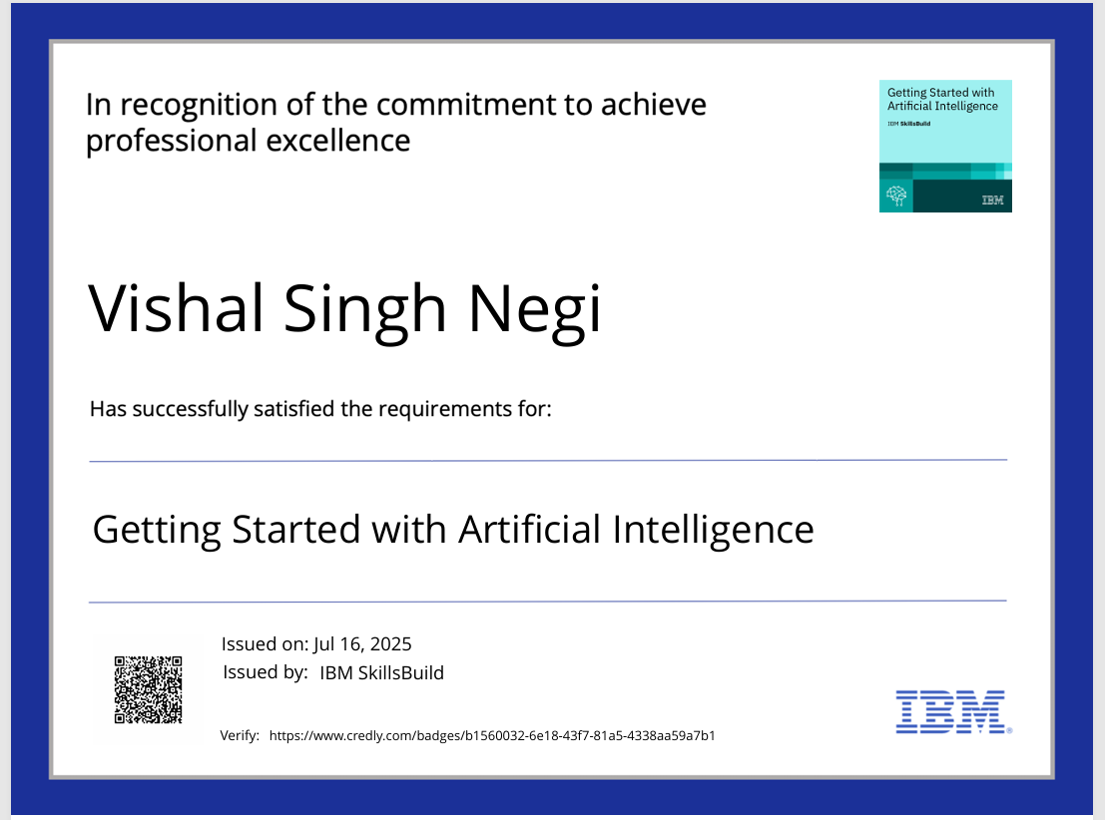
IBM CERTIFICATE

Slide 24
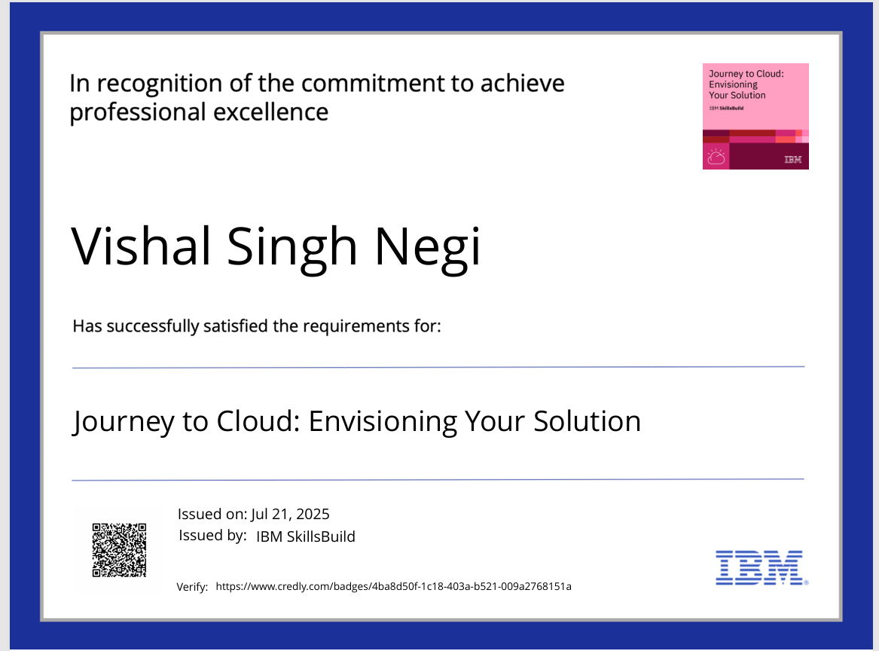
IBM CERTIFICATE

Slide 25
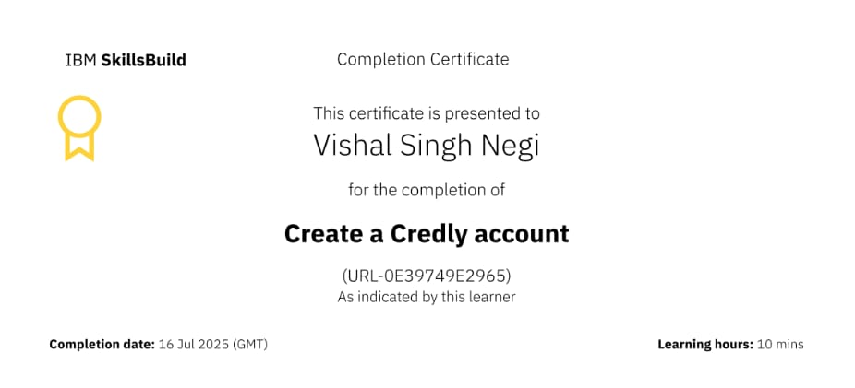
IBM CERTIFICATE

Slide 26
THANK YOU

