Slide 1
SENTARI
AGENT OS
An operating-system-inspired kernel for scheduling, isolating,
and safely running multi-agent AI systems.
Vishal Sharma • Specialization Project, 2026

Slide 2
MOTIVATION
The problem with multi-agent AI today
Frameworks like LangGraph, CrewAI, and AutoGen let agents call each other directly — with no supervisor in the loop.
No resource governance
Any agent can consume unlimited tokens/API calls, starving others or blowing the budget
No isolation
Agents share mutable state directly; a hallucinated value can corrupt another agent's context
No deadlock handling
If Agent A waits on B, and B waits on A, the system just hangs — forever
No mediated tool access
Agents call tools/APIs directly, with no validation, rate-limiting, or audit trail
No preemption
A runaway agent (infinite loop, repeated retries) keeps running until it crashes or a human kills it
Sentari — Agent OS | Vishal Sharma, 2026
2

Slide 3
APPROACH
Sentari is the manager
A thin middleware kernel that every agent action passes through. It does not replace your agent framework — it wraps it.
Scheduler
Syscall Layer
Fair turns at calling the AI model — round-robin / priority, the same algorithms OSes use for CPU time
The only door an agent can use to call a tool, read/write memory, or spawn another agent — checked and logged, every time
Memory Manager
Deadlock Detector & Preemption Manager
Each agent gets a private workspace, plus explicit, mediated access to a shared knowledge base
Watches for circular waits, breaks the cycle, and force-stops any agent that overruns budget or hangs too long
Sentari — Agent OS | Vishal Sharma, 2026
3

Slide 4
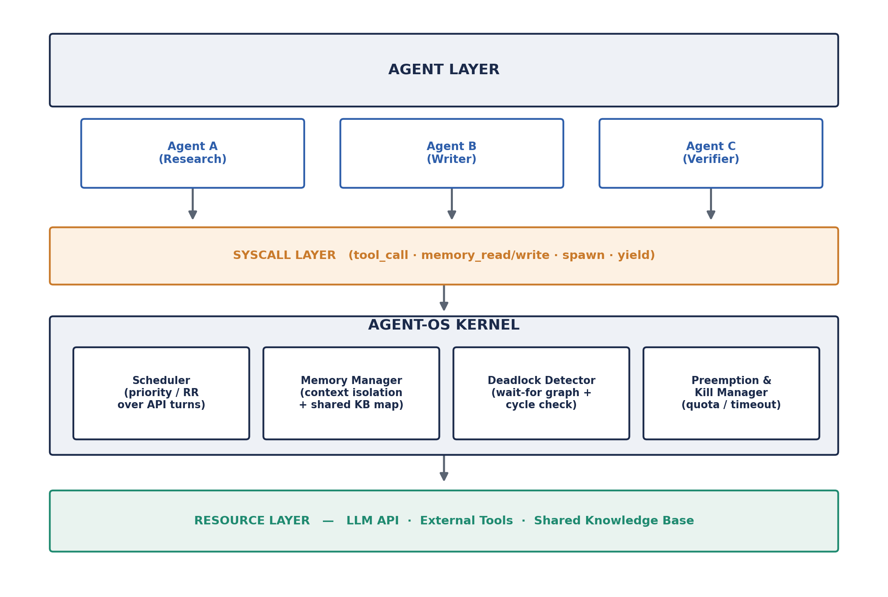
DESIGN
System architecture
Every arrow is a mediated, logged call — an agent never reaches resources directly.
Sentari — Agent OS | Vishal Sharma, 2026
4

Slide 5
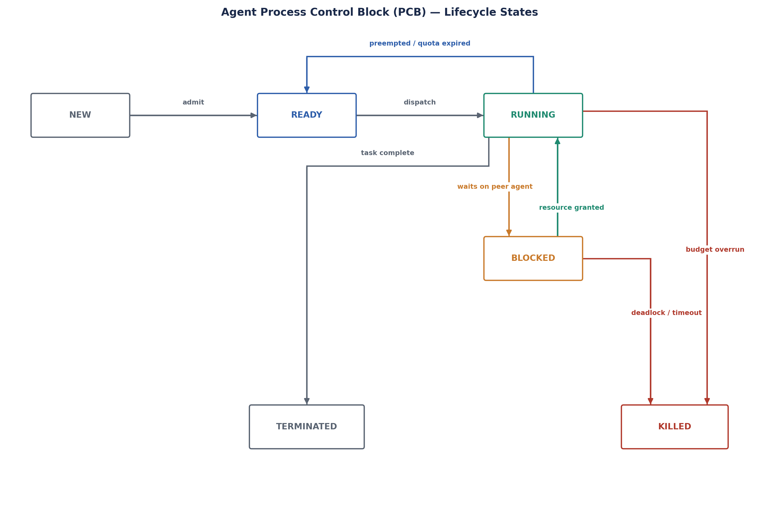
CORE CONCEPT
The Agent PCB
▸ Every agent is tracked by a Process Control Block — the same concept real OSes use for running programs
▸ agent_id, parent_id
for spawned sub-agents
▸ state
NEW → READY → RUNNING → BLOCKED → TERMINATED / KILLED
▸ priority
drives scheduling order
▸ quota_total / quota_used
token / API-call budget
▸ Exhaust quota, deadlock, or time out while blocked → the kernel forces KILLED and reclaims everything held
Sentari — Agent OS | Vishal Sharma, 2026
5

Slide 6
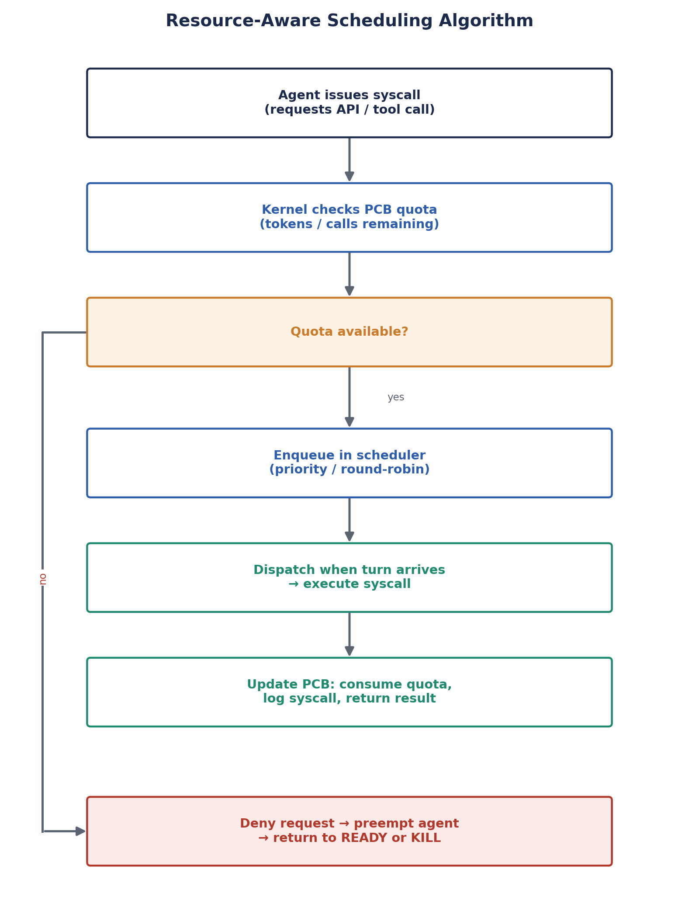
CORE CONCEPT
Scheduling algorithm
Every syscall is checked against remaining quota before it's allowed to run; dispatched fairly (round-robin / priority) if quota allows.
function on_syscall(agent, request):
if agent.quota_used >= agent.quota_total:
preempt(agent); return DENY
enqueue(scheduler_queue, agent, request)
wait_for_turn(agent)
result = execute(request)
agent.quota_used += cost(request)
log(agent, request, result)
return result
Sentari — Agent OS | Vishal Sharma, 2026
6

Slide 7
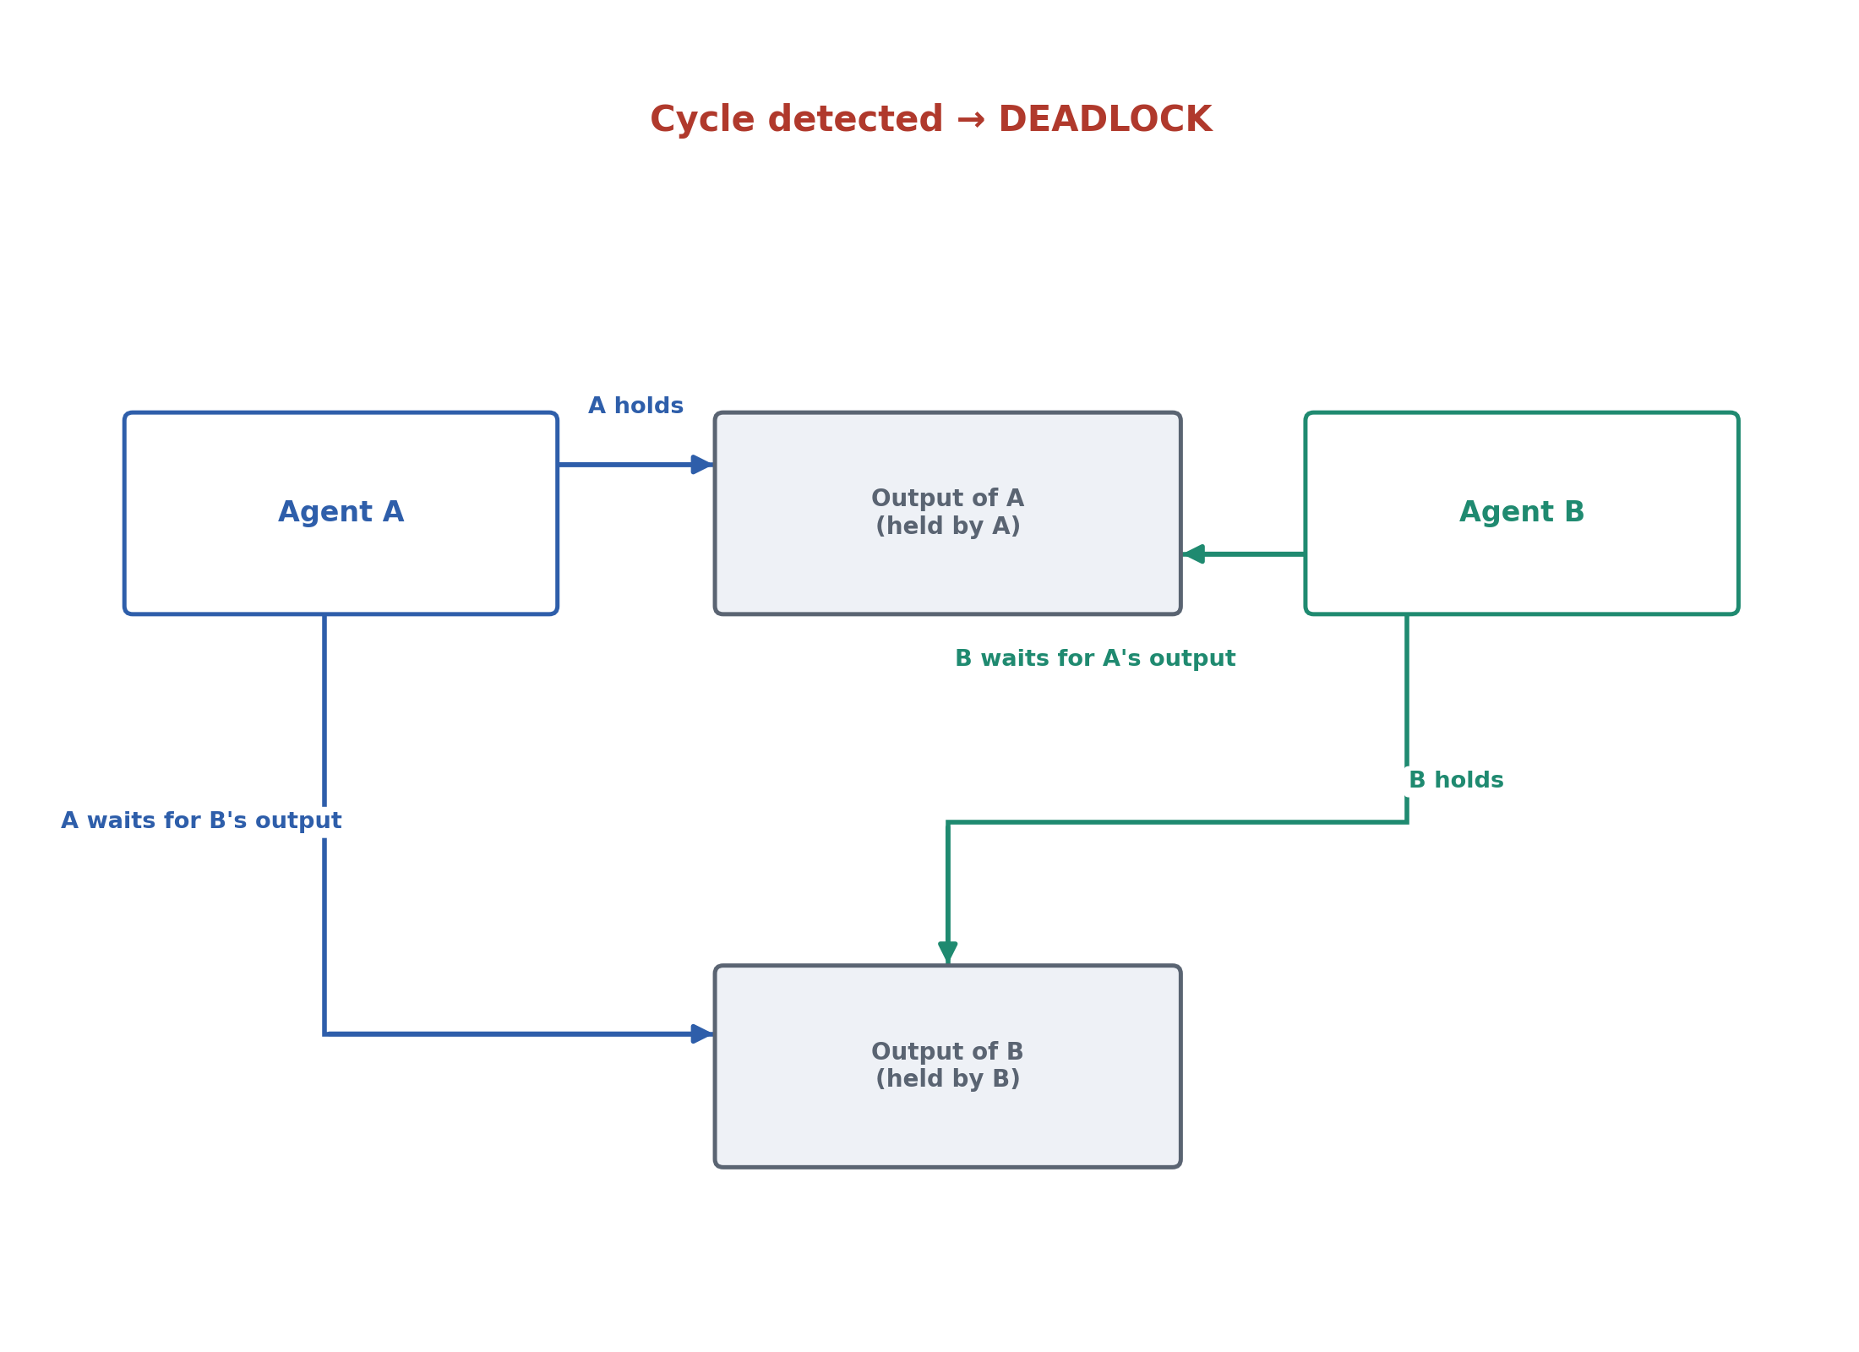
CORE CONCEPT
Deadlock detection
When A blocks on a resource held by B, an edge A→B is added to a wait-for graph. Cycle detection (DFS) runs immediately on every new edge — not on a periodic sweep.
function add_wait_edge(waiter, holder):
graph.add_edge(waiter, holder)
if has_cycle(graph, start=waiter):
cycle = extract_cycle(graph, waiter)
victim = min(cycle, key=priority)
preempt_or_kill(victim)
graph.remove_edges_for(victim)
Complexity: O(V+E) over the current wait-for graph, bounded by agents currently blocked — detection is effectively immediate.
Sentari — Agent OS | Vishal Sharma, 2026
7

Slide 8
CORE CONCEPT
Preemption & the kill manager
▸ Admission-time quota denial
exact, no partial execution — checked before a syscall ever runs
▸ Timeout-bounded preemption
asyncio.wait_for(...) forces a slow/stuck syscall to return the agent to READY
▸ Force-kill on deadlock or blocked-timeout
the KillManager transitions the agent to KILLED and force-yields the scheduler
▸ Full resource release
every resource the killed/terminated agent held is released back to waiters (FR-17)
Sentari — Agent OS | Vishal Sharma, 2026
8

Slide 9
DEMO
Live control dashboard
A FastAPI app polling the real kernel and SQLite twice a second — nothing on screen is staged.
Active Agents (PCB)
Wait-For Graph + Resources
Syscall Log
Live state, priority, quota bars, held/waiting resources for every agent
Blocking edges rendered live; deadlock cycles highlighted the instant they form
Every mediated call — agent, type, args, result — streamed live, filterable by agent/result
Plus: manual “Cockpit” to admit agents on demand, a Standard Tour / Before-After deadlock scenario switcher, and one-click restart.
Sentari — Agent OS | Vishal Sharma, 2026
9

Slide 10
DEMO
Same deadlock, mediated vs. unmediated
The dashboard drives the identical two-agent circular-wait scenario twice, side by side.
WITHOUT SENTARI (raw asyncio)
WITH SENTARI (kernel-mediated)
Agent A waits on B, B waits on A.
No supervisor is watching.
The program hangs — indefinitely.
Only a manual kill (or a crash) ends it.
The wait-for graph detects the cycle
the instant it forms.
The lower-priority agent is killed,
its resource released, the other proceeds.
Total time: milliseconds, not forever.
Sentari — Agent OS | Vishal Sharma, 2026
10

Slide 11
DEMO
MCP Bridge — live from Claude Desktop
▸ scripts/mcp_bridge.py runs as a real MCP server
registered in Claude Desktop like any other connector
▸ Exposes 4 tools
sentari_write_file, sentari_read_file, sentari_note, sentari_status
▸ Every call from an actual live chat is relayed over HTTP into the running kernel
the exact same SyscallLayer.on_syscall path as any other agent
quota-checked → resource-locked (deadlock-safe even against a colliding
write) → audit-logged → visible live on the dashboard while it happens.
Sentari — Agent OS | Vishal Sharma, 2026
11

Slide 12
ENGINEERING
Tech stack
Core kernel
Python 3.11+ (asyncio, dataclasses)
LLM integration
Anthropic / OpenAI API — pluggable provider interface
Frameworks wrapped
LangGraph, CrewAI
Persistence
SQLite — PCB store + syscall audit log
Dashboard
FastAPI + lightweight live web UI
Testing
pytest + scripted fault-injection (forced deadlocks, runaway agents)
Packaging / tooling
uv, ruff, src/-layout package
Live demo integration
MCP (Model Context Protocol) bridge into Claude Desktop
Sentari — Agent OS | Vishal Sharma, 2026
12

Slide 13
ENGINEERING
Rigor: tests & traceability
42
17
7
passing tests
functional requirements (FR-1..17)
mapped to code
independently testable
kernel subsystems
▸ Every FR maps to a module and a verifying test
e.g. FR-13 (cycle detection) → deadlock/detector.py → tests/test_deadlock.py
▸ Reliability
SyscallLayer.on_syscall catches all exceptions — one failing tool never crashes the kernel
▸ Auditability
every decision reconstructable from syscall_log + agents + resource_allocation tables
▸ Scalability
verified with 20 concurrently registered agents in tests/test_kernel_integration.py
Sentari — Agent OS | Vishal Sharma, 2026
13

Slide 14
CLOSING
Why it matters, and what's next
Aligns with UN SDG 9 (Industry, Innovation & Infrastructure) — governance infrastructure for trustworthy multi-agent AI — and SDG 12 (Responsible Consumption & Production), since quota enforcement and preemption directly cut wasted compute.
DONE
NEXT
✓ PCB model + registration
▢ Fault-injection test suite (scripted)
✓ Scheduler (round-robin, priority + aging)
▢ Fairness & overhead benchmark vs. unmanaged baseline
✓ Syscall layer, validated + audit-logged
▢ LangGraph middleware adapter
✓ Memory isolation + shared KB
▢ Dashboard/email notifications
✓ Wait-for graph + cycle detection
✓ Preemption & kill manager
✓ Live observability dashboard
✓ MCP bridge into Claude Desktop
Sentari — Agent OS | Vishal Sharma, 2026
14

Slide 15
Thank you
Questions?
github.com/Vishalsym/Sentari-AgentOS

