Slide 1
HAND DIGIT RECOGNITION USING CNN
Presented by…
T.Vishal,
Department of artificial intelligence and data science,
Sir Issac newton college of engineering and technology.

Slide 2
AGENDA
PROJECT STATEMENT
PROJECT OERVIEW
PROJECT MODELLING
RESULTS
SOLUTION AND ITS PROPOSITIONS
WOWS IN MY SOLUTION
APPLICATION AREAS

Slide 3
PROJECT OVERVIEW
Convolutional neural network (CNN, or ConvNet) can be used to predict Handwritten Digits reasonably.
We have successfully developed Handwritten digit recognition with Python, Tensorflow, and Machine Learning libraries.
Handwritten Digits have been recognized by more than 98.9% validation accuracy. Here is an overview of the project….
Data Collection
Data Preprocessing
Model Architecture Design
Compile a model
Model Training
Model evaluation
Fine-tuning and Optimization
Deployment
Monitoring and Maintenance

Slide 4
PROJECT MODELING
Handwritten digit recognition is the process to provide the ability to machines to recognize human handwritten digits.
It is not an easy task for the machine because handwritten digits are not perfect, vary from person-to-person, and can be made with many different flavors.
Basic knowledge of deep learning with Keras library, the Tkinter library for GUI building, and Python programming are required to run this amazing project.
Commands to Install the necessary libraries for this project:
pip install numpy
pip install tensorflow
pip install keras
pip install pillow

Slide 5
The MNIST dataset
Among thousands of datasets available in the market, MNIST is the most popular dataset for enthusiasts of machine learning and deep learning.
Above 60,000 plus training images of handwritten digits from zero to nine and more than 10,000 images for testing are present in the MNIST dataset.
So, 10 different classes are in the MNIST dataset.
Import libraries and dataset
At the project beginning, we import all the needed modules for training our model.
We can easily import the dataset and start working on that because the Keras library already contains many datasets and MNIST is one of them.
We call mnist.load_data() function to get training data with its labels and also the testing data with its labels.

Slide 6
Its time for the creation of the CNN model for this Python-based data science project.
A convolutional layer and pooling layers are the two wheels of a CNN model.
The reason behind the success of CNN for image classification problems is its feasibility with grid structured data.
We will use the Adadelta optimizer for the model compilation.
To start the training of the model we can simply call the model.fit() function of Keras.
It takes the training data, validation data, epochs, and batch size as the parameter.
The training of model takes some time.
To evaluate how accurate our model works, we have around 10,000 images in our dataset.
In the training of the data model, we do not include the testing data that’s why it is new data for our model.
Around 99% accuracy is achieved with this well-balanced MNIST dataset.

Slide 7
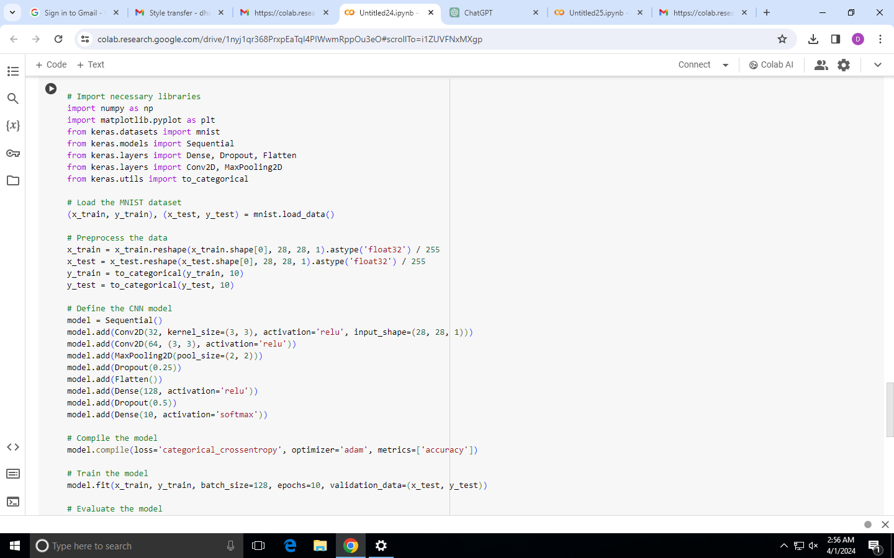
PROJECT MODELLING

Slide 8
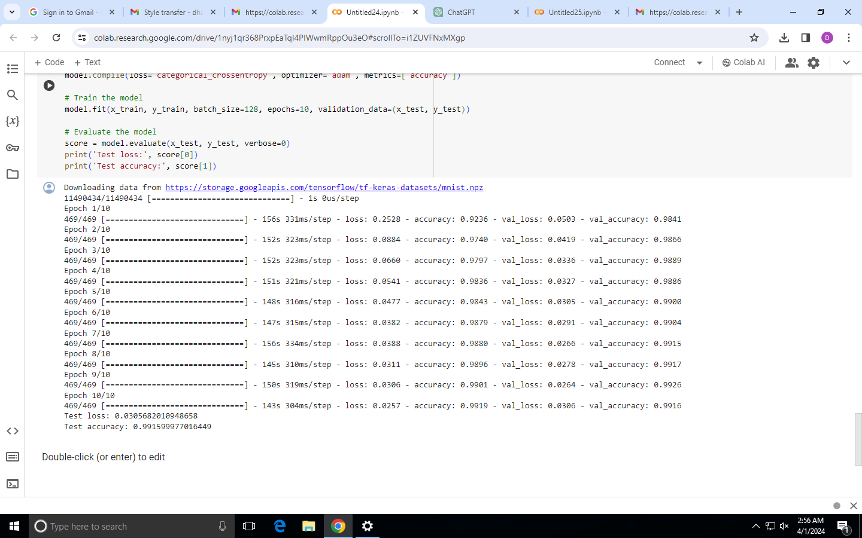
Output

Slide 9
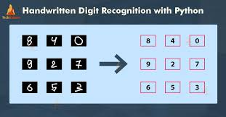

Slide 10
Handwritten digit recognition using MNIST dataset is a major project made with the help of Neural Network. It basically detects the scanned images of handwritten digits.
We have taken this a step further where our handwritten digit recognition system not only detects scanned images of handwritten digits but also allows writing digits on the screen with the help of an integrated GUI for recognition.
Approach:
We will approach this project by using a three-layered Neural Network.
The input layer: It distributes the features of our examples to the next layer for calculation of activations of the next layer.
The hidden layer: They are made of hidden units called activations providing nonlinear ties for the network.
A number of hidden layers can vary according to our requirements.
The output layer: The nodes here are called output units.
It provides us with the final prediction of the Neural Network on the basis of which final predictions can be made.

Slide 11
WOWS IN MY SOLUTION
The applications of digit recognition include in postal mail sorting, bank check processing, form data entry, etc.
The main problem lies within the ability on developing an efficient algorithm that can recognize hand written digits, which is submitted by users by the way of a scanner, tablet, and other digital devices.
Character recognition algorithms are classified into three categories.
These categories are often employed in sequence: pre-processing, feature extraction, and classification.
The pre-processing aids in the smoothness of feature extraction, while feature extraction is required for successful classification.

Slide 12
APPLICATIONS
Handwritten character recognition is one of the practically important issues in pattern recognition applications.
The applications of digit recognition include in postal mail sorting, bank check processing, form data entry, etc.
The main problem lies within the ability on developing an efficient algorithm that can recognize hand written digits, which is submitted by users by the way of a scanner, tablet, and other digital devices
The experimental results showed that the highest accuracy was obtained by Multilayer Perceptron with the value of 90.37%.

Slide 13
THANK YOU!!

