Slide 1
REC ROOM
DATE : 26/09/2023
TIME : 03:41 AM
TEAM MEMBERS
VISHAL
HEMANTH
LIKITH

Slide 2
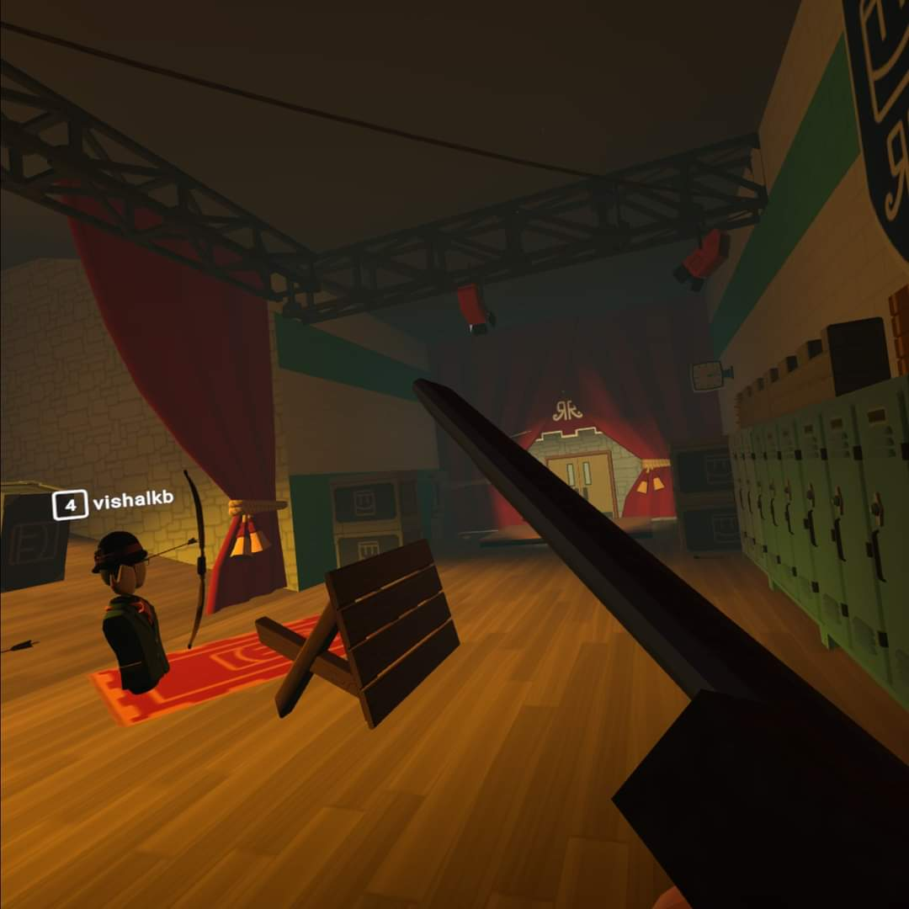
VR WORLD EXPLORATION
Purpose of the World:
The purpose of "Rec Room" is to provide a shared virtual space for users to interact, socialize, and play a variety of user-generated games and activities. It's a social platform that encourages creativity and socialization in a virtual environment.

Slide 3
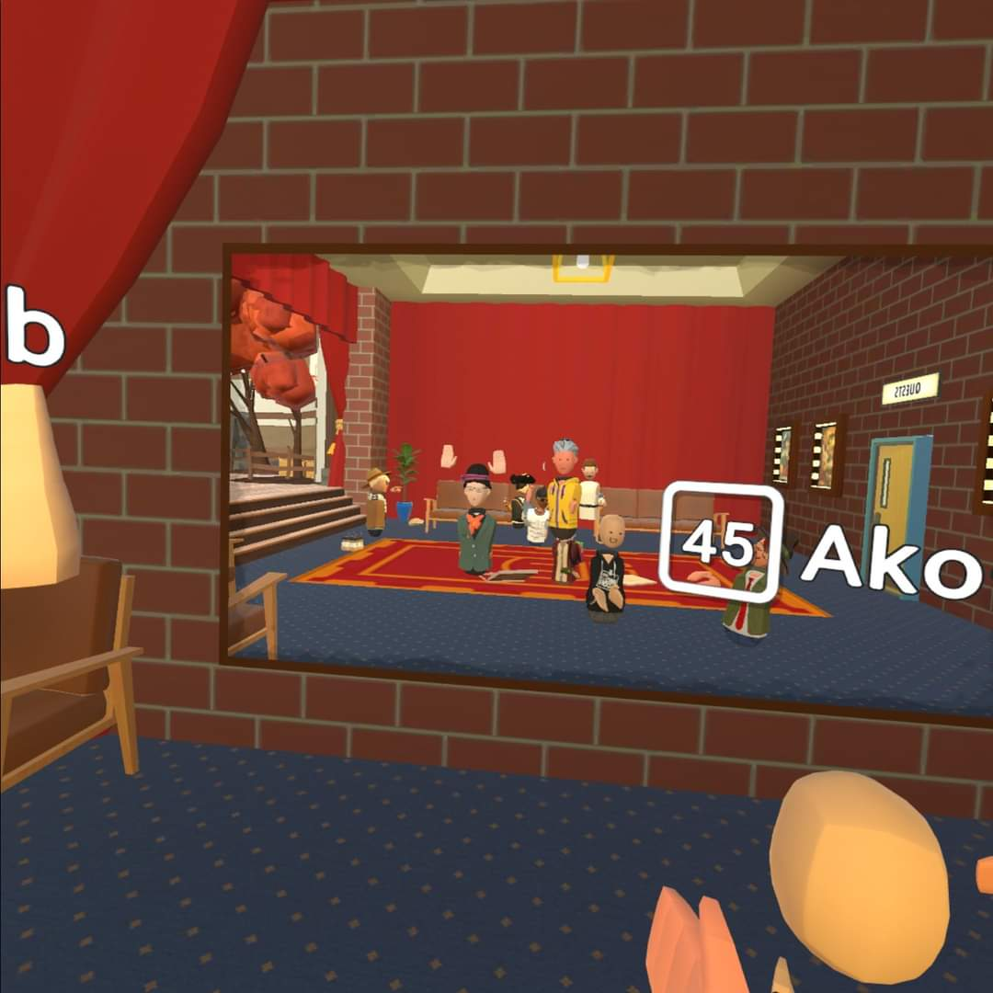
Communication with Other Users:
Users in "Rec Room" communicate with each other using a combination of voice chat and gestures. They can use the built-in microphone and speakers on their VR headsets to talk to others. Additionally, they can use hand gestures and body movements to express themselves non-verbally.

Slide 4
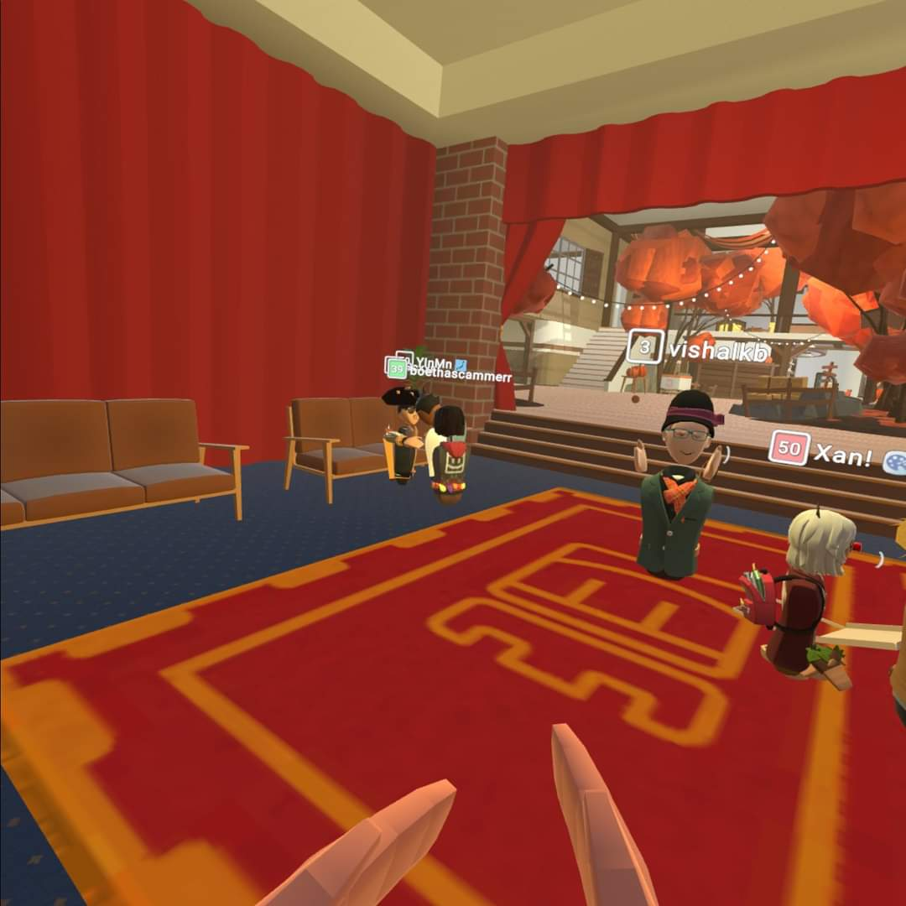
Navigation in the World:
Navigation in "Rec Room" is primarily achieved through physical movement in VR. Users can walk, run, and interact with objects using hand controllers or hand tracking, depending on their VR setup. The world is divided into various rooms and environments, and users can teleport or move around these spaces to explore and interact with others.

Slide 5
Object Selection and Manipulation:
In "Rec Room," users can interact with objects and the environment using their VR controllers. They can reach out and grab objects, move them, and manipulate them using hand gestures. The interface is designed to mimic real-world interactions as closely as possible, enhancing the immersive experience.

Slide 6
Increasing Sense of Presence:
Virtual reality technologies inherently increase the sense of presence by immersing users in a 3D environment. In "Rec Room," this is further enhanced by:
Realistic physics and interactions: Objects behave in ways that mimic their real-world counterparts, adding to the feeling of immersion.

