Slide 1
PET ADOPTION & ACCESSORIES
PFSD TEAM-50

Slide 2
Table of contents
01
02
03
Introduction
Survey
Popular pets
04
05
Benfits
Accessories
Info about Web Application
Data we have collected for the project
According to the collected data
Tips session
Requirements for the pets

Slide 3
01.
INTRODUCTION
Details of Web Application

Slide 4
INTRODUCTION
We are developing a web Application using Django and python for Pet adoption and accessories .Pet Adoption is the process of transferring responsibility for a pet that was previously owned by another party. Common sources for adoptable pets are animal shelters, rescue groups, or other pet owners.

Slide 5
02.
SURVEY
DATA WE HAVE COLLECTED

Slide 6
109
89
DOG
Members have been surveyed .
Wanted to adopt.
Most wanted pet for adoption.

Slide 7
Do you have a pet?
10%
15%
75%
Fish
Cats
Dogs

Slide 8
03.
Popular pets

Slide 9
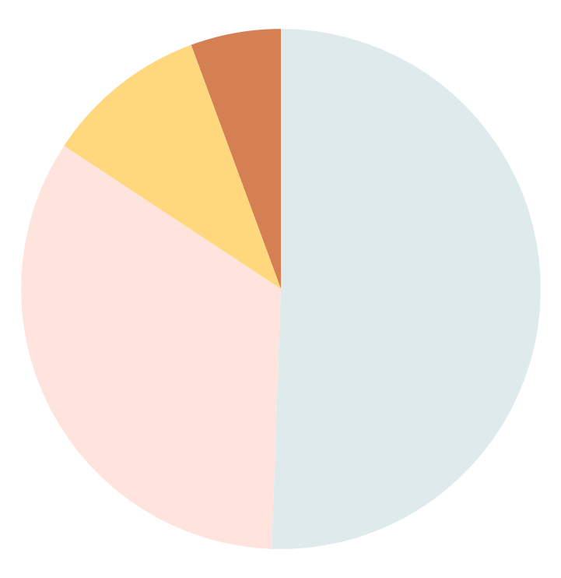
Top most popular pets
45%
9%
Dog
Fish
30%
5%
Cat
Bird

Slide 10
04.
BENFITS

Slide 11
Benefits of living with a pet
01
02
03
04
Affection and comfort
Helps us socialize
Reduces stress
Reduces risk of illness

Slide 12
Important pet care
Food
Cleaning
Health
Play
Walk
Veterinarian
Must Hygienic food
Should maintain proper maintenance
Monthly veteran visit
Must keep the pet active
Daily walk for 10mins
Monthly checkup

Slide 13
Interesting insights
40%
20%
30%
10%
Dog collars and food
Birds cages and food
Accessories Insights
Cats collars and food
Aquatic animals food and tanks.

Slide 14
Adoption process
01
Requirements
People pet profile
Proof of home
The choice
02
View the animals in kennels
Bring all household members
03
The check
Proof of enrollment in class
A home check
The confirmation
04
Pay the adoption fee
Bring your animal home!

Slide 15
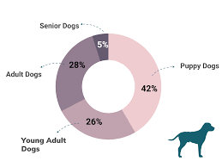
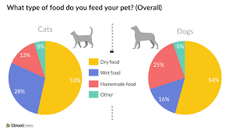
Adoption trends

Slide 16
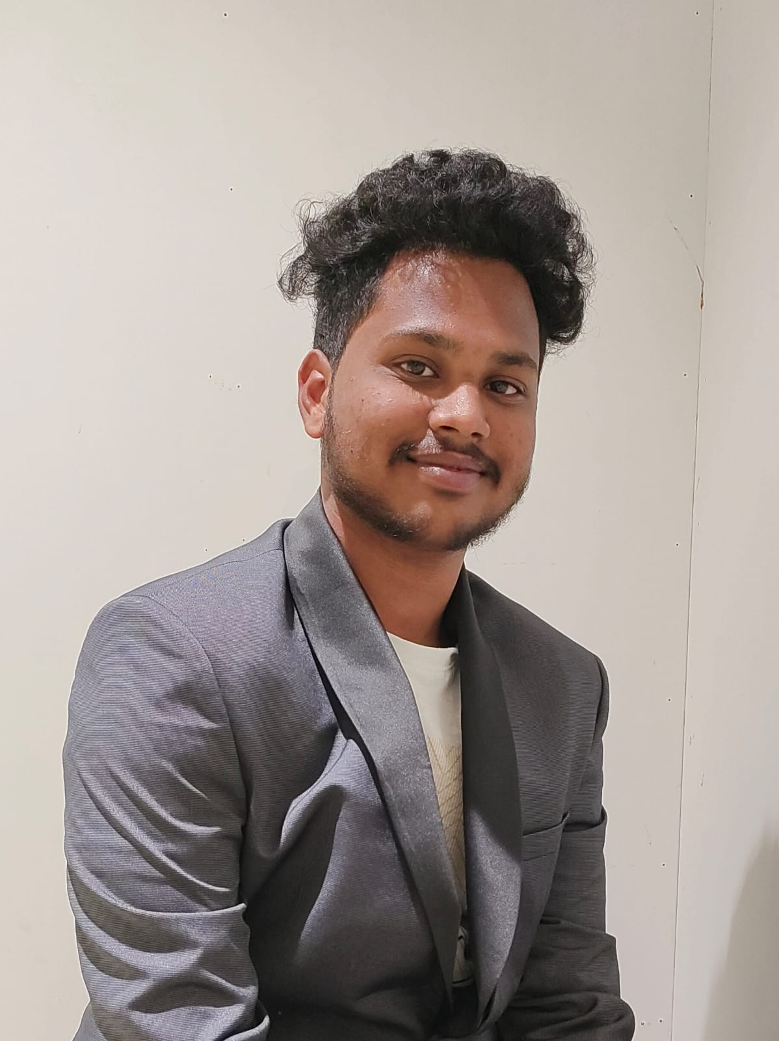

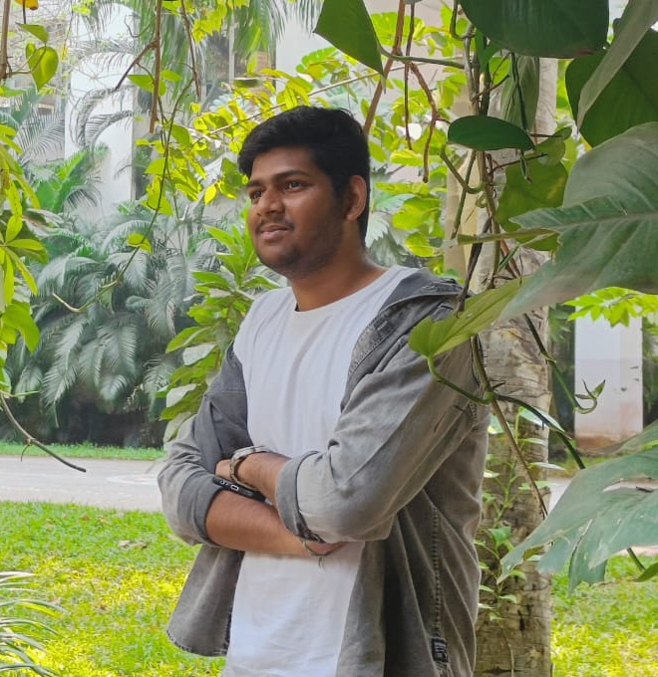
Our team
NIKHIL
VISHAL
HEMANTH

Slide 17

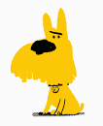
THANK
YOU

