Slide 1
Employee Data Analysis using Excel
STUDENT NAME: Vishal P
REGISTER NO: 312200241
DEPARTMENT: B.com ( A&F )
COLLEGE : S.I.V.E.T College

Slide 2
PROJECT TITLE
Employee Performance Analysis using Excel

Slide 3


AGENDA
Problem Statement
Project Overview
End Users
Our Solution and Proposition
Dataset Description
Modelling Approach
Results and Discussion
Conclusion
3/21/2024 Annual Review

Slide 4

PROBLEM STATEMENT
The organization is concerned about potential salary disparities, including gender pay gaps and inconsistencies across departments. The goal is to analyze employee salaries to ensure fairness, competitiveness, and alignment with industry standards. The outcome will guide necessary adjustments to maintain equitable and competitive compensation practices.

Slide 5

PROJECT OVERVIEW
.
This project aims to analyze employee salary data to identify disparities, such as gender pay gaps and inconsistencies across departments, ensuring fair and competitive compensation. The analysis will compare salaries internally and against industry benchmarks. The final deliverables will include a detailed report, visualizations, and recommendations for adjustments.

Slide 6

WHO ARE THE END USERS?
HR Department: Ensures fair and competitive pay. Executives: Informs salary-related decisions. Finance: Aligns salary costs with budgets. Diversity Teams: Monitors pay equity. Legal Teams: Ensures compliance with regulations.

Slide 7

OUR SOLUTION AND ITS VALUE PROPOSITION
Conditional formatting – missing Filter – Remove Formula – Performance Pivot - Summary

Slide 8
Dataset Description
Employee name
Employee Id
Gender
Department
Salary
Date of hire
Employee type
Age
Work location

Slide 9

THE "WOW" IN OUR SOLUTION
It helps the management to analyze the data’s of the employee and their salaries, for the record and understanding the information that have been recorded and it can be used for future purposes
3/21/2024 Annual Review
9

Slide 10
MODELLING
Objective
Data Preparation
Model Selection
Model Evaluation
Model Training
Addressing Disparity
Deployment
Reporting & Recommendation
10

Slide 11
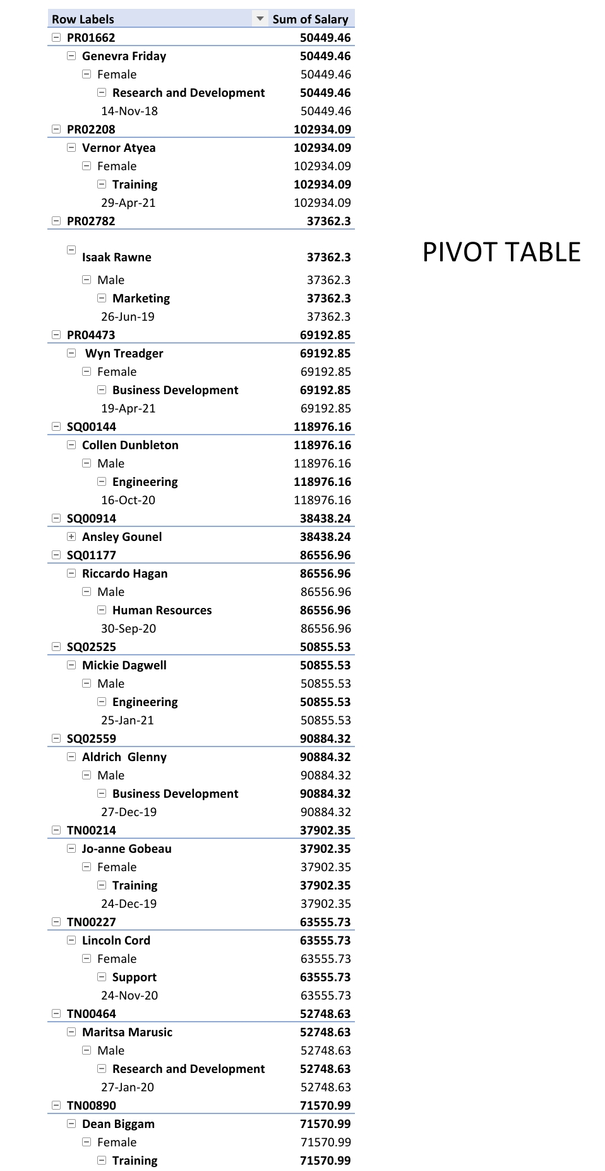
RESULTS
11

Slide 12
conclusion
This conclusion provides a clear summary of the analysis, points out key findings, discusses their implications, and suggests actionable steps to address any issues identified.

