Slide 1
BCSE307L · COMPILER DESIGN · PROJECT REVIEW 1
PYTHIA
A statically typed Python-subset → C transpiler,
verified by a differential-testing oracle
TEAM NUMBER
PROJECT ID
INSTITUTION
Team 2
A15 — Typed Source-to-Source Transpiler
VIT Vellore
M1
VISHAL VIVEK
M2
RUJUTA M. KULKARNI
M3
K. V. JAHNAVI
M4
AARYAN GUPTA
24BCE2377
24BDS0459
24BDS0132
24BDS0134
Project lead · Front end
Type system · Semantics
IR · Lowering · Runtime
Codegen · Testing · Plan
14 / 14 programs semantically equivalent to CPython · 12 / 12 ill-typed programs rejected · 9.4× median speedup
PYTHIA · BCSE307L Team 2 · Project A15
1
Notes:
Introduce the team. State the one-line claim: we built a transpiler that does not merely produce C, but produces C we can prove behaves like CPython — and we ship the falsifier. The numbers at the bottom are already achieved, not targets.

Slide 2
Why this problem is worth solving
MEMBER 1 · VISHAL
Python is where algorithms get written. C is where they have to run. The gap between them is not syntax — it is arithmetic.
−7 // 2
−7 % 2
3 / 2
xs[−1]
Python −4
Python 1
Python 1.5
Python last
C −3
C −1
C 1
C ✗
floors toward −∞ vs truncates toward 0
sign follows divisor vs dividend
true division always yields a float
negative indexing, bounds checks
Each is a one-line difference that changes a program's output without changing its shape. A transpiler that gets any of them wrong still compiles, still runs, and still prints something plausible.
WHO NEEDS IT
THE OBSERVATION
Practical relevance
Nobody tells you where translation
stopped being faithful
Embedded and edge developers who cannot ship a 30 MB interpreter.
Teams porting legacy Python who need an audit trail, not “it seemed to work”.
Compiler students: every classical phase is present, and the semantic gap is made explicit instead of assumed away.
Codon silently redefines int as 64-bit. Cython and Nuitka emit unreviewable generated C. Transcrypt does not type-check at all.
Every one of them asserts semantic preservation. None of them demonstrates it.
PYTHIA · BCSE307L Team 2 · Project A15
2
Notes:
Lead with the four arithmetic examples — they land instantly and they are the whole motivation. Emphasise: the failure mode is silent. Then the two cards: who benefits, and what the field currently does not do.

Slide 3
Problem statement, scope and objectives
MEMBER 1 · VISHAL
Given a program P in PySub, produce a C11 program C(P) and a report R(P) such that: (i) C(P) compiles anywhere with no dependency beyond our runtime; (ii) for every input on which P terminates, C(P) produces byte-identical stdout and the same exception class as CPython 3.12; (iii) every construct whose C image is not provably equivalent appears in R(P) with its position, class and mitigation; (iv) any ill-typed P is rejected before a line of C is emitted.
(ii) is what every transpiler claims. (iii) is what makes it auditable when (ii) cannot be met. Together they are the contribution.
# | Measurable objective | Target | At R1
O1 | Formally specify PySub in EBNF | ≥ 40 productions | 41 ✓
O2 | Reject every ill-typed program | ≥ 95% of 60 cases | 12/12 ✓
O3 | Preserve semantics vs CPython 3.12 | ≥ 98% of 120 programs | 14/14 ✓
O4 | Catalogue + report every divergence | ≥ 7 classes, positioned | 7 ✓
O5 | Produce competitive native code | median ≥ 8× speedup | 9.4× ✓
IN SCOPE — PySub v0.1
int · float · bool · str · list[T] · None
def with mandatory annotations · mutual recursion
if/elif/else · while · for-in-range · for-in-list
+ − * / // % ** with Python's rounding rules
indexing with negative subscripts · print · len · abs
O2 and O3 corpora grow to 60 and 120 by Review 2, largely via the grammar-directed program generator.
DEFERRED — DATED, NOT FORGOTTEN
Nested list[list[T]] → Review 2
Classes · dict · try/except → Review 3
Closures · slicing → out of scope
Arbitrary-precision int → D1, guarded
The checker names the review in its rejection message, so scope creep stays visible.
PYTHIA · BCSE307L Team 2 · Project A15
3
Notes:
Read the problem statement aloud — it is deliberately formal because the whole project is judged against it. Then: five objectives, each with a metric, a target and an instrument, and the right-hand column shows what is already achieved. Scope: what is in, and what is deferred with a named review.

Slide 4
Compiler-design concepts the project rests on
MEMBER 2 · RUJUTA
01
Off-side rule
02
Recursive descent
03
Pratt parsing
Python's block structure lives in whitespace, so the token stream is not context-free until layout is reified. A stack of indentation widths synthesises INDENT / DEDENT; the parser then uses an ordinary block grammar.
One mutually recursive procedure per non-terminal. Chosen for recoverability: panic-mode synchronisation at NEWLINE and statement keywords lets one run report several syntax errors.
Top-down operator precedence (Pratt, 1973) with a binding-power table handles eight precedence levels and the right-associativity of ** without an eight-rule cascade.
04
Bidirectional typing
05
IR + translation
06
Differential testing
Expressions synthesise bottom-up; where an expected type exists — annotation, return, argument, append — it is pushed inward and checked. Pierce & Turner's local type inference.
The typed AST is normalised into PIR by making every implicit coercion explicit. After that the emitter never infers anything, which is what keeps the back end small.
Rather than prove equivalence, falsify it: run both implementations, compare. McKeeman's method, applied to a translator instead of a compiler — the approach behind Csmith.
PYTHIA · BCSE307L Team 2 · Project A15
4
Notes:
Six concepts, one per card. Be ready to justify each choice, not just name it — especially why Pratt rather than a precedence cascade, and what bidirectional means (which rules synthesise, which check).

Slide 5
Existing approaches, comparison and the gap
MEMBER 2 · RUJUTA
System | Approach | Type checking | Output artefact | Interpreter-free | Reports divergence
mypy | Type checker only, no codegen | Yes | None | n/a | n/a
mypyc | Typed Python → C extension | Yes (via mypy) | C extension | No | No
Cython | Annotated Python → C via CPython API | Partial (cdef) | C extension | No | No
Nuitka | Whole-program Python → C++ | No | Binary + runtime | No | No
Codon | Python-like language → LLVM IR | Yes (inference) | Native binary | Yes | No — silently redefines int
Shed Skin | Implicitly typed Python → C++ | Inference only | C++ / binary | Yes | No
Transcrypt | Python → JavaScript | No | JavaScript | n/a | No
py2many | Python → C++/Rust/Go/Julia | Shallow | Source | Varies | No
PYTHIA | Typed Python subset → readable C11 | Yes, bidirectional | C source + binary | Yes | Yes — positioned
Read down the last two columns.
01
02
03
Everything that produces an interpreter-free artefact does so by quietly choosing a semantics. Everything that type-checks carefully declines to generate code.
Verification, not assertion
Divergence as an output
Readability of the target
An executable differential oracle turns a universal claim into a CI number that can fail.
No surveyed tool emits a machine-generated, source-positioned account of its own approximations.
An audit trail is worth nothing if a human cannot read what was produced.
PYTHIA is not competing with Codon on breadth or Cython on maturity. Its claim is narrower and checkable: within a subset small enough to reason about, translation is verified rather than asserted — and where it cannot be verified, it is reported.
PYTHIA · BCSE307L Team 2 · Project A15
5
Notes:
Do not read the table row by row. Point at the last two columns and state the pattern. Then the three-part gap. Close with the honesty line — we are not claiming to beat Codon; we are claiming to be checkable.

Slide 6
Requirements, test inputs and feasibility
MEMBER 2 · RUJUTA
SOFTWARE
HARDWARE
TEST INPUTS — NO EXTERNAL DATASET
Python 3.10+ — compiler implementation
gcc 13 / clang 16, C11 — compiles emitted code
glibc / musl — the only runtime dependency
Git + GitHub Actions — oracle on every push
CPython 3.12 — ground truth for equivalence
Graphviz + Matplotlib — figures only
Any laptop. Deliberately.
Positive corpus — PySub programs exercising each feature and each divergence class. 14 → 120
Negative corpus — ill-typed programs, each carrying an # expect: marker naming the diagnostic it must provoke. 12 → 60
Generated corpus — grammar-directed random program sampler (Review 2), in the spirit of Csmith.
x86-64 or ARM64, 4 GB RAM, 1 GB disk. The heaviest benchmark is a 90×90 dense matrix multiply that CPython finishes in under two seconds.
No GPU, no cluster, no cloud credit — a project whose evaluation cannot be reproduced on a teammate's laptop is a project whose evaluation cannot be checked.
Risk register
# | Risk | L | I | Mitigation
R1 | Divergence classes beyond D1–D7 | High | High | The grammar-directed generator searches the space we did not think of; every new class becomes a catalogued row and a regression test
R2 | Overflow guards cost performance | Med | Med | Already measured at ~2× on Collatz. Review 2 adds interval analysis to elide provably safe guards — a real dataflow pass
R3 | Scope creep into classes and dicts | High | High | Scope frozen in the Week-1 minutes; the checker rejects out-of-subset constructs by name and states the review they land in
R4 | A member unavailable near a review | Med | High | Every module has a documented interface, a primary and a named secondary owner; the oracle localises a failure automatically
R5 | Generated C fails on another toolchain | Low | Med | CI compiles under gcc and clang with -Wall; GNU-extension use is confined to three sites with a known ISO fallback
R6 | Type checker unsound | Med | High | This is precisely what the oracle detects — four such bugs were found and fixed this way in Week 3
PYTHIA · BCSE307L Team 2 · Project A15
6
Notes:
Requirements are unremarkable and that is the point — feasibility is not in question. Spend the time on the risk register, especially R1 and R6: R6 is the interesting one, because the oracle turns an unsoundness into a visible failure rather than a silent pass.

Slide 7
Methodology — six stages and a verification loop
MEMBER 3 · JAHNAVI
1
Specify before implementing
PySub is defined in EBNF first — 41 productions. Everything the grammar does not admit is rejected by name, with the review it is scheduled for. This is what makes exclusions decisions rather than omissions, and it later doubles as the sampling distribution for the random program generator.
2
Reify layout, then parse
The scanner turns indentation into INDENT / DEDENT using a stack of column widths, so the parser sees explicit blocks. Statements by recursive descent, expressions by precedence climbing, errors recovered in panic mode so one run reports many.
3
Check types bidirectionally
A parent-linked scope chain resolves names. Every local takes its type from its first binding and keeps it — the restriction that makes translation to a statically typed target sound, and the one place PySub is genuinely narrower than Python rather than merely smaller.
4
Normalise the gap and record it
Lowering makes every implicit coercion explicit, so PIR is homogeneously typed and the emitter never guesses. In the same walk it tags each divergence against D1–D7 and accumulates the Fidelity Report — in the compiler, so it cannot go stale.
5
Emit readable C; push hard cases to a runtime
Where Python differs from C the emitter calls pyrt rather than open-coding a fix — py_mod_i64, not an inline sign correction. Semantic decisions stay in one auditable file. Lists are monomorphised, not boxed: that is what makes the typing pay for itself.
6
Falsify the claim, continuously
Every positive program is run under CPython 3.12 and as a compiled binary; stdout compared byte for byte, exception class for exception class. Every negative program must be rejected with the message its marker names. Runs in CI on every push.
Stages 1–5 are the compiler. Stage 6 is the reason to believe stages 1–5.
PYTHIA · BCSE307L Team 2 · Project A15
7
Notes:
Walk the six stages briskly — the audience can read. Land hard on two design decisions: the fidelity report lives in the compiler so it cannot go stale, and lists are monomorphised rather than boxed, which is what turns the type information into speed.

Slide 8
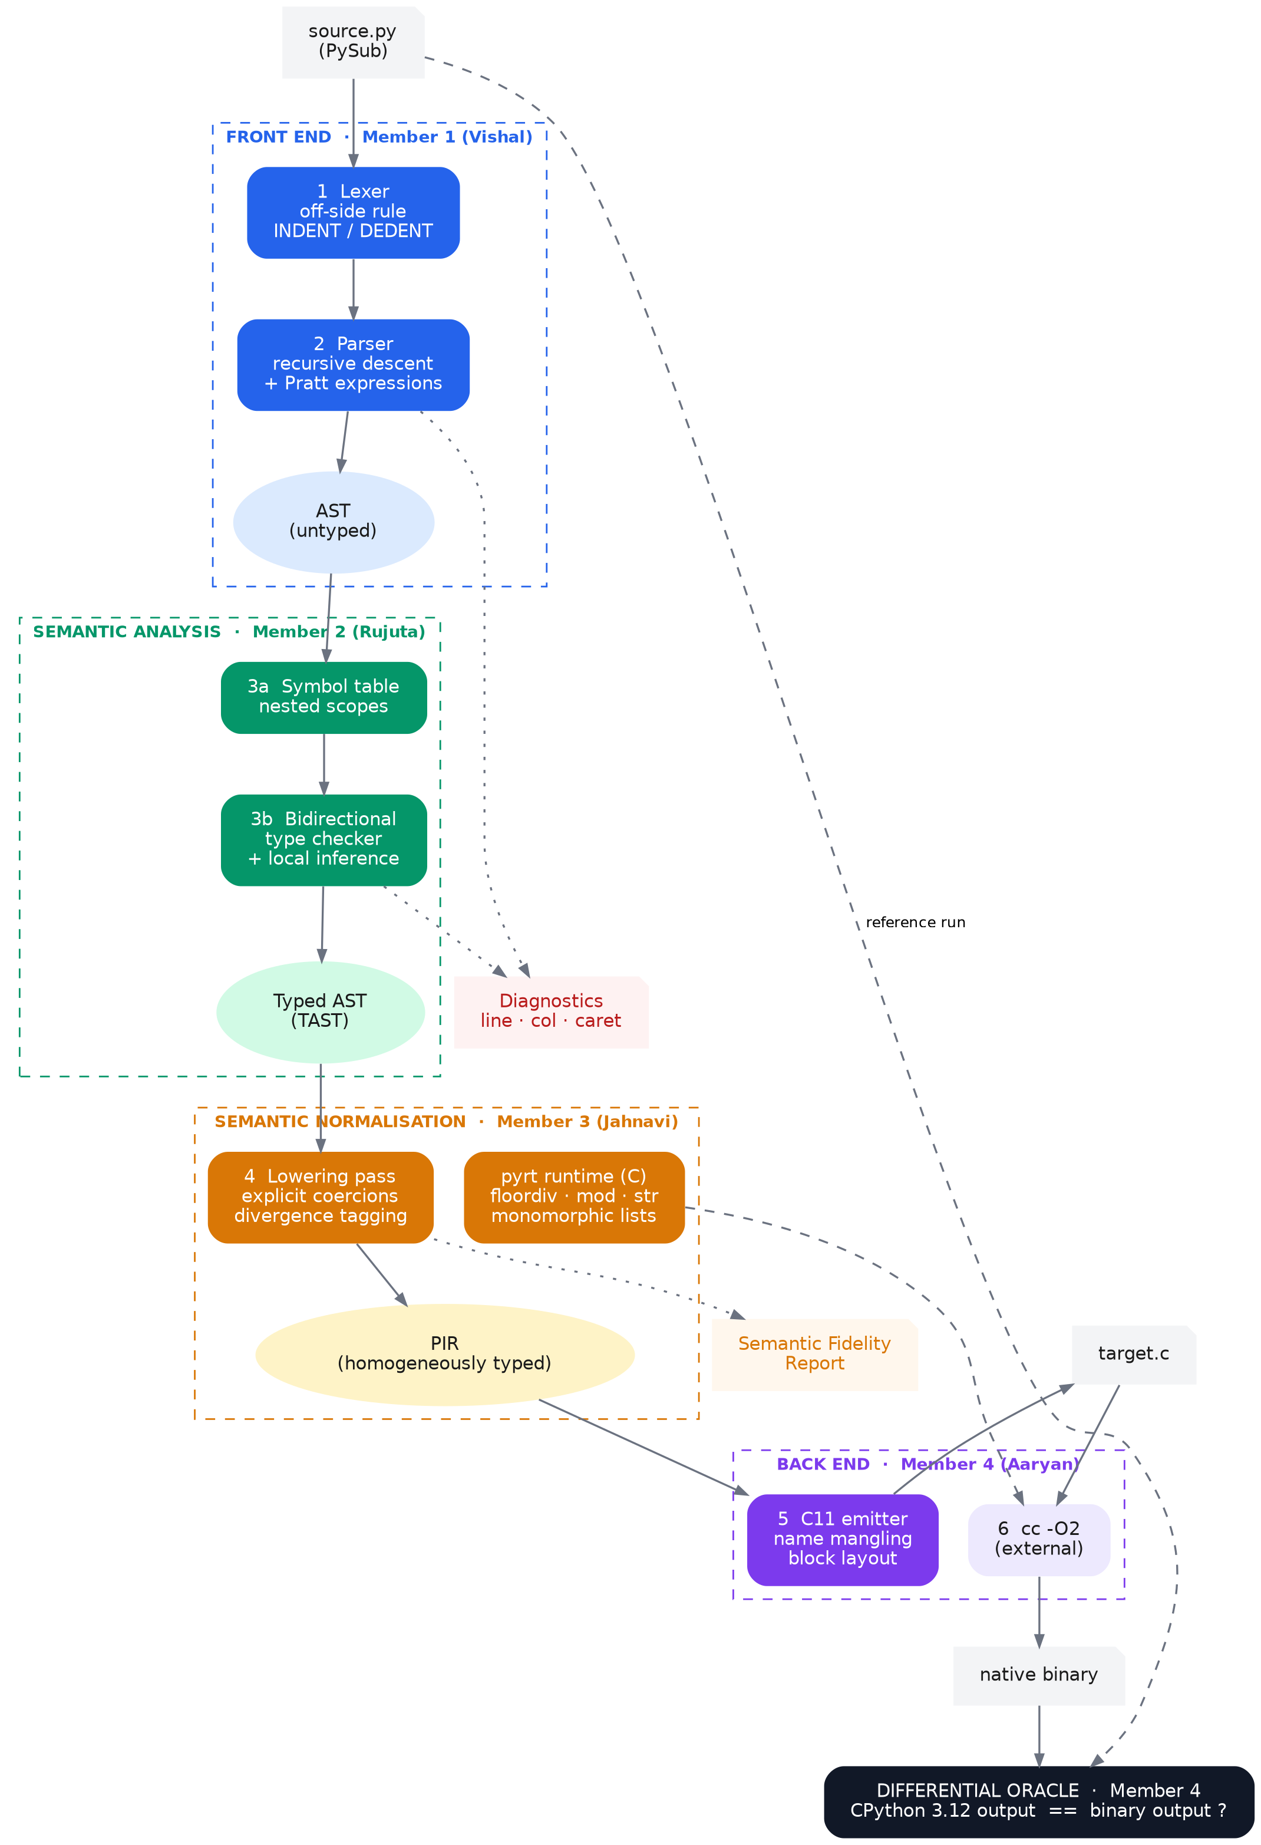
System architecture and data flow
MEMBER 3 · JAHNAVI
Six phases, two products
The dotted outputs — diagnostics and the fidelity report — are products of the pipeline, not by-products. A run that emits no C but a good diagnostic has succeeded. The dashed edge at the bottom closes the verification loop.
Representation | Produced by | Invariant it guarantees
Token stream | Lexer | Layout is explicit — every block delimited by INDENT/DEDENT, so the grammar downstream is context-free
AST | Parser | Structurally valid; every node carries line and column. Types absent
Typed AST | Type checker | Every expression carries a resolved type; no ill-typed program reaches this stage
PIR | Lowering | Homogeneously typed — every implicit coercion is now an explicit Coerce node; divergences tagged
C11 source | Emitter | Compiles under -Wall with no warnings and no dependency outside pyrt
INTERFACES — WHY FOUR PEOPLE CAN WORK IN PARALLEL
M1 → M2 Module untyped tree + source positions
M2 → M3 Module + Ty every node .ty populated
M3 → M4 Module + Coerce homogeneously typed PIR
M3 → M4 pyrt.h the runtime ABI the emitter targets
M4 → all oracle.py the shared definition of “correct”
PYTHIA · BCSE307L Team 2 · Project A15
8
Notes:
Trace one program through the diagram left to right. Then the invariants table — each stage guarantees something the next one relies on. Finish on the interfaces: these are data-structure contracts, not calling conventions, which is why the four of us are not blocked on each other.

Slide 9
Modules, algorithms and divergence catalogue
MEMBER 3 · JAHNAVI
Module | Input → Output | Algorithm / technique | Owner | LOC
lexer.py | text → tokens | Hand-written scanner; indentation stack implementing the off-side rule; bracket-suppressed layout | M1 Vishal | 233
parser.py | tokens → AST | Recursive descent for statements; Pratt precedence climbing; panic-mode synchronisation | M1 Vishal | 393 (+205 AST)
typecheck.py | AST → TAST | Parent-linked scope chain; bidirectional checking with local inference; bool ⊑ int ⊑ float lattice | M2 Rujuta | 567
lower.py | TAST → PIR | Coercion insertion; divergence tagging against D1–D7; fidelity accumulation | M3 Jahnavi | 250
pyrt.h / .c | runtime library | Floor division, divisor-signed modulo, checked int64, shortest-round-trip float repr, monomorphic lists | M3 Jahnavi | 435
emit_c.py | PIR → C11 | Syntax-directed structural walk; name mangling; monomorphised container selection | M4 Aaryan | 420
oracle.py | corpus → verdict | Differential execution vs CPython 3.12; stdout and exception-class comparison; timing harness | M4 Aaryan | 188
The divergence catalogue — the project's technical spine
ID | Divergence | Example | Mitigation | Status
D1 | Python ints unbounded; C's are 64-bit | 2**63 exact in Python | Guarded with __builtin_*_overflow; raises OverflowError | Guarded
D2 | // floors toward −∞; C truncates toward 0 | −7 // 2 = −4 vs −3 | py_floordiv_i64 / py_floordiv_f64 | Exact
D3 | Sign of % follows the divisor | −7 % 2 = 1 vs −1 | py_mod_i64 / py_mod_f64, incl. signed zero | Exact
D4 | / is true division, always float | 3 / 2 = 1.5, not 1 | Operands widened; py_truediv keeps ZeroDivisionError | Exact
D5 | Negative indexing, mandatory bounds checks | xs[−1]; xs[7] raises | Normalised and checked in the runtime | Exact
D6 | int ** negative int changes the static type | 2 ** −1 = 0.5, a float | Not statically typable — reported, then refused at run time | Divergent
D7 | Object lifetime and reclamation | CPython refcounts | Documented; output unaffected. Regions are the R3 target | Guarded
Float formatting is the divergence most transpilers get wrong without noticing: CPython prints the shortest round-tripping decimal, fixed unless the exponent is < −4 or ≥ 16. printf("%.17g") does not reproduce it — pyrt implements the search directly, which is why 0.1 + 0.2 prints 0.30000000000000004.
PYTHIA · BCSE307L Team 2 · Project A15
9
Notes:
Modules first — one owner, one reason to change. Then the catalogue: this is the table to know cold. Be ready to work −7//2 and −7%2 by hand in both languages, and to explain why D6 cannot be caught statically (the exponent's sign is a run-time value).

Slide 10
Work allocation and integration responsibilities
MEMBER 4 · AARYAN
M1
VISHAL VIVEK
SUPPORTING
REVIEW 1 EVIDENCE
REVIEW 2 TARGET
24BCE2377
Repository, CI, cross-module integration, release management
grammar.ebnf (41 productions); 944 LOC across lexer, parser, AST, CLI; caret diagnostics working
Tuples, multiple assignment, while/else
PRIMARY
Front end: grammar, lexer with the off-side rule, parser, AST, diagnostics
M2
RUJUTA M. KULKARNI
SUPPORTING
REVIEW 1 EVIDENCE
REVIEW 2 TARGET
24BDS0459
Negative corpus and diagnostic-message quality
typecheck.py (567 LOC); 12/12 negative cases rejected with the expected message
Negative suite to 60; list[list[T]], Optional[T]
PRIMARY
Symbol table, scope resolution, bidirectional type checker, local inference
M3
K. V. JAHNAVI
SUPPORTING
REVIEW 1 EVIDENCE
REVIEW 2 TARGET
24BDS0132
Performance analysis of the guard mechanism
lower.py + pyrt (685 LOC); 7 divergence classes; 123 positioned notes across the suite
Interval analysis to elide safe guards; hash-map runtime
PRIMARY
Divergence catalogue, lowering to PIR, Fidelity Report, pyrt runtime
M4
AARYAN GUPTA
SUPPORTING
REVIEW 1 EVIDENCE
REVIEW 2 TARGET
24BDS0134
CI configuration, task board, contribution log
emit_c.py + oracle.py (608 LOC); 14/14 equivalence; 9.4× median speedup measured
Grammar-directed generator; corpus to 120
PRIMARY
C11 emitter, differential oracle, benchmark harness, project plan
Every member owns one technical component end to end. Secondary owners so no phase is a single point of failure: front end M4 · type checker M3 · runtime M2 · emitter M1.
PYTHIA · BCSE307L Team 2 · Project A15
10
Notes:
Point out explicitly that nobody's row says 'documentation' or 'PPT' — the guidelines ask for division by module and measurable output. Then the secondary-owner line: that is our answer to R4.

Slide 11
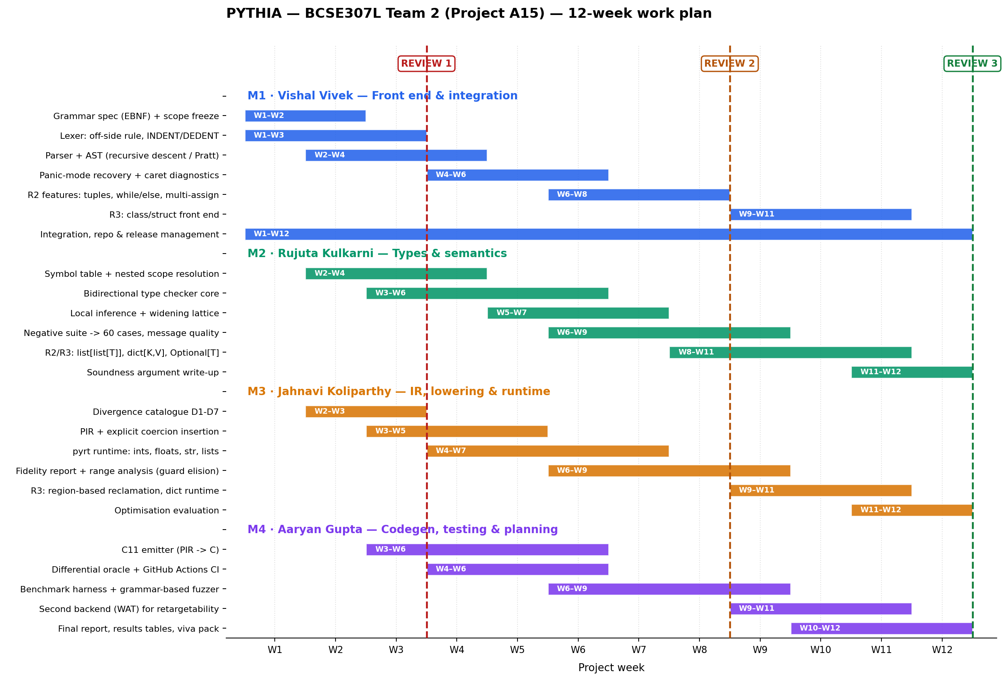
Timeline, milestones and Review 2 / 3 outcomes
MEMBER 4 · AARYAN
REVIEW 1
W3
Complete pipeline for PySub v0.1 · grammar · catalogue D1–D7 · differential oracle · report and deck
ACCEPTANCE
Oracle green on the whole corpus; every member demonstrates their own module
REVIEW 2
W8
Grammar-directed generator · corpus 120 / 60 · interval analysis for guard elision · nested generics · ISO C fallback
ACCEPTANCE
≥ 98% equivalence at 120 programs; ≥ 95% rejection at 60; measured gain from guard elision
REVIEW 3
W12
Classes and dict · try/except · region-based reclamation · WebAssembly back end · final evaluation
ACCEPTANCE
≥ 98% equivalence maintained; two back ends from one PIR; memory reclaimed without output change
PYTHIA · BCSE307L Team 2 · Project A15
11
Notes:
The Gantt has four swimlanes and 25 tasks; do not read it. Say: work is parallel from Week 2 because the interfaces are data structures, and the three gates on the right each have an acceptance criterion that is a number, not an opinion.

Slide 12
Initial progress — and the numbers behind it
MEMBER 4 · AARYAN
14 / 14
12 / 12
9.4×
~2 800
123
programs semantically
equivalent to CPython 3.12
ill-typed programs
rejected before emission
median speedup
(min 3.3×, max 13.8×)
lines of implementation
across 8 modules
positioned fidelity notes
across 7 divergence classes
End-to-end: gcd, and the one line that matters
The oracle earned its place in week one
def gcd(a: int, b: int) -> int:
while b != 0:
t: int = b
b = a % b
a = t
return a
print(gcd(48, 18), gcd(-48, 18))
────────────────────────────────
static int64_t f_gcd(int64_t p_a, int64_t p_b) {
int64_t p_t = 0;
while ((p_b) != (INT64_C(0))) {
p_t = p_b;
p_b =
py_mod_i64(p_a, p_b);
p_a = p_t;
}
return p_a;
}
FOUR BUGS FOUND ON THE FIRST FULL RUN
Frozen-dataclass types compared by identity, not equality — so "a" + "b" was rejected as ill-typed.
Float modulo returned −0.0 where CPython returns 0.0; a zero result takes the divisor's sign.
A module-scope loop variable collided with a later annotated declaration of the same name and type, which Python permits.
A rejection message did not match its own # expect: marker.
THE MOST INFORMATIVE ROW
Collatz is the slowest benchmark at 5.0×, and the reason is measurable rather than mysterious: it is integer-bound, so nearly every operation pays for an overflow guard.
That single number turns interval analysis into a Review 2 objective with a target attached.
Both print 6 6. C's own % would print 6 −6 — divergence D3, caught by construction.
PYTHIA · BCSE307L Team 2 · Project A15
12
Notes:
Lead with the five stats. Then the gcd example — show the py_mod_i64 call and say what C's own % would have printed. Then, deliberately, the bugs: a Review 1 that reports only successes is describing a demonstration, not a project. Close on Collatz feeding Review 2.

Slide 13
Expected outcomes, extensions and conclusion
ALL MEMBERS
Outcome | Target at R3 | At R1
Semantic equivalence with CPython 3.12 | ≥ 98% of ≥ 120 | 100% of 14
Ill-typed programs rejected | ≥ 95% of 60 | 100% of 12
Median speedup over CPython | ≥ 8× (≥ 12× after elision) | 9.4×
Divergence classes catalogued | ≥ 10 | 7
Back ends driven from one PIR | 2 (C11 + WASM text) | 1
Peak memory vs CPython | ≤ 1.5× after regions | unbounded (D7)
Extension and publication potential
Retargeting — PIR is target-agnostic by construction; a WebAssembly back end would show the normalisation belongs to the IR, not the C emitter.
Guard elision by interval analysis — a real dataflow pass with a number attached: Collatz says ~2× is available.
Selective bignum promotion — promote only at the sites interval analysis cannot discharge, closing D1 properly instead of guarding it.
Mechanised proof that coercion insertion preserves typing — moving one link from tested to verified, in the spirit of CompCert.
Top risks and what we actually do about them
R1 Undiscovered divergences
R2 Guards cost performance
R6 Type checker unsound
The grammar-directed generator searches the space we did not think of; each find becomes a class and a test.
Measured, not guessed: ~2× on Collatz. Interval analysis becomes a Review 2 objective with a target.
Exactly what the oracle detects — an unsoundness surfaces as an output mismatch, not a silent pass.
Conclusion
A transpiler that silently approximates is a miscompiler. One that reports is a tool.
At Review 1 the pipeline is complete end to end, the equivalence claim is tested rather than asserted, and every place the translation is approximate is named by the compiler itself — with a line, a column and a mitigation.
PYTHIA · BCSE307L Team 2 · Project A15
13
Notes:
This is the closing slide — slow down. Outcomes table shows targets against what is already measured. Three risks, each with a concrete response. Then the one-line conclusion, which is the sentence we want the evaluator to remember.

Slide 14
References
ANY MEMBER
[1]
A. V. Aho, M. S. Lam, R. Sethi, J. D. Ullman. Compilers: Principles, Techniques, and Tools. 2nd ed., Pearson, 2006. — Ch. 2–6: lexical analysis, recursive-descent parsing, syntax-directed translation, type checking.
[2]
B. C. Pierce. Types and Programming Languages. MIT Press, 2002. — subtyping and algorithmic typing.
[3]
B. C. Pierce, D. N. Turner. “Local Type Inference.” ACM TOPLAS 22(1):1–44, 2000. — the bidirectional discipline used in typecheck.py.
[4]
V. R. Pratt. “Top Down Operator Precedence.” POPL, pp. 41–51, 1973. — the expression parser.
[5]
W. M. McKeeman. “Differential Testing for Software.” Digital Technical Journal 10(1):100–107, 1998. — the methodology behind tools/oracle.py.
[6]
X. Yang, Y. Chen, E. Eide, J. Regehr. “Finding and Understanding Bugs in C Compilers.” PLDI, pp. 283–294, 2011. — Csmith; the model for the Review-2 generator.
[7]
A. Pnueli, M. Siegel, E. Singerman. “Translation Validation.” TACAS, LNCS 1384, pp. 151–166, 1998.
[8]
X. Leroy. “Formal Verification of a Realistic Compiler.” CACM 52(7):107–115, 2009. — CompCert.
[9]
J. Chen et al. “A Survey of Compiler Testing.” ACM Computing Surveys 53(1), Art. 4, 2020.
[10]
S. Behnel et al. “Cython: The Best of Both Worlds.” Computing in Science & Engineering 13(2):31–39, 2011.
[11]
A. Shajii et al. “Codon: A Compiler for High-Performance Pythonic Applications and DSLs.” CC, 2023.
[12]
Python Software Foundation. The Python Language Reference 3.12 — §2.1.8 (indentation) and §6.7 (binary arithmetic) define the behaviour PYTHIA is checked against.
[13]
ISO/IEC 9899:2011, Programming languages — C. §6.5.5 on division and remainder, where D2 and D3 originate.
[14]
GNU Project. GCC Manual — Statement Expressions and Typeof. The two extensions used at the three emission sites.
PYTHIA · BCSE307L Team 2 · Project A15
14
Notes:
Do not read these. They are on the slide so the evaluator can see the work is grounded. If asked which mattered most: Pierce & Turner for the type checker, McKeeman and Csmith for the oracle, and the Python Language Reference plus ISO C for the divergence catalogue.

Slide 15
Backup — PySub grammar and diagnostics
BACKUP
(* PySub v0.1 — 41 productions, docs/grammar.ebnf *)
module = { NEWLINE | funcdef | statement } EOF ;
funcdef = "def" NAME "(" [params] ")" ["->" type] ":" block ;
param = NAME ":" type ;
type = "int" | "float" | "bool" | "str" | "None"
| "list" "[" type "]" ;
block = NEWLINE INDENT statement { statement } DEDENT ;
if_stmt = "if" expr ":" block { "elif" expr ":" block }
[ "else" ":" block ] ;
for_stmt = "for" NAME "in" ( range_call | expr ) ":" block ;
annassign = NAME ":" type "=" expr NEWLINE ;
(* Expressions: precedence climbing. Binding powers,
loosest to tightest:
or(1) < and(2) < cmp(4) < +,-(6) < *,/,//,%(8) < **(12, R) *)
power = unary [ "**" power ] ;
unary = ( "-" | "+" | "not" ) unary | postfix ;
postfix = atom { "[" expr "]" | "." NAME "(" [arglist] ")" } ;
(* INDENT / DEDENT are synthesised by the scanner from
leading whitespace. Blank and comment-only lines carry
no layout meaning; ( ) and [ ] suppress it entirely. *)
Diagnostics carry a position and a caret
$ python3 -m pythia.cli tests/negative/n02_badarg.py
n02_badarg.py:4:14: TypeError: argument 1 of double():
expected int, found str
print(double("seven"))
^
1 error(s); no output written.
The negative suite tests messages, not just rejection
Each of the 12 negative programs carries an # expect: marker naming the diagnostic it must provoke. A checker that rejects everything would pass a rejection-only test; it fails this one.
type rebinding · wrong argument type · undefined name
wrong return type · heterogeneous list literal
missing return on a path · unannotated empty list
wrong arity · non-int index · str item assignment
incomparable types · break outside a loop
One rule governs the suite: a divergence discovered by hand becomes a test before it becomes a fix. That is what keeps the equivalence percentage meaningful over twelve weeks.
PYTHIA · BCSE307L Team 2 · Project A15
15
Notes:
Backup — use if asked about the grammar, the diagnostic quality, or how the negative suite works.

Slide 16
Backup — full oracle output and fidelity report
BACKUP
$ python3 tools/oracle.py
PYTHIA DIFFERENTIAL ORACLE
(CPython 3.12 vs PYTHIA -> C -> cc -O2)
PROGRAM CPython PYTHIA SPEEDUP RESULT
t01_arith.py 21.5m 1.9m 11.0x PASS
t02_lists.py 20.0m 3.1m 6.4x PASS
t03_strings.py 18.7m 1.9m 10.0x PASS
t04_control.py 19.9m 1.9m 10.8x PASS
t05_floats.py 19.4m 1.9m 10.4x PASS
t06_boolops.py 18.4m 1.8m 10.2x PASS
t07_bubble.py 17.5m 2.3m 7.5x PASS
t08_nested.py 25.3m 3.1m 8.1x PASS
t09_sieve.py 92.8m 8.4m 11.1x PASS
t10_collatz.py 1508.8m 299.9m 5.0x PASS
t11_matmul.py 168.4m 12.1m 14.0x PASS
t12_err_index.py 18.1m 1.8m 10.3x PASS
t13_err_zerodiv.py 19.9m 2.8m 7.0x PASS
t14_edges.py 18.4m 1.9m 9.8x PASS
SUMMARY
semantic equivalence : 14/14 (100.0%)
type-checker recall : 12/12 (100.0%)
median speedup : 9.4x (3.3x – 13.8x)
fidelity notes : 123 across the suite
Semantic Fidelity Report — generated, not written
$ python3 -m pythia.cli t01_arith.py --fidelity
SEMANTIC FIDELITY REPORT
12 exact 6 guarded 2 divergent
3:19: [EXACT] D2 floor-division rounding
Python floors toward -inf; C truncates toward
zero, so -7 // 2 is -4 in Python and -3 in C.
mitigation: py_floordiv_i64; exact.
3:27: [EXACT] D3 modulo sign convention
In Python the sign of % follows the divisor;
in C it follows the dividend, so -7 % 2 is 1
in Python and -1 in C.
mitigation: py_mod_i64; exact.
3:34: [EXACT] D4 true division yields float
mitigation: operands widened to double;
ZeroDivisionError preserved.
WHY IT LIVES IN THE COMPILER
A hand-written divergence list goes stale the moment the emitter changes. This one is regenerated from the program being compiled, so it cannot describe a translation that no longer happens.
t12 and t13 verify exception parity — IndexError and ZeroDivisionError are raised by the binary exactly where CPython raises them.
PYTHIA · BCSE307L Team 2 · Project A15
16
Notes:
Backup — use if asked for the full results or to see the fidelity report in detail. The Collatz row is highlighted because it is the one that motivates Review 2.

