Slide 1
Network Device Driver
Presented by : Vishal Wagh

Slide 2
Content :
Detecting the device
Enabling the device
Understanding the network device
Device Allocation
Device Registration
Device Registration
File Operation

Slide 3
Detecting the device :
As a first step, we need to detect the device.
begin or continue searching for a PCI device by vendor/device id
struct pci_dev * pci_find_device (unsigned int vendor, unsigned int device, const struct pci_dev * from);
vendor
PCI vendor id to match.
device
PCI device id to match.
from
Previous PCI device found in search, or NULL for new search.

Slide 4
Detecting the device :
#define VENDER_ID 0x1234
#define DEVICE_ID 0x5678
#include <linux/pci.h>
struct pci_dev *dev;
dev = pci_find_device(VENDER_ID, DEVICE_ID, NULL);
if (dev == NULL) {
printk(KERN_INFO "PCI device not found\n");
return -1; }
else{
printk(KERN_INFO "PCI device found\n");
}

Slide 5
Enabling the device :
After detecting the device, we need to enable the device.
pci_enable_device — Initialize device before it's used by a driver.
int pci_enable_device (struct pci_dev * dev);
struct pci_dev * dev
PCI device to be initialized

Slide 6
Enabling the device :
ret = pci_enable_device(dev);
if (ret != 0)
{
printk(KERN_INFO "Failed to enable device\n");
return ret;
}
else
{
printk(KERN_INFO "Enable device\n");
}

Slide 7
Understanding struct net_device :
struct net_device {
char *name;
unsigned long base_addr;
unsigned char addr_len;
unsigned char dev_addr[MAX_ADDR_LEN];
unsigned char broadcast[MAX_ADDR_LEN];
unsigned short hard_header_len;
unsigned char irq;
void *priv;
};

Slide 8
Understanding struct net_device :
name - The name of the device. If the first character of the name is null, then register_netdev assigns it the name.
base_addr - The I/O base address.
addr_len - Hardware address (MAC address) length.
dev_addr - Hardware address (Ethernet address or MAC address)
broadcast - device broadcast address.
hard_header_len - The "hardware header length" is the number of octets that lead the transmitted packet before IP header, or other protocol information.
irq - The assigned interrupt number.
priv - Private data to the driver.

Slide 9
Device Allocation :
struct net_device *alloc_netdev(int sizeof_priv, const char *name,
void (*setup)(struct net_device *));
sizeof_priv : size of the private data to be allocated for network device.
name : The name to be assigned to the network device.
setup : A callback function that will be called after the network device structure has been allocated and initialized.

Slide 10
Device Allocation :
The networking subsystem provides a number of helper function wrapped around alloc_netdev for various types of interfaces.
The most common is alloc_etherdev, which is defined in <linux/etherdevice.h>.
Struct net_device *alloc_etherdev(int sizeof_priv);
sizeof_priv : size of the private data to be allocated for network device.

Slide 11
Device Registration :
Driver needs to register the device to kernel using register_netdevice().
Here driver needs to pass the net_device instance which was earlier created by alloc_netdev().
int register_netdevice (struct net_device *dev);
dev : device to register.

Slide 12
Allocation and Registration :
my_net_device =alloc_etherdev(sizeof(my_net_device));
my_net_device->netdev_ops = &my_net_device_ops;
strcpy(my_net_device->name, "my_net_device");
if(register_netdev(my_net_device) < 0)
{
printk(KERN_ERR "my_net_device: module loaded failed\n");
return -1 ;
}
else
{
printk(KERN_INFO "my_net_device: module loaded\n");
return 0;
}

Slide 13
File Operation :
Frequently we are using following types of file opration.
Open
Stop
Hard_start_xmit
Get_stats

Slide 14
Open :
int (*open)(struct net_device *dev);
is a function pointer that is part of the "net_device_ops" data structure. This function pointer is used to register a callback function that will be called by the network stack when a network device is opened.
This is a pointer to a function that opens the device.
This function is called whenever ifconfig activates the device.
(for example, "ifconfig eth0 up").
The open method should register any system resources it needs (I/O ports, IRQ, etc.), turn on the hardware and increment module usage count.

Slide 15
Stop :
int (*stop)(struct net_device *dev);
is a function pointer that is part of the "net_device_ops" data structure. This function pointer is used to register a callback function that will be called by the network stack when a network device is stopped.
This is a pointer to a function that stops the interface.
This function is called whenever ifconfig deactivates the device.
(for example, "ifconfig eth0 down")
The stop method releases all the resources acquired by open function.

Slide 16
hard_start_xmit :
int (*hard_start_xmit) (struct sk_buff *skb, struct net_device *dev);
This function transfers a given packet on the wire.
The first argument of the function is a pointer to structure sk_buff.
Structure sk_buff is used to hold packets in Linux networking stacks.

Slide 17
SK_buff
struct sk_buff {
unsigned char *head; unsigned char *data; unsigned char *tail; unsigned char *end;
unsigned char *len; struct net_device *dev;
struct sk_buff *next;
struct sk_buff *prev;
};

Slide 18
SK_buff
head : start of the packet.
Data : start of the packet payload.
Tail : end of the packet payload.
End : end of the packet.
Len : amount of data of the packet.
struct net_device *dev : Pointer to the network device that the packet was received on or will be transmitted through.
struct sk_buff *next : Pointer to the next buffer in a linked list.
struct sk_buff *prev : Pointer to the previous buffer in a linked list.

Slide 19
Get_stats :
struct net_device_stats *(*get_stats)(struct net_device *dev);
The "get_stats" function pointer is a member of the "net_device_ops" structure
"dev": A pointer to the "net_device" structure representing the network device whose statistics are being retrieved.
The "get_stats" function is responsible for retrieving the statistics for the network device and returning a pointer to a "net_device_stats" structure containing those statistics. The statistics typically include information such as the number of packets transmitted and received, the number of errors that occurred during transmission and reception, and the number of collisions that occurred on the network.

Slide 20
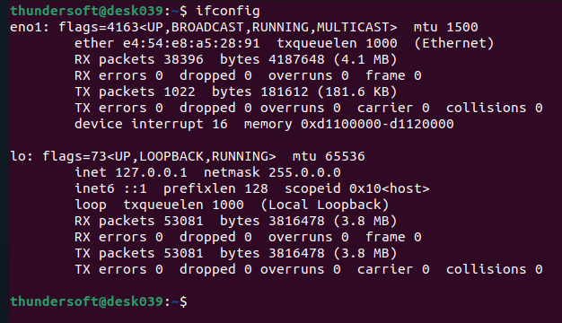

Slide 21


Slide 22
Thank You

