Slide 1
Memory Management Unit
Presented by : Vishal Wagh

Slide 2
Content :
Memory
Types of memory
Memory Management Techniques
Process Address space
Paging
Swapping
Segmentation

Slide 3
Memory
It is a data storage unit or a data storage device where data is to be processed and instructions required for processing are stored.
Types:
Primary memory
Secondary memory
Cache memory

Slide 4
Memory Management Techniques :
Memory allocation
Contiguous Memory allocation :
Fixed partitioning
Variable partitioning
Non-contiguous Memory allocation :
Paging
Segmentation

Slide 5
Fixed partitioning :
Main memory is divided into fixed partitions
Consider all the partition of main memory are same.
2mb
2mb
Fixed size of partitions
2mb
2mb
Main Memory

Slide 6
Variable partitioning :
The main memory is not having fixed partitions, so the whole main memory is continuous form.
The process dynamically get loaded into the main memory at run time.
3mb
2mb
Partitions are
done based on process size
5mb
4mb
Main Memory

Slide 7
Fragmentation :
The space that remain in the main memory after all the processes have loaded is called as hole or fragment.
There are two types of fragmentation.
Internal fragmentation :
Internal takes place in static memory allocation.
External fragmentation :
There is a enough memory space to load a new process but as it is not in continuous manner the process can’t be loaded into main memory.

Slide 8
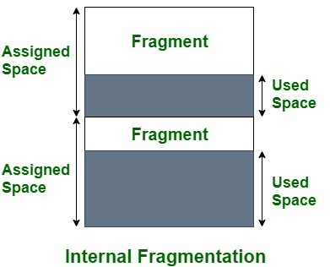
Internal Fragmentation

Slide 9
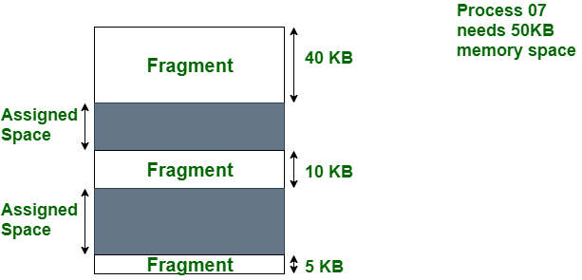
External Fragmentation :

Slide 10
Process Address Space :
A range of physical or virtual addresses which can be accessed by a processor.
Address Space can be of two types
Physical Address Space
Virtual Address Space

Slide 11
Logical and Physical address
The role of the memory management unit is to generate identical logical and physical address during compile time and load time.
Logical address :
Logical Address is used as a reference to access the physical memory location by CPU.
It is the address of the program that is generated by cpu.
Physical address :
Physical address in the computer system identifies a physical location in memory.
It is the address generated by memory management unit.

Slide 12
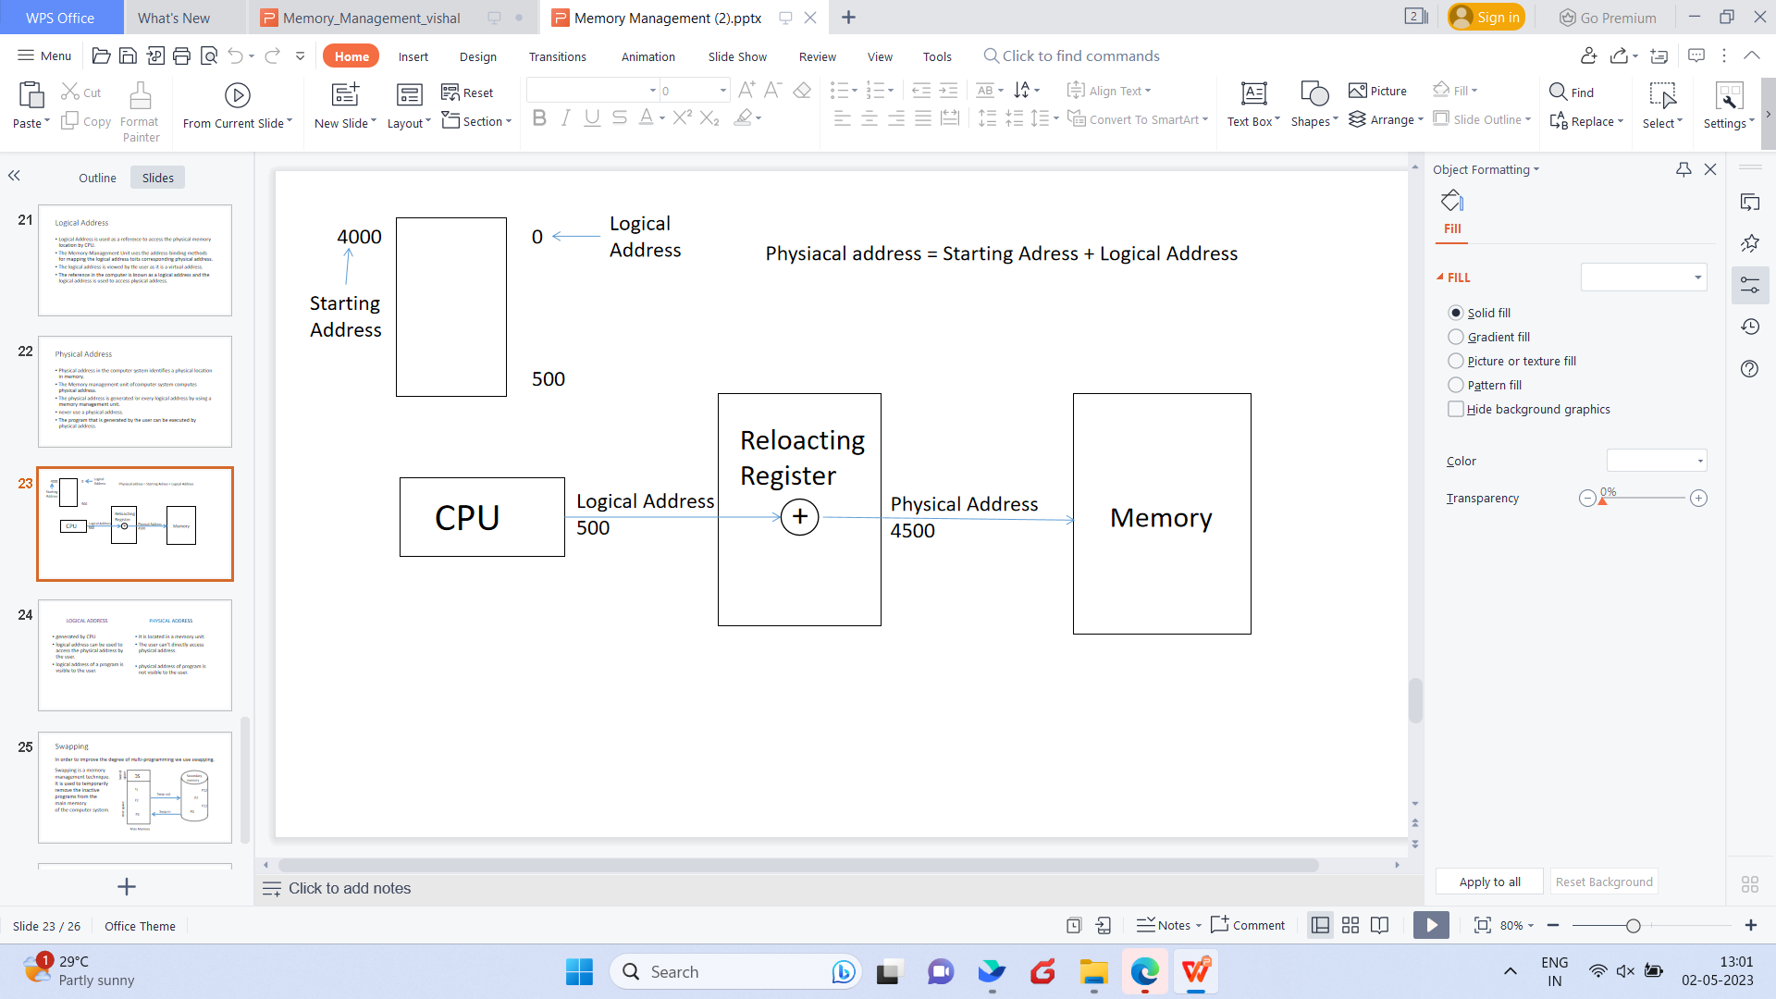
Logical and Physical address

Slide 13
Paging :
Paging is a storage mechanism that allows OS to retrieve processes from the secondary storage into the main memory in the form of pages.
Virtual memory is divided in the form of pages. The main memory will also be divided in the form of frames.
One page of the process is to be stored in one of the frames of the memory.
The sizes of each frame must be equal.
Page table : Info regarding pages

Slide 14
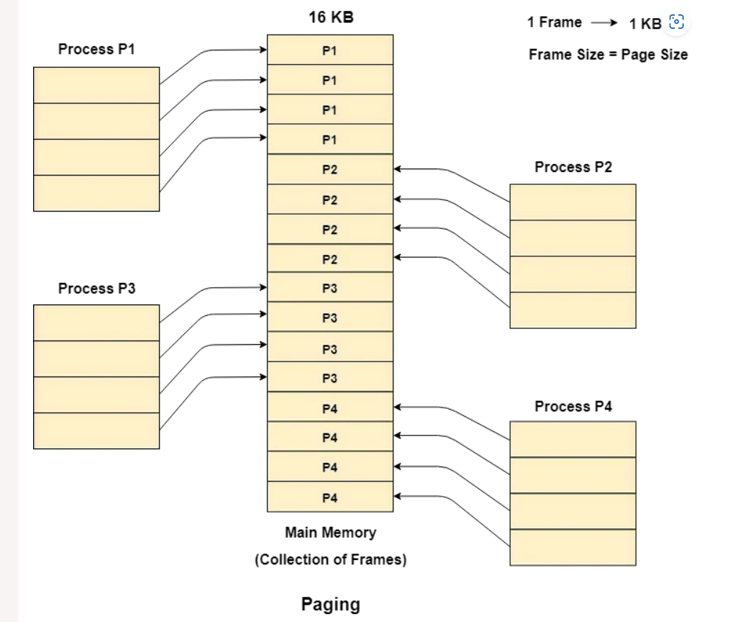
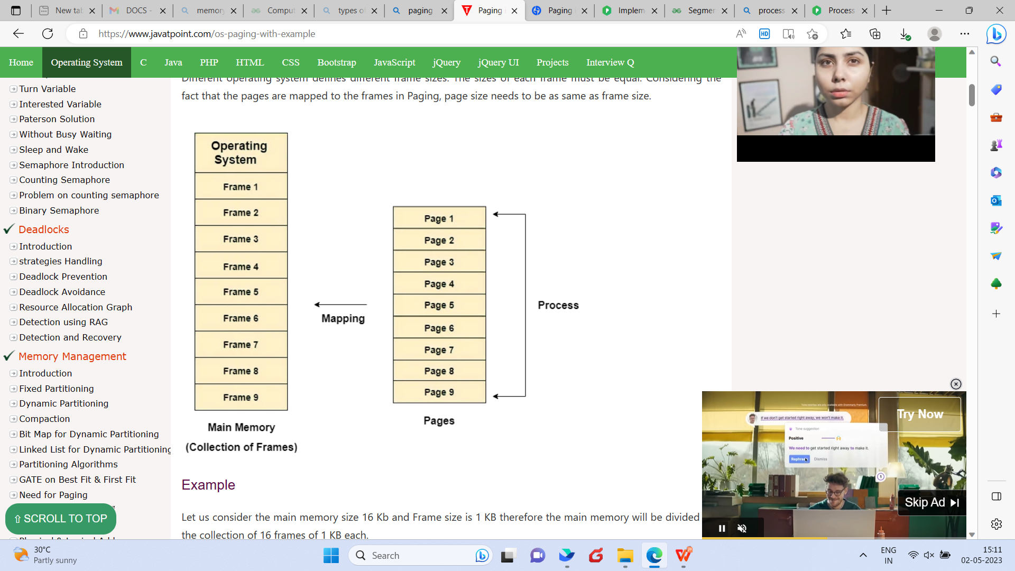
Paging :

Slide 15
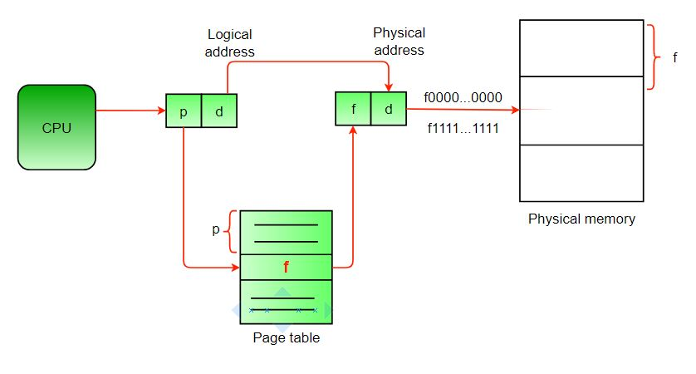
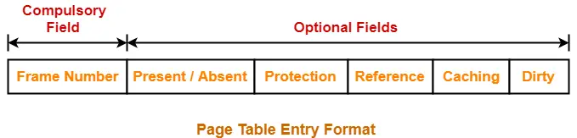
Page table :

Slide 16
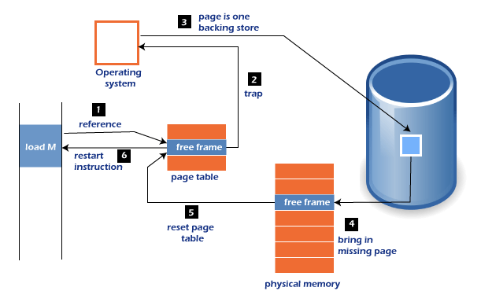
Page fault :

Slide 17
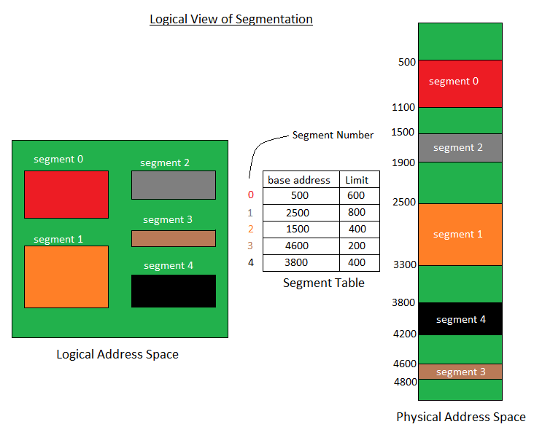
Segmentation :
A process is divided into Segments.
The chunks that a program is divided into which are not necessarily all of the same sizes are called segments.

Slide 18
Swapping :
A process can be swapped temporarily out of memory to a backing store, and then brought back into memory for continued execution.
This phenomena of process switching it’s memory is called as swapping.
It is also called as roll out, roll in.
Swapping variant used for priority-based scheduling algorithms.
Major part of swap time is transfer time

Slide 19
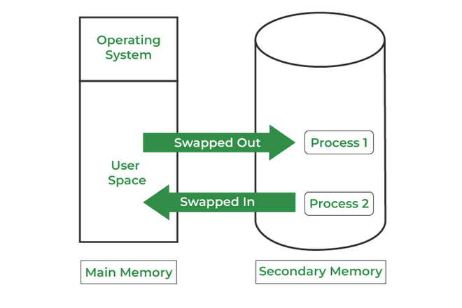
Swapping :

Slide 20
Any Queries ?
Thank You

