Slide 1
Scalability & High Availability
Scalability means that an application / system can handle greater loads by adapting.
There are two kinds of scalability:
Vertical Scalability
Horizontal Scalability (= elasticity)
Scalability is linked but different to High Availability
Let’s deep dive into the distinction, using a call center as an example

Slide 2


Vertical Scalability
Vertically scalability means increasing the size of the instance
For example, your application runs on a t2.micro
Scaling that application vertically means running it on a t2.large
Vertical scalability is very common for non distributed systems, such as a database.
RDS, ElastiCache are services that can scale vertically.
There’s usually a limit to how much you can vertically scale (hardware limit)
junior operator
senior operator

Slide 3
Horizontal Scalability
operator
operator
operator
Horizontal Scalability means increasing the number of instances / systems for your application
Horizontal scaling implies distributed systems.
This is very common for web applications / modern applications
It’s easy to horizontally scale thanks the cloud offerings such as Amazon EC2
operator
operator
operator

Slide 4
High Availability
first building in New York
High Availability usually goes hand in hand with horizontal scaling
High availability means running your
application / system in at least 2 data centers (== Availability Zones)
The goal of high availability is to survive a data center loss
The high availability can be passive (for RDS Multi AZ for example)
The high availability can be active (for horizontal scaling)
second building in San Francisco

Slide 5
High Availability & Scalability For EC2
Vertical Scaling: Increase instance size (= scale up / down)
From: t2.nano - 0.5G of RAM, 1 vCPU
To: u-12tb1.metal – 12.3 TB of RAM, 448 vCPUs
Horizontal Scaling: Increase number of instances (= scale out / in)
Auto Scaling Group
Load Balancer
High Availability: Run instances for the same application across multi AZ
Auto Scaling Group multi AZ
Load Balancer multi AZ

Slide 6

What ’ s an Auto Scaling Group?
In real-life, the load on your websites and application can change
In the cloud, you can create and get rid of servers very quickly
The goal of an Auto Scaling Group (ASG) is to:
Scale out (add EC2 instances) to match an increased load
Scale in (remove EC2 instances) to match a decreased load
Ensure we have a minimum and a maximum number of machines running
Automatically Register new instances to a load balancer

Slide 7
Auto Scaling Group in AWS
Maximum size
Actual Size / Desired Capacity
Minimum size
Scale Out as Needed
EC2
Instance
EC2
Instance
EC2
Instance
EC2
Instance
EC2
Instance
EC2
Instance
AUTO SCALING GROUP

Slide 8

Auto Scaling Group in AWS With Load Balancer
Web Traffic
Load Balancer
EC2
Instance
EC2
Instance
EC2
Instance
EC2
Instance
EC2
Instance
EC2
Instance
AUTO SCALING GROUP

Slide 9
ASGs have the following attributes
A launch configuration
AMI + Instance Type
EC2 User Data
EBS Volumes
Security Groups
SSH Key Pair
Min Size / Max Size / Initial Capacity
Network + Subnets Information
Load Balancer Information
Scaling Policies

Slide 10

Auto Scaling Alarms
It is possible to scale an ASG based on CloudWatch alarms
An Alarm monitors a metric (such as Average CPU)
Metrics are computed for the overall ASG instances
Based on the alarm:
We can create scale-out policies (increase the number of instances)
We can create scale-in policies (decrease the number of instances)
Alarm
EC2
Instance
EC2
Instance
EC2
Instance
EC2
Instance
Trigger scaling

Slide 11
Auto Scaling New Rules
It is now possible to define ”better” auto scaling rules that are directly managed by EC2
Target Average CPU Usage
Number of requests on the ELB per instance
Average Network In
Average Network Out
These rules are easier to set up and can make more sense

Slide 12
Auto Scaling Custom Metric
We can auto scale based on a custom metric (ex: number of connected users)
1. Send custom metric from application on EC2 to CloudWatch (PutMetric API)
2. Create CloudWatch alarm to react to low / high values
3. Use the CloudWatch alarm as the scaling policy for ASG

Slide 13
ASG Brain Dump
Scaling policies can be on CPU, Network… and can even be on custom metrics or based on a schedule (if you know your visitors patterns)
ASGs use Launch configurations or Launch Templates (newer)
To update an ASG, you must provide a new launch configuration / launch template
IAM roles attached to an ASG will get assigned to EC2 instances
ASG are free.You pay for the underlying resources being launched
Having instances under an ASG means that if they get terminated for whatever reason, the ASG will automatically create new ones as a replacement. Extra safety!
ASG can terminate instances marked as unhealthy by an LB (and hence replace them)

Slide 14
Auto Scaling Groups – Scaling Policies
Target Tracking Scaling
Most simple and easy to set-up
Example: I want the average ASG CPU to stay at around 40%
Simple / Step Scaling
When a CloudWatch alarm is triggered (example CPU > 70%), then add 2 units
When a CloudWatch alarm is triggered (example CPU < 30%), then remove 1
Scheduled Actions
Anticipate a scaling based on known usage patterns
Example: increase the min capacity to 10 at 5 pm on Fridays

Slide 15
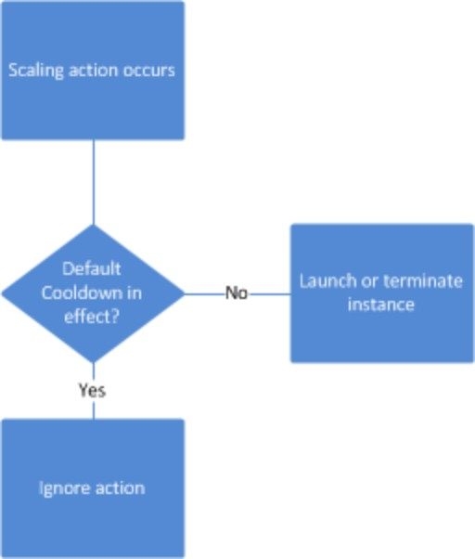
Auto Scaling Groups - Scaling Cooldowns
The cooldown period helps to ensure that your Auto Scaling group doesn't launch or terminate additional instances before the previous scaling activity takes effect.
In addition to default cooldown for Auto Scaling group, we can create cooldowns that apply to a specific simple scaling policy
A scaling-specific cooldown period overrides the default cooldown period.
One common use for scaling-specific cooldowns is with a scale-in policy—a policy
that terminates instances based on a specific criteria or metric. Because this policy
terminates instances, Amazon EC2 Auto Scaling needs less time to determine whether to terminate additional instances.
If the default cooldown period of 300 seconds is too long—you can reduce costs by applying a scaling-specific cooldown period of 180 seconds to the scale-in policy.
If your application is scaling up and down multiple times each hour, modify the
Auto Scaling Groups cool-down timers and the CloudWatch Alarm Period that triggers the scale in
https://docs.aws.amazon.com/autoscaling/ec2/userguide/Cooldown.html

Slide 16
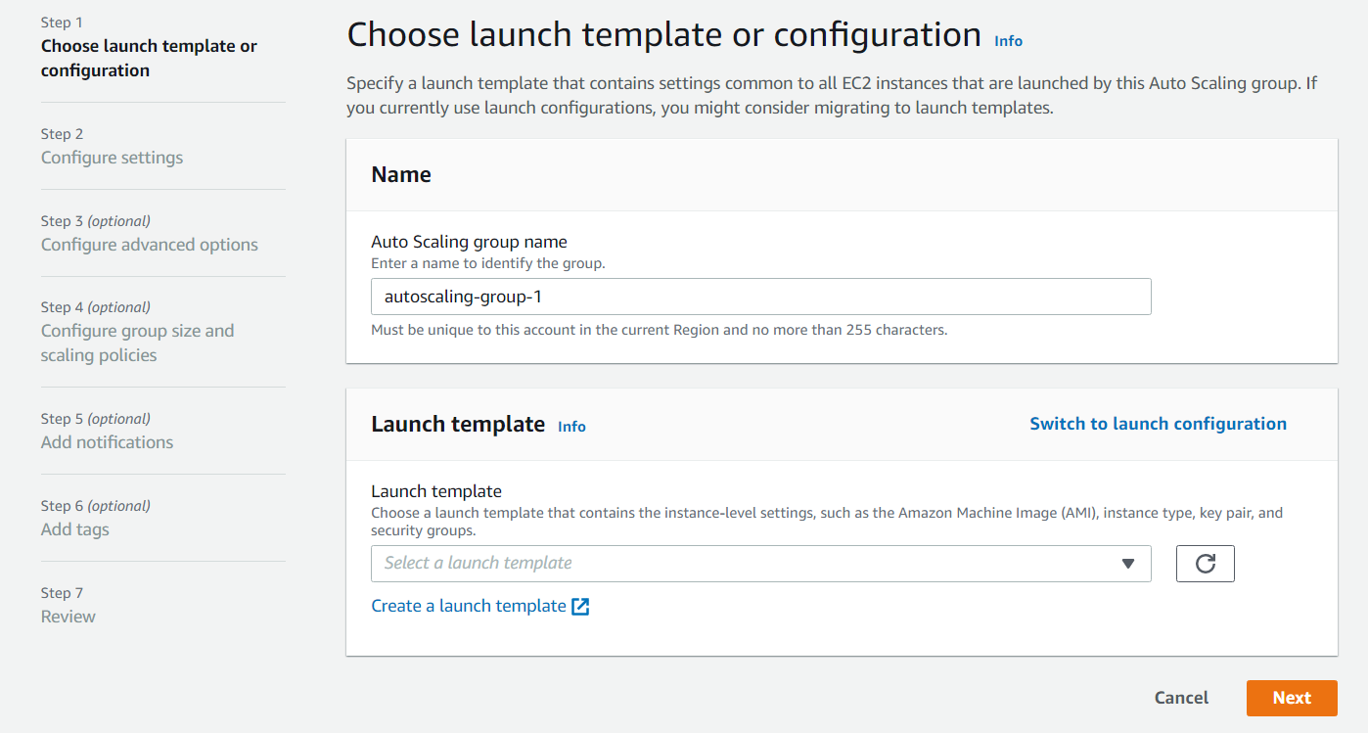
CREATING AUTOSCALING GROUPS

Slide 17
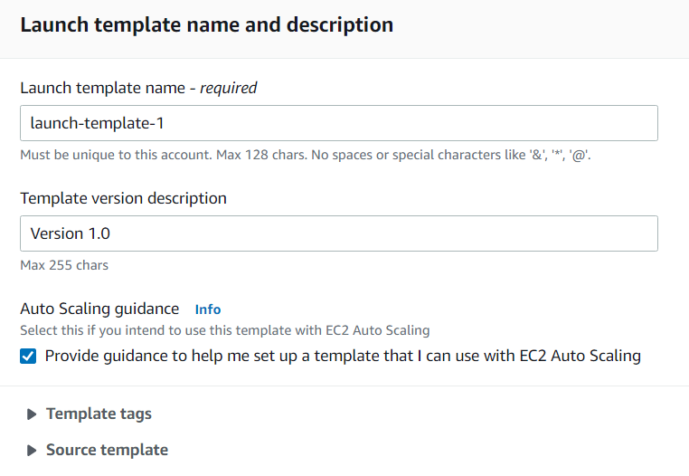

Slide 18
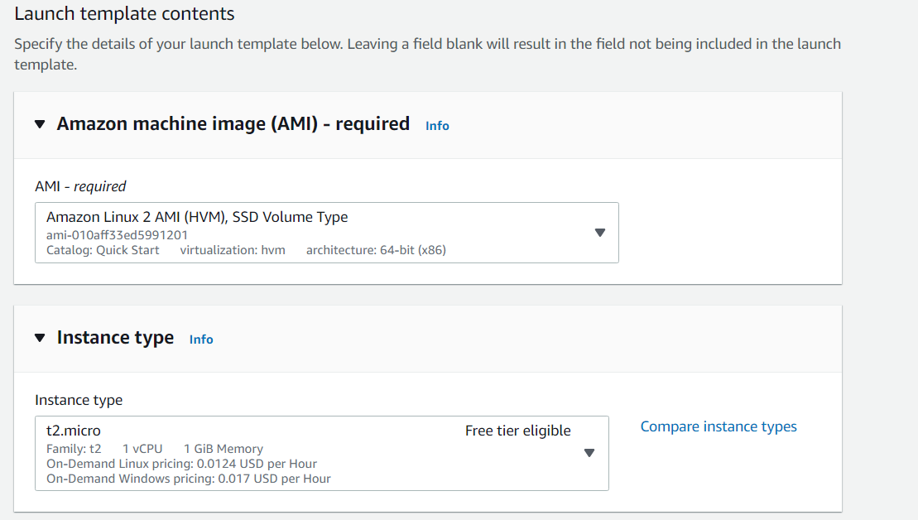

Slide 19
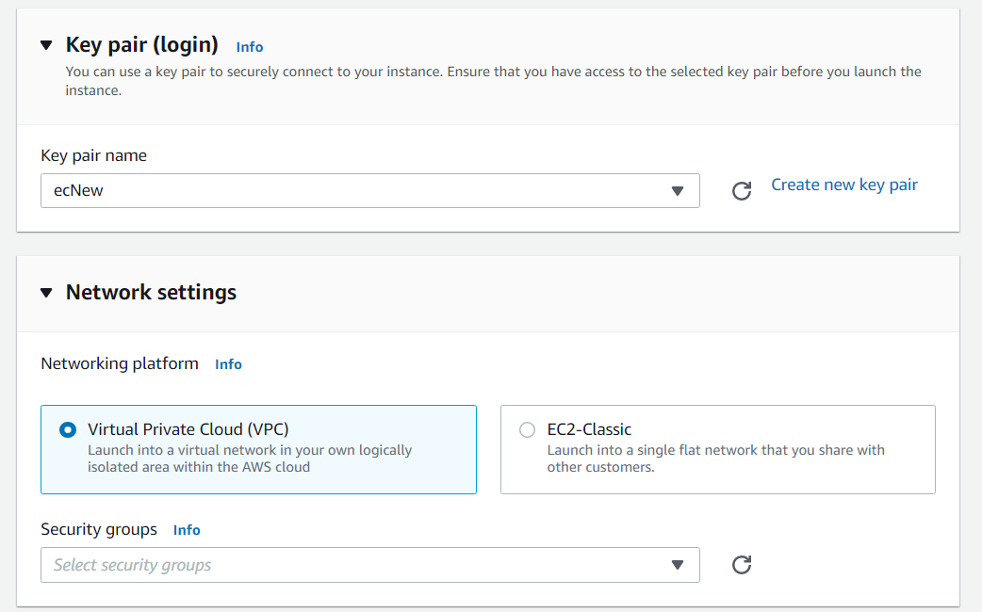

Slide 20
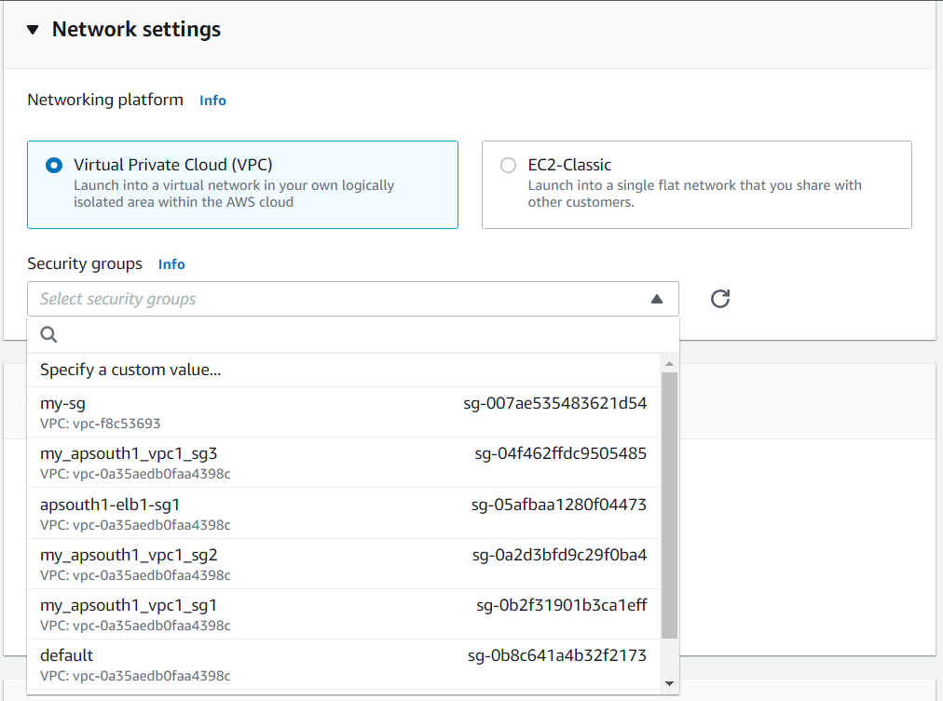

Slide 21
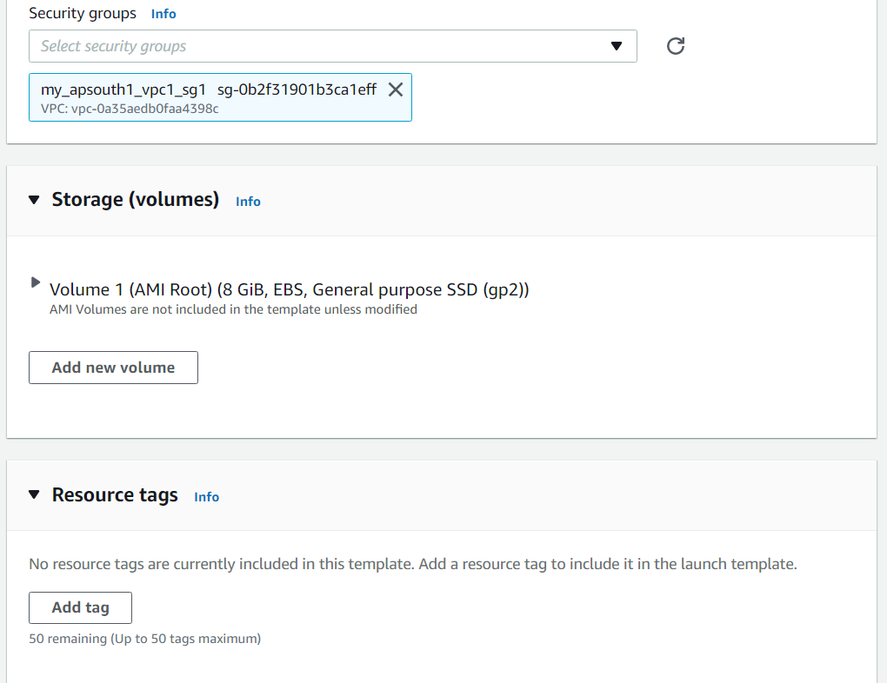

Slide 22
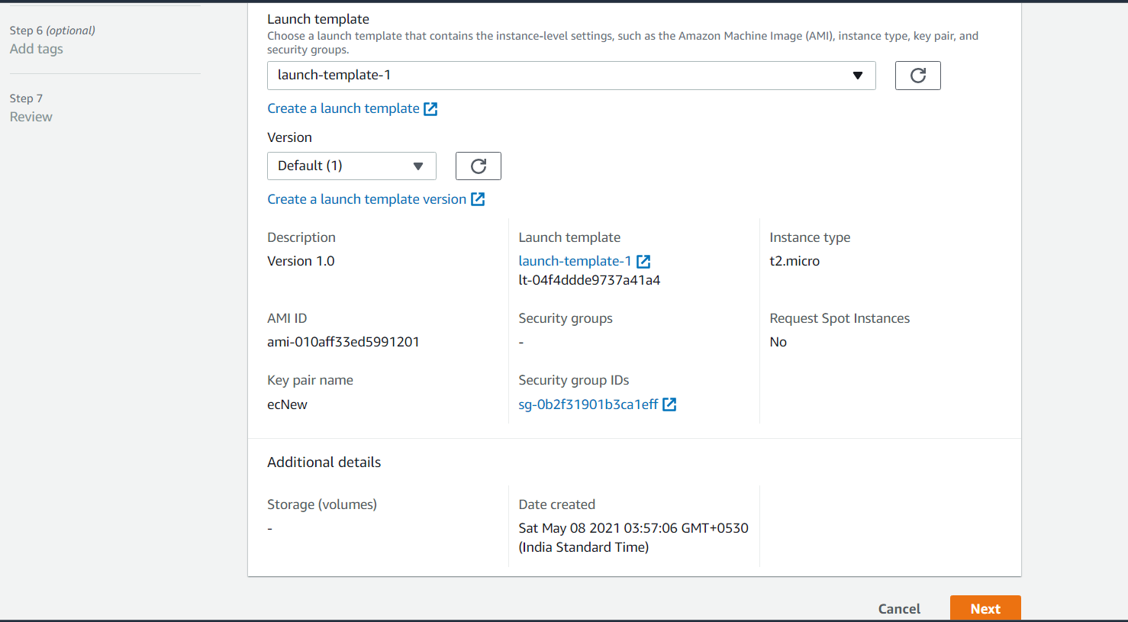

Slide 23
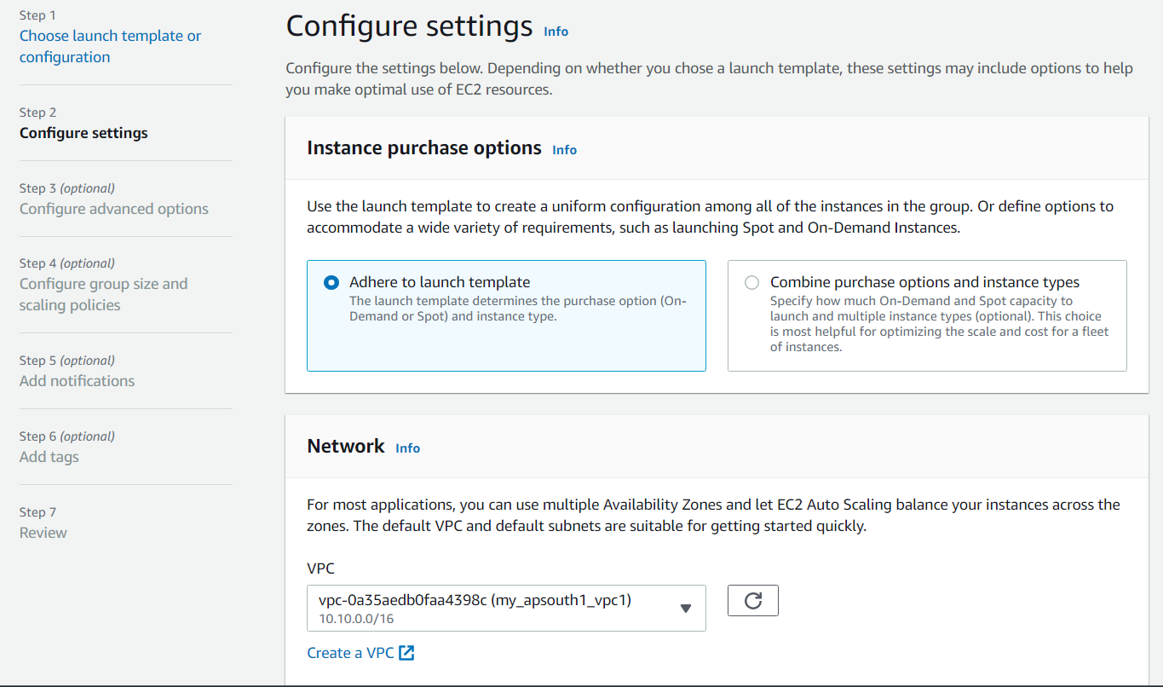

Slide 24
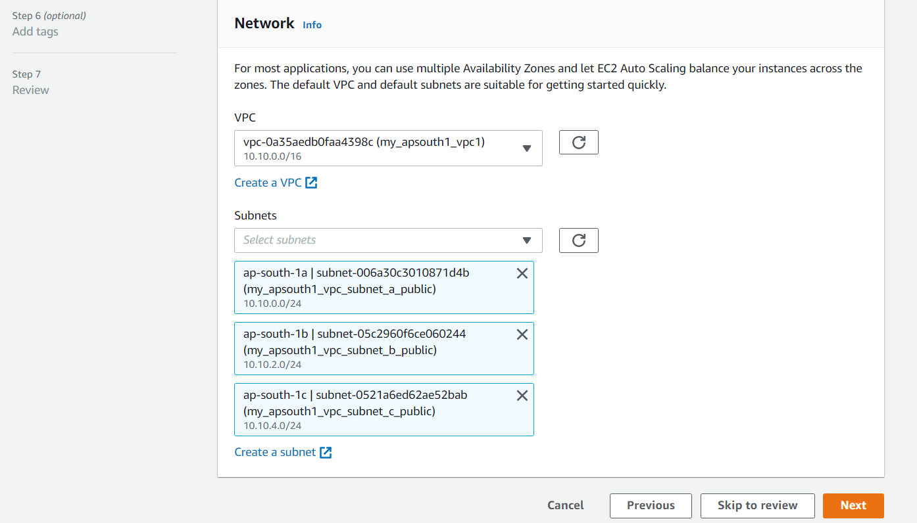
Notes:
So that Auto Scaling group can create instance in all three subnets.

Slide 25
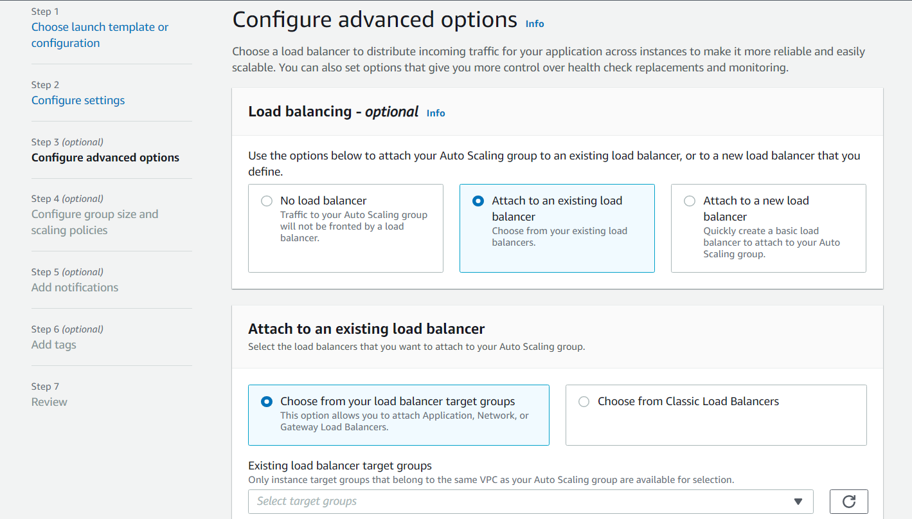

Slide 26
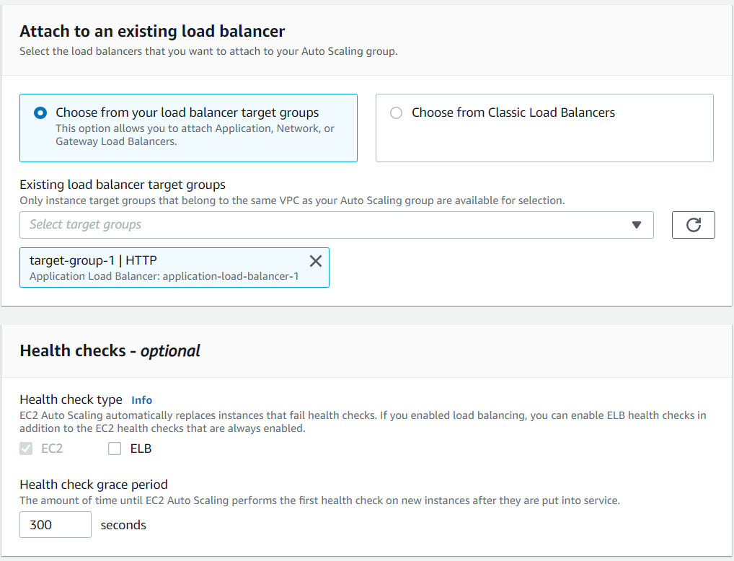

Slide 27
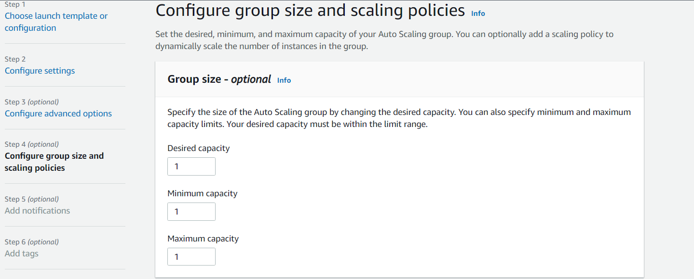

Slide 28
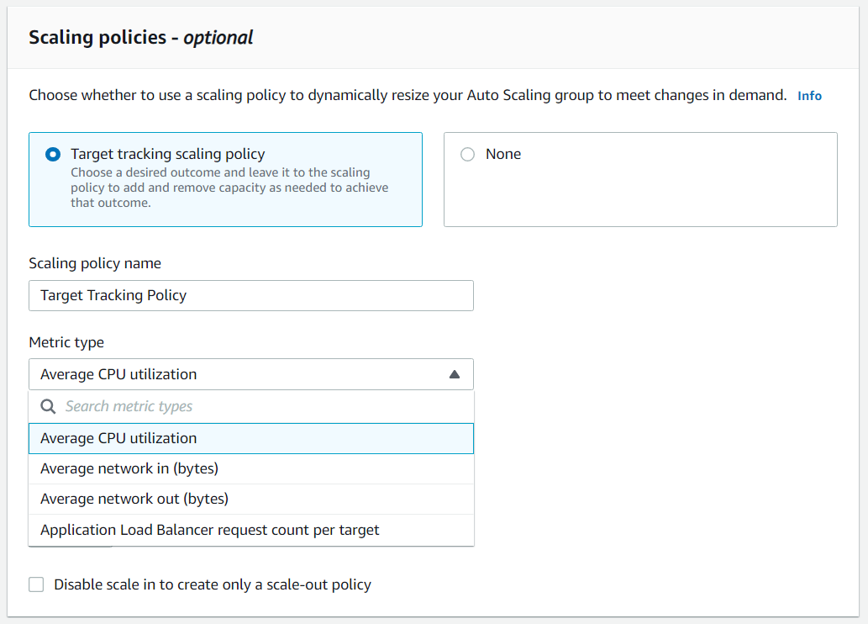

Slide 29
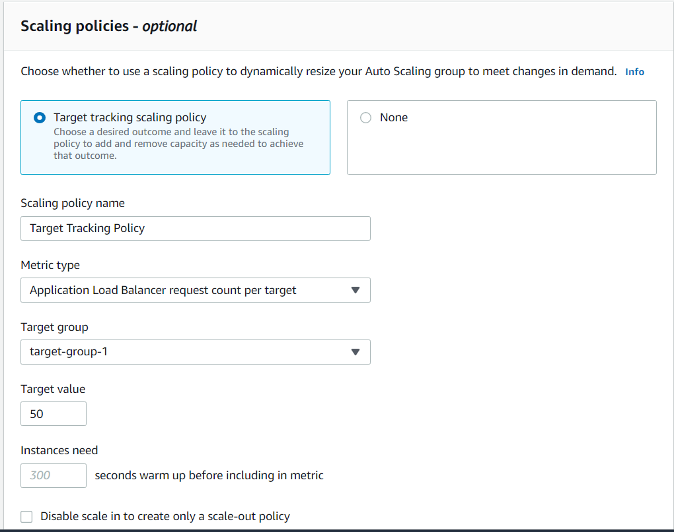
Notes:
ASG will check if on target-group-1 requests are more than target value then it will scale out the EC2 instances in any three availability zone and register that EC2 with target group assigned while we attached a load balancer to it.

