Slide 1
Amazon RDS(Relational Database ServicE)
Amazon Relational Database Service (Amazon RDS) is a web service that makes it easier to set up, operate, and scale a relational database in the AWS Cloud.
Why do you want a managed relational database service? Because Amazon RDS takes over many of the difficult and tedious management tasks of a relational database:
When you buy a server, you get CPU, memory, storage, and IOPS, all bundled together. With Amazon RDS, these are split apart so that you can scale them independently. If you need more CPU, less IOPS, or more storage, you can easily allocate them.
Amazon RDS manages backups, software patching, automatic failure detection, and recovery.
To deliver a managed service experience, Amazon RDS doesn't provide shell access to DB instances. It also restricts access to certain system procedures and tables that require advanced privileges.
You can have automated backups performed when you need them, or manually create your own backup snapshot. You can use these backups to restore a database. The Amazon RDS restore process works reliably and efficiently.
You can use the database products you are already familiar with: MySQL, MariaDB, PostgreSQL, Oracle, Microsoft SQL Server.
You can get high availability with a primary instance and a synchronous secondary instance that you can fail over to when problems occur. You can also use MariaDB, Microsoft SQL Server, MySQL, Oracle, and PostgreSQL read replicas to increase read scaling.
In addition to the security in your database package, you can help control who can access your RDS databases by using AWS Identity and Access Management (IAM) to define users and permissions. You can also help protect your databases by putting them in a virtual private cloud.

Slide 2
DB instances
The basic building block of Amazon RDS is the DB instance. A DB instance is an isolated database environment in the AWS Cloud. Your DB instance can contain multiple user-created databases. You can access your DB instance by using the same tools and applications that you use with a standalone database instance. You can create and modify a DB instance by using the AWS Command Line Interface, the Amazon RDS API, or the AWS Management Console.
Each DB instance runs a DB engine. Amazon RDS currently supports the MySQL, MariaDB, PostgreSQL, Oracle, and Microsoft SQL Server DB engines. Each DB engine has its own supported features, and each version of a DB engine may include specific features. Additionally, each DB engine has a set of parameters in a DB parameter group that control the behavior of the databases that it manages.
The computation and memory capacity of a DB instance is determined by its DB instance class. You can select the DB instance that best meets your needs. If your needs change over time, you can change DB instances.
DB instance storage comes in three types: Magnetic, General Purpose (SSD), and Provisioned IOPS (PIOPS). They differ in performance characteristics and price, allowing you to tailor your storage performance and cost to the needs of your database. Each DB instance has minimum and maximum storage requirements depending on the storage type and the database engine it supports. It's important to have sufficient storage so that your databases have room to grow. Also, sufficient storage makes sure that features for the DB engine have room to write content or log entries.
You can run a DB instance on a virtual private cloud (VPC) using the Amazon Virtual Private Cloud (Amazon VPC) service. When you use a VPC, you have control over your virtual networking environment. You can choose your own IP address range, create subnets, and configure routing and access control lists.

Slide 3
You can have up to 40 Amazon RDS DB instances, with the following limitations:
10 for each SQL Server edition (Enterprise, Standard, Web, and Express) under the "license-included" model
10 for Oracle under the "license-included" model
40 for MySQL, MariaDB, or PostgreSQL
40 for Oracle under the "bring-your-own-license" (BYOL) licensing model
Each DB instance has a DB instance identifier. This customer-supplied name uniquely identifies the DB instance when interacting with the Amazon RDS API and AWS CLI commands. The DB instance identifier must be unique for that customer in an AWS Region.
The identifier is used as part of the DNS hostname allocated to your instance by RDS. For example, if you specify db1 as the DB instance identifier, then RDS will automatically allocate a DNS endpoint for your instance, such as db1.123456789012.us-east-1.rds.amazonaws.com, where 123456789012 is the fixed identifier for a specific region for your account.
Each DB instance supports a database engine. Amazon RDS currently supports MySQL, MariaDB, PostgreSQL, Oracle, Microsoft SQL Server, and Amazon Aurora database engines.
When creating a DB instance, some database engines require that a database name be specified. A DB instance can host multiple databases, or a single Oracle database with multiple schemas. The database name value depends on the database engine:
For the MySQL and MariaDB database engines, the database name is the name of a database hosted in your DB instance. Databases hosted by the same DB instance must have a unique name within that instance.
For the Oracle database engine, database name is used to set the value of ORACLE_SID, which must be supplied when connecting to the Oracle RDS instance.
For the Microsoft SQL Server database engine, database name is not a supported parameter.
For the PostgreSQL database engine, the database name is the name of a database hosted in your DB instance. A database name is not required when creating a DB instance. Databases hosted by the same DB instance must have a unique name within that instance.
Amazon RDS creates a master user account for your DB instance as part of the creation process. This master user has permissions to create databases and to perform create, delete, select, update, and insert operations on tables the master user creates. You must set the master user password when you create a DB instance, but you can change it at any time using the Amazon AWS command line tools, Amazon RDS API operations, or the AWS Management Console. You can also change the master user password and manage users using standard SQL commands.

Slide 4
DB instance class types
Amazon RDS supports three types of instance classes: Standard, Memory Optimized, and Burstable Performance.
The following are the Standard DB instance classes available:
db.m6g – General-purpose instance classes powered by AWS Graviton2 processors. These deliver balanced compute, memory, and networking for a broad range a general purpose workloads.
You can modify a DB instance to use one of the DB instance classes powered by AWS Graviton2 processors by completing the same steps as any other DB instance modification.
db.m5d – Newest generation instance classes that are optimized for low latency, very high random I/O performance, and high sequential read throughput.
db.m5 – Latest generation general-purpose instance classes that provide a balance of compute, memory, and network resources, and are a good choice for many applications. The db.m5 instance classes provide more computing capacity than the previous db.m4 instance classes. They are powered by the AWS Nitro System, a combination of dedicated hardware and lightweight hypervisor.
db.m4 – General-purpose instance classes that provide more computing capacity than the previous db.m3 instance classes.
db.m3 – General-purpose instance classes that provide more computing capacity than the previous db.m1 instance classes.
db.m1 – Earlier generation general-purpose instance classes.

Slide 5
The following are the Memory Optimized DB instance classes available:
db.z1d – Instance classes optimized for memory-intensive applications. These offer both high compute capacity and a high memory footprint. High frequency z1d instances deliver a sustained all core frequency of up to 4.0 GHz.
db.x1e – Instance classes optimized for memory-intensive applications. These offer one of the lowest price per gibibyte (GiB) of RAM among the DB instance classes and up to 3,904 GiB of DRAM-based instance memory.
db.x1 – Instance classes optimized for memory-intensive applications. These offer one of the lowest price per GiB of RAM among the DB instance classes and up to 1,952 GiB of DRAM-based instance memory.
db.r6g – Instance classes powered by AWS Graviton2 processors. These are ideal for running memory-intensive workloads in open-source databases such as MySQL and PostgreSQL.
You can modify a DB instance to use one of the DB instance classes powered by AWS Graviton2 processors by completing the same steps as any other DB instance modification.
db.r5b – Instance classes that are memory-optimized for throughput-intensive applications. Powered by the AWS Nitro System, db.r5b instances deliver up to 60 Gbps bandwidth and 260,000 IOPS of EBS performance, which is the fastest block storage performance on EC2.
db.r5d – Instance classes that are optimized for low latency, very high random I/O performance, and high sequential read throughput.
db.r5 – Latest generation instance classes optimized for memory-intensive applications. These offer improved networking and Amazon Elastic Block Store (Amazon EBS) performance. They are powered by the AWS Nitro System, a combination of dedicated hardware and lightweight hypervisor.
db.r4 – Instance classes optimized for memory-intensive applications. These offer improved networking and Amazon EBS performance.
db.r3 – Instance classes that provide memory optimization.
db.m2 – Earlier generation memory-optimized instance classes.

Slide 6
The following are the Burstable Performance DB instance classes available:
db.t3 – Next generation instance classes that provide a baseline performance level, with the ability to burst to full CPU usage. These instance classes provide more computing capacity than the previous db.t2 instance classes. They are powered by the AWS Nitro System, a combination of dedicated hardware and lightweight hypervisor.
db.t2 – Instance classes that provide a baseline performance level, with the ability to burst to full CPU usage.

Slide 7



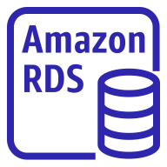
RDS – Storage Auto Scaling
Helps you increase storage on your RDS DB instance dynamically
When RDS detects you are running out of free database storage, it scales automatically
Avoid manually scaling your database storage
You have to set Maximum Storage Threshold (maximum limit for DB storage)
Automatically modify storage if:
Free storage is less than 10% of allocated storage
Low-storage lasts at least 5 minutes
6 hours have passed since last modification
Useful for applications with unpredictable workloads
Supports all RDS database engines (MariaDB,
MySQL, PostgreSQL, SQL Server, Oracle)
Application
Read/Write
Storage

Slide 8


RDS Read Replicas for read scalability
Up to 5 Read Replicas
Within AZ, Cross AZ or Cross Region
Replication is ASYNC, so reads are eventually consistent
Replicas can be promoted to their own DB
Applications must update the connection
string to leverage read replicas
Application
reads
writes
reads
reads
ASYNC
replication
ASYNC
replication
RDS DB
instance read replica
RDS DB
instance
RDS DB
instance read replica

Slide 9
RDS Read Replicas – Use Cases
You have a production database that is taking on normal load
You want to run a reporting application to run some analytics
You create a Read Replica to run the new workload there
The production application is unaffected
Read replicas are used for SELECT (=read) only kind of statements (not INSERT, UPDATE, DELETE)
Production
Application
Reporting Application
reads
reads
ASYNC
replication
RDS DB
instance
RDS DB
instance read replica

Slide 10
RDS Read Replicas – Network Cost
In AWS there’s a network cost when data goes from one AZ to another
For RDS Read Replicas within the same region, you don’t pay that fee
Region/AZ
us-east-1a
RDS DB
instance
Region/AZ
eu-west-1b
RDS DB
instance read replica
Same Region / Different AZ
us-east-1a us-eas1b
VS
ASYNC
Replication
ASYNC
Replication
RDS DB
instance
RDS DB
instance read replica
Same Region
Free
Cross-Region
$$$

Slide 11

RDS Multi AZ (Disaster Recovery)
SYNC replication
One DNS name – automatic app failover to standby
Increase availability
Failover in case of loss of AZ, loss of network, instance or storage failure
No manual intervention in apps
Not used for scaling
Multi-AZ replication is free
Note:The Read Replicas be setup as Multi AZ for Disaster Recovery (DR)
Application
writes
reads
One DNS name – automatic failover
SYNC
replication
RDS DB
instance standby (AZ B)
RDS Master DB instance (AZ A)

Slide 12

RDS – From Single-AZ to Multi-AZ
Zero downtime operation (no need to stop the DB)
Just click on “modify” for the database
The following happens internally:
A snapshot is taken
A new DB is restored from the snapshot in a new AZ
Synchronization is established between the two databases
RDS DB
instance
Standby DB
SYNC
Replication
snapshot
restore
DB snapshot

Slide 13
RDS Security - Encryption
At rest encryption
Possibility to encrypt the master & read replicas with AWS KMS - AES-256 encryption
Encryption has to be defined at launch time
If the master is not encrypted, the read replicas cannot be encrypted
Transparent Data Encryption (TDE) available for Oracle and SQL Server
In-flight encryption
SSL certificates to encrypt data to RDS in flight
Provide SSL options with trust certificate when connecting to database
To enforce SSL:
PostgreSQL: rds.force_ssl=1 in the AWS RDS Console (Parameter Groups)
MySQL: Within the DB:
GRANT USAGE ON *.* TO 'mysqluser'@'%' REQUIRE SSL;

Slide 14
RDS Encryption Operations
Encrypting RDS backups
Snapshots of un-encrypted RDS databases are un-encrypted
Snapshots of encrypted RDS databases are encrypted
Can copy a snapshot into an encrypted one
To encrypt an un-encrypted RDS database:
Create a snapshot of the un-encrypted database
Copy the snapshot and enable encryption for the snapshot
Restore the database from the encrypted snapshot
Migrate applications to the new database, and delete the old database

Slide 15
RDS Security – Network & IAM
Network Security
RDS databases are usually deployed within a private subnet, not in a public one
RDS security works by leveraging security groups (the same concept as for EC2 instances) – it controls which IP / security group can communicate with RDS
Access Management
IAM policies help control who can manage AWS RDS (through the RDS API)
Traditional Username and Password can be used to login into the database
IAM-based authentication can be used to login into RDS MySQL & PostgreSQL

Slide 16


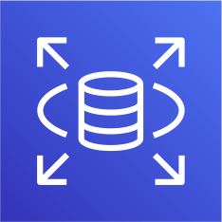

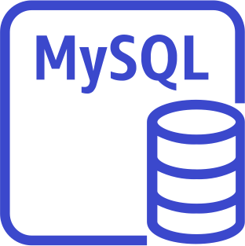
RDS - IAM Authentication
IAM database authentication works with
MySQL and PostgreSQL
You don’t need a password, just an
authentication token obtained through IAM & RDS API calls
Auth token has a lifetime of 15 minutes
EC2 Security group
IAM Role
RDS Service
API Call
Get Auth Token
EC2
SSL encryption Pass Auth Token
Benefits:
Network in/out must be encrypted using SSL
IAM to centrally manage users instead of DB
Can leverage IAM Roles and EC2 Instance profiles for easy integration
RDS Security group

Slide 17
RDS Security – Summary
Encryption at rest:
Is done only when you first create the DB instance
or: unencrypted DB => snapshot => copy snapshot as encrypted => create DB from snapshot
Your responsibility:
Check the ports / IP / security group inbound rules in DB’s SG
In-database user creation and permissions or manage through IAM
Creating a database with or without public access
Ensure parameter groups or DB is configured to only allow SSL connections
AWS responsibility:
No SSH access
No manual DB patching
No manual OS patching
No way to audit the underlying instance

Slide 18
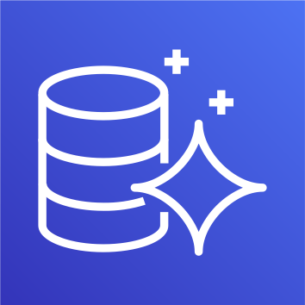
Amazon Aurora
Aurora is a proprietary technology from AWS (not open sourced)
Postgres and MySQL are both supported as Aurora DB (that means your drivers will work as if Aurora was a Postgres or MySQL database)
Aurora is “AWS cloud optimized” and claims 5x performance improvement over MySQL on RDS, over 3x the performance of Postgres on RDS
Aurora storage automatically grows in increments of 10GB, up to 64 TB.
Aurora can have 15 replicas while MySQL has 5, and the replication process is faster (sub 10 ms replica lag)
Failover in Aurora is instantaneous. It’s HA (High Availability) native.
Aurora costs more than RDS (20% more) – but is more efficient

Slide 19
Aurora High Availability and Read Scaling
6 copies of your data across 3 AZ:
4 copies out of 6 needed for writes
3 copies out of 6 need for reads
Self healing with peer-to-peer replication
Storage is striped across 100s of volumes
One Aurora Instance takes writes (master)
Automated failover for master in less than 30 seconds
Master + up to 15 Aurora Read Replicas serve reads
Support for Cross Region Replication
AZ 1 W _{R} | AZ 2 R R | AZ 3 R R
Sha Replication + | red storage Volume Self Healing + Aut | o Expanding

Slide 20

Aurora DB Cluster
client
Writer Endpoint
Pointing to the master
Reader Endpoint
Connection Load Balancing
Auto Scaling
W
R
R R R
Shared storage Volume
Auto Expanding from 10G to 64 TB
R

Slide 21
Features of Aurora
Automatic fail-over
Backup and Recovery
Isolation and security
Industry compliance
Push-button scaling
Automated Patching with Zero Downtime
Advanced Monitoring
Routine Maintenance
Backtrack: restore data at any point of time without using backups

Slide 22
Aurora Security
Similar to RDS because uses the same engines
Encryption at rest using KMS
Automated backups, snapshots and replicas are also encrypted
Encryption in flight using SSL (same process as MySQL or Postgres)
Possibility to authenticate using IAM token (same method as RDS)
You are responsible for protecting the instance with security groups
You can’t SSH

Slide 23
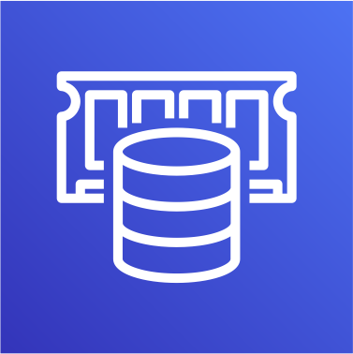
Amazon ElastiCache Overview
The same way RDS is to get managed Relational Databases…
ElastiCache is to get managed Redis or Memcached
Caches are in-memory databases with really high performance, low latency
Helps reduce load off of databases for read intensive workloads
Helps make your application stateless
AWS takes care of OS maintenance / patching, optimizations, setup, configuration, monitoring, failure recovery and backups
Using ElastiCache involves heavy application code changes

Slide 24
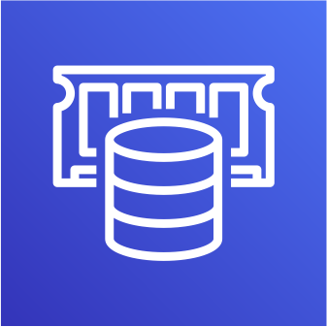
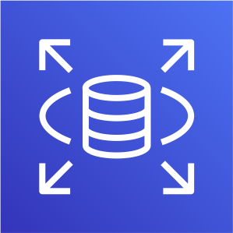
ElastiCache
Solution Architecture - DB Cache
Applications queries ElastiCache, if not
Amazon ElastiCache
available, get from RDS and store in ElastiCache.
Helps relieve load in RDS
Cache must have an invalidation strategy to make sure only the most current data is used in there.
application
Cache hit
Cache miss
Read from DB
Write to cache
Amazon RDS

Slide 25
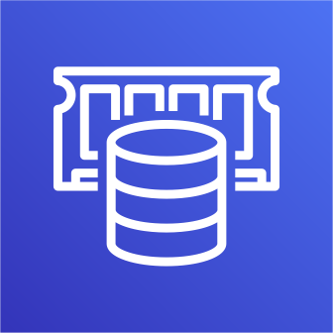
ElastiCache
Solution Architecture – User Session Store
User logs into any of the application
The application writes the session data into ElastiCache
The user hits another instance of our application
The instance retrieves the data and the user is already logged in
User
application
Write session
Amazon ElastiCache
application
Retrieve session
application

Slide 26
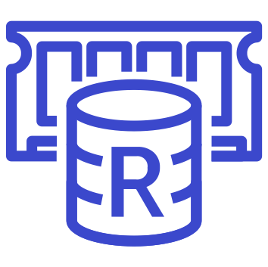
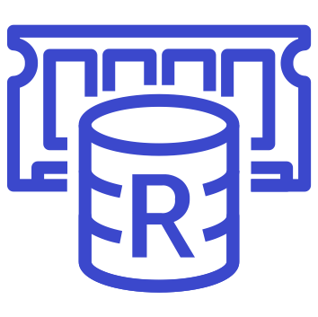


ElastiCache – Redis vs Memcached
REDIS
Multi AZ with Auto-Failover
Read Replicas to scale reads and have high availability
Data Durability using AOF persistence
Backup and restore features
MEMCACHED
Multi-node for partitioning of data (sharding)
No high availability (replication)
Non persistent
No backup and restore
Multi-threaded architecture
+
Replication
sharding

Slide 27


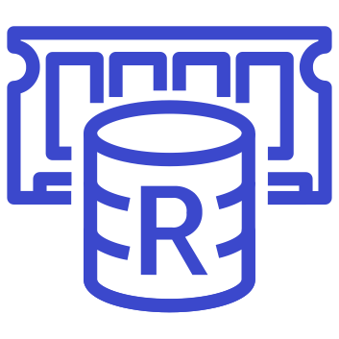
ElastiCache – Cache Security
All caches in ElastiCache:
Do not support IAM authentication
IAM policies on ElastiCache are only used for AWS API-level security
Redis AUTH
You can set a “password/token” when you create a Redis cluster
This is an extra level of security for your cache (on top of security groups)
Support SSL in flight encryption
Memcached
Supports SASL-based authentication (advanced)
EC2 Security group
EC2
Client
SSL encryption Redis AUTH
Redis Security group

Slide 28
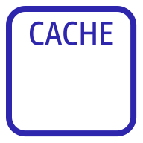
ElastiCache Replication: Cluster Mode Disabled
One primary node, up to 5 replicas
Asynchronous Replication
The primary node is used for read/write
The other nodes are read-only
One shard, all nodes have all the data
Guard against data loss if node failure
Multi-AZ enabled by default for failover
Helpful to scale read performance
Redis (cluster mode disabled) Cluster
with Replication
Shard
Primary Node
…
0-5 Replica Nodes

Slide 29
ElastiCache Replication: Cluster Mode Enabled
Redis (cluster mode enabled) Cluster with Replication
Data is partitioned across shards (helpful to scale writes)
Each shard has a primary and up to 5 replica nodes (same concept as before)
Multi-AZ capability
Availability Zone
Availability Zone
Shard 1
Primary Node
…
0-5 Replica Nodes
Up to 500 nodes per cluster:
500 shards with single master
250 shards with 1 master and 1 replica
…
83 shards with one master and 5 replicas
Shard N
Primary Node
…
0-5 Replica Nodes

Slide 30
Caching Implementation Considerations
Read more at: https://aws.amazon.com/caching/implementation- considerations/
Is it safe to cache data? Data may be out of date, eventually consistent
Is caching effective for that data?
Pattern: data changing slowly, few keys are frequently needed
Anti patterns: data changing rapidly, all large key space frequently needed
Is data structured well for caching?
example: key value caching, or caching of aggregations results
Which caching design pattern is the most appropriate?

Slide 31
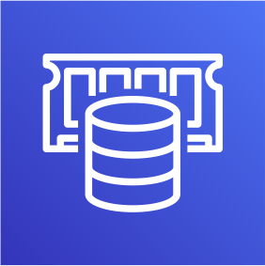
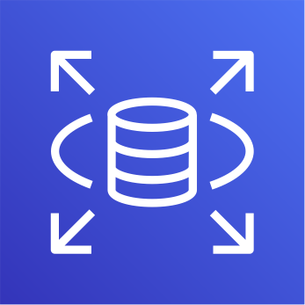
Lazy Loading / Cache-Aside / Lazy Population
Pros
Only requested data is cached (the cache isn’t filled up with unused data)
Node failures are not fatal (just increased latency to warm the cache)
Cons
Cache miss penalty that results in 3 round trips, noticeable delay for that request
Stale data: data can be updated in the database and outdated in the cache
Amazon ElastiCache
application
Cache hit
Cache miss
Read from DB
Write to cache
Amazon RDS

Slide 32
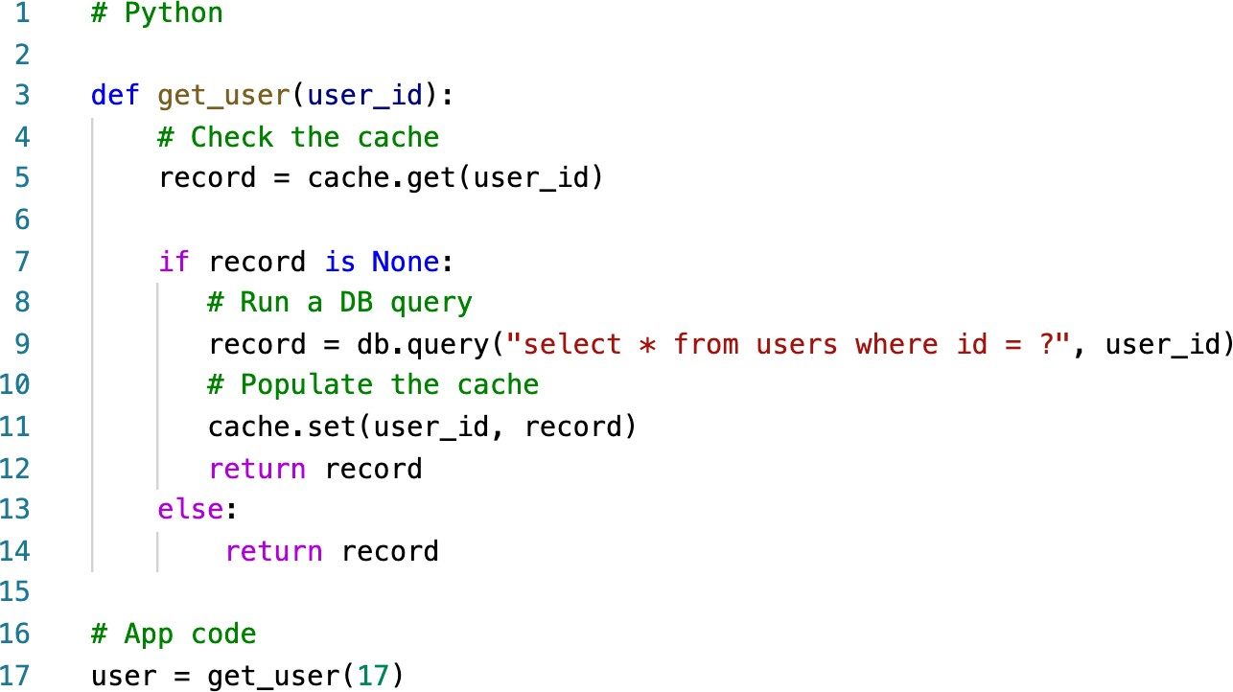
Lazy Loading / Cache-Aside / Lazy Population Python Pseudocode

Slide 33
Write Through –
Add or Update cache when database is updated
Pros:
Data in cache is never stale, reads are quick
Write penalty vs Read penalty (each write requires 2 calls)
Cons:
Missing Data until it is added / updated in the DB. Mitigation is to implement Lazy Loading strategy as well
Cache churn – a lot of the data will never be read
Amazon ElastiCache
application
Cache hit
1) Write to DB
2) Write to cache
Amazon RDS

Slide 34
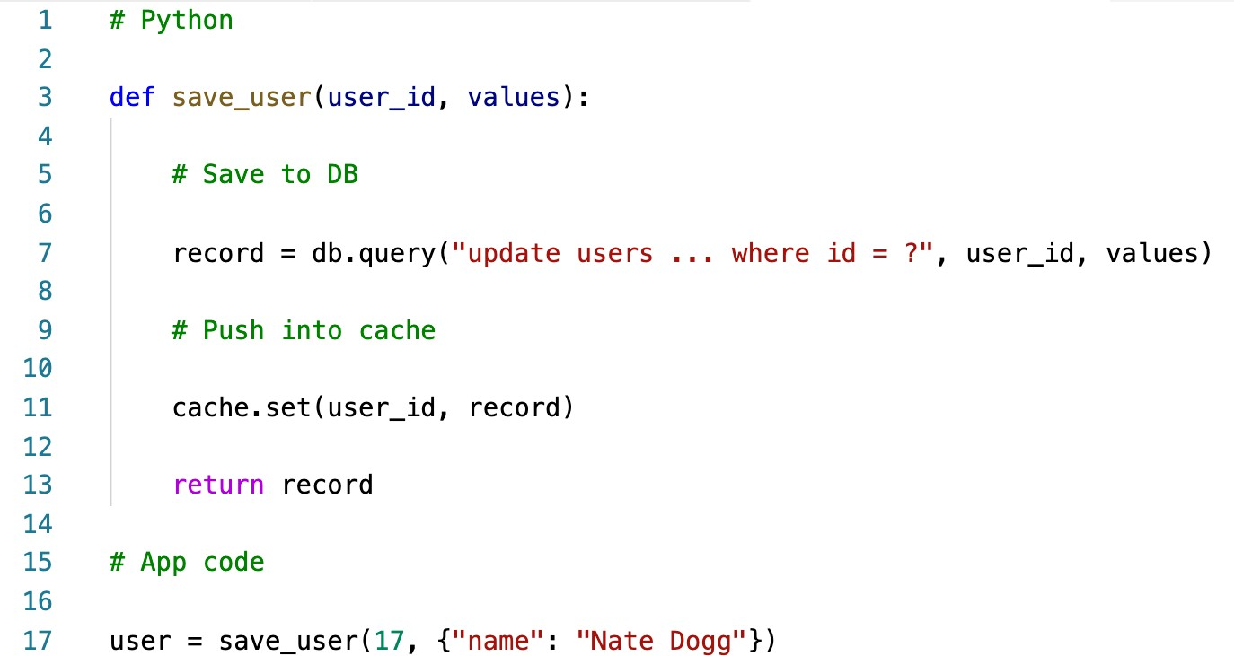
Write-Through Python Pseudocode

Slide 35
Cache Evictions and Time-to-live (TTL)
Cache eviction can occur in three ways:
You delete the item explicitly in the cache
Item is evicted because the memory is full and it’s not recently used (LRU)
You set an item time-to-live (or TTL)
TTL are helpful for any kind of data:
Leaderboards
Comments
Activity streams
TTL can range from few seconds to hours or days
If too many evictions happen due to memory, you should scale up or out

Slide 36
Final words of wisdom
Lazy Loading / Cache aside is easy to implement and works for many situations as a foundation, especially on the read side
Write-through is usually combined with Lazy Loading as targeted for the queries or workloads that benefit from this optimization
Setting a TTL is usually not a bad idea, except when you’re using Write- through. Set it to a sensible value for your application
Only cache the data that makes sense (user profiles, blogs, etc…)
Quote: There are only two hard things in Computer Science: cache invalidation and naming things

