Slide 1
Amazon Elastic Block Store (Amazon EBS)
Amazon Elastic Block Store (Amazon EBS) provides block level storage volumes for use with EC2 instances. EBS volumes behave like raw, unformatted block devices. You can mount these volumes as devices on your instances. EBS volumes that are attached to an instance are exposed as storage volumes that persist independently from the life of the instance. You can create a file system on top of these volumes, or use them in any way you would use a block device (such as a hard drive). You can dynamically change the configuration of a volume attached to an instance. We recommend Amazon EBS for data that must be quickly accessible and requires long-term persistence. EBS volumes are particularly well-suited for use as the primary storage for file systems, databases, or for any applications that require fine granular updates and access to raw, unformatted, block-level storage. Amazon EBS is well suited to both database-style applications that rely on random reads and writes, and to throughput-intensive applications that perform long, continuous reads and writes.
An EBS (Elastic Block Store) Volume is a network drive you can attach to your instances while they run
It allows your instances to persist data, even after their termination
They can only be mounted to one instance at a time (at the CCP level)
They are bound to a specific availability zone
Analogy : Think of them as a “network USB stick”
Free tier: 30 GB of free EBS storage of type General Purpose (SSD) or Magnetic per month

Slide 2
Features of Amazon EBS
You create an EBS volume in a specific Availability Zone, and then attach it to an instance in that same Availability Zone. To make a volume available outside of the Availability Zone, you can create a snapshot and restore that snapshot to a new volume anywhere in that Region. You can copy snapshots to other Regions and then restore them to new volumes there, making it easier to leverage multiple AWS Regions for geographical expansion, data center migration, and disaster recovery.
Amazon EBS provides the following volume types: General Purpose SSD, Provisioned IOPS SSD, Throughput Optimized HDD, and Cold HDD. For more information, see EBS volume types. The following is a summary of performance and use cases for each volume type.
General Purpose SSD volumes (gp2 and gp3) balance price and performance for a wide variety of transactional workloads. These volumes are ideal for use cases such as boot volumes, medium-size single instance databases, and development and test environments.
Provisioned IOPS SSD volumes (io1 and io2) support up to 64,000 IOPS and 1,000 MiB/s of throughput. This enables you to predictably scale to tens of thousands of IOPS per EC2 instance.
Throughput Optimized HDD volumes (st1) provide low-cost magnetic storage that defines performance in terms of throughput rather than IOPS. These volumes are ideal for large, sequential workloads such as Amazon EMR, ETL, data warehouses, and log processing.
Cold HDD volumes (sc1) provide low-cost magnetic storage that defines performance in terms of throughput rather than IOPS. These volumes are ideal for large, sequential, cold-data workloads. If you require infrequent access to your data and are looking to save costs, these volumes provides inexpensive block storage.

Slide 3
You can create your EBS volumes as encrypted volumes, in order to meet a wide range of data-at-rest encryption requirements for regulated/audited data and applications. When you create an encrypted EBS volume and attach it to a supported instance type, data stored at rest on the volume, disk I/O, and snapshots created from the volume are all encrypted.
You can create point-in-time snapshots of EBS volumes, which are persisted to Amazon S3. Snapshots protect data for long-term durability, and they can be used as the starting point for new EBS volumes. The same snapshot can be used to instantiate as many volumes as you wish. These snapshots can be copied across AWS Regions.
Performance metrics, such as bandwidth, throughput, latency, and average queue length, are available through the AWS Management Console. These metrics, provided by Amazon CloudWatch, allow you to monitor the performance of your volumes to make sure that you are providing enough performance for your applications without paying for resources you don't need.

Slide 4

EC2 Instance Store
EBS volumes are network drives with good but “limited” performance
If you need a high-performance hardware disk, use EC2 Instance Store
Better I/O performance
EC2 Instance Store lose their storage if they’re stopped (ephemeral)
Good for buffer / cache / scratch data / temporary content
Risk of data loss if hardware fails
Backups and Replication are your responsibility

Slide 5
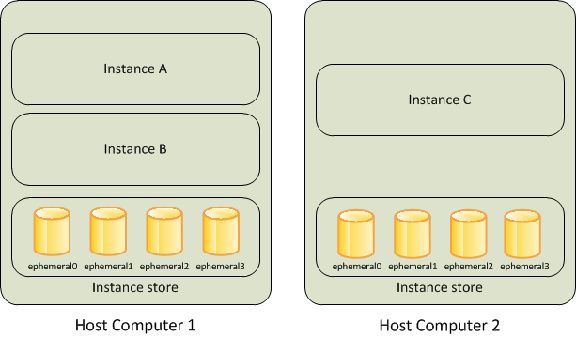
An instance store provides temporary block-level storage for your instance. This storage is located on disks that are physically attached to the host computer. Instance store is ideal for temporary storage of information that changes frequently, such as buffers, caches, scratch data, and other temporary content, or for data that is replicated across a fleet of instances, such as a load-balanced pool of web servers. An instance store consists of one or more instance store volumes exposed as block devices. The size of an instance store as well as the number of devices available varies by instance type.

Slide 6
Instance store lifetime
You can specify instance store volumes for an instance only when you launch it. You can't detach an instance store volume from one instance and attach it to a different instance. The data in an instance store persists only during the lifetime of its associated instance. If an instance reboots (intentionally or unintentionally), data in the instance store persists. However, data in the instance store is lost under any of the following circumstances:
The underlying disk drive fails
The instance stops
The instance hibernates
The instance terminates
Therefore, do not rely on instance store for valuable, long-term data. Instead, use more durable data storage, such as Amazon S3, Amazon EBS, or Amazon EFS. When you stop, hibernate, or terminate an instance, every block of storage in the instance store is reset. Therefore, your data cannot be accessed through the instance store of another instance. If you create an AMI from an instance, the data on its instance store volumes isn't preserved and isn't present on the instance store volumes of the instances that you launch from the AMI. If you change the instance type, an instance store will not be attached to the new instance type.

Slide 7
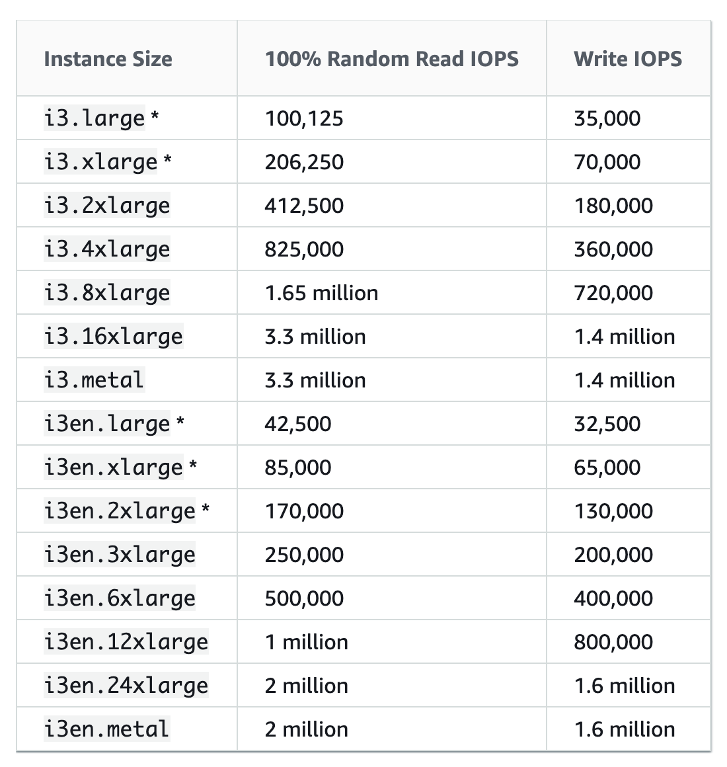
Local EC2 Instance Store
Very high IOPS

Slide 8
EBS Volume Types
EBS Volumes come in 6 types
gp2 / gp3 (SSD): General purpose SSD volume that balances price and performance for a wide variety of workloads
io1 / io2 (SSD): Highest-performance SSD volume for mission-critical low-latency or high-throughput workloads
st1 (HDD): Low cost HDD volume designed for frequently accessed, throughput- intensive workloads
sc1 (HDD): Lowest cost HDD volume designed for less frequently accessed workloads
EBS Volumes are characterized in Size | Throughput | IOPS (I/O Ops Per Sec)
When in doubt always consult the AWS documentation – it’s good!
Only gp2/gp3 and io1/io2 can be used as boot volumes

Slide 9
EBS Volume Types Use cases General Purpose SSD
Cost effective storage, low-latency
System boot volumes,Virtual desktops, Development and test environments
1 GiB - 16 TiB
gp3:
Baseline of 3,000 IOPS and throughput of 125 MiB/s
Can increase IOPS up to 16,000 and throughput up to 1000 MiB/s independently
gp2:
Small gp2 volumes can burst IOPS to 3,000
Size of the volume and IOPS are linked, max IOPS is 16,000
3 IOPS per GB, means at 5,334 GB we are at the max IOPS

Slide 10
EBS Volume Types Use cases Provisioned IOPS (PIOPS) SSD
Critical business applications with sustained IOPS performance
Or applications that need more than 16,000 IOPS
Great for databases workloads (sensitive to storage perf and consistency)
io1/io2 (4 GiB - 16 TiB):
Max PIOPS: 64,000 for Nitro EC2 instances & 32,000 for other
Can increase PIOPS independently from storage size
io2 have more durability and more IOPS per GiB (at the same price as io1)
io2 Block Express (4 GiB – 64 TiB):
Sub-millisecond latency
Max PIOPS: 256,000 with an IOPS:GiB ratio of 1,000:1
Supports EBS Multi-attach

Slide 11
EBS Volume Types Use cases Hard Disk Drives (HDD)
Cannot be a boot volume
125 MiB to 16 TiB
Throughput Optimized HDD (st1)
Big Data, Data Warehouses, Log Processing
Max throughput 500 MiB/s – max IOPS 500
Cold HDD (sc1):
For data that is infrequently accessed
Scenarios where lowest cost is important
Max throughput 250 MiB/s – max IOPS 250

Slide 12
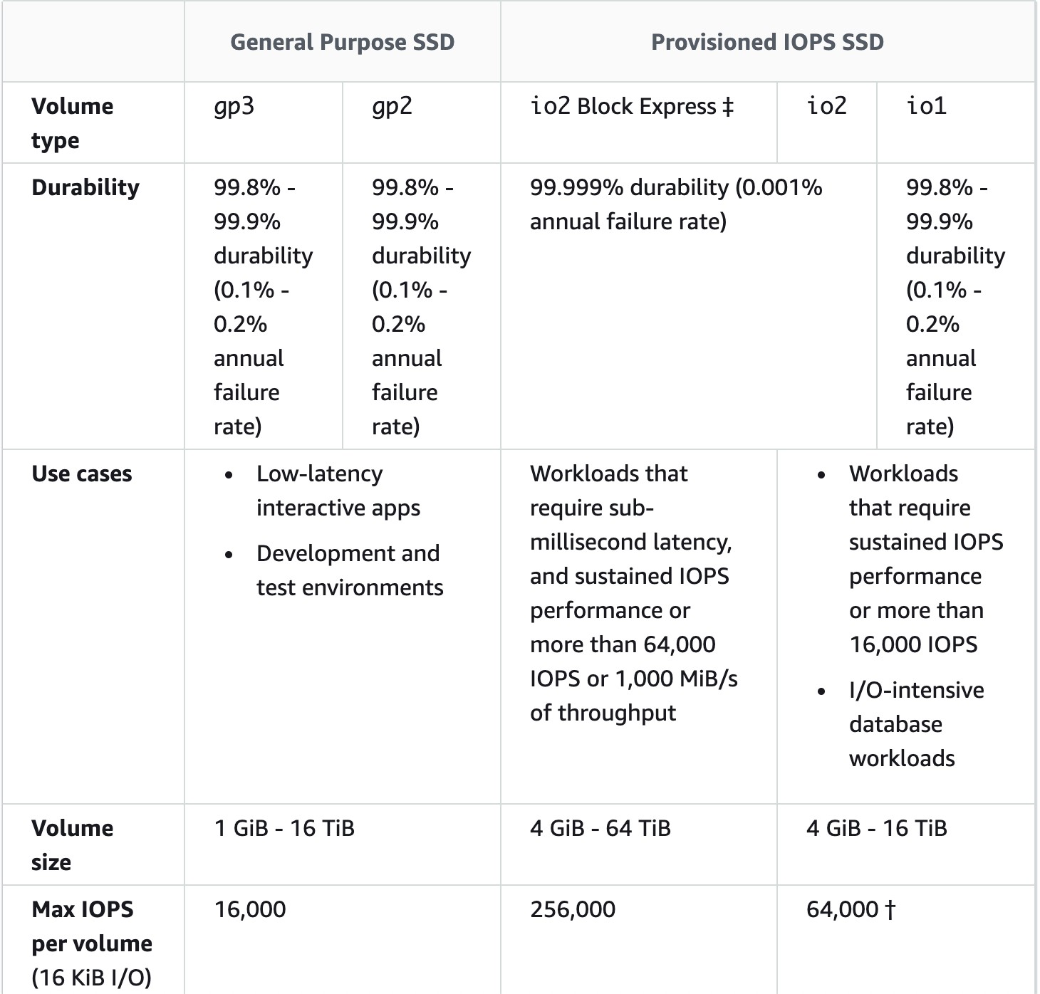
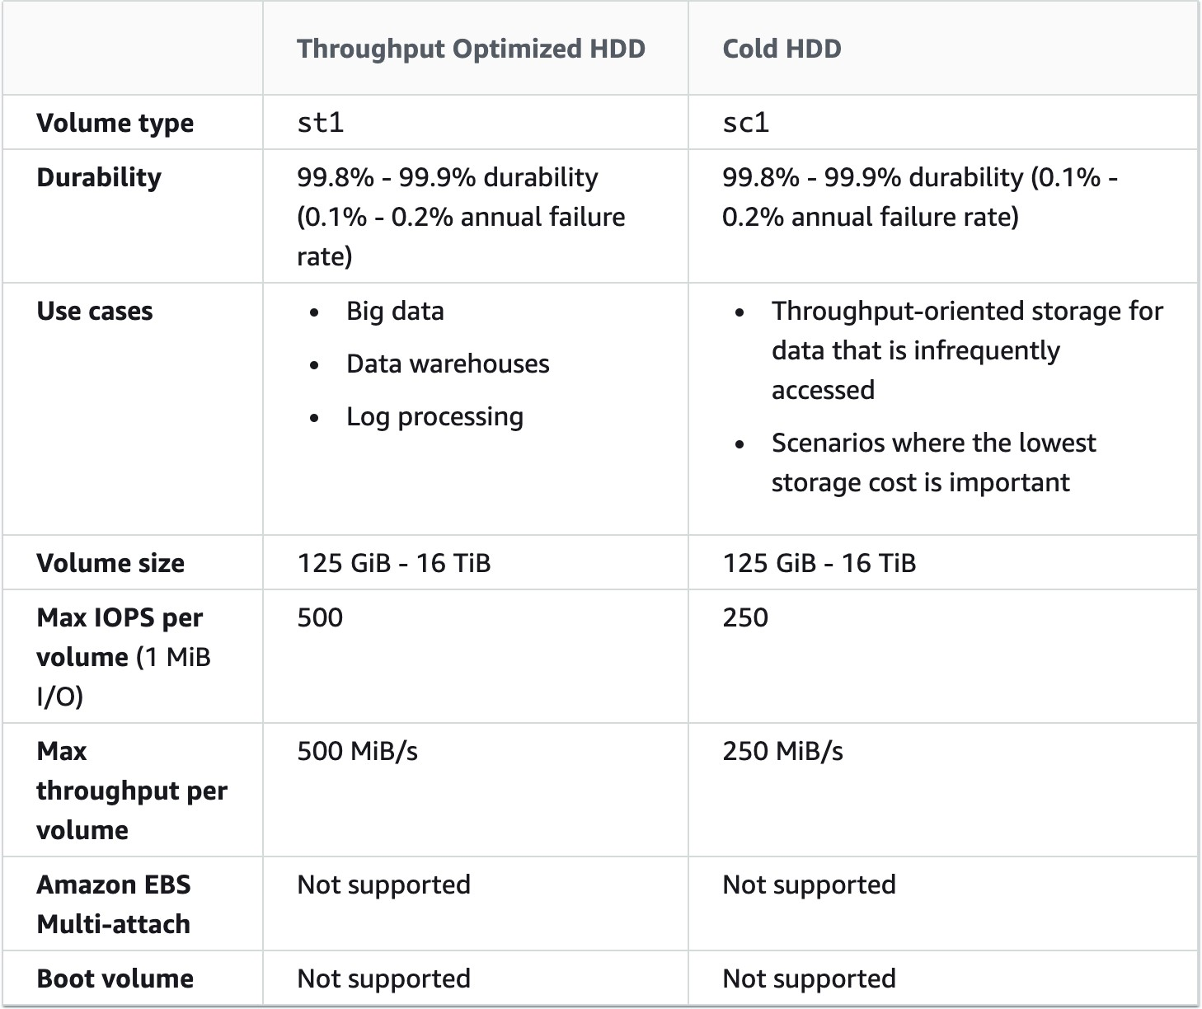
EBS – Volume Types Summary
https://docs.aws.amazon.com/AWSEC2/latest/UserGuide/ebs-volume-types.html#solid-state-drives

Slide 13








EBS Volume - Example
US-EAST-1A
US-EAST-1B
EBS (10 GB)
EBS (100 GB)
EBS (50 GB)
EBS (50 GB)
EBS (10 GB)
unattached

Slide 14
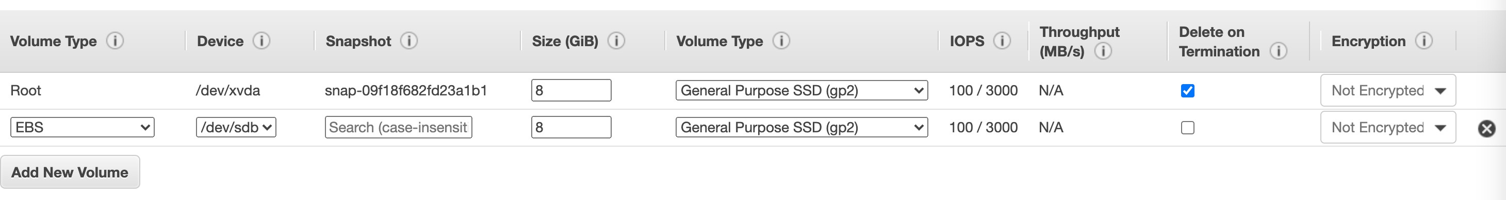
EBS – Delete on Termination attribute
Controls the EBS behaviour when an EC2 instance terminates
By default, the root EBS volume is deleted (attribute enabled)
By default, any other attached EBS volume is not deleted (attribute disabled)
This can be controlled by the AWS console / AWS CLI
Use case: preserve root volume when instance is terminated

Slide 15





EBS Snapshots
Make a backup (snapshot) of your EBS volume at a point in time
Not necessary to detach volume to do snapshot, but recommended
Can copy snapshots across AZ or Region
US-EAST-1A
US-EAST-1B
EBS Snapshot
EBS (50 GB)
snapshot
restore
EBS (50 GB)

Slide 16
Amazon Elastic File System (Amazon EFS)
Amazon Elastic File System (Amazon EFS) provides a simple, serverless, set-and-forget, elastic file system that lets you share file data without provisioning or managing storage. It can be used with AWS Cloud services and on-premises resources, and is built to scale on demand to petabytes without disrupting applications. With Amazon EFS, you can grow and shrink your file systems automatically as you add and remove files, eliminating the need to provision and manage capacity to accommodate growth.
Amazon EFS offers you the choice of creating file systems using Standard or One Zone storage classes. Standard storage classes store data within and across multiple availability zones (AZ). One Zone storage classes store data redundantly within a single AZ, at a 47% lower price compared to file systems using Standard storage classes, for workloads that don’t require multi-AZ resilience.
Amazon EFS offers four storage classes: two Standard storage classes, Amazon EFS Standard and Amazon EFS Standard-Infrequent Access (EFS Standard-IA), and two One Zone storage classes, Amazon EFS One Zone, and Amazon EFS One Zone-Infrequent Access (EFS One Zone-IA).
While workload patterns vary, customers typically find that 80% of files are infrequently accessed (and suitable for infrequent access storage classes), and 20% are actively used (suitable for EFS Standard and EFS One Zone storage classes), resulting in an effective storage cost as low as $0.043/GB-month¹ for file systems with One Zone storage classes, and $0.08/GB-month² for file systems with Standard storage classes. Amazon EFS transparently serves files from both frequently accessed and infrequent accessed storage classes in a common file system namespace.
Amazon EFS is designed to provide massively parallel shared access to thousands of Amazon EC2 instances, and AWS containers and serverless compute services including Amazon Elastic Container Service (ECS), Amazon Elastic Kubernetes Service (EKS), AWS Fargate, and AWS Lambda, enabling your applications to achieve high levels of aggregate throughput and IOPS with consistent low latencies.

Slide 17
EFS – Elastic File System
Managed NFS (network file system) that can be mounted on many EC2
EFS works with EC2 instances in multi-AZ
Highly available, scalable, expensive (3x gp2), pay per use
EC2
us-east-1a
EC2
us-east-1b
EC2
us-east-1c
Security Group
EFS

Slide 18
EFS – Elastic File System
Use cases: content management, web serving, data sharing, Wordpress
Uses NFSv4.1 protocol
Uses security group to control access to EFS
Compatible with Linux based AMI (not Windows)
Encryption at rest using KMS
POSIX file system (~Linux) that has a standard file API
File system scales automatically, pay-per-use, no capacity planning!

Slide 19
EFS – Performance & Storage Classes
EFS Scale
1000s of concurrent NFS clients, 10 GB+ /s throughput
Grow to Petabyte-scale network file system, automatically
Performance mode (set at EFS creation time)
General purpose (default): latency-sensitive use cases (web server, CMS, etc…)
Max I/O – higher latency, throughput, highly parallel (big data, media processing)
Throughput mode
Bursting (1 TB = 50MiB/s + burst of up to 100MiB/s)
Provisioned: set your throughput regardless of storage size, ex: 1 GiB/s for 1 TB storage
Storage Tiers (lifecycle management feature – move file after N days)
Standard: for frequently accessed files
Infrequent access (EFS-IA): cost to retrieve files, lower price to store

Slide 20




EBS vs EFS – Elastic Block Storage
EBS volumes…
can be attached to only one instance at a time
are locked at the Availability Zone (AZ) level
gp2: IO increases if the disk size increases
io1: can increase IO independently
To migrate an EBS volume across AZ
Take a snapshot
Restore the snapshot to another AZ
EBS backups use IO and you shouldn’t run them while your application is handling a lot of traffic
Root EBS Volumes of instances get terminated by default if the EC2 instance gets terminated. (you can disable that)
Availability Zone 1
EBS
Availability Zone 2
EBS
snapshot
restore
EBS Snapshot

Slide 21




EBS vs EFS – Elastic File System
Mounting 100s of instances across AZ
EFS share website files (WordPress)
Only for Linux Instances (POSIX)
Availability Zone 1
Availability Zone 2
Linux
EFS
Mount
Target
Linux
EFS has a higher price point than EBS
Can leverage EFS-IA for cost savings
EFS
Mount
Target
Remember: EFS vs EBS vs Instance Store
EFS

