Slide 1
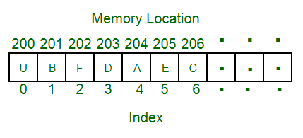
Arrays
An array is a collection of items stored at contiguous memory locations. The idea is to store multiple items of the same type together. This makes it easier to calculate the position of each element by simply adding an offset to a base value, i.e., the memory location of the first element of the array (generally denoted by the name of the array).
The above image can be looked as a top-level view of a staircase where you are at the base of the staircase. Each element can be uniquely identified by their index in the array (in a similar way as you could identify your friends by the step on which they were on in the above example).

Slide 2
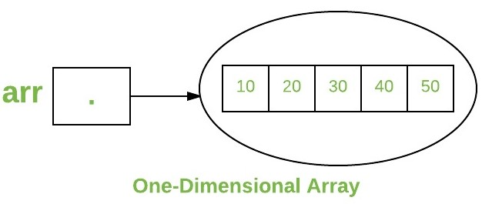
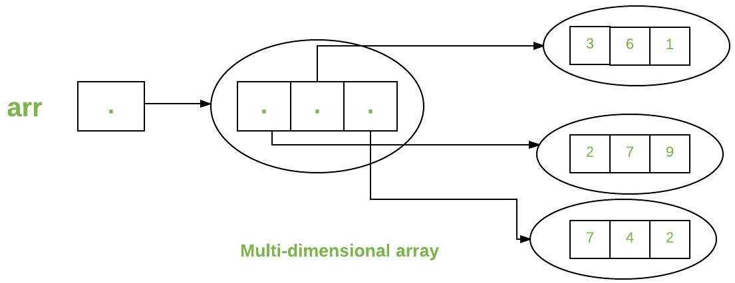
Arrays

Slide 3
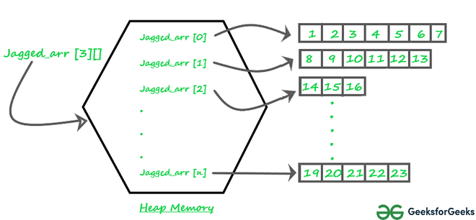
Jagged Arrays In JAVA
A jagged array is an array of arrays such that member arrays can be of different sizes, i.e., we can create a 2-D array but with a variable number of columns in each row. These types of arrays are also known as Jagged arrays.

Slide 4
Jagged Arrays In JAVA
Declaration and Initialization of Jagged array :
Syntax: data_type array_name[][] = new data_type[n][]; //n: no. of rows
array_name[] = new data_type[n1] //n1= no. of colmuns in row-1
array_name[] = new data_type[n2] //n2= no. of colmuns in row-2
array_name[] = new data_type[n3] //n3= no. of colmuns in row-3
.
.
.
array_name[] = new data_type[nk] //nk=no. of colmuns in row-n

Slide 5
Jagged Arrays In JAVA
Alternative, ways to Initialize a Jagged array :
int arr_name[][] = new int[][] { new int[] {10, 20, 30 ,40}, new int[] {50, 60, 70, 80, 90, 100},
new int[] {110, 120}
};
OR
int[][] arr_name = {
new int[] {10, 20, 30 ,40}, new int[] {50, 60, 70, 80, 90, 100}, new int[] {110, 120}
};
OR
int[][] arr_name = { {10, 20, 30 ,40}, {50, 60, 70, 80, 90, 100}, {110, 120}
};

Slide 6
1.Program for Array Rotation
METHOD 1 (Using temp array)
Input arr[] = [1, 2, 3, 4, 5, 6, 7], d = 2, n =7
1) Store the first d elements in a temp array
temp[] = [1, 2]
2) Shift rest of the arr[]
arr[] = [3, 4, 5, 6, 7, 6, 7]
3) Store back the d elements
arr[] = [3, 4, 5, 6, 7, 1, 2]
Time complexity : O(n)
Auxiliary Space : O(d)

Slide 7
1.Program for Array Rotation
METHOD 2 (Rotate one by one)
leftRotate(arr[], d, n)
start
For i = 0 to i < d
Left rotate all elements of arr[] by one
end
Time complexity : O(n * d) Auxiliary Space : O(1)

Slide 8
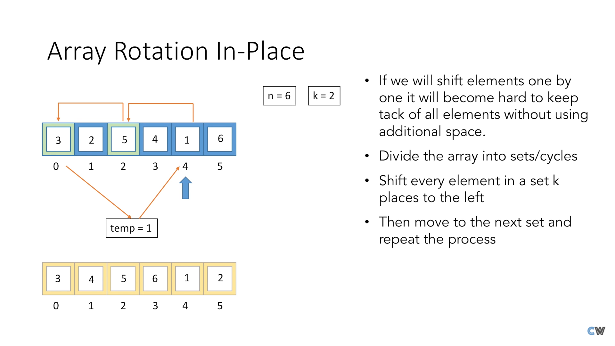
1.Program for Array Rotation
METHOD 3 (A Juggling Algorithm)
Time complexity : O(n) Auxiliary Space : O(1)

Slide 9
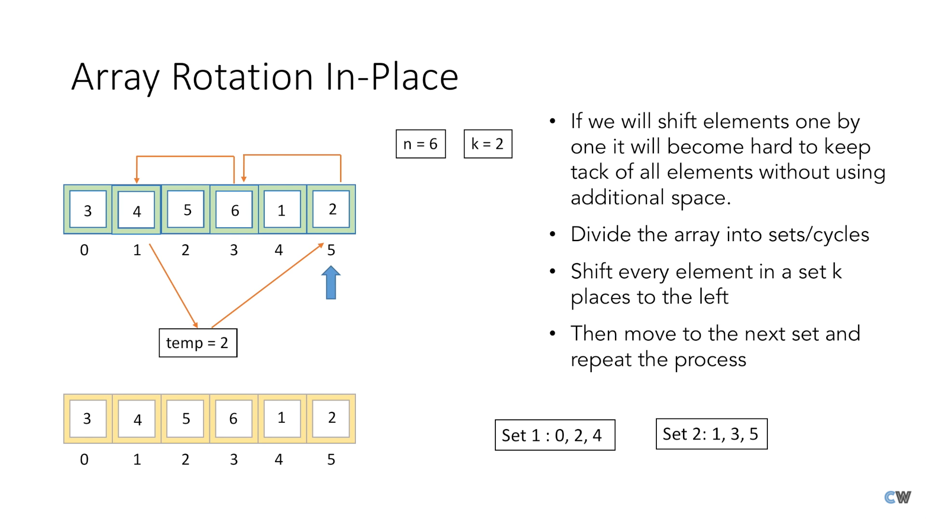
1.Program for Array Rotation
METHOD 3 (A Juggling Algorithm)

Slide 10
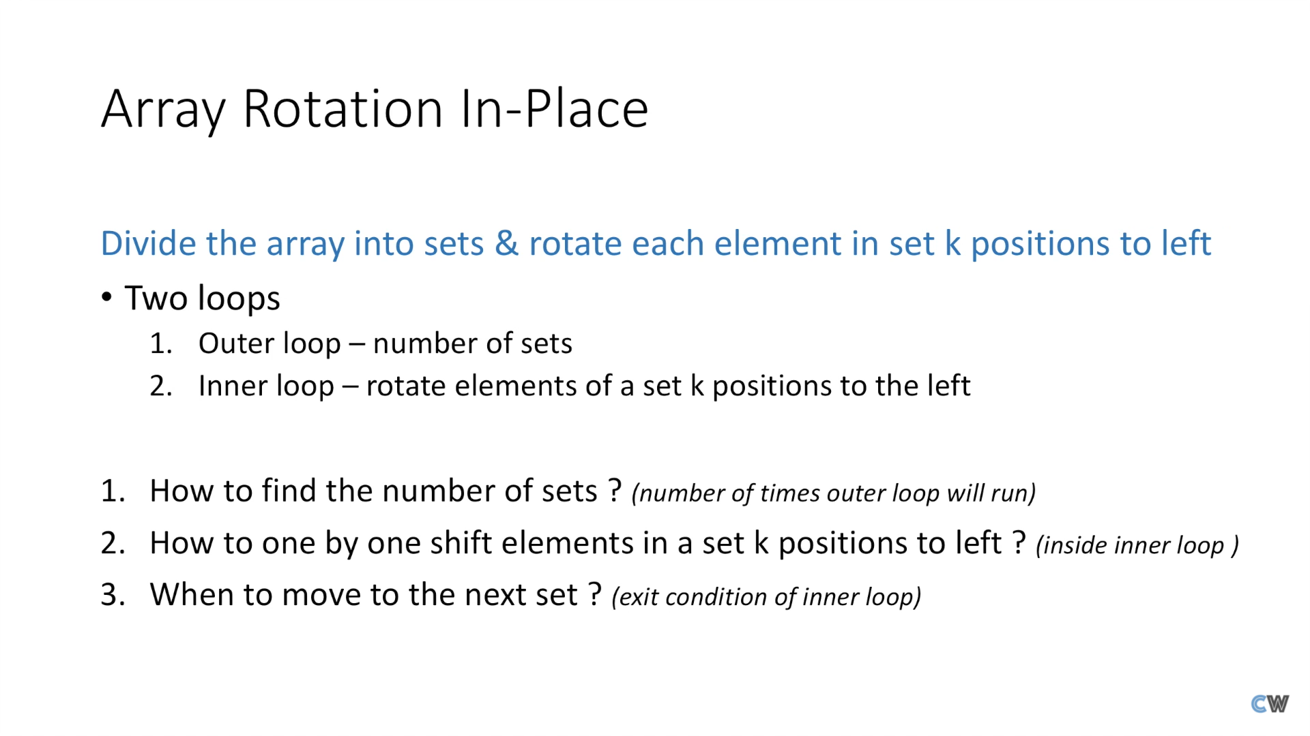
1.Program for Array Rotation
METHOD 3 (A Juggling Algorithm)

Slide 11
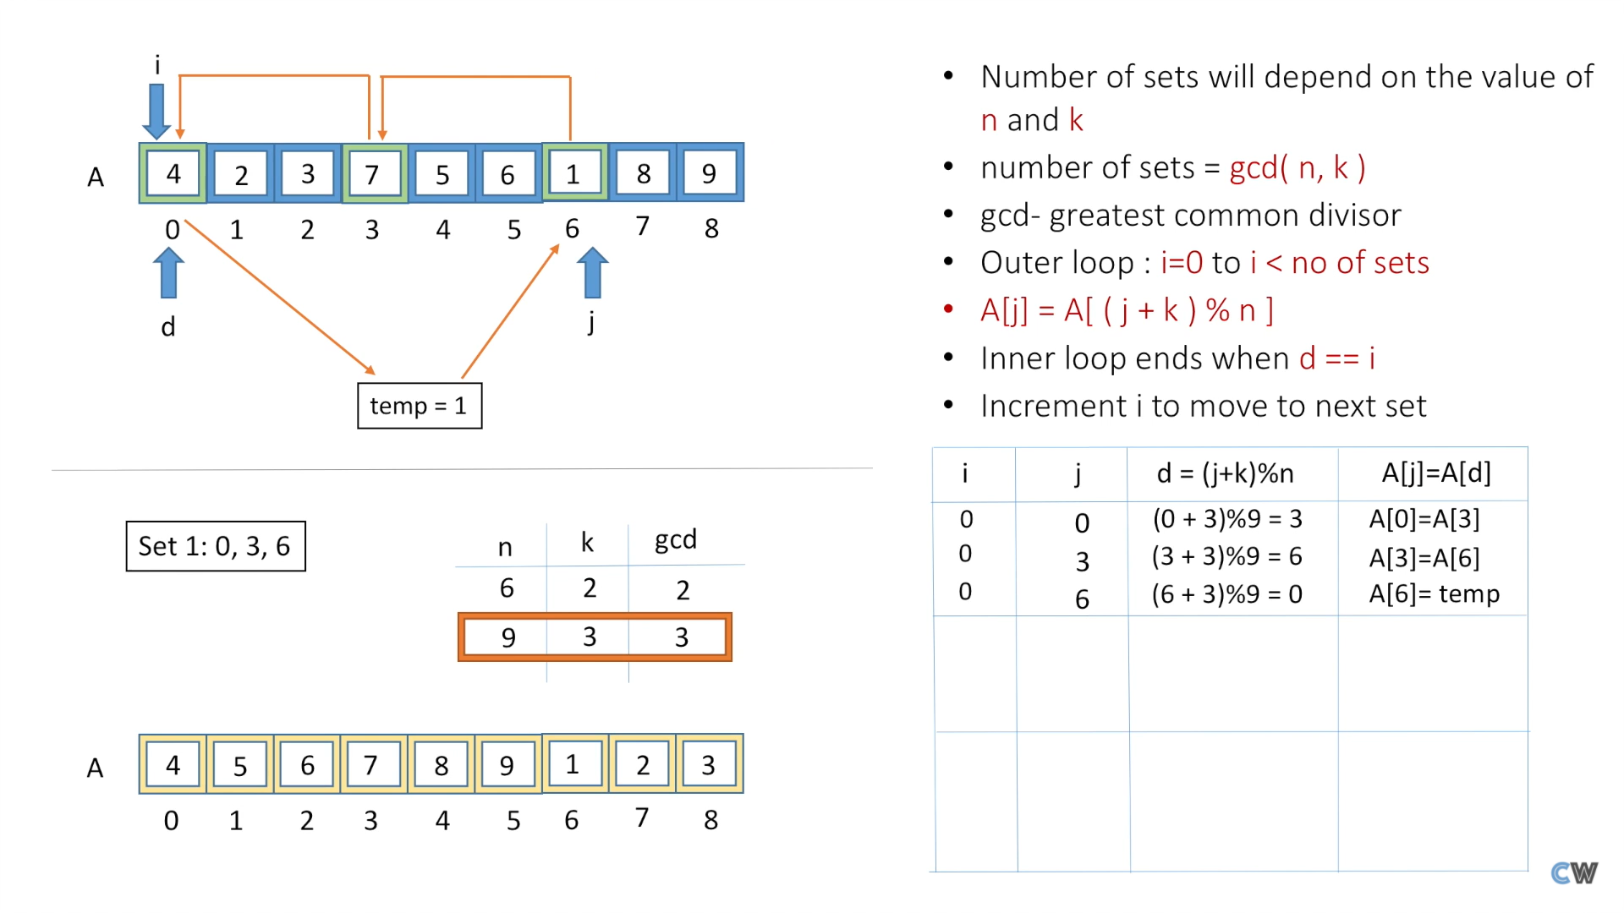
1.Program for Array Rotation
METHOD 3 (A Juggling Algorithm)

Slide 12
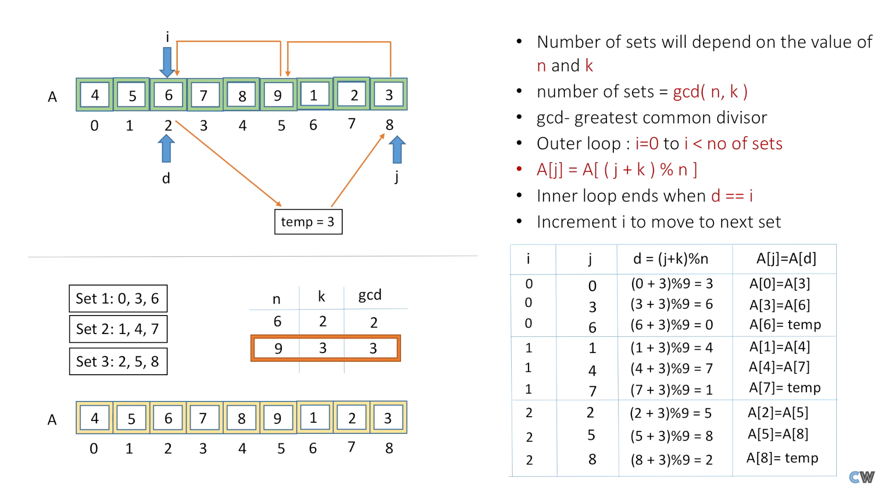
1.Program for Array Rotation
METHOD 3 (A Juggling Algorithm)

Slide 13
1.Program for Array Rotation
Method 4 (The Reversal Algorithm) :
Algorithm :
rotate(arr[], d, n)
reverse(arr[], 1, d) ;
reverse(arr[], d + 1, n);
reverse(arr[], 1, n);
Let AB are the two parts of the input array where A = arr[0..d-1] and B = arr[d..n-1]. The idea of the algorithm is :
Reverse A to get ArB, where Ar is reverse of A.
Reverse B to get ArBr, where Br is reverse of B.
Reverse all to get (ArBr) r = BA.
Example :
Let the array be arr[] = [1, 2, 3, 4, 5, 6, 7], d =2 and n = 7
A = [1, 2] and B = [3, 4, 5, 6, 7]
Reverse A, we get ArB = [2, 1, 3, 4, 5, 6, 7]
Reverse B, we get ArBr = [2, 1, 7, 6, 5, 4, 3]
Reverse all, we get (ArBr)r = [3, 4, 5, 6, 7, 1, 2]

Slide 14
1.Program for Array Rotation
Block swap algorithm for array rotation

