Slide 1
LOAD BALANCING
A load balancer serves as the single point of contact for clients. Clients send requests to the load balancer, and the load balancer sends them to targets, such as EC2 instances. To configure your load balancer, you create target groups, and then register targets with your target groups. You also create listeners to check for connection requests from clients, and listener rules to route requests from clients to the targets in one or more target groups.
Load balancer state -
A load balancer can be in one of the following states:
provisioning
The load balancer is being set up.
active
The load balancer is fully set up and ready to route traffic.
active_impaired
The load balancer is routing traffic but does not have the resources it needs to scale.
failed
The load balancer could not be set up.

Slide 2
Connection idle timeout -
For each request that a client makes through a load balancer, the load balancer maintains two connections. The front-end connection is between a client and the load balancer. The back-end connection is between the load balancer and a target. The load balancer has a configured idle timeout period that applies to its connections. If no data has been sent or received by the time that the idle timeout period elapses, the load balancer closes the connection. To ensure that lengthy operations such as file uploads have time to complete, send at least 1 byte of data before each idle timeout period elapses, and increase the length of the idle timeout period as needed.
For back-end connections, we recommend that you enable the HTTP keep-alive option for your EC2 instances. You can enable HTTP keep-alive in the web server settings for your EC2 instances. If you enable HTTP keep-alive, the load balancer can reuse back-end connections until the keep-alive timeout expires. We also recommend that you configure the idle timeout of your application to be larger than the idle timeout configured for the load balancer.
By default, Elastic Load Balancing sets the idle timeout value for your load balancer to 60 seconds.

Slide 3


What is load balancing?
Load balancers are servers that forward internet traffic to multiple servers (EC2 Instances) downstream.
EC2
Instance
Load Balancer
User 1
User 2
User 3
EC2
Instance
EC2
Instance

Slide 4
Why use a load balancer?
Spread load across multiple downstream instances
Expose a single point of access (DNS) to your application
Seamlessly handle failures of downstream instances
Do regular health checks to your instances
Provide SSL termination (HTTPS) for your websites
Enforce stickiness with cookies
High availability across zones
Separate public traffic from private traffic

Slide 5
Health Checks
Health Checks are crucial for Load Balancers
They enable the load balancer to know if instances it forwards traffic to are available to reply to requests
The health check is done on a port and a route (/health is common)
If the response is not 200 (OK), then the instance is unhealthy
Classic Load Balancer (v1)
EC2
Instances
Health Checks
Port 4567 Route /health

Slide 6
How Elastic Load Balancing works
A load balancer accepts incoming traffic from clients and routes requests to its registered targets (such as EC2 instances) in one or more Availability Zones. The load balancer also monitors the health of its registered targets and ensures that it routes traffic only to healthy targets. When the load balancer detects an unhealthy target, it stops routing traffic to that target. It then resumes routing traffic to that target when it detects that the target is healthy again.
You configure your load balancer to accept incoming traffic by specifying one or more listeners. A listener is a process that checks for connection requests. It is configured with a protocol and port number for connections from clients to the load balancer. Likewise, it is configured with a protocol and port number for connections from the load balancer to the targets.
Elastic Load Balancing supports the following types of load balancers:
Application Load Balancers
Network Load Balancers
Gateway Load Balancers
Classic Load Balancers
There is a key difference in how the load balancer types are configured. With Application Load Balancers, Network Load Balancers, and Gateway Load Balancers, you register targets in target groups, and route traffic to the target groups. With Classic Load Balancers, you register instances with the load balancer.

Slide 7
Availability Zones and load balancer nodes
When you enable an Availability Zone for your load balancer, Elastic Load Balancing creates a load balancer node in the Availability Zone. If you register targets in an Availability Zone but do not enable the Availability Zone, these registered targets do not receive traffic. Your load balancer is most effective when you ensure that each enabled Availability Zone has at least one registered target.
We recommend enabling multiple Availability Zones for all load balancers. With an Application Load Balancer however, it is a requirement that you enable at least two or more Availability Zones. This configuration helps ensure that the load balancer can continue to route traffic. If one Availability Zone becomes unavailable or has no healthy targets, the load balancer can route traffic to the healthy targets in another Availability Zone.
After you disable an Availability Zone, the targets in that Availability Zone remain registered with the load balancer. However, even though they remain registered, the load balancer does not route traffic to them.

Slide 8
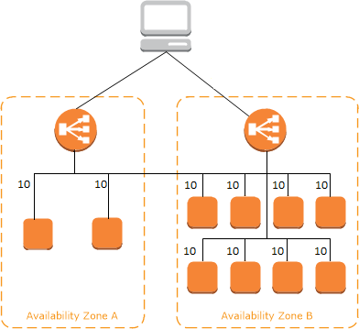
Cross-zone load balancing
The nodes for your load balancer distribute requests from clients to registered targets. When cross-zone load balancing is enabled, each load balancer node distributes traffic across the registered targets in all enabled Availability Zones. When cross-zone load balancing is disabled, each load balancer node distributes traffic only across the registered targets in its Availability Zone.
The following diagrams demonstrate the effect of cross-zone load balancing. There are two enabled Availability Zones, with two targets in Availability Zone A and eight targets in Availability Zone B. Clients send requests, and Amazon Route 53 responds to each request with the IP address of one of the load balancer nodes. This distributes traffic such that each load balancer node receives 50% of the traffic from the clients. Each load balancer node distributes its share of the traffic across the registered targets in its scope.
If cross-zone load balancing is enabled, each of the 10 targets receives 10% of the traffic. This is because each load balancer node can route its 50% of the client traffic to all 10 targets.

Slide 9
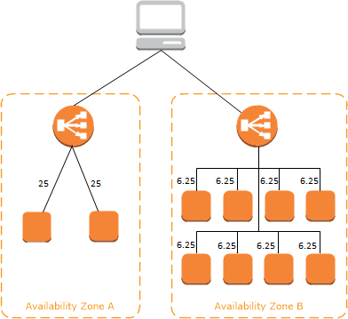
If cross-zone load balancing is disabled:
Each of the two targets in Availability Zone A receives 25% of the traffic.
Each of the eight targets in Availability Zone B receives 6.25% of the traffic.
This is because each load balancer node can route its 50% of the client traffic only to targets in its Availability Zone.
With Application Load Balancers, cross-zone load balancing is always enabled.
With Network Load Balancers and Gateway Load Balancers, cross-zone load balancing is disabled by default. After you create the load balancer, you can enable or disable cross-zone load balancing at any time.
When you create a Classic Load Balancer, the default for cross-zone load balancing depends on how you create the load balancer. With the API or CLI, cross-zone load balancing is disabled by default. With the AWS Management Console, the option to enable cross-zone load balancing is selected by default.

Slide 10
Request routing
Before a client sends a request to your load balancer, it resolves the load balancer's domain name using a Domain Name System (DNS) server. The DNS entry is controlled by Amazon, because your load balancers are in the amazonaws.com domain. The Amazon DNS servers return one or more IP addresses to the client. These are the IP addresses of the load balancer nodes for your load balancer. With Network Load Balancers, Elastic Load Balancing creates a network interface for each Availability Zone that you enable. Each load balancer node in the Availability Zone uses this network interface to get a static IP address. You can optionally associate one Elastic IP address with each network interface when you create the load balancer.
As traffic to your application changes over time, Elastic Load Balancing scales your load balancer and updates the DNS entry. The DNS entry also specifies the time-to-live (TTL) of 60 seconds. This helps ensure that the IP addresses can be remapped quickly in response to changing traffic.
The client determines which IP address to use to send requests to the load balancer. The load balancer node that receives the request selects a healthy registered target and sends the request to the target using its private IP address.

Slide 11
HTTP headers
Application Load Balancers and Classic Load Balancers automatically add X-Forwarded-For, X-Forwarded-Proto, and X-Forwarded-Port headers to the request.
For front-end connections that use HTTP/2, the header names are in lowercase. Before the request is sent to the target using HTTP/1.1, the following header names are converted to mixed case: X-Forwarded-For, X-Forwarded-Proto, X-Forwarded-Port, Host, X-Amzn-Trace-Id, Upgrade, and Connection. All other header names are in lowercase.
Application Load Balancers and Classic Load Balancers honor the connection header from the incoming client request after proxying the response back to the client.
When Application Load Balancers and Classic Load Balancers receive an Expect header, they respond to the client immediately with an HTTP 100 Continue without testing the content length header, remove the Expect header, and then route the request.

Slide 12
Load balancer scheme
When you create a load balancer, you must choose whether to make it an internal load balancer or an internet-facing load balancer. Note that when you create a Classic Load Balancer in EC2-Classic, it must be an internet-facing load balancer. The nodes of an internet-facing load balancer have public IP addresses. The DNS name of an internet-facing load balancer is publicly resolvable to the public IP addresses of the nodes. Therefore, internet-facing load balancers can route requests from clients over the internet. The nodes of an internal load balancer have only private IP addresses. The DNS name of an internal load balancer is publicly resolvable to the private IP addresses of the nodes. Therefore, internal load balancers can only route requests from clients with access to the VPC for the load balancer. Both internet-facing and internal load balancers route requests to your targets using private IP addresses. Therefore, your targets do not need public IP addresses to receive requests from an internal or an internet-facing load balancer. If your application has multiple tiers, you can design an architecture that uses both internal and internet-facing load balancers. For example, this is true if your application uses web servers that must be connected to the internet, and application servers that are only connected to the web servers. Create an internet-facing load balancer and register the web servers with it. Create an internal load balancer and register the application servers with it. The web servers receive requests from the internet-facing load balancer and send requests for the application servers to the internal load balancer. The application servers receive requests from the internal load balancer.

Slide 13

Types of load balancer on AWS
AWS has 3 kinds of managed Load Balancers
Classic Load Balancer (v1 - old generation) – 2009
HTTP, HTTPS, TCP
Application Load Balancer (v2 - new generation) – 2016
HTTP, HTTPS, WebSocket
Network Load Balancer (v2 - new generation) – 2017
TCP, TLS (secure TCP) & UDP
Overall, it is recommended to use the newer / v2 generation load balancers as they provide more features
You can setup internal (private) or external (public) ELBs

Slide 14


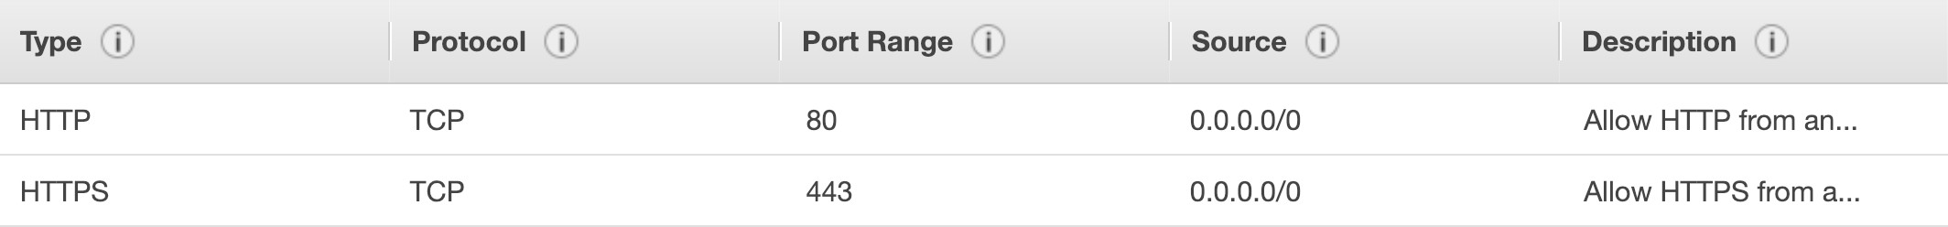
Load Balancer Security Groups LOAD BALANCER
HTTPS / HTTP
From anywhere
HTTP Restricted to Load balancer
Users
EC2
Load Balancer Security Group:
Application Security Group: Allow traffic only from Load Balancer

Slide 15
Load Balancer Good to Know
LBs can scale but not instantaneously – contact AWS for a “warm-up”
Troubleshooting
4xx errors are client induced errors
5xx errors are application induced errors
Load Balancer Errors 503 means at capacity or no registered target
If the LB can’t connect to your application, check your security groups!
Monitoring
ELB access logs will log all access requests (so you can debug per request)
CloudWatch Metrics will give you aggregate statistics (ex: connections count)

Slide 16



Classic Load Balancers (v1)
Supports TCP (Layer 4), HTTP & HTTPS (Layer 7)
Health checks are TCP or HTTP based
Fixed hostname XXX.region.elb.amazonaws.com
listener
internal
Client
CLB
EC2

Slide 17

Application Load Balancer (v2)
Application load balancers is Layer 7 (HTTP)
Load balancing to multiple HTTP applications across machines (target groups)
Load balancing to multiple applications on the same machine (ex: containers)
Support for HTTP/2 and WebSocket
Support redirects (from HTTP to HTTPS for example)

Slide 18
Application Load Balancer (v2)
Routing tables to different target groups:
Routing based on path in URL (example.com/users & example.com/posts)
Routing based on hostname in URL (one.example.com & other.example.com)
Routing based on Query String, Headers (example.com/users?id=123&order=false)
ALB are a great fit for micro services & container-based application (example: Docker & Amazon ECS)
Has a port mapping feature to redirect to a dynamic port in ECS
In comparison, we’d need multiple Classic Load Balancer per application

Slide 19





Application Load Balancer (v2) HTTP Based Traffic
Target Group for Users application
Health Check
WWW
Route /user
HTTP
External Application Load Balancer (v2)
Target Group for Search application
Health Check
WWW
Route /search
HTTP

Slide 20
Application Load Balancer (v2) Target Groups
EC2 instances (can be managed by an Auto Scaling Group) – HTTP
ECS tasks (managed by ECS itself) – HTTP
Lambda functions – HTTP request is translated into a JSON event
IP Addresses – must be private IPs
ALB can route to multiple target groups
Health checks are at the target group level

Slide 21





Application Load Balancer (v2) Query Strings/Parameters Routing
External Application Load Balancer (v2)
Target Group 1
AWS – EC2 based
?Platform=Mobile
WWW
Requests
Target Group 2
On-premises – Private IP routing
?Platform=Desktop

Slide 22

Application Load Balancer (v2) Good to Know
Fixed hostname (XXX.region.elb.amazonaws.com)
The application servers don’t see the IP of the client directly
The true IP of the client is inserted in the header X-Forwarded-For
We can also get Port (X-Forwarded-Port) and proto (X-Forwarded-Proto)
Load Balancer IP (Private IP)
Client IP 12.34.56.78
EC2
Instance
Connection termination

Slide 23

Network Load Balancer (v2)
Network load balancers (Layer 4) allow to:
Forward TCP & UDP traffic to your instances
Handle millions of request per seconds
Less latency ~100 ms (vs 400 ms for ALB)
NLB has one static IP per AZ, and supports assigning Elastic IP
(helpful for whitelisting specific IP)
NLB are used for extreme performance,TCP or UDP traffic
Not included in the AWS free tier

Slide 24

Network Load Balancer (v2) TCP (Layer 4) Based Traffic
Target Group for Users application
Health Check
WWW
TCP + Rules
TCP
External Network Load Balancer (v2)
Target Group for Search application
Health Check
WWW
TCP + Rules
HTTP

Slide 25

Load Balancer Stickiness
It is possible to implement stickiness so
that the same client is always redirected
to the same instance behind a load balancer
This works for Classic Load Balancers & Application Load Balancers
The “cookie” used for stickiness has an expiration date you control
Use case: make sure the user doesn’t lose his session data
Enabling stickiness may bring imbalance to the load over the backend EC2 instances
Client A
Client B
Client C
EC2
Instance
EC2
Instance

Slide 26
SSL/TLS - Basics
An SSL Certificate allows traffic between your clients and your load balancer to be encrypted in transit (in-flight encryption)
SSL refers to Secure Sockets Layer, used to encrypt connections
TLS refers to Transport Layer Security, which is a newer version
Nowadays, TLS certificates are mainly used, but people still refer as SSL
Public SSL certificates are issued by Certificate Authorities (CA)
Comodo, Symantec, GoDaddy, GlobalSign, Digicert, Letsencrypt, etc…
SSL certificates have an expiration date (you set) and must be renewed

Slide 27

Load Balancer - SSL Certificates LOAD BALANCER
HTTPS (encrypted) Over www
HTTP
Over private VPC
EC2
Instance
Users
The load balancer uses an X.509 certificate (SSL/TLS server certificate)
You can manage certificates using ACM (AWS Certificate Manager)
You can create upload your own certificates alternatively
HTTPS listener:
You must specify a default certificate
You can add an optional list of certs to support multiple domains
Clients can use SNI (Server Name Indication) to specify the hostname they reach
Ability to specify a security policy to support older versions of SSL / TLS (legacy clients)

Slide 28






SSL – Server Name Indication (SNI)
SNI solves the problem of loading multiple SSL
certificates onto one web server (to serve multiple websites)
It’s a “newer” protocol, and requires the client
to indicate the hostname of the target server in the initial SSL handshake
Target group for www.mycorp.com
Target group for Domain1.example.com
The server will then find the correct certificate, or return the default one
I would like www.mycorp.com
Client
ALB
Note:
Only works for ALB & NLB (newer generation), CloudFront
Does not work for CLB (older gen)
SSL Cert: Domain1.example.com
Use the correct SSL cert
SSL Cert: www.mycorp.com
….

Slide 29
Elastic Load Balancers – SSL Certificates
Classic Load Balancer (v1)
Support only one SSL certificate
Must use multiple CLB for multiple hostname with multiple SSL certificates
Application Load Balancer (v2)
Supports multiple listeners with multiple SSL certificates
Uses Server Name Indication (SNI) to make it work
Network Load Balancer (v2)
Supports multiple listeners with multiple SSL certificates
Uses Server Name Indication (SNI) to make it work

Slide 30


ELB – Connection Draining
Feature naming:
CLB: Connection Draining
Target Group: Deregistration Delay (for ALB & NLB)
Waiting for existing
connections to complete
EC2
DRAINING
Time to complete “in-flight requests” while the instance is de-registering or unhealthy
Stops sending new requests to the instance which is de-registering
Between 1 to 3600 seconds, default is 300 seconds
Can be disabled (set value to 0)
Set to a low value if your requests are short
EC2
Users
ELB
EC2
New connections
Established to all other instances

Slide 31
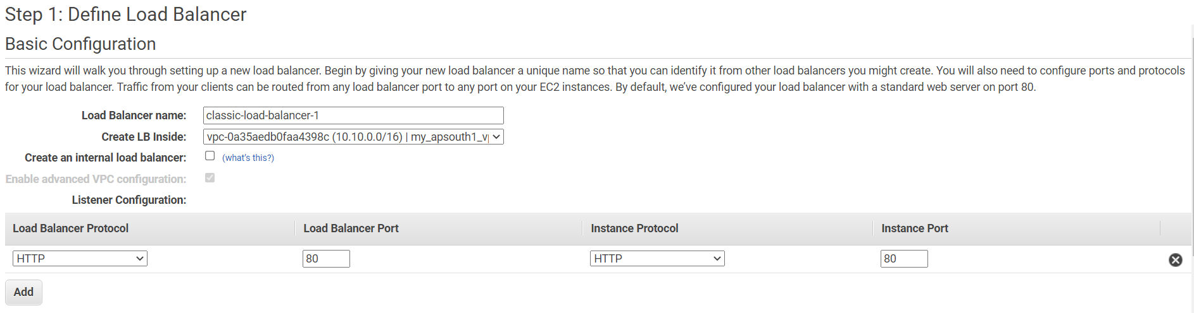
CREATING CLB

Slide 32
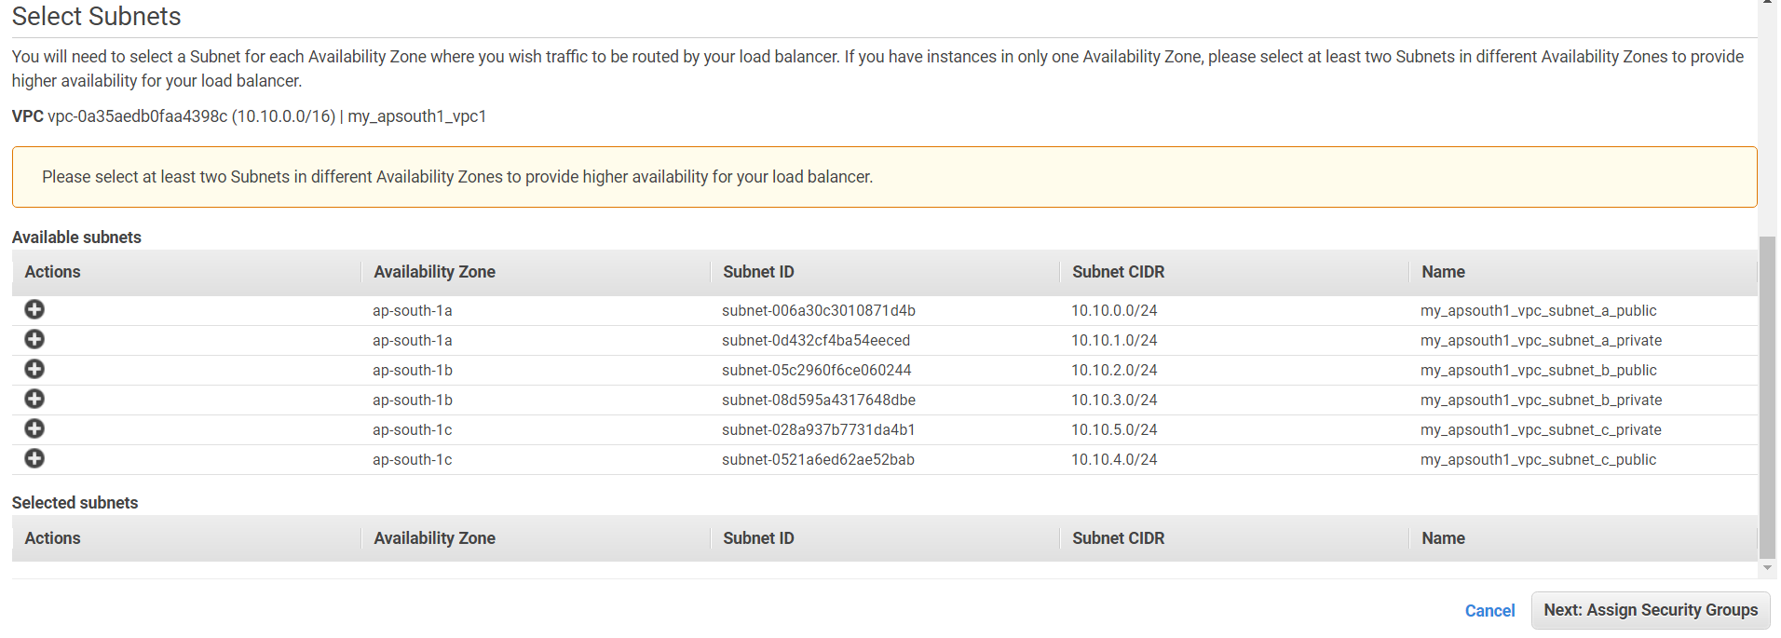

Slide 33
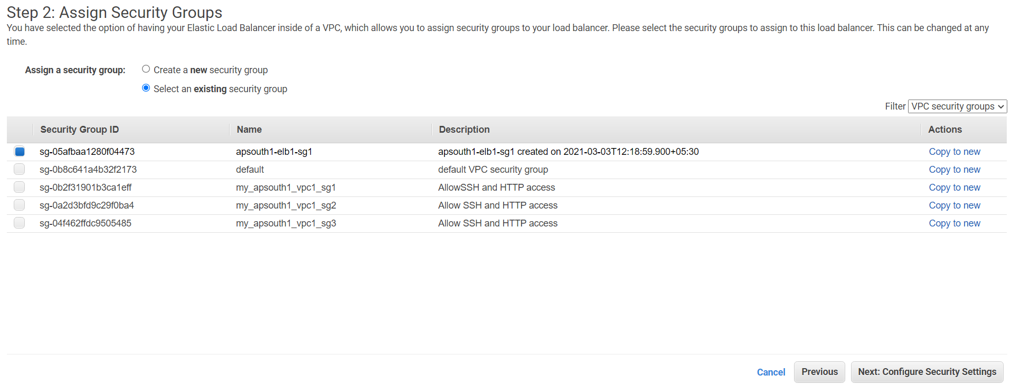

Slide 34
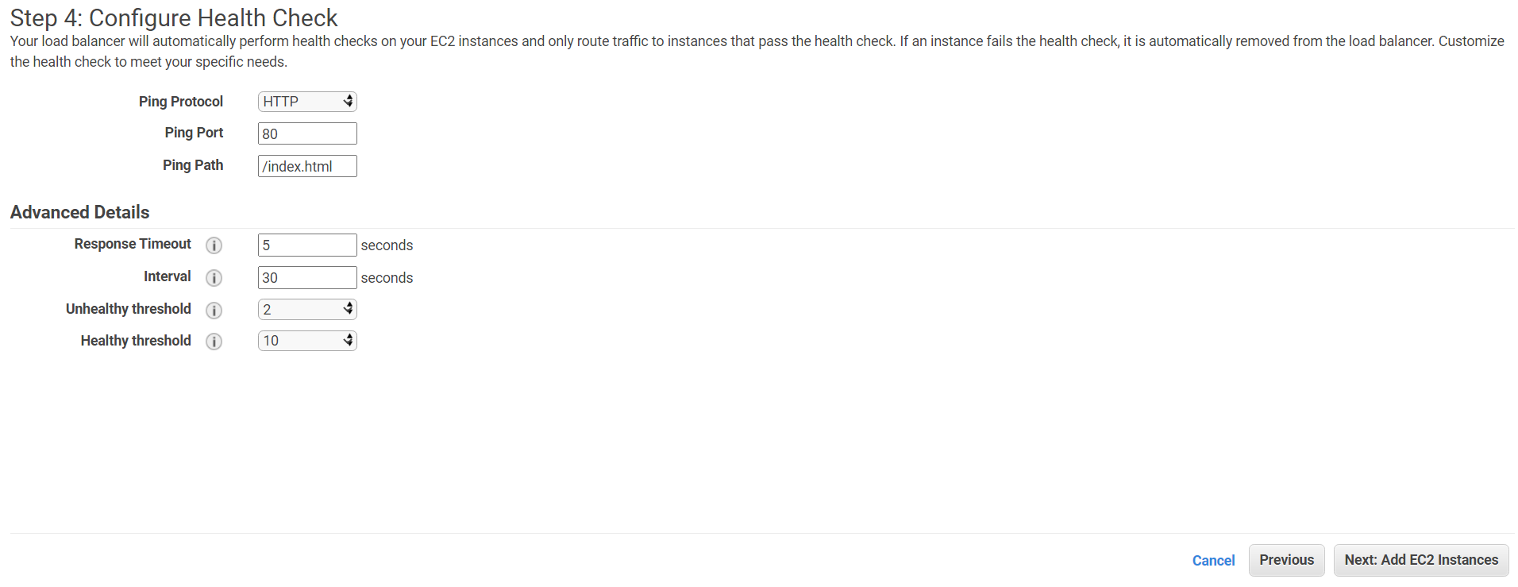

Slide 35
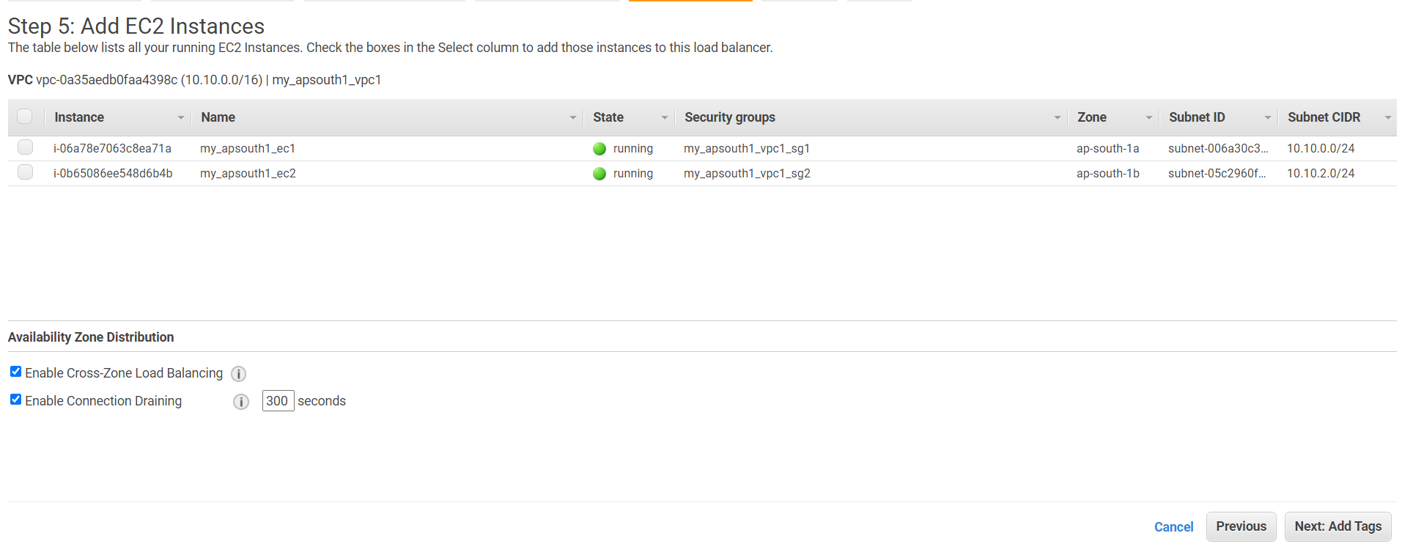

Slide 36
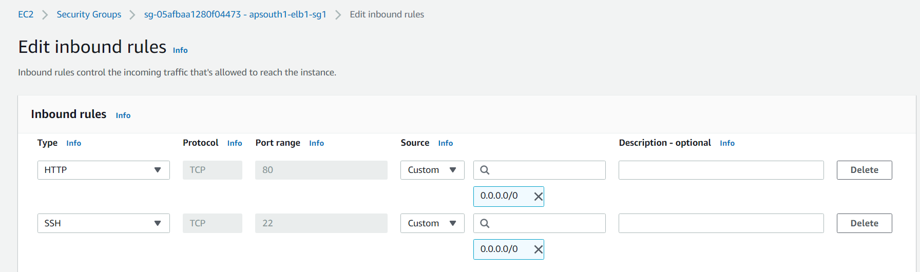

Slide 37
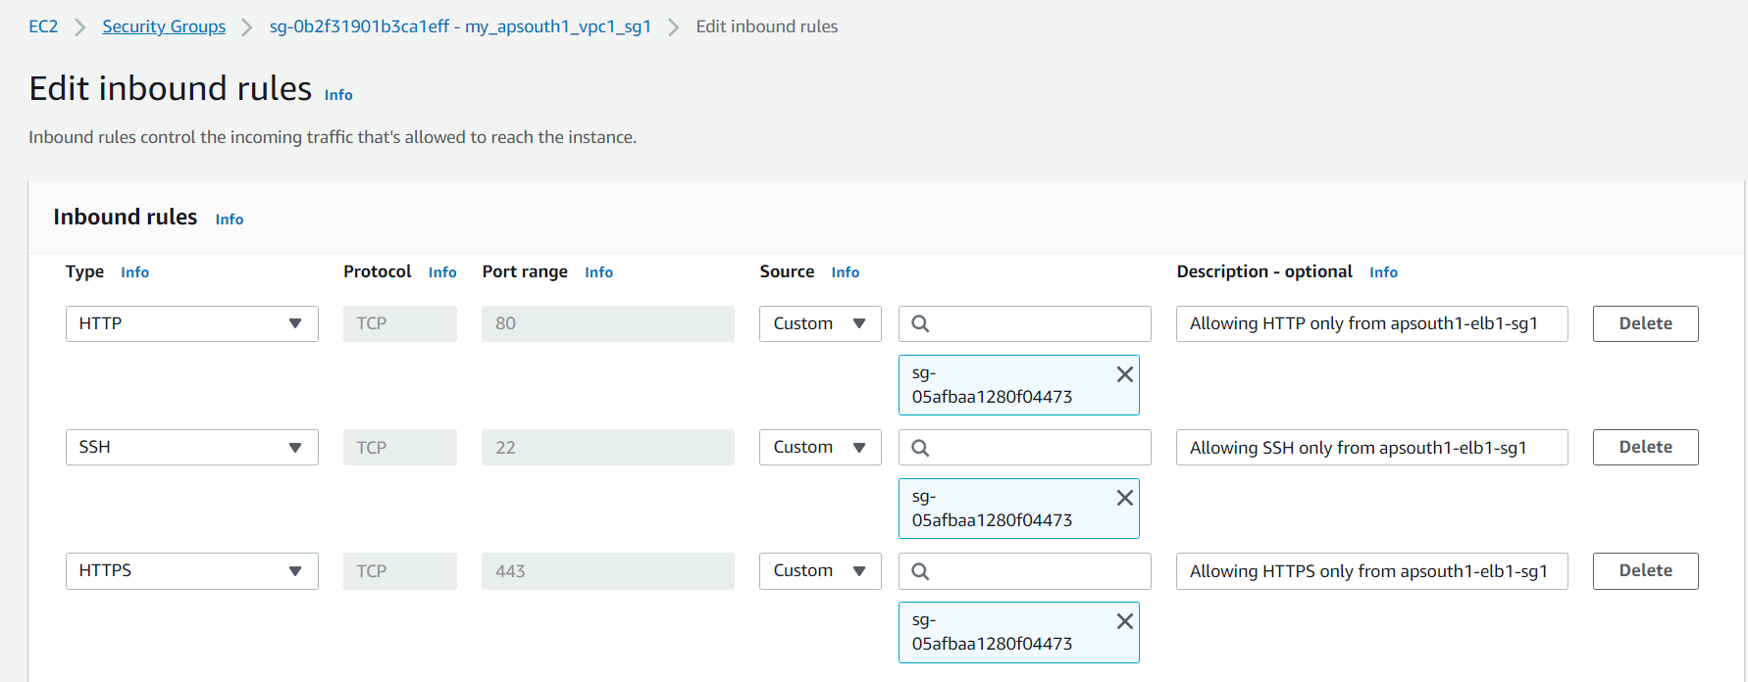

Slide 38
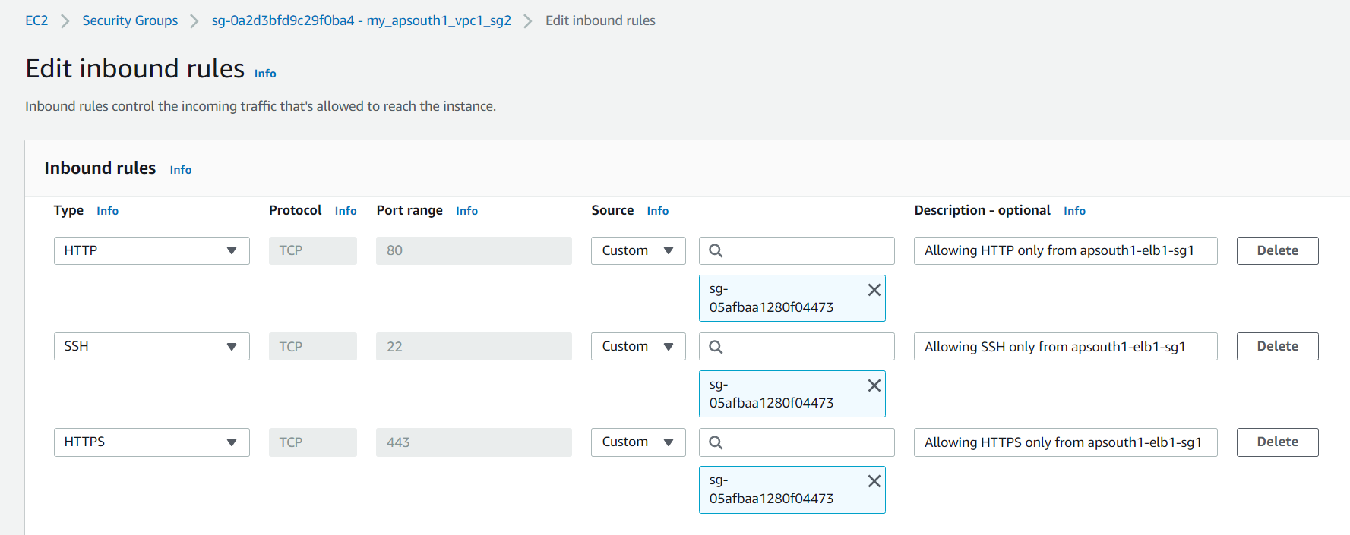

Slide 39
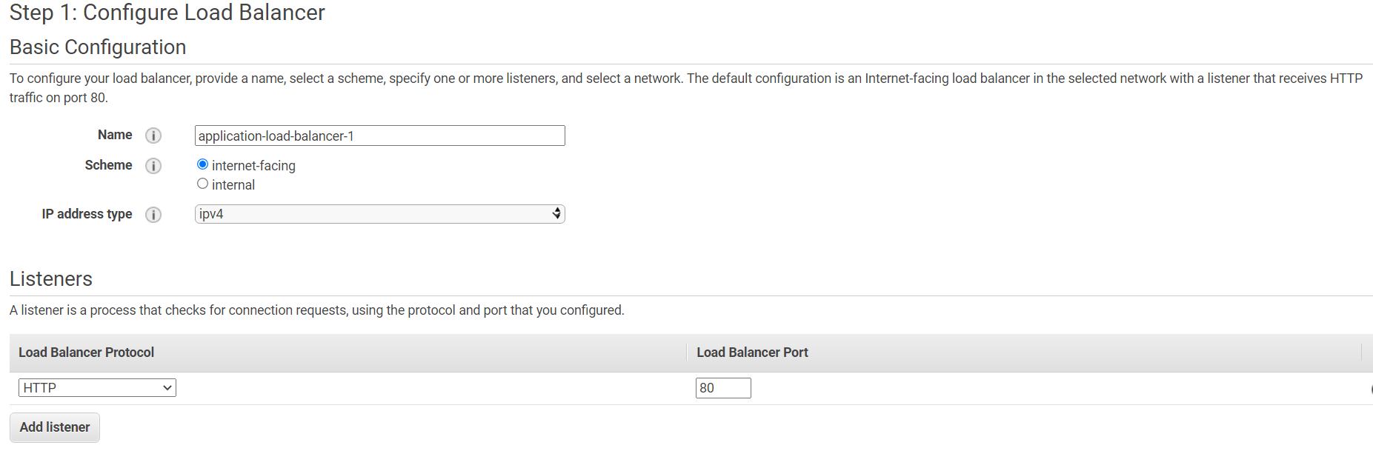
CREATING ALB

Slide 40
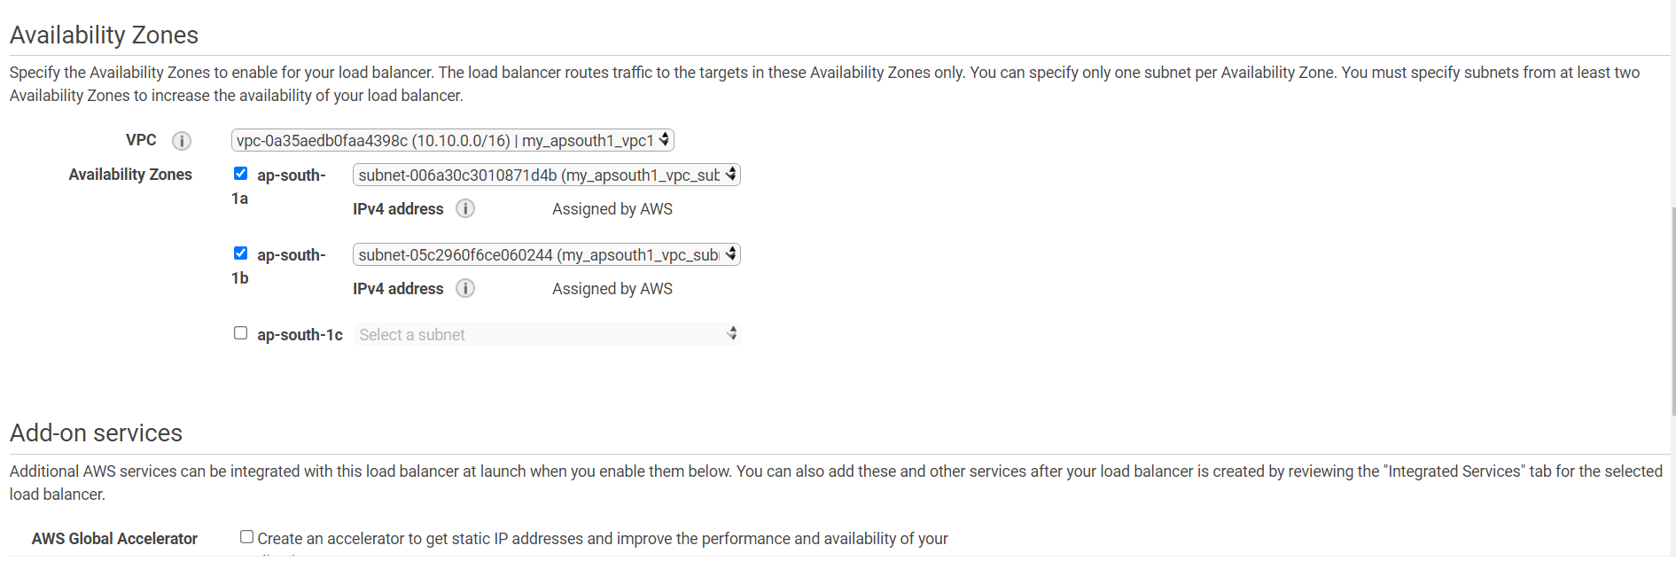

Slide 41
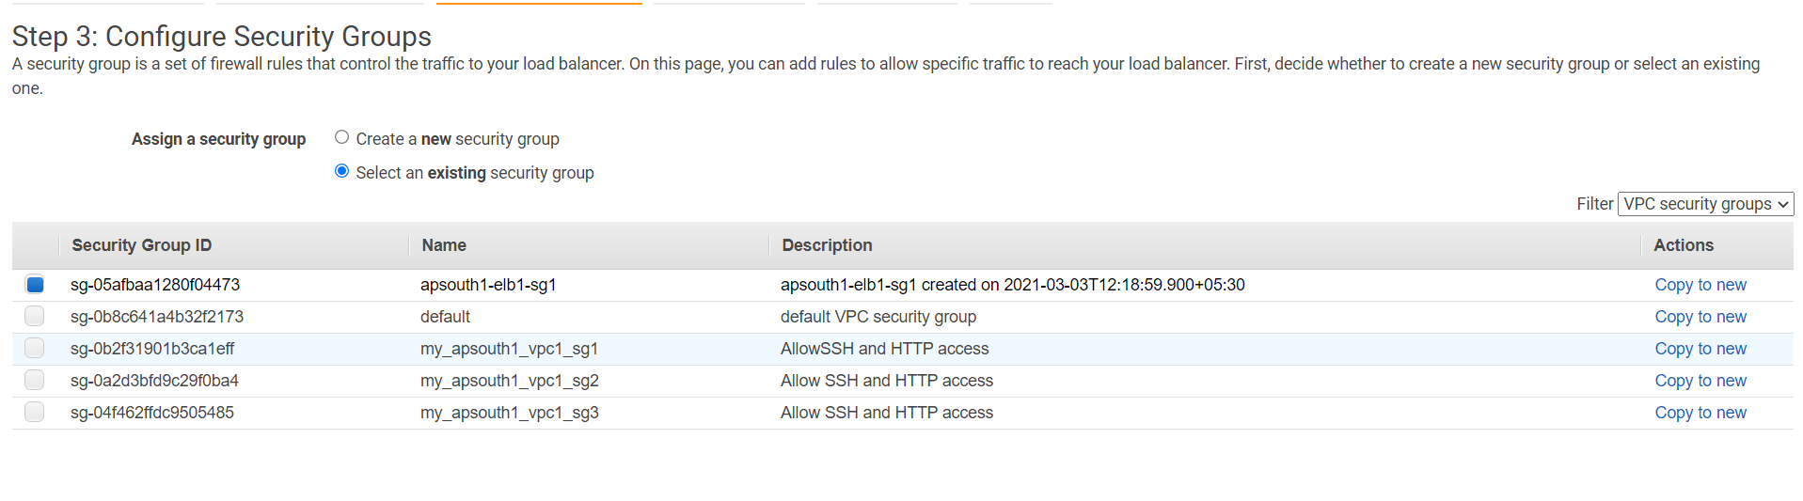

Slide 42
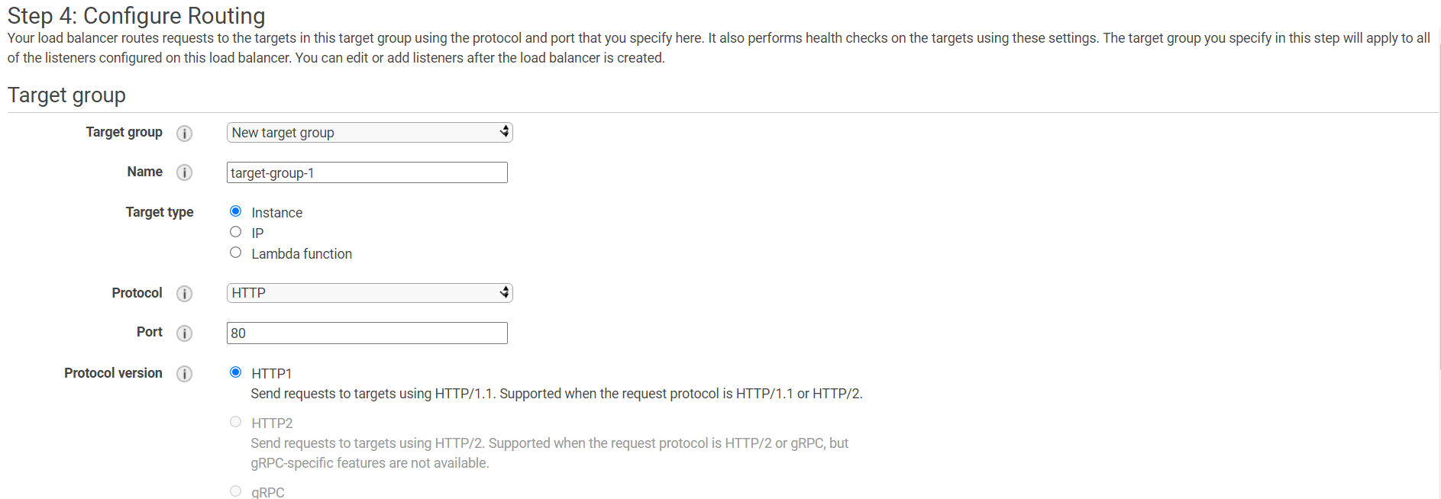

Slide 43
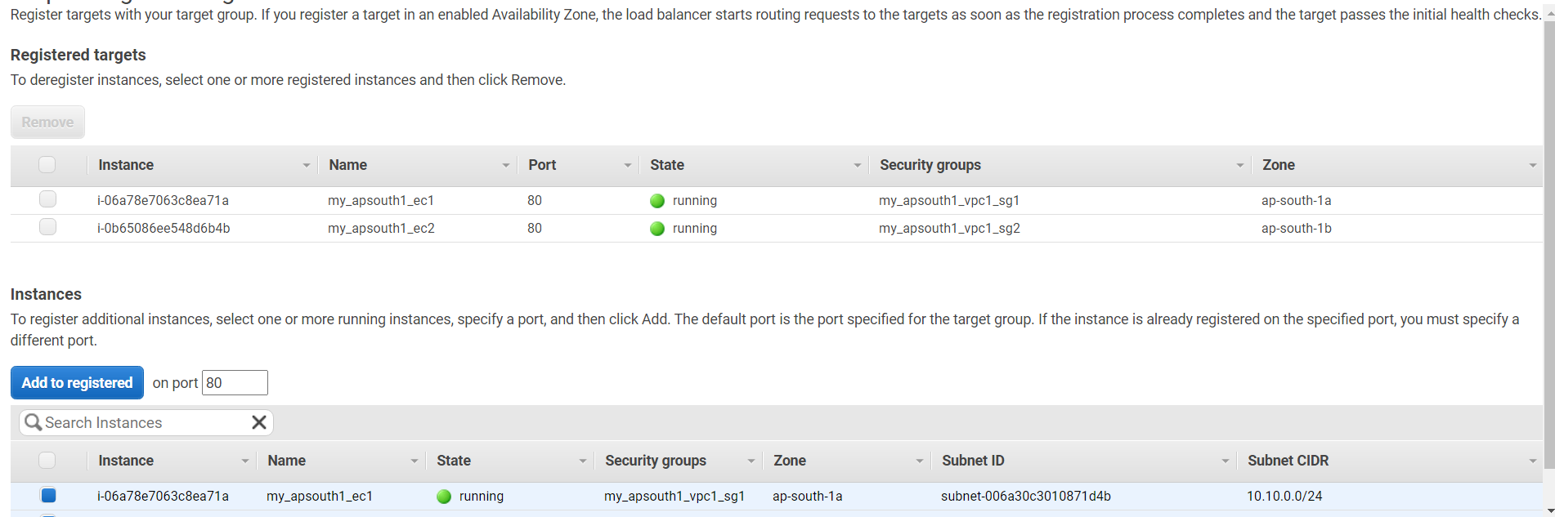

Slide 44
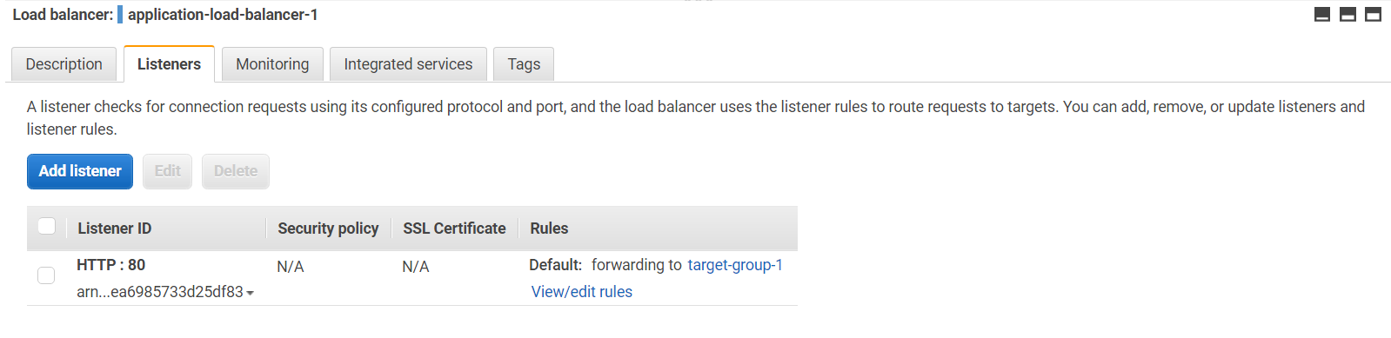

Slide 45
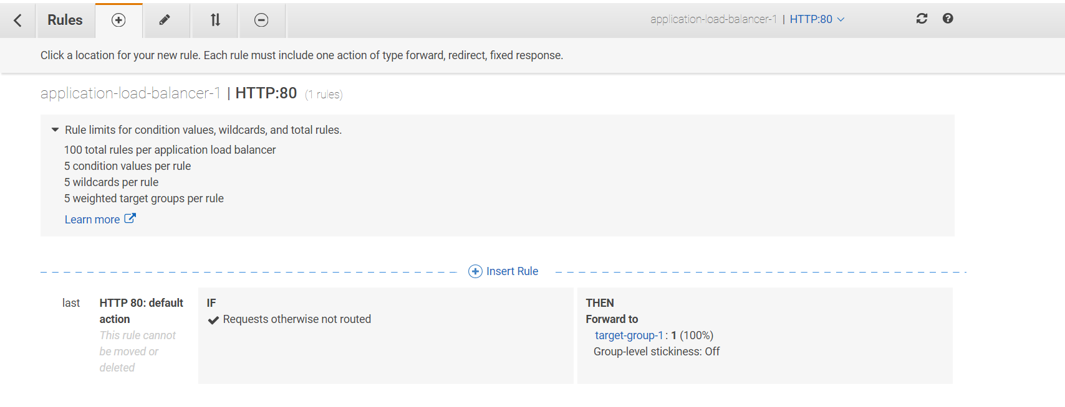

Slide 46
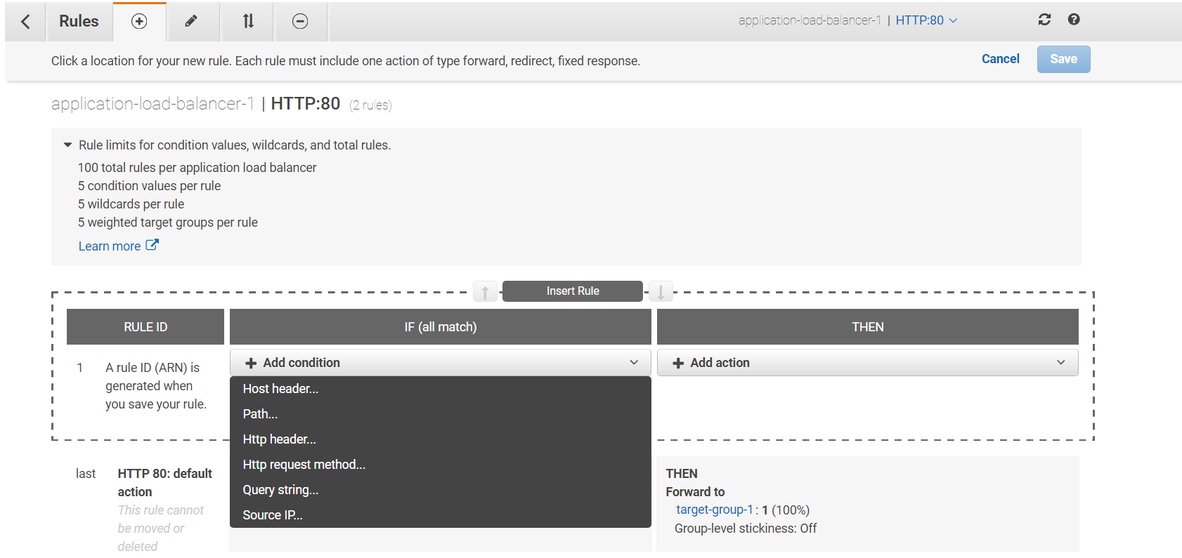

Slide 47
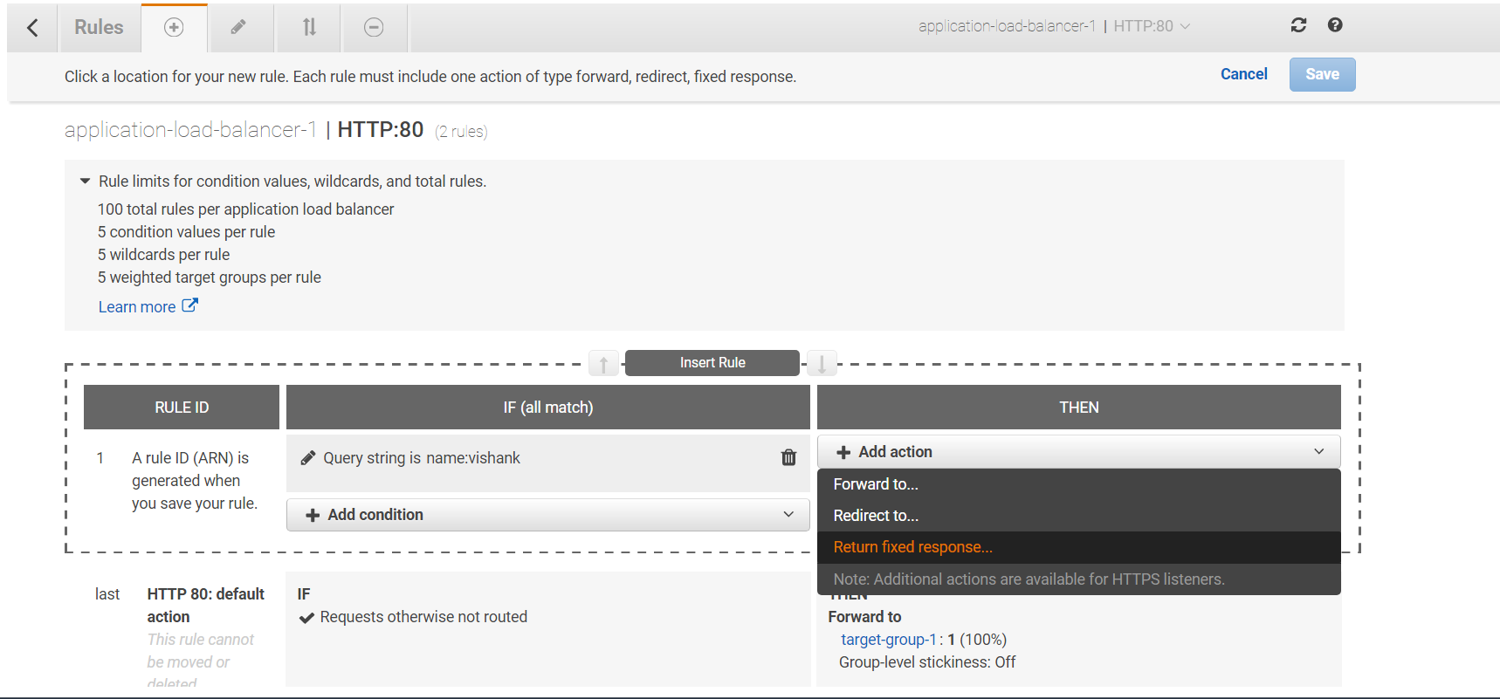

Slide 48
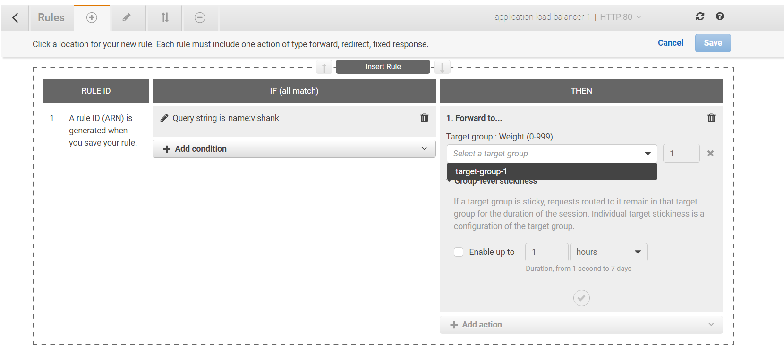

Slide 49
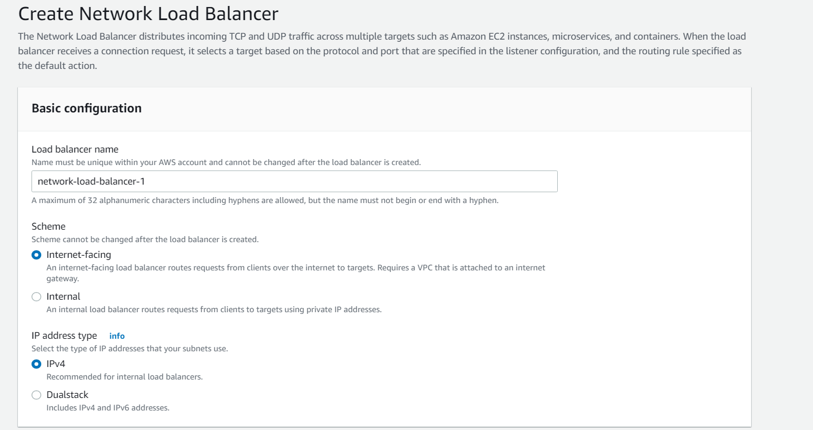
CREATING NLB(This does not have any security group only registered instances have those and we have to configure those security groups to access targets)

Slide 50
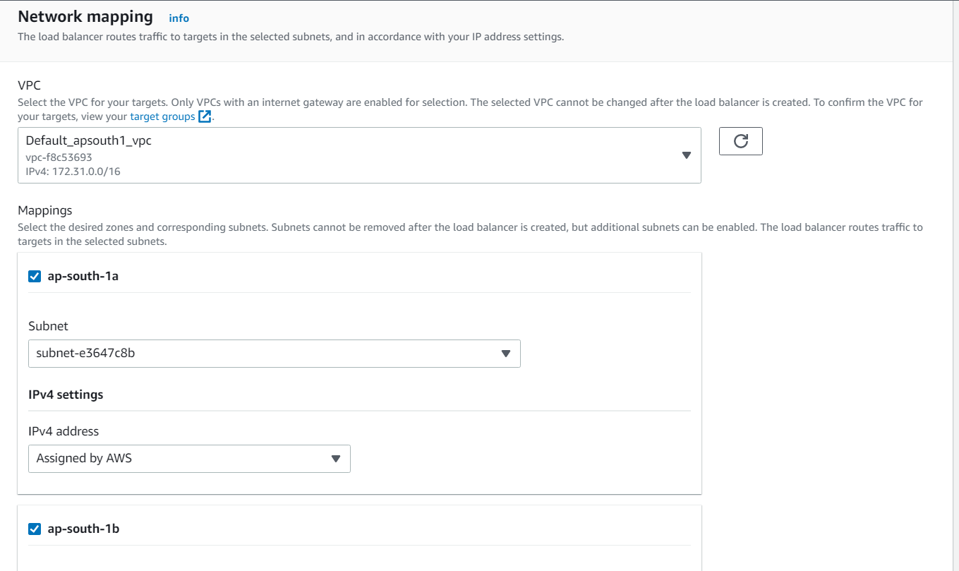

Slide 51
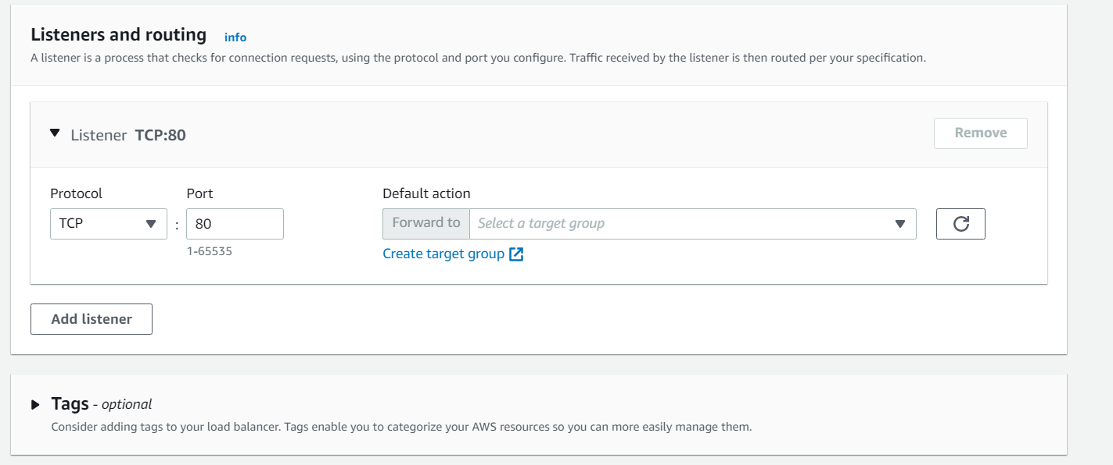

Slide 52
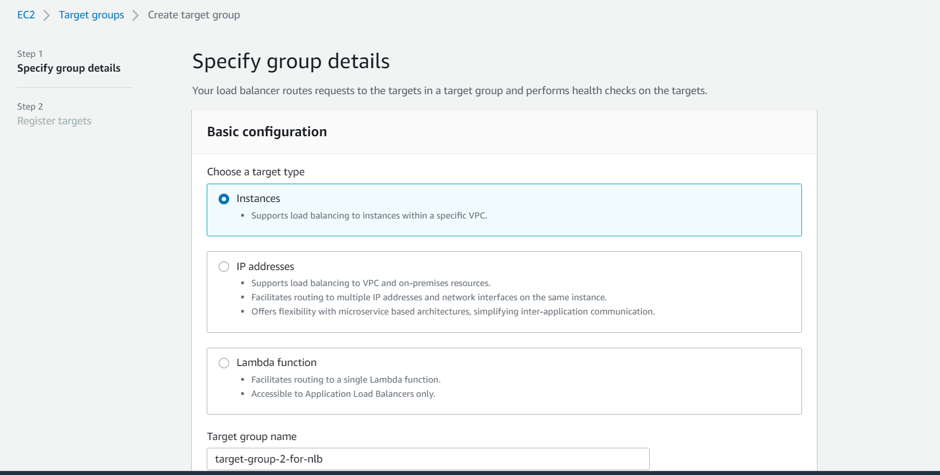

Slide 53
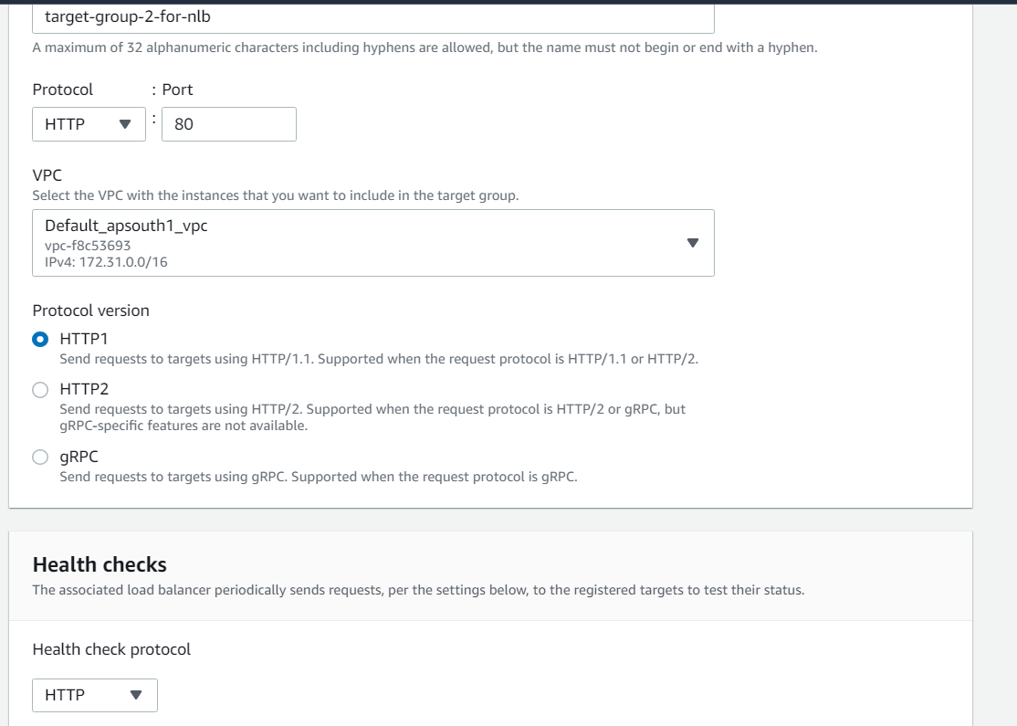

Slide 54
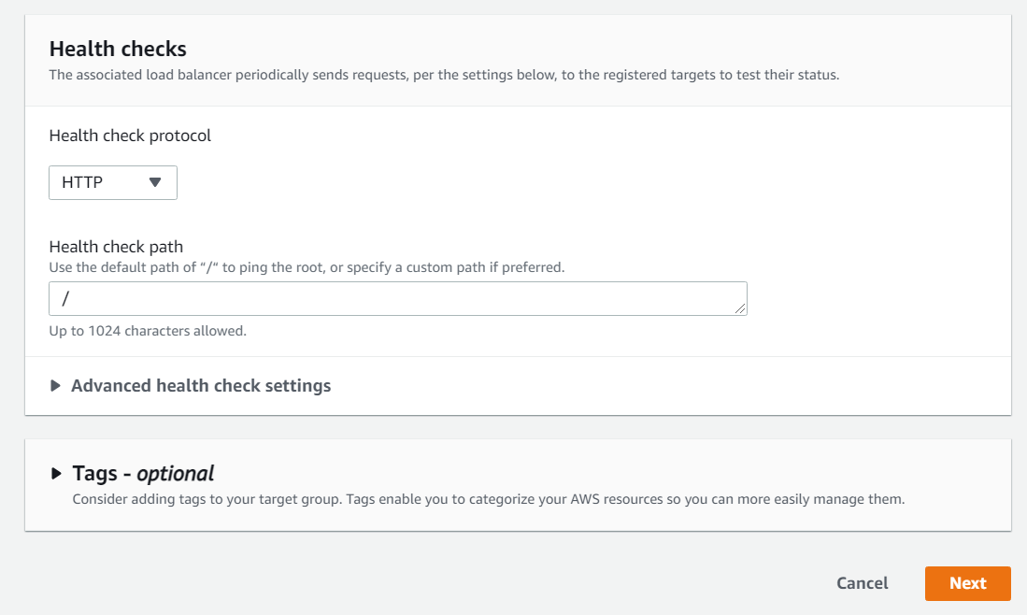

Slide 55
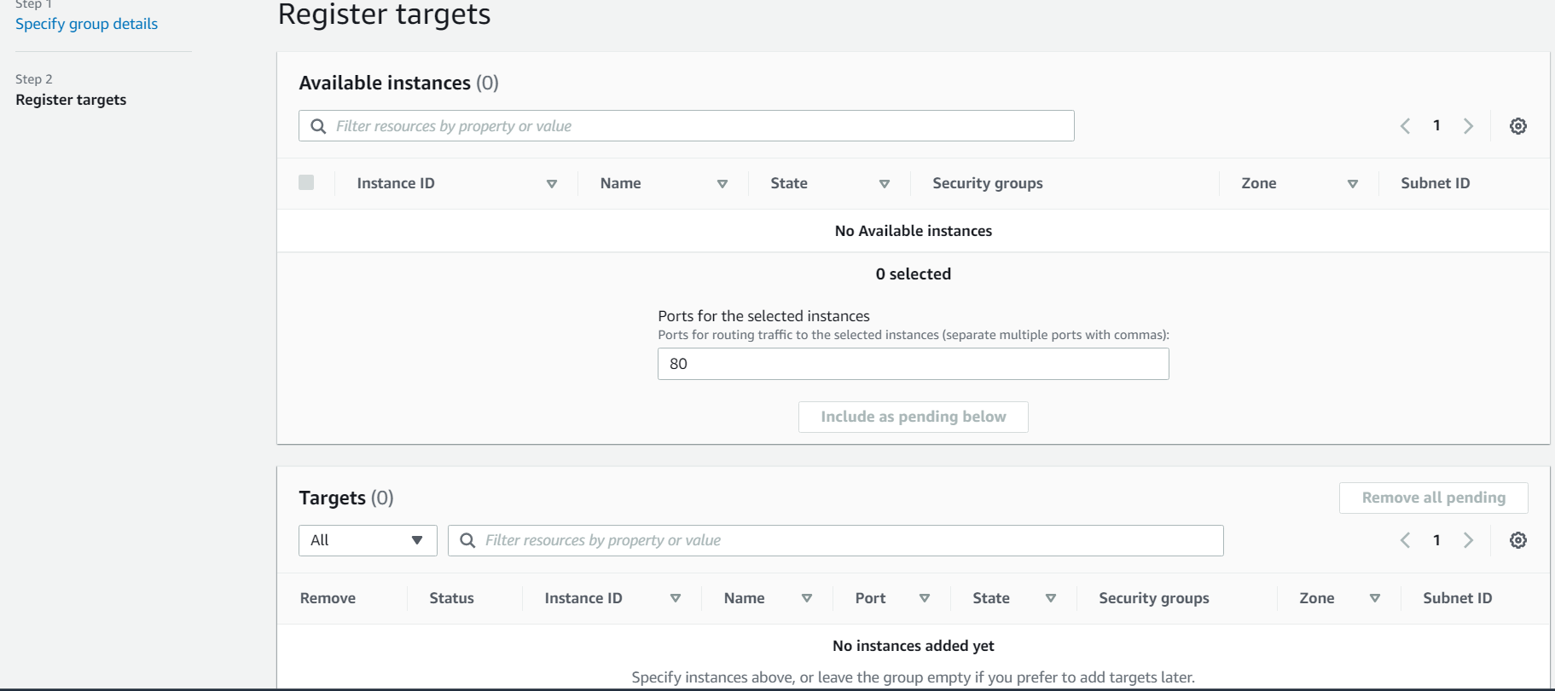

Slide 56
