Slide 1

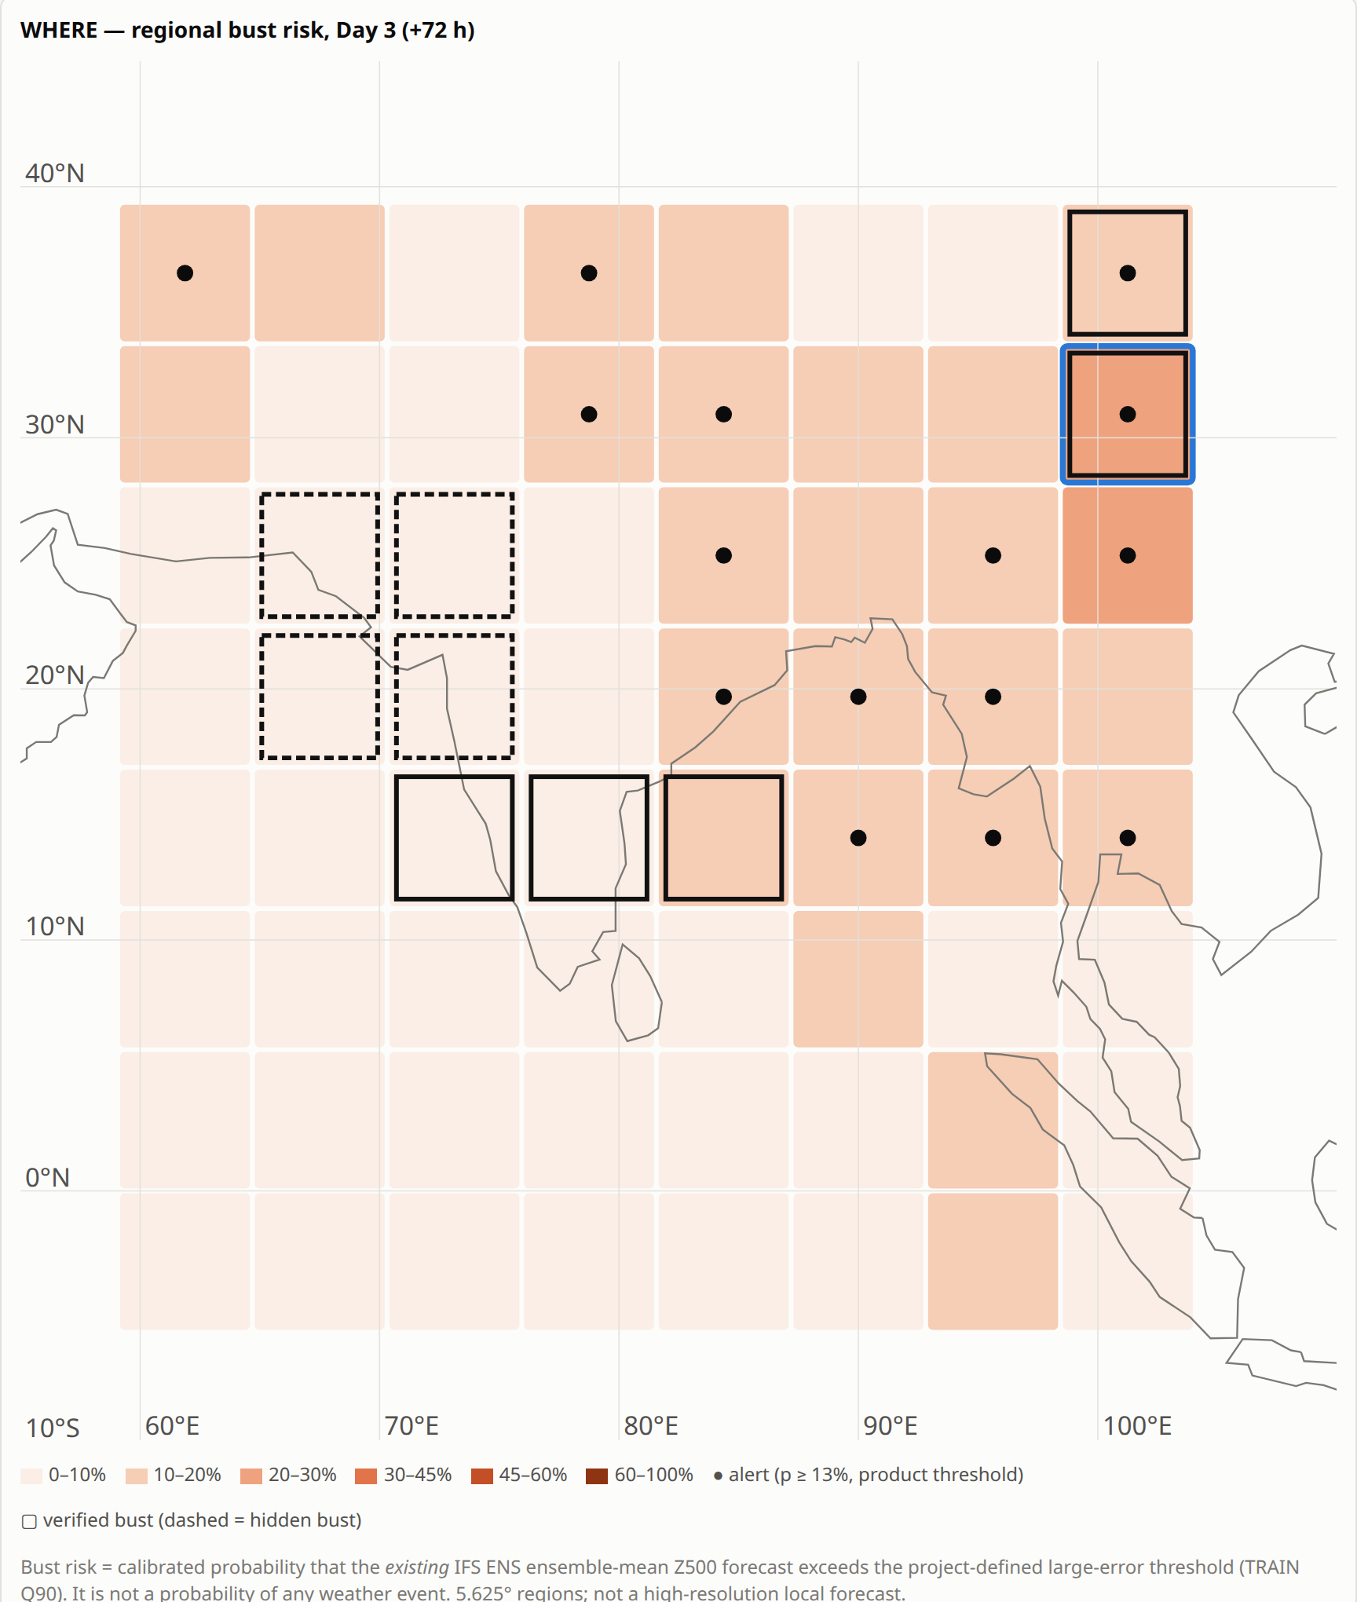
SMART INDIA HACKATHON 2026
TITLE PAGE
FORECAST BUST SENTINEL
AI-Based Forecast Reliability Intelligence for Medium-Range Forecasts
A reliability layer over an existing NWP ensemble: it estimates where and when (Day 1–10) the forecast is likely to incur a large error — it does not replace the forecast.
Problem Statement ID – SIH26079
Problem Statement Title – AI-Based Forecast Bust Detection for Medium-Range Weather Forecasts
Organization – Ministry of Earth Sciences (MoES) — National Centre for Medium Range Weather Forecasting (NCMRWF)
Theme – Smart Automation
PS Category – Software
Team ID – 174190
Team Name (Registered on portal) – OVER_CLOCKED
Real prototype output (historical replay, 2022-02-02 12 UTC): calibrated Day 3 bust risk over 64 native 5.625° regions (ECMWF IFS ENS via WeatherBench 2); outlined boxes = ERA5-verified busts after reveal.
@SIH Idea submission · Team OVER_CLOCKED (174190) · SIH26079
1

Slide 2
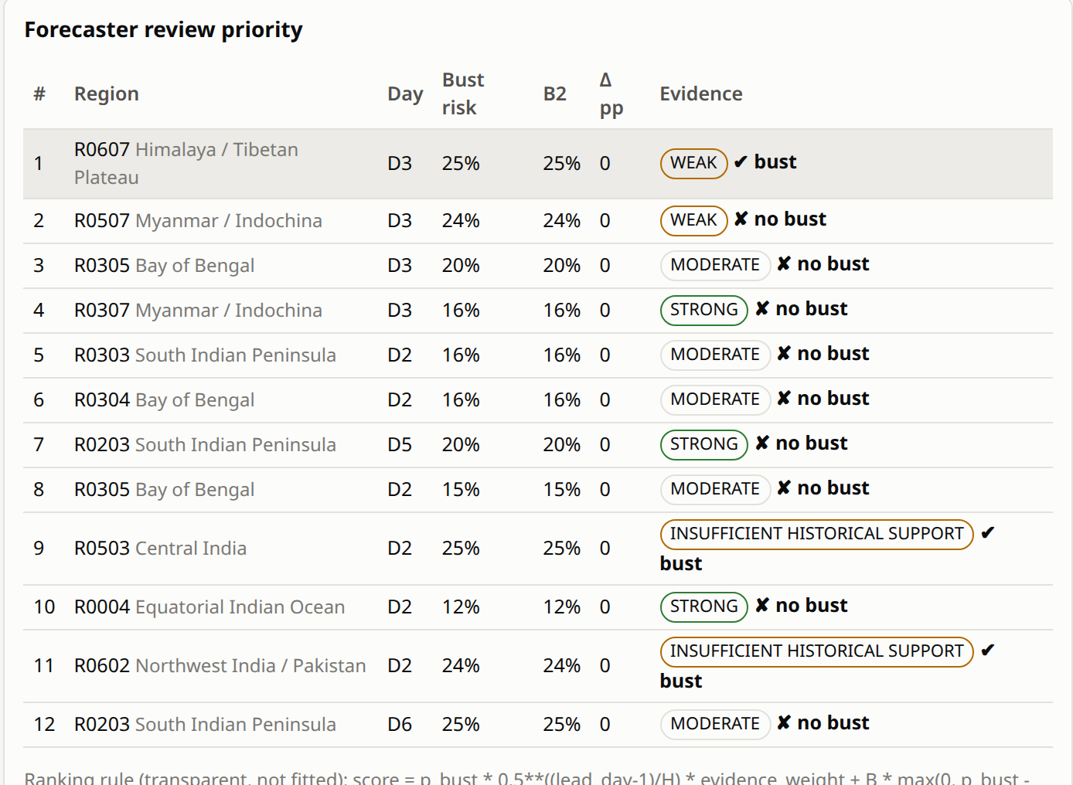
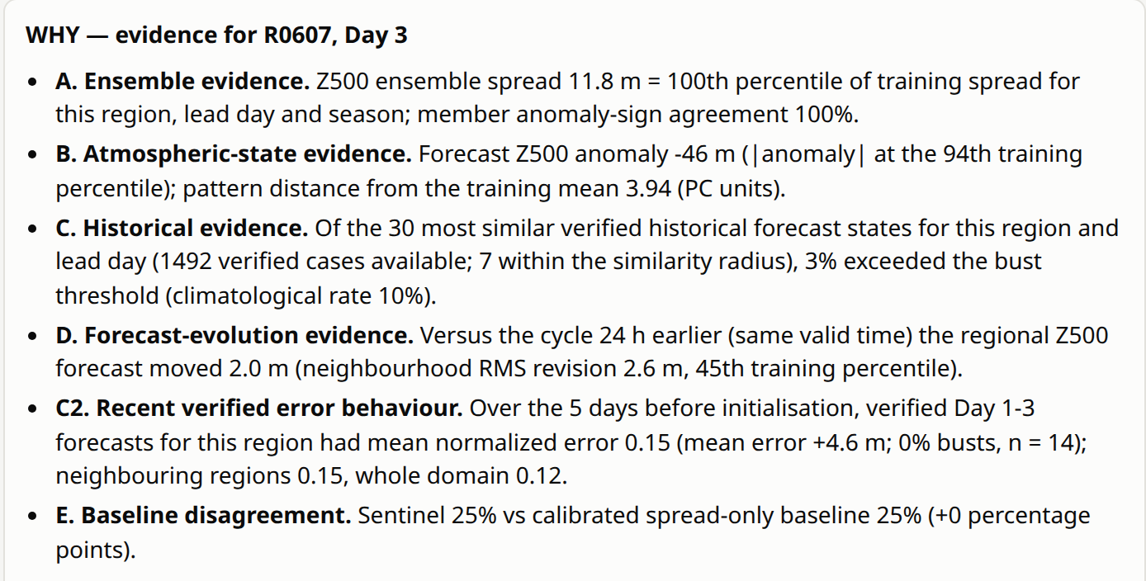
OVER_
CLOCKED
Forecast Bust Sentinel: Proposed Solution
We do not replace the NWP forecast — we estimate when it is likely to fail, show why, and learn from verified failures
The Forecast Reliability Challenge
How Forecast Bust Sentinel Works
Project-Level Differentiation
Busts in rapidly evolving systems
Monsoon depressions, WDs, cyclones, heat waves, active/break phases → large medium-range errors that affect operational decisions.
01
CHARACTERIZE
Current NWP forecast + ensemble behaviour + atmospheric state
Conditional Reliability Layer
“What does the current forecast state imply about its reliability?”
02
PREDICT
Calibrated bust probability per region, Day 1–10
Historical Forecast-State Memory
“What happened when previous forecasts looked like this?”
Ensemble spread helps — but is not enough
IFS ENS spread–error correlation only 0.21 (Day 1) to 0.56 (Day 10) over our target regions (2022).
03
CONTEXTUALIZE
Compare with strong spread-only baseline (B2) + retrieve similar historical forecast states
Spread-vs-Sentinel Disagreement
“What does the richer model see that spread alone does not — and vice versa?”
Region × lead-time reliability gap
Forecasters need WHERE and WHEN to be cautious, per region, Day 1–10 — not one global skill score.
04
QUALIFY
Support/OOD + evidence strength + attribution + forecaster review priority
Evidence-Aware Reliability
“Is the risk strongly supported or based on weak precedent?”
History as evidence
Verified errors of similar past forecast states are rarely available at forecast time.
VERIFY & REMEMBER
ERA5 verification + failure fingerprint + expanding historical memory
05
Closed Verification Loop
Forecast → verification → failure fingerprint → reusable memory
Live prototype evidence (historical replay, real 2022 IFS ENS case)
Where the differentiation lies — the integrated workflow
SPREAD BASELINE
SENTINEL
SUPPORT
VERIFICATION
MEMORY
What does ensemble uncertainty suggest?
What do forecast state + historical behaviour suggest?
How strong is the historical evidence?
What actually happened?
What to remember for a future similar state?
Honest status: on the locked 2022 test, Sentinel matches the strong B2 spread baseline (AUPRC 0.136 both) — no skill gain claimed. The differentiation is the calibrated, evidence-qualified, verified workflow, not a new algorithm.
Regional Day 3 risk map
Review priority + B2 + support, after reveal
WHY panel: number-backed evidence A–E
@SIH Idea submission · Team OVER_CLOCKED (174190) · SIH26079
2

Slide 3
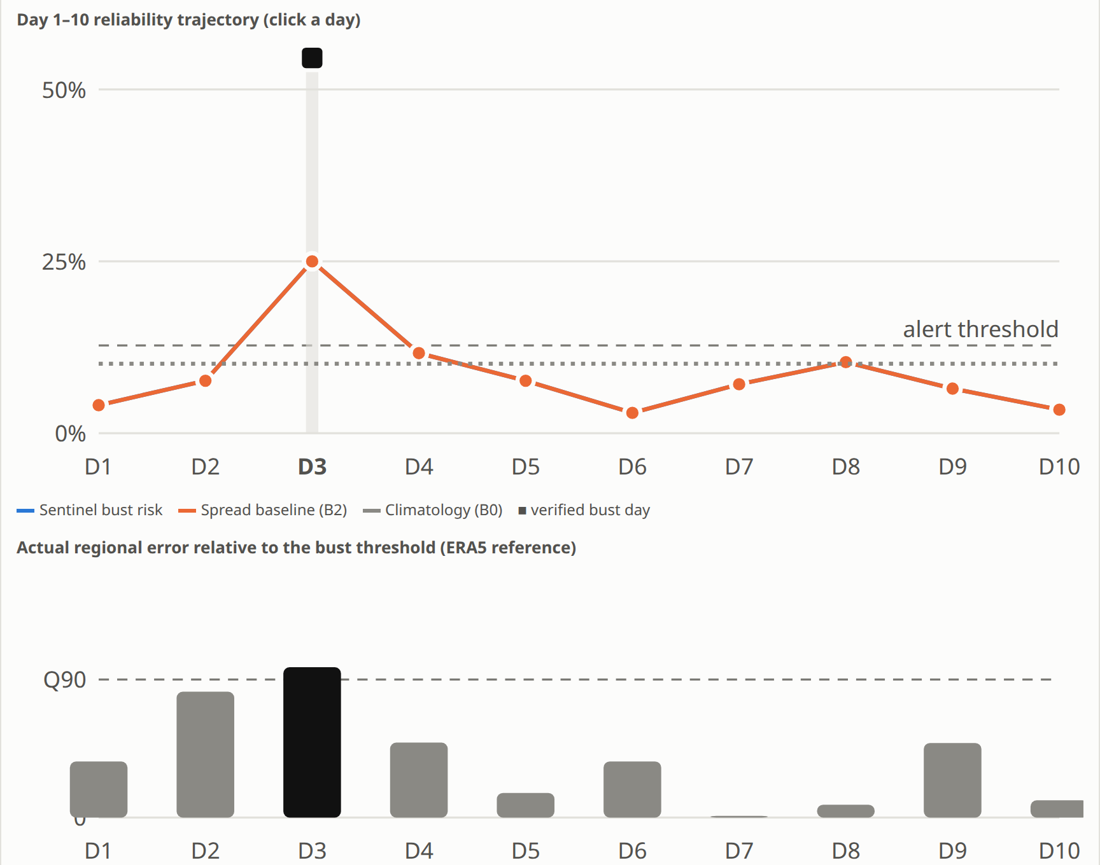
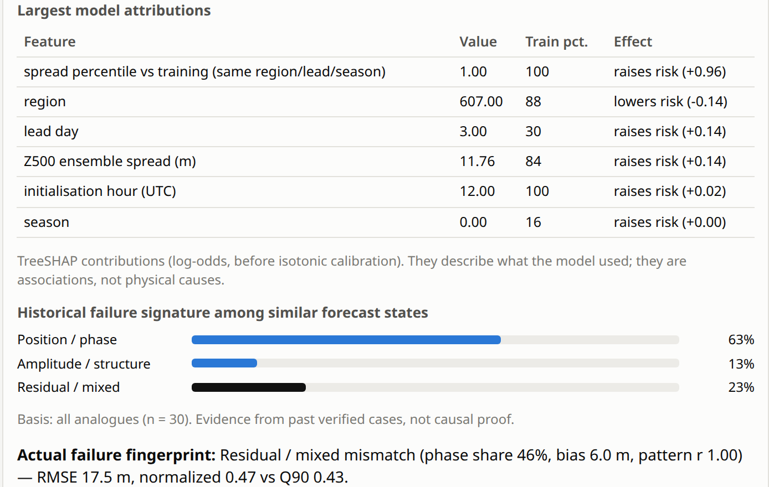
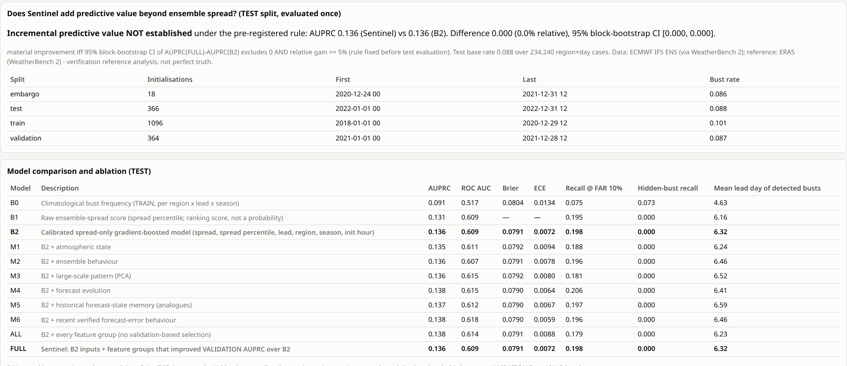
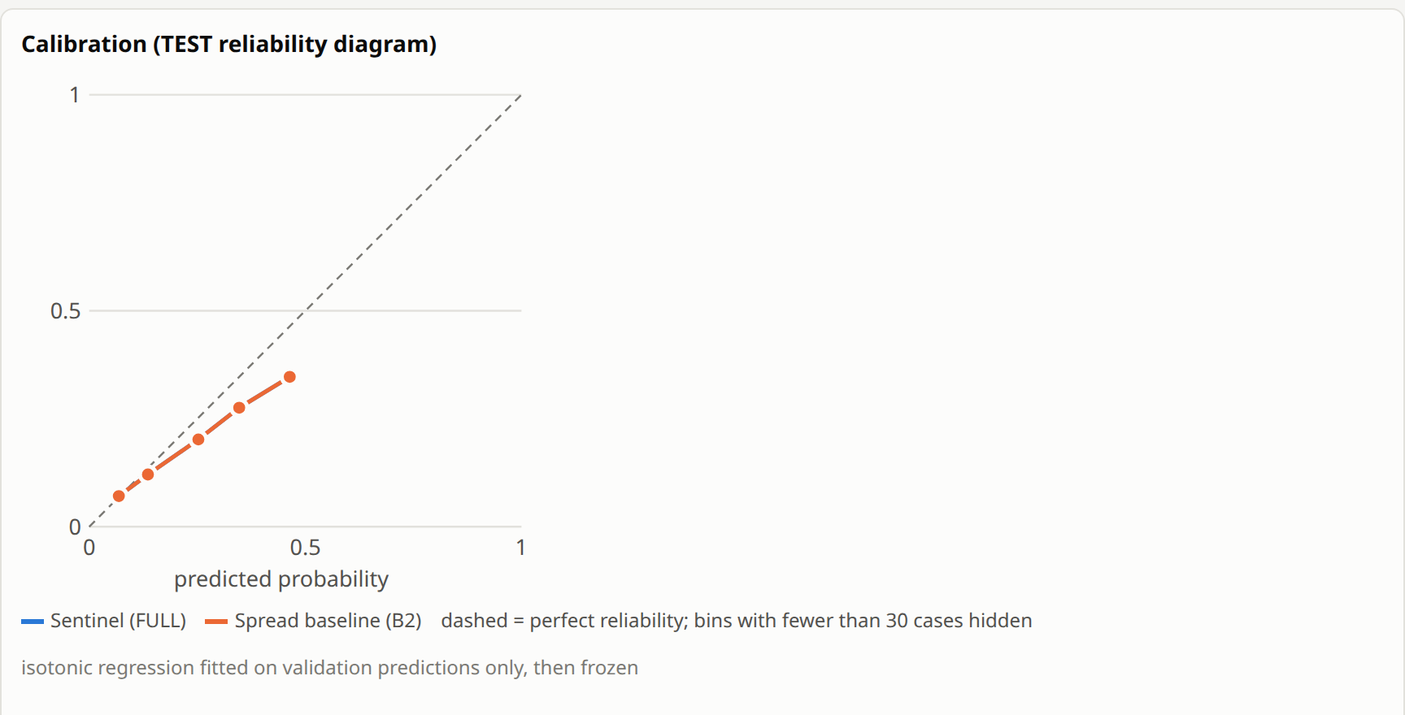
OVER_
CLOCKED
TECHNICAL APPROACH
From a real 50-member ensemble to a calibrated, verified, explainable Day 1–10 reliability output
1 DATA & VERIFICATION
2 TARGET & MODELLING
ECMWF IFS ENS
50 members, 2018–22
(WeatherBench 2)
ERA5 reference
at valid time
(init + lead)
Area-weighted
regional Z500
RMSE, Day 1–10
Historical
error archive
(verified cases)
Region ×
Day 1–10
Regional
Z500 RMSE
TRAIN-derived
normalisation
TRAIN-only Q90
(region·lead·season)
Bust
label
Grid: native 64×32 (5.625°) product — 64 target regions over 5°S–40°N, 60–105°E; wider context domain for features. Not 5°×5° (bandwidth-limited download).
ERA5 is a reanalysis reference, not perfect truth. Anomaly climatology from ERA5 1990–2017 (pre-dates all experiment years).
B0
Climatology
TRAIN bust frequency
B1
Spread
spread-percentile score
B2
Calibrated spread-only
GBT + isotonic (strong)
Sentinel
Forecast-state model
one shared XGBoost (CPU hist): region, lead, season + state features
3 FEATURE INTELLIGENCE (forecast-initialisation info only)
4 VALIDATION & TRUST — locked 2022 test, scored once
ENSEMBLE BEHAVIOUR
spread, percentile, IQR, skew, member agreement
ATMOSPHERIC STATE
Z500/700/850 anomaly & gradients (wind/MSLP: dev experiment, pending)
Train 2018–20 (1,096 inits)
Validation 2021 (364)
Locked test 2022 (366)
LARGE-SCALE PATTERN
TRAIN-only PCA, 8 frozen components
FORECAST EVOLUTION
revision vs earlier cycle, same valid time
2022 test | AUPRC | ROC AUC | Brier | ECE | Rec@10%FAR | Hidden-bust rec.
B0 climatology | 0.091 | 0.517 | 0.0804 | 0.0134 | 0.075 | 0.073
B1 spread score | 0.131 | 0.609 | — | — | 0.195 | 0.000
B2 calibrated spread | 0.136 | 0.609 | 0.0791 | 0.0072 | 0.198 | 0.000
Sentinel (FULL) | 0.136 | 0.609 | 0.0791 | 0.0072 | 0.198 | 0.000
HISTORICAL MEMORY
analogues (strictly earlier inits) + recent verified error
Rule fixed in advance: a group enters Sentinel only if it beats B2 on 2021 validation. None did → FULL uses B2 inputs.
Test base rate 0.088 · 234,240 region×day cases · warning lead of detected busts 6.3 d · spatial Jaccard 0.082 · spread-skill ratio 0.79→~1.0
5 PROTOTYPE: FastAPI + React dashboard on precomputed real 2022 replay cases
Stack
Python · xarray/Zarr
XGBoost (CPU) · isotonic
TreeSHAP attribution
FastAPI · React/Vite
46 pytest + 3 vitest pass
Day 1–10 trajectory vs B2 + verified error
Attribution + failure signature
Analytics: pre-registered Sentinel-vs-B2 test
Calibration (validation-fit isotonic)
@SIH Idea submission · Team OVER_CLOCKED (174190) · SIH26079
3

Slide 4
OVER_
CLOCKED
FEASIBILITY AND VIABILITY
Built and evaluated end-to-end on real historical data with a CPU-only pipeline
1 FEASIBILITY — demonstrated
2 KEY CHALLENGES — stated honestly
Real data: 5 years of 50-member ECMWF IFS ENS + ERA5 (WeatherBench 2), 457/457 chunks downloaded (~4.5 GB).
CPU-friendly: one shared gradient-boosted model, no GPU; full train→evaluate→replay→UI via scripts/run_all.sh.
Modular ingestion: ForecastSourceAdapter interface (IFS ENS adapter live; NCMRWF boundary defined).
Reproducible: manifests, frozen thresholds/PCA/calibrators, seeds, software versions persisted.
Precomputed replay: 12 real 2022 cases, blind forecast file + separately served verification.
No NCMRWF NEPS data accessible yet → not integrated or evaluated on NCMRWF output.
Variables: geopotential only so far; wind/MSLP/vorticity features in a dev-split experiment (pending).
Predictability ceiling: on 2022, Sentinel did not beat spread-only B2; hidden busts (low spread) not detected.
Weak historical support for novel states; one test year; research archive ≠ operational performance.
Resolution: native 5.625° boxes (~1 MB/s link), not 5°×5° or high-resolution local output.
3 MITIGATION & TRUST
4 VIABILITY & SCALE — path
Chronological split + purged embargo; train-only normalisation, thresholds and PCA; validation-only calibration.
Analogue memory uses strictly earlier initialisations; pre-registered improvement rule; 2022 scored once.
Support/OOD category + evidence strength shown next to every probability; weak support is visibly flagged.
Full provenance in the UI; forecaster makes the call — Sentinel only prioritises review.
Research prototype
NCMRWF-compatible ingestion
Operational reliability service
Regional / national deployment
BUILT
PLANNED
PLANNED
PLANNED
Next variables after Z500: precipitation, temperature, wind (Phase 2). Adding a new source = one adapter; the target, models and UI are source-agnostic.
IMPLEMENTATION STATUS — current vs planned
Implemented: data pipeline · labels · B0/B1/B2 · Sentinel + ablations · calibration · analogues · support/OOD · attribution · replay + verification · fingerprint · API · dashboard. In progress: wind/MSLP dynamics group (dev split only). Planned: NCMRWF ingestion, live operation.
@SIH Idea submission · Team OVER_CLOCKED (174190) · SIH26079
4

Slide 5
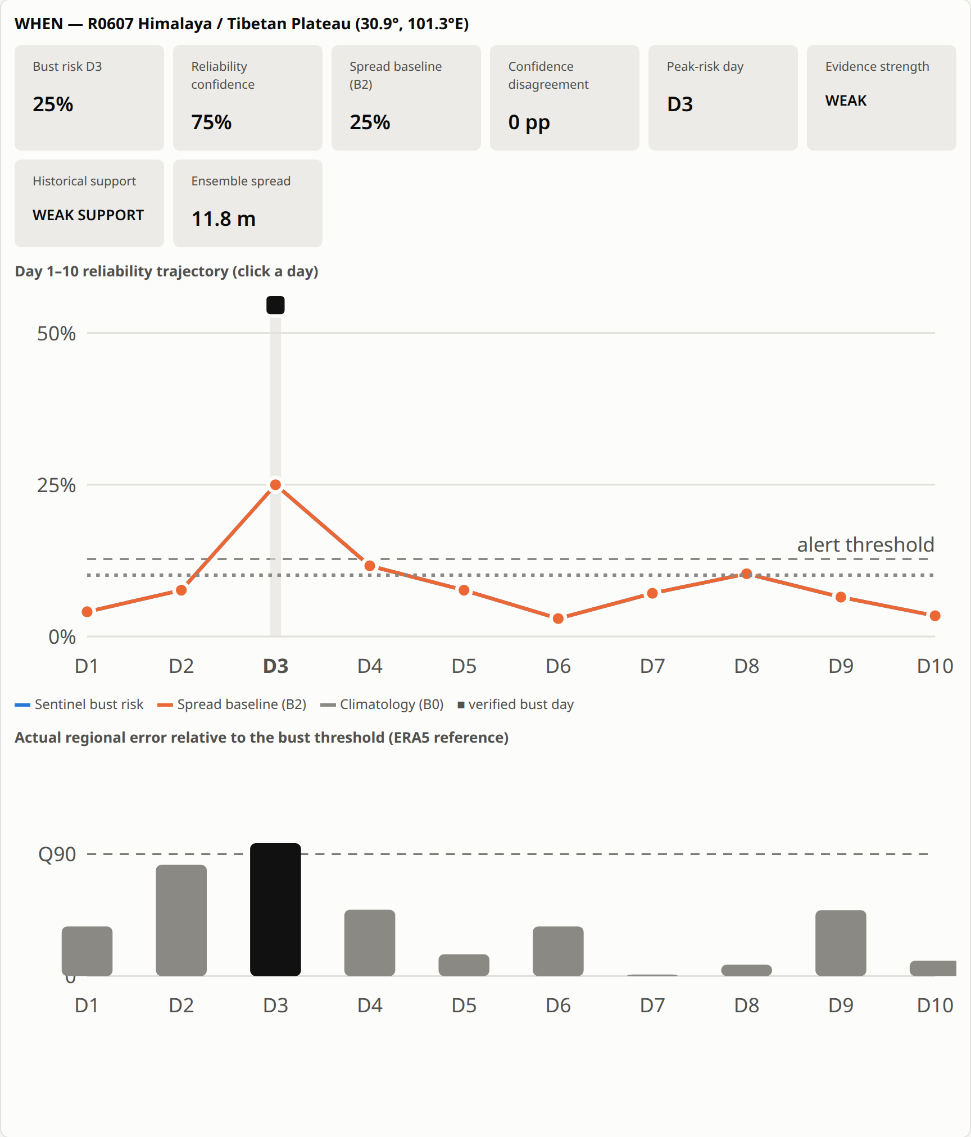
OVER_
CLOCKED
IMPACT AND BENEFITS
Helping forecasters answer: where to look, when to be cautious, why, how strong the evidence is — and what happened
1 KEY USERS
2 OPERATIONAL BENEFITS
3 FORECAST KNOWLEDGE
4 STRATEGIC VALUE
NCMRWF medium-range forecasters (primary)
Weather-sensitive operational decision makers
Disaster-management stakeholders — via forecaster-reviewed guidance, not public warnings
Earlier identification of regions where the forecast may be unreliable
Lead-time-aware: Day 1–10 trajectory + peak-risk day
Reduced manual screening: transparent review-priority queue
Transparent, number-backed reasons
Historical forecast-state memory grows with every verified forecast
Failure fingerprints (position/phase, amplitude/structure, residual)
Verification feedback per region and lead day
Reusable, auditable evidence
Better interpretation of medium-range forecast reliability
Supports weather-sensitive planning with qualified confidence
Source-agnostic architecture that can sit on NCMRWF ensembles (planned)
No lives-saved or savings figures claimed — not yet measured
REAL-WORLD IMPACT SCENARIO — replayed on a real 2022 case (2022-02-02 12 UTC, hidden-bust stress case)
1
2
3
4
5
Forecast issued
IFS ENS 50-member run; Sentinel sees only init-time information (blind mode)
Reliability screened
64 regions × Day 1–10 scored; calibrated risk vs B2 vs climatology
Risky region identified
R0607 Himalaya/Tibetan Plateau, Day 3: 25% risk (climatology 10%), evidence WEAK
Forecaster investigates
Evidence A–E: spread at 100th pct, anomaly, 30 analogues, revision, recent errors
Verified + memory updated
ERA5 reveal: bust at Day 3; fingerprint residual/mixed stored for future analogues
Same case in the prototype after “Reveal verification” (real replay output)
@SIH Idea submission · Team OVER_CLOCKED (174190) · SIH26079
5

Slide 6
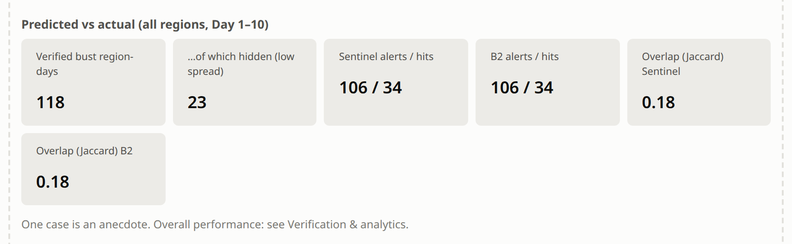
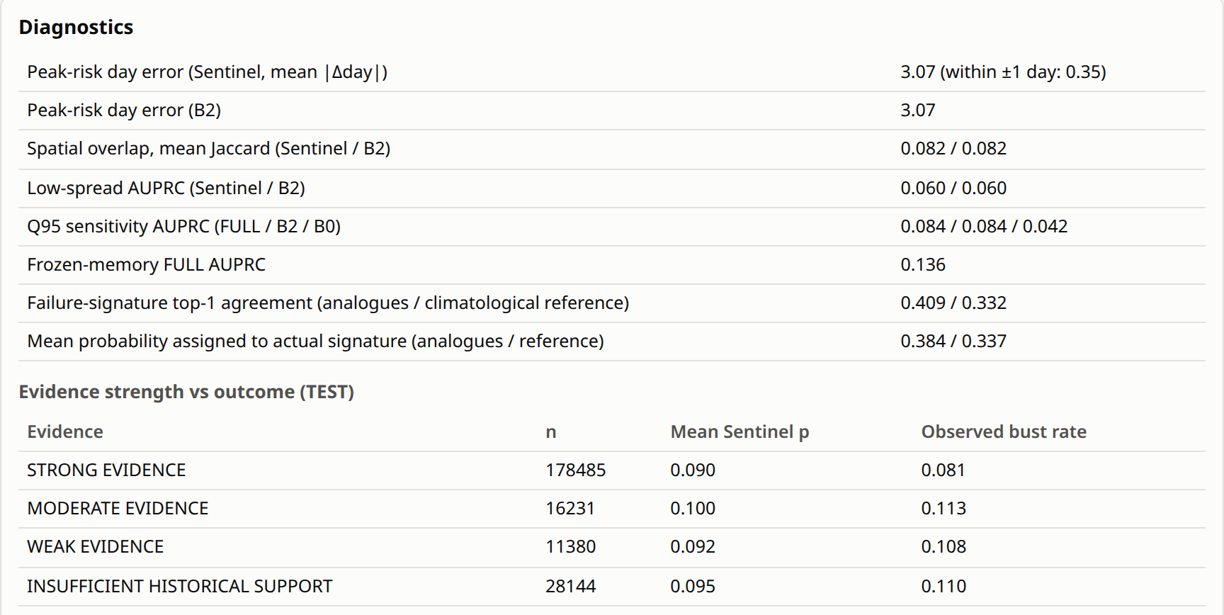
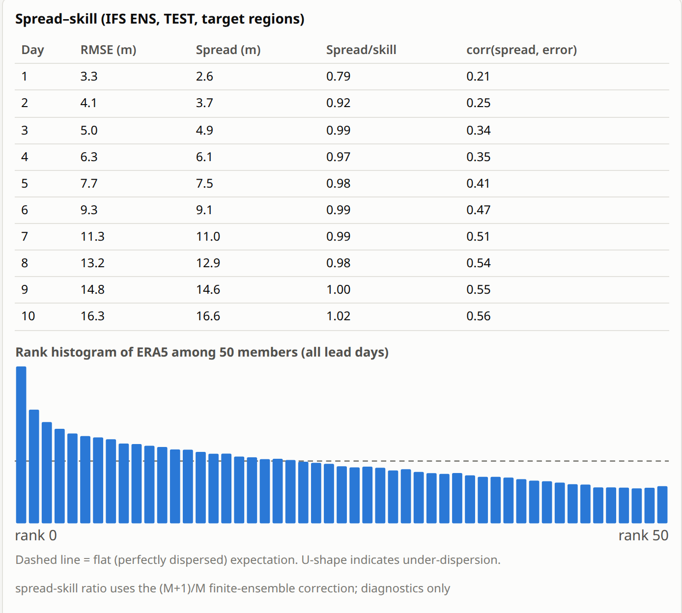
OVER_
CLOCKED
RESEARCH AND REFERENCES
Built on public research data and established forecast-verification science
Research Sources
Prototype Evidence (real 2022 replay / test artifacts)
SIH26079 problem statement — MoES / NCMRWF, Smart India Hackathon 2026.
Rasp, S. et al. (2024) WeatherBench 2: A benchmark for the next generation of data-driven global weather models. JAMES 16, e2023MS004019. (IFS ENS + ERA5 archive used)
Hersbach, H. et al. (2020) The ERA5 global reanalysis. Q. J. R. Meteorol. Soc. 146, 1999–2049.
Bougeault, P. et al. (2010) The THORPEX Interactive Grand Global Ensemble (TIGGE). Bull. Amer. Meteor. Soc. 91, 1059–1072.
Leutbecher, M. & Palmer, T. N. (2008) Ensemble forecasting. J. Comput. Phys. 227, 3515–3539. (spread–skill)
Rodwell, M. J. et al. (2013) Characteristics of occasional poor medium-range weather forecasts for Europe. Bull. Amer. Meteor. Soc. 94, 1393–1405. (forecast busts)
Chen, T. & Guestrin, C. (2016) XGBoost: A scalable tree boosting system. Proc. KDD 2016, 785–794.
Lundberg, S. M. et al. (2020) From local explanations to global understanding with explainable AI for trees. Nature Machine Intelligence 2, 56–67. (TreeSHAP)
Verification reveal: predicted vs actual busts, all regions, Day 1–10 (one case)
Diagnostics incl. failure-signature agreement 0.409 vs 0.332
Spread–skill + ERA5 rank histogram (2022)
Decision flow
Forecast
Reliability model
Risk + evidence
Forecaster review
Verification
Failure memory
Links & Resources
GitHub repository: github.com/Vishant-1001/hmmm
Prototype: runs locally — scripts/serve.sh (FastAPI + built UI); no public deployment yet
Docs in repo: methodology · leakage controls · evaluation · model card · limitations
Failure memory feeds the analogue search for the next forecast (loop closed in replay; live operation planned).
@SIH Idea submission · Team OVER_CLOCKED (174190) · SIH26079
6

