Slide 1
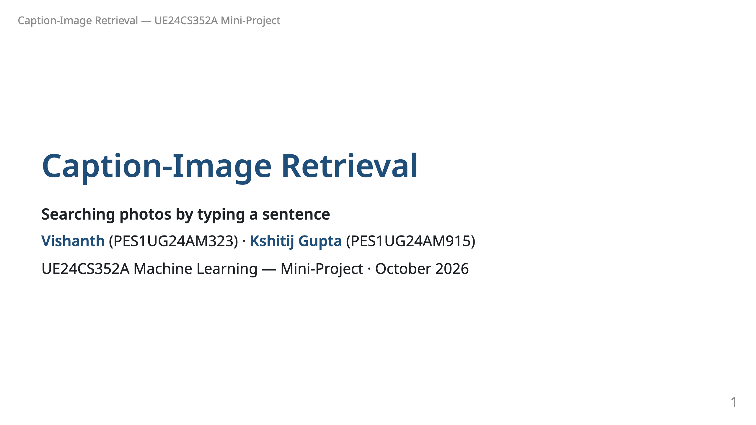
Notes:
Say: "Our project is a search engine for photos. You describe the photo in plain English, and it finds it."

Slide 2
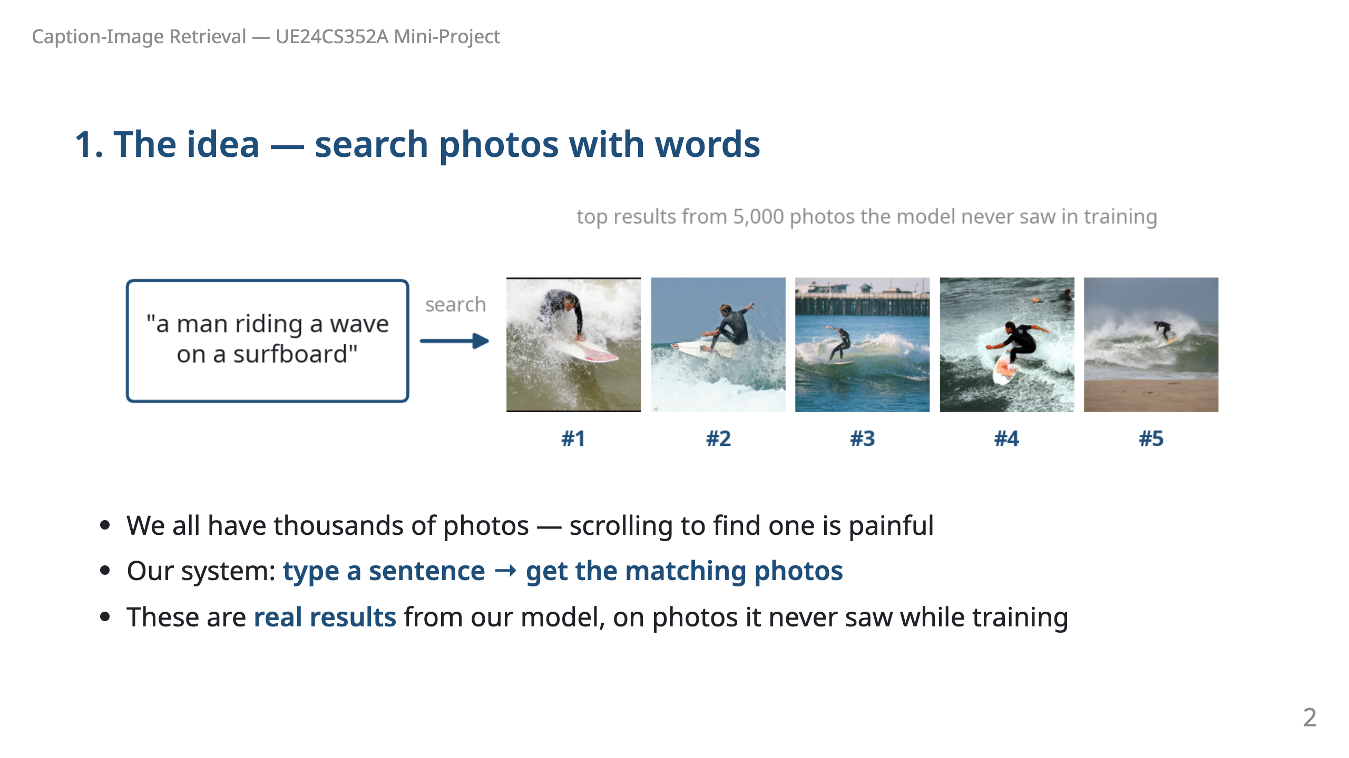
Notes:
Say: "This is a real query on our trained model. It searched 5,000 photos it had never seen, and all top five are surfers. Nobody tagged these photos — the model looked at the pixels."

Slide 3
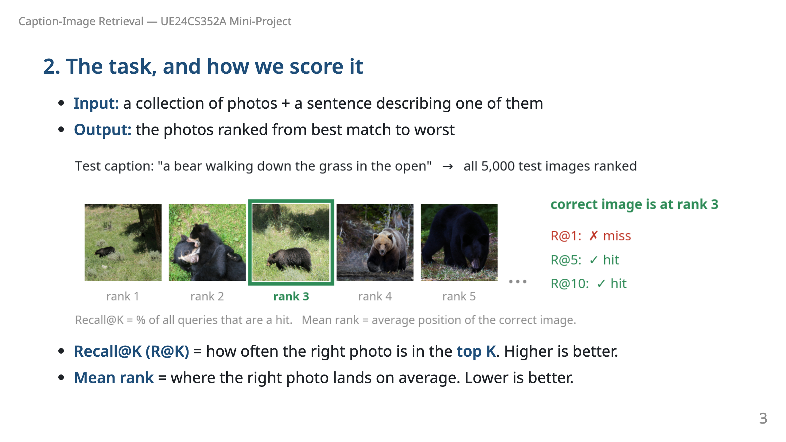
Notes:
Say: "To measure quality we take a caption written for a known photo and check where that photo lands. Here it is 3rd: a miss for R@1 but a hit for R@5 and R@10. We repeat this for all 25,000 test captions and report the percentage."

Slide 4
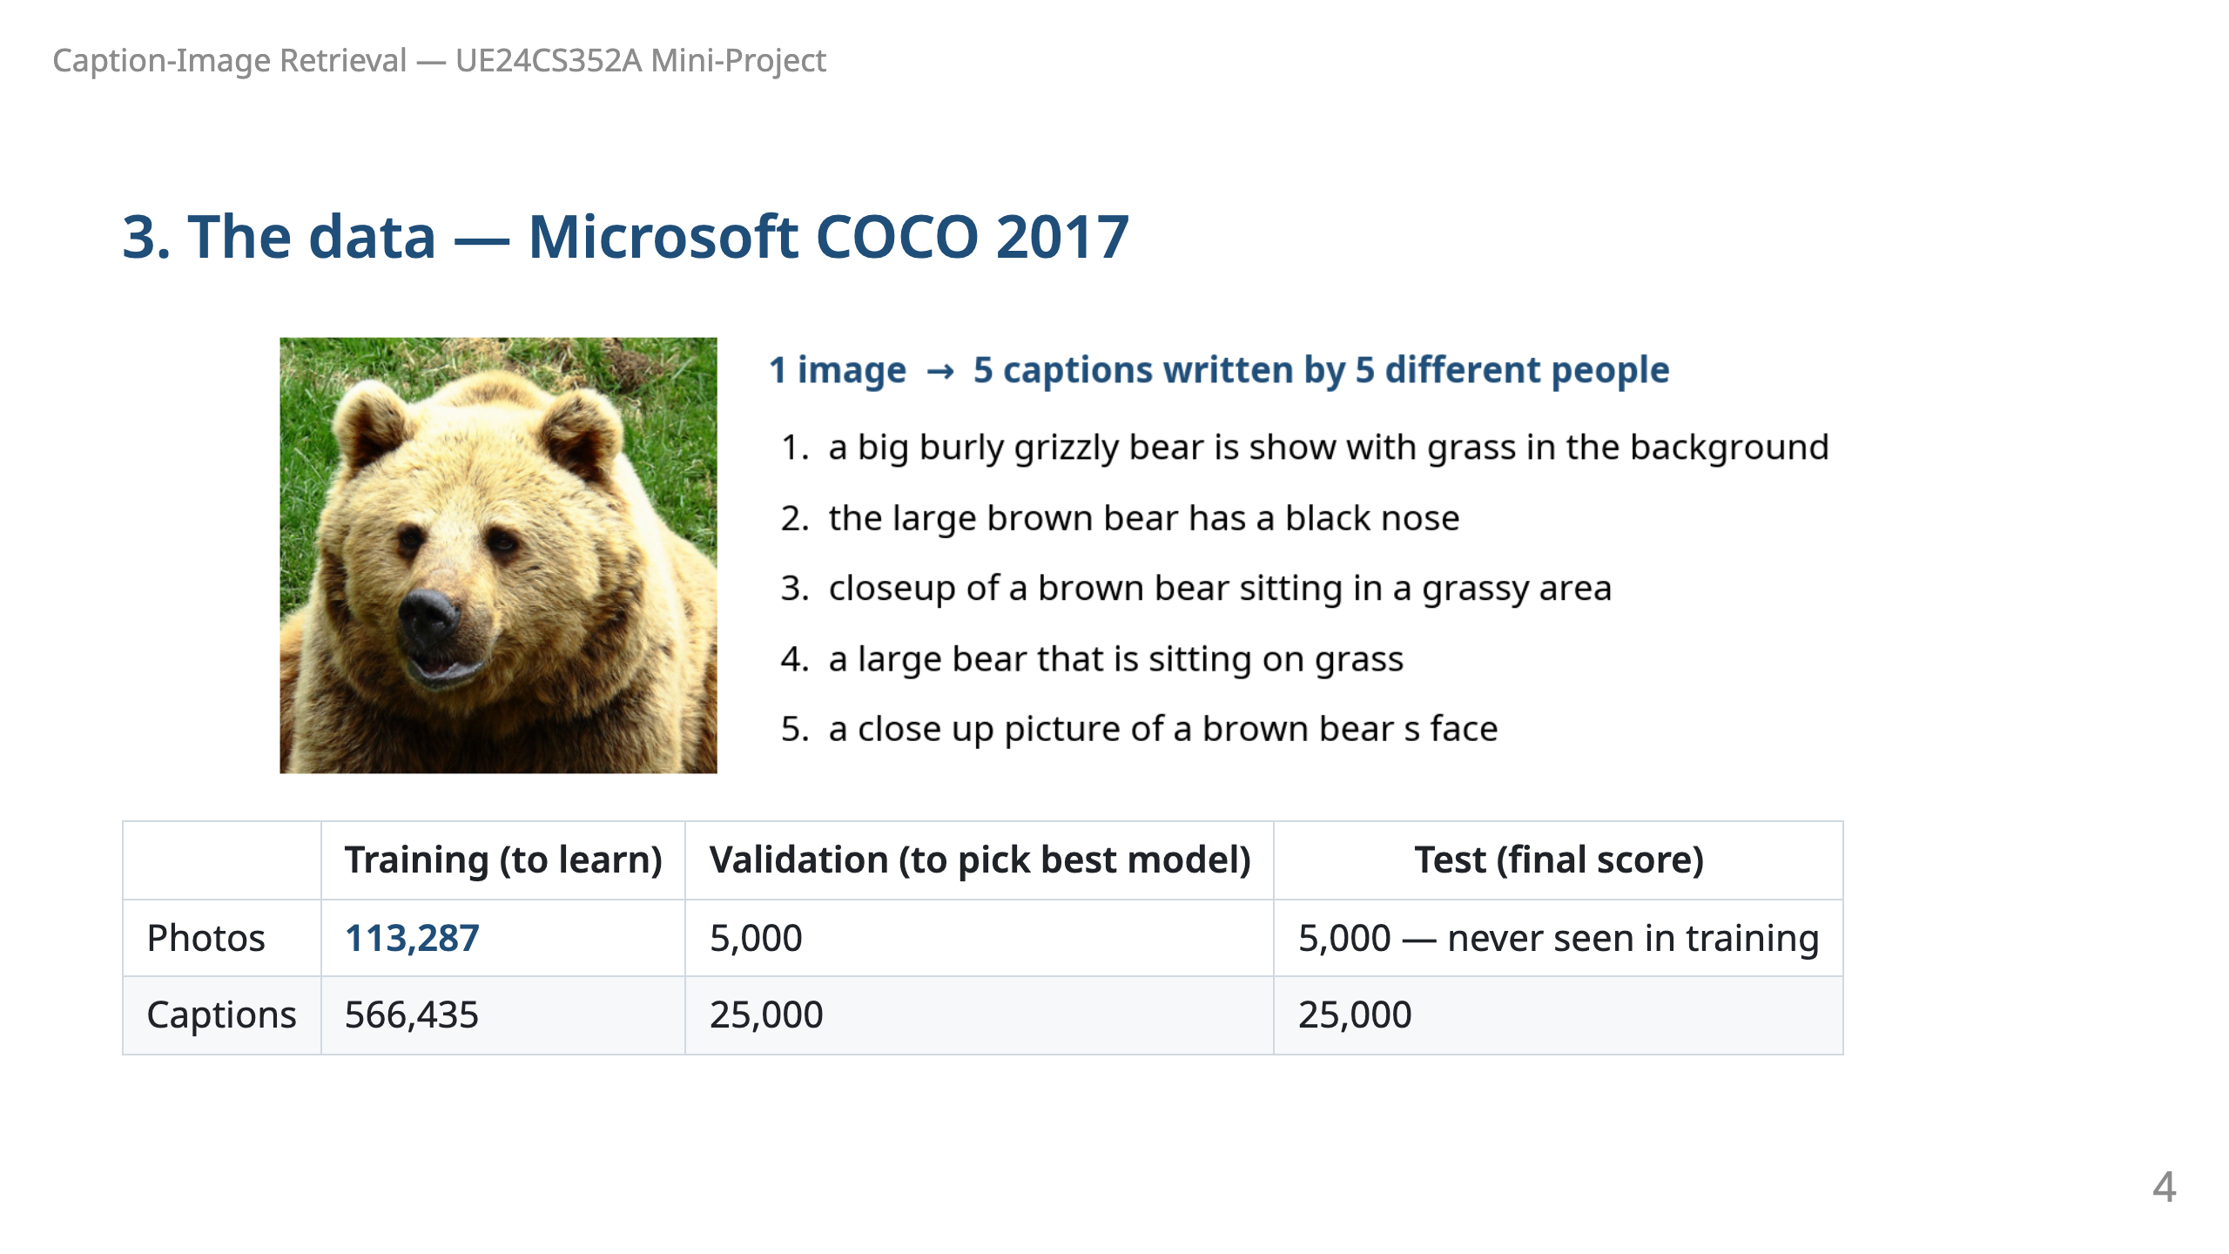
Notes:
Say: "COCO is a public dataset of everyday photos. Every photo was described by five different people. We learn from 113 thousand photos, pick our best model with 5,000 more, and report final scores on another 5,000 the model has never seen." Captions average about 10 words; 95% have 15 or fewer.

Slide 5
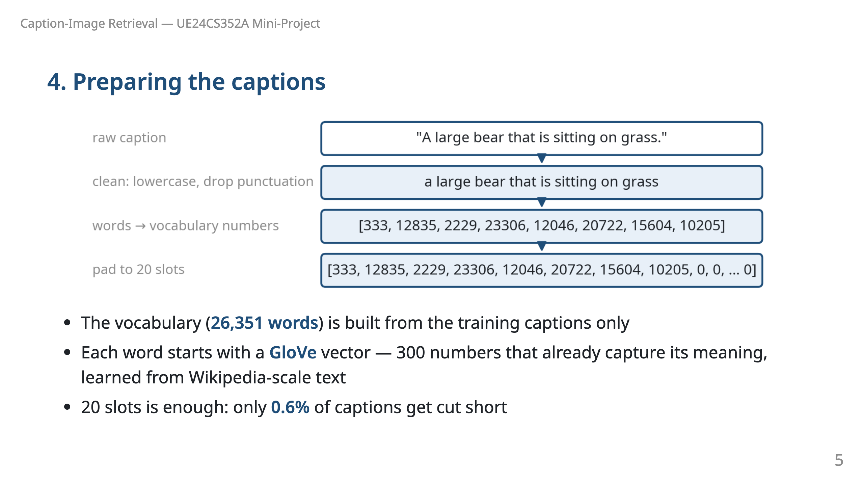
Notes:
Say: "Computers need numbers, so every word gets an ID, and every ID gets a vector of 300 numbers from GloVe. GloVe already knows that 'dog' and 'puppy' are similar. It covers 99.87% of the words in our captions." Words never seen in training become <unk> — only 0.2% of test words.

Slide 6
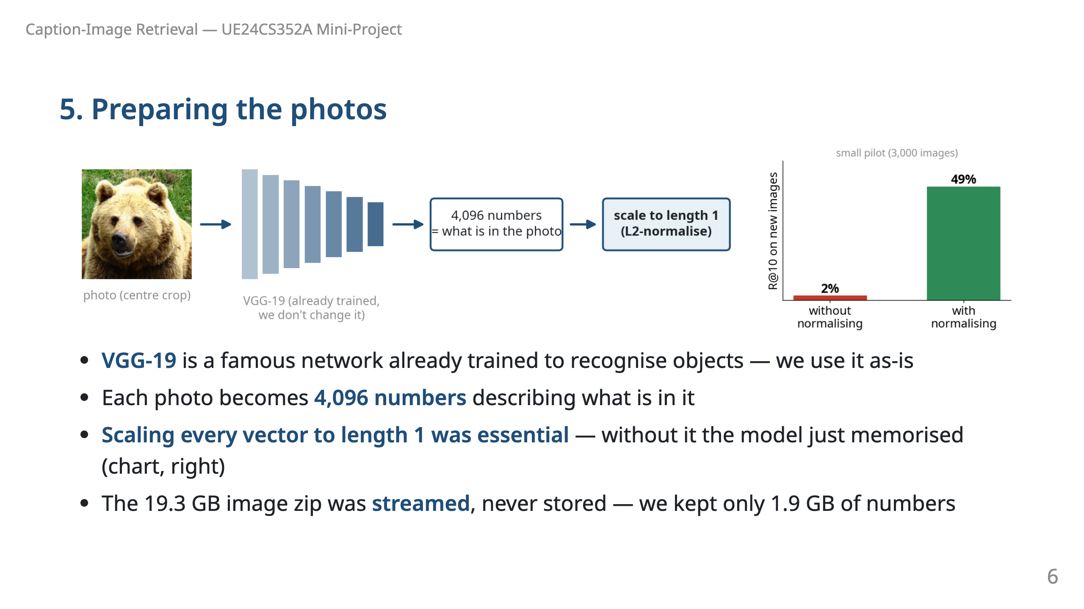
Notes:
Say: "We don't train the image network ourselves — VGG-19 already recognises objects. We ask it for 4,096 numbers per photo. One lesson we learned the hard way: those vectors must be scaled to the same length. In a small test, without that step the model scored 2%; with it, 49%."

Slide 7
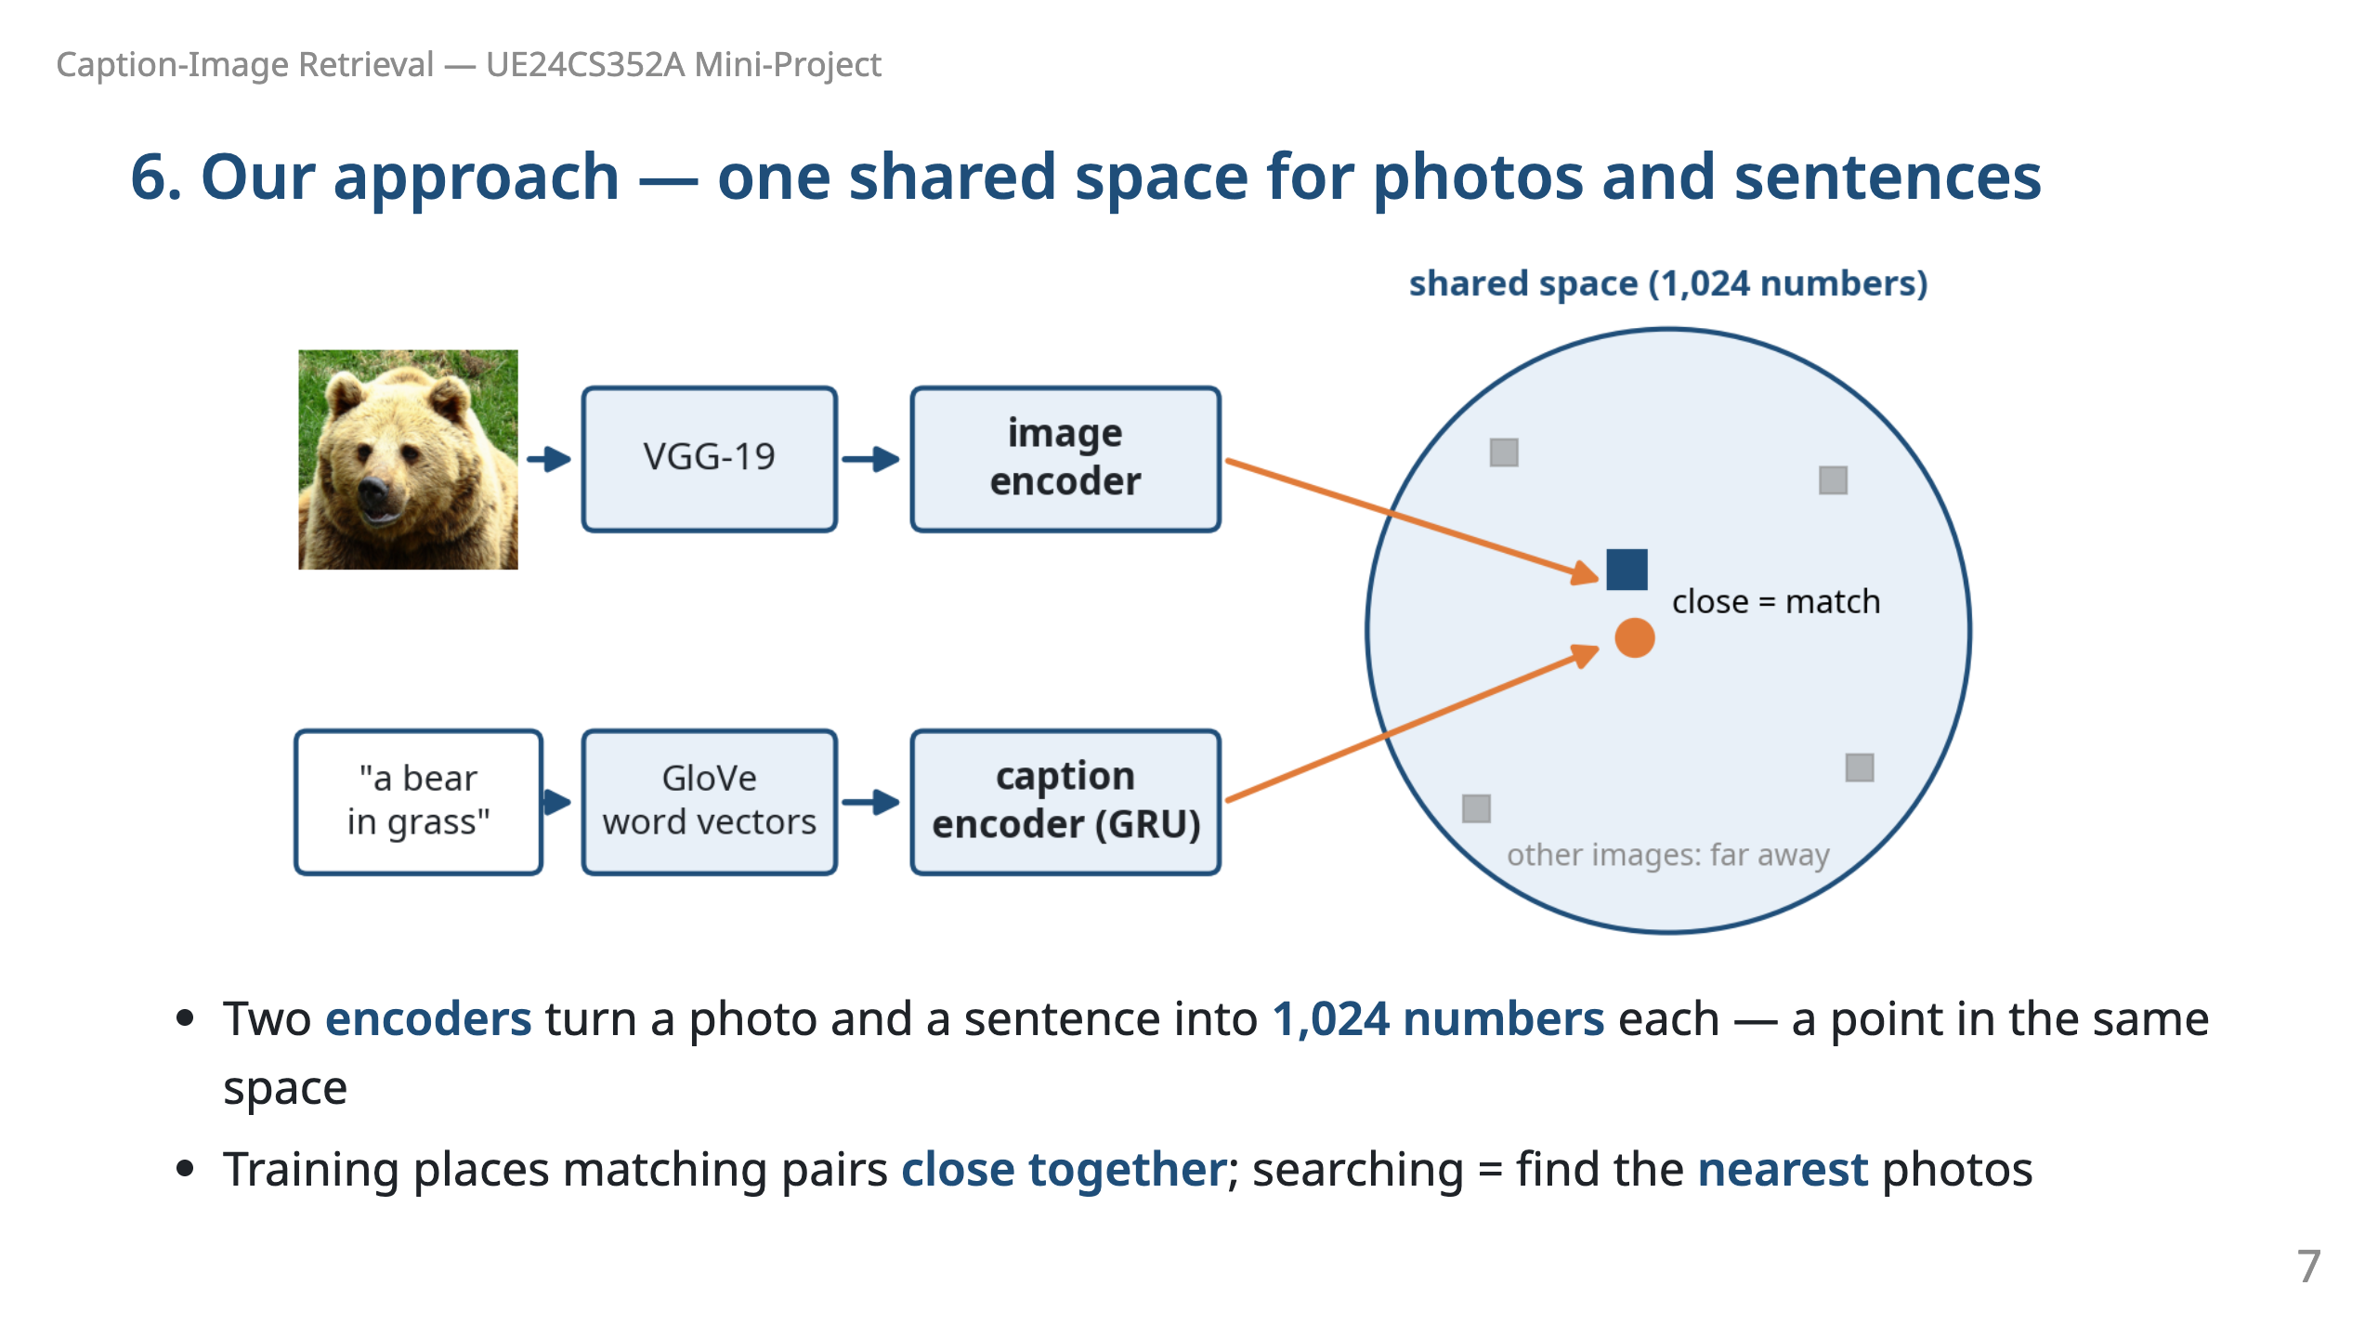
Notes:
Say: "Photos and sentences are different kinds of data, so we can't compare them directly. We learn two encoders that map both into the same space. A sentence lands next to the photos it describes. Searching is then just measuring distance."

Slide 8
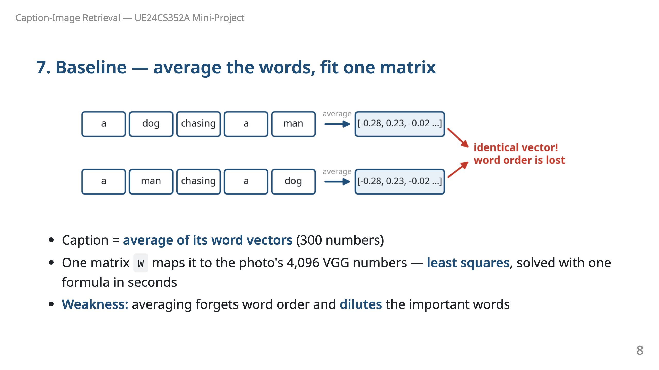
Notes:
Say: "Our simple baseline averages the word vectors and fits a linear map, like linear regression with many outputs. It is fast, but look: 'a dog chasing a man' and 'a man chasing a dog' give exactly the same numbers. These are real GloVe values."

Slide 9
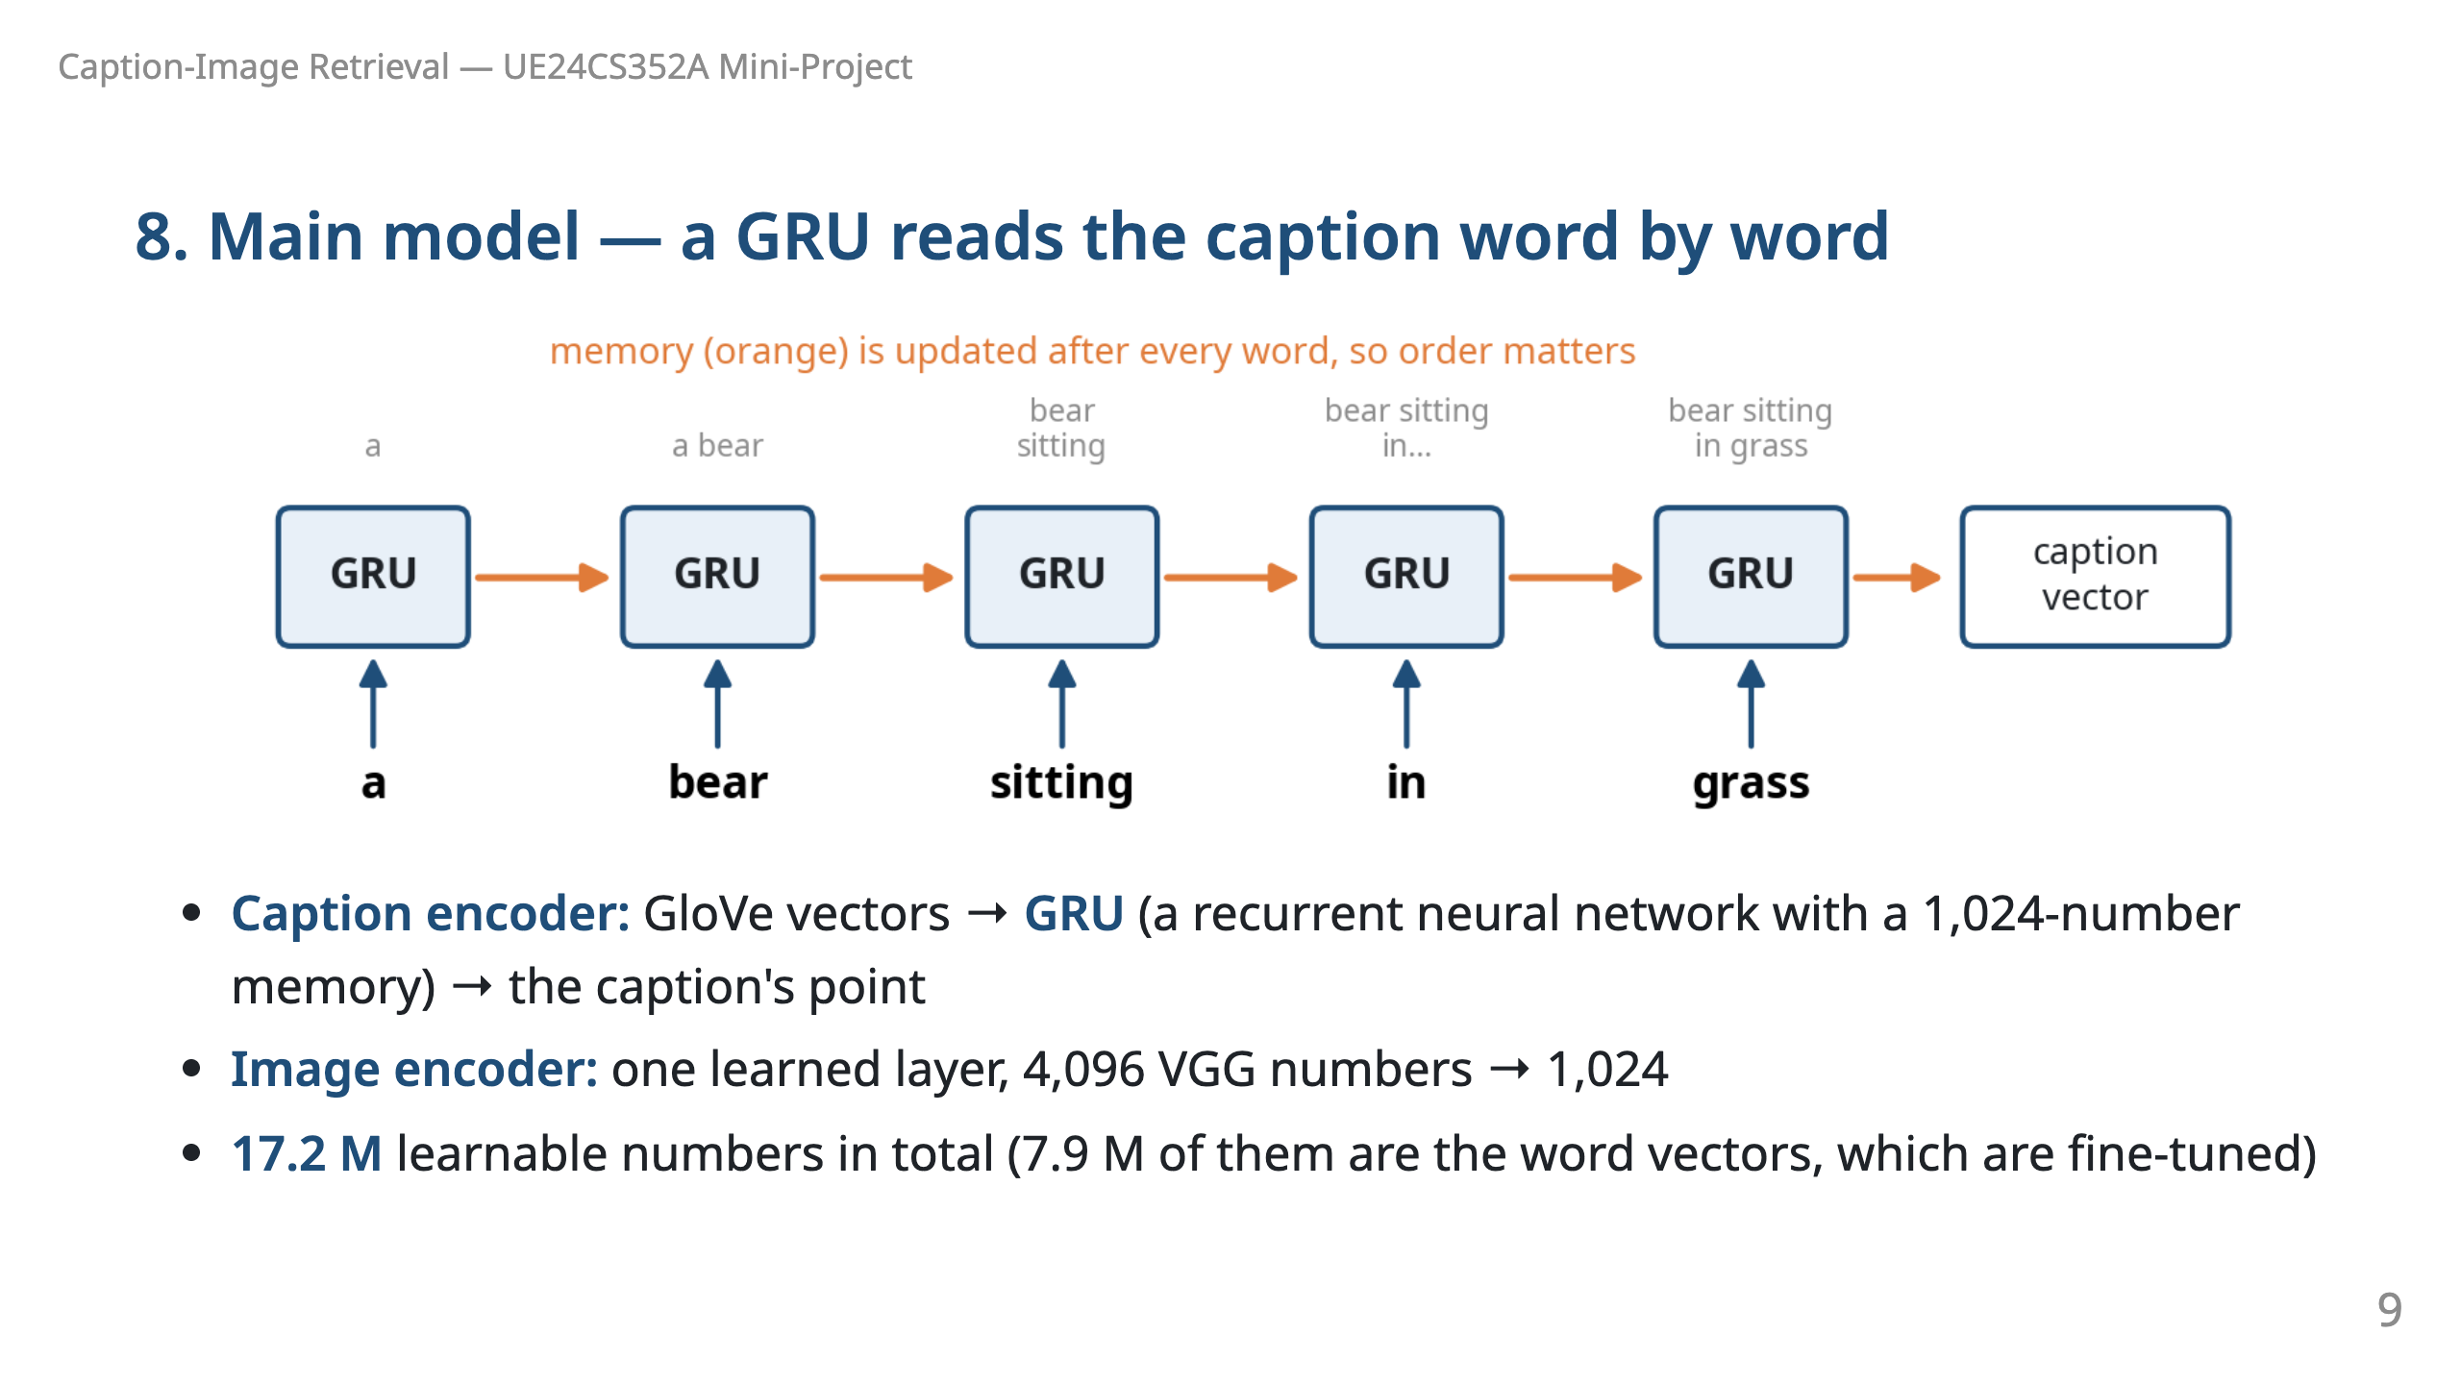
Notes:
Say: "Instead of averaging, a GRU reads the words in order and keeps a memory that it updates after each word. So it knows 'dog chasing man' is different from 'man chasing dog', and it learns which words matter." Based on Vendrov et al. (2015).

Slide 10
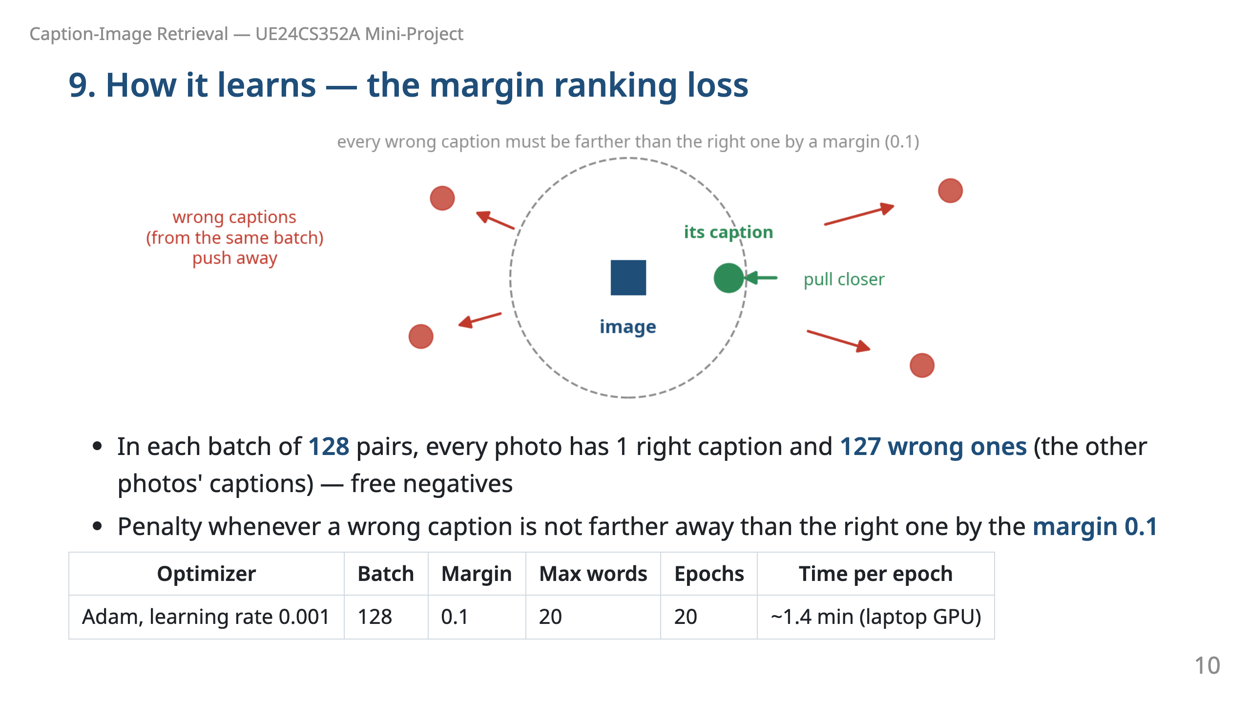
Notes:
Say: "Training is a game of pull and push: pull each photo's own caption closer, push the other captions away. We never need extra labels — the other examples in the batch are the wrong answers." We also tried learning rate 0.05 (the reference paper's); the loss fell but accuracy stayed near chance, so we used 0.001. We keep the epoch with the best validation score.

Slide 11
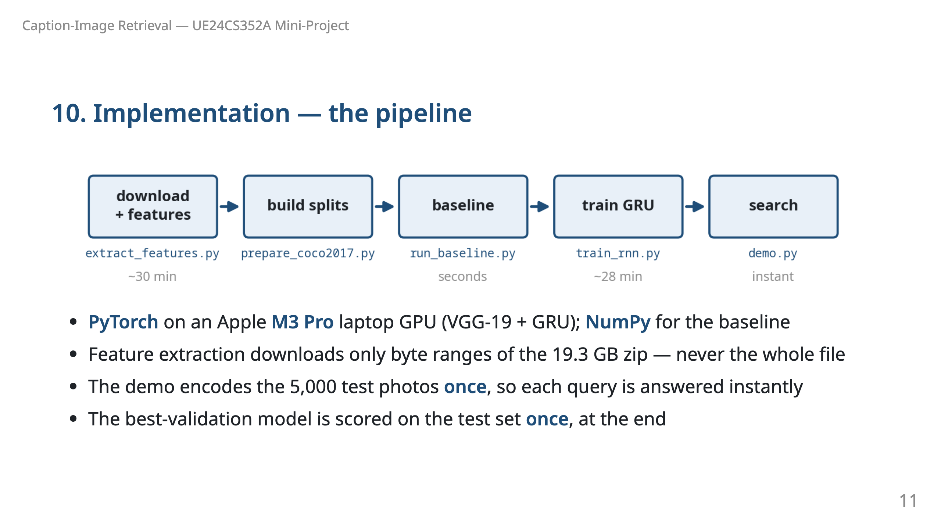
Notes:
Say: "Everything ran on a laptop. The full pipeline is five scripts — from raw COCO images to an interactive search demo." Other modules: data.py, glove.py, vocab.py, baseline.py, models.py, retrieve.py, remote_zip.py.

Slide 12
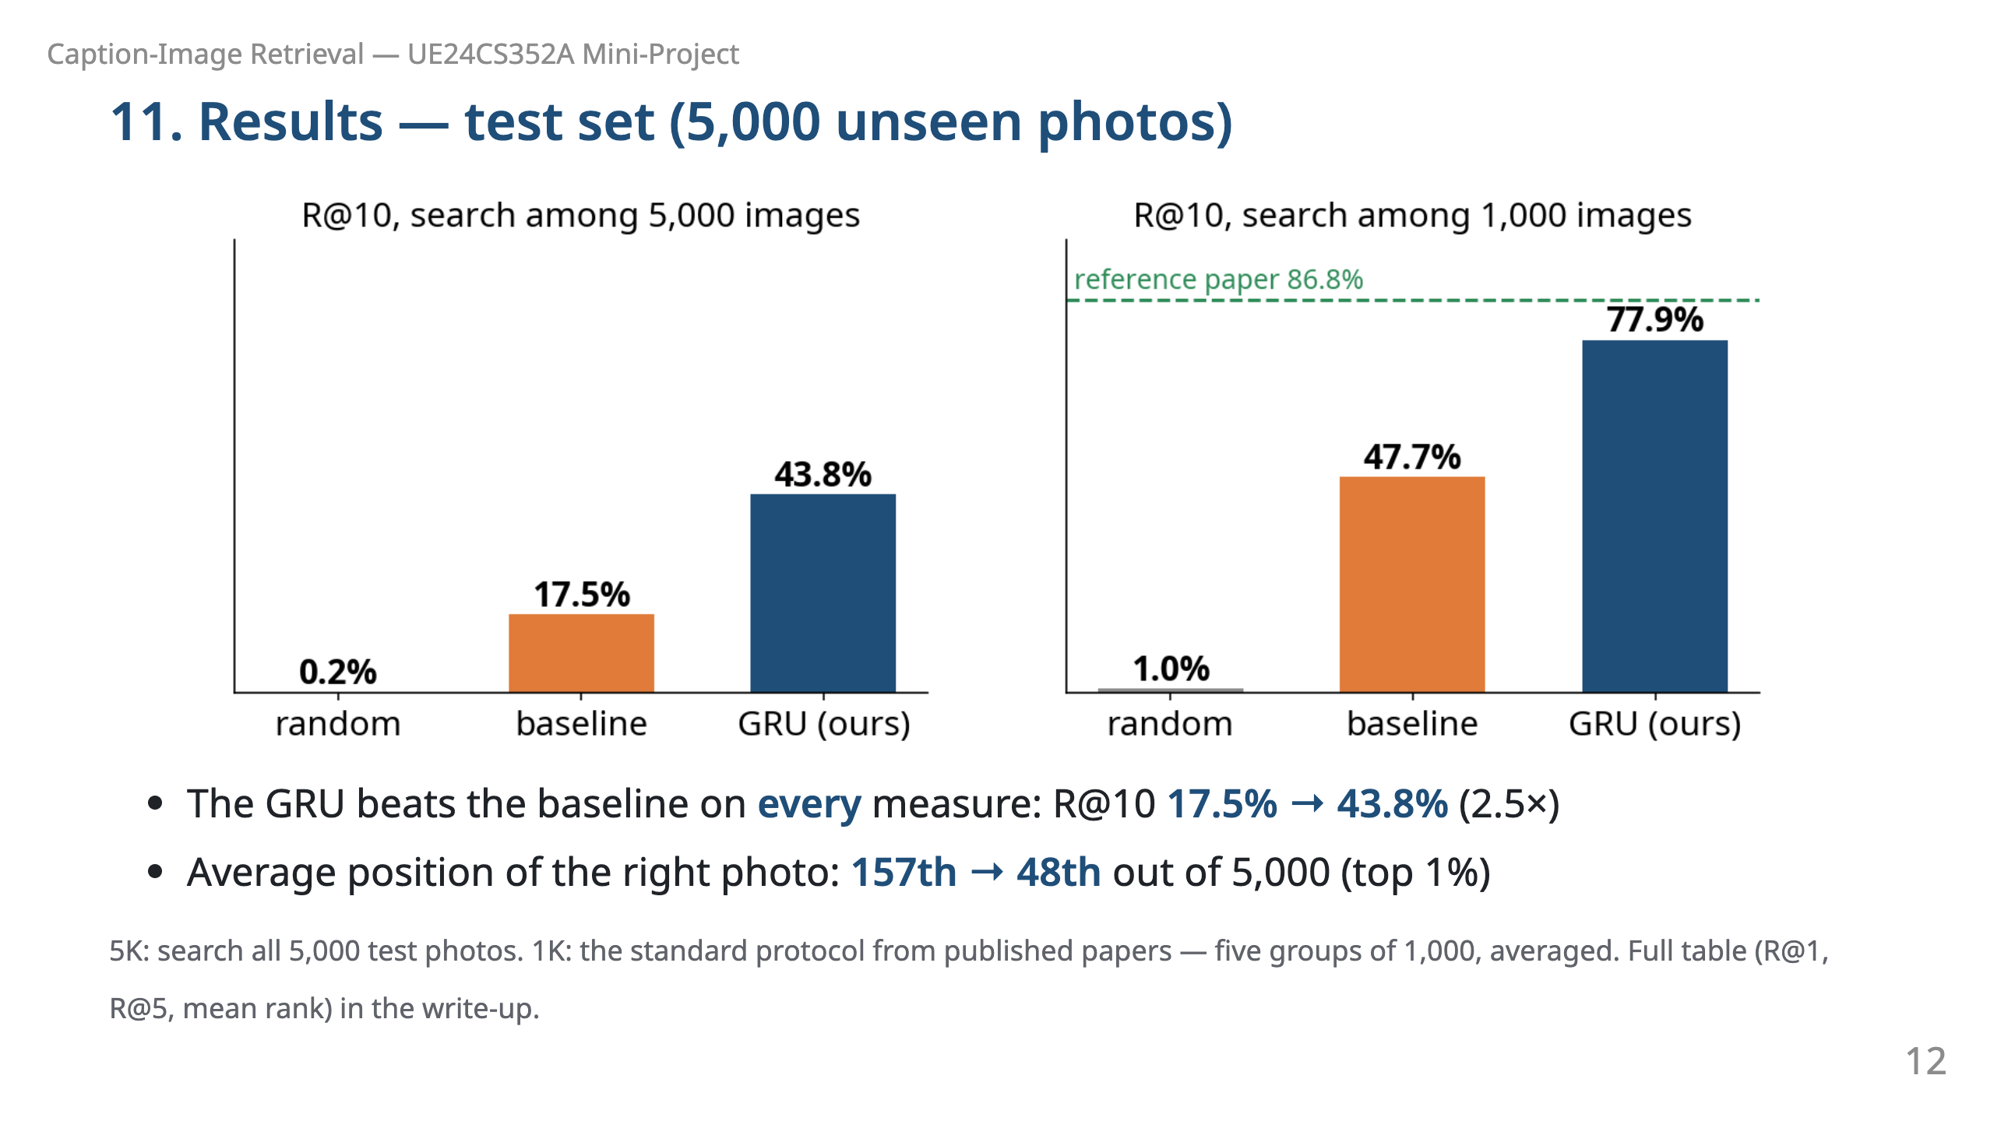
Notes:
Numbers to have ready. 5K — baseline R@1 2.8, R@5 10.7, R@10 17.5, mean rank 156.7; GRU 10.4, 30.6, 43.8, 48.1. 1K — baseline 9.7, 31.6, 47.7, 32.2; GRU 26.9, 62.4, 77.9, 10.4. Random guessing: R@10 0.2% (5K), 1% (1K).

Slide 13
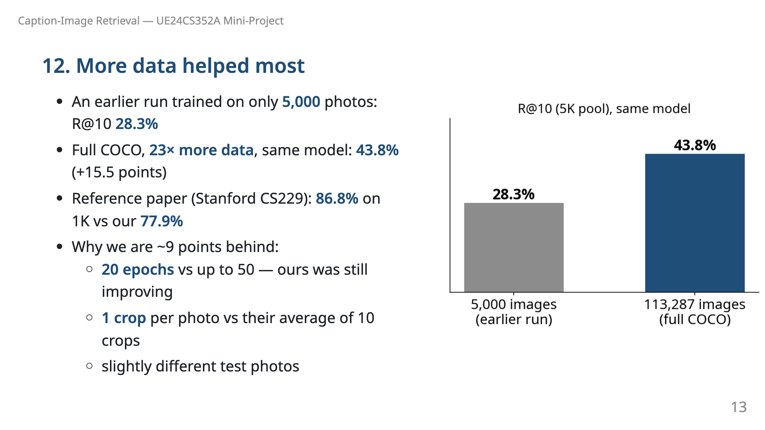
Notes:
Say: "The biggest single improvement was simply using all the data. We are close to the published result; the remaining gap is explained by shorter training and simpler image features, which we chose to finish on time." Vendrov et al. (2015) GRU: 85.8% on 1K.

Slide 14
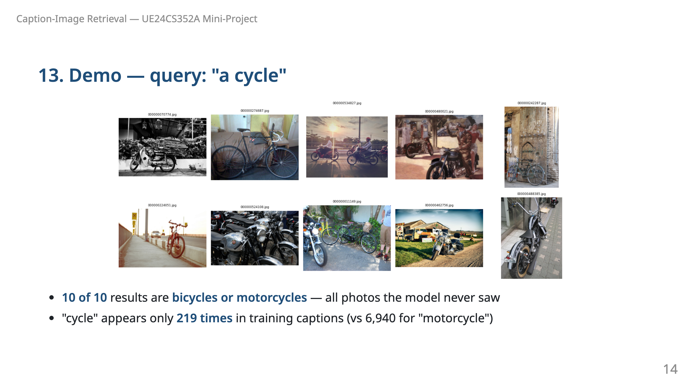
Notes:
Say: "Even a rare word works: the model learned that 'cycle' is related to bikes from just a few hundred examples, helped by GloVe." Our earlier 5k-photo model got 8 of 10, with a locomotive and a clock among the misses.

Slide 15
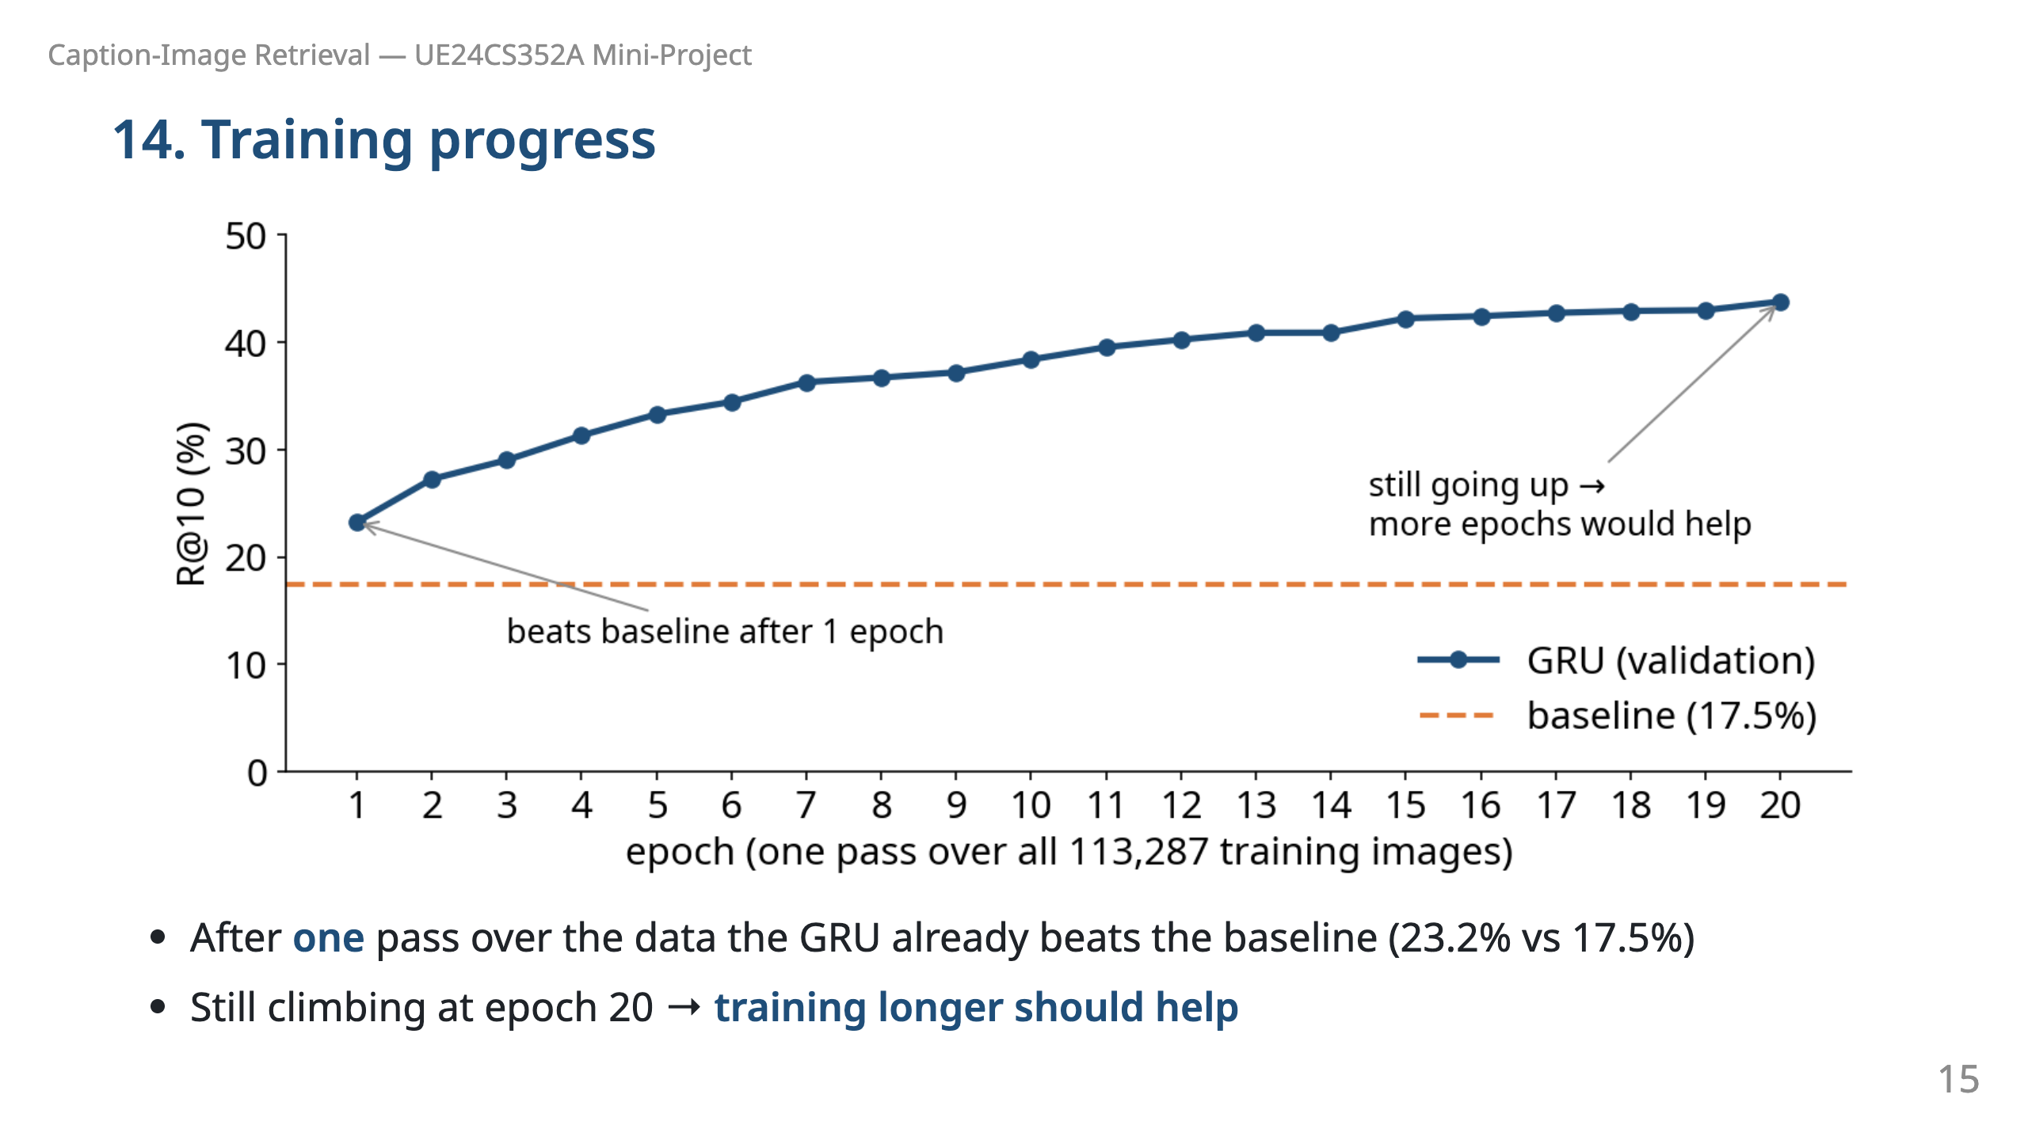
Notes:
Say: "Each epoch is one pass over all 113 thousand training photos and takes about 1.4 minutes. The curve has not flattened yet, so more epochs would likely close more of the gap to the paper." Loss fell from 180 to 24.

Slide 16
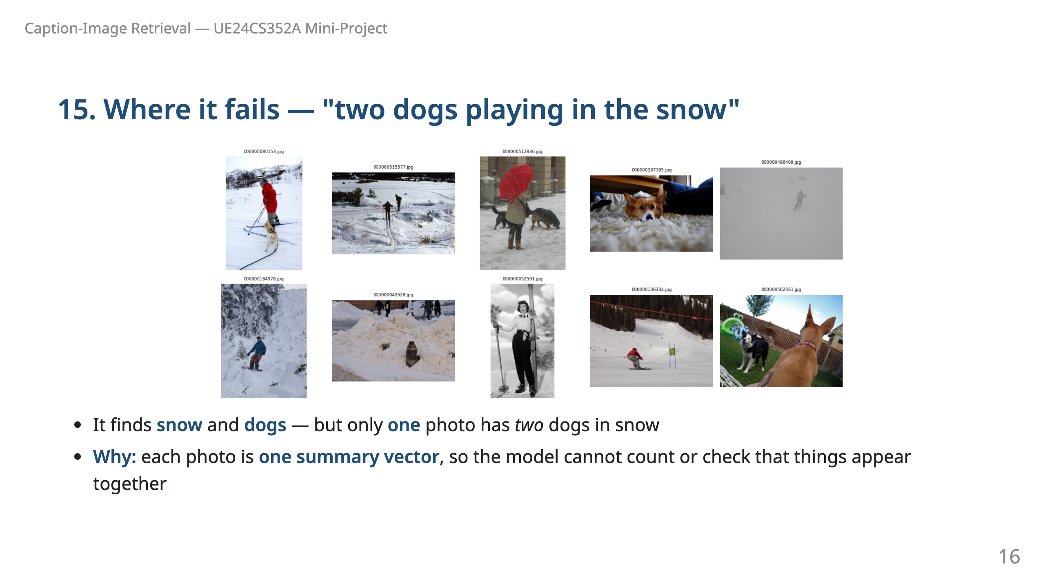
Notes:
Say: "Being honest about limits: the sentence side understands 'two dogs' and 'snow', but the photo side is a single summary of the whole picture. It cannot look at regions or count objects. Fixing that needs attention over image regions."

Slide 17
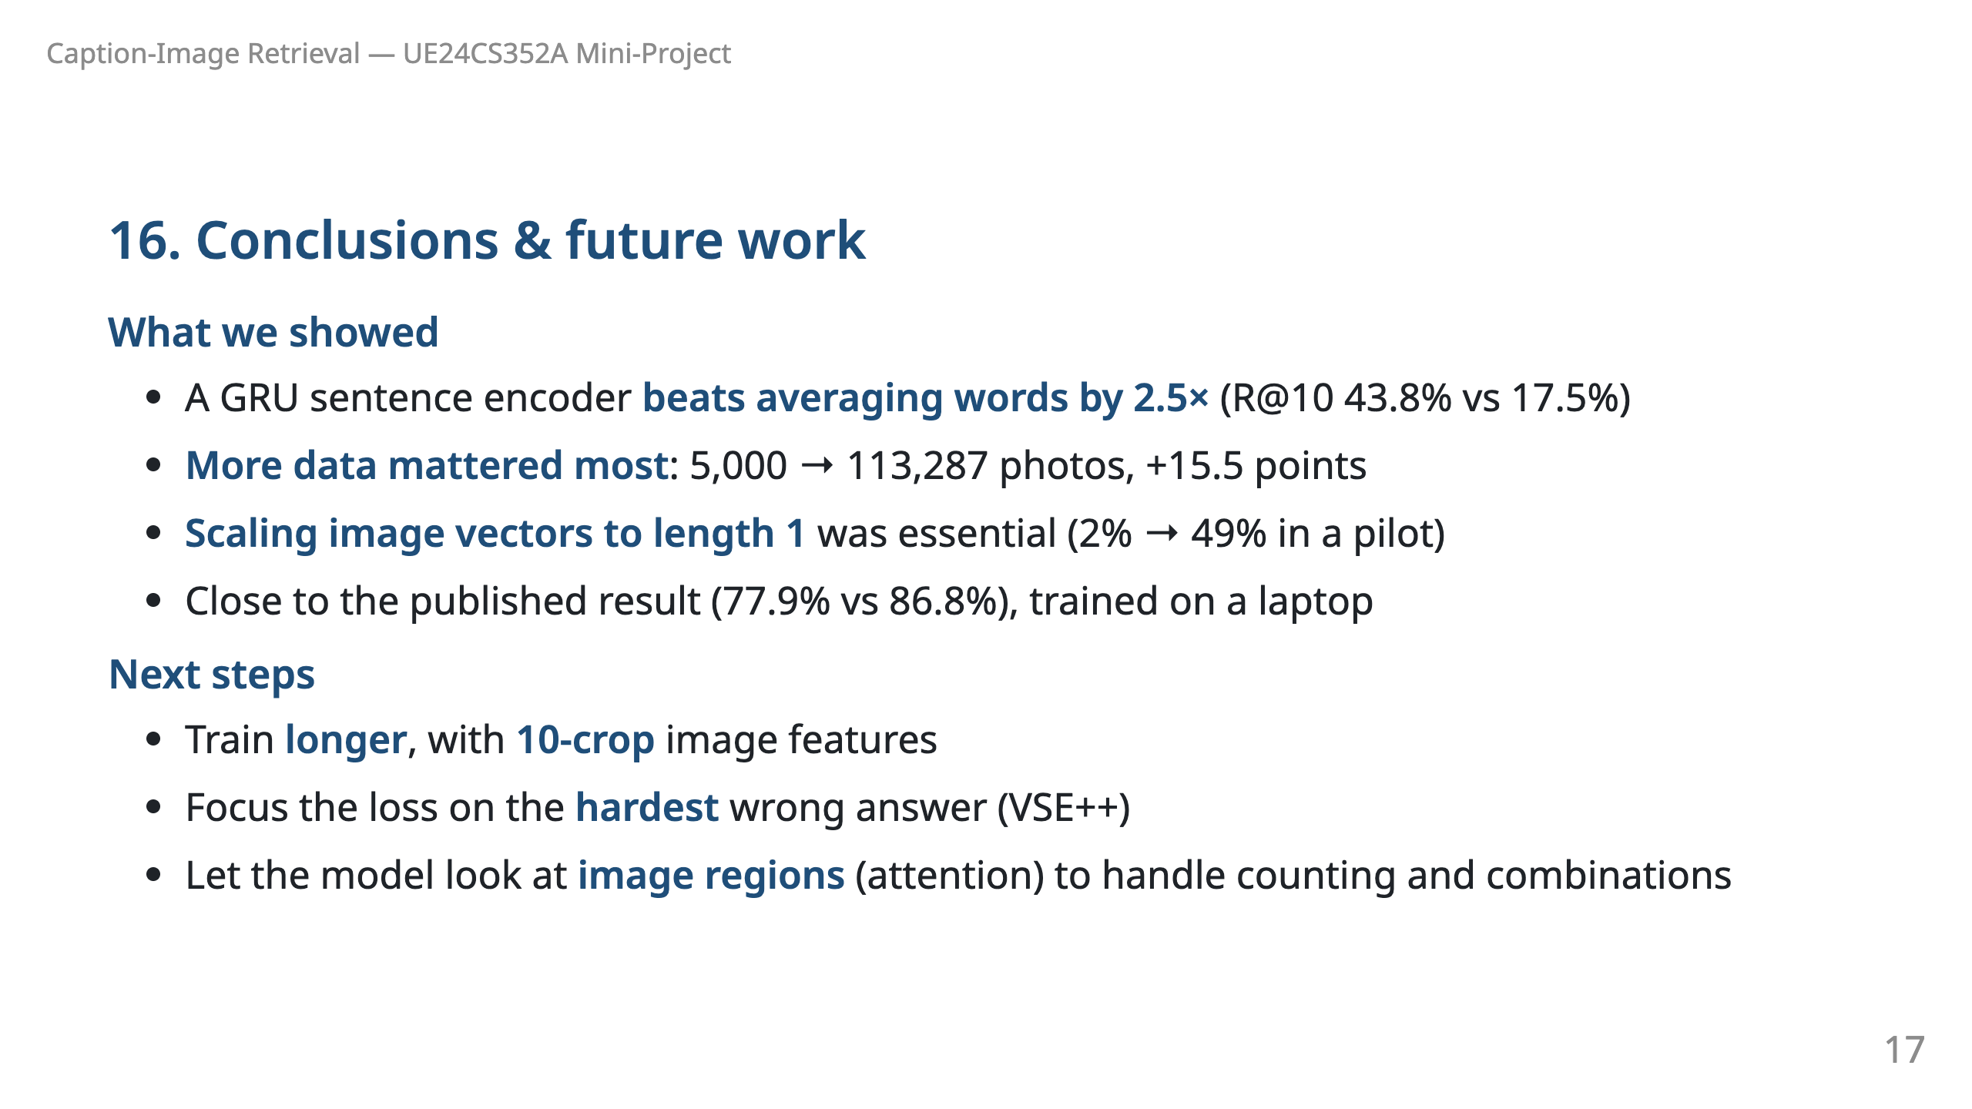
Notes:
Say: "In short: reading words in order beats averaging, data scale matters most, and a small preprocessing detail made or broke the model."

Slide 18
