Slide 1
NATURAL LANGUAGE INTERFACES TO DOMAIN SPECIFIC KNOWLEDGE BASES – AN ILLUSTRATION FOR QUERYING ELEMENTS OF THE PERIODIC TABLE
COMP 6591 PROJECT PRESENTATION
TEAM T107 1. Ananya Varsha - 40197012
2. Saghana Mahesh Sarma - 40198979
3. Sivakumaran Malli Janarthanan - 40155790
4. Vishanth Surresh - 40181942

Slide 2
Introduction
Knowledge Representation is predominantly used in the field of Artificial Intelligence.
But there is a lack of Domain specific Data Knowledge.
Our Project aids to solve this issue by implementing a knowledge base system for the periodic table.
Secondly, we are using NLP to understand the user input and map those natural language inputs to Knowledge base and provide answers to the user.

Slide 3

Why we have selected this Paper
NLP and NLI are trending topics that currently Data Scientist and Data Engineers are working in the IT industry
As Data Engineers/Scientists we are very eager to work on this paper as it relates to our job roles and provides us a array of new learning experiences.
Additionally, we found that Connecting Prolog with NLP is very interesting.

Slide 4
Literature Review
In the last couple of years, numerous researchers have focused on developing NLP for Business Analysis, and these NLPs have been developed both for relational databases and knowledge bases. NLI for complex aggregates was proposed by Gupta [5].
Setlur[6] developed an NLI for visual analysis. He employed probabilistic grammar-based approach with predefined rules that are dynamically updated based on the data visualizations.
Some major problems while developing NLI and NLP are due to the natural language phenomenon, such as, lack of concise and definitions, ambiguity, influence and change of context, etc.

Slide 5
Natural Language Processing
The ability of a machine to read, comprehend and derive a possible meaning from human languages is known as Natural Language processing.
NLP tends to process large volumes of textual data at ease. [1]
NLP also allows structuring a highly unstructured data source.
At present, there are numerous open source libraries for NLP which helps us to perform operations easily.
We have also leveraged the use of NLP libraries for our implementation in Python. [2]

Slide 6
Prolog
A simple logic programming language, widely used in the field of Artificial Intelligence.
It was predominantly used as a declarative programming language.
The core of Prolog lies in the logic that is being applied.
logic is expressed as relations called as Facts and Rules.
It is easy to build a data representation and does not require much programming effort.
Execution of a Prolog program is initiated by the user's posting of a single goal, called the query. [3]

Slide 7
KBS addressed by the paper
The knowledge base in this paper has been organized and structured in terms of Prolog predicates, facts and rules.
These have been represented using Horn clause of first order predicate logic.
The knowledge base of the periodic table, i.e their properties and physical structure have been coded as Prolog predicates. [4]

Slide 8
KBS addressed by the paper
Facts:
period_group(atomicNumber, symbol, element, group, period, discoverer).
physical(atomicNumber, symbol, element, metal, nonmetal, density, meltingPoint, boilingPoint, atomicRadius, electronegativity.
magnetic(atomicNumber, symbol, element, magnetism).
type(atomicNumber, symbol, element, type).
phase(atomicNumber, symbol, element, phase, radioactive).

Slide 9
Areas of KB system utilized
Prolog facts, rules & queries.
Complex structures.
Lists & it’s manipulation.
Extended logic programming – Python.
Categorial syllogism.

Slide 10
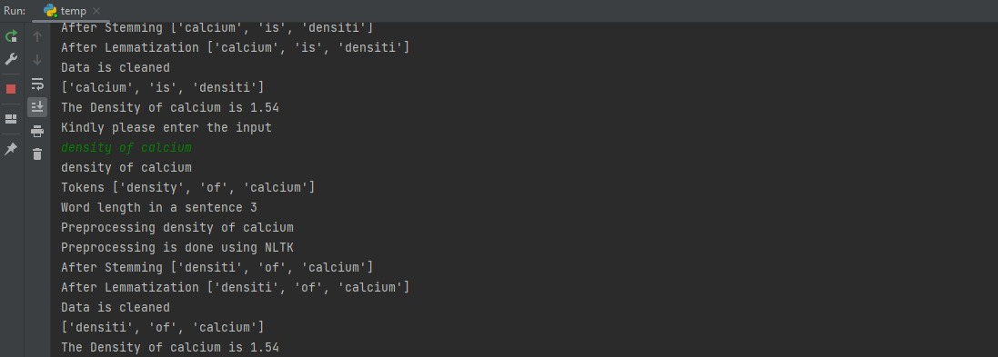
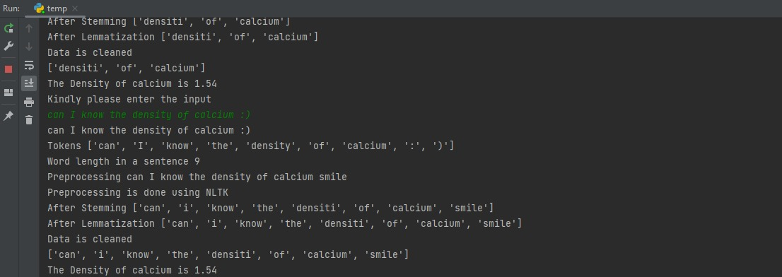
Implementation

Slide 11
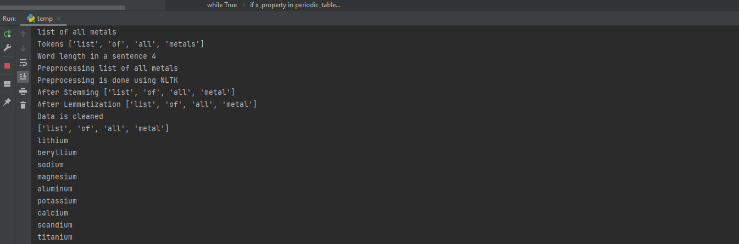
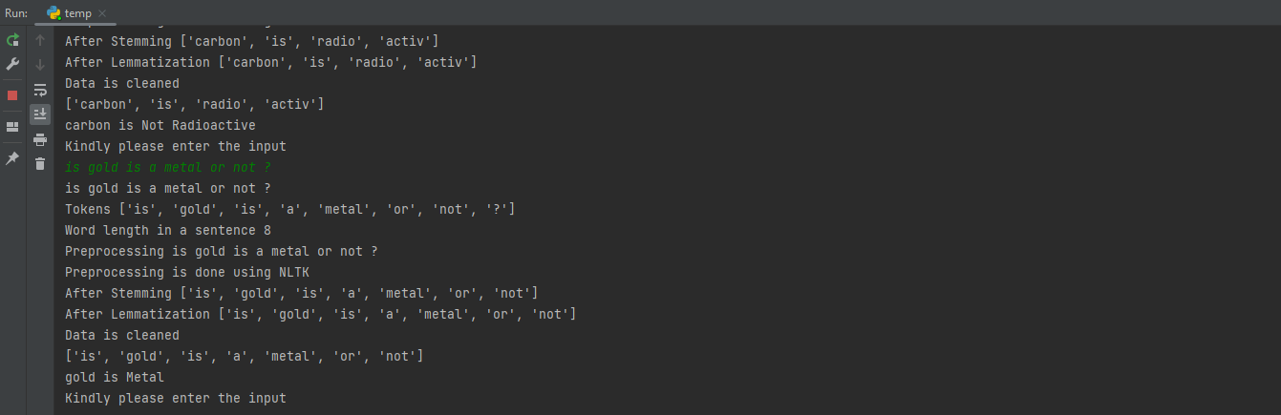
Implementation

Slide 12
Conclusion
An integration between the logical programming of Prolog and the most widely utilized scripting language Python have been performed in this paper.
It provides us a wide array of learning experiences, both with Prolog and NLP.

Slide 13
References
[1] https://en.wikipedia.org/wiki/Natural_language_processing
[2] https://towardsdatascience.com/your-guide-to-natural-language-processing-nlp-48ea2511f6e1
[3] https://en.wikipedia.org/wiki/Prolog
[4] Rohil, Mukesh Kumar, et al. "Natural language interfaces to domain specific knowledge bases: an illustration for querying elements of the periodic table." 2018 IEEE 17th International Conference on Cognitive Informatics & Cognitive Computing (ICCI* CC). IEEE, 2018.
[5] Gupta, Abhijeet. "Complex Aggregates In Natural Language Interface To Databases." International Institute of Information Technology, Hyderabad (2013).
[6] Setlur, Vidya, et al. "Eviza: A natural language interface for visual analysis." Proceedings of the 29th annual symposium on user interface software and technology. 2016.

Slide 14
Thanks!
Any questions?

