Slide 1
Customer Behaviour Analysis
What drives revenue across 3,900 purchases: insights from SQL and Power BI
Python | MySQL | Power BI

Slide 2
The data at a glance
3,900
$233K
$59.76
3.75 / 5
customers
total revenue
avg purchase
avg review rating
Cleaned in Python: 37 missing ratings filled with the category median, duplicate promo column dropped, age quartile groups added.
Analysed in MySQL: 10 business questions. Visualised in Power BI: one interactive page.

Slide 3
Clothing and Accessories drive 77% of revenue
Clothing: 44.7%
Accessories: 31.8%
Footwear: 15.5%
Outerwear: 7.9%
Outerwear has only two products (Jacket, Coat), so it stays the smallest category.

Slide 4
Spending is even across age and gender
Male: $157,890
68% of customers, $59.54 avg spend
Female: $75,191
32% of customers, $60.25 avg spend. Revenue gap comes from customer count, not spend per purchase.

Slide 5
Loyal base, but subscriptions add little
80% Loyal
No subscriber lift
43% use discounts
3,116 of 3,900 customers have more than 10 previous purchases. Only 2% are new.
Subscribers spend $59.49 vs $59.87. Repeat buyers subscribe at 27.6%, vs 27.0% overall.
839 of 1,677 discounted purchases were above average, at $79.79 on average.

Slide 6
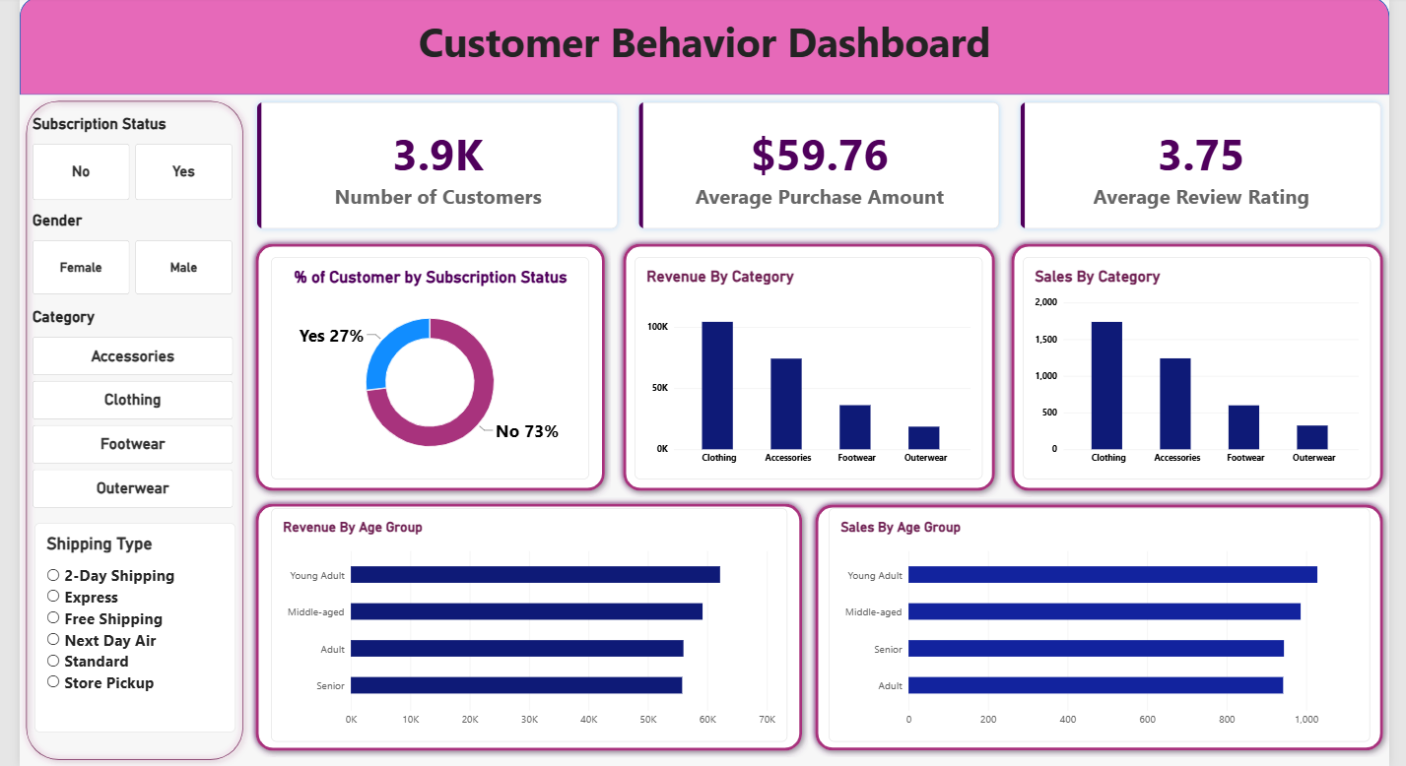
The Power BI dashboard
KPI cards
Customers, avg purchase, avg rating
Charts
Revenue and sales by category and age group
Slicers
Subscription, gender, category, shipping

Slide 7
Takeaways and next steps
Focus on Clothing and Accessories: they bring in 77% of revenue.
Spend per purchase is nearly the same ($58 to $61) in every group, so customer volume drives revenue.
Test a subscriber benefit or conversion campaign, since subscribers do not spend more.
Review discount depth: half of discount users would likely spend above average anyway.
Next: add finer loyalty tiers, a state-level view, and significance tests.

