Slide 1
TELECOM CHURN ANALYSIS By-Vishay Thakur

Slide 2
DATA OVERVIEW
Provided with two datasets i.e. ‘Active Customers’ & ‘Churned Customers’
Shape of both the datasets is (9999,29) & (10000,30) for active and churned respectively

Slide 3
Missing Values With Percentage
Talking about “Active Customers” , the maximum missing values are in COMPUTER_OWNER with a count of 3055 which is approx 30.55% of the complete data and similar to this we have SALES_CHANNEL with a count of 2906 which is approx 29.06% of the complete data.
There are more missing values in the data which can be observed from the given figure

Slide 4
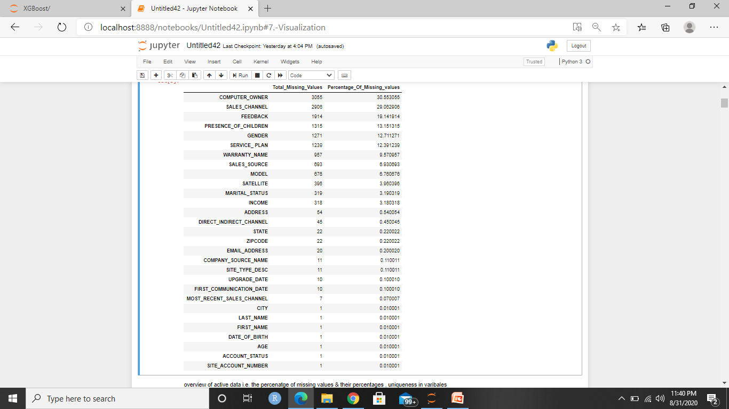

Slide 5
In “Churned Customers” the features with maximum missing values are COMPUTER_OWNER with a count of 3243 which is approx 32.43% of the complete feature and similar to this we have another feature SALES_CHANNEL with a count of 2602 which is approx 26.02% of the complete feature
We also have missing values in many other features which can be observed from the figure .

Slide 6
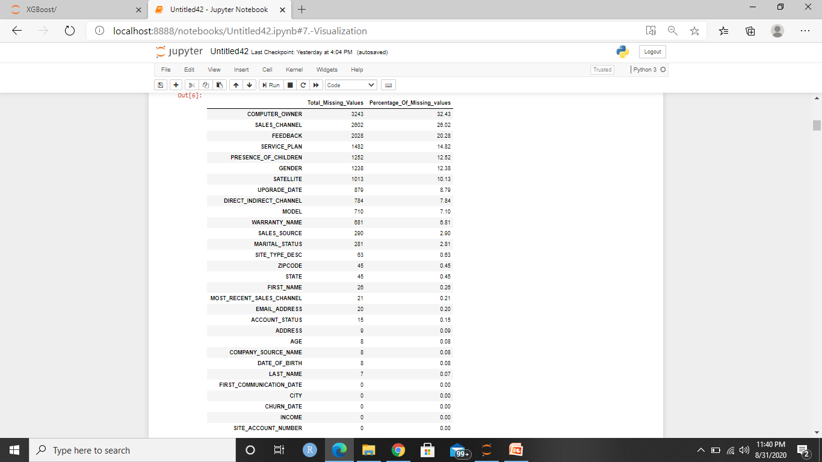

Slide 7
Exploratory Data Analysis
Since both the datasets needs to be concatenated for calssification, so did EDA on both the datasets simultaneously but separately.

Slide 8
ACCOUNT_STATUS
Took “ACCOUNT_STATUS” as the dependent variable.
Active data had 13 inactive accounts, instead of doing any treatment, simply dropped the rows with inactive account status.
Churned data had 15 missing values, simply dropped them.

Slide 9
SERVICE_PLAN
Changed Active['SERVICE_PLAN'] to Active['SERVICE_ PLAN'] , as it was misspelled
For Churned['SERVICE_PLAN'] , ‘ Professional Plus’ have been changed to ‘Proplus’ , ‘Professional’ to ‘Pro’ , 'Power15', to 'Power150‘

Slide 10
MODEL
There is almost 45% increment in the customers who shifted to model ‘HN7000S’ , and also made HN7000S the top model amongst all.
Although, HN7000S being the most preferred model, but the maximum revenue generated from the plans up gradation is provided by the customers who are having model HN9000 in both of the cases.
In Active data model DW4020 has been changed DW4000

Slide 11
DIRECT_INDIRECT_CHANNEL
This feature is having 9 missing values , imputed them with mode i.e. ‘Indirect’
Converting the two categories in binary form i.e. 0&1

Slide 12
SALES_SOURCE
Category ‘0’ has been replaced to unknown
Their was a great change in the categories of both datasets
Active data was having 29 whereas Churned dataset was holding 133 different categories of sales source.

Slide 13
States & Cities
The network has been increased to one more state.
Talking about the cities , the company has expanded its network to a great extent within the cities.

Slide 14
Here is list of states in which the network has been expanded in more cities.
States | Cities Earlier | Cities At Present
CA | 70 | 103
TX | 52 | 84
NY | 33 | 41
CO | 29 | 40
VA | 28 | 37
MD | 27 | 36
IL | 24 | 35
MI | 22 | 34
MO | 21 | 33
OR | 18 | 29
WA | 16 | 25

Slide 15
FEEDBACK
Almost 19.5% active customers didn’t give any feedback.
From the total known count, the customers who all gave feedback resposnse as good , 26% have upgraded their plans.
The feedback responses have been converted in to binary form

Slide 16
SATELLITE
We have good amount satellites.
Converted the satellites complete name in to their prefixes or with their domain names.
The satellite named as 0 has been renamed as unknown

Slide 17
SITE_TYPE_DESC
Converted the categories in to binary form.

Slide 18
WARRANTY_NAME
The maximum counts are in the categories of 0.
0 has been renamed as unknown .
Unknown warrant holds almost 85% customers.

Slide 19
MOST_RECENT_SALES_CHANNEL
0 has been renamed as unknown category

Slide 20
GENDER
Categories converted in to binary form.

Slide 21
INCOME
Categories ‘A’ , ‘B’ , ‘C’ , ‘D’ have been converted in to integer type as shown in the table below

Slide 22
Descriptor | Description
0 | Annual Income < $10K
1 | Annual Income > $10K < 20K
2 | Annual Income > $20K < 30K
3 | Annual Income > $30K < 40K
4 | Annual Income > $40K < 50K
5 | Annual Income > $50K < 60K
6 | Annual Income > $60K < 70K
7 | Annual Income > $70K < 80K
8 | Annual Income > $80K < 90K
9 | Annual Income > $90K < 100K
10 | Annual Income > $100K < 110K
11 | Annual Income > $110K < 120K
12 | Annual Income > $120K < 130K
13 | Annual Income > $130K < 140K
14 | Annual Income > $140K

Slide 23
MARITAL_STATUS
We have 3 categories in marital status
In churned data we have a category denoted by “.” , since it was holding a significant count , so renamed that 4rth category as unknown

Slide 24
PRESENCE_OF_CHILDREN
No change in the feature

Slide 25
COMPUTER_OWNER
Converted the categories in to binary form.

Slide 26
UPGRADE_DATE
Using datetime.index , tried to find is their any specific month people choose to upgrade?
No significant results can be observed as the up gradation is all months is almost same.

Slide 27
DURATION
Duration is the new variable created by finding the difference between ‘FIRST_COMMUNICATION_DATE’ and ‘UPGRADE_DATE’ .
This gave us count of days, from how long the customer is being with us.

Slide 28
DROPPING THE VARIABLES
SITE_ACCOUNT_NUMBER
FIRST_NAME
FIRST_COMMUNICATION_DATE
UPGRADE_DATE
FIRST_NAME
LAST_NAME
ADDRESS
CITY
ZIPCODE
EMAIL_ADDRESS
DATE_OF_BIRTH
MOST_RECENT_SALES_CHANNEL
WARRANTY_NAME
SALES_SOURCE
COMPANY_SOURCE_NAME
STATE

Slide 29
FINAL FEATURES
ACCOUNT_STATUS
MODEL
SALES_CHANNEL
DIRECT_INDIRECT_CHANNEL
FEEDBACK
SATELLITE
SITE_TYPE_DESC
GENDER
AGE
INCOME
MARITAL_STATUS
PRESENCE_OF_CHILDREN
COMPUTER_OWNER
SERVICE_PLAN
Satellite
DURATION

Slide 30
MISSING VALUE TREATMENT
All the feature’s missing values have been replaced with mode

Slide 31
CONCATENATION
Both the datasets have been concatenated.
Final shape of the data (19970,15)

Slide 32
DUMMIES CREATION
Dummies created for the concatenated data.
Shape of the data set after dummies creation is (19970,48)

Slide 33
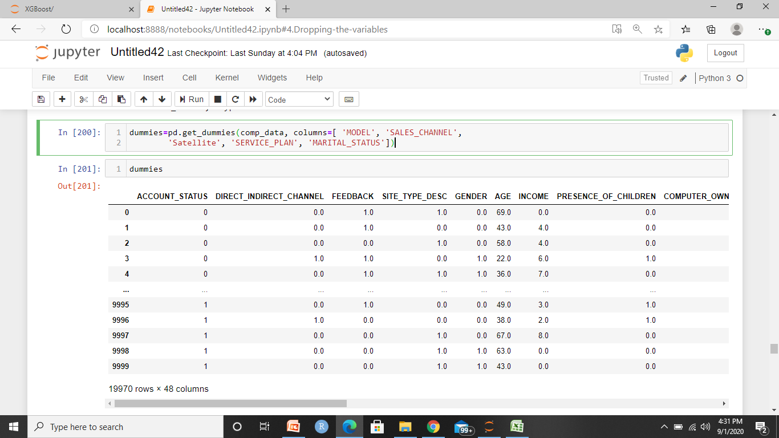

Slide 34
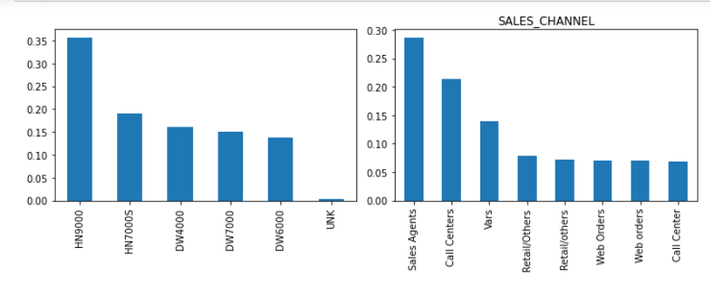
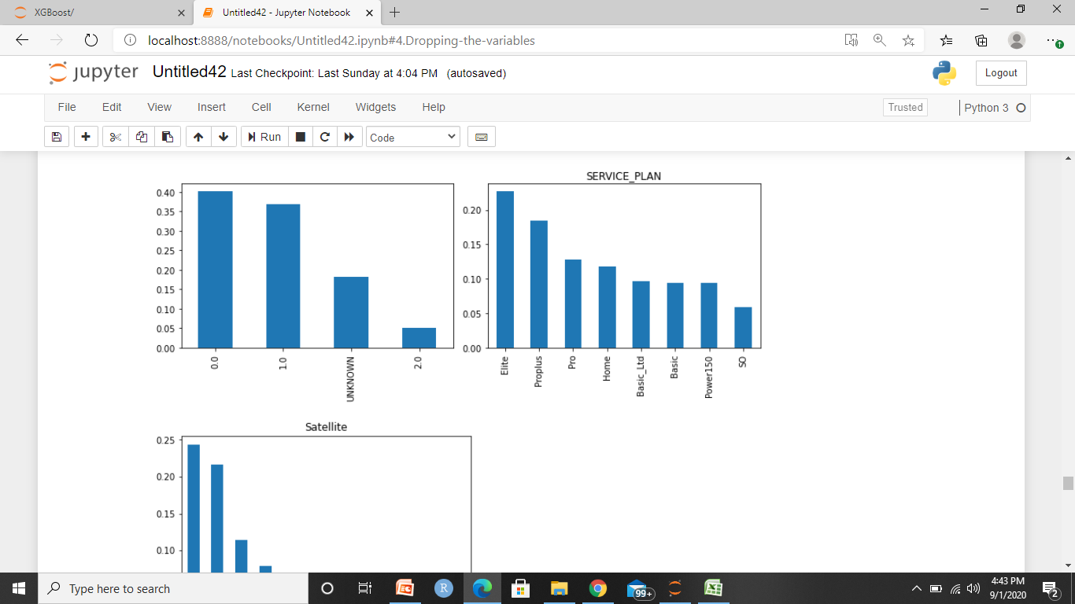
VISUALIZATION OF CATEGORICAL FEATURES
MODEL
MARITAL_STATUS

Slide 35
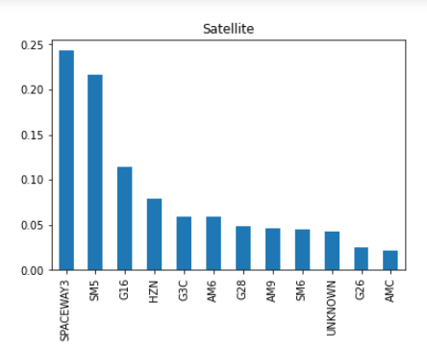

Slide 36
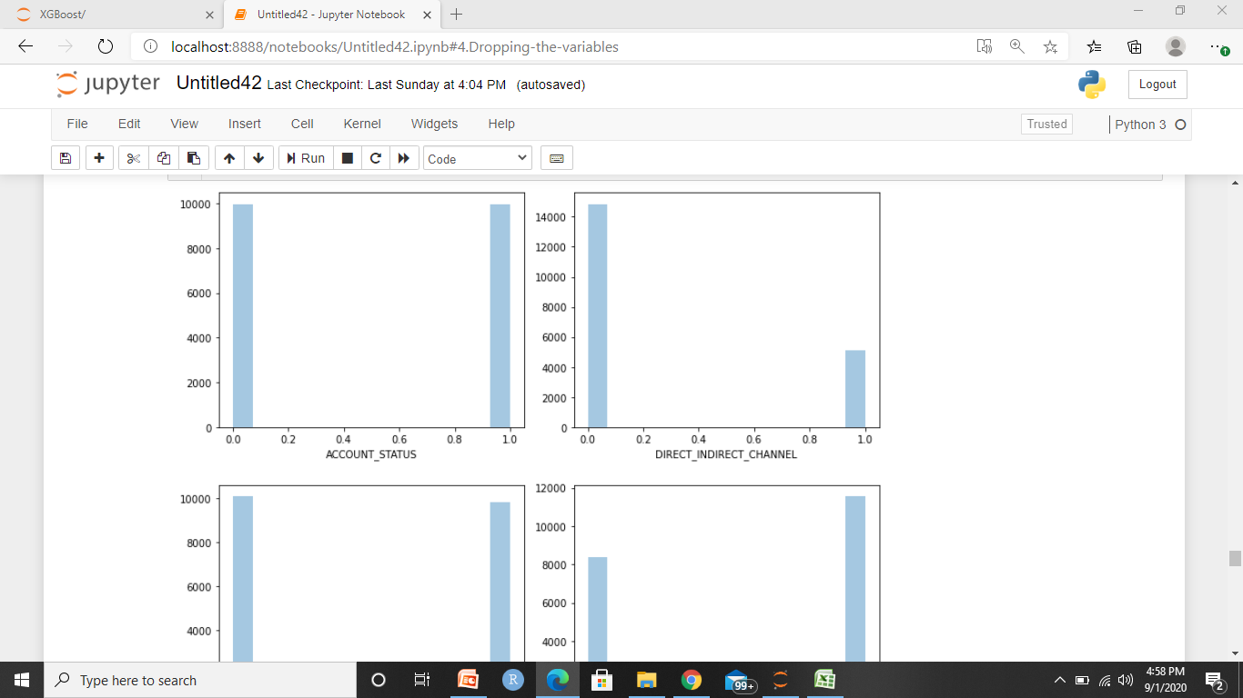
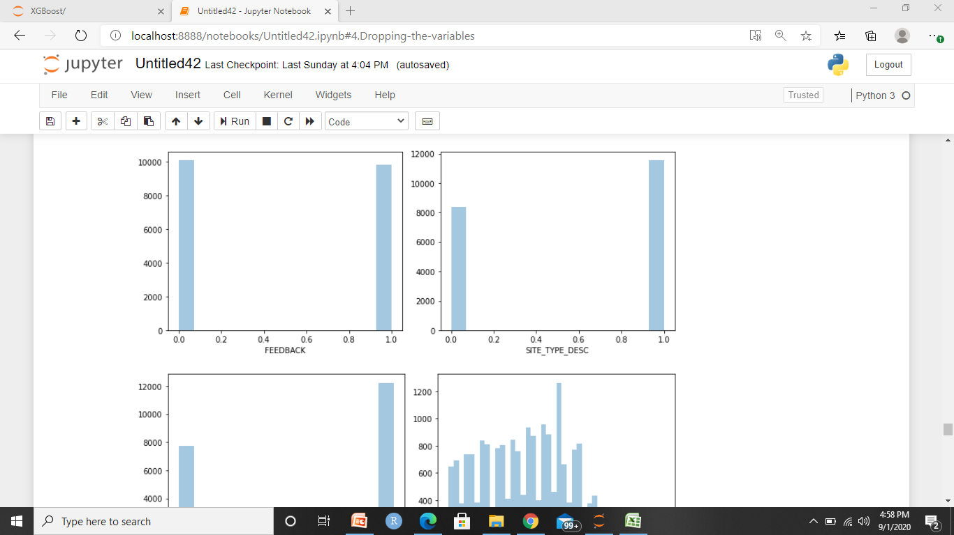
VISUALIZATION OF NUMERICAL FEATURES

Slide 37
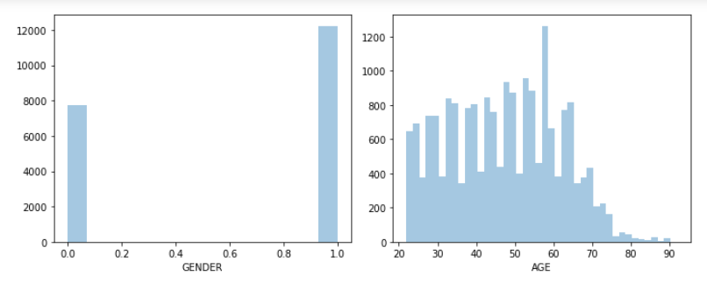
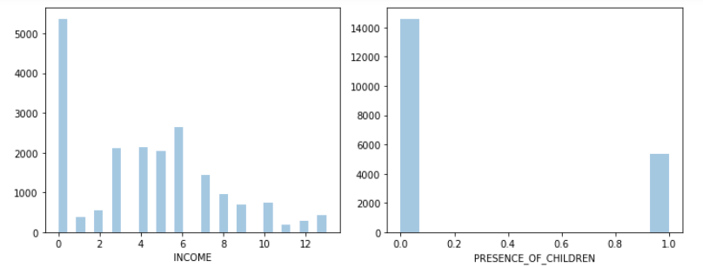

Slide 38
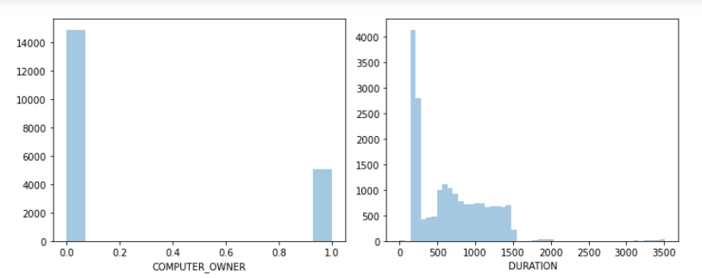

Slide 39
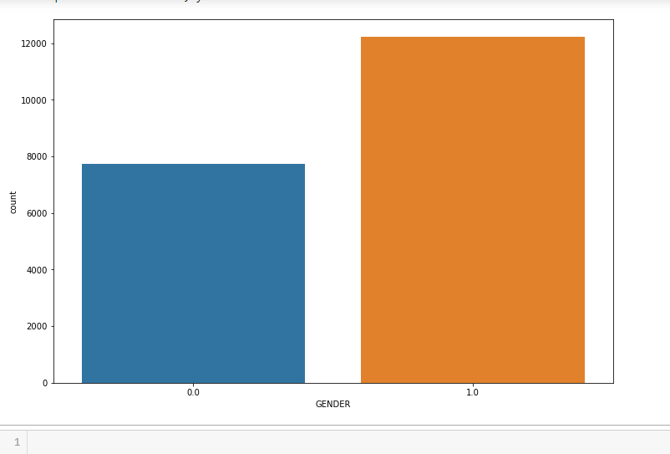
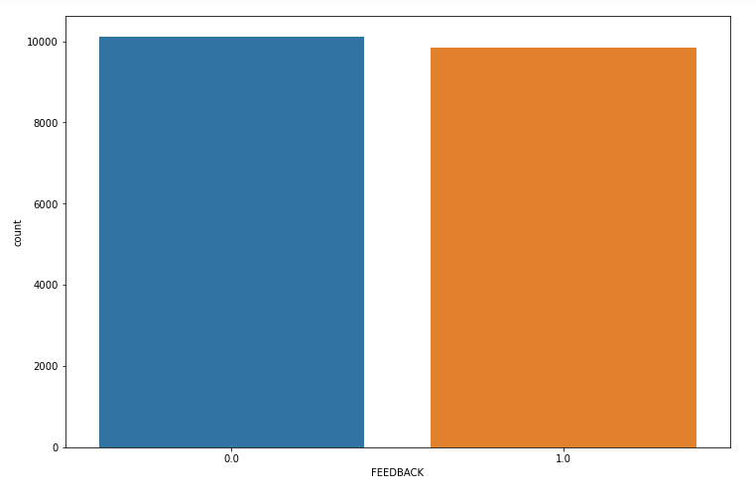

Slide 40
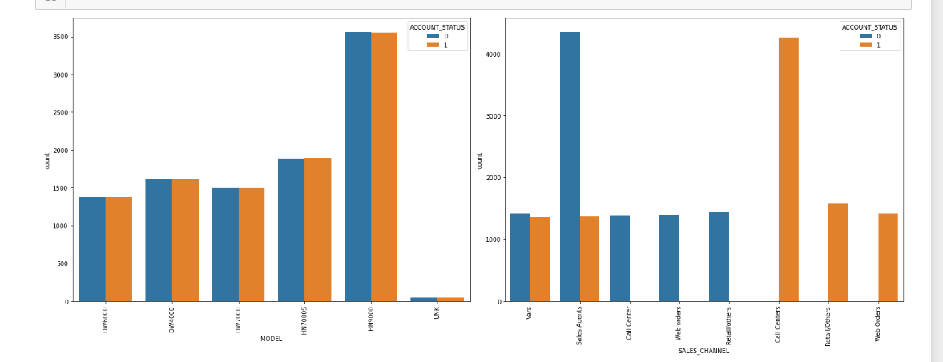
VISUALIZATION WITH RESPECT TO ACCOUNT STATUS

Slide 41
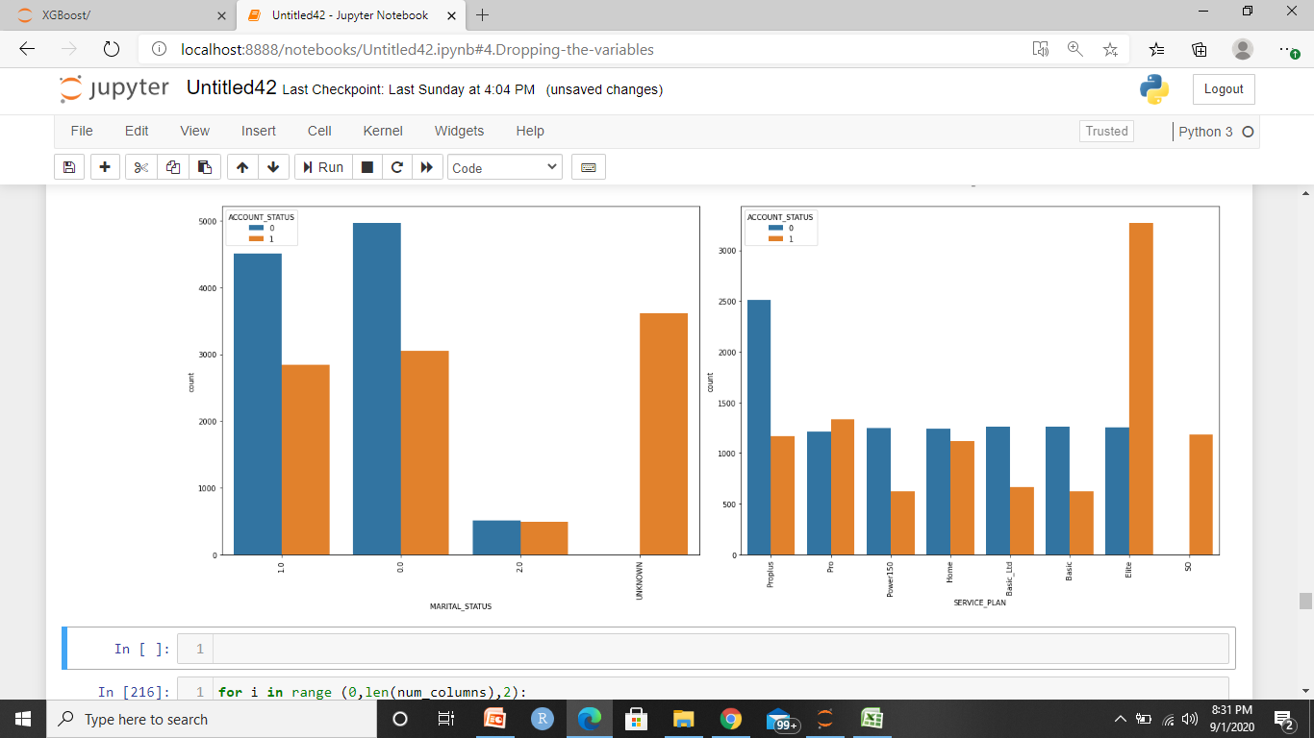

Slide 42
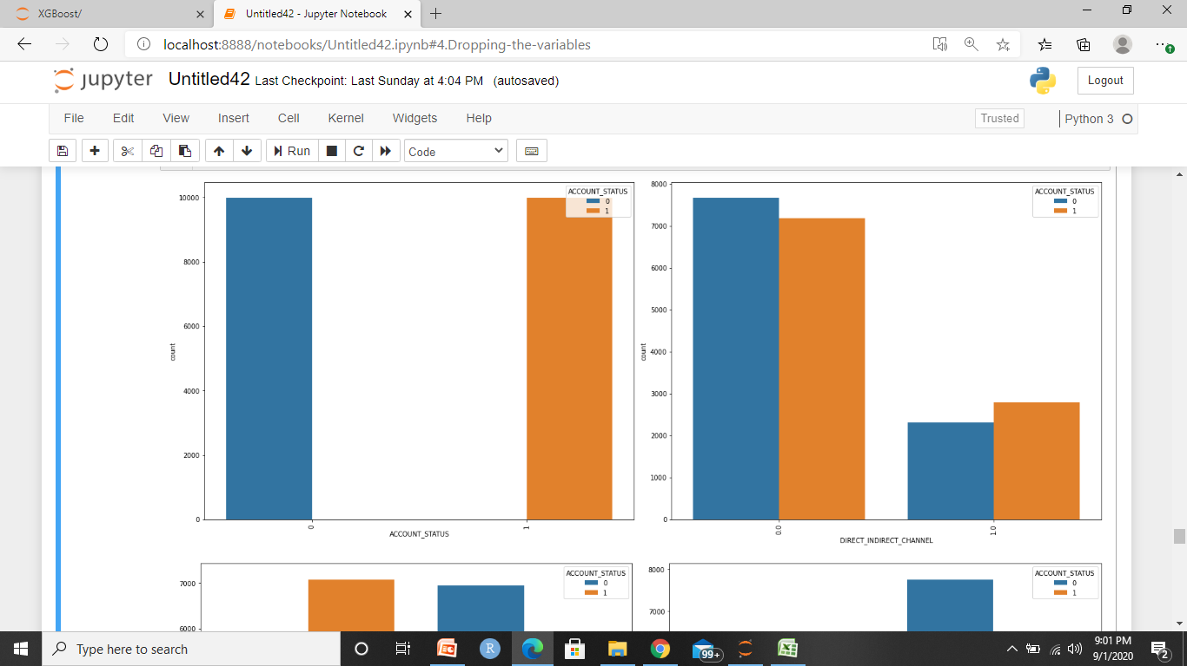

Slide 43
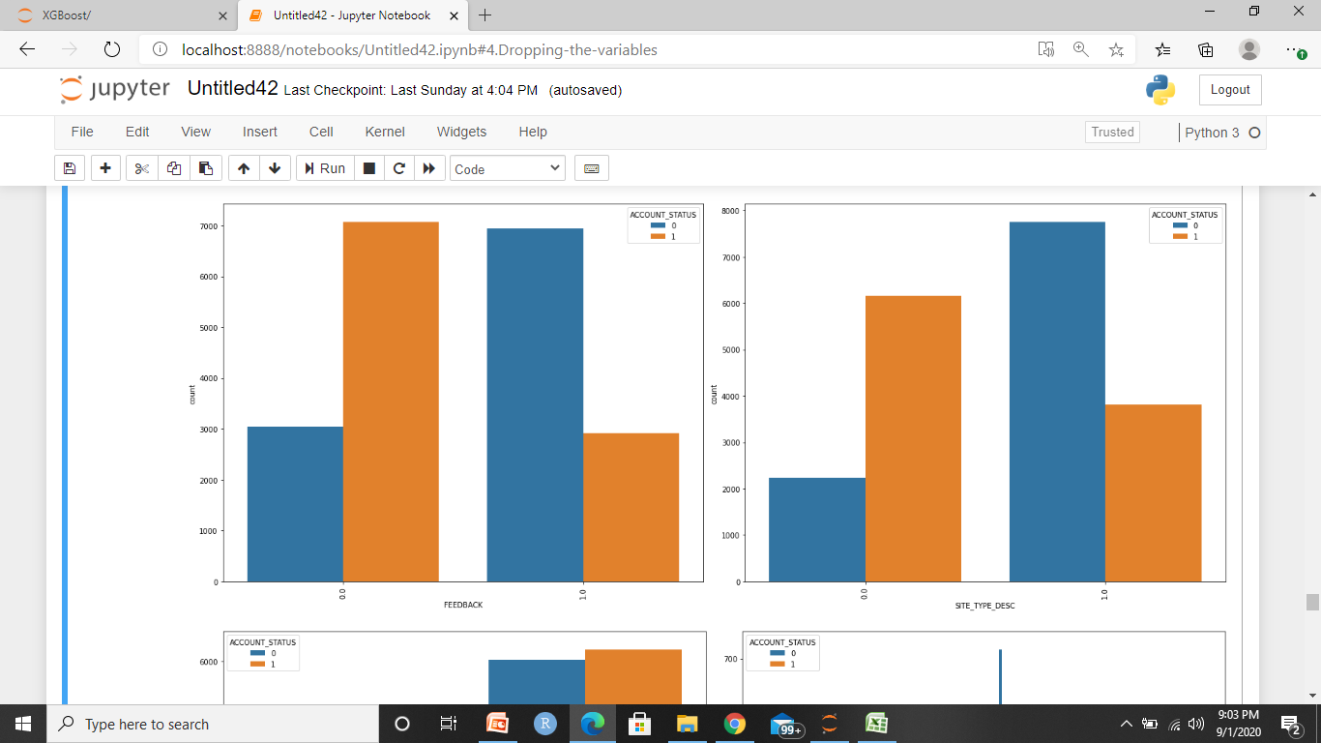

Slide 44
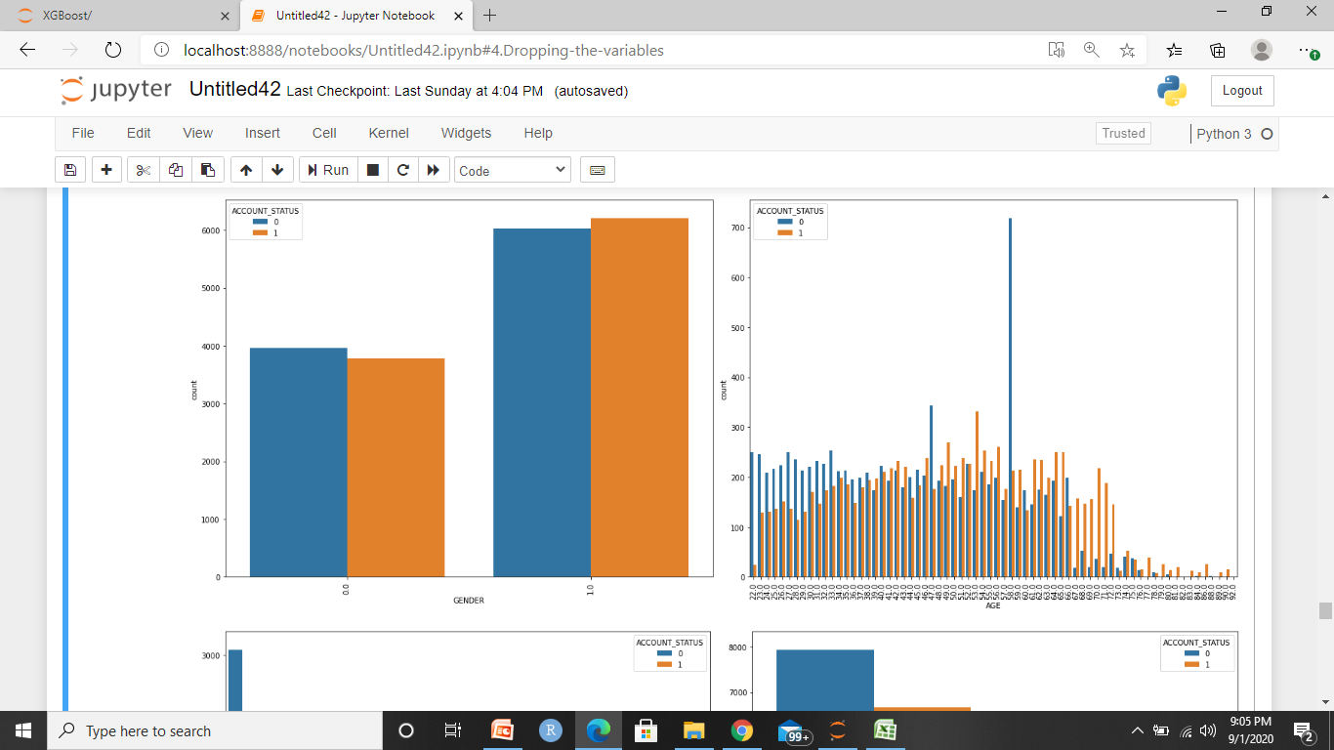

Slide 45
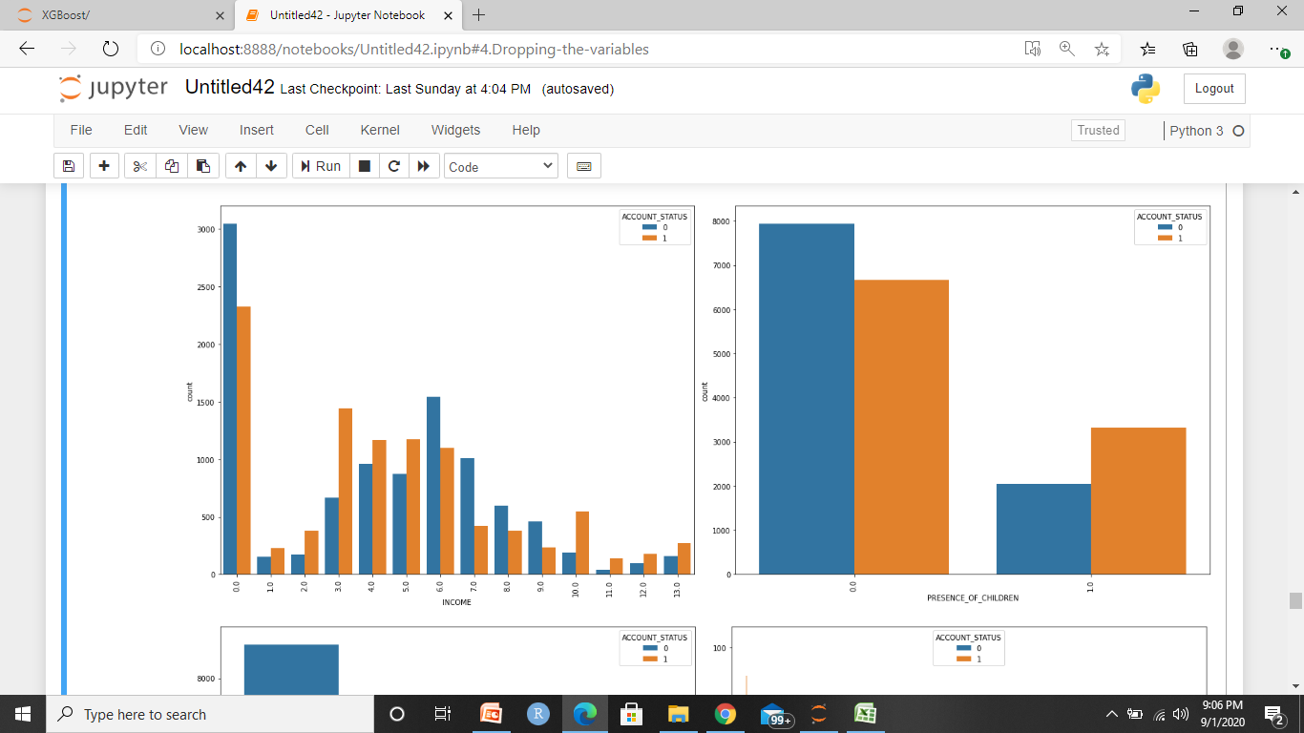

Slide 46
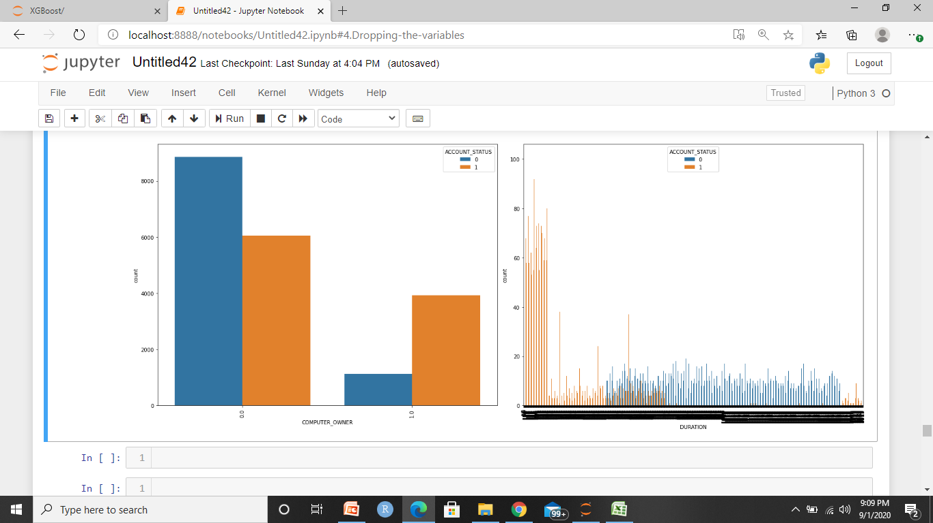

Slide 47
ACTIVE DATA DUMMIES
Dummies creation of active customers for P.C.A .
We will be doing P.C.A and segmentation on active customers.
Standardizing the final selected features.

Slide 48
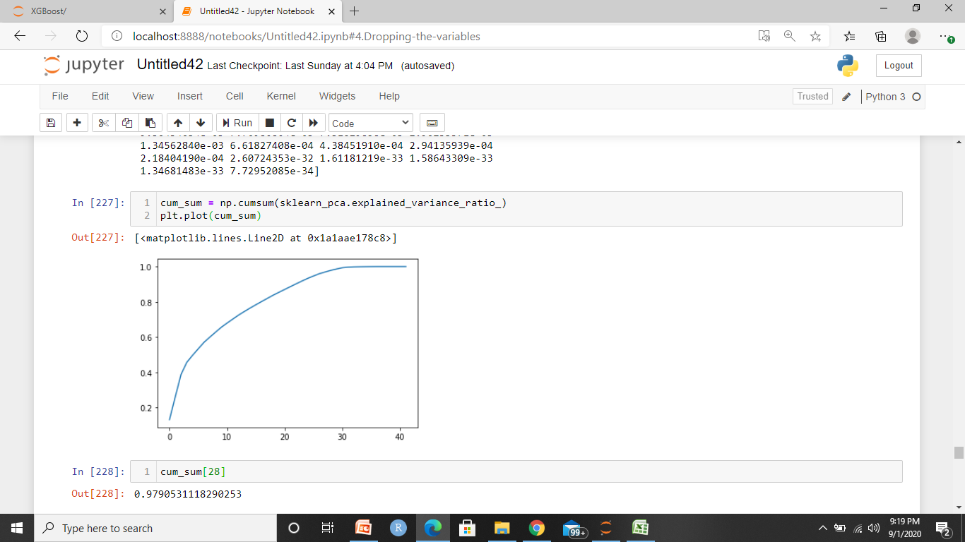
P.C.A.
Shape of the dummies data (9985,42)
After P.C.A. we are getting 97.9% variance explained with only 28 features which is pretty decent.

Slide 49
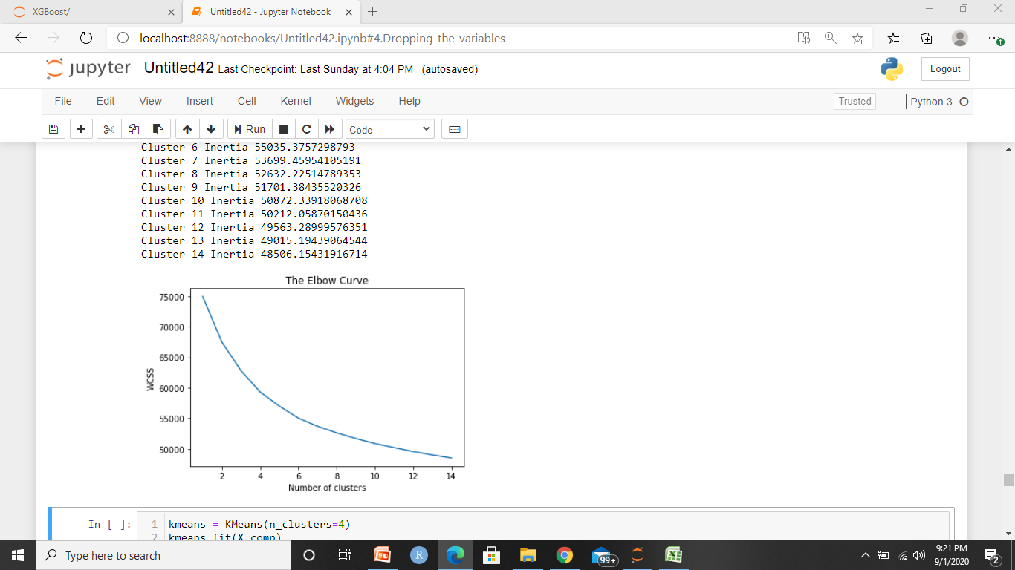
K-MEANS CLUSTERRING

Slide 50
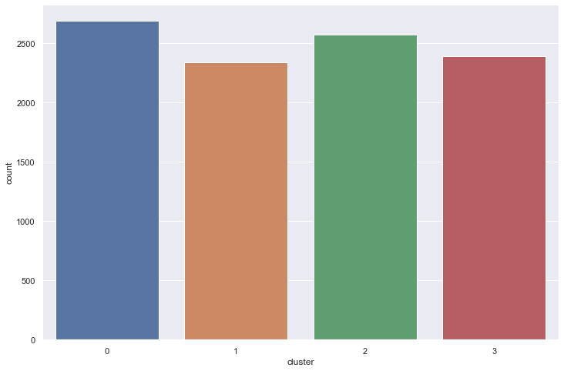
CLUSTERS

Slide 51
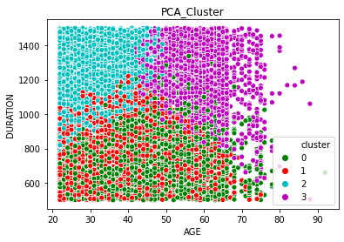
CLUSTER- AGE VS DURATION

Slide 52
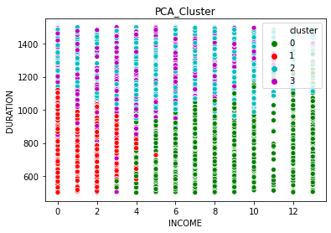
CLUSTER- INCOME VS DURATION

Slide 53
STANDARDIZATION
Standardizing the variables before proceeding for classification.
Used standard_scalar for standardizing.

Slide 54
SPLITTING OF DATA
Splitting the data in to 80-20 ratio.

Slide 55
MODEL USED FOR CLASSIFICATION
Random_Forest
XGBoost
SVM

Slide 56
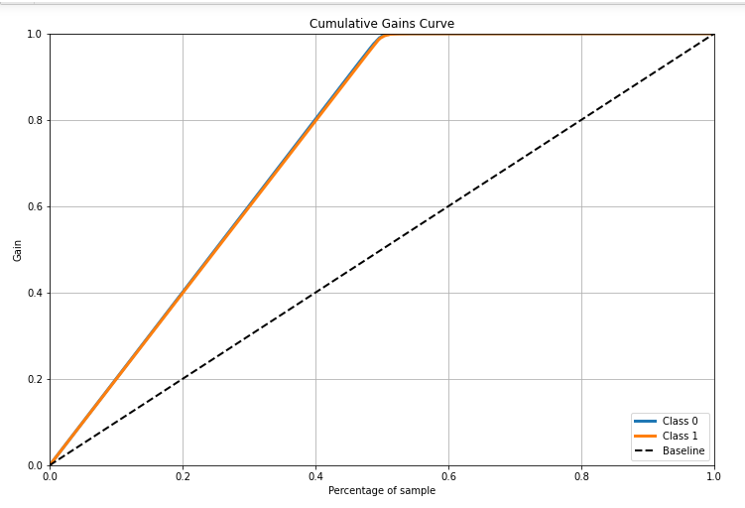
CUMULATIVE GAINS CURVE
For training sample

Slide 57
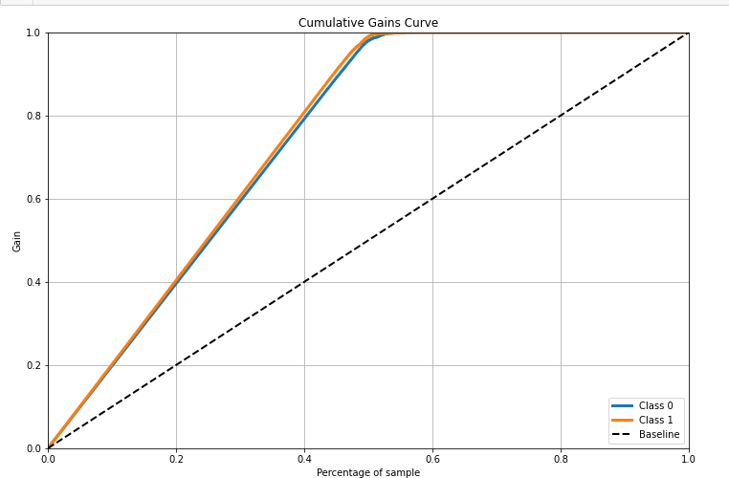
For testing sample

Slide 58
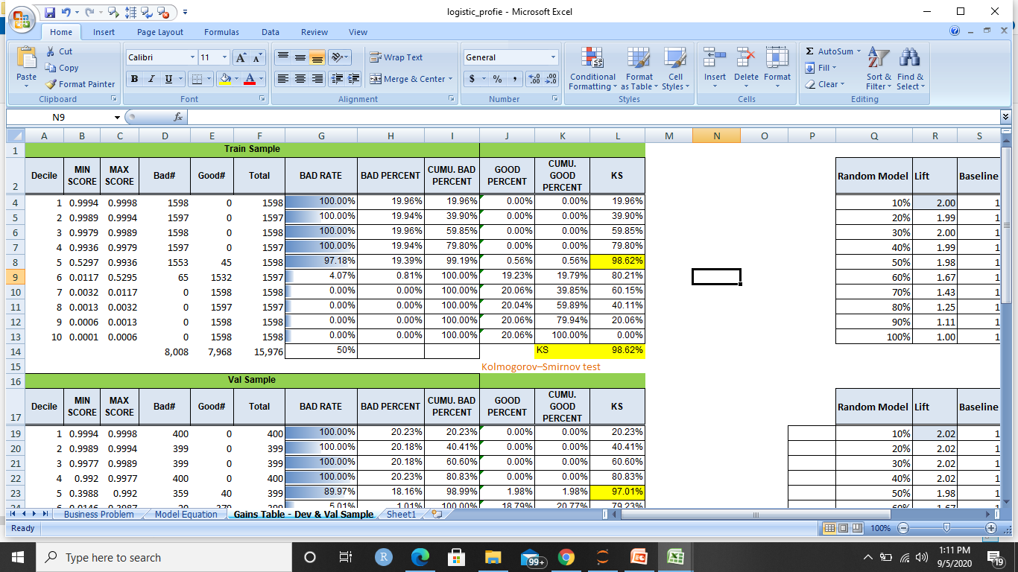
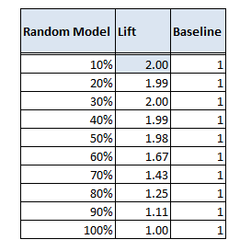
PROFILE DECILE
TRAIN SAMPLE

Slide 59
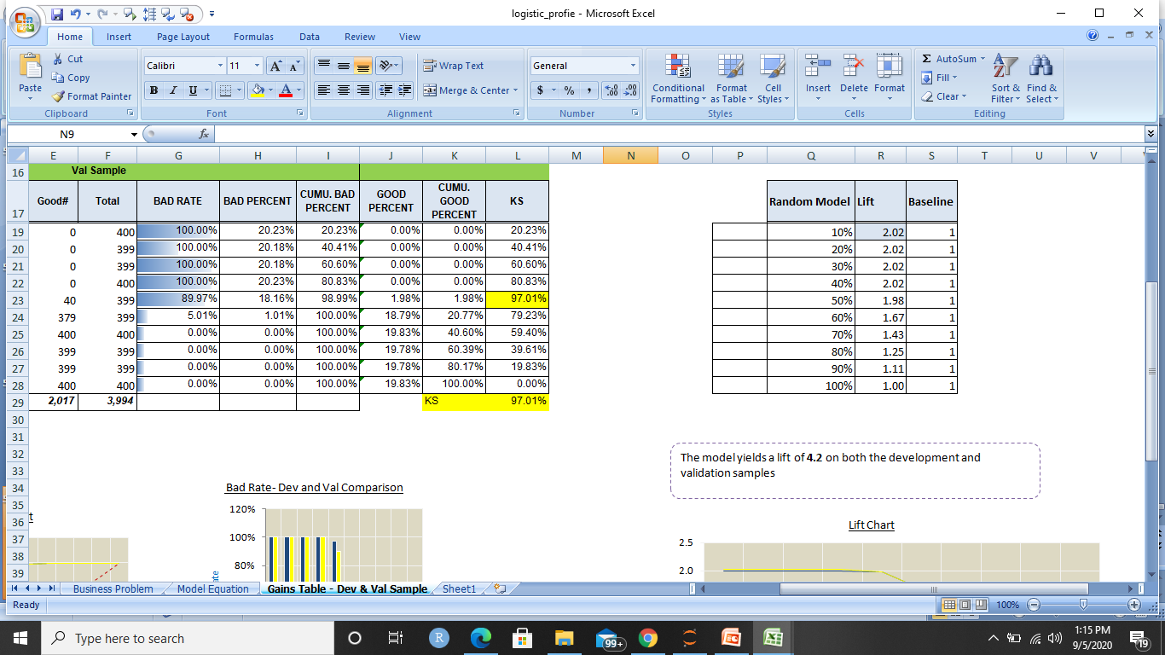
TESTING SAMPLE

Slide 60
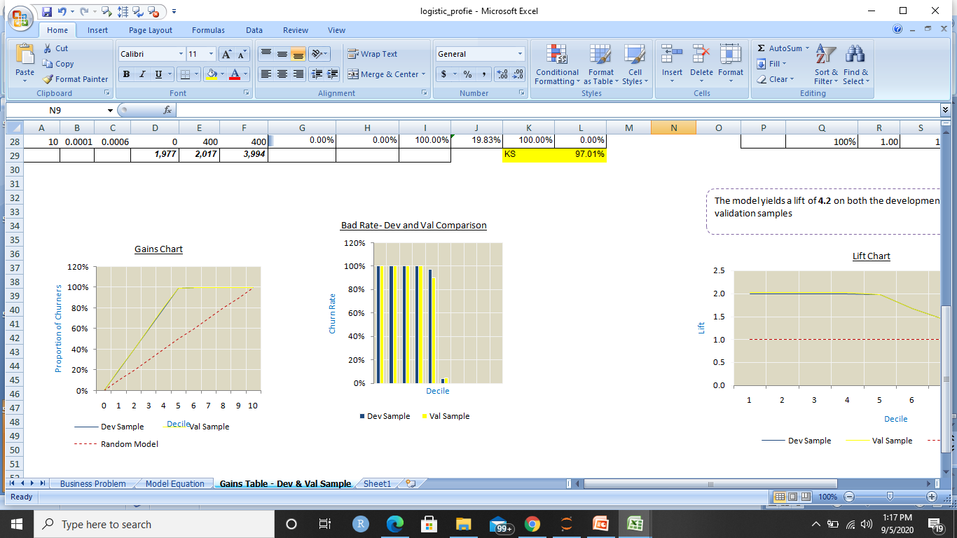
GAINS CHART & BAD RATE COMPARISION

Slide 61
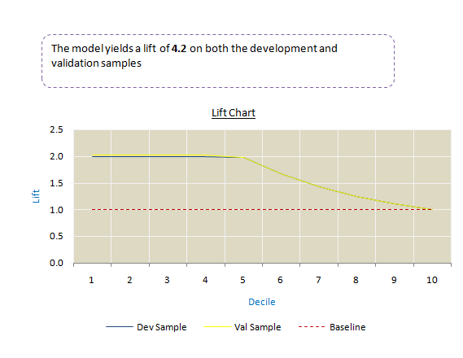
LIFT CHART

Slide 62
Thank You

