Slide 1
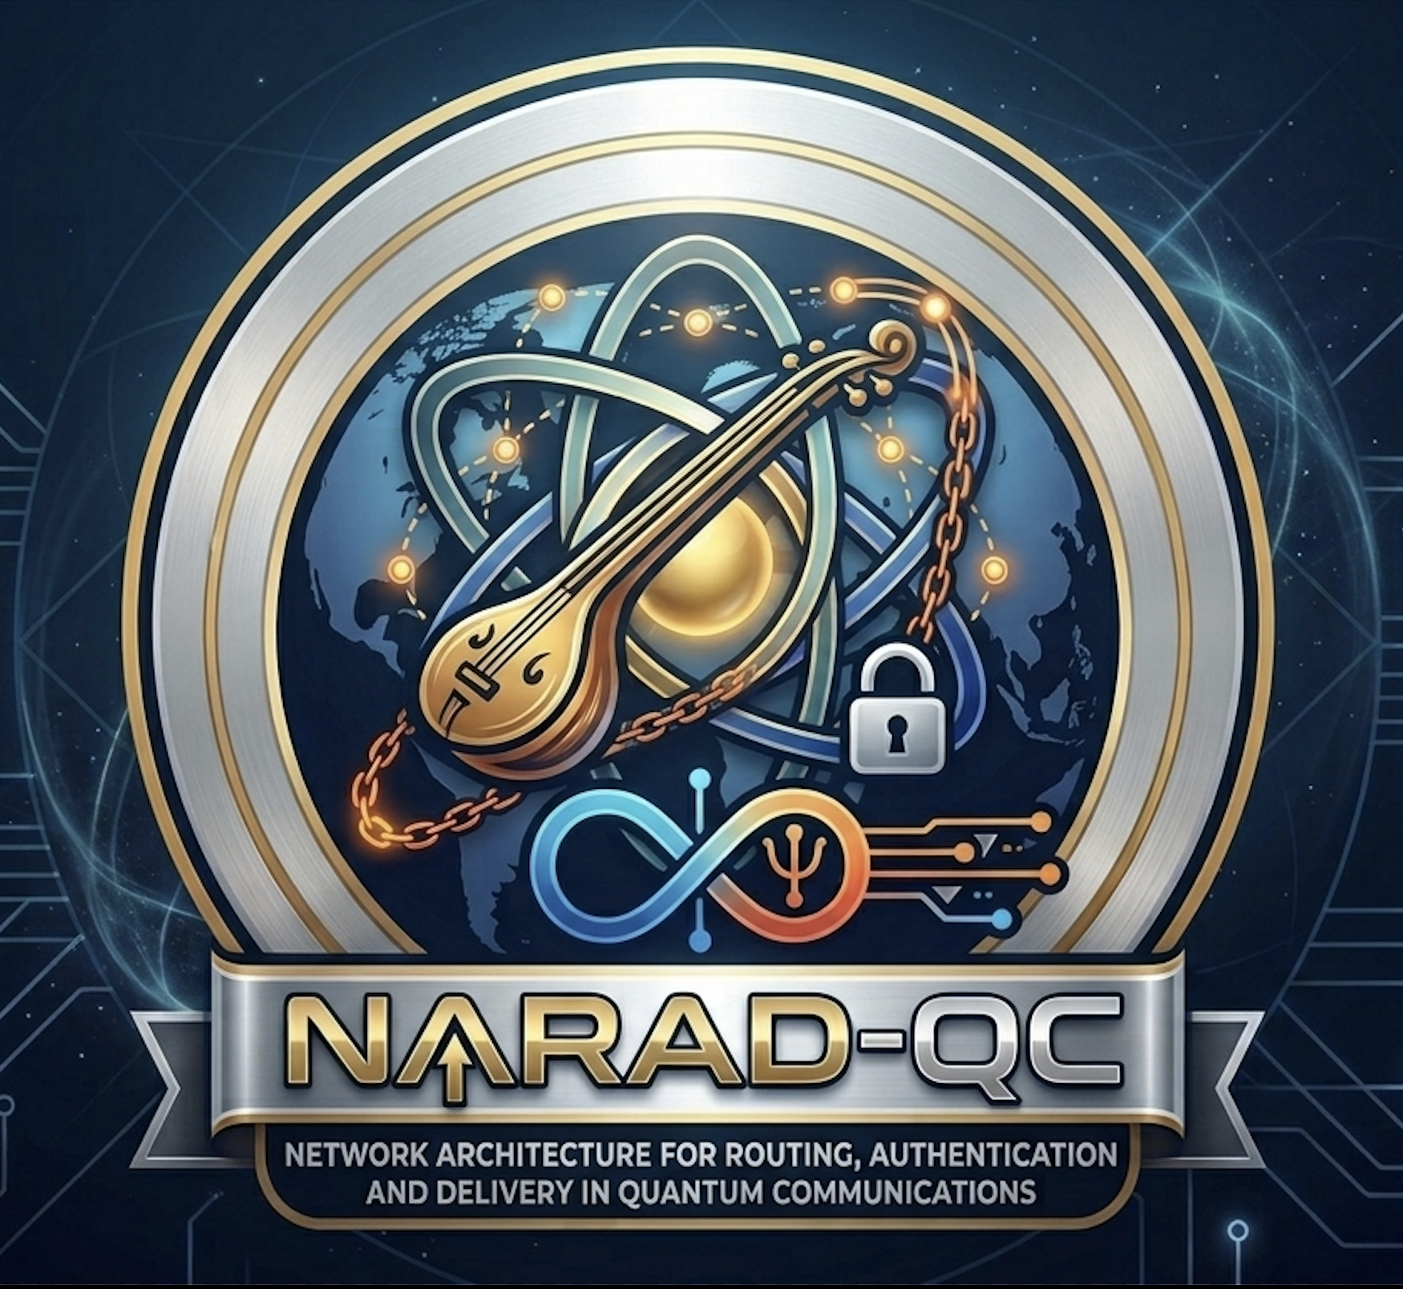
NARAD - QC
Network Architecture for Routing, Authentication and Delivery in Quantum Communications
Vishesh Goyal - VisheshVerse

Slide 2
The Question
Using the quantum repeaters, we can increase the distance between two users for the QKD to be successful.
BUT
What happens if there are multiple repeaters? Multiple chains? Multiple pathways?
So, which repeaters can be trusted? Which pathway would be most efficient?
How do we decide which is the most efficient pathway?
Vishesh Goyal - VisheshVerse

Slide 3
The Proposed Solution – NARAD-QC
Use a classical channel over the quantum channel just to decide which is the authenticated and most efficient channel for the qubits to survive.
Use quantum repeaters as channel nodes to establish a topology of network for the entanglement to be created more efficiently.
Vishesh Goyal - VisheshVerse

Slide 4
The Process of NARAD-QC
The user Alice initiates by telling the classical channel that she wishes to communicate with Bob.
The channel authenticates Alice and Bob as the user.
Then, it searches the entire topology of quantum repeaters authenticating each repeater in the process and deciding which is the most efficient channel to create the entanglement.
The parameters used for deciding the channel :
  Low QBER
  Key generation latency
  Number of repeater hops
  Link success probability
  Least distance possible
  Least time required
Vishesh Goyal - VisheshVerse

Slide 5
The Final Expected Model of NARAD-QC
NARAD-QC becomes a small quantum-secure communication network simulator.
Vishesh Goyal - VisheshVerse

Slide 6
The Phase Plan NARAD-QC
Phase | Target | Status
Phase 0 | Establish a baseline BB84 protocol with no distance in a perfectly ideal scenario | Completed
Phase 1 | Add the distance in between the two users to evaluate how the distance affects the Key Establishment during QKD | Completed
Phase 2 | Add a single repeater between two users to users to evaluate how adding a repeater can be better than the results of Phase 1 | Completed
Phase 3 | Add multiple repeaters in a single linear chain to evaluate the scalability between two users. | Thinking in Process
Phase 4 | Add multiple chains of multiple repeaters and a classical channel to authenticate and route the entanglement. | Not started
Phase 5 | Add 2 more users to measure the requirements of quantum memory, queue length and available resources and stress test the system. | Not Started
Vishesh Goyal - VisheshVerse

Slide 7
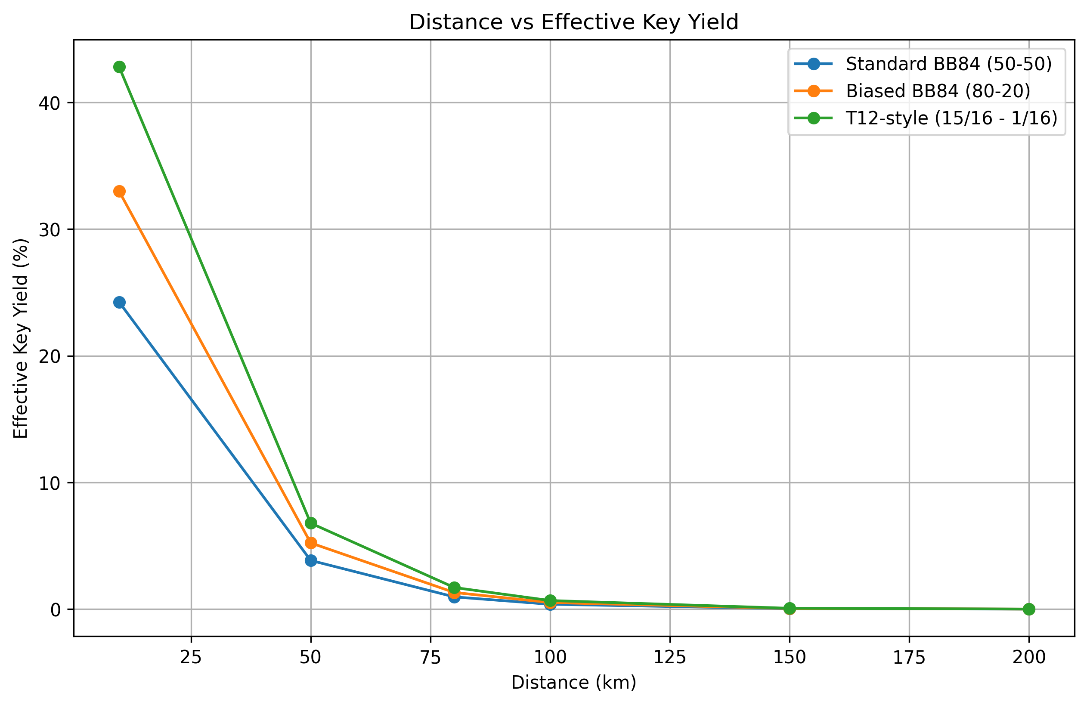
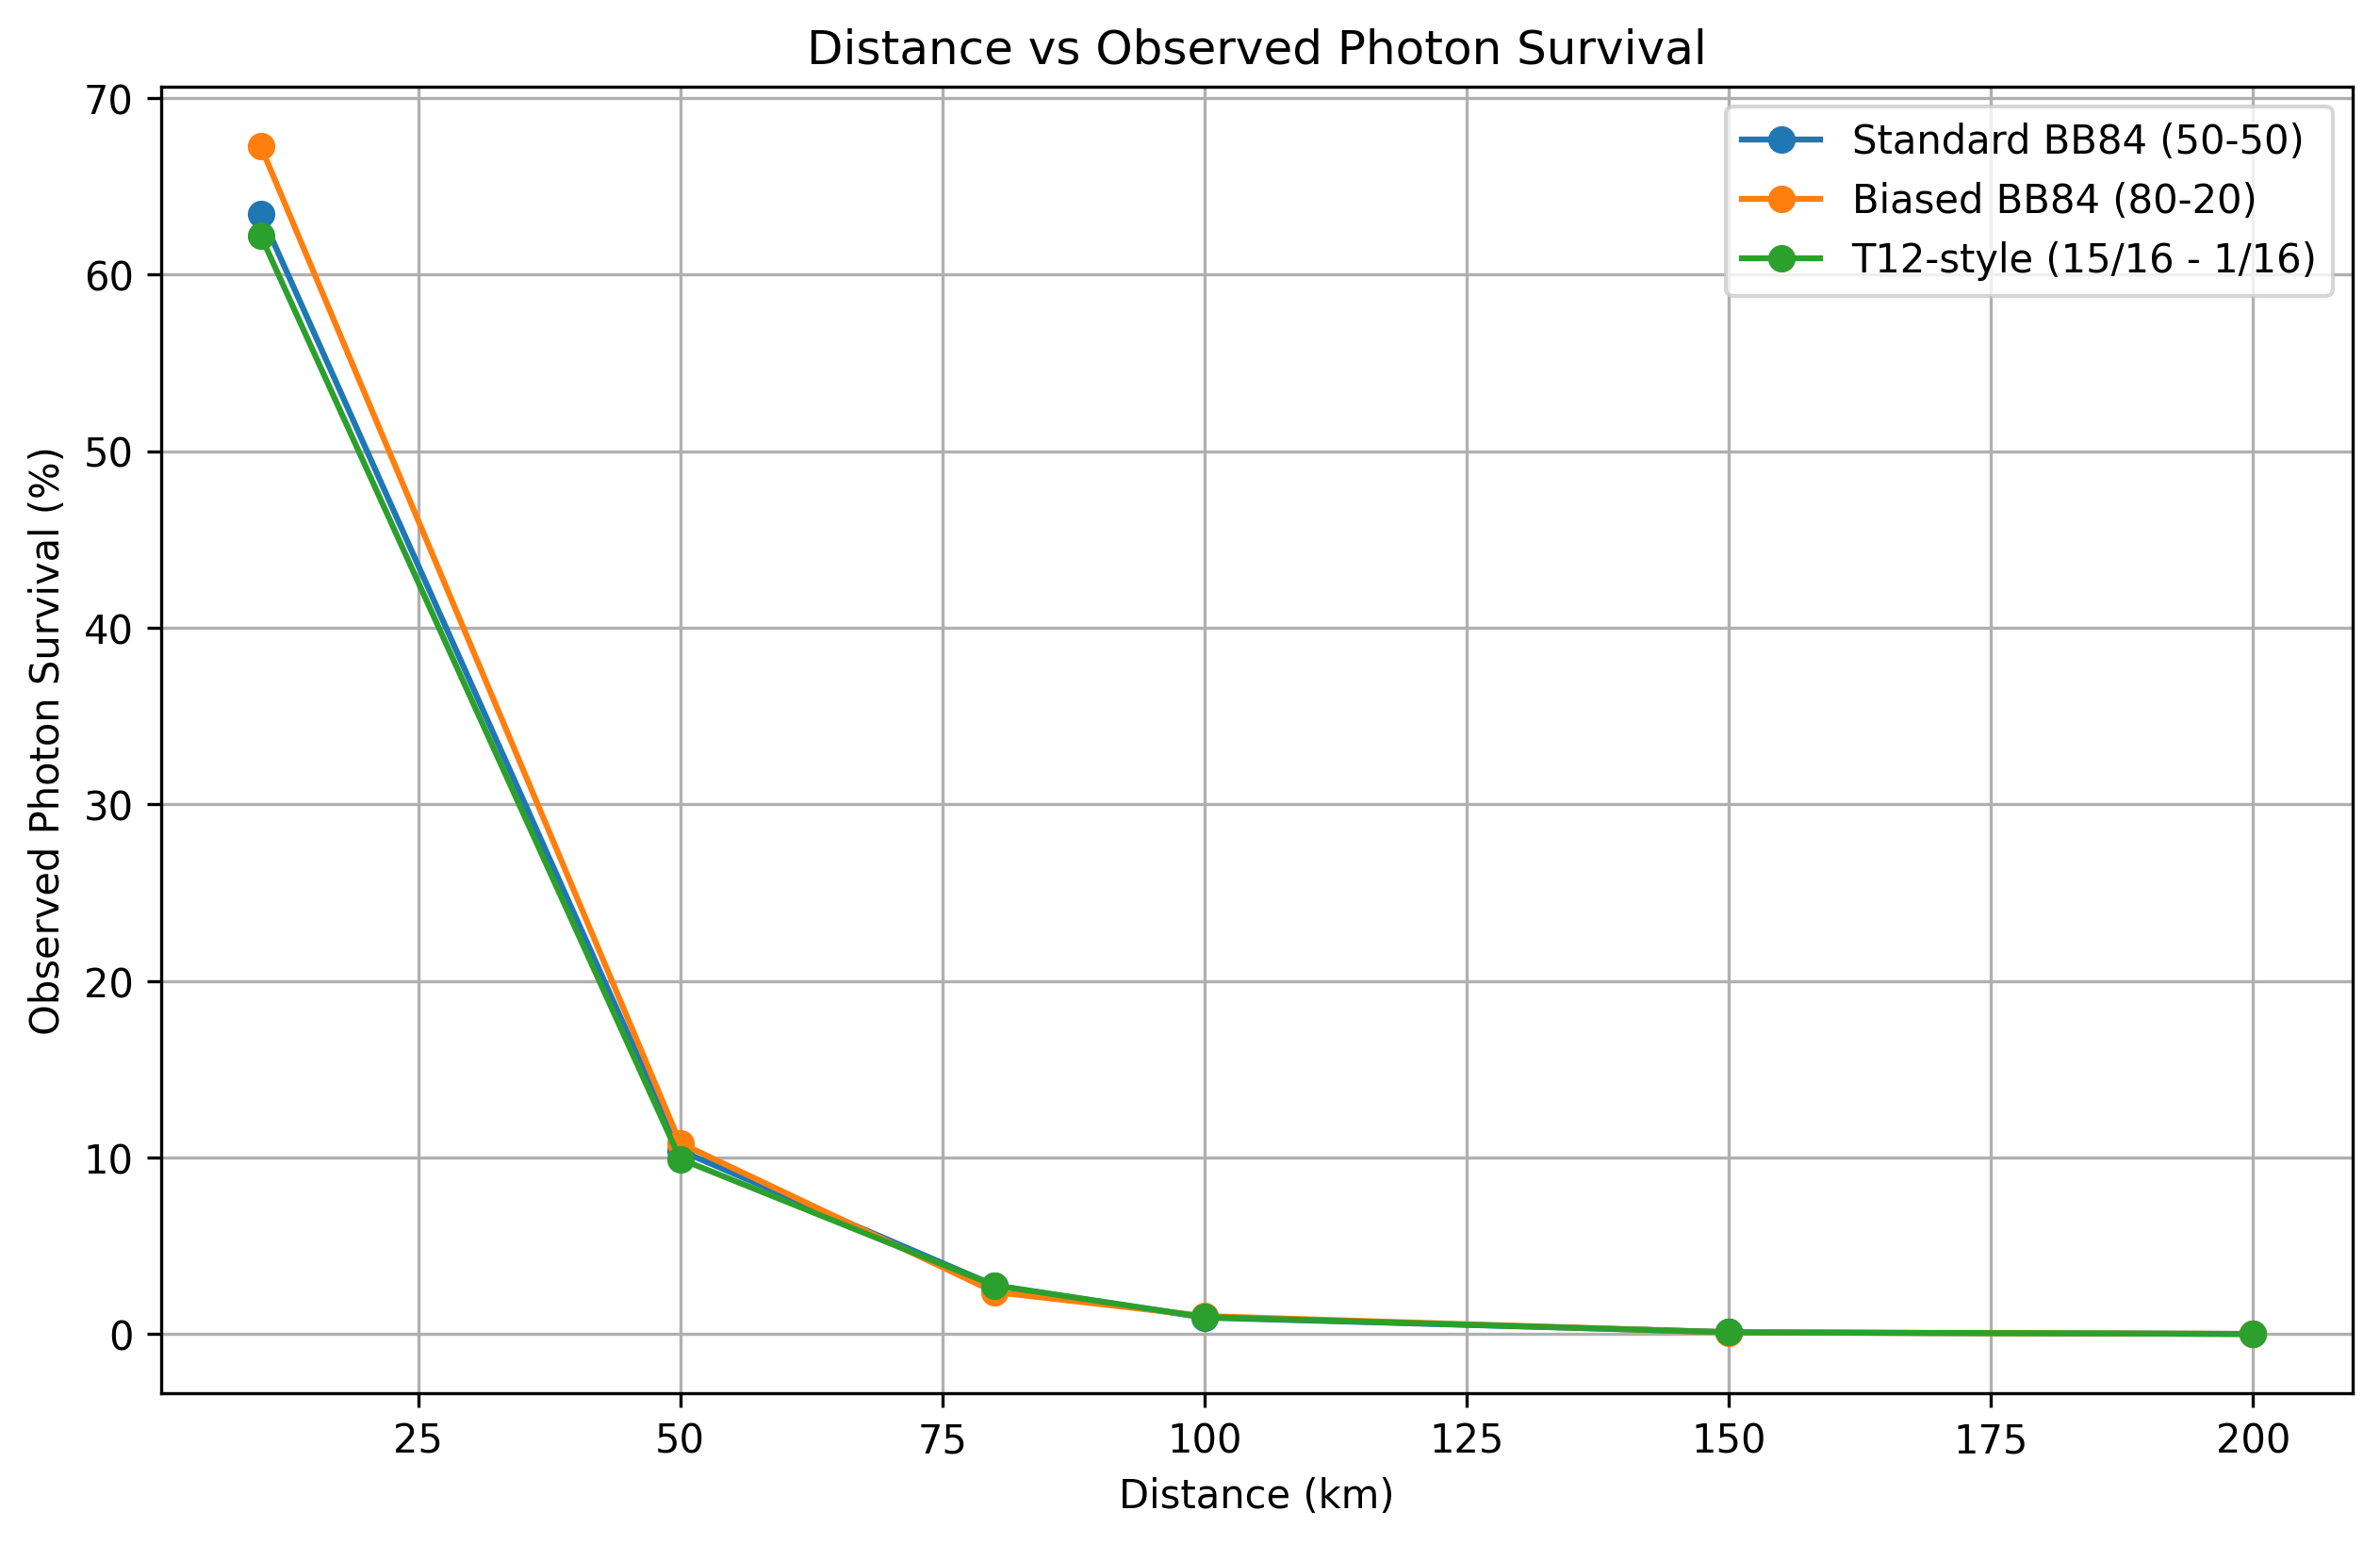
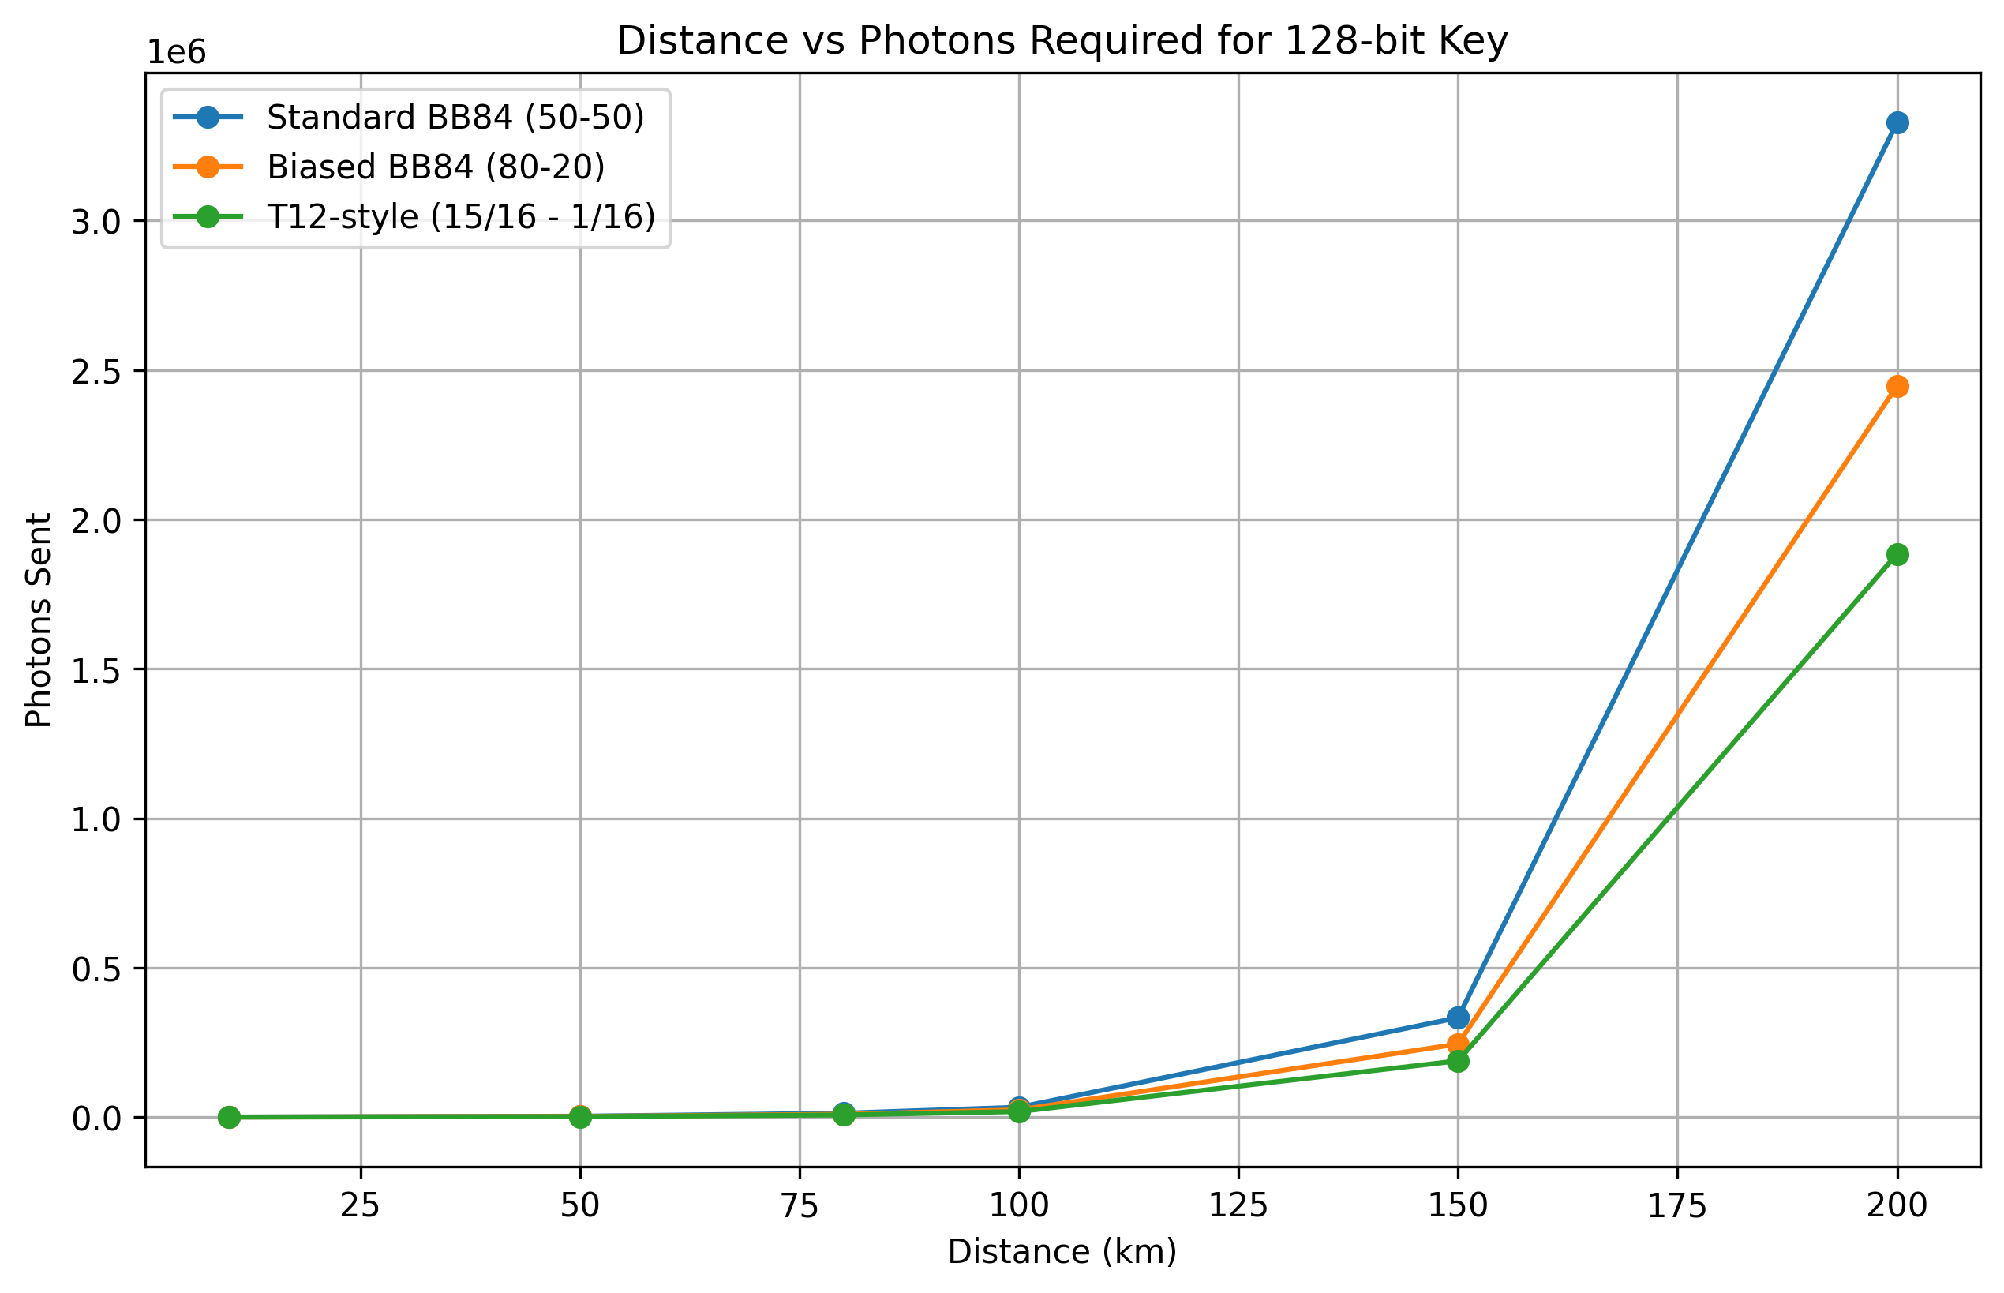
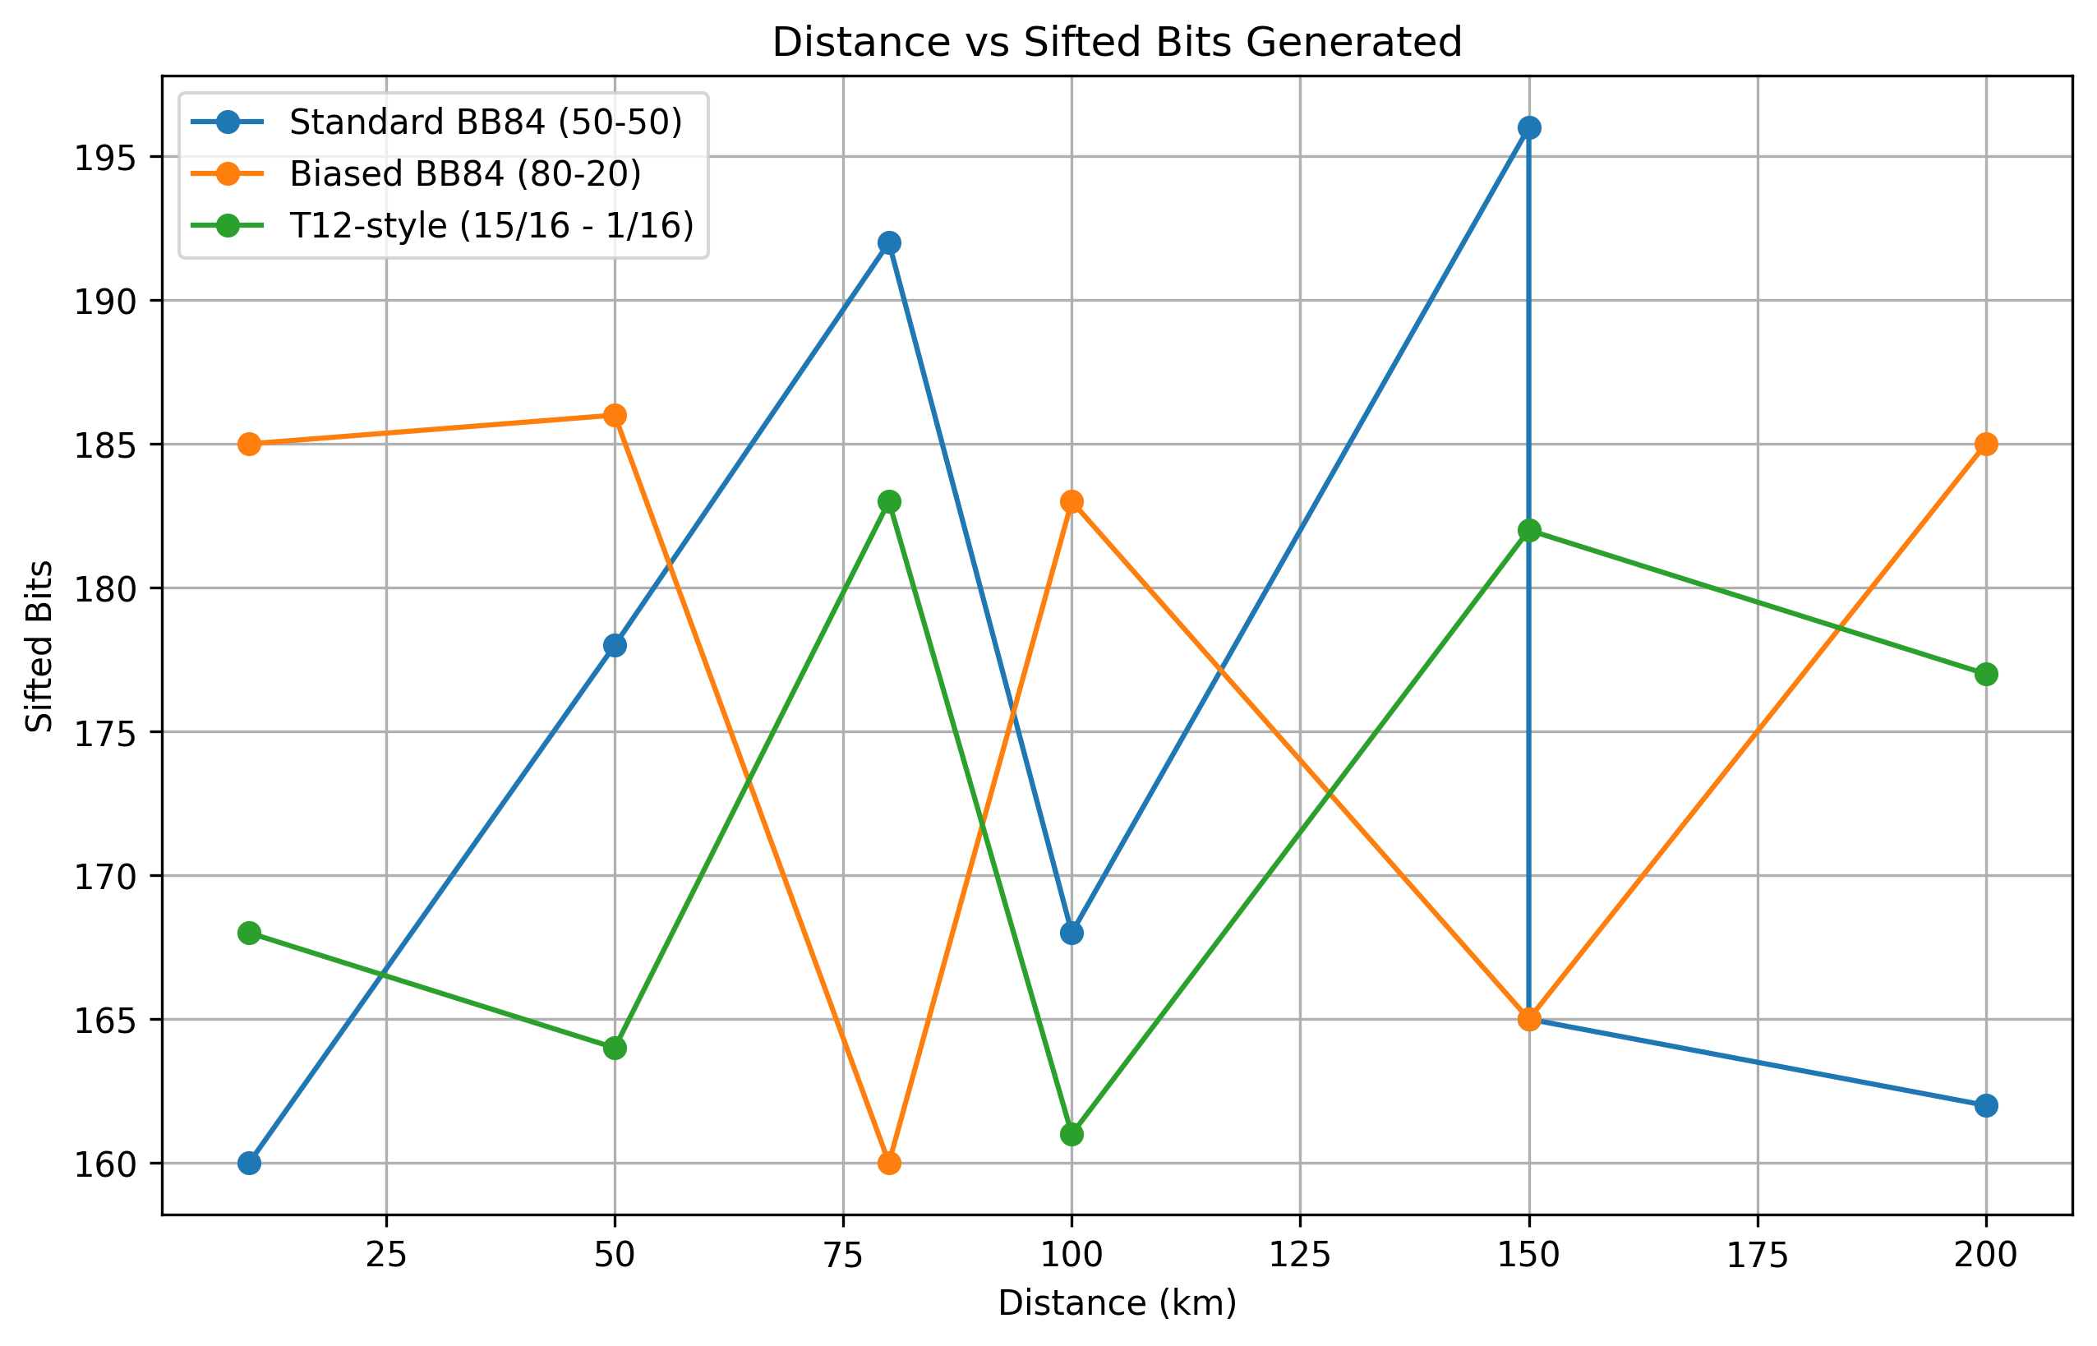
Results of Phase 1 NARAD-QC
Vishesh Goyal - VisheshVerse

Slide 8
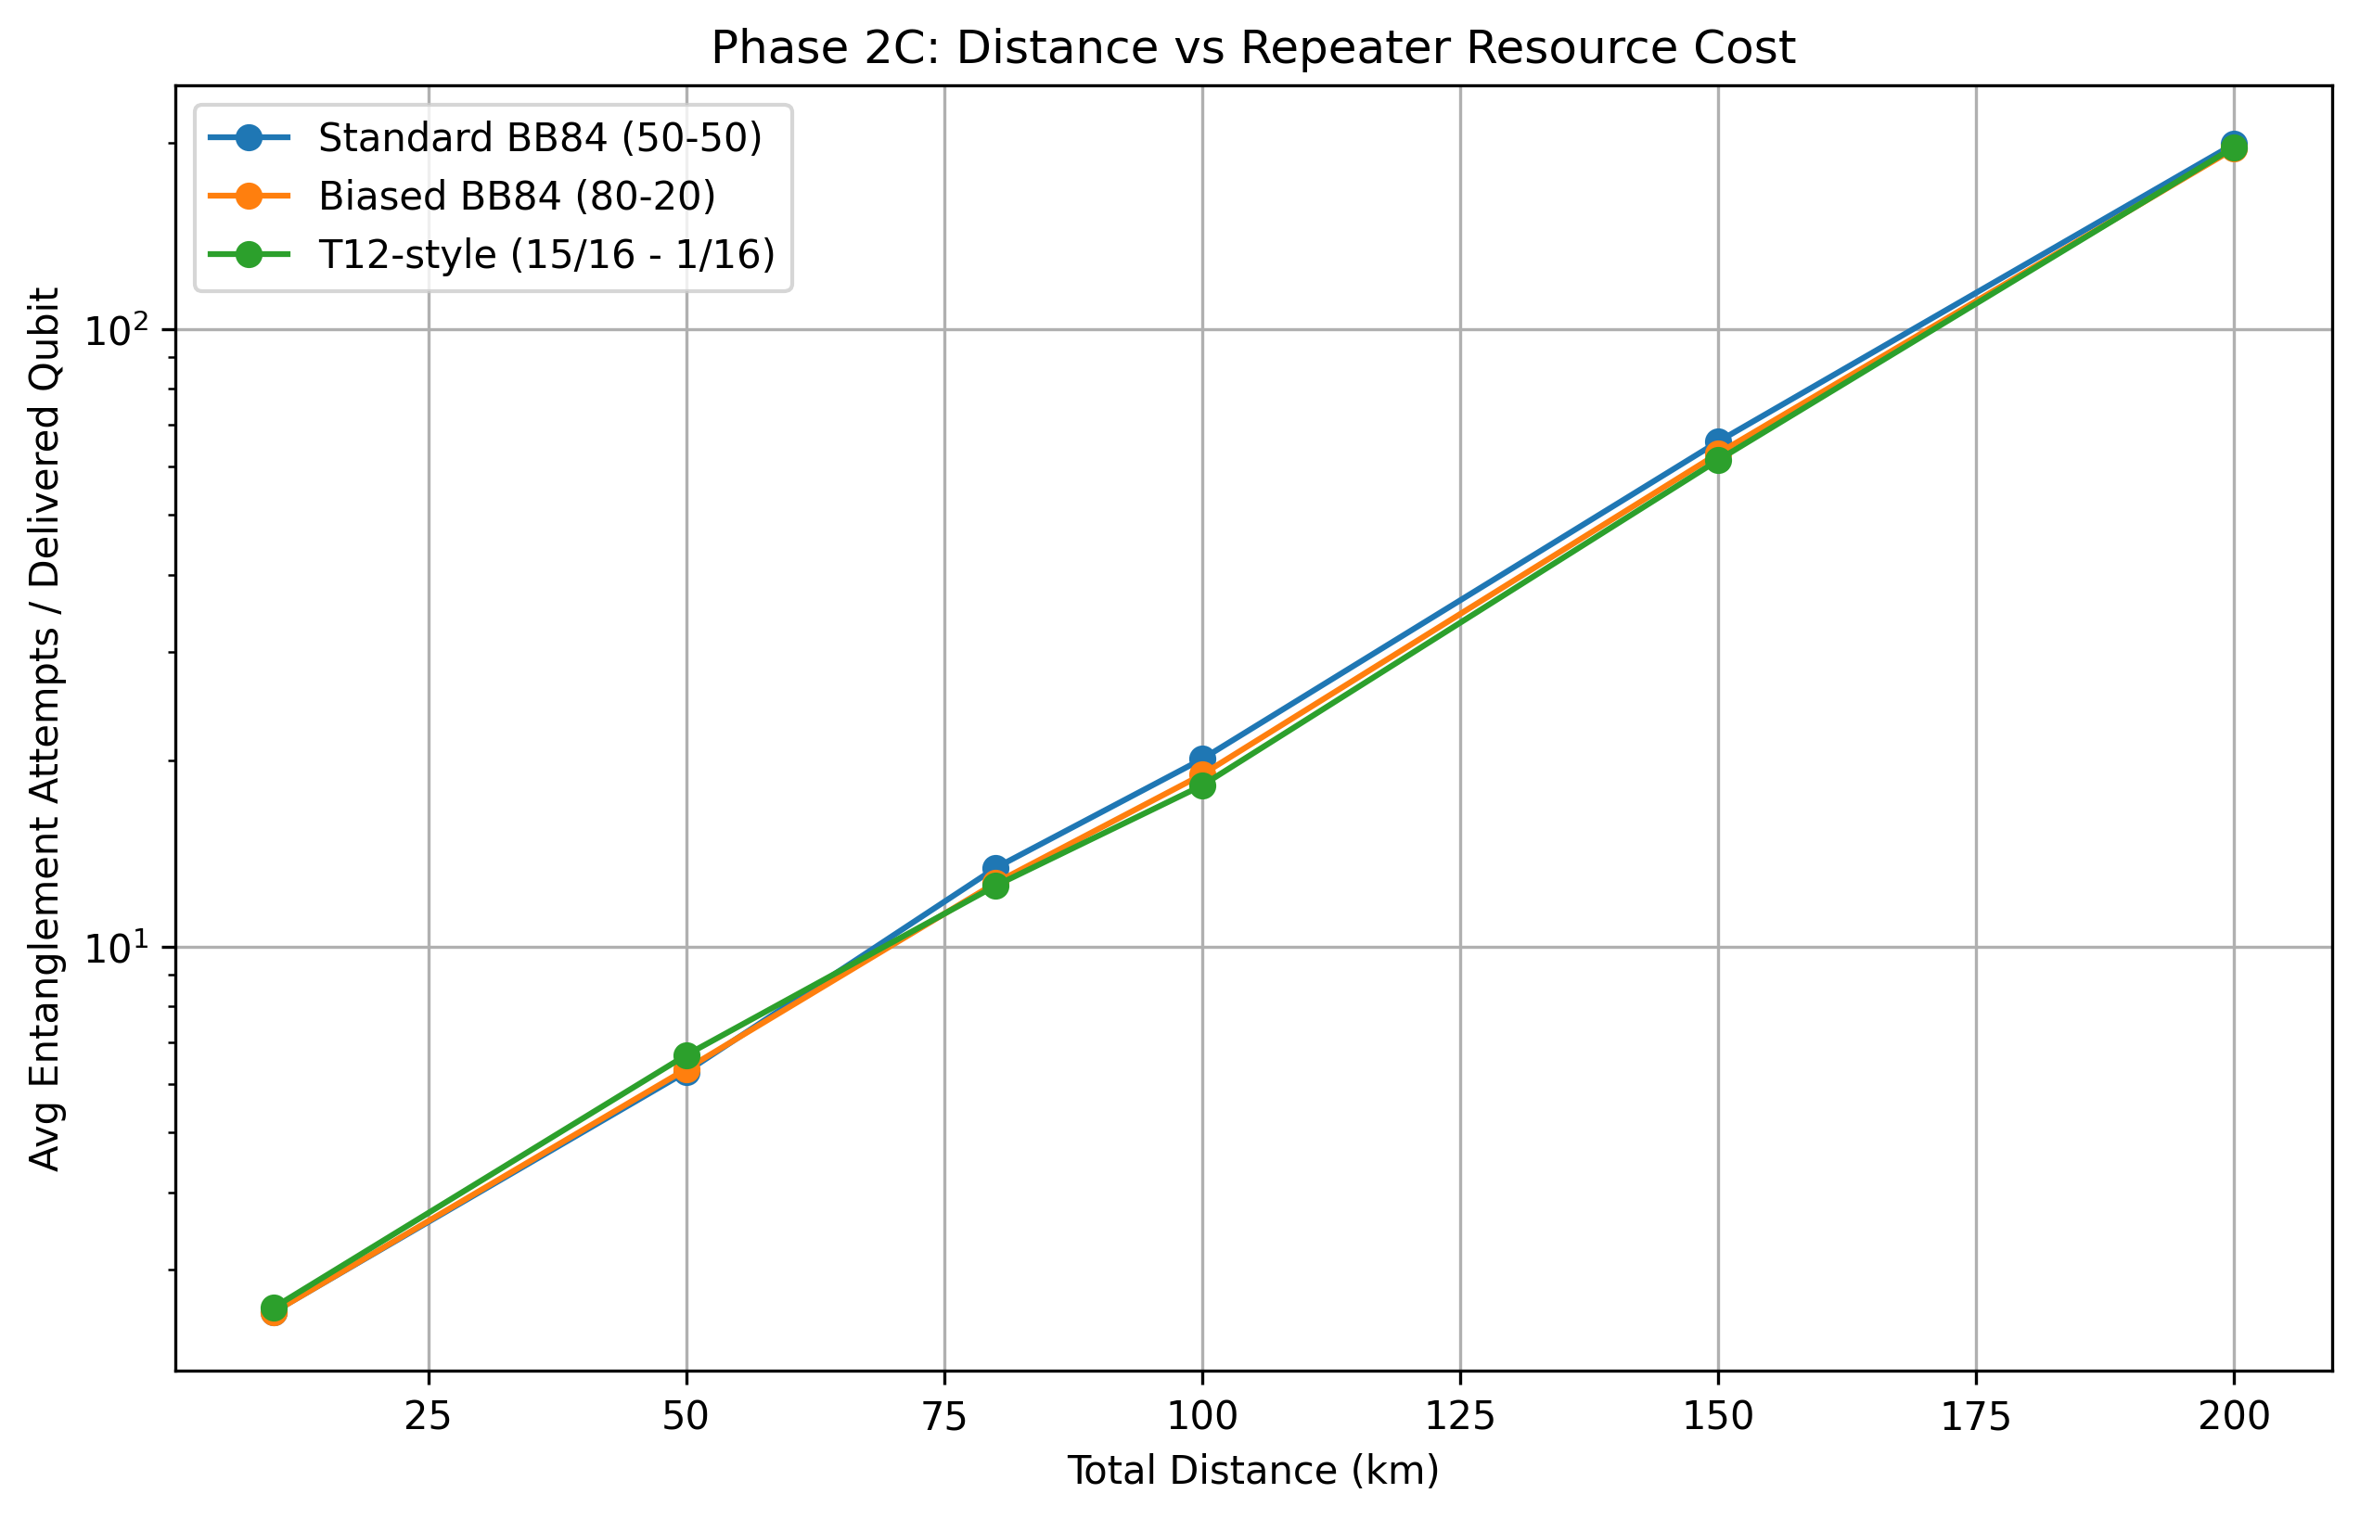
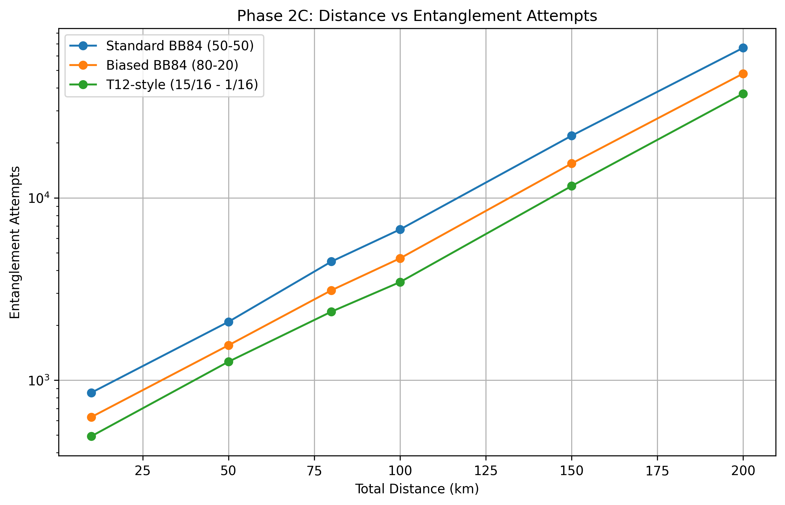
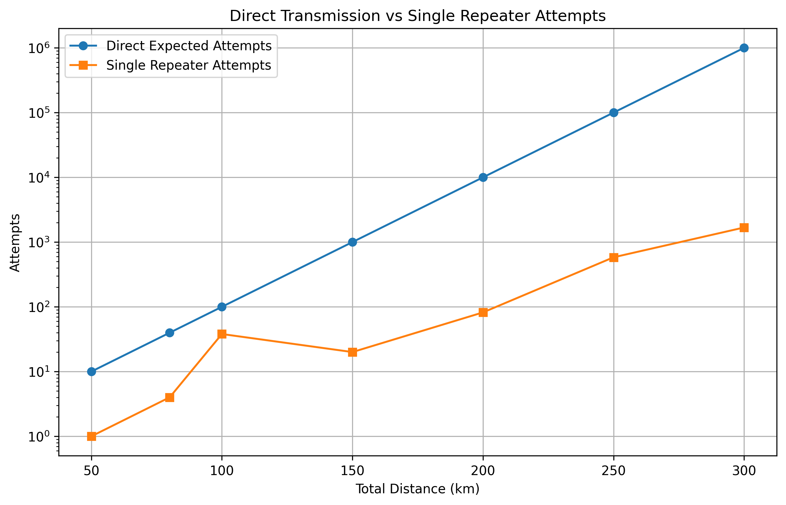
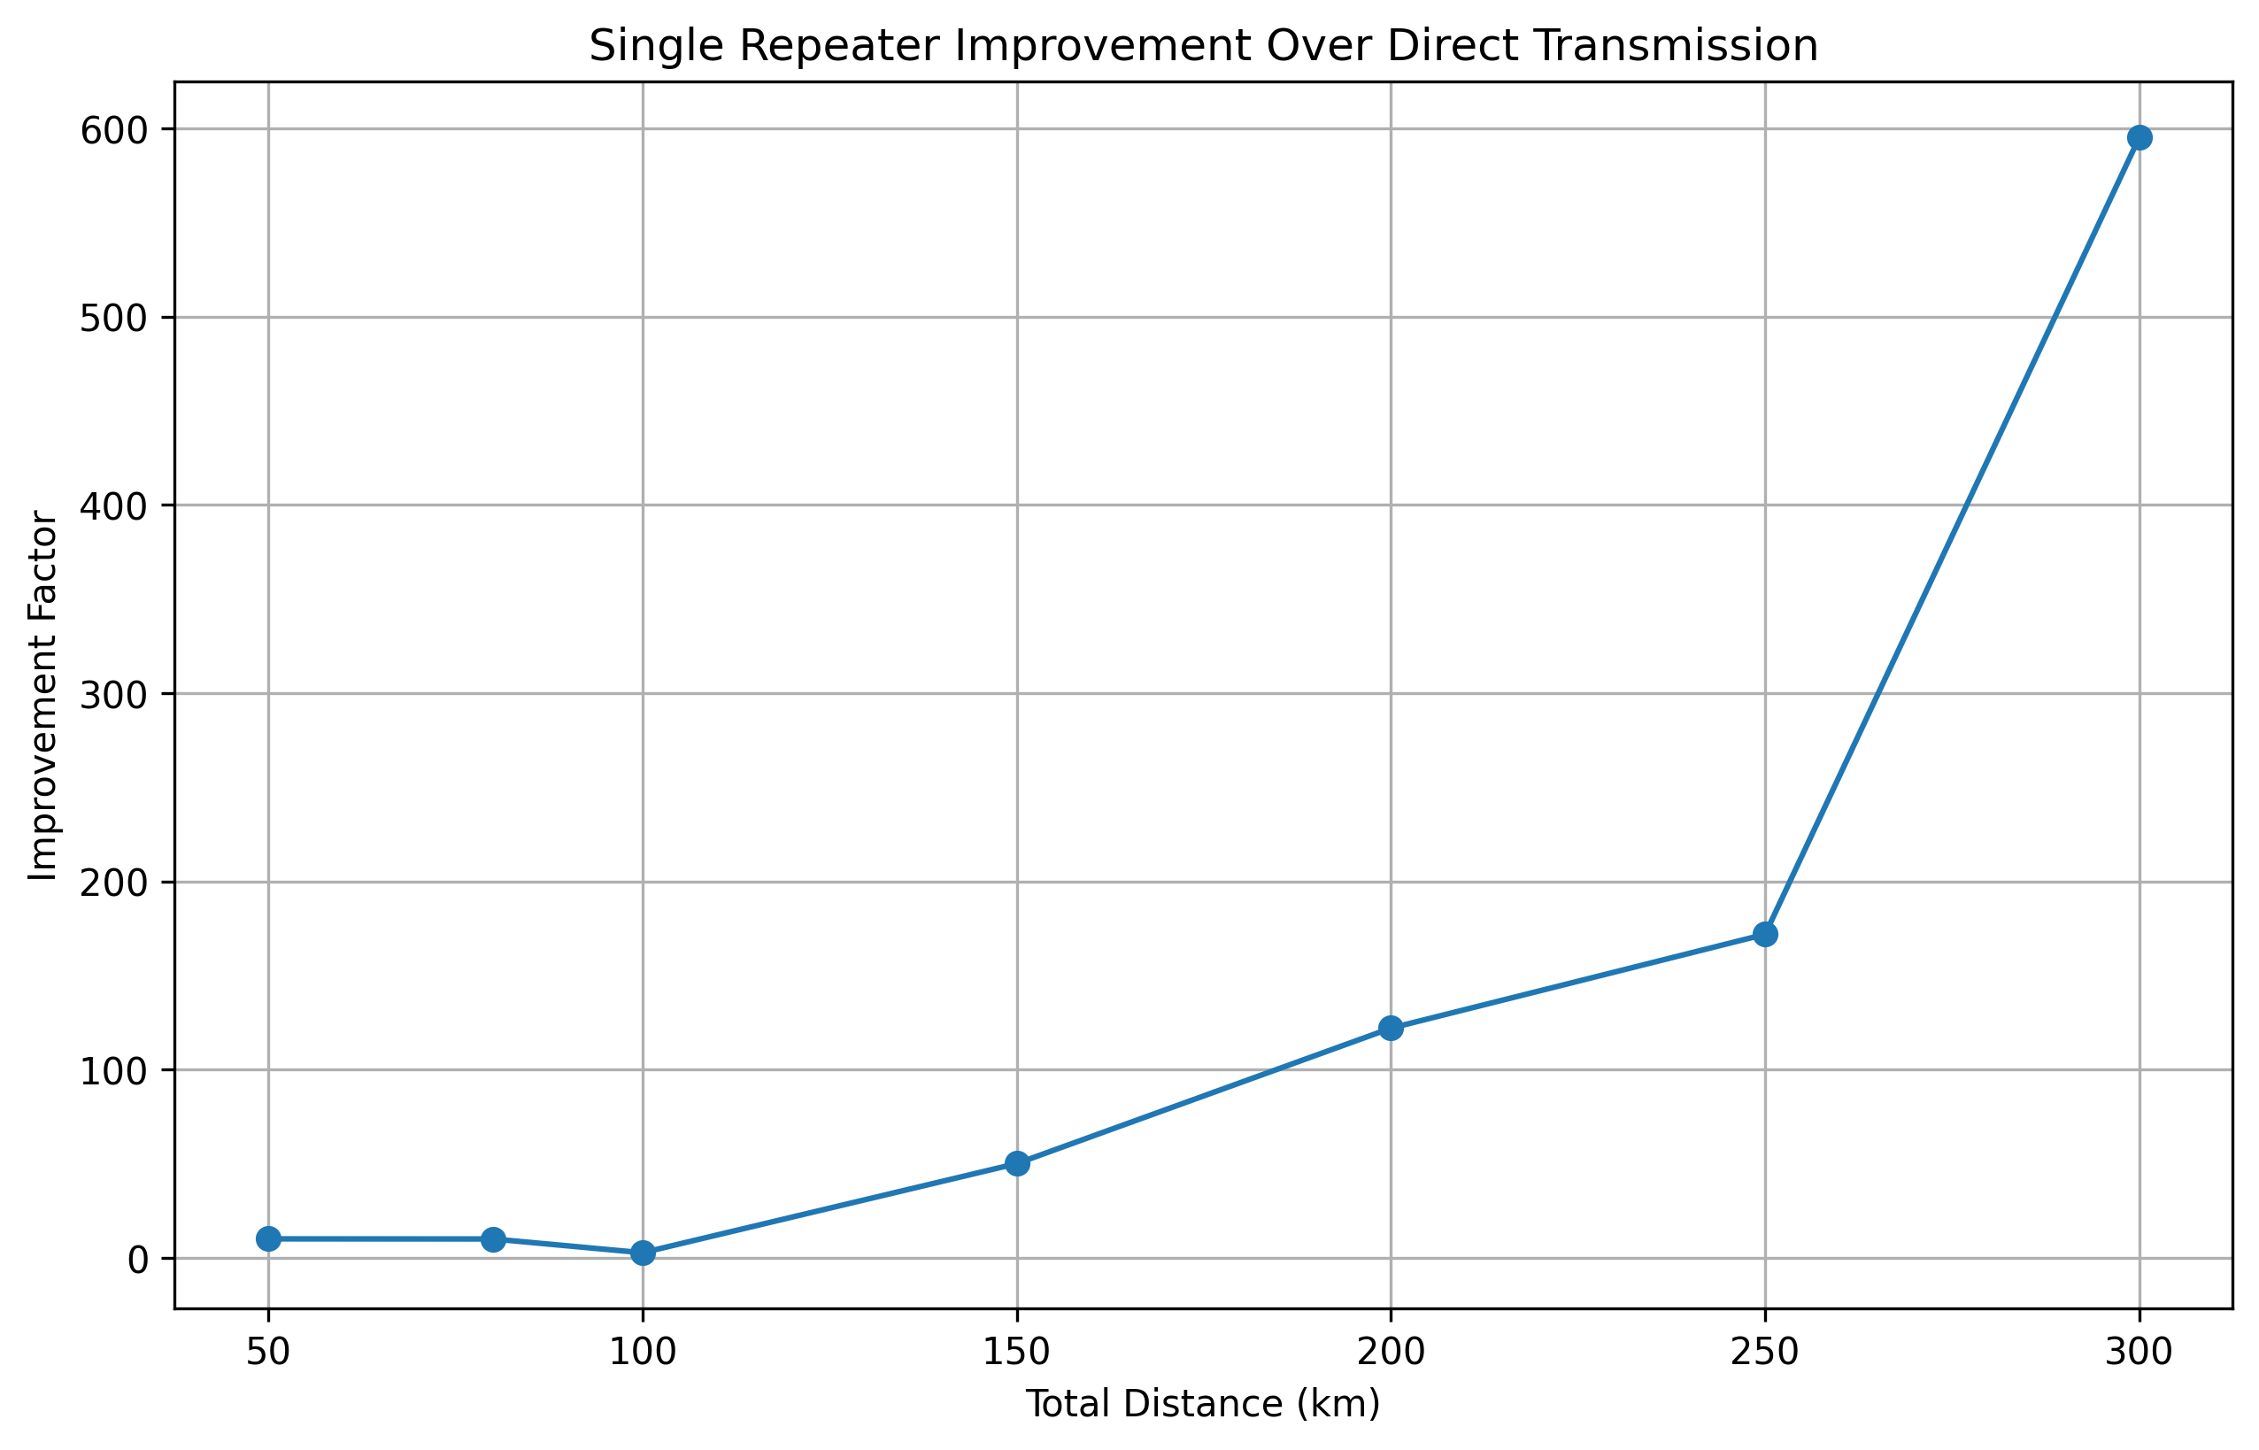
Results of Phase 2 NARAD-QC
Vishesh Goyal - VisheshVerse

