Slide 1

RealityCheck : An Evidence-Grounded Hallucination Correction Pipeline for LLMs
By Vishesh Goyal
In the guidance of Dr. Jayita Saha
VisheshVerse
Notes:
Good morning professors. Today, I am giving my UG Thesis presentation for RealityCheck. It is a hallucination detection and correction system for LLMs. Made by me under the guidance of Dr. Jayita Saha, the system is complete and ready as an end to end deployable pipeline. Me and Jayita ma'am are targetting to publish this as a research paper in a journal.

Slide 2

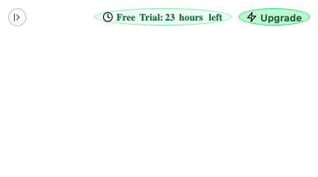
Myself Vishesh
Vishesh Goyal – VisheshVerse
Notes:
Before we move on to the actual project, here is a brief introduction about myself. I am Vishesh Goyal. Currently, I am in my fourth year and working at IIT Delhi as a quantum communications research intern under the National Quantum Mission. I have a strong interest in Quantum Computing and Quantum Cyber Security and wish to purse a PhD into the subject as my career path.

Slide 3
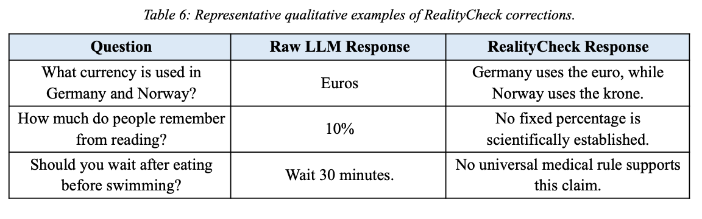
The Problem
LLMs sound confident, even when they're wrong or partially correct.
Vishesh Goyal – VisheshVerse​
Notes:
A large majority of people have started to use LLMs in different domains, requirements and work sensitivity. However, LLM responses are not always correct. The tone of presentation, the adaptive user psychology and the language fluency presents the answers in a way that it convinces the people and they trust it blindly without making an effort to search for the correctness of the response. As you can see in the table, a raw LLM can give partial, incorrect or contradictory claims when making a statement. The bigger problem in this is the lack of accountability with the user disclaimer that the companies put "ChatGPT is an AI and can make mistakes." The developers term it as Hallucinations.

Slide 4
The Effect of Hallucinations
Healthcare → false medical claims → bad clinical decisions
Academic research → fabricated citations, wrong stats
Public platforms → confident misinformation spreads at scale
The danger isn't the error, it's the fluency around the error
Vishesh Goyal – VisheshVerse​
Notes:
The hallucination is a very big problem for every person. Apart from hampering with the work and reducing the efficiency, the domain criticality is equally important. For example,
In healthcare sector, false medical claims generated by the LLMs can lead to bad clinical decisions. Earlier, when people faced any medical problem like coughing, they googled it and then made the decision of going to the doctor or not. Now, instead of Google, people rely on LLMs.
In academic research, fabricated citations and wrong statistics can lead to a bad research output effecting the reliability of the research.

Slide 5
What Already Exists and Why are they insufficient?
RAG → grounds generation, doesn't fix errors already made
NLI verification → struggles with compound/multi-hop claims
CoVe (self-verification) → limited by model's own knowledge, costly
KGR (knowledge graphs) → accurate but domain-limited
WikiChat → Wikipedia-grounded, but discards unverifiable claims entirely
No existing system corrects a response inline, before delivery, without retraining the model.
That's the exact gap RealityCheck is built for.
Vishesh Goyal – VisheshVerse​
Notes:
The problem has been tackled to a scale by many different technologies.
RAG, the retrieval augmented generation, looks at the answer and identify hallucination patterns by comparing generated answers to retrieved context.
NLI verfication struggles with complex sentences or claims where two or three different conclusions chain up into a big claim.
In self verification system, we ask the LLM itself to look at its response and find the hallucinations, detect mismatch and correct them. But they are limited by model's own knowledge and increase the number of tokens and the cost associated.
Knowledge graphs make the generation much more accurate but limits the information only to the extent of the graph.
No existing system corrects a response inline, before delivery, without retraining the model. That's the exact gap RealityCheck is built for.

Slide 6
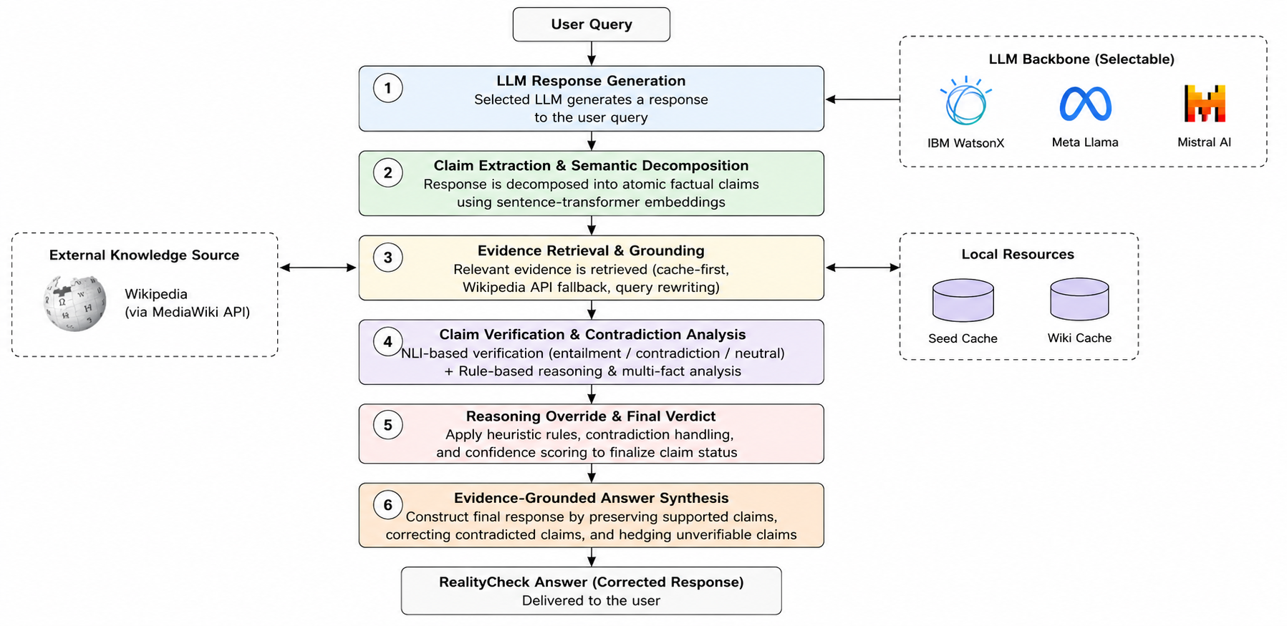
Introducing RealityCheck
Modular, six-phase, model-agnostic correction pipeline
Operates externally. No fine-tuning, no architecture changes
Generate → Extract → Retrieve → Verify → Override → Synthesize
Vishesh Goyal – VisheshVerse​
Notes:
So, we introduce RealityCheck. It is a six phase pipeline system to correct the LLM answers before they become visible to the user. Instead of focusing on danger identification and danger correction, our focus was on danger avoidance. RealityCheck is a model agnostic system. So, it can be used with any LLM without any issues. Plus, it is an external layer on top of the LLM. So, there is no architecture reworking required from the implementing model. Additionally, there is no limitation on the extent of knowledge since the system cross verfies the data directly from the source added at the time of implementation.

Slide 7
Dataset: TruthfulQA
817 questions across 38 categories (health, law, finance, history, conspiracy theories)
Designed to trigger popular misconceptions, not just test ignorance
Perfect fit for RealityCheck as we target fluent-but-false answers, not knowledge gaps
Vishesh Goyal – VisheshVerse​

Slide 8
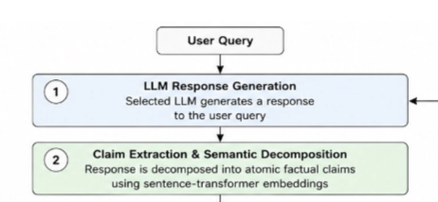
The Process Step 1 : Claim Extraction
LLM response → split into sentences
Each sentence checked for "checkability" (factual cue: named entity, year, verb pattern)
Subjective/hedged sentences → marked non-checkable, skipped
Context-dependent fragments enriched using the original question
Vishesh Goyal – VisheshVerse​
Notes:
Let's start with the methodology of the system. First and foremeost, we have the claim extraction. When the user asks a question, LLM generates a response. RealityCheck takes the response and breaks it down to extract the claims by the LLMs. Each sentence gets checked for checkability by identifying the names, year, factual data signs like percentages, language use from NLP etc.
The subjective sentences that vary from person to person are marked as non checkable and skipped entirely.

Slide 9

The Process Step 2 : Evidence Retrieval
Cache-first, 3-layer strategy:
Local seed evidence bank
Wikipedia MediaWiki API (+ OpenSearch fallback)
Direct source URL (if available)
Retrieved pages chunked + ranked by semantic similarity
Top-k chunks kept as claim-specific evidence
Vishesh Goyal – VisheshVerse​
Notes:
After the claims are extracted, we do an evidence retrieval from the trustworthy source. All the results that are about to be shown were created keeping the Wikipedia as the database, the source of truth. During a real world deployment, we can add or change the knowledge bank to the deployment's requirements.
We use a 3 layer strategy. RealityCheck maintains a cache database whenever it searches for anything. This saves the cost of Wikipedia API. If the answer is unavailable in the cache, we switch to Wikipedia's MediaWiki API and open google search. During the development of the project, TruthfulQA dataset had the wikipedia pages for all the questions, so we added them and increased the trust weightage on them.
After the wikipedia API delivers the result, we chunk the pages on the basis of the information they are giving. Then, the chunks' information is ranked by semantic similarity to the original user question and top k chunks are kept. Rest of them get added to the cache bank.

Slide 10
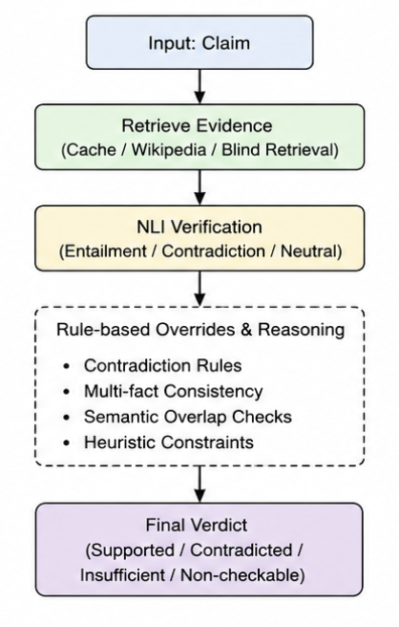
The Process Step 3 : The Verification Engine
Four fused signals, not one classifier:
Semantic similarity (relevance gate)
NLI cross-encoder (entailment / contradiction / neutral)
Rule-based overrides (misattributed quotes, negation, compound facts)
Noisy-OR aggregation across multiple chunks
Vishesh Goyal – VisheshVerse​

Slide 11
The Process Step 4 : Decision Logic
Relevance below threshold → Insufficient
Else if contradiction score high → Contradicted
Else if support score high → Supported
Else → Insufficient (conservative fallback, by design)
Temporal claims (age/date) → handled via deterministic arithmetic, not NLI
Vishesh Goyal – VisheshVerse​

Slide 12
The Process Step 5 : Answer Synthesis
Supported → kept as-is
Contradicted → repaired using best evidence + correction templates
Insufficient evidence → hedged or omitted
Non-checkable → passed through unchanged
Deterministic = no secondary hallucination
Vishesh Goyal – VisheshVerse​
Notes:
Once the decisions have been made and the system knows the correct answer and factual correctness, the next important step is to rewrite the model in a way that it looks as compelling and attention grabbing as the original answer. The supported claims are kept as they are, contradicted are repaired using best evidences from the Wikipedia search, insufficient evidences are removed and non checkable pass through as it is.

Slide 13
The Experimental Setup
3 models tested: IBM Granite, Meta Llama, MistralAI Mistral
Same system prompt, same constraints, same question set
No fine-tuning, no model-specific tweaking
Controlled comparison → differences reflect model behavior, not bias
Vishesh Goyal – VisheshVerse​
Notes:
We tested the system against three models, IBM's Granite, Meta Llama and MistralAI's Mistral. We keep the same system prompt, the same set of contraints and sme question set with the target that the difference in answers should show model's weaknesses and behaviours without giving any bias to either of the models.

Slide 14
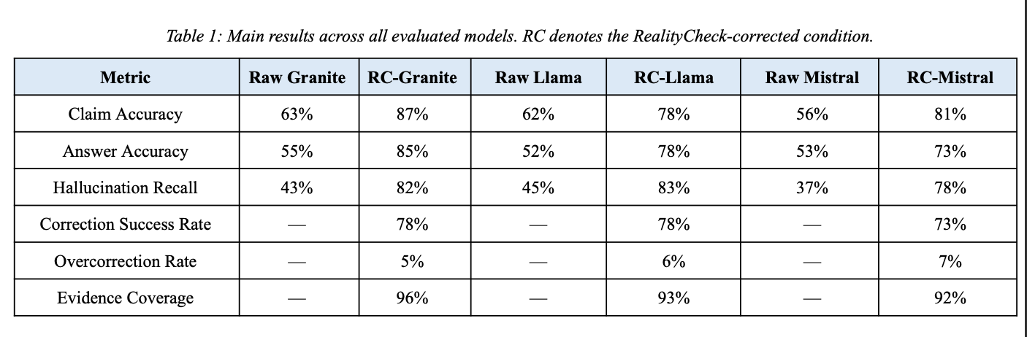
The Results
Vishesh Goyal – VisheshVerse​
Notes:
These are the results we achieved after doing a repetitive trial across all three models by the same set of questions. As you can see, across all three models, the accuracy and hallucination recall has successfully increased by at least 15 percentage points each.

Slide 15
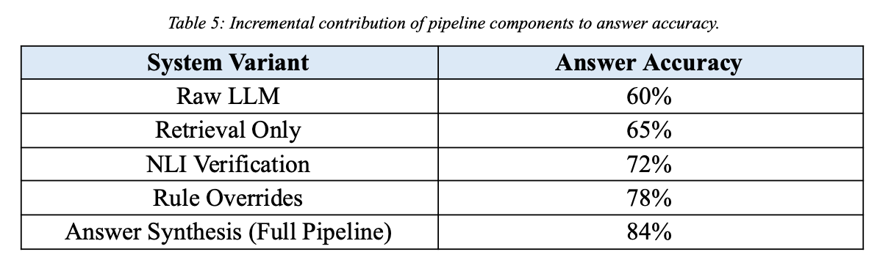
The Necessity of Each Step
Every component adds real value. No single piece does it alone
Vishesh Goyal – VisheshVerse​

Slide 16
The Identified Limitations and the Future Scope
Weak retrieval on niche topics
Multi-hop reasoning claims
Borderline subjective questions → occasional false contradictions
Wikipedia-only → coverage ceiling on recent/contested topics
Vishesh Goyal – VisheshVerse​
Notes:
We have identified some limitations when our model fails to perform any meaningful upgrade to the answer.
When the question comes from a niche or not a widely known topic, there is very limited information available about it. When the knowledge source itself is not big enough, all the subsequent topics have lesser data to work on. As a future scope, we plan to decrease the dependence on Wikipedia as our sole knowledge base.
Multi hop reasoning : When a group of individual sources collect up and form a chain of reasoning, the system isn't able to connect those dots together and form a reason. That can definitely be a natural extension of the current project.
Borderline subjective questions : When the person's question mixes the actual real world phenomenon with something specific to them, the system sometimes creates false contradictions because a large chunk of the LLMs response might be coming from the user's perspective and the framing of the question.

Slide 17
Conclusion
Hallucinations can't be eliminated. But they can be caught and corrected before they reach the user
No retraining, no architecture rework, fully model-agnostic
RealityCheck = a practical, deployable trust layer for LLMs
Vishesh Goyal – VisheshVerse​

