Slide 1


PACE UNIVERSITY
CAPSTONE PROJECT
CS-668
Midterm Presentation-
AuRa Discovery – An Agentic Graph-RAG System
for Biomedical Drug Discovery
Presented By-
Judith Ria Talari
Sasank Dhulipudi

Slide 2












1.Introduction
8.Conclusion
TABLE OF CONTENTS
7. References
2.Literature Review
3. Dataset
6.Proposed Solution
5.Exploratory Data Analysis

Slide 3
INTRODUCTION
130,000+ adverse drug events annually in the US
DDI-related hospitalizations cost $3.5B/year
2.5M biomedical papers published yearly on PubMed
Existing databases (ChEMBL, DrugBank) lag behind research by months/years
Manual extraction is slow, error-prone, and doesn't scale
Our Question/Problem Statement:
Can an AI agent read the medical literature, validate what it finds, and discover dangerous drug interactions — faster and more accurately than a human expert?

Slide 4
INTRODUCTION
Why This System & Who Needs It?
End Users: Pharmacologists, clinical researchers, healthcare AI systems, pharma companies
Capabilities: Automated literature mining, real-time ChEMBL validation, conflict detection, novel discovery identification, knowledge graph construction, domain-specialized extraction
Why Agentic AI: Different tasks require different reasoning strategies + conditional routing + error recovery → solved with LangGraph

Slide 5
BACKGROUND
Historical Benchmark - DDIExtraction 2013
What it is: The seminal "Shared Task" (SemEval-2013 Task 9) that defined the DDI extraction problem for a decade.
The Dataset: 1,017 documents from DrugBank and MedLine abstracts, manually annotated for 4 types of interactions: Mechanism, Effect, Advice, and Interact.
Classic Approach:
Technology: Support Vector Machines (SVMs) with non-linear kernels.
Performance: The top-performing teams achieved an F1-score of 0.65.
The Problem (The Gap):
Brittle Features: Relied on manual "feature engineering" (detecting specific sentence structures).
Lack of Generalization: Failed when scientific language evolved or sentence structures became complex.
Static Output: Models provided a label but no real-world verification or "reasoning."

Slide 6
BACKGROUND
State-of-the-Art - PubTator 3.0
What it is: A premier NIH resource using transformer-based AI to index over 1 billion biomedical relations across 36 million abstracts.
Key Innovation: Integrates advanced Named Entity Recognition (AIONER) with LLM capabilities (GPT-4) to improve search factuality.
The Approach:
Precomputed Annotations: Most relations are "pre-extracted" to allow for lightning-fast semantic search.
Entity Normalization: Automatically maps drug mentions to standardized MeSH or ChEMBL identifiers.
The Remaining Gap:
Dynamic Latency: Because it relies on weekly updates/precomputation, it can lag behind daily preprints.
Closed-Loop Limitation: While it is a world-class search tool, it does not act as an autonomous agent that cross-references findings against clinical ground truth in a self-correcting loop.

Slide 7

DATASET
Data Sources:
A. PubMed Central (Input)
Source: NCBI E-utilities API
43 papers ingested from pharmacology(2025–2026)
Query: warfarin, aspirin, statins, metformin + "drug interaction"
Format: XML → JSON with PMID, DOI, title, abstract, authors, date
B. ChEMBL (Validation)
Source: EMBL-EBI REST API
2.3M compound records, 20M bioactivity measurements
Used for real-time drug name validation
Returns: ChEMBL ID, mechanism of action, drug targets
C. Neo4j Knowledge Graph (Output)
Nodes: Paper (43), Drug (~30), Author (~300)
Edges: INTERACTS_WITH (22), WROTE
Stores all validated DDI findings with metadata
Note : Due to Gemini API Rate limit constraints, 19 of 43 papers have been fully processed at the time of this presentation. The remaining 24 will be completed for the final submission.

Slide 8
DATASET
Dataset Stats Table:
Note : Due to Gemini API Rate limit constraints, 19 of 43 papers have been fully processed at the time of this presentation. The remaining 24 will be completed for the final submission.
Metric | Value
Total Papers Ingested | 43
Papers Processed | 19
Papers Pending | 24 (API rate limit)
Total Interactions Extracted | 22
ChEMBL Coverage | 95% (21/22)
Novel Discoveries | 5% (1/22)
Conflict Rate | 0% (0/22)
Avg Abstract Length | 190 words
Avg Authors per Paper | 7.1

Slide 9
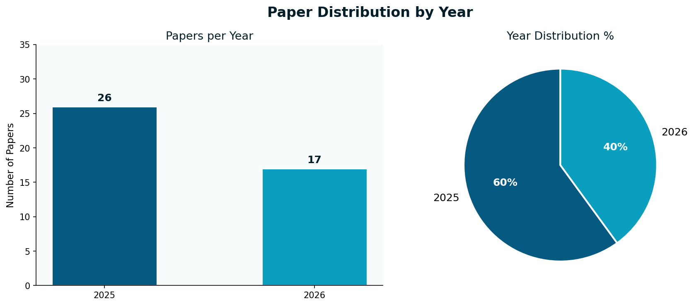
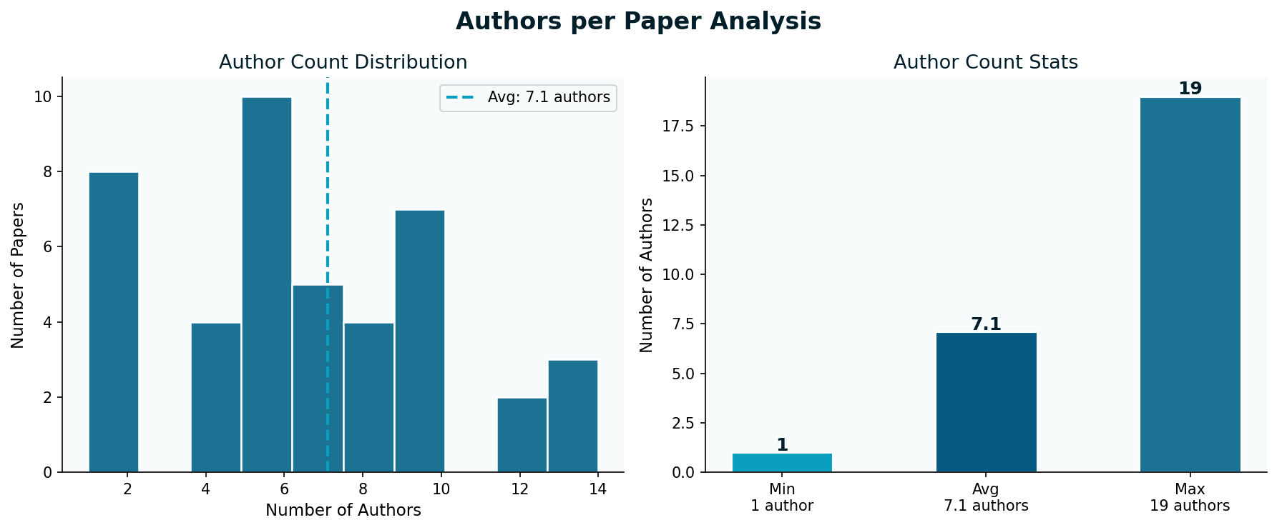
EXPLORATORY DATA ANALYSIS
Charts and Graphs

Slide 10
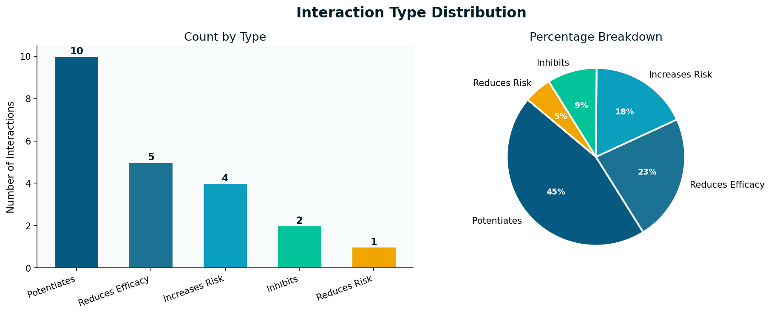
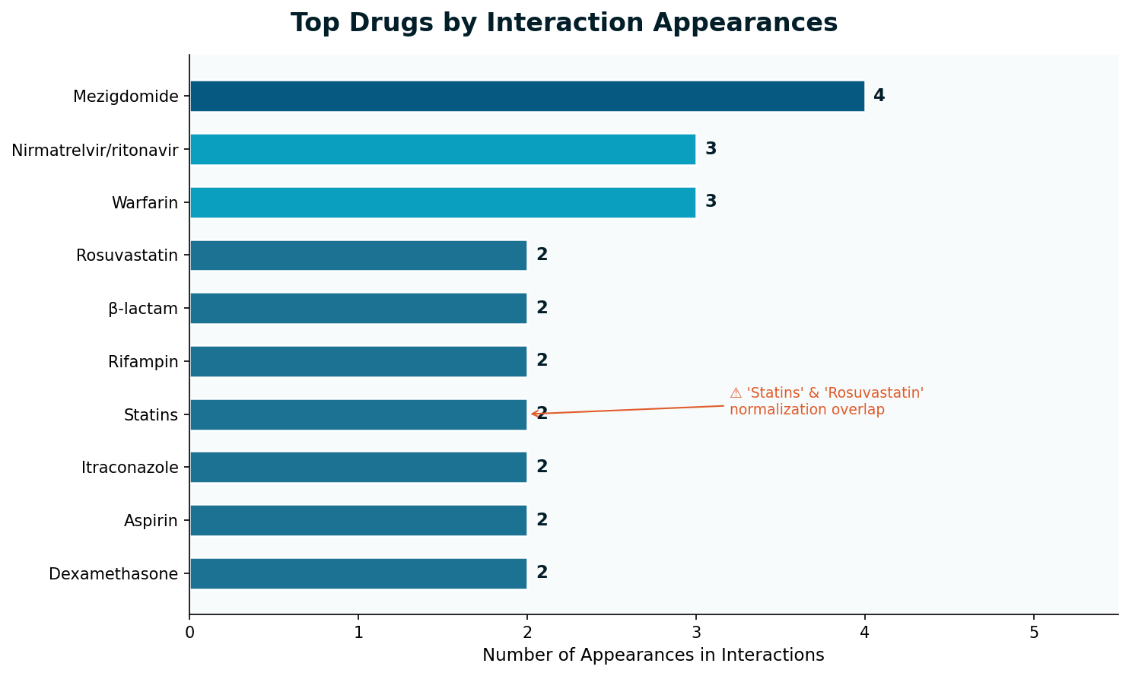
EXPLORATORY DATA ANALYSIS
Charts and Graphs

Slide 11
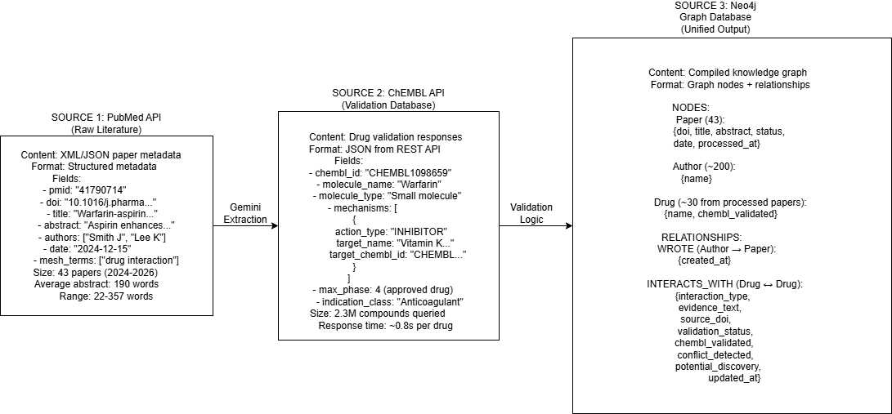
EXPLORATORY DATA ANALYSIS
Data Sources and How they compile into
Why Gemini?
Gemini 2.5-Flash was selected for its free tier API access via Google AI Studio, providing 5 RPM and 20 RPD without any cost — sufficient for our batch processing pipeline for testing the framework.

Slide 12
EXPLORATORY DATA ANALYSIS
Input Output transformation
Example Input:
PMID: 41790714
DOI: 10.1016/j.pharma.2024.12.003
Title: "Warfarin and aspirin interaction mechanisms in atrial fibrillation"
Abstract (186 words):
“Background: Concurrent use of warfarin and aspirin remains controversial in atrial fibrillation patients. This study investigated the pharmacokinetic and pharmacodynamic interactions. Methods: We analysed 150 patients on dual therapy versus warfarin monotherapy. INR, bleeding events, and aspirin metabolism were monitored. Results: Aspirin significantly potentiated warfarin's anticoagulant effect, with 68% of dual therapy patients showing INR >3.0 versus 22% in monotherapy (p<0.001). Bleeding events were 2.3-fold higher in combination therapy (HR 2.31, 95% CI 1.45-3.67). Aspirin's COX-1 inhibition enhanced warfarin's vitamin K antagonism. Conclusion: The combination increases bleeding risk and requires careful INR monitoring. Dose adjustment recommended when initiating aspirin in warfarin-treated patients.”

Slide 13
EXPLORATORY DATA ANALYSIS
Input Output transformation
Extraction Output (From Gemini):
json
{
"interactions": [
{
"drug_a": "Aspirin",
"drug_b": "Warfarin",
"interaction_type": "Potentiates",
"evidence_text": "Aspirin significantly potentiated warfarin's anticoagulant effect, with 68% of dual therapy patients showing INR >3.0",
"confidence": 0.95
}
],
"source_doi": "10.1016/j.pharma.2024.12.003",
"extraction_notes": "Found 1 high-confidence interaction with clinical evidence"
}
Neo4j Storage (After Validation):
Query to retrieve:
cypher
MATCH (d1:Drug {name: "Aspirin"})-[r:INTERACTS_WITH]->(d2:Drug {name: "Warfarin"})
WHERE r.source_doi = "10.1016/j.pharma.2024.12.003"
RETURN d1, r, d2
Result:
json
{
"drug_a": {
"name": "Aspirin",
"chembl_validated": true,
"chembl_id": "CHEMBL25"
},
"interaction": {
"interaction_type": "Potentiates",
"evidence_text": "Aspirin significantly potentiated warfarin's anticoagulant effect...",
"source_doi": "10.1016/j.pharma.2024.12.003",
"validation_status": "validated",
"chembl_validated": true,
"conflict_detected": false,
"potential_discovery": false,
"updated_at": "2026-03-10T15:23:45Z"
},
"drug_b": {
"name": "Warfarin",
"chembl_validated": true,
"chembl_id": "CHEMBL1098659"
}
}}

Slide 14
EXPLORATORY DATA ANALYSIS
Query Search Criteria
How Papers Were Found — PubMed Query
Exact Query Used:
drug interaction[MeSH Terms] AND pharmacology[MeSH Terms]
Date range: 2025/01/01 → 2026/03/10
Max results: 50 Returned: 43 papers
Why MeSH terms (not keywords):- MeSH = Medical Subject Headings
Controlled vocabulary by NLM
More precise than free-text search
Papers are human-tagged so less noise}

Slide 15
EXPLORATORY DATA ANALYSIS
Response Retrieval Mechanism
3-step retrieval flow:
Step 1 — ChEMBL Lookup per drug- Exact name match first → synonym fallback
Returns: ChEMBL ID, mechanism of action, approval status
Rate: ~0.8s per drug
Step 2 — Batch Optimization
Step 3 — Neo4j Storage with Metadata
Every interaction stored with:
Without Batching | With Batching
44 API calls (22 x 2) | 30 Unique drug calls
~35 seconds | ~24 seconds
Duplicate lookups | Deduplicated by lowercase key
drug_a, drug_b | who interacts
interaction_type | How they interact
evidence_text | Proof from paper
source_doi | Traceable to original paper
chembl_validated | True/false
conflict_detected | True/false
potential_discovery | True/false

Slide 16
EXPLORATORY DATA ANALYSIS
Query Search Criteria
How Papers Were Found — PubMed Query
Exact Query Used:
drug interaction[MeSH Terms] AND pharmacology[MeSH Terms]
Date range: 2025/01/01 → 2026/03/10
Max results: 50 Returned: 43 papers
Why MeSH terms (not keywords):- MeSH = Medical Subject Headings
Controlled vocabulary by NLM
More precise than free-text search
Papers are human-tagged so less noise}

Slide 17
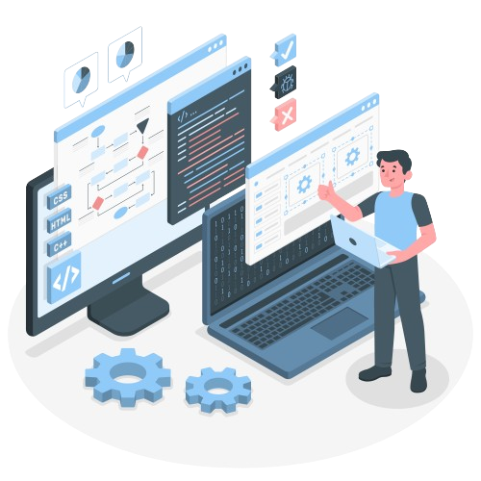
PROPOSED SOLUTION
Tech Stack
Component | Technology | Purpose
LLM | Google Gemini | DDI extraction from abstracts
Orchestration | LangGraph | Conditional agentic workflow
Validation DB | ChEMBL REST API | Drug verification
Graph DB | Neo4j | Knowledge storage & querying
Framework | LangChain + Pydantic | Abstractions & data validation
Input Source | PubMed NCBI API | Biomedical literature

Slide 18
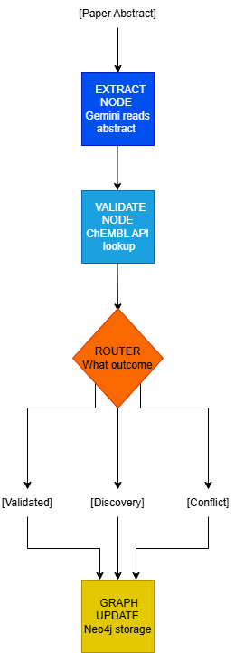
PROPOSED SOLUTION
LangGraph Worflow
Context Management:
No long-term memory — each paper processed independently
Drug validation results cached within each batch
All results persisted in Neo4j graph

Slide 19
PROPOSED SOLUTION
Current Limitation:
24/43 papers pending due to Gemini API token limits
Will be resolved for final submission
Next Steps:
Process remaining 24 papers
Add web UI for natural language queries
Add vector embeddings for semantic search
Use Local LLM for Validation

Slide 20
REFERENCES
Background / Literature Review:
[1] Wei, C-H., Allot, A., Lai, P-T., Leaman, R., Tian, S., Luo, L., Jin, Q., Wang, Z., Chen, Q., & Lu, Z. (2023). PubTator 3.0: an AI-powered literature resource for unlocking biomedical knowledge. Nucleic Acids Research. (Open Access)
[2] Kim, S., Liu, H., Yeganova, L., & Wilbur, W.J. Extracting drug-drug interactions from literature using a rich feature-based linear kernel approach. Journal of Biomedical Informatics.
[3] Segura-Bedmar, I., Martínez, P., & Herrero-Zazo, M. (2013). SemEval-2013 Task 9: Extraction of Drug-Drug Interactions from Biomedical Texts (DDIExtraction 2013). Proceedings of SemEval-2013.
Tools & Databases:
[4] Mendez, D. et al. (2019). ChEMBL: towards direct deposition of bioassay data. Nucleic Acids Research.
[5] NCBI E-utilities API — https://eutils.ncbi.nlm.nih.gov
[6] LangGraph Documentation — https://langchain-ai.github.io/langgraph
[7] Neo4j Graph Database — https://neo4j.com
[8] Google AI Studio (Gemini API) — https://ai.google.dev

Slide 21
THANK YOU
ANY QUESTIONS?

