Slide 1

WIPRO NGA Program – Embedded Testing
Capstone Project Presentation – 19th and 20th Mar
Project Title Here - Automated Testing of JpetStore Website
Presented by – Vishesh Manusani (B6)
Id: 24647
www.rpsconsulting.in

Slide 2
Contents
Introduction
About the Application
Project structure
Test cases and outputs
Reports
CI/CD Integration
Conclusion

Slide 3
Project Overview
The project aims to test Automation using Selenium(Java), Cucumber, and POM for JPetStore a website specifically designed for automated testing

Slide 4
Introduction
The goal of this capstone project is to use Selenium WebDriver, Cucumber (BDD), and Page Object Model (POM) to automate the testing of the JPetStore website.
The goal is to develop a strong automation framework that verifies important features including user authentication, product information, search, and cart actions.
The project is organized with TestNG/JUnit for test execution and Maven for dependency management.
To increase dependability, the framework will include synchronization strategies, assertions, and exception handling.
Additionally, Extent Reports will be used to generate comprehensive execution reports. This project intends to provide a scalable and maintainable test automation suite for effective validation of the JPetStore website by adhering to best coding techniques, modular test case design, and reusable components.

Slide 5
About the Application
JPetStore is a web-based e-commerce application designed for online pet shopping. It is a demo website commonly used for testing and learning purposes, especially in automation testing projects. The platform allows users to browse different pet categories, view product details, add items to the shopping cart, and manage user accounts.
Key Features:
Home Page : Displays available pet categories such as Dogs, Cats, Birds, Fish, and Reptiles.
Search Functionality: Users can search for pets by name, category, or product ID.
Product Details: This page Shows product title, description, price, availability, and images.
Shopping Cart: Enables adding, removing, and updating product quantities.
User Authentication: Allows user registration, login, logout, and password change. Stores user account details for order management and gives internationalization support.
JPetStore is widely used for Selenium automation testing as it covers various real-world e-commerce functionalities, making it an ideal test application.

Slide 6
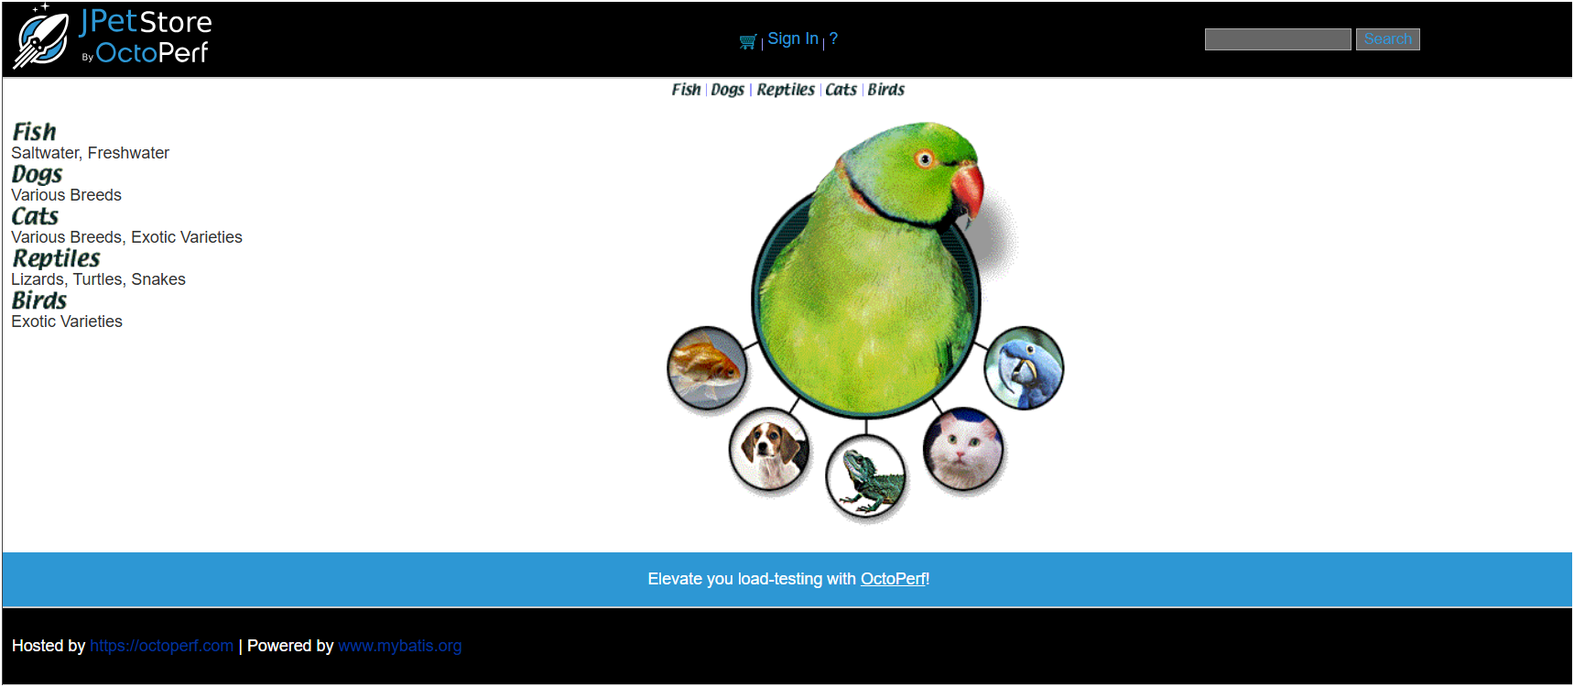
Handling Webpage

Slide 7
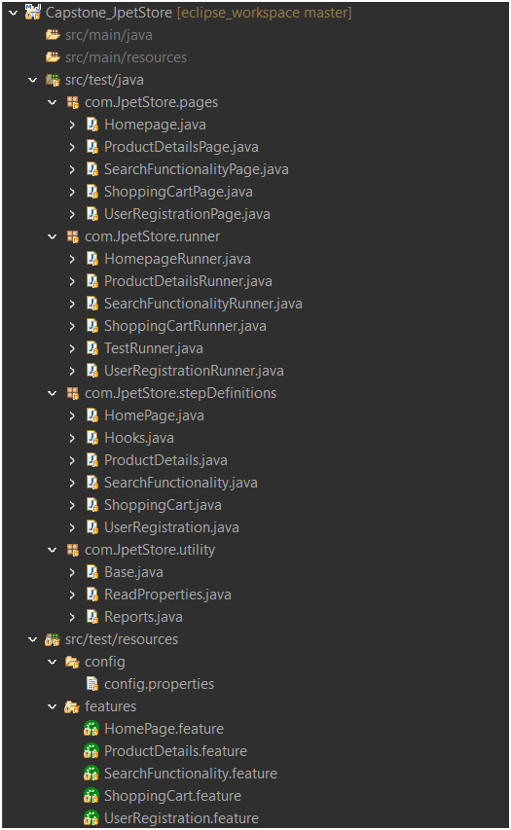
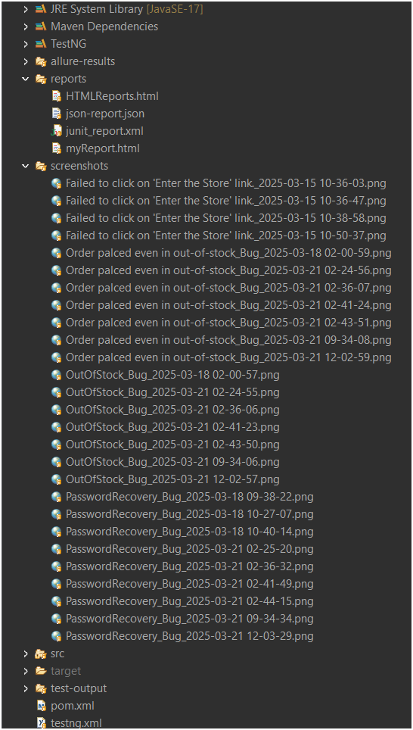
Project Structure

Slide 8
Testing Process
Implemented a Hybrid Test Automation Framework combining BDD (Cucumber), Data-Driven Testing, and POM with Selenium & TestNG for structured test execution.

Slide 9
Major Functionalities Automated
User Registration & Login
Search Functionality
Product Details Validation
Shopping Cart & Checkout
Reporting & CI/CD Integration

Slide 10
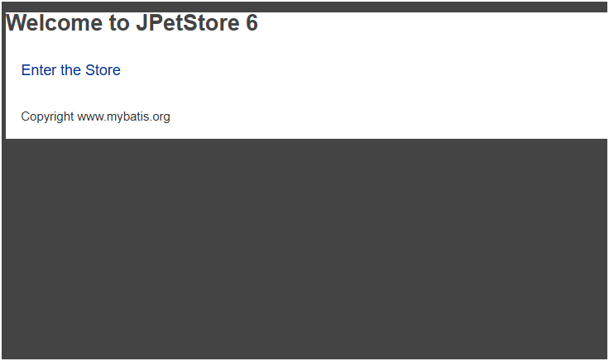
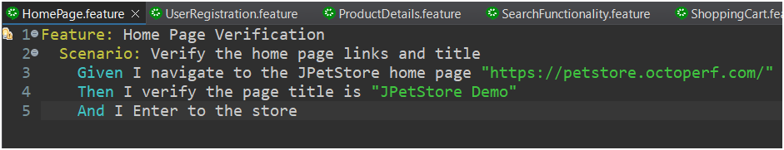
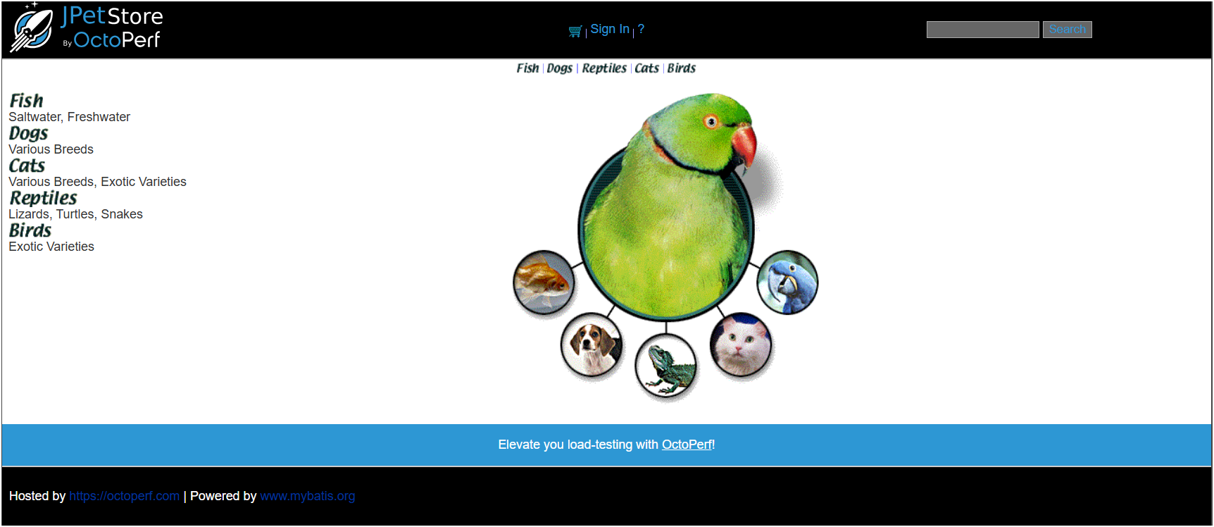
TEST CASES
1. Home page – Verify the homepage URL, title, and navigation links and ensured pet categories are displayed correctly.

Slide 11
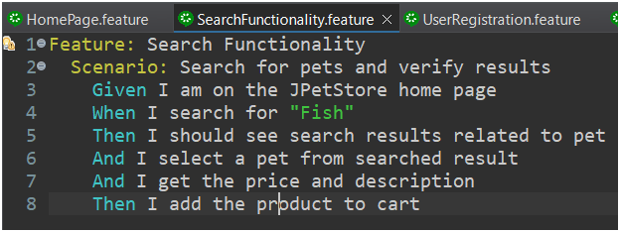
TEST CASES
2. Search Functionality – Automated search with valid and invalid inputs, verifying product availability , pricing and language selection feature.

Slide 12
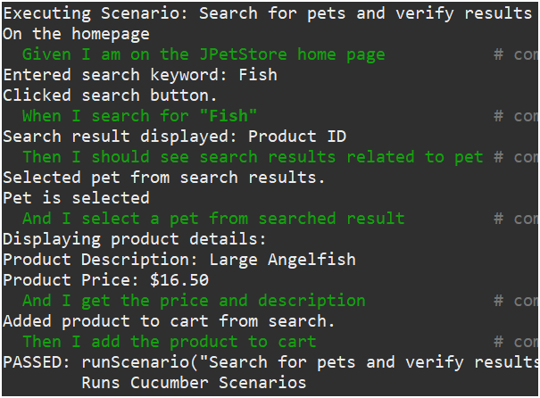
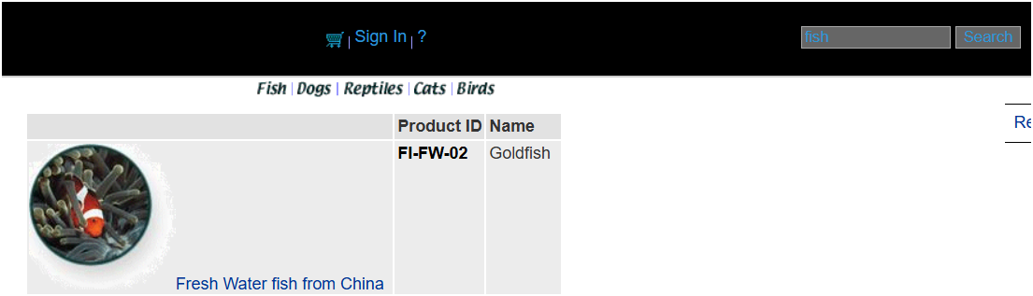
Output of search functionality

Slide 13
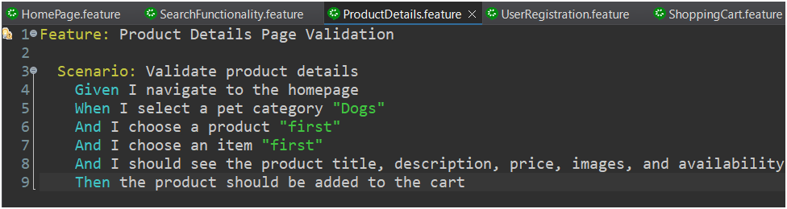
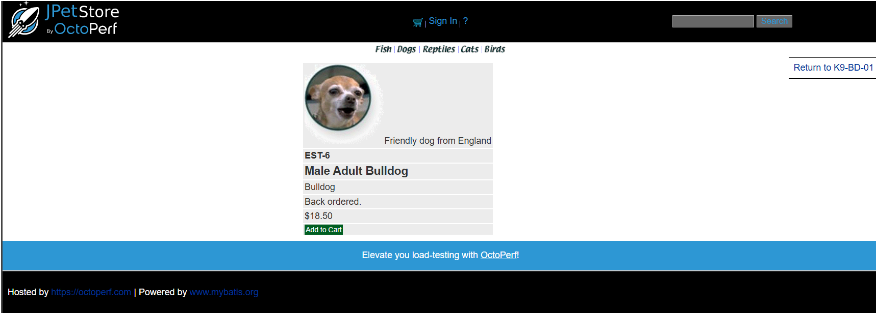
TEST CASES
3. Product Details page – Validate product title, description, price, and images and testing whether products are added to wish-list or not

Slide 14
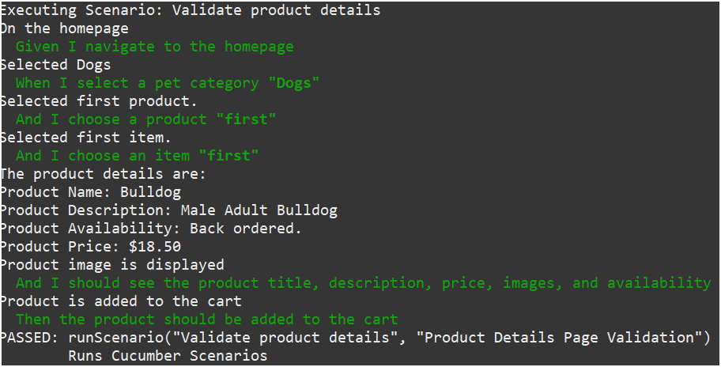
Output of product details

Slide 15
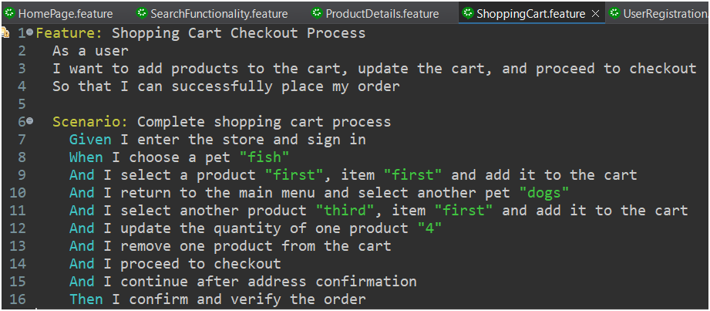
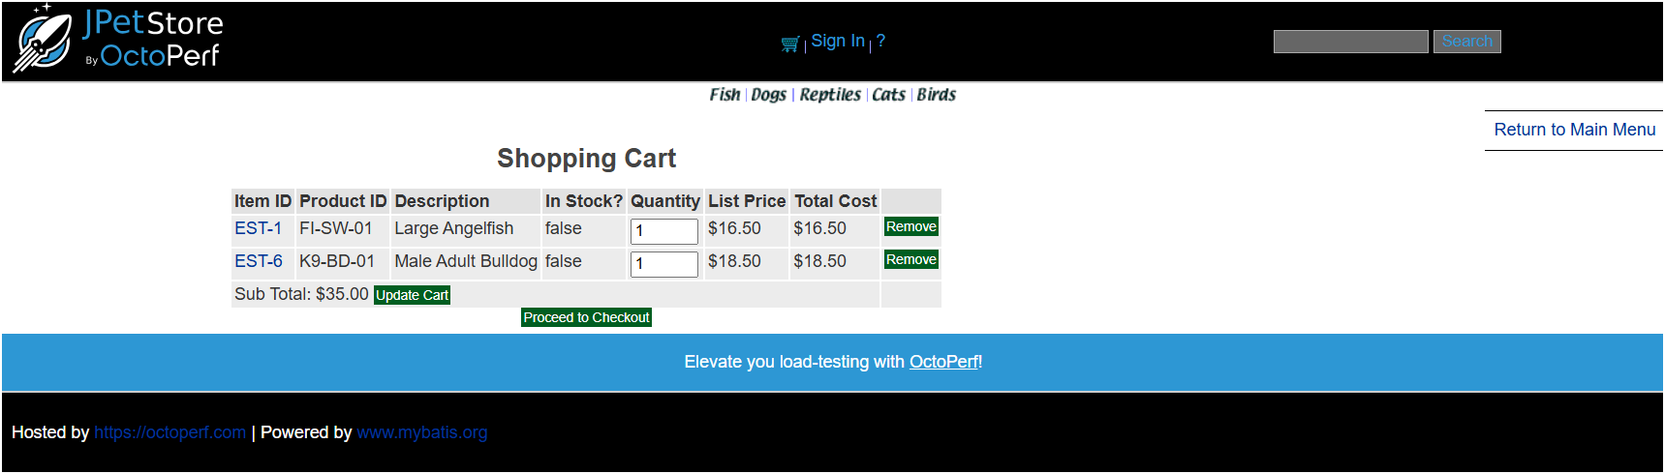
TEST CASES
4. Shopping Cart Operations - Automate adding items to the cart and verifying cart updates.

Slide 16
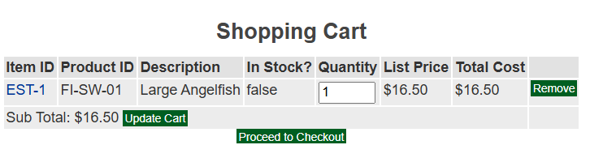
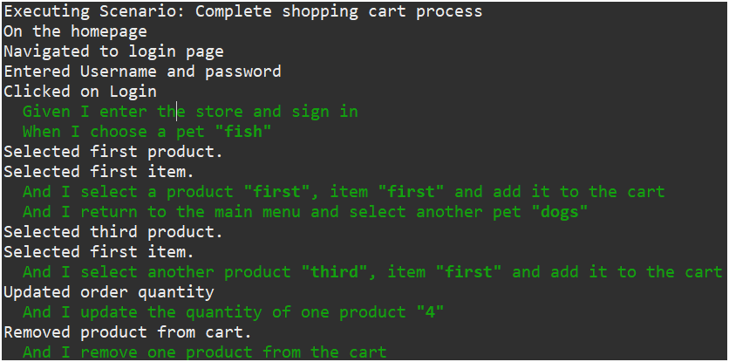
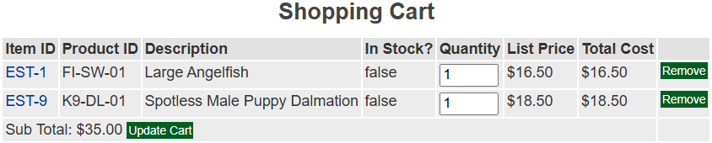
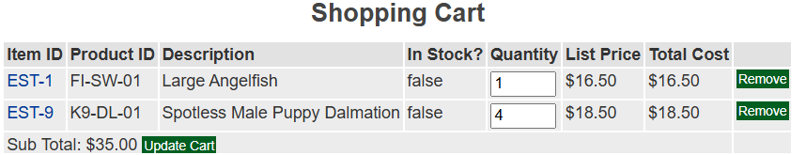
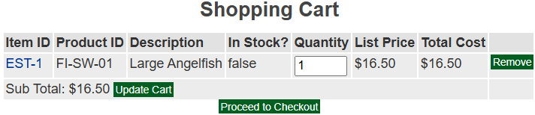
Output of Shopping cart operations

Slide 17
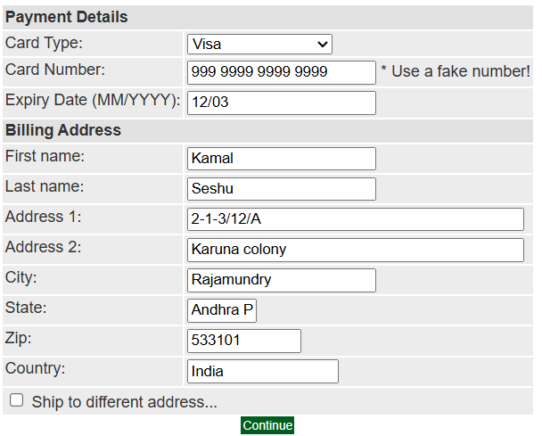
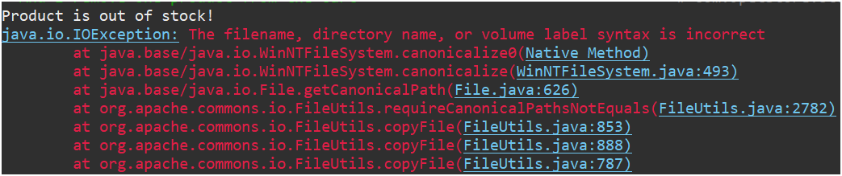
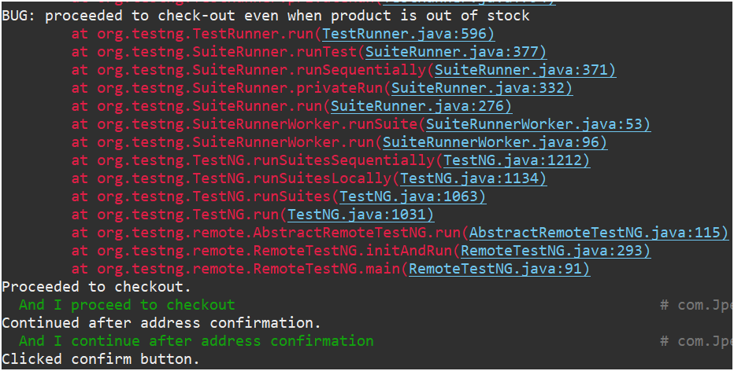
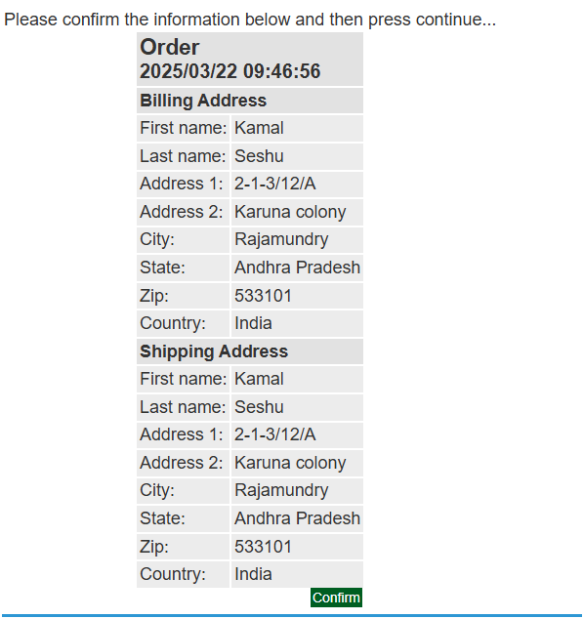
Output of Shopping cart operations

Slide 18
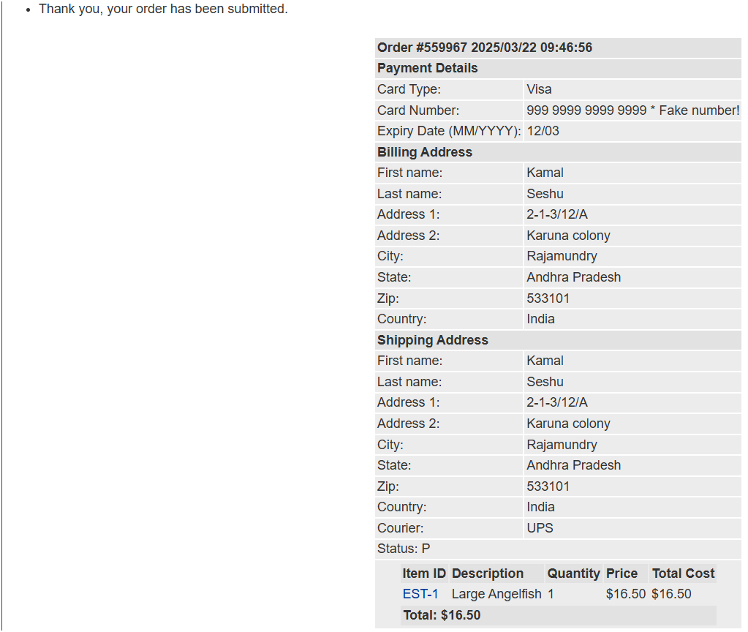
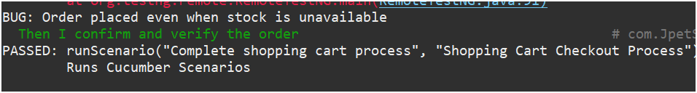
Output of Shopping cart operations

Slide 19
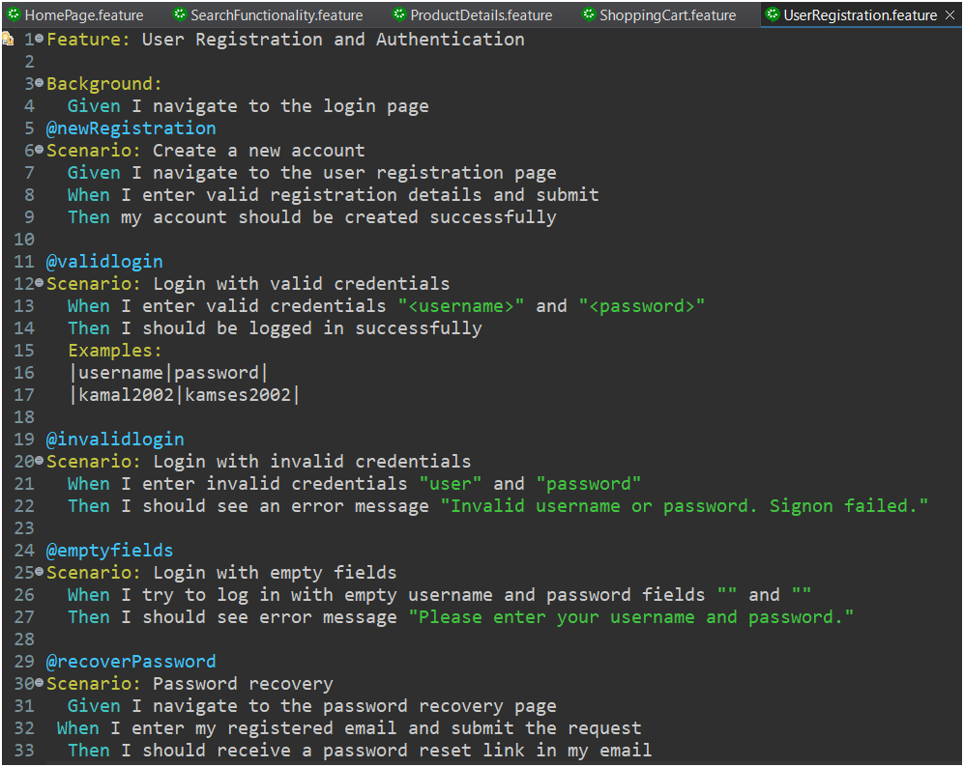
TEST CASES
5. User Registration – Automate new user registration, login, logout, and validate the change password functionality.

Slide 20
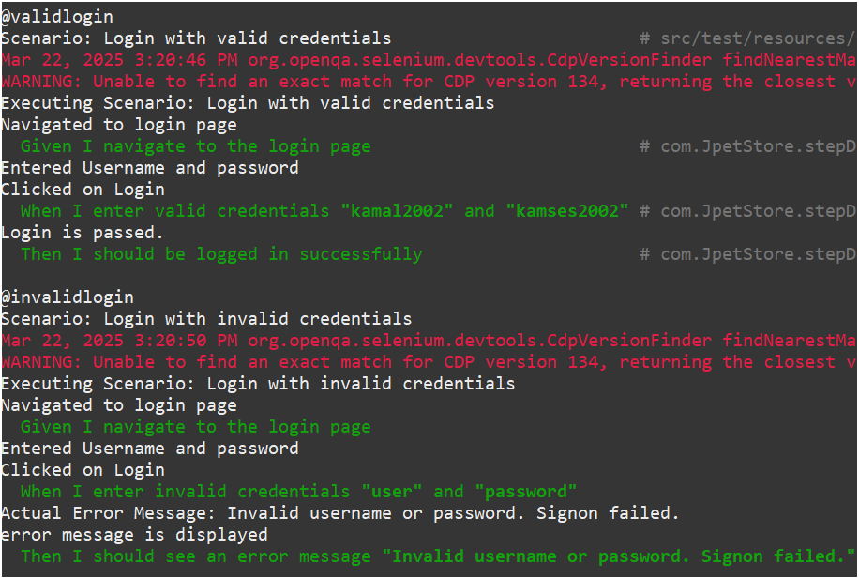
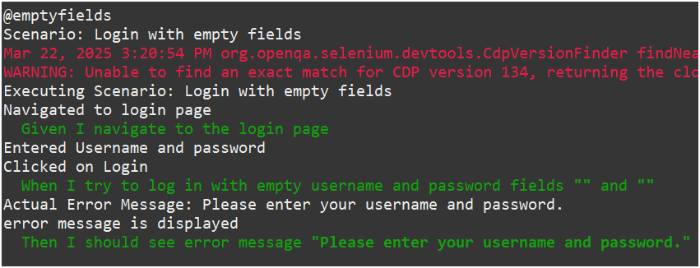
Output of User Registration

Slide 21
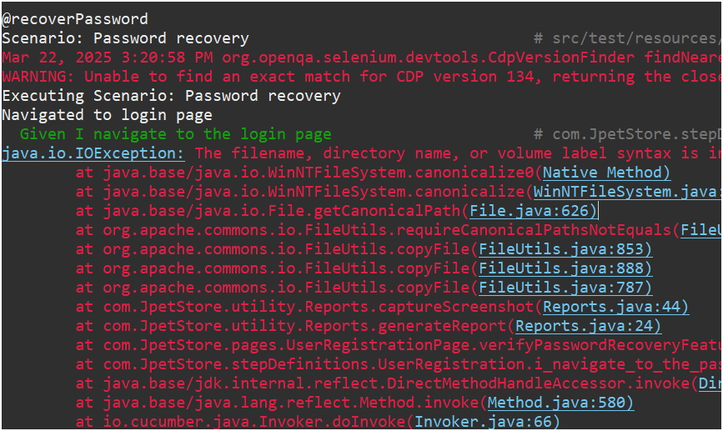
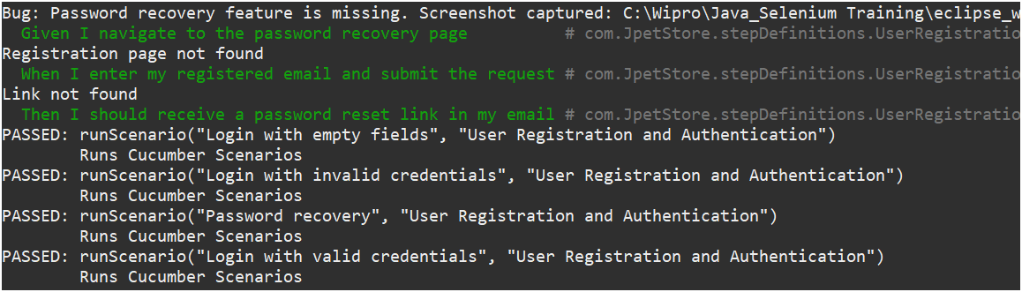
Output of User Registration

Slide 22
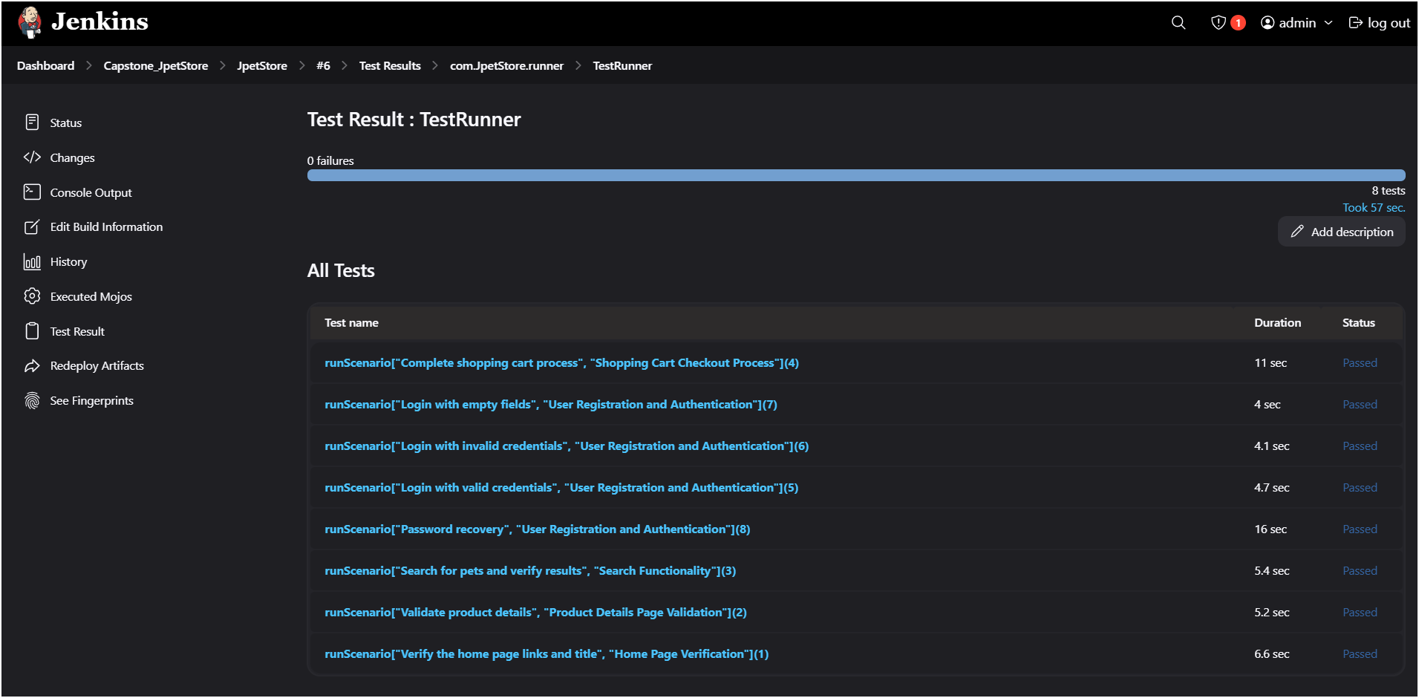
CI/CD Integration
CI/CD Integration – Automated the build, test execution, and reporting process using Jenkins. Integrated Continuous Integration(CI) to trigger test runs on code commits and Continuous Deployment (CD) to ensure seamless test execution and reporting.

Slide 23
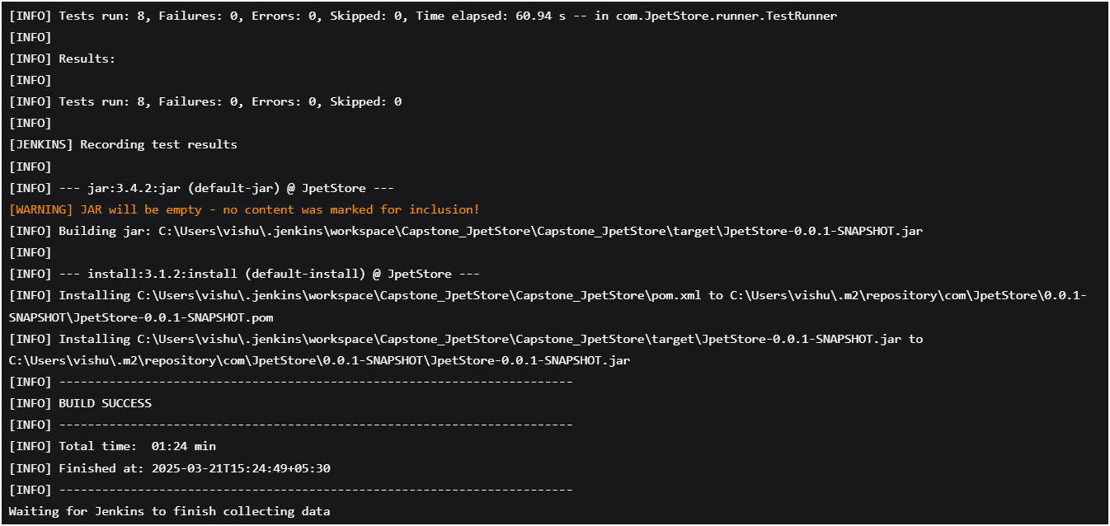
CI/CD Integration

Slide 24
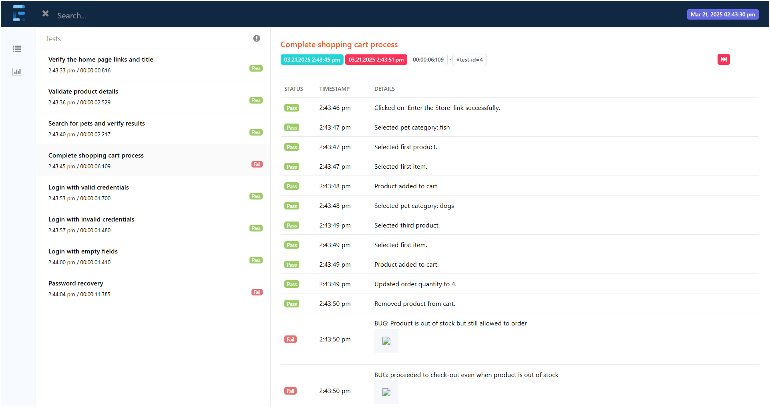
Extent Report
Reporting : Generate Extent reports for test execution

Slide 25
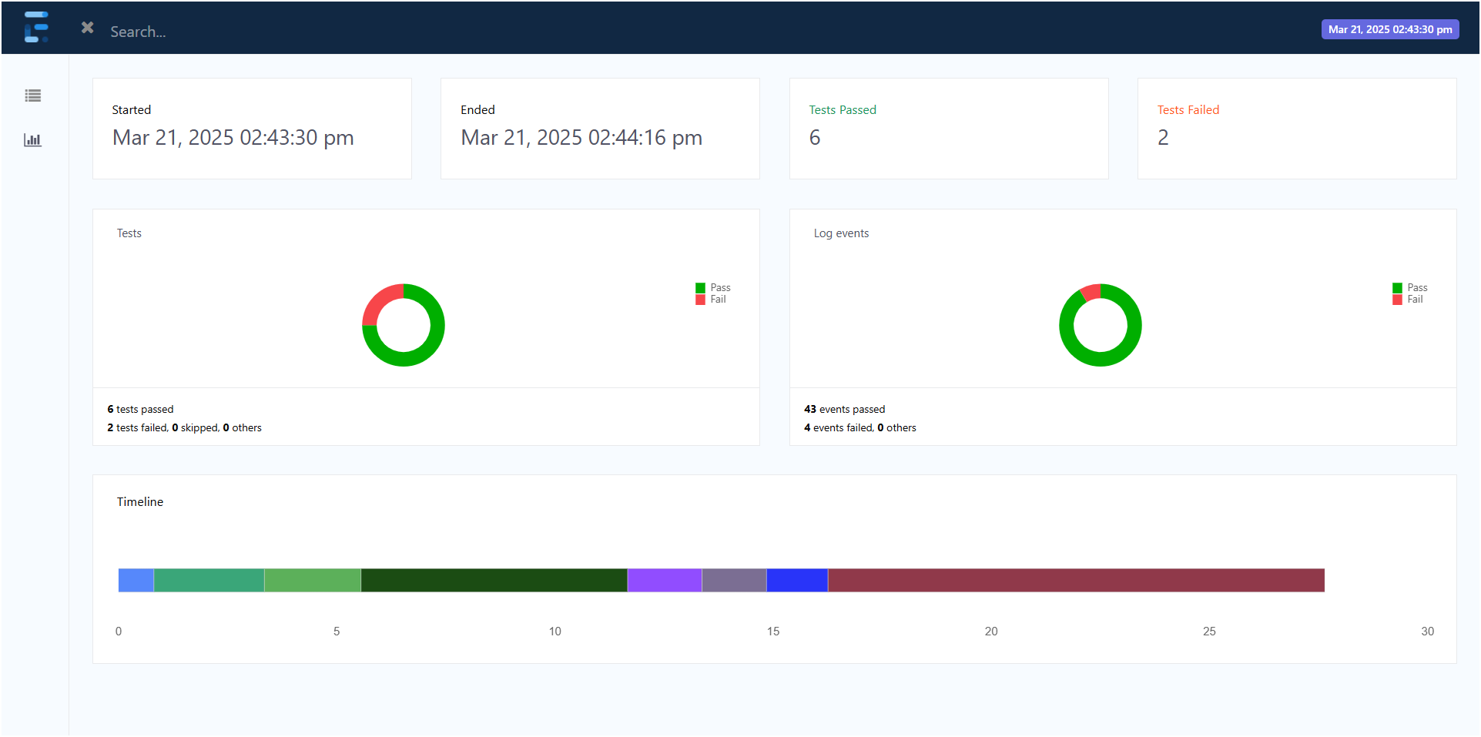
Extent Report
Reporting : Generate Extent reports for test execution

Slide 26
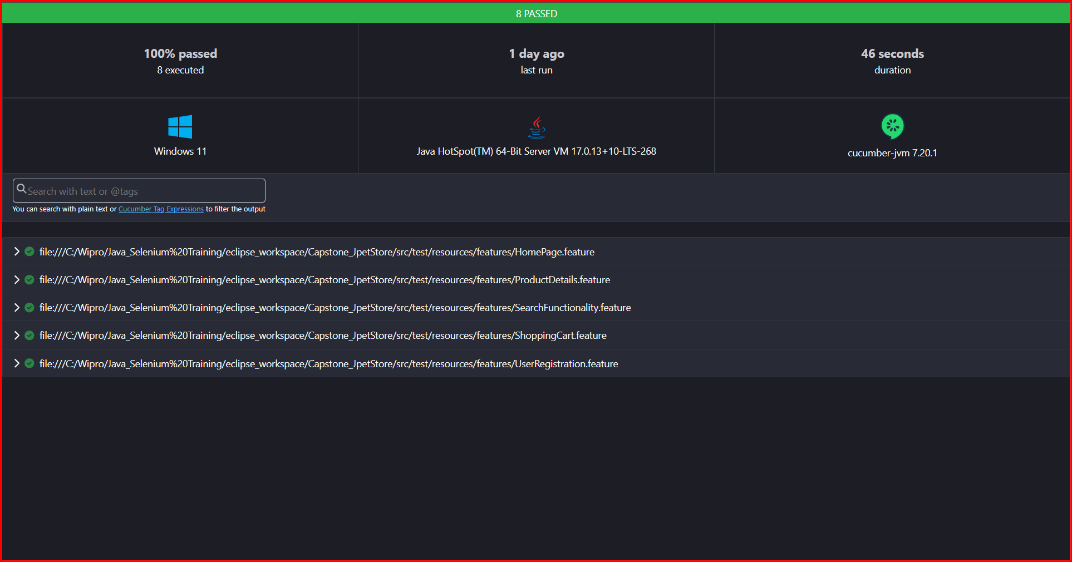
Html Report
Reporting : Generate Html reports for test execution

Slide 27
Conclusion
The JPetStore Automation Project ensures a scalable, maintainable, and efficient test framework using Selenium, Cucumber (BDD), TestNG, and Maven.
By adopting the Page Object Model (POM), it enhances test readability and reusability.
Key functionalities such as user registration, login, search, product selection, cart operations, and checkout are automated, ensuring smooth user interactions.
The project integrates CI/CD using Jenkins, enabling continuous testing, automated builds, and seamless execution.
Comprehensive reporting using Extent Reports provides detailed insights into test execution and failures.
By ensuring robust test coverage, this project delivers a reliable and efficient automation framework, helping maintain a seamless user experience on JPetStore.

