Slide 1
Analysis of Microservice Performance in Serverless Computing
Yu-Cheng Chen, Sai Raghavendra Grandhi, Michael Enriquez, Vishesh Sharma

Slide 2
Outline
Introduction
Environmental Setup
Performance Results
Conclusions

Slide 3
Introduction

Slide 4
Serverless Computing Basics
No server management
Flexible scaling
Pay for value
Automated high availability
Notes:
No need to provision or maintain any servers. There is no software or runtime to install, maintain, or administer.
Your application can be scaled automatically or by adjusting its capability through toggling the units of consumption, rather than units of individual servers
Pay for consistent throughput or execution duration rather than by server unit
Serverless provides built in availability and fault tolerance. You don’t need to architect for these capabilities since the services running the application provide them by default.

Slide 5

AWS Lambda
Use cases: Data processing, real-time file processing, real-time stream processing, backend code for mobile/IoT, web applications
Notes:
No need to manage server, just upload your code to lambda and it is ready to execute.
Scales precisely with the size of your workload
Charged for every 100ms your code executes and number of times your code is triggered. No cost while code is not running

Slide 6
COLD vs WARM
COLD start: Occurs when an AWS Lambda function is invoked after not being used for an extended period of time resulting in increased invocation latency
WARM start: A repeated invocation to a preexisting container hosting microservice code.
Notes:
Main takeaway from previous slide is that most of the use cases mentioned rely on real time execution, so the difference between a COLD and WARM start is not negligible

Slide 7
Goals
Analyze factors that may impact performance of microservices running in serverless cloud computing platforms.
The main factors we are considering are: infrastructure elasticity, load balancing, memory reservations, and programming languages
Determine pitfalls and best practices to consider when using serverless computing to have better performance.

Slide 8
Experimental Setup

Slide 9
Elasticity - Setup
Python 3.6
Checks for existence of a temporary file, and creates one if the file is not found. This allows for detection of a new container or a previously used container, therefore determining a COLD vs WARM start.
Lambda function creates an array of 10,000 operands and selects randomly from that array to determine the operand for one of each of the 200,000 mathematic equations being run to induce computational stress.

Slide 10
Elasticity - Testing
Leverage AWS API Gateway to create a persistent endpoint link to trigger the Lambda function
Leverage Hey: a program designed to send a number of requests in the provided concurrency level and print out statistics.
By changing a key feature such as memory allotment, the container can be forced to restart guaranteeing a COLD start scenario.
At this point varying the level of concurrency can allow us to determine the performance impact of increasing concurrency during a COLD vs WARM start

Slide 11
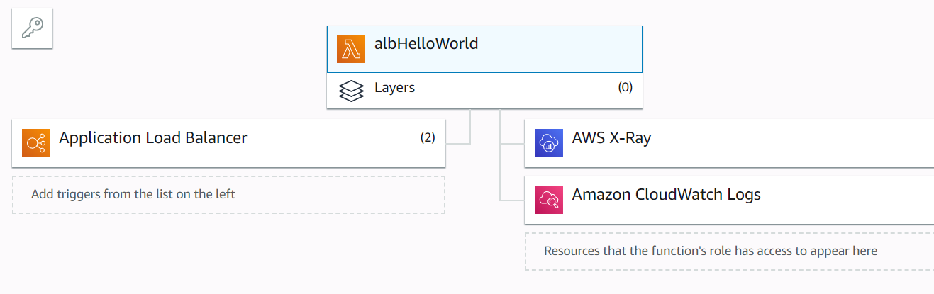
Load Balancing - Setup
Ruby - 2.5
Integrated Application Load Balancer with AWS Lambda and added a listener for checking the connection requests.
Connected JMeter with the HTTP server of the corresponding AWS Lambda function which was used for executing the concurrent requests.

Slide 12
Load Balancing - Testing
To investigate the load balancing performance of warm service requests, we executed 6 sets of 100 concurrent requests.
Used JMeter for varying the ramp-up period from 10 seconds to 180 seconds, keeping the number of concurrent requests constant.
AWS X-Ray recorded the traces of the execution for each set of requests.
The average response time was recorded and the results were plotted on the graph.

Slide 13
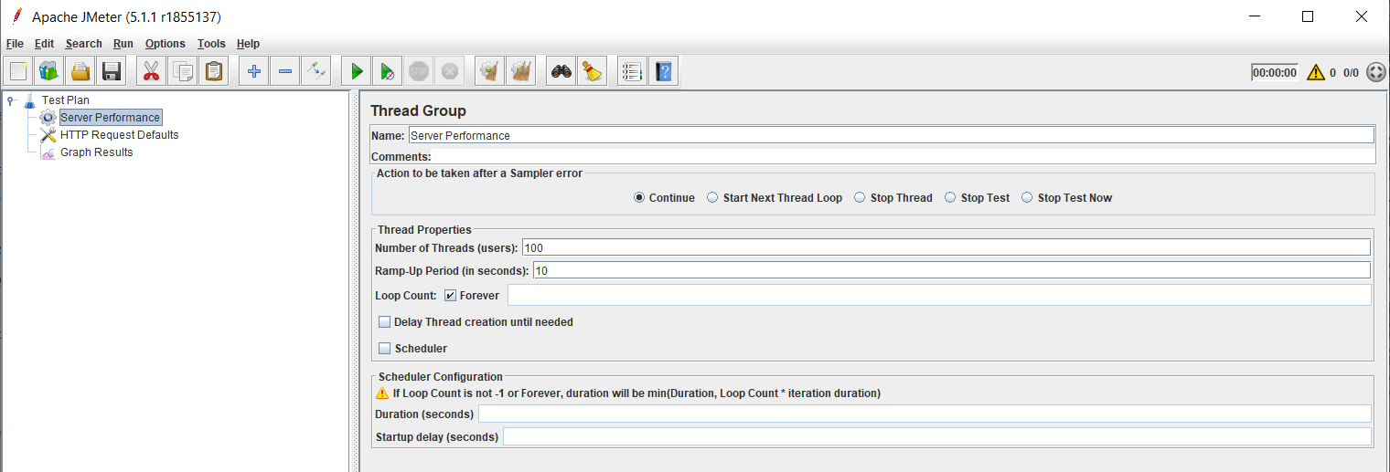
JMeter Setup

Slide 14
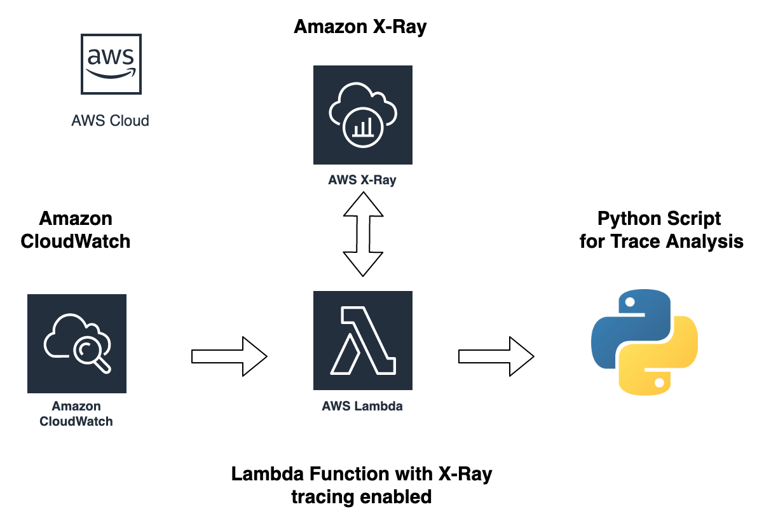
Memory and Prog. Languages Experiment Pipeline

Slide 15
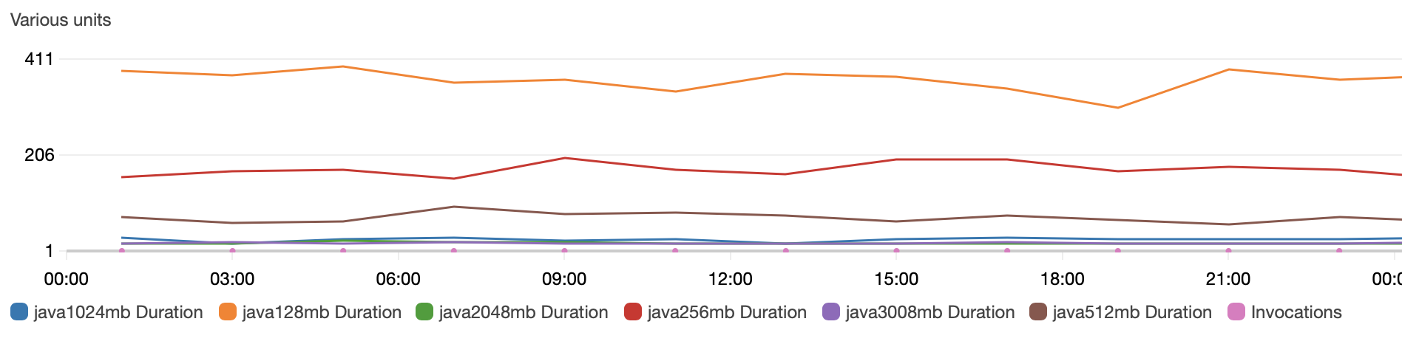
Memory - Setup
Python 3.7/ Java 8
6 variant memory configurations.
CloudWatch Events trigger Lambda Functions every 2 hours.
AWS X-Ray records the function execution traces.

Slide 16
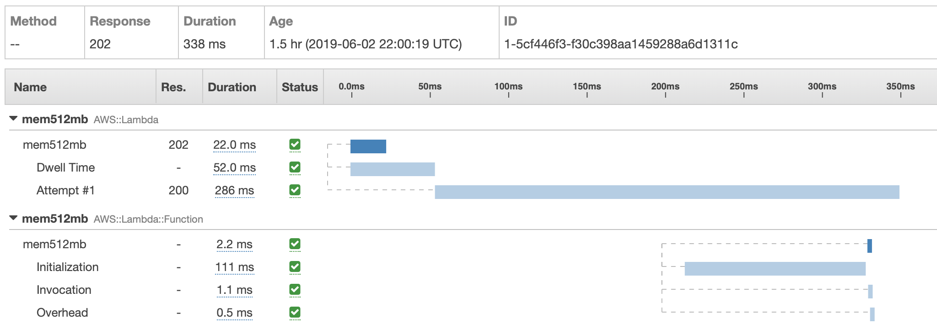
Memory - Testing
AWS CLI (Command Line Interface) / AWS X-Ray API is used to access traces recorded by X-Ray.
Container cold start time is calculated by (AWS::Lambda::Function start_time - AWS::Lambda start_time)
Mean of data for 4 days is shown in the result.
Cold Start Time

Slide 17
Programming Languages
Ran lambda functions in different programming languages
Python 3
Java
Node.js
Cold Start experiment ran for 2 days, with execution for every 40 minutes.
Warm Start experiment ran for 1 hour, with an execution every 2 minutes.
Used CloudWatch Events and X-Ray for metrics

Slide 18
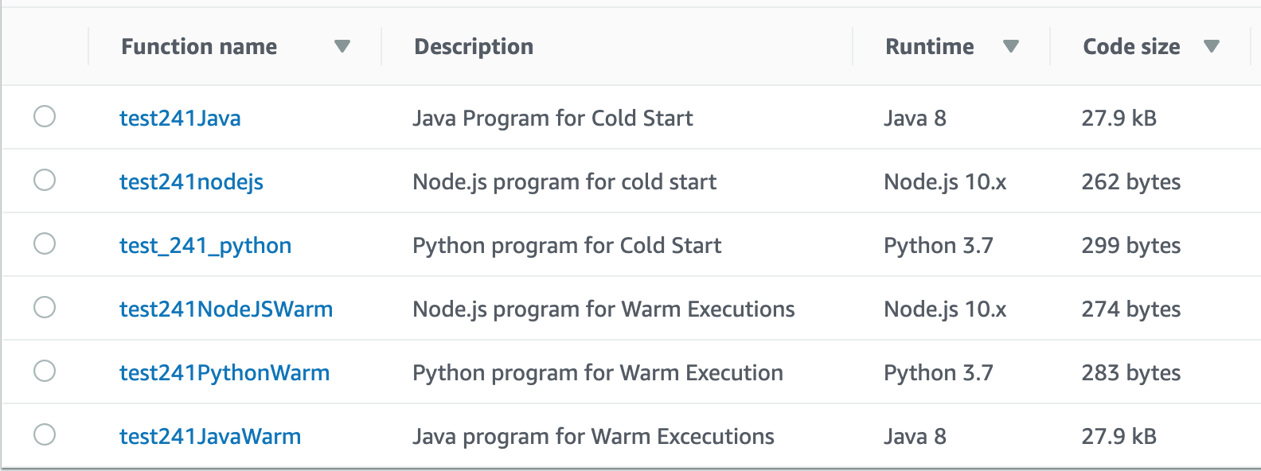
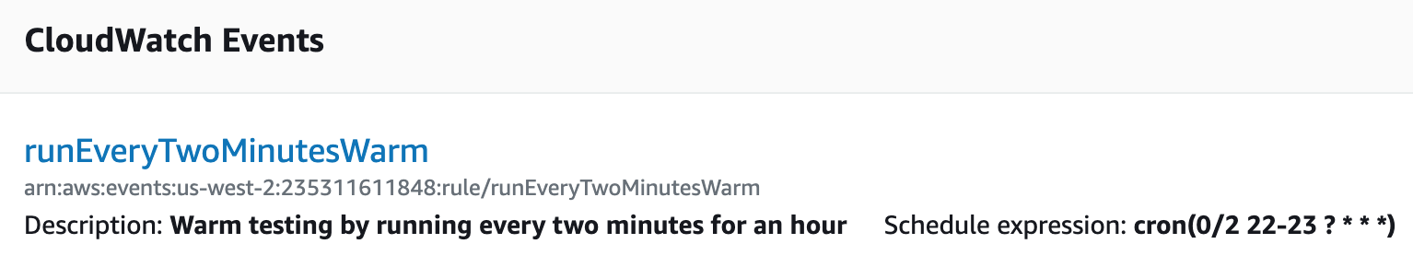
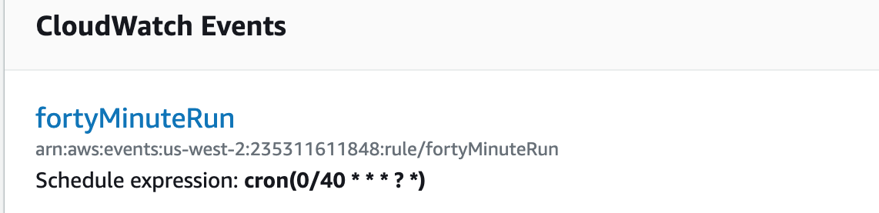

Slide 19
Performance Results

Slide 20
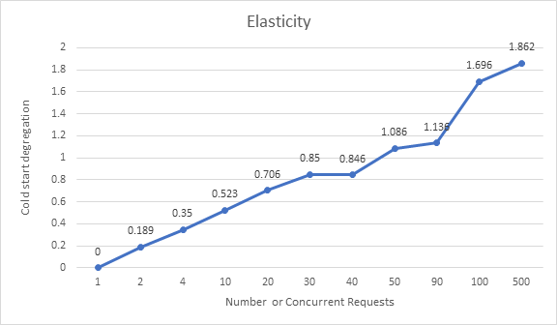
Elasticity

Slide 21
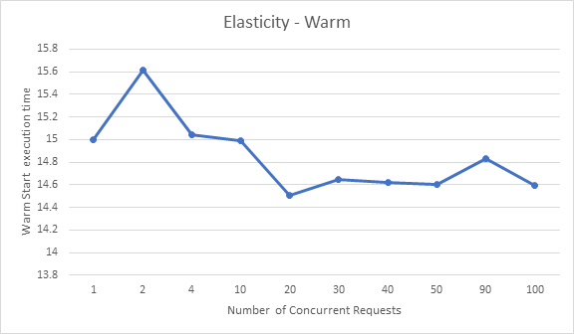
Elasticity - Continued

Slide 22
Elasticity - Continued
Increasing the level of concurrency for a Lambda function saw a steady increase in additional COLD start delay.
If a concurrency of 1 is to be considered the baseline for COLD start delays there was an increase of up to nearly an additional 2 seconds when running 500 concurrent requests to the same Lambda function.
Under COLD start conditions the function took 15.815 seconds to complete with a concurrency of 1.
This was still slower than the slowest tested value for a high concurrency WARM execution which was 14.934
Latency tends to decrease or stagnate as concurrency is increased during WARM requests

Slide 23
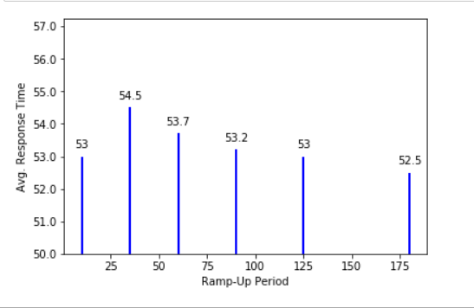
Load Balancing

Slide 24
Load Balancing - Continued
Each stress test reflects the amount of CPU time and average response time with respect to the ramp-up period.
Tested the average response time by varying the ramp-up period from 10 seconds to 180 seconds for 100 concurrent requests.
Higher average response time for the requests when the ramp-up period was low, but then the avg. response time steadily decreases with the increase in the duration between the concurrent requests.

Slide 25
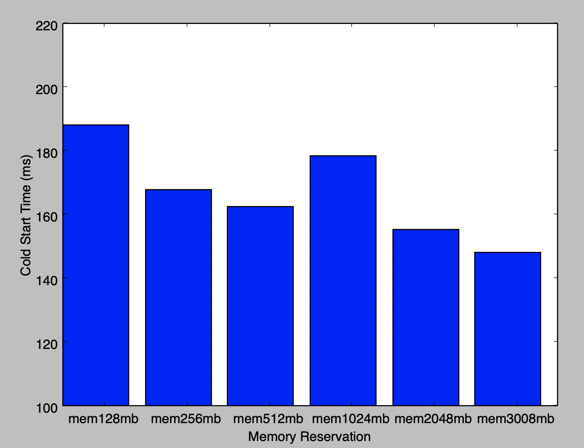
Memory Reservations
Memory Reservation - Python
y = -0.0103x + 178.67

Slide 26
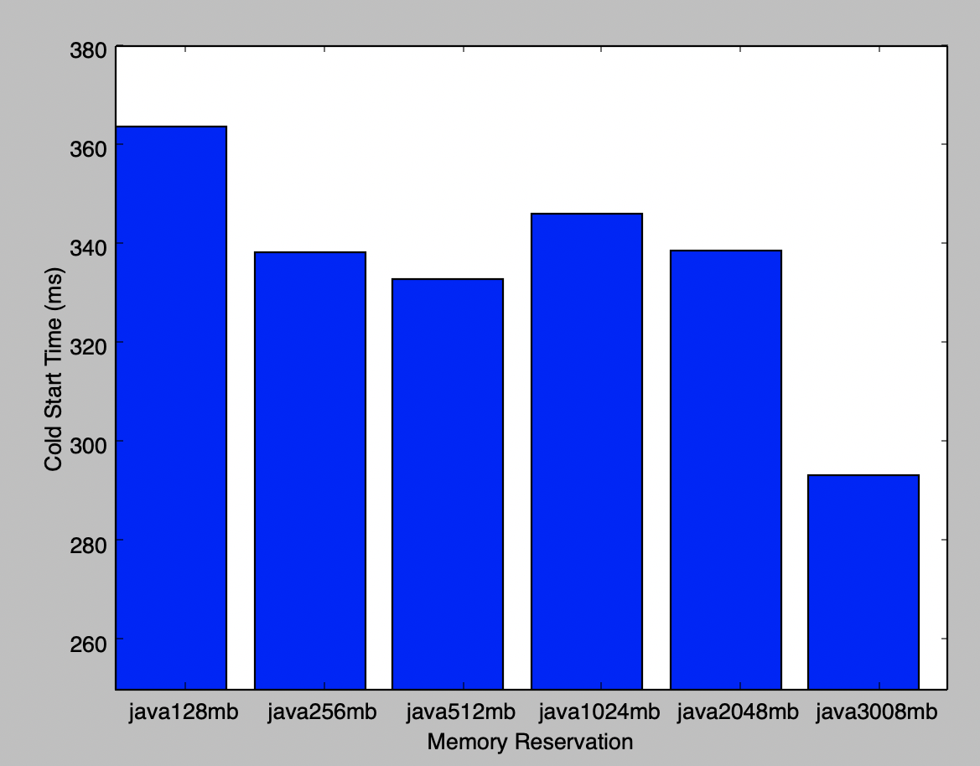
Memory Reservations - Continued
Memory Reservation - Java
y = -0.0172x + 354.79

Slide 27
Memory Reservations - Continued
Increasing of the memory allocated to the function tends to decrease the COLD start time.
10 ~ 17 ms decrease of COLD start time per GB of memory reservation depending on different languages.
Java has an overall higher COLD start time comparing to Python.

Slide 28
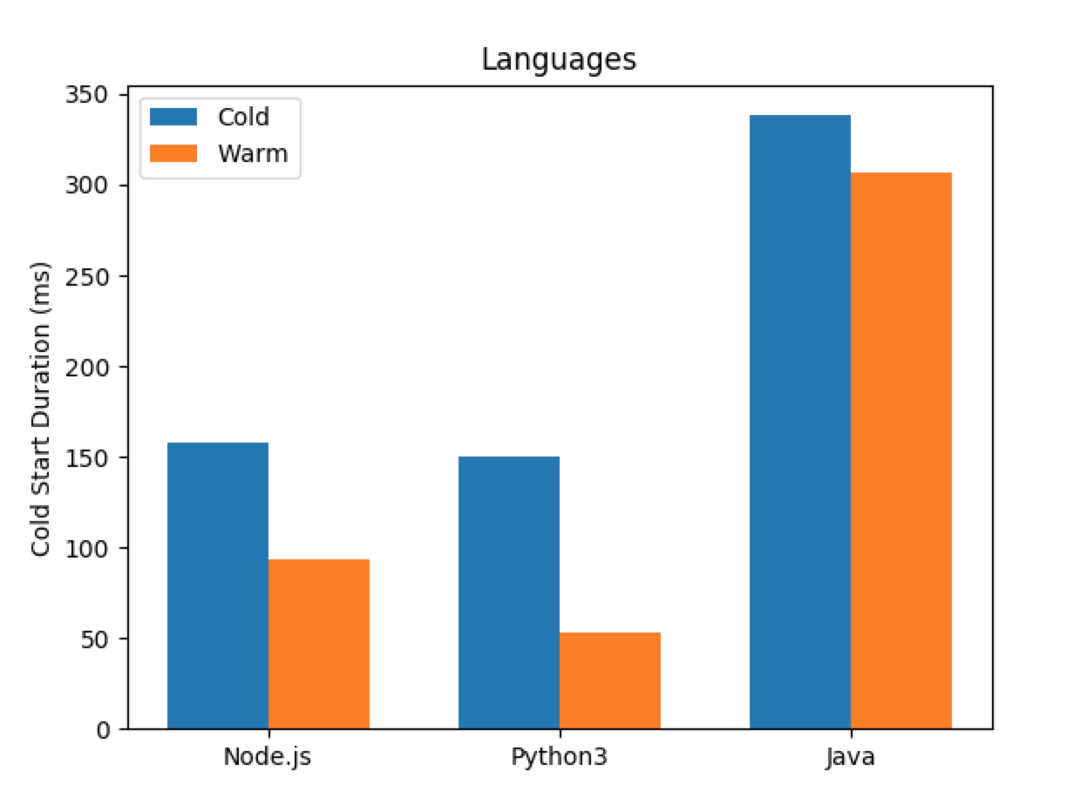
Programming Languages
Node.js:
Cold: 157.648 ms
Warm: 93.543 ms
Python:
Cold: 150.43 ms
Warm: 53.042 ms
Java:
Cold: 338.214 ms
Warm: 306.75

Slide 29
Conclusions

Slide 30
Conclusions
Invocation time will increase in parallel to an increase in concurrency for COLD starts, so pinging a lambda function to keep it WARM is recommended if the function use is time sensitive.
The memory configuration could reduce ~15 % of start time for COLD function, but the start time could still be 5 times higher than WARM function.
The average response time decreases with the increase in ramp-up period when there is a greater delay between the execution for the WARM concurrent requests
Programming languages that are compile-based, had higher cold start times compared to interpreter-based programs.

Slide 31
References
https://read.acloud.guru/how-long-does-aws-lambda-keep-your-idle-functions-around-before-a-cold-start-bf715d3b810
https://medium.com/@nathan.malishev/lambda-cold-starts-language-comparison-%EF%B8%8F-a4f4b5f16a62
https://aws.amazon.com/lambda/
https://ieeexplore.ieee.org/abstract/document/8360324
https://github.com/rakyll/hey

Slide 32
THANK YOU

