Slide 1
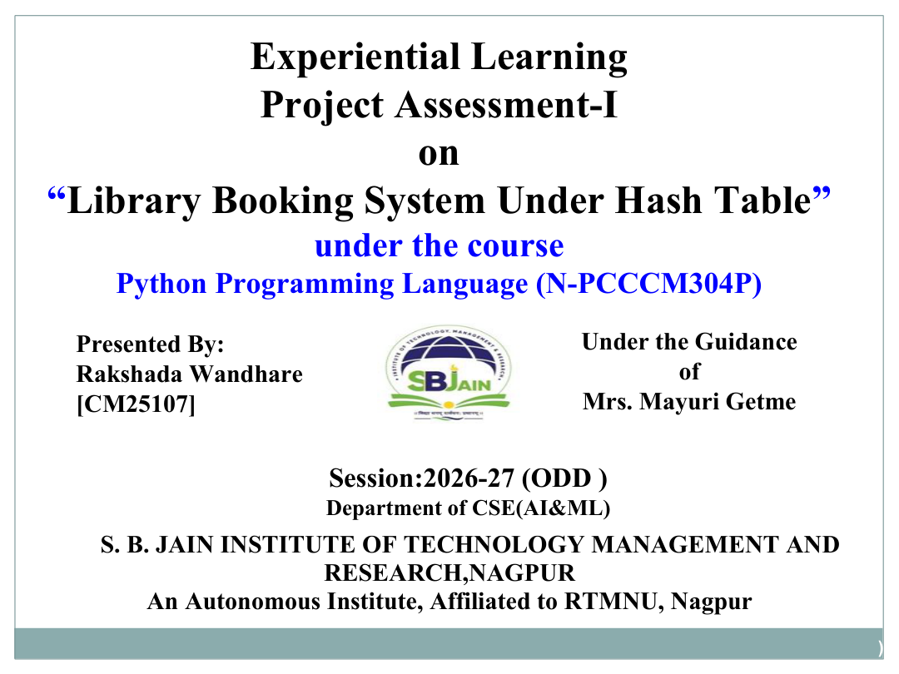
“Inventory Stock Analysis System”
Vishesh Shrikhande
[CM25124]

Slide 2
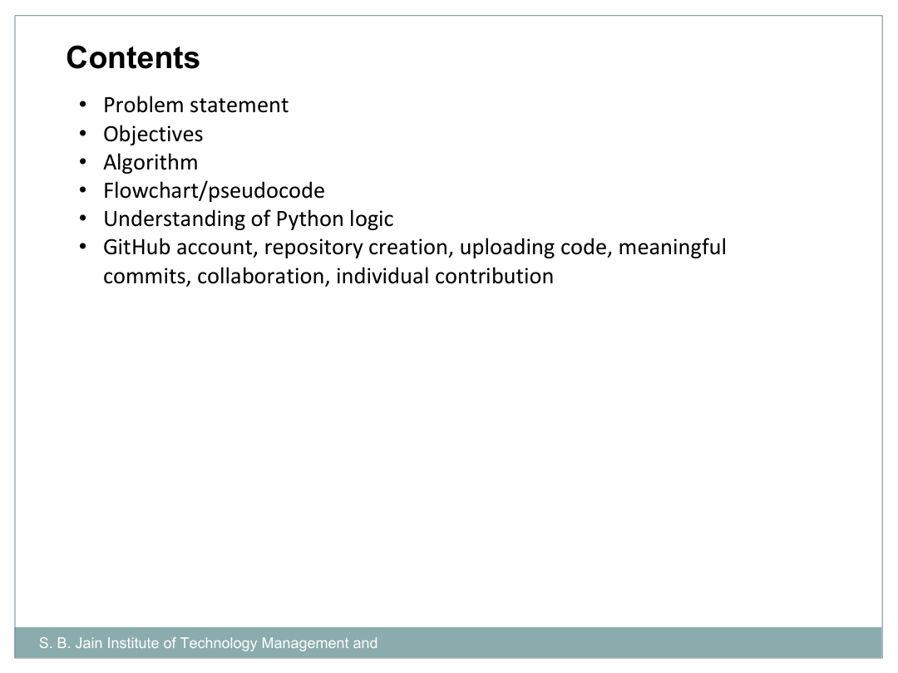
• Problem statement
• Objectives
• Algorithm
• Flowchart
• Understanding of Python logic
• Graphical representation and working
• GitHub account, repository & collaboration
• Individual contribution
• Result / expected output

Slide 3
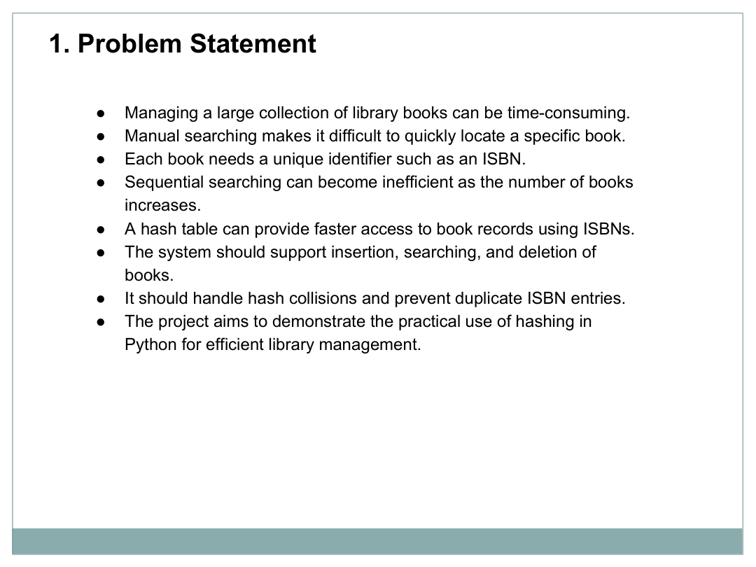
• Manual inventory tracking can be time-consuming and error-prone.
• It can be difficult to know the current stock of each item quickly.
• Sales must be recorded and deducted from available stock.
• Low-stock items need to be identified before they run out.
• Restocking should update the available quantity correctly.
• The project demonstrates a simple inventory system using Python lists, loops and conditions.

Slide 4
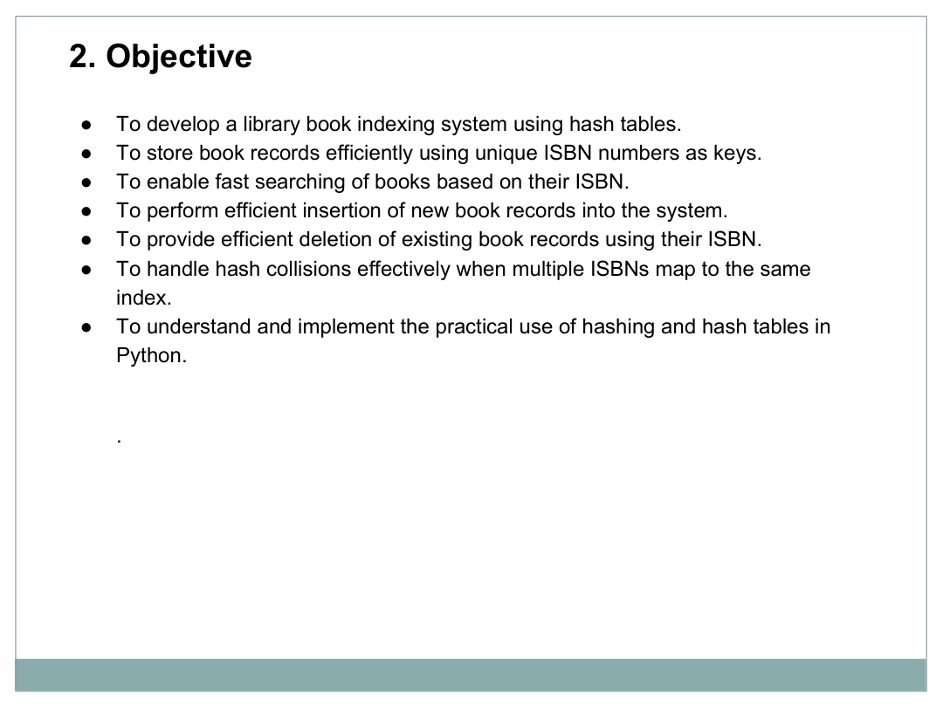
To develop a simple Inventory Stock Analysis System using Python arrays/lists.
To maintain and track the stock levels of different items.
To record sales and automatically update the available stock.
To provide restocking functionality for inventory items.
To identify items that reach or fall below their reorder level.
To generate item-wise summaries showing stock, units sold, and total sales.
To understand the practical use of arrays, loops, conditional statements, and user input in Python.

Slide 5
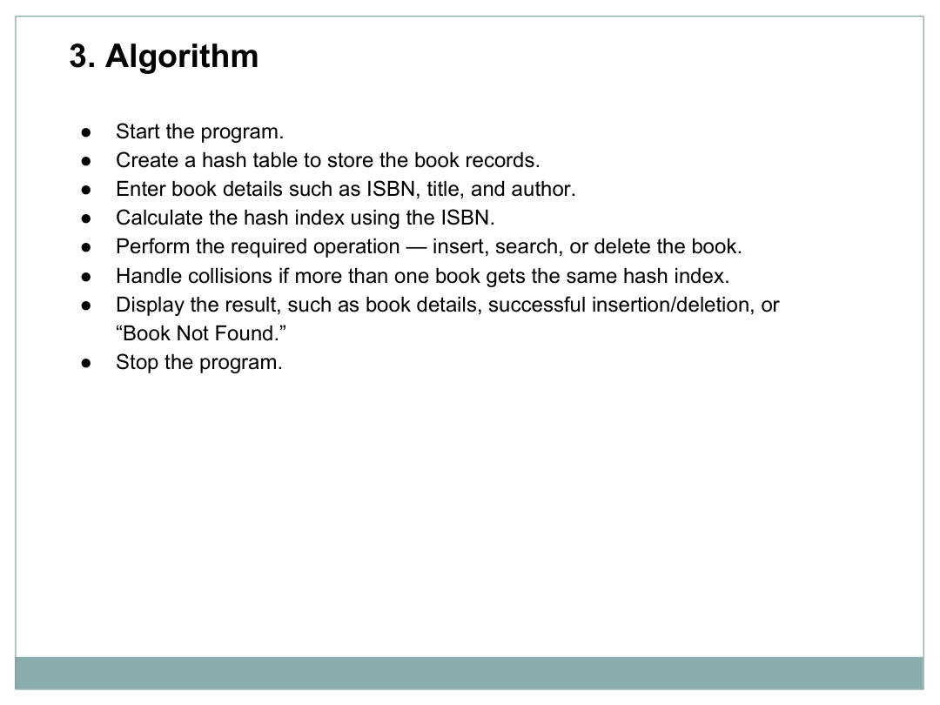
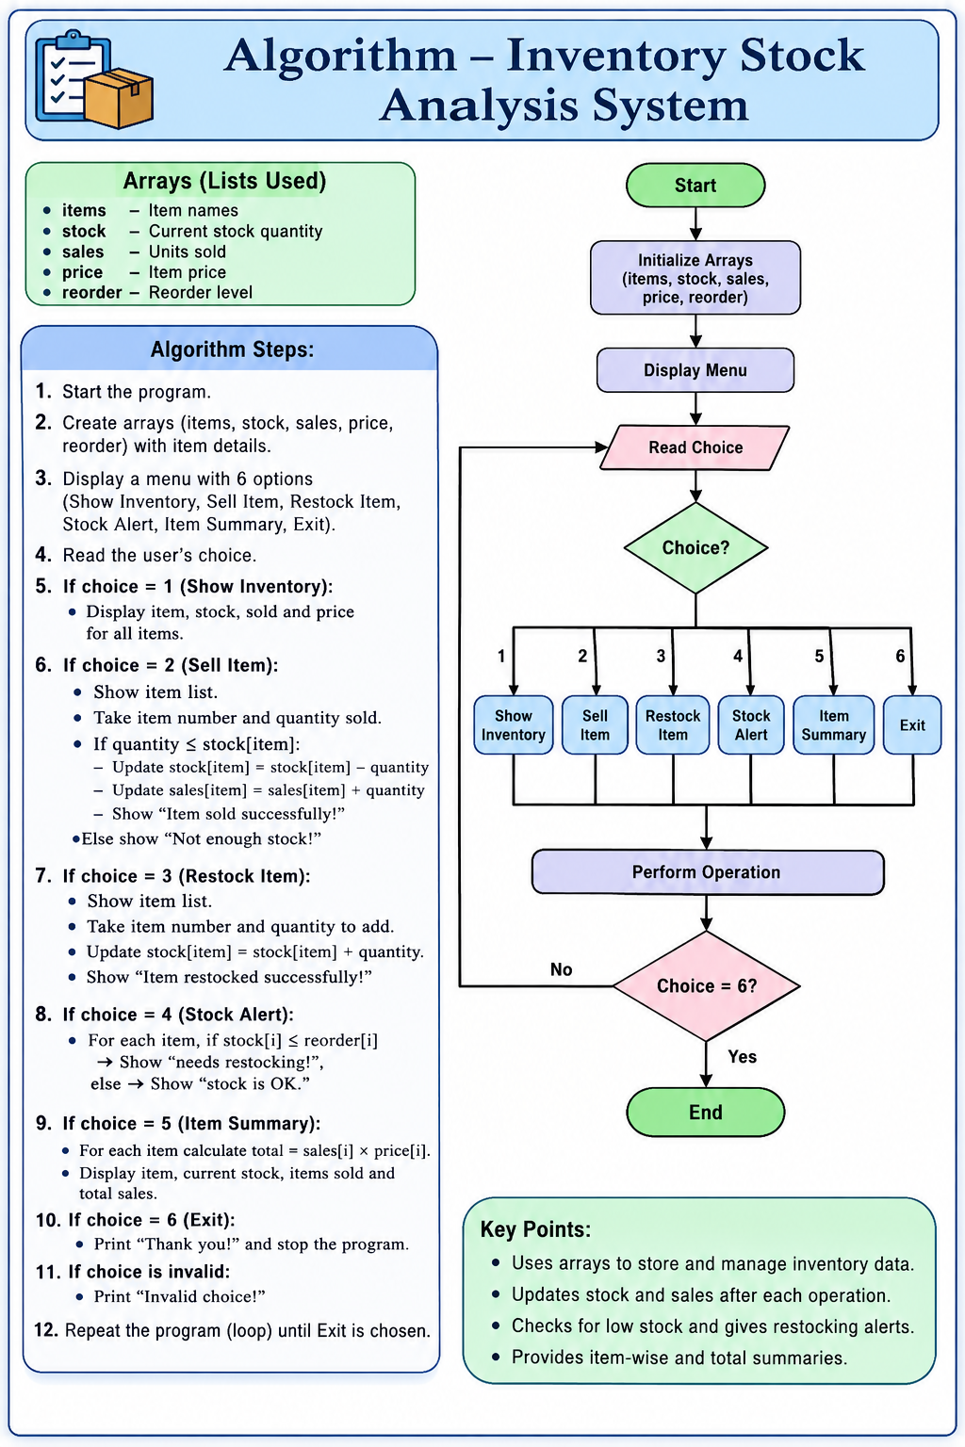
ALGORITHM – INVENTORY MANAGEMENT SYSTEM
1. Start the program.
2. Initialize item, stock, sales, price, and reorder lists.
3. Display the menu with 9 options.
4. Read the user's choice.
5. Show inventory details when choice is 1.
6. Sell an item and update stock and sales when choice is 2.
7. Add stock when choice is 3.
8. Display stock alerts when choice is 4.
9. Calculate item-wise sales when choice is 5.
10. Search and display item details when choice is 6.
11. Calculate total inventory value when choice is 7.
12. Calculate total revenue when choice is 8.
13. Exit the program when choice is 9.
14. Display an error for invalid choices.
15. Repeat until the user selects Exit.
16. End the program.

Slide 6
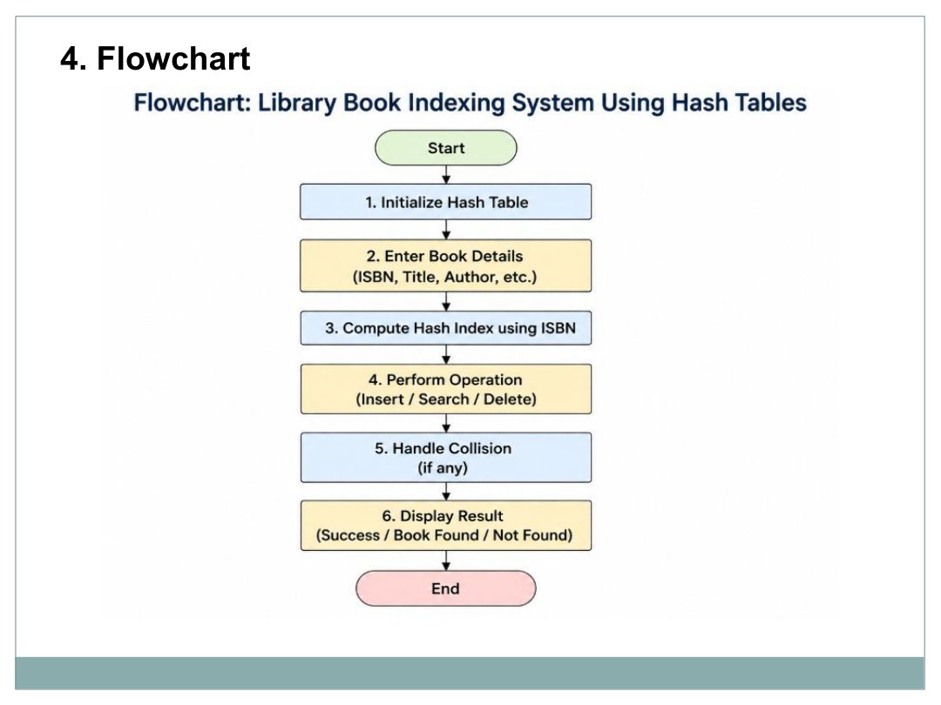
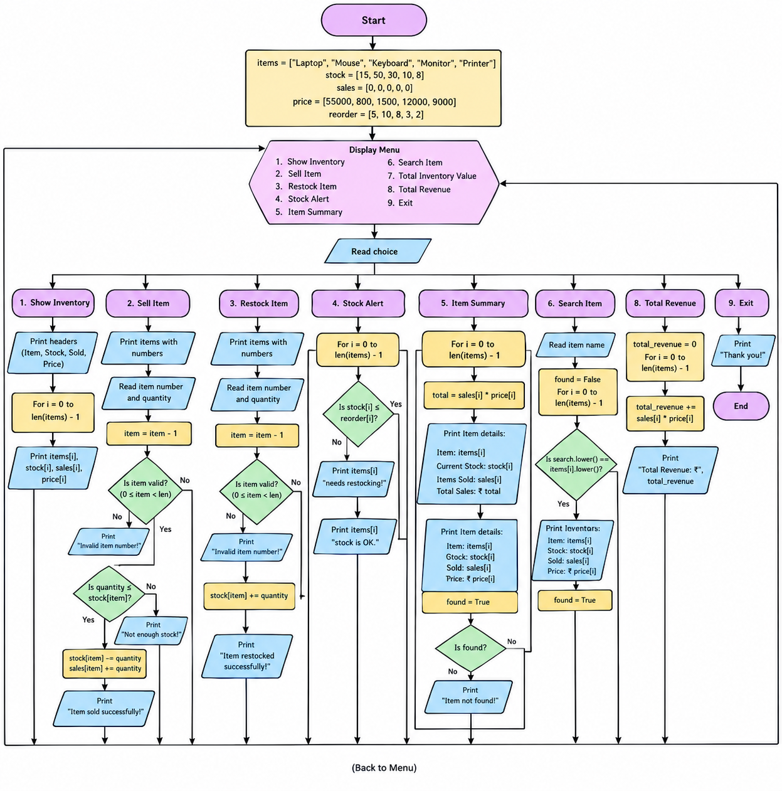

Slide 7
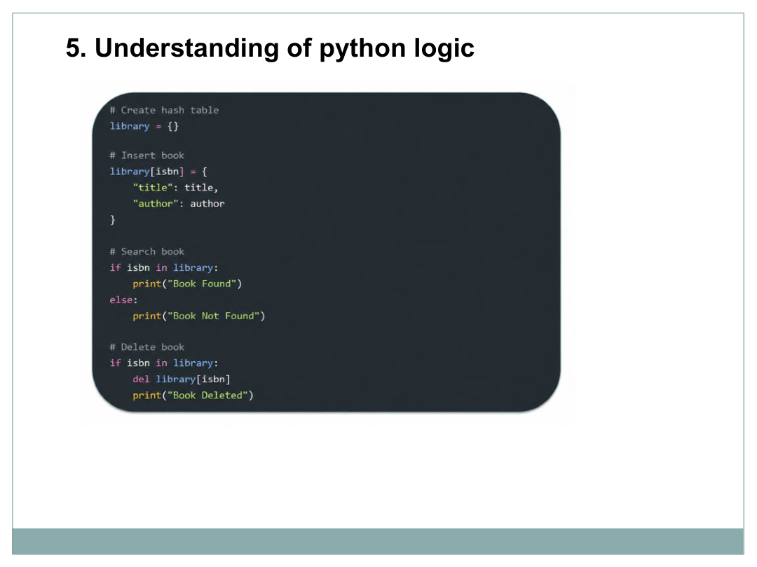
items=["Laptop","Mouse","Keyboard","Monitor","Printer"]
stock=[15,50,30,10,8]
sales=[0,0,0,0,0]
price=[55000,800,1500,12000,9000]
reorder=[5,10,8,3,2]
while True:
print("\n===== INVENTORY SYSTEM =====")
print("1. Show Inventory")
print("2. Sell Item")
print("3. Restock Item")
print("4. Stock Alert")
print("5. Item Summary")
print("6. Search Item")
print("7. Total Inventory Value")
print("8. Total Revenue")
print("9. Exit")
choice=int(input("Enter your choice: "))
if choice==1:
print("\nItem\t\tStock\tSold\tPrice")
for i in range(len(items)):
print(items[i],"\t",stock[i],"\t",sales[i],"\t",price[i])
elif choice==2:
print("\nItems:")
for i in range(len(items)):
print(i+1,".",items[i])
item=int(input("Enter item number: "))-1
quantity=int(input("Enter quantity sold: "))
if item>=0 and item<len(items):
if quantity<=stock[item]:
stock[item]-=quantity
sales[item]+=quantity
print("Item sold successfully!")
else:
print("Not enough stock!")
else:
print("Invalid item number!")
elif choice==3:
print("\nItems:")
for i in range(len(items)):
print(i+1,".",items[i])
item=int(input("Enter item number: "))-1
quantity=int(input("Enter quantity to add: "))
if item>=0 and item<len(items):
stock[item]+=quantity
print("Item restocked successfully!")
else:
print("Invalid item number!")
elif choice==4:
print("\n===== STOCK ALERT =====")
for i in range(len(items)):
if stock[i]<=reorder[i]:
print(items[i],"needs restocking!")
else:
print(items[i],"stock is OK.")
elif choice==5:
print("\n===== ITEM SUMMARY =====")
for i in range(len(items)):
total=sales[i]*price[i]
print("\nItem:",items[i])
print("Current Stock:",stock[i])
print("Items Sold:",sales[i])
print("Total Sales: ₹",total)
elif choice==6:
search=input("Enter item name: ")
found=False
for i in range(len(items)):
if search.lower()==items[i].lower():
print("\nItem Found!")
print("Item:",items[i])
print("Stock:",stock[i])
print("Sold:",sales[i])
print("Price: ₹",price[i])
found=True
if found==False:
print("Item not found!")
elif choice==7:
total_value=0
for i in range(len(items)):
total_value+=stock[i]*price[i]
print("\nTotal Inventory Value: ₹",total_value)
elif choice==8:
total_revenue=0
for i in range(len(items)):
total_revenue+=sales[i]*price[i]
print("\nTotal Revenue: ₹",total_revenue)
elif choice==9:
print("Thank you!")
break
else:
print("Invalid choice!")

Slide 8
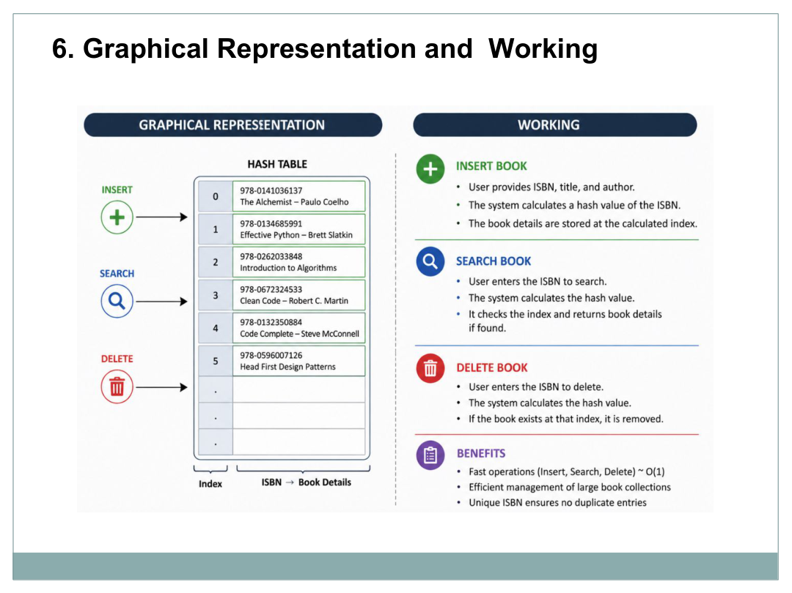
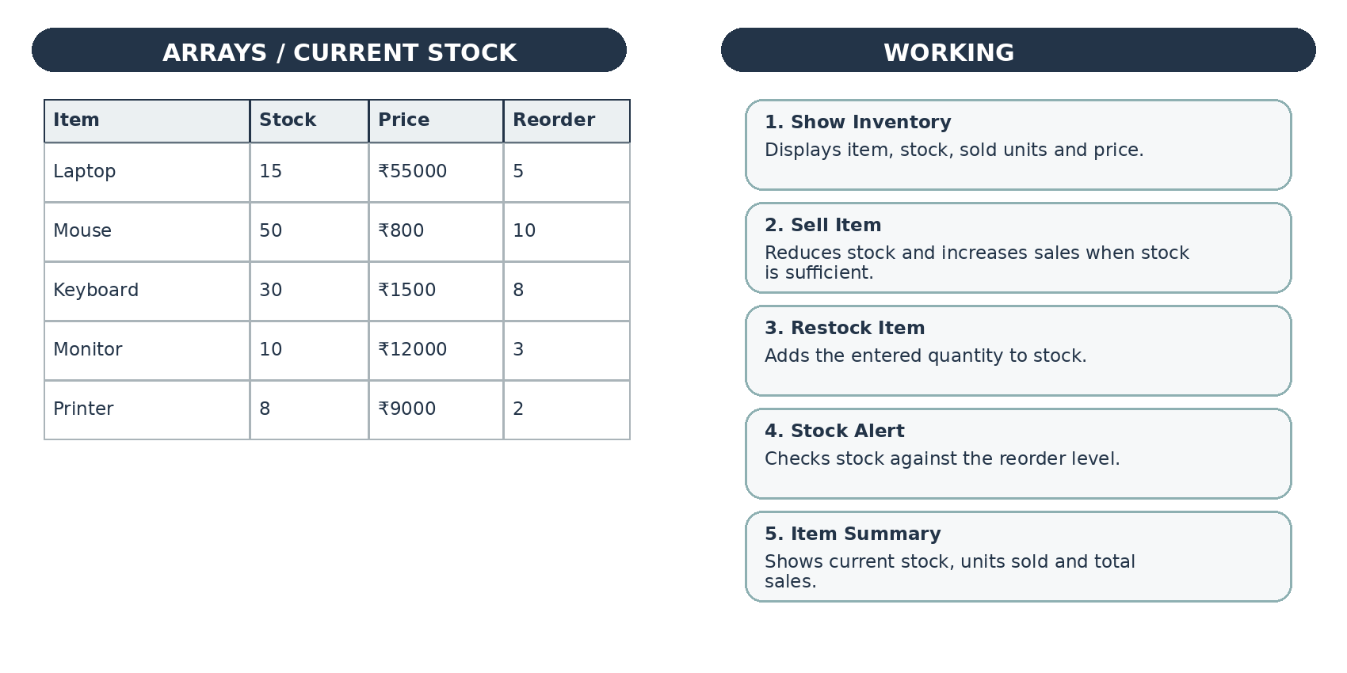

Slide 9
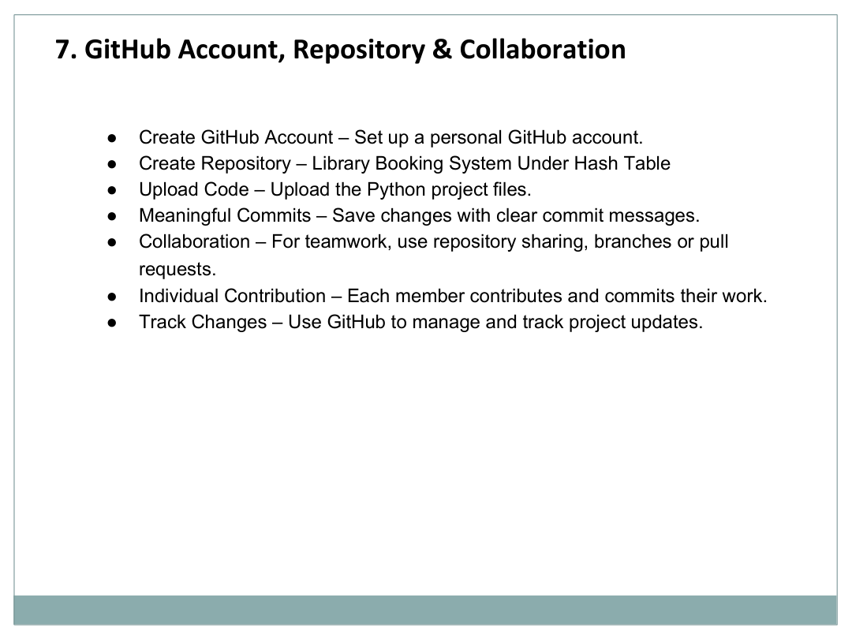
• Create a GitHub account for project version control.
• Create a repository named “Inventory Stock Analysis System”.
• Upload the Python source code and project documentation.
• Use meaningful commit messages when making changes.
• Use branches or pull requests when collaborating with others.
• Track project updates and keep the final code version organized.

Slide 10
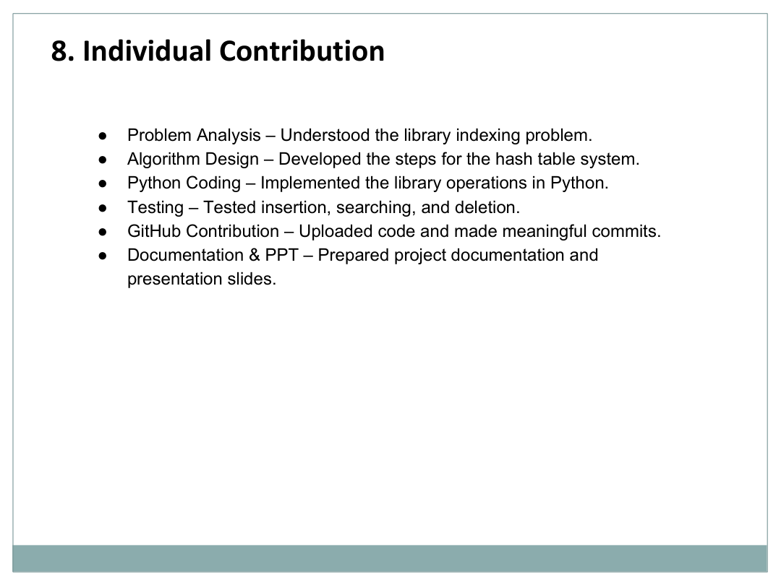
• Problem Analysis – Identified the need for simple stock and sales tracking.
• Array Design – Created lists for items, stock, sales, price and reorder levels.
• Python Coding – Implemented the menu-driven inventory operations.
• Testing – Checked inventory display, selling, restocking, alerts and summaries.
• Documentation – Prepared the algorithm, flowchart, output and presentation.
• Project Presentation – Organized the final project explanation using the supplied template.

Slide 11
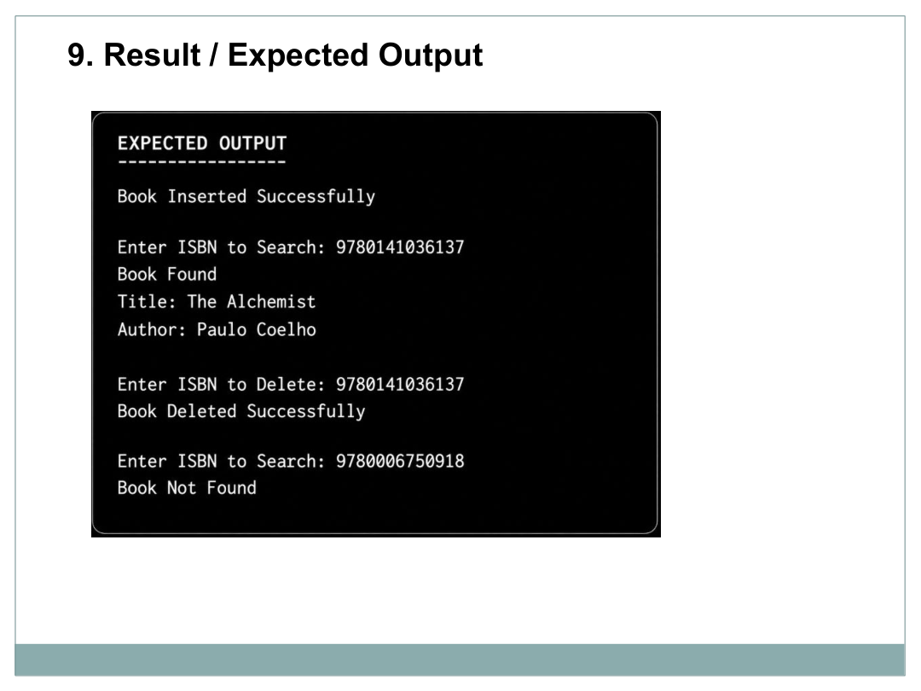
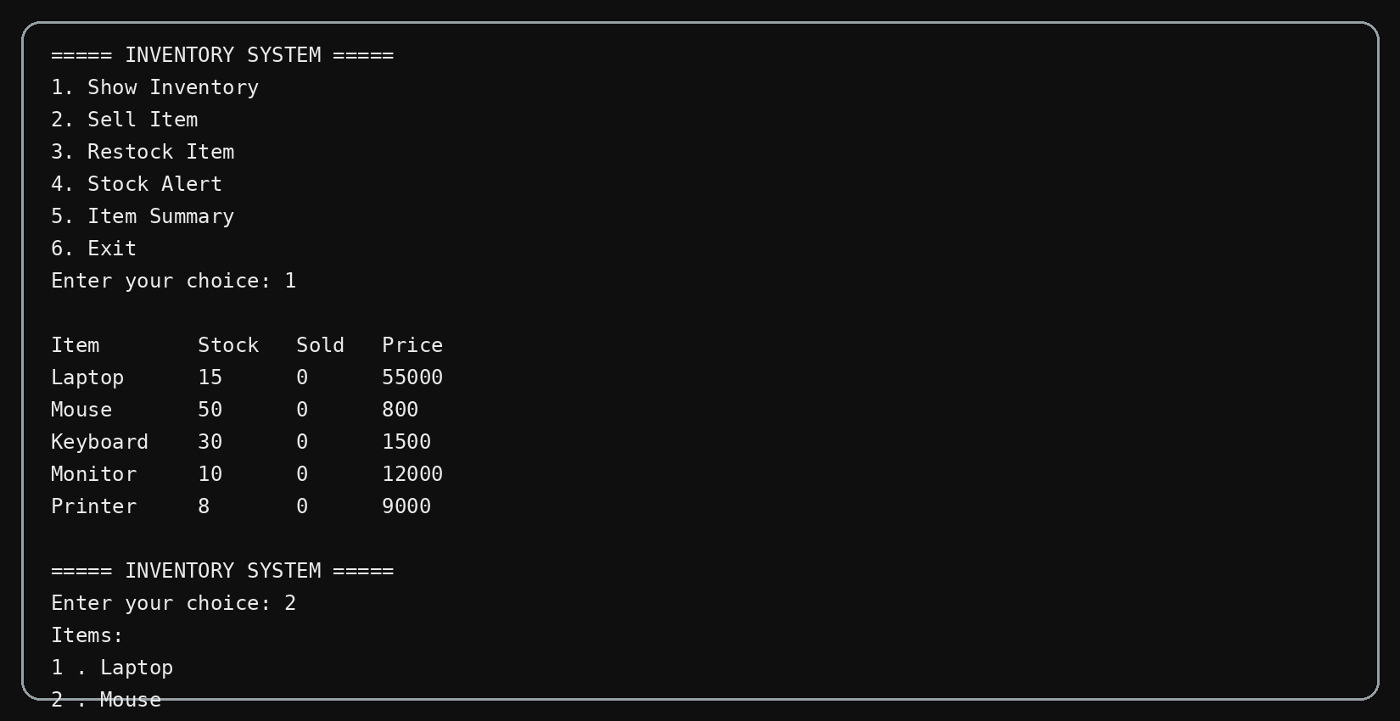

Slide 12
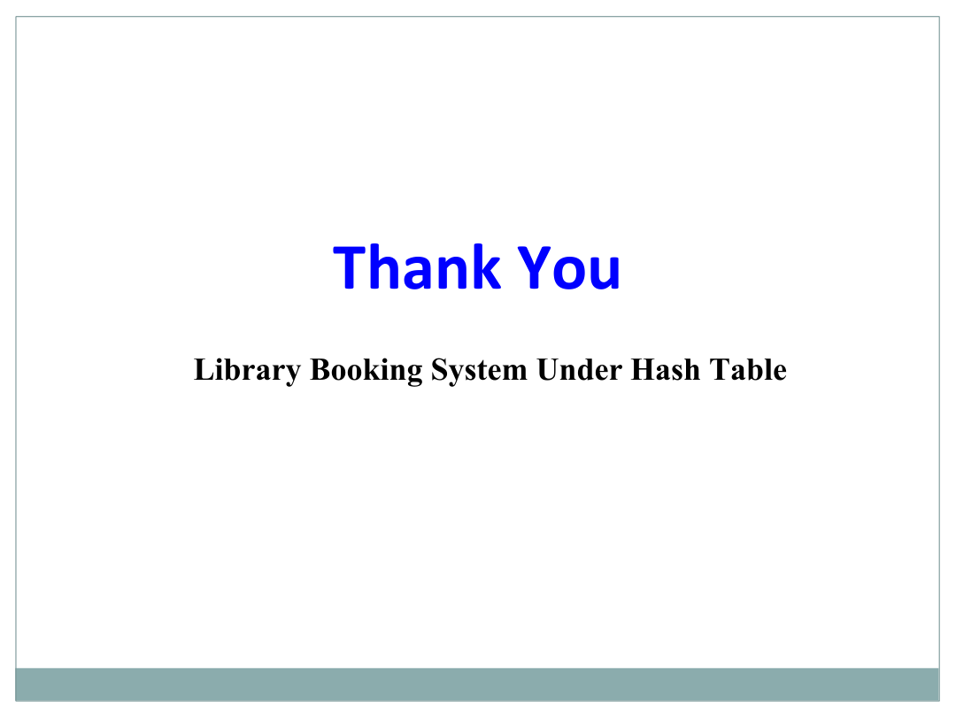
Inventory Stock Analysis System

