Slide 1

B.TECH–M.TECH DUAL DEGREE PROJECT · OCEAN ENGINEERING AND NAVAL ARCHITECTURE
Multi-Step Significant Wave Height Forecasting in the Bay of Bengal
Hybrid machine-learning and deep-learning frameworks, 6 to 72 hours ahead
Vishesh Bhagwandas Agarwal
Roll No. 22NA30045
Supervisor: Professor Swapnadip De Chowdhury
Department of Ocean Engineering and Naval Architecture
Indian Institute of Technology Kharagpur
10 November 2026
Notes:
One sentence: a data-driven model that forecasts wave height up to three days ahead at buoy locations in the Bay of Bengal, built and tested so that no future information leaks into training.

Slide 2
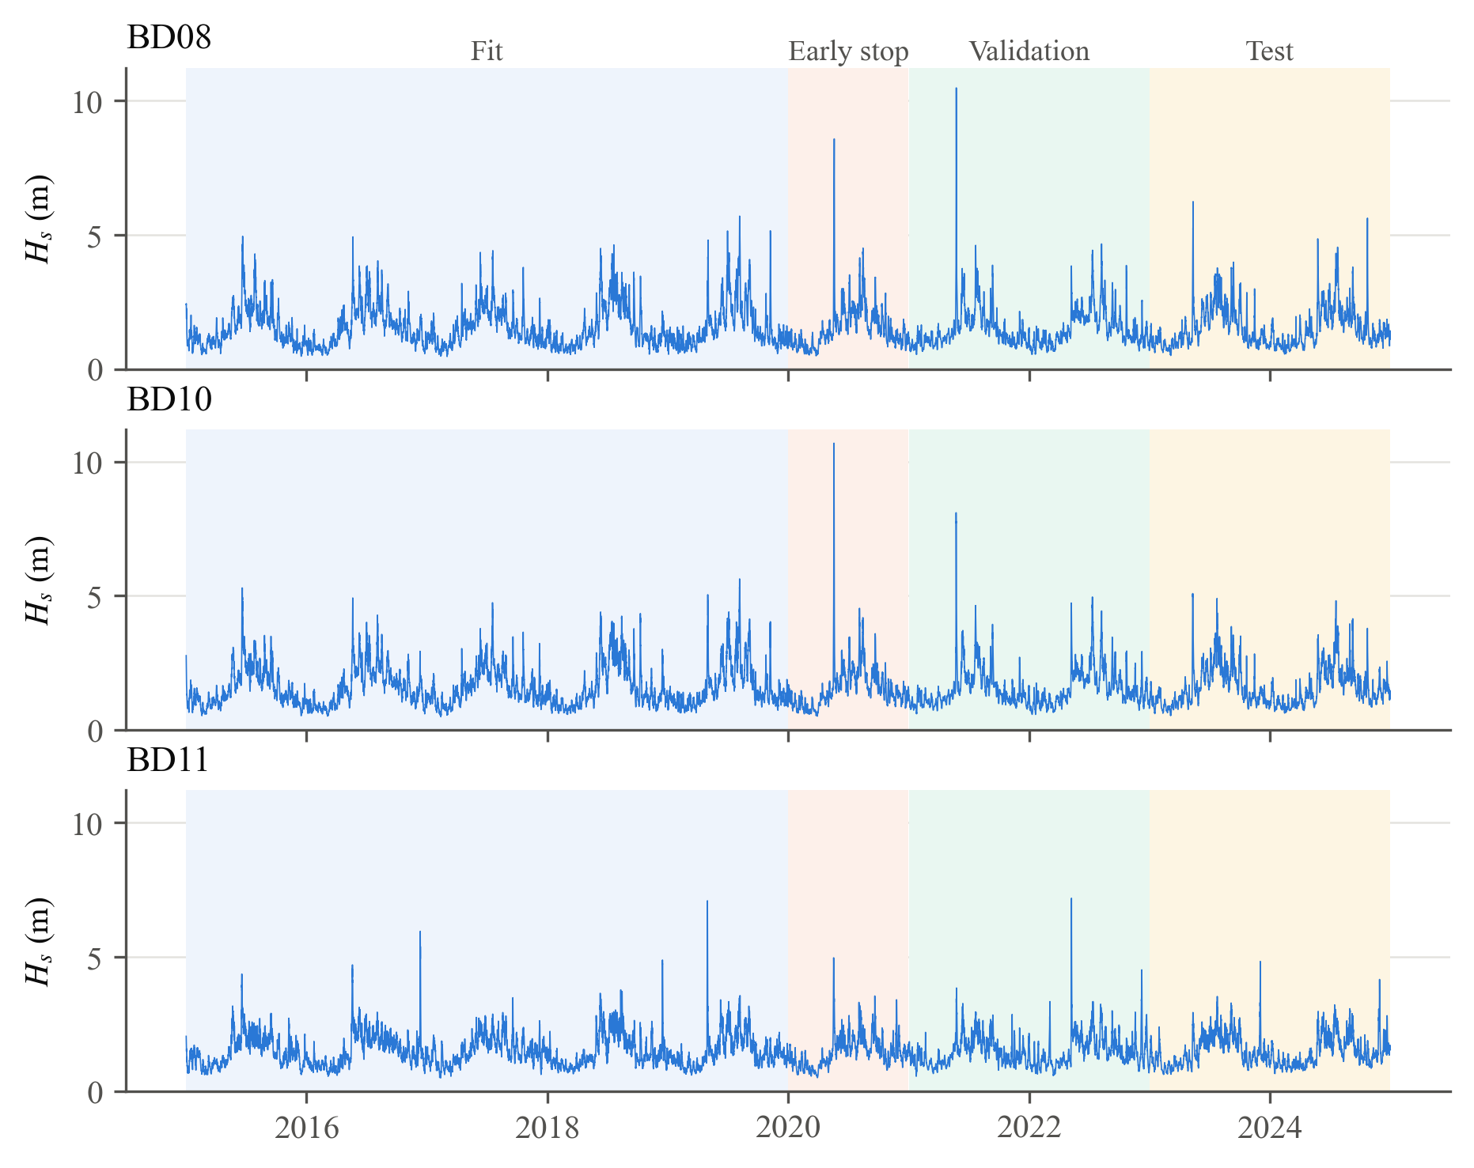
Cyclones lift a 1.5 m sea to 10 m within a day
The Bay of Bengal needs fast, reliable wave forecasts at fixed points: ports, platforms, moorings
10.7 m
Peak Hs at BD10 in cyclone Amphan, May 2020
≈ 1.5 m
Mean Hs at all three sites
Numerical models (WAM, WAVEWATCH III) need supercomputers and NWP forcing
A point forecaster can be cheap, fast and retrained as data arrive
ERA5 Hs at the three OMNI buoy positions, 2015–2024 (Hersbach et al. 2020); cyclone identification from IMD reports
2 / 21
Notes:
Point to the spikes: each one is a named cyclone (Amphan, Yaas, Fani, Mocha). Between them the monsoon cycle dominates. The engineering need is a forecast at a fixed location, which is exactly what a data-driven model can give cheaply.

Slide 3
Objectives and contributions
Forecast Hs at 6, 12, 24, 48 and 72 h, without leakage, and without feeding forecasts back
Objectives
My contributions
Leakage-free pipeline: ERA5 + INCOIS buoys, aligned and physically featured
Direct multi-step LightGBM and CatBoost, Bayesian-tuned
Seq2Seq Bi-LSTM with attention and a peak-weighted loss
Fair comparison with persistence, climatology and ARIMA, including cyclones
1
Containment rule for splits
Inputs and all targets of a sample inside one block
2
Physics features
Wind stress, pressure tendency, air–sea ΔT, sin/cos directions
3
Fast all-origin ARIMA
One Kalman pass gives the statsmodels forecast at every origin
4
Peak-weighted loss
Under-predicting a storm costs 6× an ordinary error
5
Tested, reproducible code
Automated tests for every guardrail; all tables regenerate
3 / 21
Notes:
These five items are what I designed and built myself, beyond applying existing libraries.

Slide 4
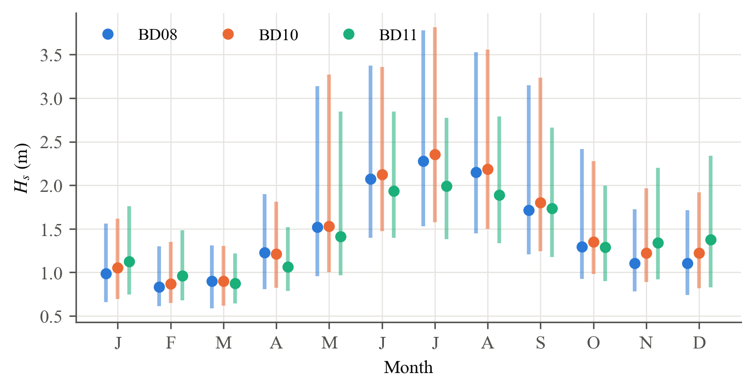
Data: ten years of hourly ERA5 at three buoy sites
87,672 hours per site, no gaps; one CDS time-series request per buoy instead of 60 gridded requests
87,672
8
Hours per site, 2015–2024
ERA5 variables per site
8–25 km
0
Buoy to matched ERA5 node (KD-tree on the sphere)
Missing hours after quality control
Block | Years | Use
Fit | 2015–2019 | Training
Early stop | 2020 | Rounds / epochs
Validation | 2021–2022 | Hyperparameters
Test | 2023–2024 | Reported results only
Buoy reader, spike test and gap rules are built and tested; OMNI data were not yet received
So the target here is ERA5 Hs at the buoy positions
ERA5 (ECMWF / Copernicus C3S, CC-BY-4.0); OMNI buoys BD08, BD10, BD11 (INCOIS)
4 / 21
Notes:
Explain why ERA5: complete, homogeneous, and the CDS time-series service delivered ten years per site in minutes. Seasonal cycle: monsoon peak in July at the northern sites, relatively higher winter seas at BD11. Be upfront that the buoy data had not arrived, so ERA5 is the target.

Slide 5
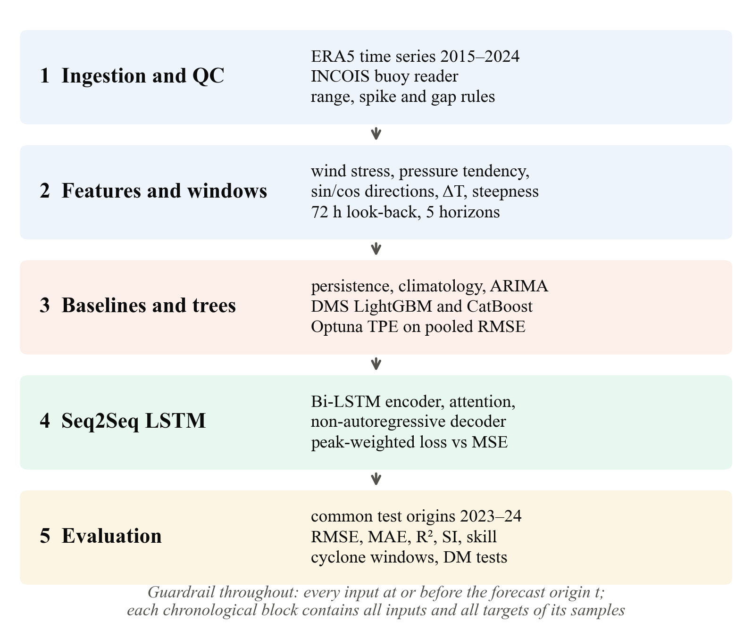
Methodology: five phases, one guardrail
Every input at or before the forecast origin; every block holds all inputs and targets of its samples
5 / 21
Notes:
Walk top to bottom. The guardrail at the bottom is the thread through all phases: it is what makes the test scores honest.

Slide 6
Zero look-ahead, by construction and by test
The common multi-step leak: the last training samples have targets inside the validation period
1
Containment rule
2
Causal features
A sample with origin t belongs to block [Ts, Te] only if t − 72 h ≥ Ts and t + 72 h ≤ Te
Backward differences and trailing windows only; a test changes the future and checks the past is unchanged
3
Causal gap filling
4
Train-only statistics
Forward fill only, because interpolation would read past the gap. Filled values are never targets
Scalers, peak threshold and climatology are computed on the fit block alone
3 blocks
Early stopping (2020), hyperparameter selection (2021–22) and reporting (2023–24) never share data, so the validation score is optimised only once and the test score is untouched.
6 / 21
Notes:
This slide answers the first question an examiner should ask: how do you know you did not leak the future? The answer is a rule, enforced in code and checked by tests.

Slide 7
Features encode the physics of wave generation
Wind stress, duration, pressure falls, stability and direction, all from data at or before t
Feature | Definition | Why it matters
Wind stress τ | ρa Cd(U) |U| (u, v) | Momentum input to the sea; grows ≈ U²
Stress history | mean τ, max U over 6, 12, 24 h | Waves are duration-limited
Pressure tendency | p(t) − p(t − h), h = 3, 12, 24 h | Falling pressure warns of a depression
Pressure anomaly | p − 30-day trailing mean | Synoptic signal without the monsoon
Air–sea ΔT | T2m − SST | Unstable air transfers more momentum
Directions | sin θ, cos θ (waves and wind) | Removes the 359° → 0° jump
Wind–wave alignment | cos(θwind − θwave) | Wind sea (+1) vs crossing swell (≤ 0)
Steepness | Hs / L0, L0 = gT²/2π | Young wind sea vs long swell
Drag coefficient after Large and Pond (1981), held constant above 25 m/s (Powell et al. 2003)
7 / 21
Notes:
Pick two to explain: the stress history (a 20 m/s wind that has blown for 24 hours makes bigger waves than one that started an hour ago) and the pressure tendency (the earliest local sign of a cyclone).

Slide 8
Direct multi-step: one model per lead time
Recursive one-step models feed their own errors back; direct models never do
1
Samples
2
Trees: one model per horizon
Inputs: the last 72 h of Hs and forcing. Targets: Hs(t + 6), (t + 12), (t + 24), (t + 48), (t + 72)
78 lagged and current features; LightGBM and CatBoost; boosting rounds set by early stopping per horizon
3
Bayesian tuning
4
Baselines
Optuna TPE with median pruning; the objective is the RMSE pooled over the five horizons on 2021–22
Persistence, day-of-year climatology, and ARIMA(2,1,1) with frozen training parameters, forecast from every origin
Ben Taieb et al., Expert Systems with Applications 39 (2012)
8 / 21
Notes:
The trees and the LSTM see exactly the same forecast origins, so every comparison later is like for like.

Slide 9
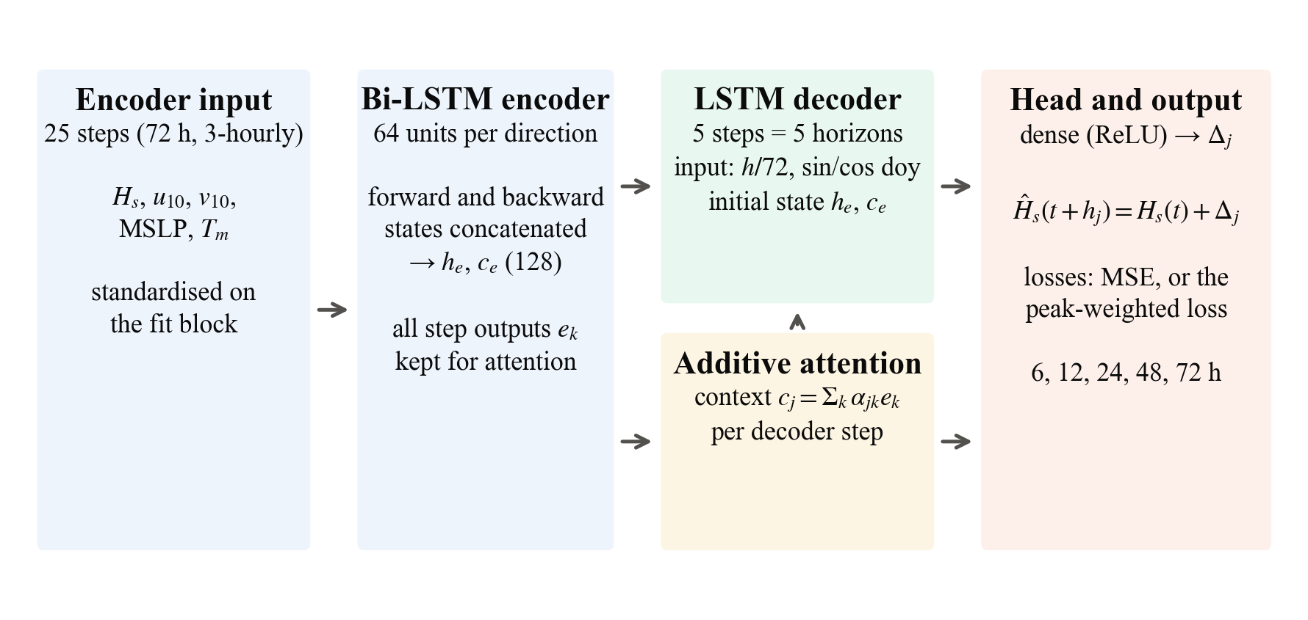
Seq2Seq Bi-LSTM with attention
The decoder sees only what is known at forecast time: the lead time and the season
Non-autoregressive decoder: all five horizons in one pass, no prediction fed back, no exposure bias
Residual head: forecast = Hs(t) + Δ, so the untrained network starts from persistence
9 / 21
Notes:
Explain attention in one sentence: each horizon can look back at the part of the 72-hour history that matters most for it.

Slide 10
A loss that refuses to miss storms
Ordinary seas: plain squared error. Extreme seas: errors ×2, under-predictions ×6
L = mean over horizons of [1 + s(y) · (β + γ · 1{y > ŷ})] · (y − ŷ)²
where s(y) = sigmoid((y − q95) / 0.25 m), β = 1 and γ = 4
1
Why
2
How it is smooth
3
How it is tested
Missing a cyclone peak is far costlier than a false alarm for ports and shipping
The sigmoid makes the weight continuous in y, and the loss stays continuous at y = ŷ
An identical network trained with MSE isolates the effect of the loss
10 / 21
Notes:
q95 is the 95th percentile of training Hs: 3.0 m at BD08, 3.1 m at BD10 and 2.6 m at BD11.

Slide 11
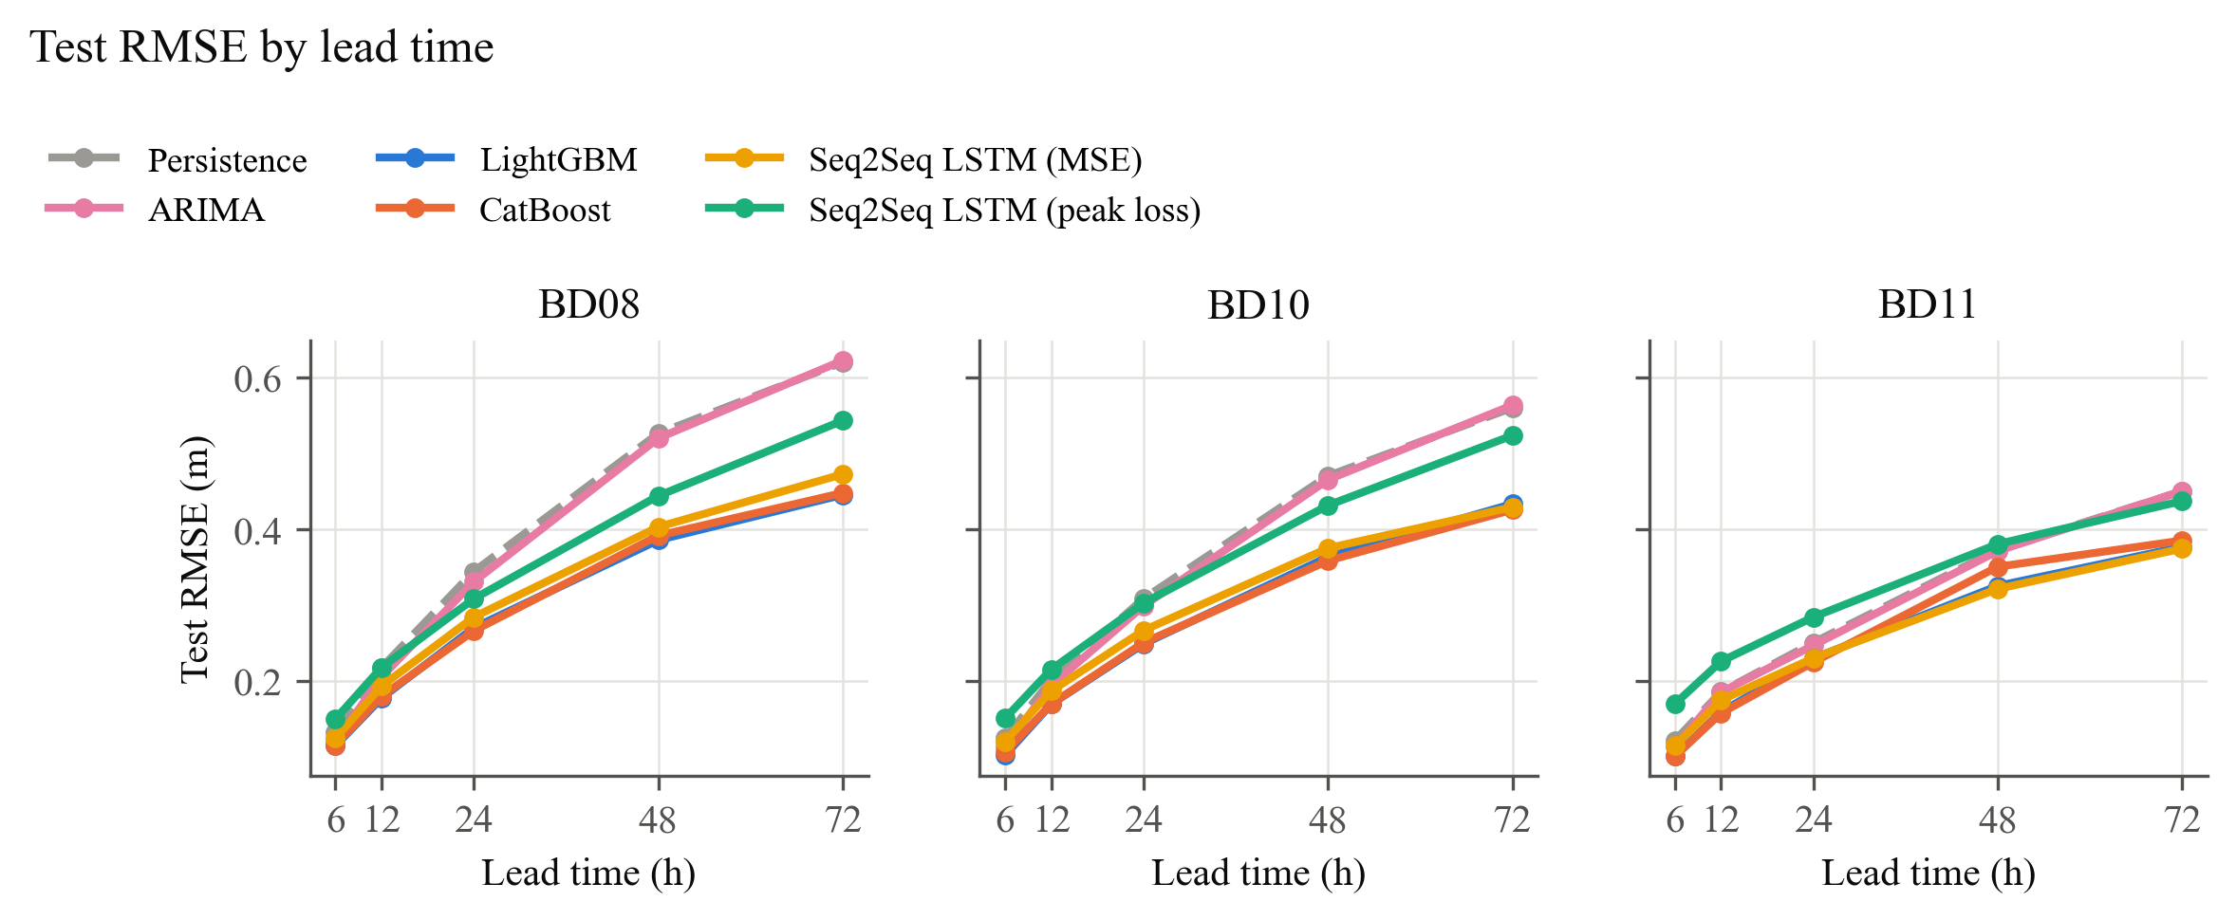
Trees beat persistence: −18% at 24 h, −23% at 72 h
RMSE grows with lead time for every model; the gap to the baselines widens with it
0.25 m
Best RMSE at 24 h (CatBoost), mean of 3 sites
0.42 m
Best RMSE at 72 h (LightGBM)
Persistence: 0.30 m at 24 h, 0.54 m at 72 h; ARIMA improves on it only at short lead times
All models scored on the same 17,400+ forecast origins per site
Test period 2023–2024, unseen in training, early stopping and tuning; target ERA5 Hs at the buoy positions
11 / 21
Notes:
Read the chart left to right: at 6 hours everyone is close to persistence because the sea state barely changes; by 72 hours the learned models are clearly ahead.

Slide 12
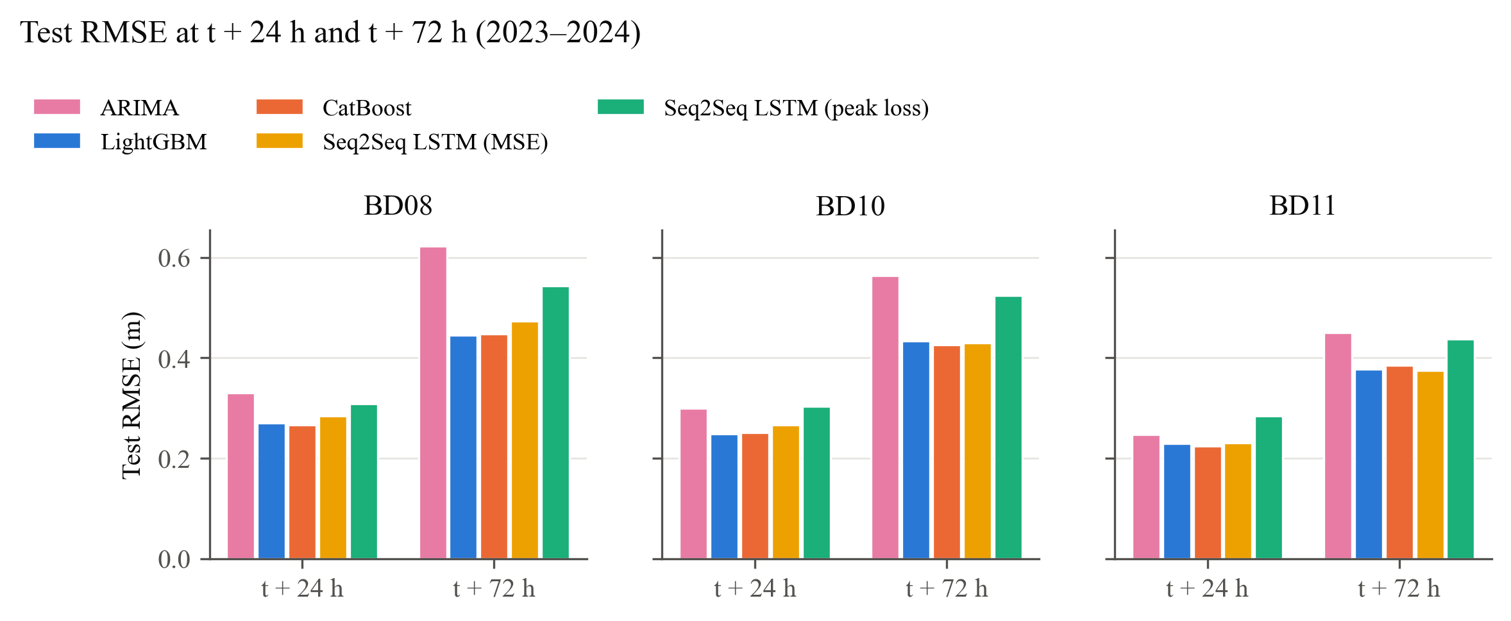
ARIMA, trees and LSTM at 24 h and 72 h
Gradient boosting and the Seq2Seq LSTM are close; both are well ahead of ARIMA
Test period 2023–2024, unseen in training, early stopping and tuning; target ERA5 Hs at the buoy positions
12 / 21
Notes:
Same colours throughout the talk: blue LightGBM, orange CatBoost, green LSTM with the peak loss, yellow LSTM with MSE, pink ARIMA.

Slide 13
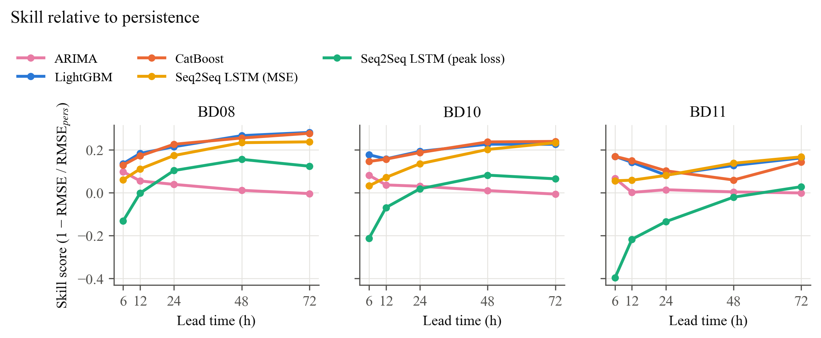
Skill rises with lead time
SS = 1 − RMSE / RMSE(persistence): the further ahead, the more the forcing adds
Test period 2023–2024, unseen in training, early stopping and tuning; target ERA5 Hs at the buoy positions
13 / 21
Notes:
Positive skill means better than persistence. Skill near zero at 6 hours is expected; it is the long horizons where a forecaster earns its keep.

Slide 14
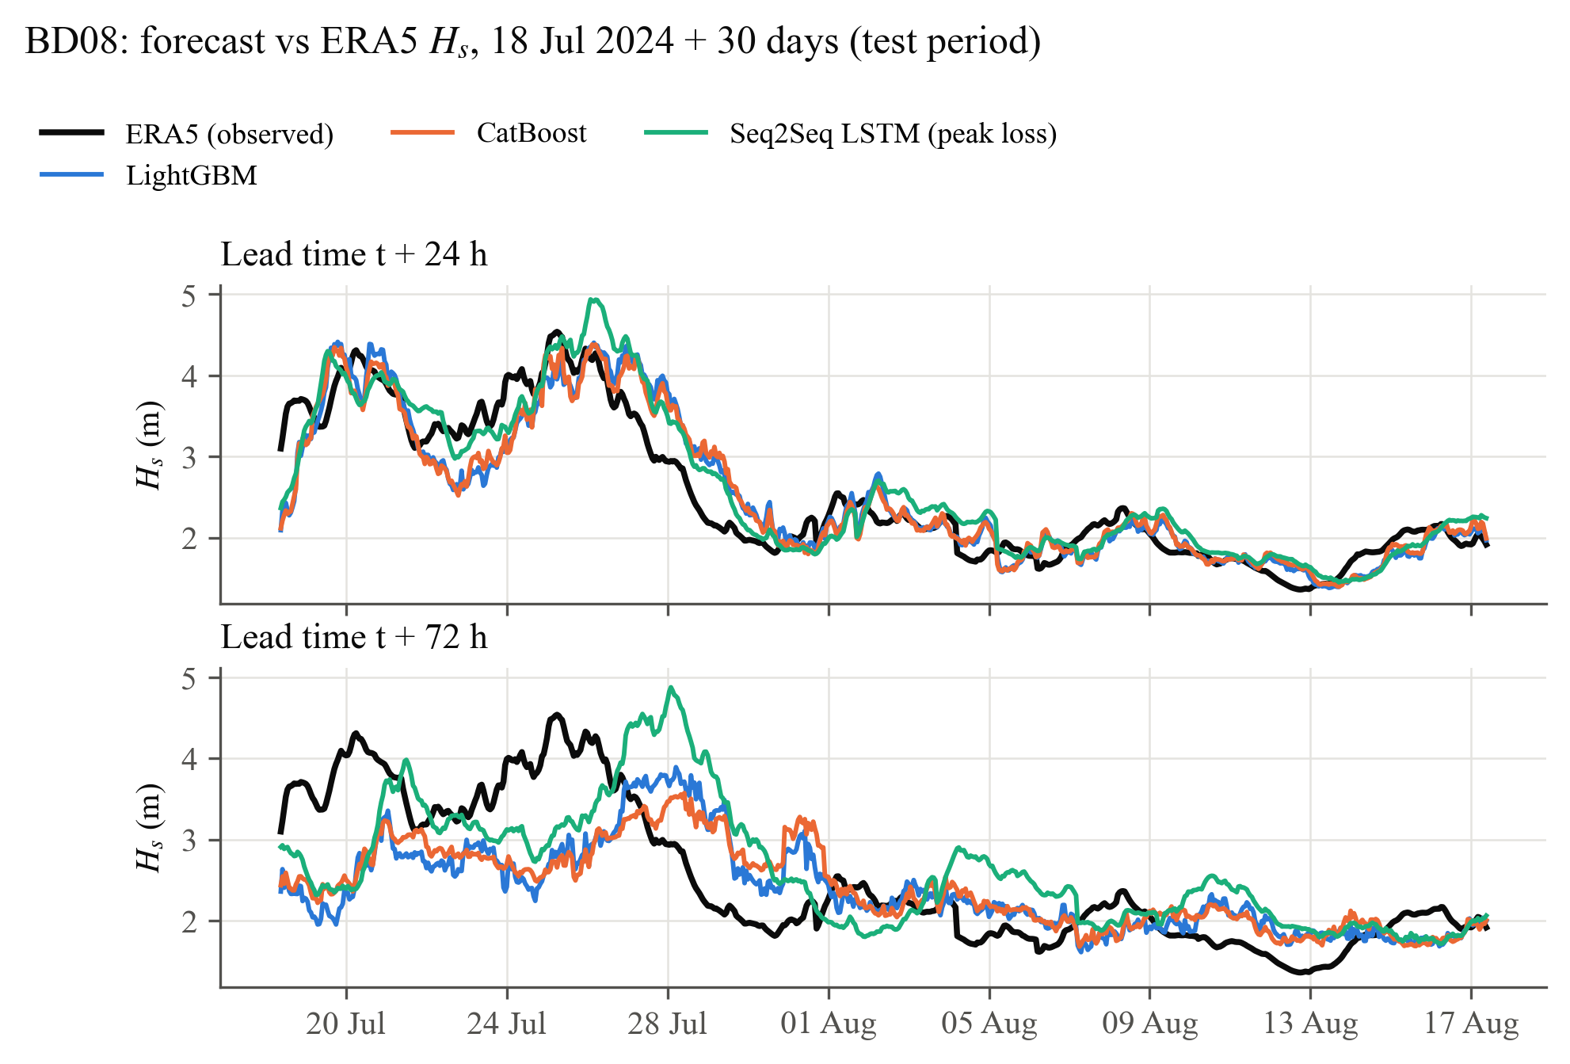
A month of forecasts against ERA5
At 24 h the models track each event; at 72 h they keep the level but damp short events
Test period 2023–2024, unseen in training, early stopping and tuning; target ERA5 Hs at the buoy positions
14 / 21
Notes:
Window chosen automatically as the most variable 30 days of the test period at BD08.

Slide 15
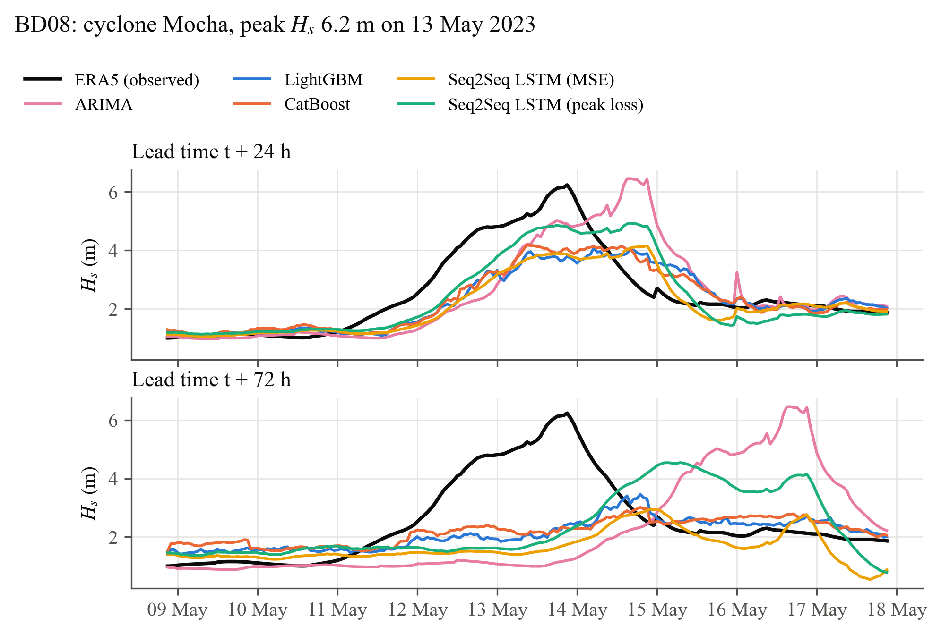
Cyclone Mocha: peak 6.2 m at BD08
24 h ahead the rise and timing are captured; 72 h ahead no model sees the storm coming
Test period 2023–2024, unseen in training, early stopping and tuning; target ERA5 Hs at the buoy positions
15 / 21
Notes:
Three days before the peak the cyclone is far from the buoy and leaves almost no trace in the local wind, pressure and wave history. This is the clearest argument for adding forecast forcing.

Slide 16
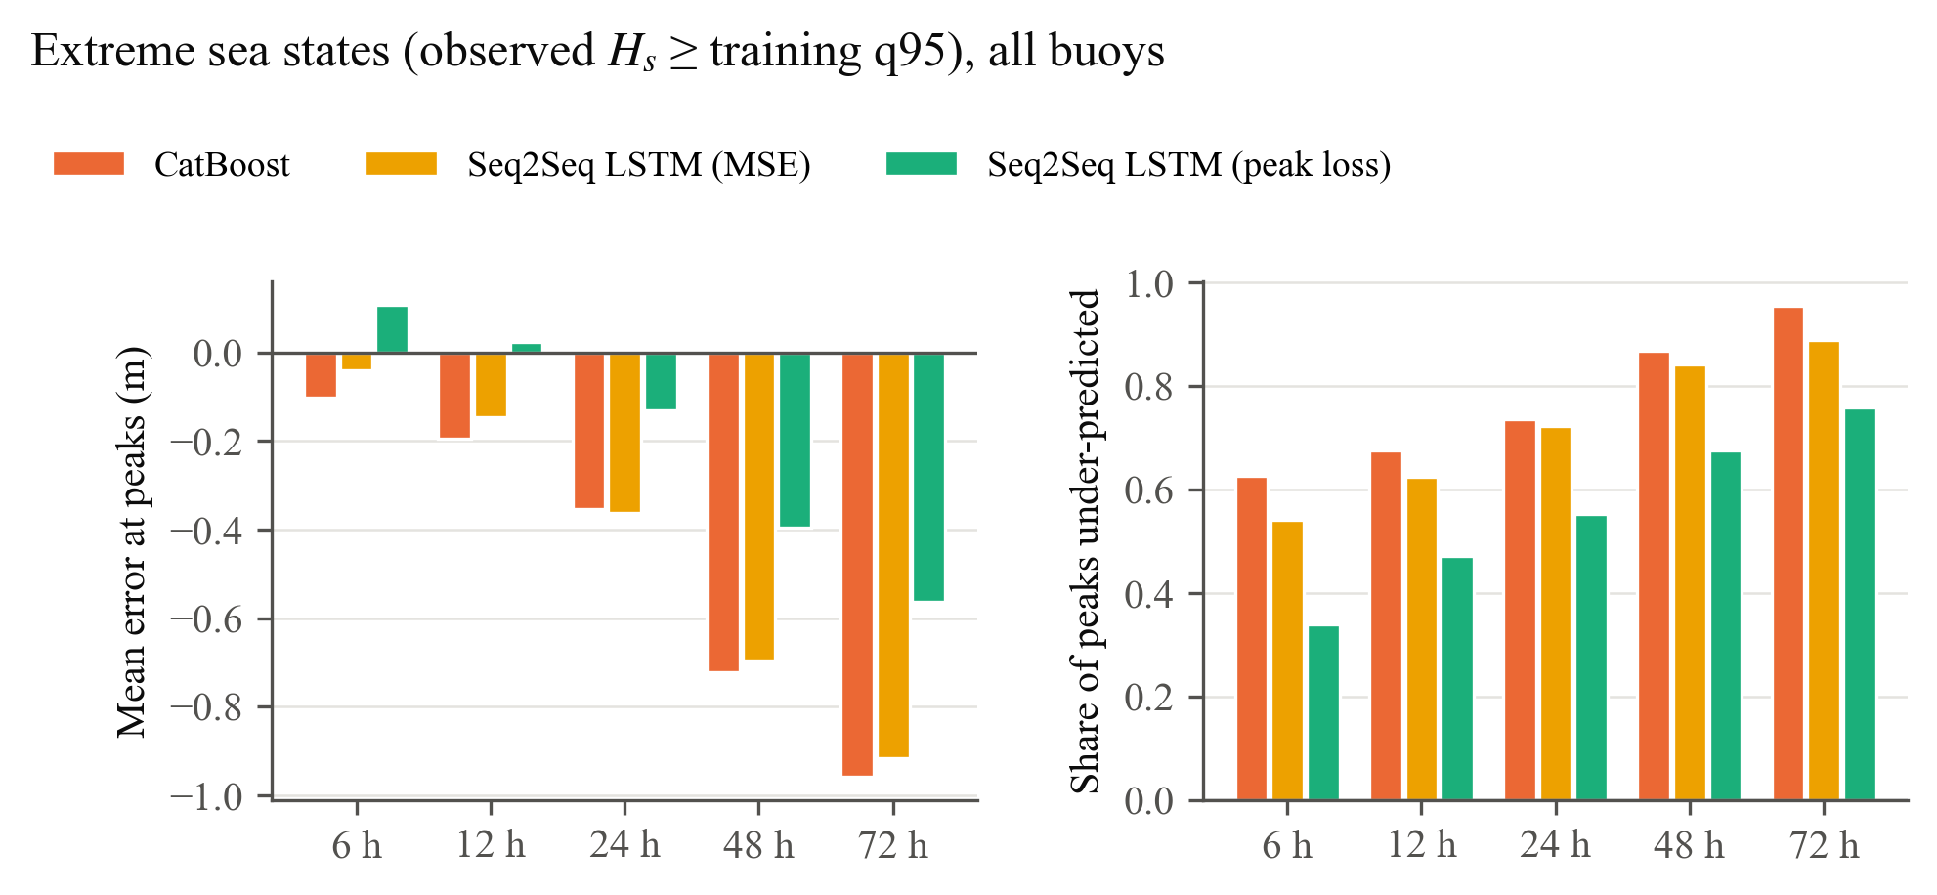
The peak-weighted loss misses fewer storms
Under-predicted extremes at 24 h: 72% → 55%; overall RMSE +14%
55%
of extremes under-predicted at 24 h with the peak loss
72%
with the MSE loss
Lowest RMSE of all models on extreme seas, and mean error within ±0.07 m inside cyclone windows
Trade-off by design: higher overall RMSE, fewer missed peaks; choose the loss by the application
Extreme subset: observed Hs ≥ training 95th percentile, all sites pooled
16 / 21
Notes:
This is the key result for safety applications. The overall RMSE gets a little worse because the loss tolerates over-prediction near the threshold.

Slide 17
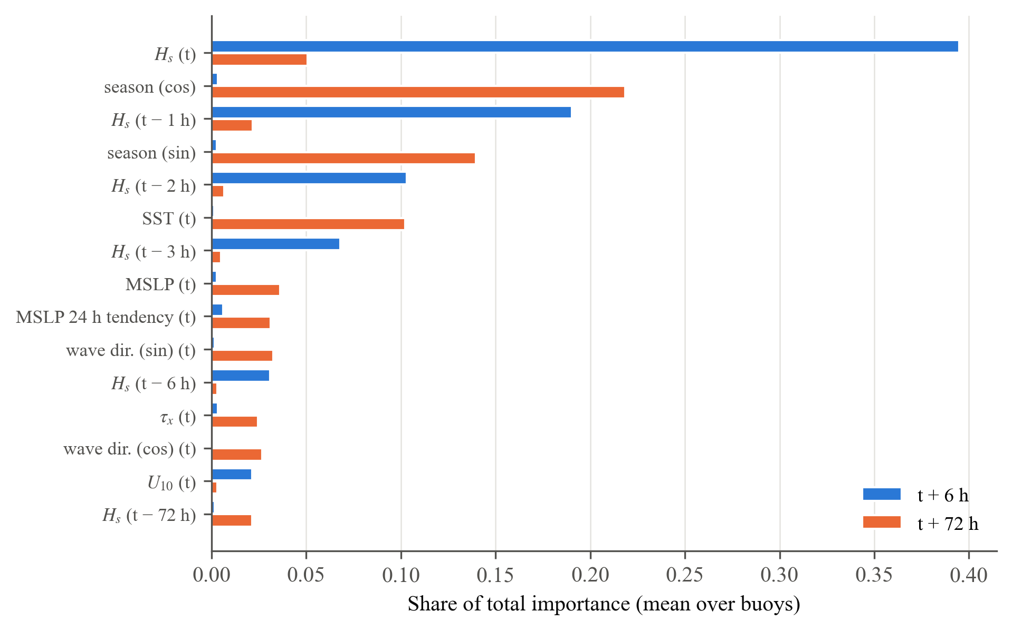
What the trees learned is physically sensible
6 h: the last three hours of Hs. 72 h: season, SST and pressure, i.e. a state-aware climatology
Reading the chart
Short range = persistence plus a growth or decay correction
Long range = the slow large-scale state: monsoon phase, SST, pressure level
The 24 h pressure tendency is the one fast signal that still counts at 72 h
17 / 21
Notes:
CatBoost gain importance averaged over the three sites.

Slide 18
Trees or LSTM?
Similar accuracy here; each has a role
1
Gradient boosting
2
Seq2Seq LSTM
78 engineered inputs, tuned, fast to train on a CPU, easy to explain; one model per lead time
Learns from raw sequences, one network for all horizons, consistent trajectories; hosts custom losses such as the peak loss
The trees benefit from feature engineering and tuning; the LSTM from its loss and architecture.
Check at BD08: giving the LSTM the 17 physics features cut its RMSE by 3–6%, narrowing the gap; at BD11 the LSTM is already best at 48–72 h.
For a fast, transparent operational baseline the trees are hard to beat; with buoy targets, forecast forcing and a GPU the LSTM has more headroom.
18 / 21
Notes:
Be balanced: the comparison was done under a limited computing budget, which favours the cheaper trees.

Slide 19
Limitations and future work
The pipeline is ready for the next step: buoy targets and forecast forcing
Limitations
Future work
Target is ERA5, which smooths cyclone peaks; buoy verification pending
Only information up to t; no NWP forecast forcing
Point inputs; remote swell sources unseen
15-minute tuning budgets on a laptop CPU; LSTM untuned
Fine-tune on OMNI buoy observations
NWP winds for t + h as decoder inputs
Spatial inputs: ConvLSTM or graph networks
Probabilistic (quantile) forecasts for go / no-go decisions
Tree + LSTM ensemble on a GPU
19 / 21
Notes:
Stress that the buoy reader, QC and alignment are already built and tested, so swapping the target is a configuration change.

Slide 20
Conclusions
−18%
−23%
−23%
72→55%
RMSE vs persistence at 24 h
RMSE vs persistence at 72 h
RMSE vs ARIMA at 72 h
Extremes under-predicted at 24 h, MSE → peak loss
Take-aways
Data-driven point forecasts of wave height, trained on open reanalysis data, give useful skill to three days at a tiny fraction of the cost of a numerical wave model.
Thank you. Questions?
Leakage-free by construction and by test
Direct multi-step: no error feedback
Physics features make trees competitive
Cyclones 72 h ahead need forecast forcing
Notes:
Summarise the numbers, then the one-sentence take-away. Invite questions.

Slide 21
References
Full list of 34 references in the thesis report (IEEE style)
[1] H. Hersbach et al., “The ERA5 global reanalysis,” Quarterly Journal of the Royal Meteorological Society, vol. 146, no. 730, pp. 1999–2049, 2020, doi: 10.1002/qj.3803.
[2] Copernicus Climate Change Service, “ERA5 hourly time-series data on single levels from 1940 to present,” Climate Data Store, dataset, 2024. [Online]. Available: https://cds.climate.copernicus.eu/datasets/reanalysis-era5-single-levels-timeseries
[3] Indian National Centre for Ocean Information Services, “Moored buoy observations, Ocean Moored buoy Network for the northern Indian Ocean (OMNI),” Hyderabad, India. [Online]. Available: https://incois.gov.in
[4] India Meteorological Department, Reports on Cyclonic Disturbances over the North Indian Ocean, RSMC – Tropical Cyclones, New Delhi, India, annual reports 2015–2024.
[5] The WAMDI Group, “The WAM model—A third generation ocean wave prediction model,” Journal of Physical Oceanography, vol. 18, no. 12, pp. 1775–1810, 1988.
[6] The WAVEWATCH III Development Group, “User manual and system documentation of WAVEWATCH III version 6.07,” NOAA/NWS/NCEP/MMAB, College Park, MD, USA, Tech. Note 333, 2019.
[7] L. H. Holthuijsen, Waves in Oceanic and Coastal Waters. Cambridge, U.K.: Cambridge University Press, 2007.
[8] M. C. Deo, A. Jha, A. S. Chaphekar, and K. Ravikant, “Neural networks for wave forecasting,” Ocean Engineering, vol. 28, no. 7, pp. 889–898, 2001.
[9] S. Fan, N. Xiao, and S. Dong, “A novel model to predict significant wave height based on long short-term memory network,” Ocean Engineering, vol. 205, Art. no. 107298, 2020.
[10] S. Ben Taieb, G. Bontempi, A. F. Atiya, and A. Sorjamaa, “A review and comparison of strategies for multi-step ahead time series forecasting based on the NN5 forecasting competition,” Expert Systems with Applications, vol. 39, no. 8, pp. 7067–7083, 2012.
[11] W. G. Large and S. Pond, “Open ocean momentum flux measurements in moderate to strong winds,” Journal of Physical Oceanography, vol. 11, no. 3, pp. 324–336, 1981.
[12] M. D. Powell, P. J. Vickery, and T. A. Reinhold, “Reduced drag coefficient for high wind speeds in tropical cyclones,” Nature, vol. 422, pp. 279–283, 2003.
[13] S. Hochreiter and J. Schmidhuber, “Long short-term memory,” Neural Computation, vol. 9, no. 8, pp. 1735–1780, 1997.
[14] M. Schuster and K. K. Paliwal, “Bidirectional recurrent neural networks,” IEEE Transactions on Signal Processing, vol. 45, no. 11, pp. 2673–2681, 1997.
[15] I. Sutskever, O. Vinyals, and Q. V. Le, “Sequence to sequence learning with neural networks,” in Advances in Neural Information Processing Systems 27, 2014, pp. 3104–3112.
[16] D. Bahdanau, K. Cho, and Y. Bengio, “Neural machine translation by jointly learning to align and translate,” in Proc. 3rd International Conference on Learning Representations (ICLR), San Diego, CA, USA, 2015.
[17] J. H. Friedman, “Greedy function approximation: A gradient boosting machine,” Annals of Statistics, vol. 29, no. 5, pp. 1189–1232, 2001.
[18] G. Ke et al., “LightGBM: A highly efficient gradient boosting decision tree,” in Advances in Neural Information Processing Systems 30, 2017, pp. 3146–3154.
[19] L. Prokhorenkova, G. Gusev, A. Vorobev, A. V. Dorogush, and A. Gulin, “CatBoost: Unbiased boosting with categorical features,” in Advances in Neural Information Processing Systems 31, 2018, pp. 6638–6648.
[20] T. Akiba, S. Sano, T. Yanase, T. Ohta, and M. Koyama, “Optuna: A next-generation hyperparameter optimization framework,” in Proc. 25th ACM SIGKDD International Conference on Knowledge Discovery and Data Mining, 2019, pp. 2623–2631.
[21] J. Bergstra, R. Bardenet, Y. Bengio, and B. Kégl, “Algorithms for hyper-parameter optimization,” in Advances in Neural Information Processing Systems 24, 2011, pp. 2546–2554.
[22] G. E. P. Box, G. M. Jenkins, G. C. Reinsel, and G. M. Ljung, Time Series Analysis: Forecasting and Control, 5th ed. Hoboken, NJ, USA: Wiley, 2015.
[23] F. X. Diebold and R. S. Mariano, “Comparing predictive accuracy,” Journal of Business & Economic Statistics, vol. 13, no. 3, pp. 253–263, 1995.
[24] D. Harvey, S. Leybourne, and P. Newbold, “Testing the equality of prediction mean squared errors,” International Journal of Forecasting, vol. 13, no. 2, pp. 281–291, 1997.
[25] L. Mentaschi, G. Besio, F. Cassola, and A. Mazzino, “Problems in RMSE-based wave model validations,” Ocean Modelling, vol. 72, pp. 53–58, 2013.
[26] D. P. Kingma and J. Ba, “Adam: A method for stochastic optimization,” in Proc. 3rd International Conference on Learning Representations (ICLR), San Diego, CA, USA, 2015.
21 / 21
Notes:
Backup slide with the sources behind the data, the models and the verification methods.

