Slide 1
Time Series Prediction and Forecasting
For Delhi Weather Data
Vishesh Kumar, 2000681520049
Department of Computer Science and Engineering(Artificial Intelligence)

Slide 2
Introduction
Time series prediction and forecasting play a crucial role in various domains, including weather data analysis. This presentation focuses on analyzing weather data for Delhi and forecasting future weather patterns.

Slide 3
Data Collection
The weather data for Delhi is collected from
Kaggle. The collected data undergoes preprocessing steps to handle missing values and ensure data quality.

Slide 4
Exploratory Data Analysis
Exploratory data analysis (EDA) involves visualizing and analyzing historical weather data for Delhi. This includes examining trends, seasonality, and any anomalies in the data.

Slide 5
Methodology
For time series forecasting, before model building comes an important step of feature engineering.
For this, the creation of time step features like trend and seasonality features like fourier coeff are used to estimate a LinearRegression Model.
The next model is the Hybrid model for different parts of the time series process:=
  LinearRegression for the trend and seasonality analysis.
  XGBoost or NN for time lag features.

Slide 6
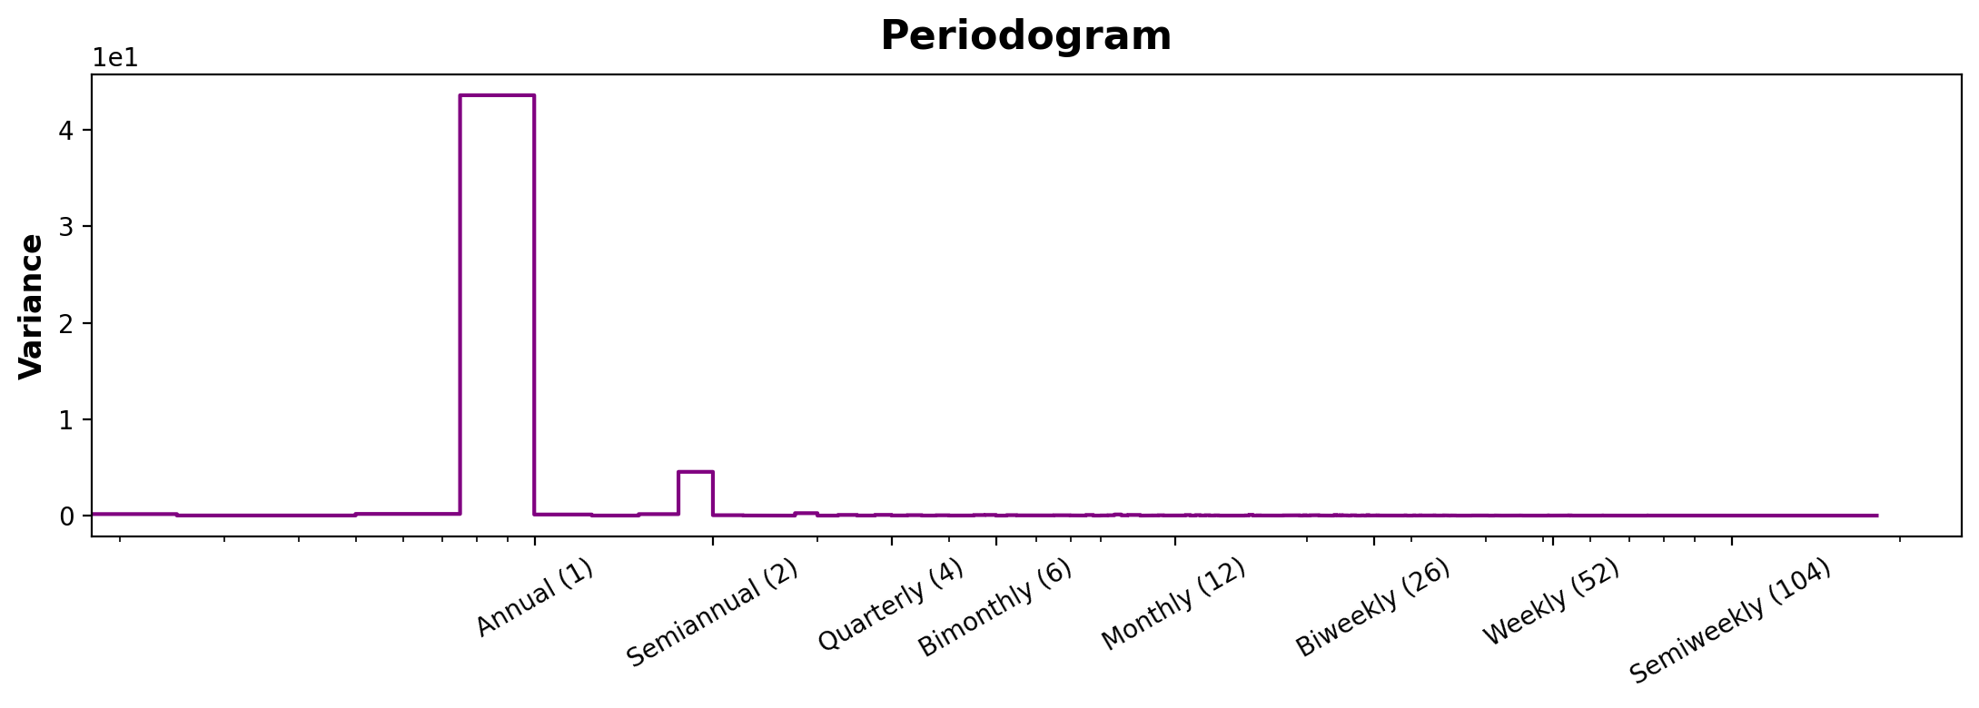
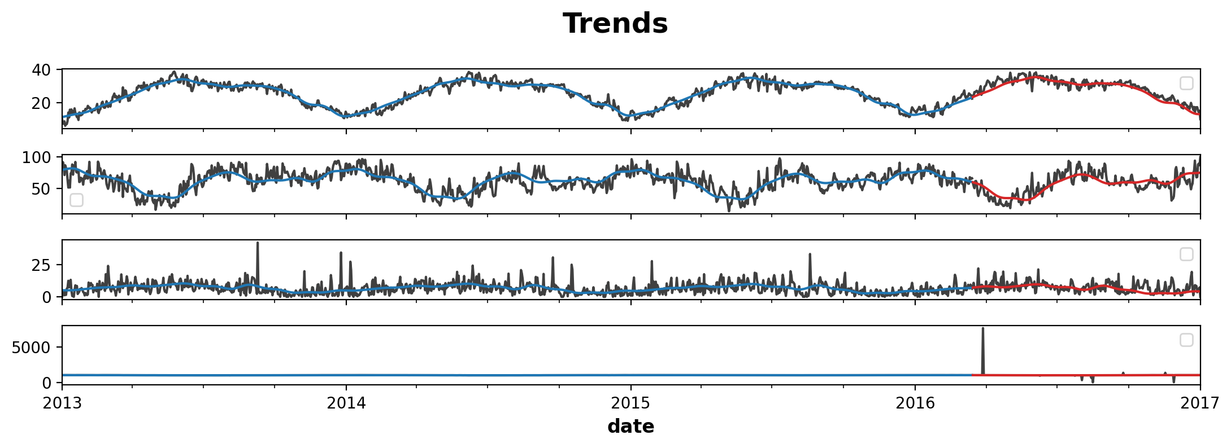

Slide 7
Forecasting
Using the trained model, weather patterns are forecasted for the next week in Delhi. The forecasted data provides insights into expected temperature, humidity, precipitation, and other weather metrics.

Slide 8
Evaluation
The performance of the forecasting model is evaluated using metrics such as Mean Absolute Error (MAE), Mean Squared Error (MSE), and Root Mean Squared Error (RMSE). This helps assess the accuracy of the predictions.
The RMSE of the model in this first iteration reached about 2.

Slide 9
Conclusion
In conclusion, time series prediction and forecasting for weather data in Delhi provide valuable insights for planning and decision-making. Further research could explore more advanced modeling techniques and incorporate additional data sources.

