Slide 1
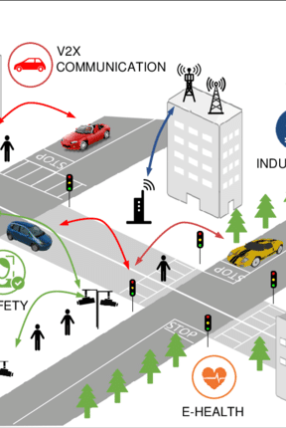
Distributed Data Stream Processing For Analytics
Vishrut Goti
Vishesh Mehta
Yogesh Dholakiya

Slide 2
Objectives
Stream Processing and Distributed Stream Processing.
Distributed Stream Processing Architecture.
Distributed Stream Processing Frameworks.
Evaluation Metrics.
Choosing the best Framework.

Slide 3
Stream Processing
Stream processing is the technology used for processing the continuous streams of data, in real-time as it arrives, to gain meaningful insights from it.
Unlike batch processing, which processes data in chunks after accumulating it over a period, stream processing deals with data instantaneously.
Modern systems generate data at unprecedented rates and volumes, necessitating immediate processing to derive value.
Industries require real-time analytics for immediate decision-making (e.g., financial trading, emergency response).

Slide 4
Distributed Stream Processing
As cities become smarter and more data-driven, the influx of real-time data from IOT devices presents challenges like achieving low latency and high throughput.
Distributed stream processing refers to the use of a network of computers (a distributed system) to process large streams of real-time data.
It involves partitioning data across multiple machines to process large volumes of data more efficiently.
Also, Distributed Stream Processing supports scalability and flexibility in data handling, which are essential as Smart Cities evolve.

Slide 5
Architecture
Data Sources: sensors, logs, user interactions, financial transactions, etc.
Data Ingestion: Collecting the data streams and transferring them into the system.
Stream Processing Engines: The actual processing of data streams. It typically consists of multiple nodes that can process data in parallel. Each node can perform operations such as filtering, aggregation, windowing, or complex event processing on its portion of the stream.
Storage: Post-processing, the results may be stored for further analysis.
Actions: The processed data can trigger actions or outputs, such as alerts, real-time reports, updating live dashboards.

Slide 6
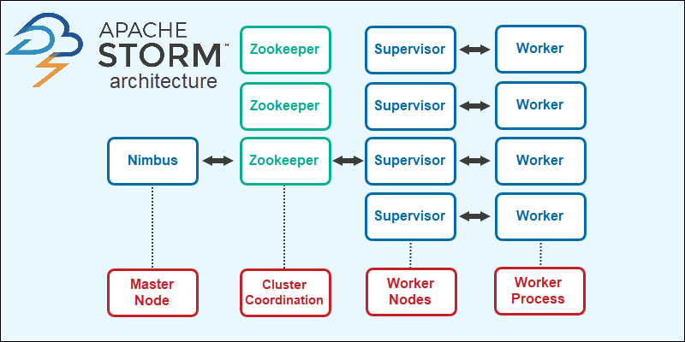
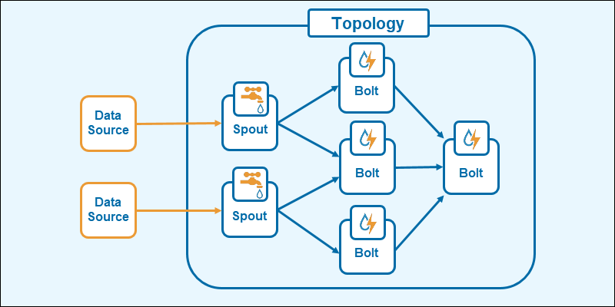
Apache Storm
Nimbus: Acts as the master, distributing data and coordinating tasks.
Supervisor: Runs worker processes that execute parts of the processing topology.
Zookeeper: Handles coordination between Nimbus and Supervisors to maintain cluster state.
Spouts: Retrieves the data continuously, transform the information into tuple streams, and send the data to bolts.
Bolts: Performs the processing logic, aggregations, stream joins, tuple filtering, etc. The output creates new streams for additional processing through other bolts or stores the data in a database.

Slide 7
Features:
Fault-tolerant, scalable, and guarantees data processing.
Supports multiple programming languages, enhancing flexibility for developers.
Use Cases:
Real-time analytics, monitoring systems, ETL operations, and more.
Employed by major companies like Twitter for real-time content personalization and spam detection.
Advantages:
Real-time processing capability allows for immediate data-driven decisions.
Scalable architecture adjusts resources dynamically based on processing demands.

Slide 8
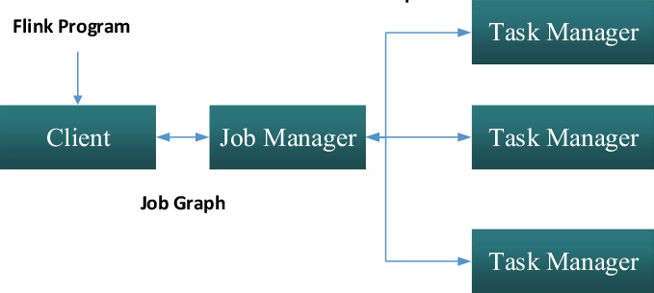
Apache Flink
Job Manager: Coordinates the distributed execution and is responsible for resource management, job scheduling, and fault recovery.
Task Manager: Executes tasks and handles data buffering and processing.
DataStream API: Enables the development of robust pipeline definitions for streaming and batch jobs.

Slide 9
Features:
Fault Tolerance: Provides built-in mechanisms for state checkpointing and recovery.
Advanced Windowing: Handles complex windowing and time operations for stream processing.
Use Cases:
Real-time analytics, network monitoring, fraud detection, and machine learning applications.
Alibaba, one of the world's largest e-commerce platforms, uses Apache Flink for real-time analytics and optimization of marketing strategies.
Advantages:
Robust State Management: Supports stateful computations across large-scale data streams.

Slide 10
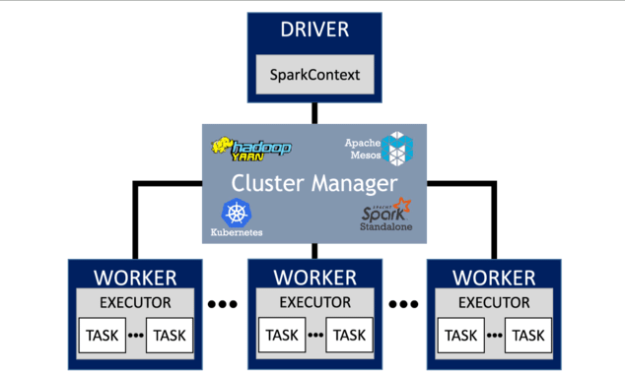
Apache Spark
Driver: Master node responsible for converting the application into set of task to e executed by the executers.
Cluster Manager: Pluggable component for acquiring cluster resources and is responsible for allocating resources to Spark applications.
Executers: Processes that executes the tasks and return the result to the driver.
Resilient Distributed Datasets: Fault Tolerant collections of elements that can be operated parallelly.

Slide 11
Features:
Processes Data at high velocity, up to 100 times faster in memory and 10 faster on disk than Hadoop MapReduce.
Offers high-level APIs ad supports set of higher-level tools like Spark SQL for Structured Data Processing, Mllib for Machine Learning, GraphX for Graph Processing.
Use Cases:
Uber uses Apache Spark for processing petabytes of data to provide real-time updates to users and data,
Netflix uses Spark Mllib to recommend movies to users based on past viewing patterns.
Advantages:
Supports multiple languages, allowing users to write applications in their preferred language.
Support for SQL queries, streaming data, machine learning, graph data processing, beside MapReduce operations.

Slide 12
Latency
Apache Spark:
Higher latency due to micro-batching approach.
Best for batch processing and tasks where real-time response is not critical.
Apache Flink:
Designed for low-latency, real-time processing.
Ideal for applications requiring immediate data insights and event-driven processing.
Apache Storm:
Provides ultra-low latency, suitable for real-time analytics and high-speed data processing tasks.
Summary:
Flink and Storm are preferable for real-time use cases requiring rapid processing.
Spark is more suited for complex transformations on large datasets where processing time is less sensitive.

Slide 13
Throughput
Apache Spark:
High throughput capabilities, especially effective in batch processing scenarios.
Dominant in complex analytics tasks, including machine learning and graph processing.
Apache Flink:
Balances high throughput with low latency, excelling in streaming analytics and event-driven applications.
Supports both batch and real-time processing efficiently.
Apache Storm:
Handles very high throughput but can be resource-intensive.
Suitable for scenarios where speed of data processing is paramount.

Slide 14
Best Framework?
The choice of a DSP framework largely depends on specific project requirements, including the need for real-time processing, fault tolerance, and the complexity of data transformations.
For real-time, critical applications requiring instant data processing, Apache Flink is recommended due to its lower latency.
Apache Spark Streaming is suitable for high-throughput needs, where immediate processing is less critical.
Apache Storm hits a sweet spot with good all-around performance but shines when consistent, reliable processing is needed.

Slide 15
References:
https://www.researchgate.net/publication/333706228_Evaluation_of_distributed_stream_processing_frameworks_for_IoT_applications_in_Smart_Cities
https://www.researchgate.net/publication/329608498_A_Survey_of_Distributed_Stream_Processing_Systems_for_Smart_City_Data_Analytics
https://www.researchgate.net/publication/313451303_Performance_evaluation_of_big_data_frameworks_for_large-scale_data_analytics

Slide 16
Thank you

