Slide 1
Project Parachute
Enabling people to move at liberty
By Team:
Vishesh Thakur
Robert Cheng
Zhuoran Huang

Slide 2
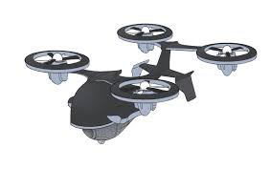
What is Project Parachute ?
Electronic commerce
Next generation delivery system
The competence to overcome time and location constraints
Offers itinerant delivery
Less money and manpower

Slide 3
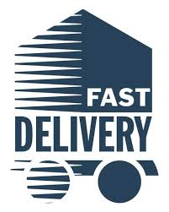
Need and purpose
Buyers are not restricted to stay at a fixed physical location for delivery.
Permits quicker and safer delivery of the product.
The system will be environmental friendly and hence will lead to less carbon footprints.

Slide 4
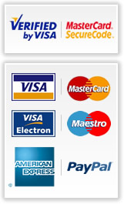
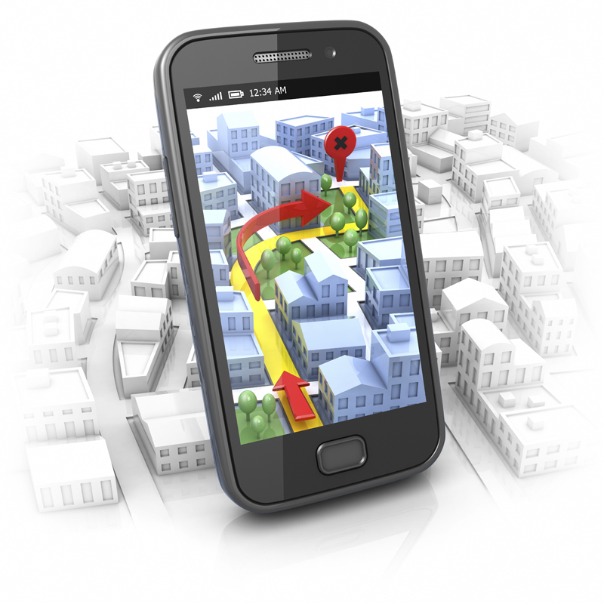

What information will be processed?
Information about the products that the customer has ordered.
Payment method
Shipping address
Shipping methods
Option for the consumers to have the product delivered where they are on the date of delivery.
Before date of delivery notify the customers confirming whether they want the product to be delivered at home or to their mobile location.
Permission from the consumer to access their location.
On the date of delivery get permission from customers and authentication method to track.
Provide notification that the product is delivered ( nearest drop location) and ready for a pick up.

Slide 5

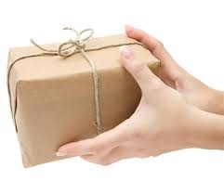
How will the information be input?
By whom?
When?
Where?
Input is from BUYER who places an order by selecting the method of delivery and specifies the shipping address(Back up)
A day prior to delivery, a request is sent by retailer asking the buyer to approve of they being tracked.
Upon delivery notification and drop location details will be thrown to the buyer. When the buyer picks up the order, a confirmation email is sent.

Slide 6
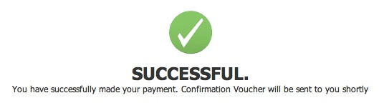
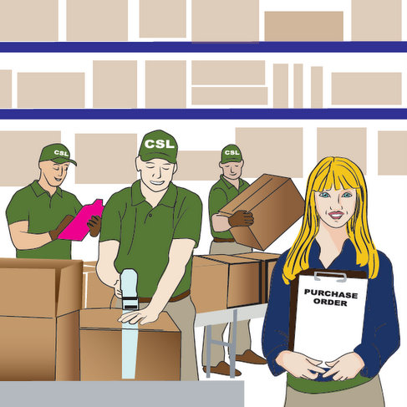

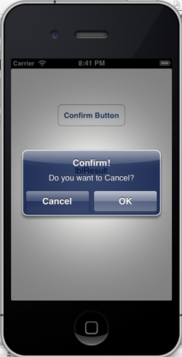

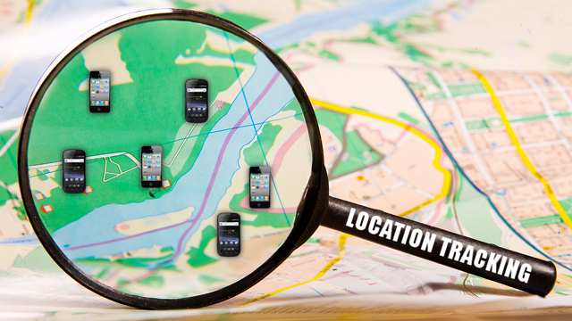
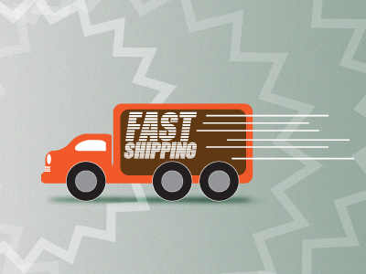
How will the data be processed?

Slide 7
What is the output?
1. Basic delivery information including delivery method, selected drop spot, backup address, receiver's’ info
2. Notifications that alert the arrival of the package, as well as the pick up of the package.
3. ID for consumers to identify themselves while picking up their package.
4. The feedback status of drone and the deliveries.
Who will use it:
Both consumers and e-commerce can benefited from the output. For consumer, it provides a better experience, for business owners, they manage their drone fleet better and get to know their consumers from a new perspective.

Slide 8


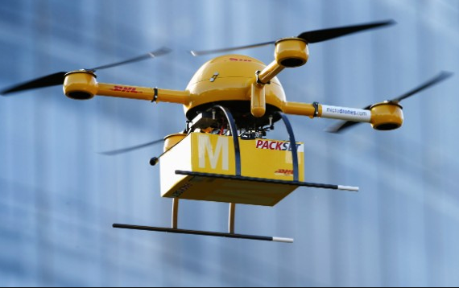
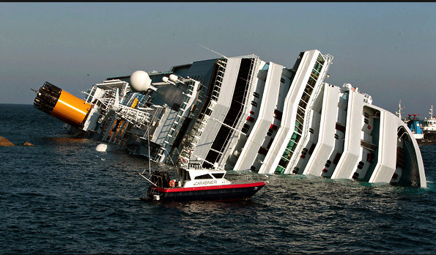

Tricky use case
Description
What’s the problem ?
Our solution
What is expected to happen ?

Slide 9

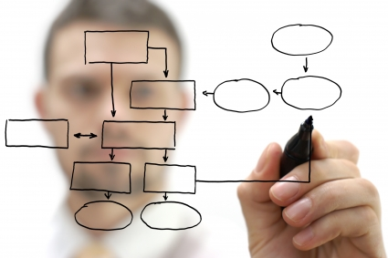
Functional Requirements:
Basic E-commerce layout features which includes browsing through product catalogs.
Payment must be successfully processed.
Shipping address has to be provided.
Capture option of either delivering to physical address or to the place where the consumer will be on the date of delivery.
Customer has to provide response whether they want the product to be delivered at their physical address or to be tracked.
If the option of product being delivered to the location where the consumer will be at is selected then tracking process will begin else the product will be delivered to the provided shipping address.
Based on the tracking data, the product will be delivered to the nearest drop location.
Notification will be sent to pick up.
In order to pick up the product proof of ID must be provided.

Slide 10
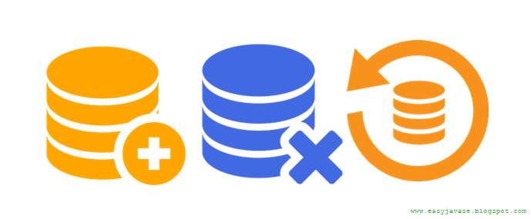

Will there be current data which needs to be updated?
The current data might get updated based upon the customers appeal of wanting to be tracked or not.
Earlier racking request will be turned down and the product will be delivered to the backup address.
Real time location, working status and potential arriving time of delivery
What controls will be needed for the system(security etc.)
Confidentiality of the customer’s details (address, credit card information) must be maintained.
At the time of pick up a valid proof of ID must be provided.

Slide 11
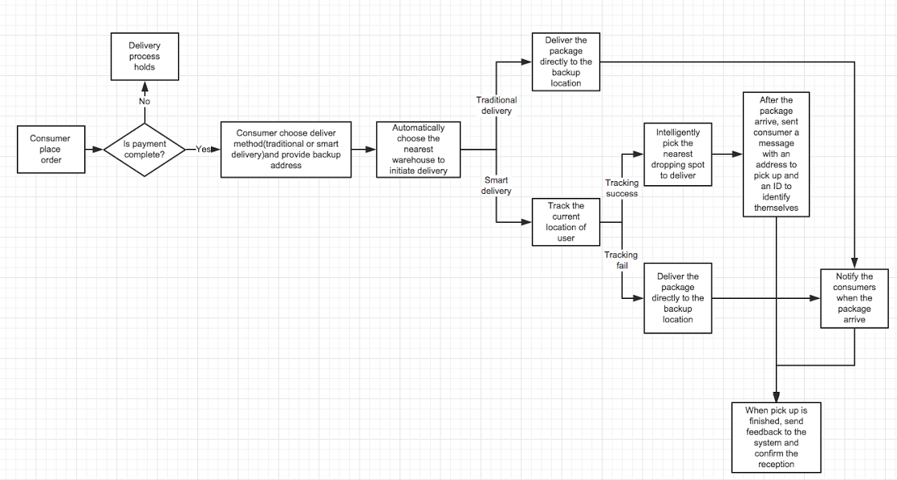
What is the flow of information in the system?

Slide 12
Thank you!

