Slide 1
Superstore Sales Dashboard: Key Insights
Task 4 – Dashboard Design
Date: June 05, 2025

Slide 2
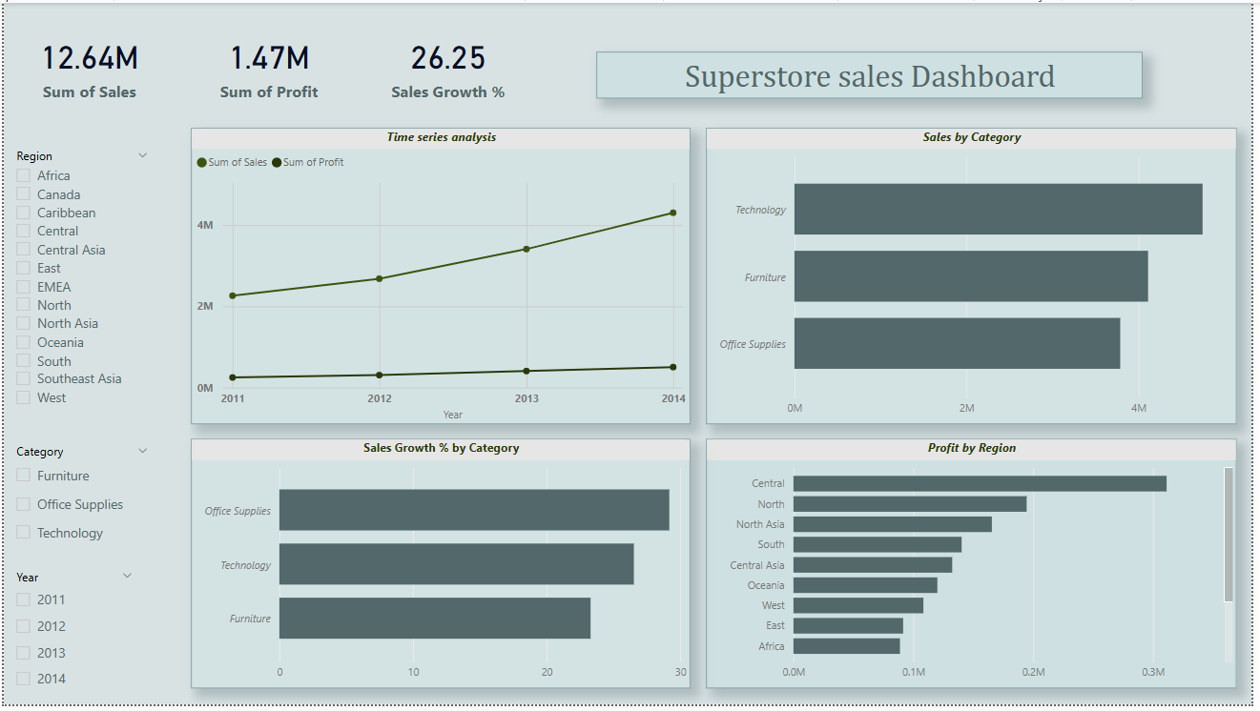
Dashboard Overview
Interactive dashboard showing sales, profit, and growth trends across regions and categories.

Slide 3
Key Insights
Sales: Technology category has the highest sales ($800K over 2011-2014).
Profit: APAC region has the highest profit ($150K), driven by high sales in Technology.
Growth: Furniture category shows the highest sales growth (e.g., 15% YoY growth from 2013 to 2014).
Trends: Sales and profit peak in December each year, likely due to holiday demand.

Slide 4
Recommendations
Focus on High Performers: Target Technology products in the APAC region with marketing campaigns.
Growth Opportunities: Invest in Furniture products, as they show strong growth potential.
Monitor Trends: Use the dashboard to track seasonal peaks (e.g., December) and adjust strategies accordingly.

Slide 5
How to Use the Dashboard
Use the Region slicer to focus on specific markets (e.g., APAC, EMEA).
Use the Category slicer to analyze product performance (e.g., Technology, Furniture).
Use the Year slicer to track trends over time (e.g., 2011-2014).
Monitor KPIs (Total Sales, Total Profit, Sales Growth %) to identify opportunities.

Slide 6
THANK YOU

