Slide 1

Note: The data and information in this document is reflective of a hypothetical situation and client. This document is to be used for KPMG Virtual Internship purposes only.
Sprocket Central Pty Ltd
Data analytics approach

Slide 2
Note: The data and information in this document is reflective of a hypothetical situation and client. This document is to be used for KPMG Virtual Internship purposes only.
Agenda
Introduction
Data Exploration
Model Development
Interpretation

Slide 3
Note: The data and information in this document is reflective of a hypothetical situation and client. This document is to be used for KPMG Virtual Internship purposes only.
Introduction
Customer segmentation and Recommendations
Customer Segmentation Based on Gender and Age groups.
Customers or sales based on product class and product line
Wealth segment-based customer identification
State wise customer identification
Problem Statement
Analytical Approach
Sprocket Central Pty Ltd specialize in high quality bike accessible cycling accessories.
Marketing team is looking to boost business based on customer trends and behavior.
Targeting 1000 new customers to bring highest value to the business.

Slide 4
Note: The data and information in this document is reflective of a hypothetical situation and client. This document is to be used for KPMG Virtual Internship purposes only.
Data Exploration
Data Quality Assessment
Table | Inaccurate Data | Inconsistent Data
Customer Addresses |  | State, address
Customer Demographics | Job_titles, DOB, deceased_indicator | Gender, DOB, tenure
Transactions | product_id, brand, product_line, product_class , product_size, standard_cost ,online_order | product_id, brand, product_line, product_class , product_size, standard_cost,product_first_sold_date

Slide 5
Note: The data and information in this document is reflective of a hypothetical situation and client. This document is to be used for KPMG Virtual Internship purposes only.
Data Exploration
Data Transformation
In Transaction Table Null Values were removed from columns.
In Customer Demographics table Data inconsistencies in DOB and Gender columns were removed and values were recoded with consistent information.
In customer Address Table State column values were Recoded to get consistent information.

Slide 6
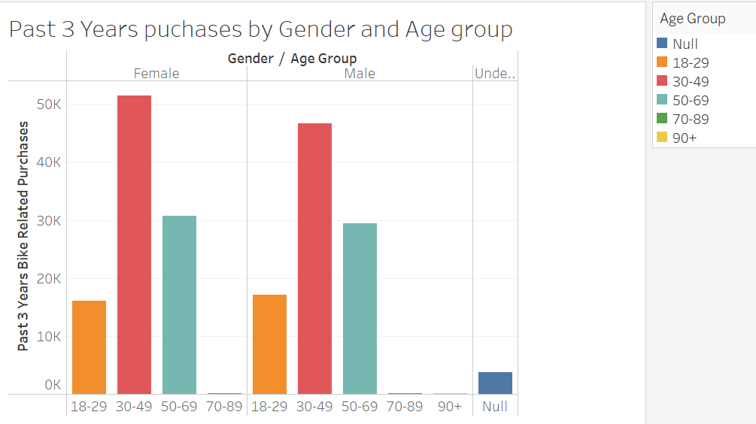
Note: The data and information in this document is reflective of a hypothetical situation and client. This document is to be used for KPMG Virtual Internship purposes only.
Data Exploration
Customer Identification Based On Age, Wealth Segment and Gender:
Based on Data exploration the greatest number of purchases were done by the customers in Age-Group 30-49.
There is no significant difference in purchases done by Male and Female customer.
Another significant piece of customer segment are Mass customer who has done significant higher number of purchases.

Slide 7
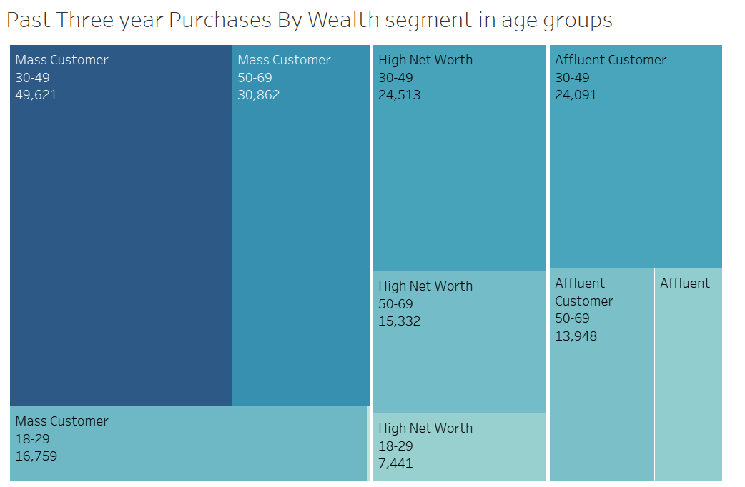
Note: The data and information in this document is reflective of a hypothetical situation and client. This document is to be used for KPMG Virtual Internship purposes only.
Data Exploration
Customer Identification Based On Age, Wealth Segment and Gender:
Based on Data exploration the greatest number of purchases were done by the Mass customers in Age-Group 30-49.
Another significant piece of customer segment of age group 30-49 are most significant buyers across all wealth segment.

Slide 8
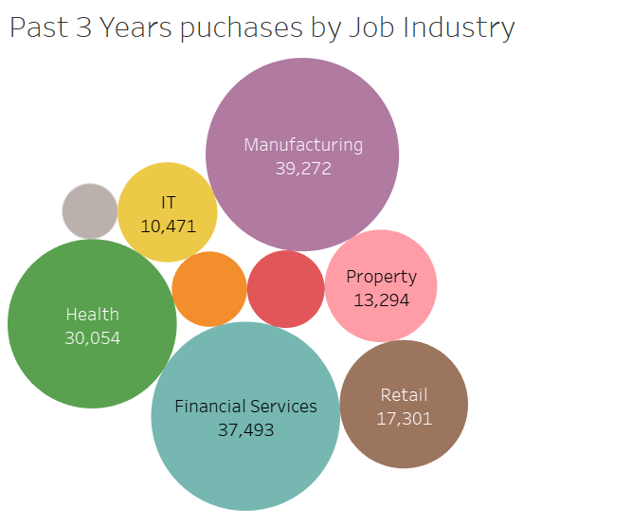
Note: The data and information in this document is reflective of a hypothetical situation and client. This document is to be used for KPMG Virtual Internship purposes only.
Data Exploration
Customer Analysis Based on Job Industry:
Based on data exploration the top three customers job industry are : Manufacturing, Financial Services and Health
Customers from Manufacturing have made the greatest number of purchases.

Slide 9
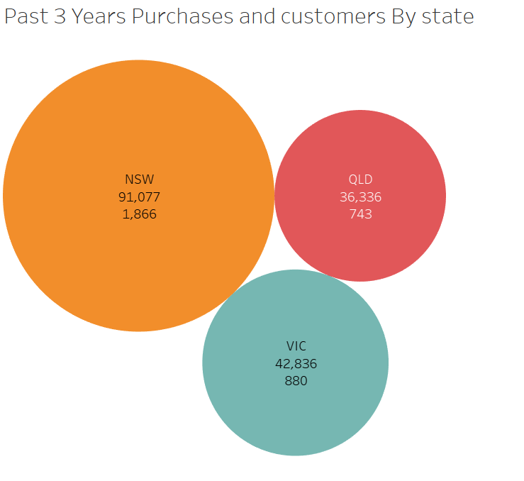
Note: The data and information in this document is reflective of a hypothetical situation and client. This document is to be used for KPMG Virtual Internship purposes only.
Data Exploration
Customer Analysis Based on Address:
Based on data exploration the greatest number of customers were from New South Wales.
Customers from New South Wales have made the greatest number of purchases.

Slide 10
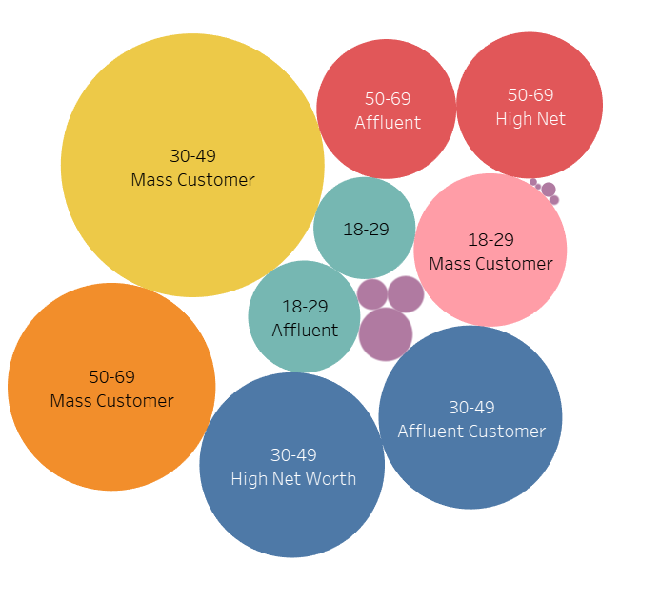
Note: The data and information in this document is reflective of a hypothetical situation and client. This document is to be used for KPMG Virtual Internship purposes only.
Interpretation
Targeting High Value Customers
Customers in Following segments are most valuable for the business.
Customers in age group 30-49
Customers working in Manufacturing, Financial Services and Health industry.
Customer from Mass Customer wealth segment.

Slide 11
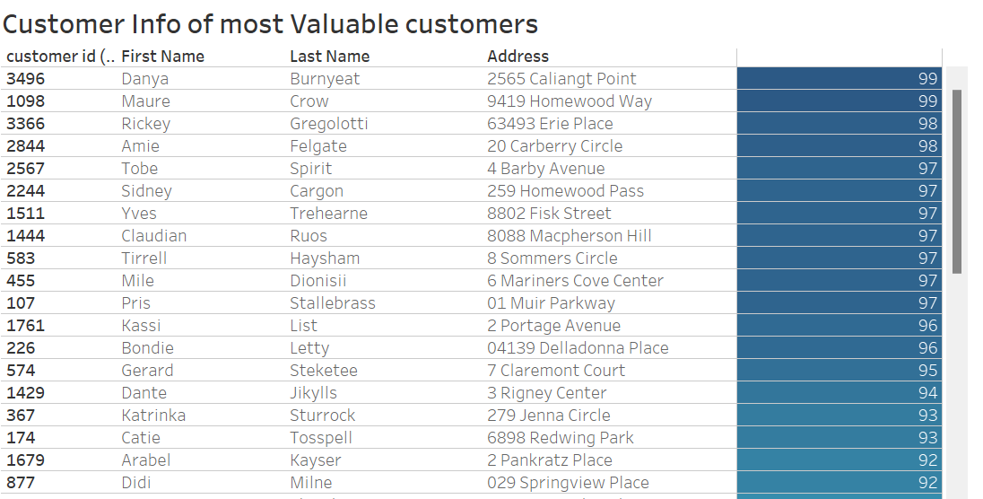
Note: The data and information in this document is reflective of a hypothetical situation and client. This document is to be used for KPMG Virtual Internship purposes only.
Model Development
Top Customers from Data Based On Customer Analysis

Slide 12
Note: The data and information in this document is reflective of a hypothetical situation and client. This document is to be used for KPMG Virtual Internship purposes only.
Thank You

