Slide 1




Unlocking Secure User Access with Amazon Cognito
Amazon Cognito is a fully managed user directory and authentication service that simplifies user management for web and mobile applications.
By Vishma D
pre e ncode d. png

Slide 2

What is Amazon Cognito?
Simplifies User Authentication
Provides a secure and scalable way to authenticate users
for your applications, eliminating the need for complex backend infrastructure.
Manages User Data
Handles user registration, sign-in, and account
management, allowing you to focus on your core application logic.
pre e ncode d. png

Slide 3
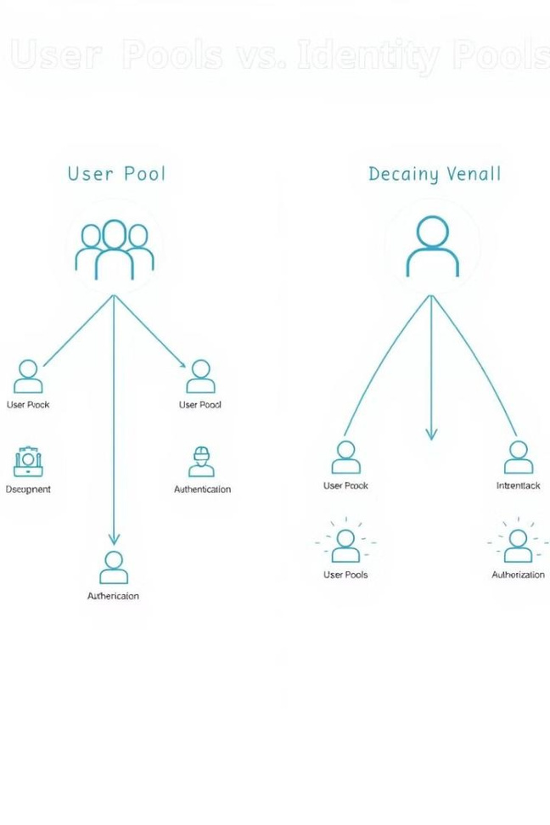


User Pool vs. Identity Pool
1
User Pool
Creates a custom user directory for your application with features
like user registration, sign-
in, and password
management.
2
Identity Pool
Provides temporary, limited-time access to AWS resources for authenticated or unauthenticated users, using existing identity providers like Google or Facebook.
pre e ncode d. png

Slide 4



User Pool Features and Capabilities
User Registration and Sign-In
Password Management
Handles password reset, password strength requirements, and multi- factor authentication (MFA).
Provides a secure and user-
friendly way for users to register and sign in to your application.
Social Login Integration
Simplifies user sign-in by allowing users to authenticate using existing social media accounts.
pre e ncode d. png

Slide 5
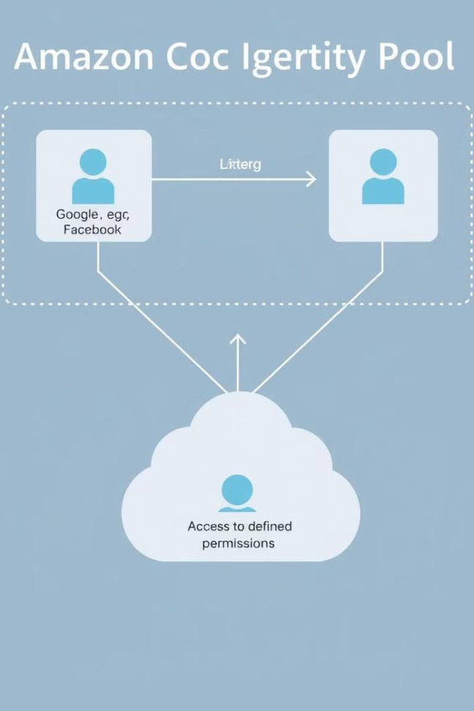



Identity Pool Features and Capabilities
Federated Identity
Allows users to authenticate using existing social media accounts or other identity providers.
AWS Resource Access
Provides temporary access to AWS resources like S3, DynamoDB, and Lambda functions.
Security and Permissions
Offers granular control over which AWS resources users can access.
pre e ncode d. png

Slide 6
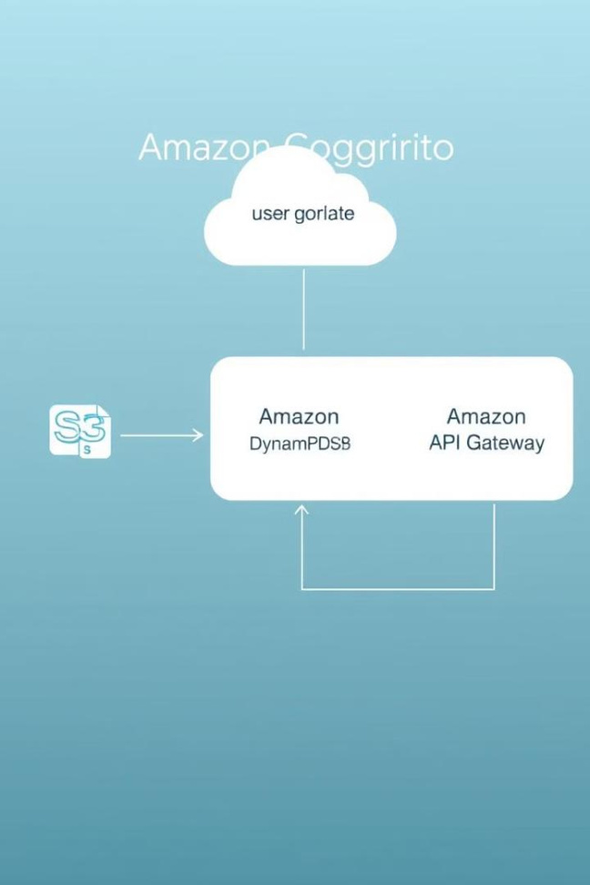

Integrating Cognito with Other AWS Services
1
Integrate Cognito with Amazon S3 for secure user data storage.
2
Use Cognito with Amazon DynamoDB for user profile management.
3
Secure your APIs with Cognito and Amazon API Gateway.
pre e ncode d. png

Slide 7
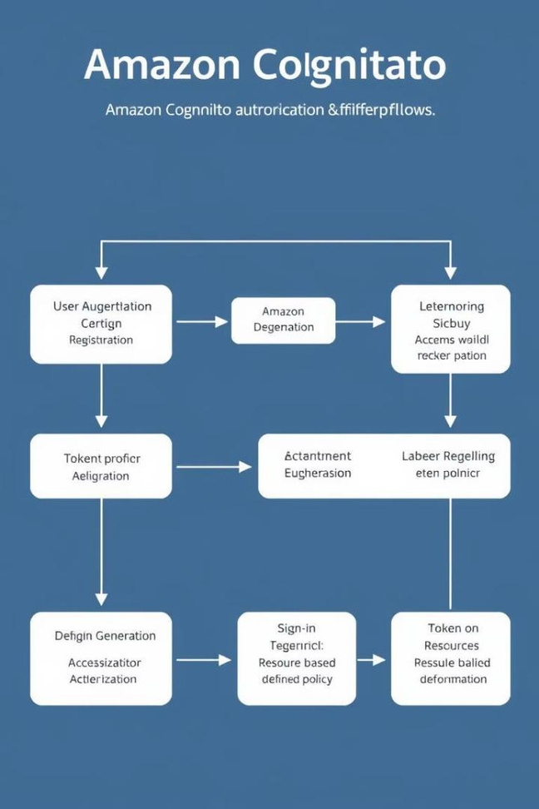


Authentication and Authorization Flows
User Registration
New users register with their email and password or through social login.
Sign-In
Users authenticate with their credentials or social accounts.
Token Generation
Cognito issues access and ID tokens for secure access to your application.
Authorization
Your application verifies user permissions based on the issued tokens.
pre e ncode d. png

Slide 8



Conclusion and Key Takeaways
Simplified User Management
1
Secure Authentication
2
3
Flexible Integration
Amazon Cognito is a powerful tool for securely managing user access and authentication in your web and mobile applications, boosting efficiency and enhancing user experience.
pre e ncode d. png

