Slide 1

AIS/GNSS Spoofing Threat Intelligence Platform
SEMESTER 5–7 CAPSTONE PROPOSAL
SEED OF A REAL COMPANY
Every day, thousands of ships broadcast their position over AIS, an open radio protocol with no authentication. That makes it easy to manipulate, and we are already seeing GPS jamming and spoofing show up as a real operational problem in the Baltic, Black Sea, Persian Gulf, and Red Sea. What used to be an edge case is now something operators have to plan for. Regulators are even starting to set hard 2026 deadlines. The gap is obvious: a specialized, ML-driven, agentic threat intelligence platform that monitors ship-position data in real time, flags when something looks wrong, and explains the why in plain English. The good news is that the raw data is already out there, and you can build a credible first version this semester.

Slide 2

This Is Not a Hypothetical Threat
This is a real, documented problem in the physical world. GPS jamming and spoofing against shipping has been reported across the Baltic Sea, Black Sea, Persian Gulf, and Red Sea for years, and maritime advisory groups now treat it as an ongoing operational risk, not an edge case.
The Protocol Was Built Without Security
Incidents Keep Piling Up
Detection Is Still Mostly Manual
AIS, or Automatic Identification System, was designed in the 1990s for collision avoidance, not security. It has no authentication and no encryption. With basic VHF gear, someone can spoof a vessel identity, fake a position, or make a ship disappear from tracking entirely.
Recent industry reporting says maritime cyber incidents more than doubled year over year, from about 408 to 828 documented cases. Satellite and VSAT links into onboard systems are widely seen as the highest-risk path between the IT stack and the navigation stack.
Analysts still rely on spreadsheets and eyeballing tracks on a map. There is a specific lie being broadcast on an open channel, in real time, and we still do not have good automation for catching it.

Slide 3

Why Now: Three Timing Forces Converging
In practice, startups win when the timing shift is real, not when the problem is merely interesting. Here, three forces are moving together at the same time: regulatory pressure, technical readiness, and commercial demand. When those line up, buyers stop treating the issue as a future concern and start budgeting for it now.
⏱ Regulatory Deadline Pressure
🧠 The ML Has Caught Up
💰 Insurers Are Asking the Question
The IACS Unified Requirements E26 and E27, which cover cyber resilience for ships and onboard systems, are moving into practical verification in 2026. The US Coast Guard is introducing new cyber rules in the same window, and EU NIS2 adds pressure for European-flagged and European-trading vessels. In my experience, deadlines like this are what turn a known risk into a funded procurement decision.
A few years ago, AIS spoofing detection was still mostly rule-based: speed thresholds, clustering, and manual review. That is no longer the state of the art. Over the last two to three years, researchers have shown deep sequence models, including LSTM, Bi-LSTM, and transformer-based trajectory models, detecting spoofed tracks with precision and recall both above 0.95 against real and adversarially generated spoofed data. The methods are proven. What was missing was productization.
Marine insurers already price risk by route and cargo, so a continuously updated signal that a vessel's tracked position may be false is immediately useful. This is the kind of data product they will buy if it is reliable, because they already purchase weather risk data, piracy risk data, and sanctions-screening data as part of normal operations. The buyer exists, the use case is clear, and the timing is right.
The rare combination: Real threat, real regulatory clock, real technical feasibility, and a real unserved buyer. That combination is unusual, and it is happening now.

Slide 4
Why This Is Specialized, Not Generic
DOMAIN DEPTH
Your professor's biggest warning was about generic cybersecurity with a domain label pasted on top. This is not that. The specialization is not "cybersecurity, but on a boat." It is a genuinely different technical problem from generic network intrusion detection.
Physics-Constrained Attack Surface
Domain-Specific Threat Actors
The attack surface is a physical broadcast protocol with hard constraints. A real ship cannot teleport, cannot exceed certain speeds, and cannot violate turning radii. Detecting spoofing is fundamentally a trajectory physics and anomaly problem, closer to signal processing and sequence modeling than to log-based intrusion detection. Physics is the first line of defense here, which makes this a very different problem class from IT security.
The threat actors and motives are domain-specific: sanctions evasion, piracy-adjacent deception, military and geopolitical GPS-denial zones, and illegal fishing fleet concealment. A general-purpose anomaly detector has no idea which of those it is looking at. A specialized one, trained on maritime context, can distinguish them and say something useful about why a track looks wrong, not just that it does.
A Specific Ecosystem to Sell Into
The regulatory and business context, including IACS, flag states, P&I clubs, and classification societies, is its own ecosystem. You have to understand that ecosystem to sell into it. That knowledge is a moat. This is the difference between "we put a ship emoji on a SIEM" and an actual specialized capability.

Slide 5

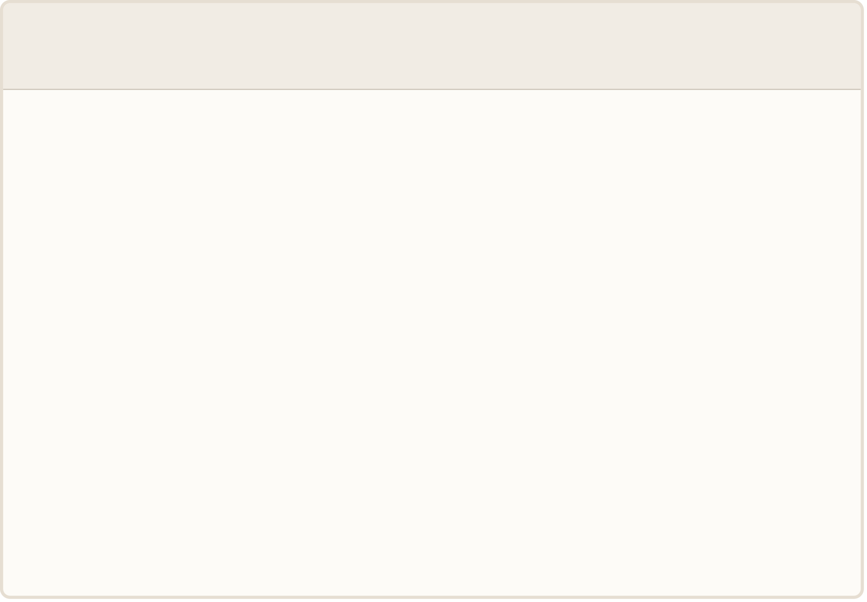
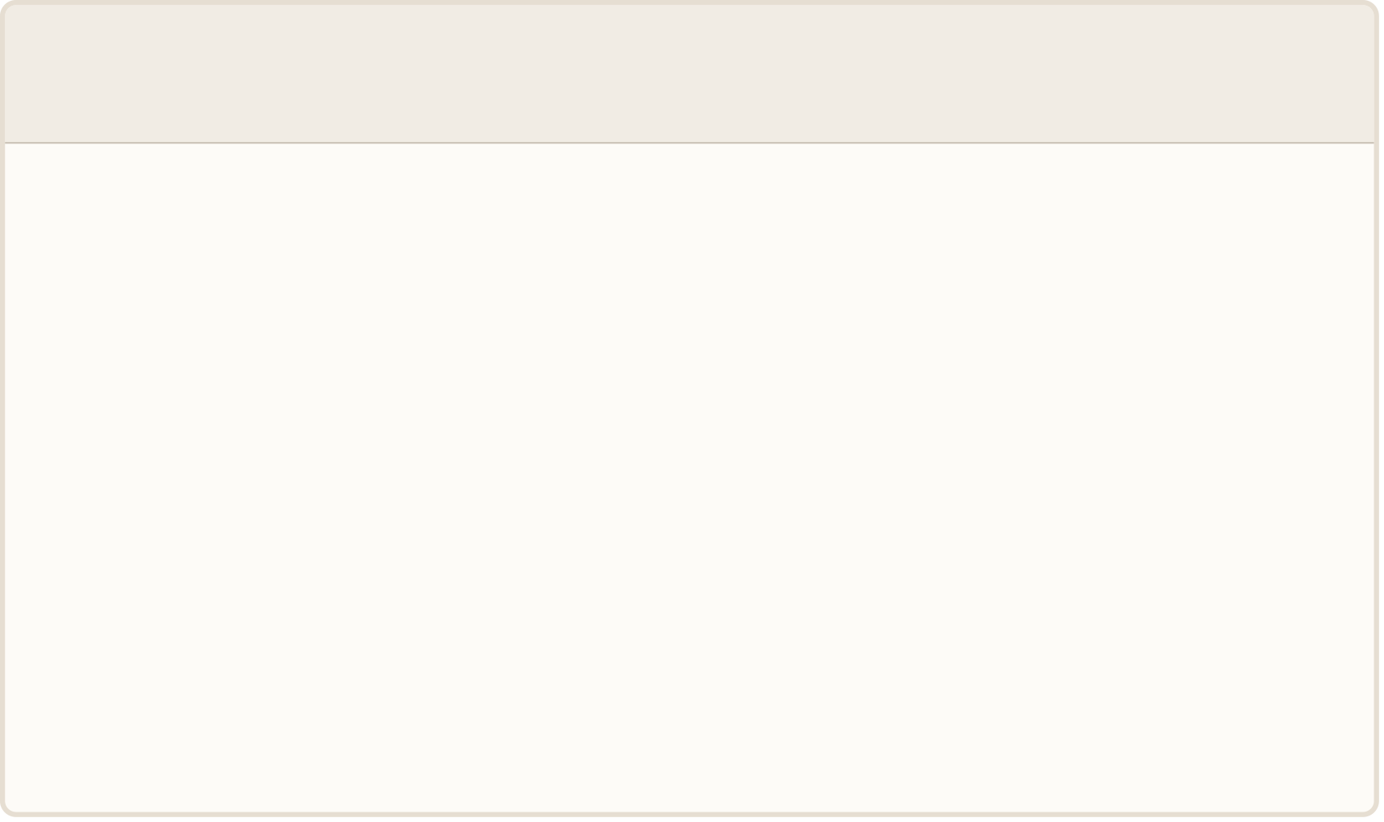
Technical Architecture: The ML Detection Layer
Being concrete matters here. “AI does detection” is not an architecture. This is the actual ML layer: what it ingests, what it models, and what it emits.
1
2
Input: Real-Time AIS Messages
Core Model: Sequence-Based Trajectory Prediction
Real-time and historical AIS messages: MMSI, timestamp, latitude and longitude, speed over ground, course over ground, heading, and rate of turn. These fields are broadcast openly and are available from public feeds. Historical data provides the training corpus, while real-time feeds provide the operational detection surface.
A sequence model, starting with Bi-LSTM and likely evolving toward a transformer-based trajectory model in Stage 2, trained to predict a vessel's next plausible position and state given its recent track and known vessel-class physical constraints. Prediction error beyond what the vessel's real-world physics allow is the core spoofing signal. This is not a generic anomaly score; it is a physics-grounded deviation measure.
3
4
Secondary Signal: Fleet-Wide Clustering
What This Genuinely Contributes
Unsupervised clustering, DBSCAN-style, across the fleet to catch coordinated or systemic anomalies, for example many vessels in a region suddenly showing the same class of error, which is the fingerprint of area-wide jamming rather than a single spoofed vessel. This layer distinguishes a targeted attack on one ship from a regional GPS-denial event affecting dozens.
It is the difference between a human analyst eyeballing a chart and a system that can watch tens of thousands of vessels simultaneously, at machine speed, and flag the handful worth human attention. That is a real capability uplift, not decoration. The published literature already supports precision and recall above 0.95, so the task is to productize what researchers have proven.

Slide 6
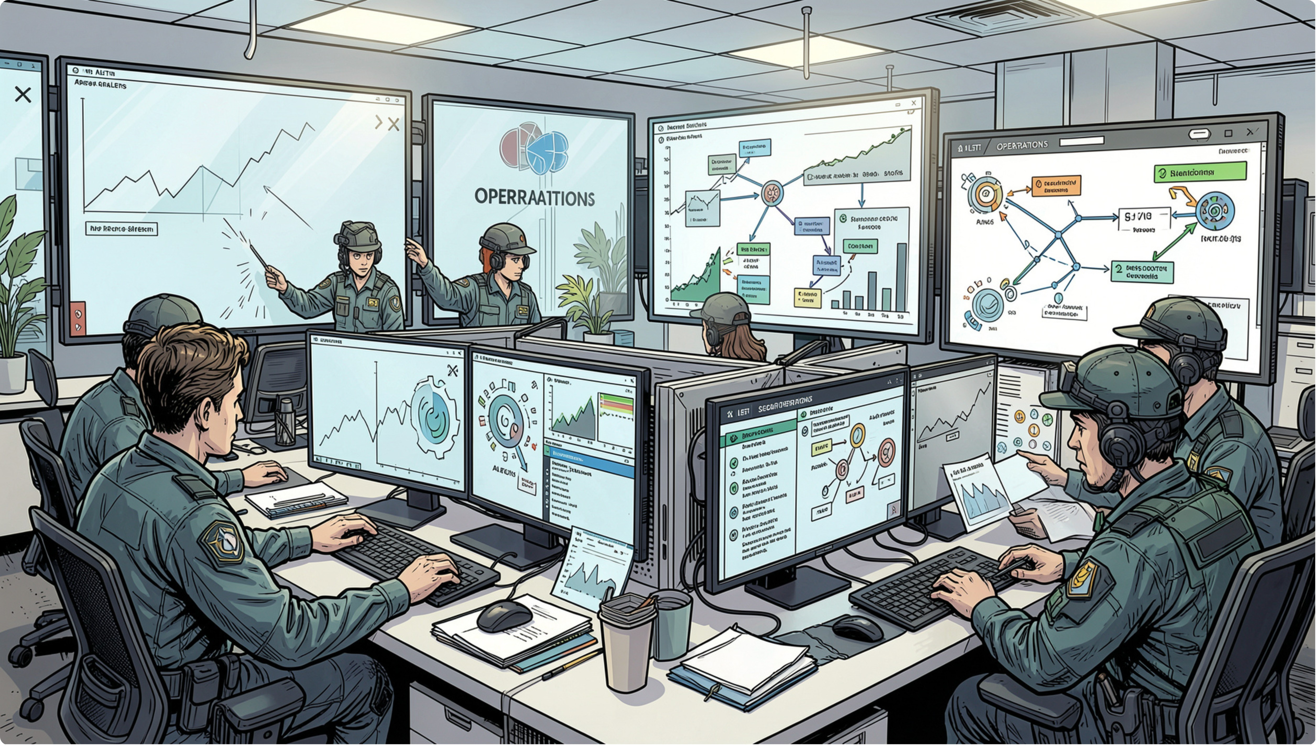
Technical Architecture: The Agentic Investigation Layer
REAL SECURITY WORK, NOT A CHATBOT
This is the part that proves the system does actual security work. When the model flags an anomaly, it hands off to an investigation agent, not to a raw alert that gets dumped on an analyst.
The agent pulls the vessel's recent trajectory history, its declared vessel class and known operator, and checks that against known GPS-denial and jamming zones built from public advisories and the system's own incident history. It also looks for corroboration: are nearby vessels showing similar anomalies, which points to area jamming and lower severity, or is this vessel isolated, which raises the likelihood of targeted spoofing or deliberate AIS manipulation?
From there, it drafts a structured incident report with evidence, a confidence score, and a plain-language explanation of the pattern it matched. It only escalates to a human analyst when confidence is genuinely low or the pattern is novel. Over time, this agent can do more than triage individual events. It can correlate incidents into campaigns, identify an emerging jamming zone before it is officially reported, maintain a live map of known-risk areas, and eventually propose which advisories should go out.
That is the difference between a security workflow and a chatbot wrapper. It is bounded, explainable, escalating investigation logic that does real analytical work.

Slide 7




The Business Case: Who Has the Problem and Who Pays
This business case is not theoretical. It is grounded in how the market already buys, how procurement already works, and a product shape that fits what the target customer already purchases.
Who Has the Problem
Who Pays First
Initial Product Form
Expansion Path
Any organization that needs to trust a vessel's declared position: shippers, charterers, flag states, port authorities, and especially marine insurers and P&I (Protection & Indemnity) clubs, who ultimately carry the financial risk when a vessel's actual position, route, or behavior does not match what was declared. This is a direct commercial problem with real loss exposure.
Marine insurers and P&I clubs are the clearest early buyers. They already purchase third-party risk data as part of normal operations, including weather risk, piracy risk, and sanctions-screening feeds. AIS integrity risk data fits that buying motion cleanly. It is an extension of an existing category, not a new one, which materially reduces the sales and education burden compared with selling a new security tool into a ship operator's IT stack.
A subscription API and data feed: an AIS integrity score per vessel per time window, plus an incident report stream for flagged anomalies. The pricing model should follow the same pattern insurers already use for risk-data subscriptions, tiered by coverage area or by the number of vessels and routes monitored. No new procurement category, no new budget line, just a new data source inside an existing workflow.
The first product should stay narrow and defensible. From there, the natural expansion is direct integration into fleet-management software sold to operators, a public AIS trust score that shippers and charterers can use before contracting a vessel, and eventually a broader maritime navigation integrity product line that includes ECDIS and bridge-network signals. The entry point is focused, but the market surface area is much larger.

Slide 8


Competitive Landscape: What Exists and What Doesn't
The goal here is to be precise about the market, not optimistic. Based on the current scan, there does not appear to be a dedicated, insurer-facing, ML-driven AIS/GNSS spoofing intelligence company operating as a standalone product. That could indicate a real gap in the market, or simply that this is a harder category than it first appears.
Competitor | What They Do | What They Don't Do
CYTUR | Operates a maritime threat-intelligence platform and publishes an annual white paper. This is the closest current analog and confirms that the market will pay for intelligence in this general category. | It is a broad OT and IT platform, not a focused AIS/GNSS integrity product. It is not insurer-first, and there is no clear evidence of standalone ML-driven trajectory anomaly detection.
MarineTraffic / AIS Aggregators | Provide raw tracking data and some basic anomaly flags. They remain the dominant source of AIS data globally. | They are not built as security or integrity threat-intelligence products. They are not the buyer's system of record for risk decisions, and they do not provide an agentic investigation layer.
Darktrace, TXOne, OT Security Vendors | Cover maritime as part of a broader industrial security portfolio. These are established, enterprise-grade vendors with funding and distribution. | They are not specialized AIS-integrity products. Their approach is generic OT security, not models trained on maritime trajectory physics or domain-specific threat patterns.
Our Position | Focused, insurer-first, ML-driven AIS/GNSS spoofing intelligence with an agentic investigation layer that produces scored, explainable incident reports. | The sales motion is still early, industry relationships are limited, and the category is unproven. The differentiation has to be sharp. It cannot just be "we also do maritime security."
The gap may be real, but it still needs verification. CYTUR's exact product coverage has not been reviewed in depth yet. The consensus and red-team pass in the final card is intended to close that uncertainty before Stage 1 is locked.

Slide 9
Three-Semester Build Plan
Each stage has a clear deliverable, a defensible milestone, and a learning objective. The progression is from prototype to intelligence system to operational, sellable product.
Stage 1 — Semester 5: Detection Prototype
Stage 3 — Semester 7: Operational Product
Real AIS data ingestion from public feeds, plus published labeled spoofing datasets (IEEE DataPort synthetic GPS spoofing dataset) as ground truth. A working Bi-LSTM trajectory-anomaly detector benchmarked against published precision/recall figures (target: >0.95). A first version of the investigation agent: pull context, check against a hand-built list of known jamming zones, produce a structured incident report. A demo dashboard covering documented real-world incidents (Baltic/Black Sea jamming events) as proof-of-concept narrative. This is already a complete Semester 5 project.
Harden the system into a real API/data-feed product: reliability, uptime, a real ingestion pipeline. Build the insurer-facing product surface: the integrity-score API, the incident-report stream, a simple web dashboard. Formalize the business case with pilot feedback, and make a real go/no-go call on whether to pursue this as an actual company. This is the point where "a college project that could become a startup" turns into "a product two or three insurers are already using."
1
2
3
Stage 2 — Semester 6: Intelligence System
Move from a hand-built jamming-zone list to a continuously updated one, built from accumulating incident history plus public advisories. Add the fleet-wide clustering layer to distinguish area-wide jamming from targeted spoofing. Begin building "campaign correlation" capability: linking multiple incidents into a single ongoing story. Begin informal outreach to two or three marine insurers or P&I clubs for pilot conversations — their feedback should shape what Stage 3 actually builds.
3
0.95
2026
Semesters
Target Precision/Recall
Regulatory Deadline
From prototype to operational product
Benchmarked against published literature baselines
IACS E26/E27 and US Coast Guard cyber rules

Slide 10

Honest Limitations and the Path to Validation
Before we commit real semester time, there are a few specific unknowns that need to be closed. None of them are red flags by themselves. They are the normal validation gaps you expect before taking a concept from promising to investable.
What Still Needs Validation
How We Overcome Them
Insurer sales motion: The business case is a strong hypothesis, not a confirmed one. Marine insurance is relationship-driven and fairly closed. Three students without existing industry relationships will need real outbound effort, probably starting with smaller or more innovation-friendly insurers and brokers rather than the largest incumbents.
AIS data licensing: Raw terrestrial and satellite AIS reception is genuinely open, but coverage is uneven in open ocean, and some aggregated or enriched feeds are commercially licensed. We need to verify exactly which sources can legally support a commercial product and which are research only.
CYTUR's exact coverage: CYTUR and adjacent players are real, funded competitors. They may already be moving in this direction. The differentiation has to be sharp: insurer-first, integrity score as a product, not just "we also do maritime security."
False-positive rate: The hardest technical problem is distinguishing malicious spoofing from ordinary GPS degradation, equipment failure, or benign transponder error. Published research looks good in aggregate, but the false-positive rate in a real product is what determines whether an insurer trusts the feed and keeps paying for it.
Run the red-team pass before Stage 1
Treat false positives as a first-class metric
Close the CYTUR and data licensing questions fast, in weeks, not months. The consensus and red-team research prompt below is ready to run.
Report precision and recall against published baselines explicitly from Stage 1. Design the agent's escalation logic around confidence, not raw anomaly score, from day one.
Start insurer outreach in Stage 2
Frame the agent around why, not just what
Not late in Stage 3. Early, informal conversations with innovation-friendly brokers will validate the business case with real feedback well before anyone is asked to commit budget.
Focus on why this is spoofing and not degradation. That keeps it a genuine security investigation capability rather than a plain anomaly detector, and it is the most technically interesting part of the system to build.

