Slide 1

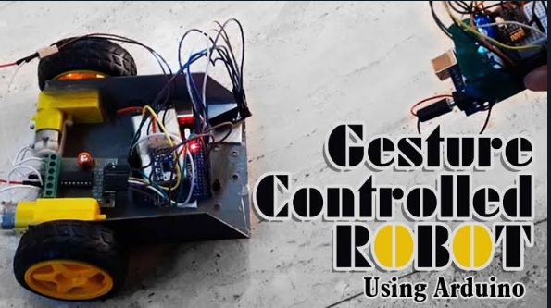
BCSE421L ROBOTICS: KINEMATICS, DYNAMICS AND MOTION CONTROL
HAND GESTURE CONTROLLED ROBOT
RAHUL K 21BRS1619
NAGAVISHNESH 21BRS1312
SUMANTH MN 21BRS1504
SIYAMALA 21BRS1710
LAVANYA 21BRS1187

Slide 2
INTRODUCTION:
Robots are playing an important role in automation across all the sectors like construction, military, medical, manufacturing, etc. After making some basic robots like line follower robot,computer controlled robot etc, we have developed this accelerometer based gesture controlled robot by using arduino uno. In this project we have used hand motion to drive the robot. For this purpose we have used accelerometer which works on acceleration. A robot is a machines specially one programmable by a computer capable of carrying out a complex series of actions automatically. A robot can be guided by an external control device, or the control may be embedded within. Robots may be constructed to evoke human form, but most robots are task-performing machines, designed with an emphasis on stark functionality, rather than expressive aesthetics.

Slide 3
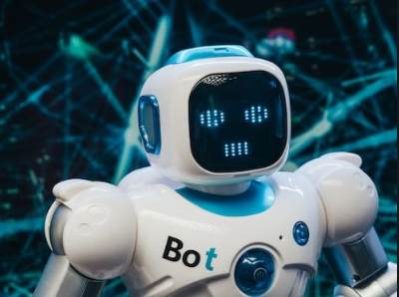
Robots can be autonomous or semi-autonomous and range from humanoids such as Honda's Advanced Step in Innovative Mobility (ASIMO) and TOSY's TOSY Ping Pong Playing Robot (TOPIO) to industrial robots, medical operating robots, patient assist robots, dog therapy robots, collectively programmed swarm robots, UAV drones such as General Atomics MQ-1 Predator, and even microscopic nano robots. By mimicking a lifelike appearance or automating movements, a robot may convey a sense of intelligence or thought of its own. Autonomous things are expected to proliferate in the future, with home robotics and the autonomous car as some of the main drivers

Slide 4
ABSTRACT:
A hand gesture robot is a robotic system that can recognize and respond to hand gestures made by a human user.
The robot typically uses sensors, such as cameras or depth sensors, to detect and track the user's hand movements.
The system then interprets these movements as commands and performs specific actions in response, such as moving
in a certain direction or performing a specific task. Hand gesture robots can be used in a variety of applications,
including industrial automation, human-robot interaction, and gaming. In industrial settings, hand gesture robots can be used to control and manipulate heavy machinery, reducing the need for manual labor. In human-robot interaction, hand gestures can be used to provide a natural and intuitive way for users to control and interact with robots.

Slide 5
In gaming, hand gestures can be used to control the actions of virtual characters or objects.The development of hand gesture robots involves a combination of computer vision, machine learning, and robotics techniques. Machine learning algorithms are
trained to recognize specific hand gestures and associate them with specific actions. Robotics technologies are used to physically implement the actions, such as moving the robot's arms or executing tasks.In conclusion, hand gesture robots have the potential to revolutionize the way we interact with technology and perform tasks. By providing a natural and intuitive interface, they can make technology more accessible and increase efficiency in a variety of industries.

Slide 6
Application of hand gestures control robot:
Hand gesture control of robots refers to the use of hand motions or signals to control the actions of a robot. This type of control can be achieved through the use of various technologies, including computer vision, motion tracking, and gesture recognition algorithms. Some common applications of hand gesture control in robots include:
Human-robot interaction: Hand gestures can be used as a natural and intuitive way for people to interact with robots, allowing them to control the robot's movements and actions without the need for buttons or touchscreens.
Industrial automation: In industrial settings, hand gestures can be used to control robots for tasks such as welding, painting, or assembly. The use of hand gestures can increase safety and efficiency by reducing the need for physical contact with the robot.

Slide 7
Gaming and entertainment: Hand gestures can be used to control robots in gaming and entertainment applications, such as allowing players to control the movements of robots in video games.
Medical applications: In medical settings, hand gestures can be used to control robots for tasks such as surgical assistance or rehabilitation exercises.There are a number of challenges associated with hand gesture control of robots, including the need for robust gesture recognition algorithms, the requirement for accurate motion tracking, and the need to ensure safety in situations where robots are operating near people.
Nevertheless, hand gesture control is a promising area of research and development with the potential to revolutionize the way we interact with robots.

Slide 8
FUTURE SCOPE:
In future we can design a wireless robot which can sense hand gesture by using wireless technologies.
It can be used in military applications as a robotic vehicle which can be handled by a soldier to avoid casualties.
Our system has shown the possibility that interaction with machines through gestures is a feasible task and the set of detected gestures could be enhanced to more commands by implementing a more complex model of an advanced vehicle for not only in limited space while also in the broader area as in the roads too.
In the future, service robot executing many different tasks from private movement to a full-fledged advanced automotive that can make disabled to able in all sense.

Slide 9


